Slide 1
Electrical muscle stimulation (ems) in medicine & palliative care.
Let’s talk about regeneration!
Christos Stefanou
MD, EDICM, PhD-cand
Assoc. Prof. Medicine
Internist, Intensivist.
Orlando, FL; Aug. 2015.
stefanouchristos@hotmail.com
No conflicts of interest.
Notes:
I am CS, Intensivist, and will introduce to you the essential role of EMS in medicine and PC. Most importantly the regeneration properties of ems, which are currently being explored, will be brought up.

Slide 2
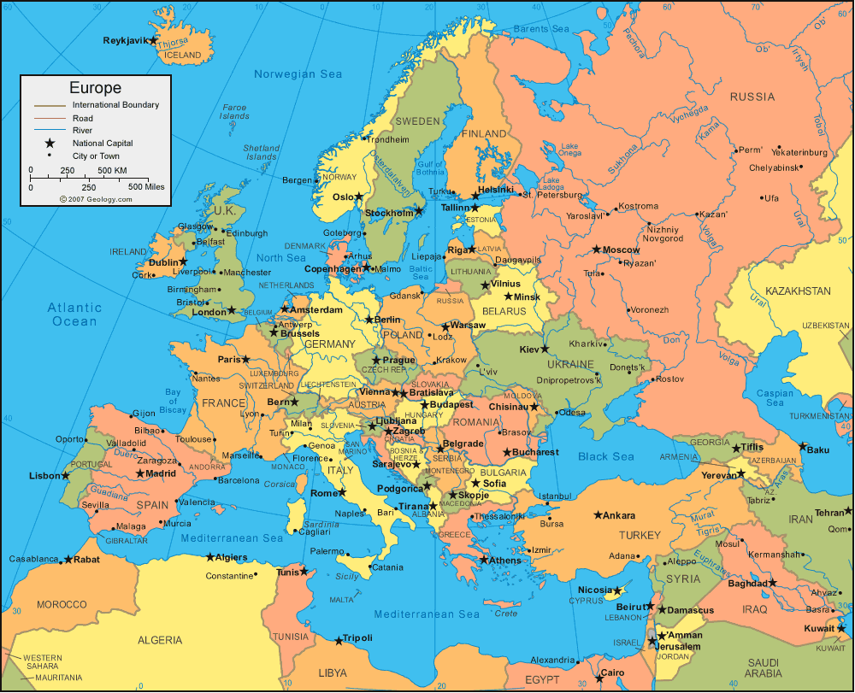
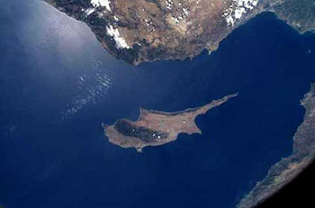
ELECTRICAL MUSCLE STIMULATION (ems)
20min
~US >
Directions
~exercise?
stefanouchristos@hotmail.com
Notes:
That’s where I ve just travelled from to speak to you about this exciting topic, (if you put a magnifying lens here that is what you get, a marvelous spot for holidays called Cyprus, in eastern Mediterranean) and, within 20’ to give you a taste on ems. With so many thousands of publications this task may be like reviewing US within 20’. I came up with this tiny review aiming to provide a mere stigma of the directions. But I may be available to you on my email for any Qs that may rise during your practice, about which I am very eager to promptly assist.

Slide 3
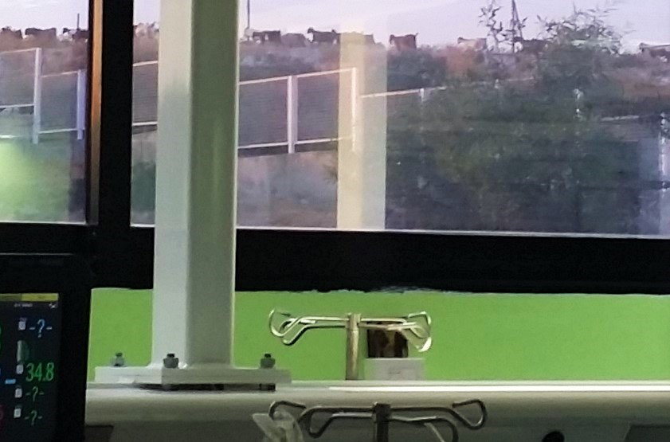
Notes:
What we see from our ICU windows. All goats have signed consent for the purpose of this presentation.

Slide 4

Today’s talk on Electrical Muscle Stimulation (EMS)
A. Introduction: about. Technical facts.
B. Established & investigational uses/ evidence.
C. EMS & exercise; Tissue regeneration & EPCs.
D. Own research.
E. Safety/ problems.
F. Summary of EMS role in palliative care.
Notes:
Today’s talk begins with technical characteristics of the electrical current; then we’ll take a look at the approved & almost approved uses. EMS will subsequently be compared to exercise. They both induce systemic tissue regeneration, and endothelial progenitor cells, EPCs, factors of regeneration, attest this truth quite loudly. My thesis is on EMS pathophysiology, and will summarize our findings.
#mXze.!Af-gFPvq7lz0z

Slide 5
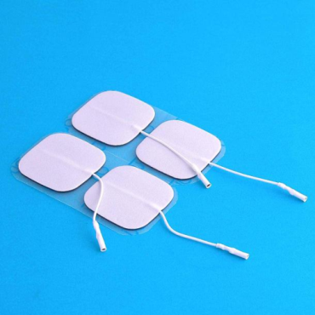
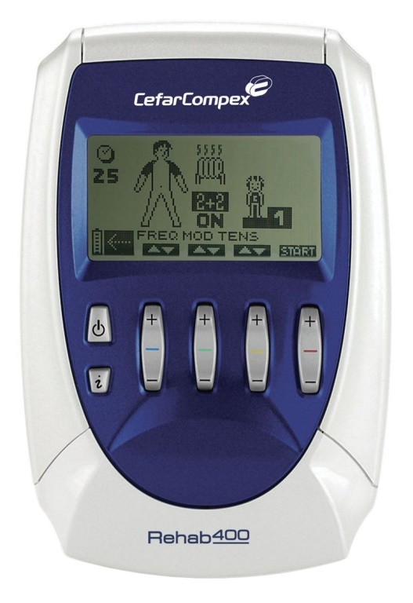
EMS (NMES), Generalities
Skin electrodes in proximity to muscle (intact nerve)
Stimulator (programmable) (IM nerve branches)
Electricity into body
unique: no CNS order (pt participation)
Muscles contract (bedside)
No patient stability (> any phase)
↓$
Used w/wo PT
Notes:
An intact motor nerve is a prerequisite for eliciting muscle contractions. EMS activates intramuscular nerve branches . It requires no active pt participation or pt transfers; nor hemodynamic/ respiratory stability; is low cost; and applicable for all phases of disease.

Slide 6
Suggested settings for most muscle strengthening applications
Daily/ bid sessions, 30 -240’; crescendo:
Submax tolerated I; ~ 40-60% of voluntary Fmax
Biphasic square pulses of 100-400μs.
25-100Hz, ~2-12s on/ 5-25s off.
Reduced for fragile, women, ↑ SC fat /edema
Studies should report the parameters.
Thigh &calf muscles.
Maffiuletti,et al. (2010) Physiological and methodological considerations
for the use of NMES. Eur J Appl Phys, 110(2), 223–234.
Notes:
In order to maximize ems efficacy, like any medical application, it requires some form of dosing. These are some numbers that can be used, although evidence is still poor: EMS needs to be applied ~once to twice daily, x30-240min, gradually increasing; starting in submaximal current tolerated, raising q3-5’ to compensate anticipated force degeneration during repeated stimulation

Slide 7
FDA-approved uses
Prevention or retardation of disuse atrophy
Relaxation of muscle spasms
Muscle re-education
Immediate post-surgical stimulation of calf muscles to prevent venous thrombosis
Maintaining or increasing range of motion
Increasing local blood circulation
Notes:
These EMS applications are endorsed by FDA; we’ll go through them.There are another as many off-label uses with fair evidence of efficacy; some may receive approval soon. Lack of indication-specific approval is not legal in the States.

Slide 8
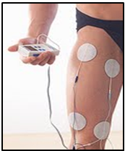
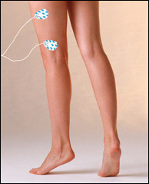
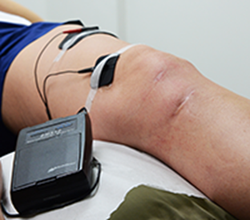
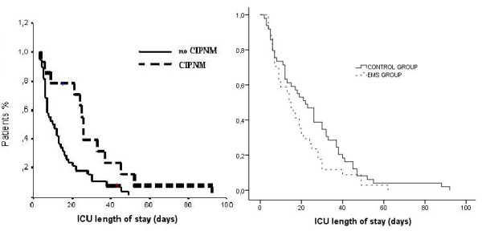
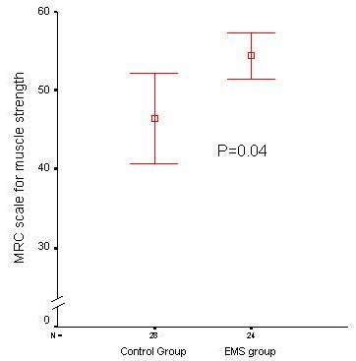
Muscle strength (no mass ↑)
VS.
?ITT?
Routsi, V.. et al. EMS prevents CIPNM: a randomized parallel intervention trial, Critical Care, vol. 14, no. 2, p. R74, 2010
Notes:
EMS has nothing to add for shaping or fixing skin imperfections, FDA warns. However it goes far and beyond. This RCT of 140 pts, intervention vs. control, shows strength & ICU LOS improvement.

Slide 9
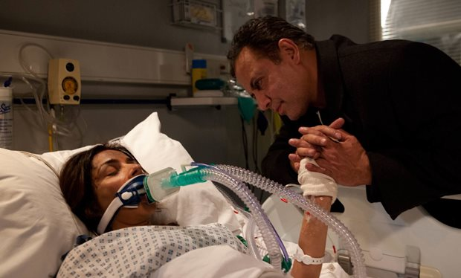
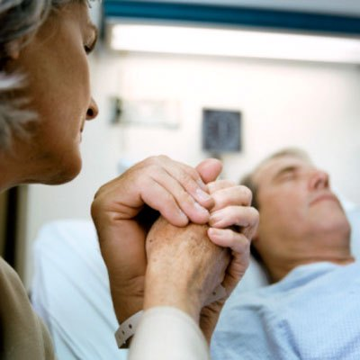
ICUAW: a catastrophe [1/2]
Definition & Pathophysiology.
Epidemiology & risk factors
Clinical presentation, consequences, prognosis.
de Jonghe B, Lacherade J... et al: ICUAW: risk factors and prevention. Crit Care M, 2009, 37:S.
Sillen MJ, Speksnijder, et al. (2009), Effects of NMES of muscles of ambulation in patients with
CHF or COPD: Chest 136: 44–61.
Maffiuletti N.. et al (2013); NMES for preventing skeletal-muscle weakness and wasting in
critically ill: a syst rev. BMC, 11(1), 137.
Notes:
Let’s rash through this… disaster, in pts who cannot mobilize. It presents during their active Dx, but pts remain weak thereafter x Ms-yrs. It affects ~1/3 of the critically ill. RFs are sepsis, steroids, NMBs, AGs, hyperglycemia, Dx severity. Is a symmetrical peripheral muscle paresis, sparing CNs. Dx is clinical, MRC score > 48/60 rules it out. Causes MV weaning failure, aspirations/ VAP, increased LOS & related complications, e.g.. DVT, DTIs, inability to participate in PT (a vicious cycle worsening ICUAW), atelectasies; & largely contributing to the post ICU syndrome with psychosocial impact

Slide 10
ICUAW: a catastrophe [2/2]
Treatment/ Ppx
Evidence of EMS
-Review (RCTs in which current parameters are reported): POSITIVE EFFECT (no meta- analysis)
-Other studies with positive effect: CHF, COPD
(1-2M: improved 6MWD, SOB, QoL)
Abdellaoui A, Prefaut, et al: Skeletal muscle effects of EMS after COPD exacerbation: a pilot study. Eur Respir J 2011, 38:781–788.
Notes:
EMS may be a means of Ppx and Tx. Conclusions are not final, but in reviewing all related RCTs in which visible contractions occurred, EMS shows positive effect.

Slide 11
EMS in DVT prophylaxis sp surgery
VTE > MVA + Ca breast + AIDS.
Mechanism:
EMS ~triples vein return velocity; & increases circulating tPA
(b) Indirect evidence from exercise shear-stress (>cytoskeletal changes, eNOS, prostacycline, nuclear factor (NF) kappaB, c-fos, c-jun, SP-1, ICAM-1, MCP-1, tissue factor, PDGF-B, transforming growth factor-beta1, Cox-II...)
-FDA >square pulses 50ms, 0-5 V, for painless ems, 1-2Hz.
Spyropoulos AC; Emerging strategies in the prevention of VTE in hospitalized medical patients; Chest. 2005 Aug;128(2):958-69
Cohen, A. T., et al (2007). VTE in Europe. The number of VTEs, morbidity, mortality. Thromb Haemost, 98, 756.
B.J Broderick et al; A pilot evaluation of NMES-based methodology for prevention of venous stasis; Med. Eng.& Phys 32 (2010).
Kopetzky CD. Wien Med Wochenschr; Combined compression and EMS; 1994;144(10-11):238-42
M. Izumi, et al; Prevention of Venous Stasis in the Lower Limb by TENS; Eur J Vasc Endovasc Surg (2010) 39, 642e645.
Lobastov KV et al; Haemodynamic and clinical efficacy of EMS of the venous outflow in prev of postop VTE; Ang Sosud Khir. 2013;19(2)
Nicolaides, A. N., et al. Prevention and treatment VTE-International Consensus Statement. Intnl Angio (2013): 111-260.
Notes:
EMS protects against VTE through acceleration of blood flow, postoperatively. Suggested settings are shown.

Slide 12
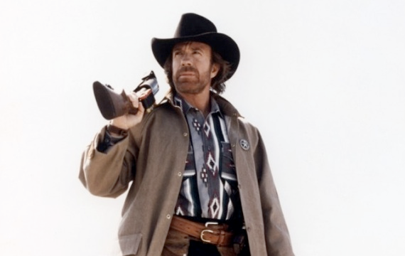
I trained EMS.
Notes:
He trained it

Slide 13
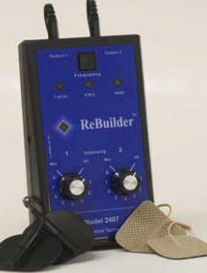
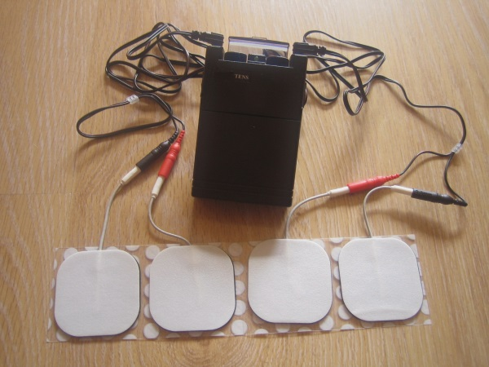
TENS
Commonly Prescribed Drugs for neuropathic pain
pregabalin / gabapentin
duloxetine
nortriptyline
opioids
high frequency (>50 Hz) with an intensity below motor contraction,
or low (2-10 Hz, sensory level TENS).
Review of Medical Physiology, 24th edition, William F. Ganong (2013)
Notes:
Transcutaneous electrical nerve stimulation, TENS, propagates along smaller afferent fibers specifically to override pain impulses. It has occasional proven clinical efficacy.

Slide 14
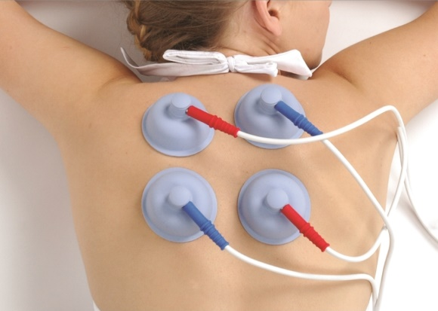
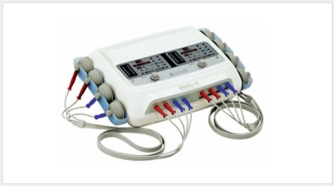
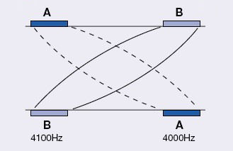
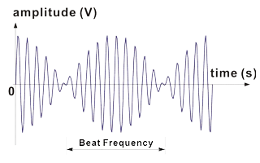
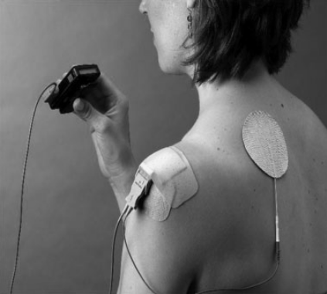
Interferential therapy (a variation of TENS)> pain types
Notes:
IFC is efficient 4 pain: post-surgical/trauma; back; sprains; neuralgic; Reflex Sympathetic Dystrophy; shingles; knee OA. On the bottom you see an ems application for hemiplegic shoulder pain.

Slide 15
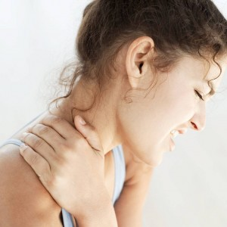
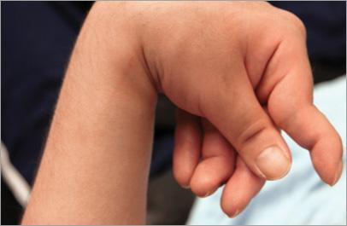
Muscle spasm & spasticity
↓ Botox needs
Posture
Walk
Function
Cross-education
cramps
Hofstoetter US et al; Modific spasticity by TC spinal cord stimulation
in individuals with incomplete SCI; J Spin Cord Med. 2014
Wilkenfeld AJ. Review of ES, botulinum toxin, and their combination
for spastic drop foot. J Rehabil Res Dev. 2013;50(3):315–26.
Notes:
Spasticity is associated with increased muscle tone, & antagonist contraction. EMS potentiates BTX local effects hence reduces its requirements (translates into less cost and fewer SE); & increases antagonist muscle force.

Slide 16
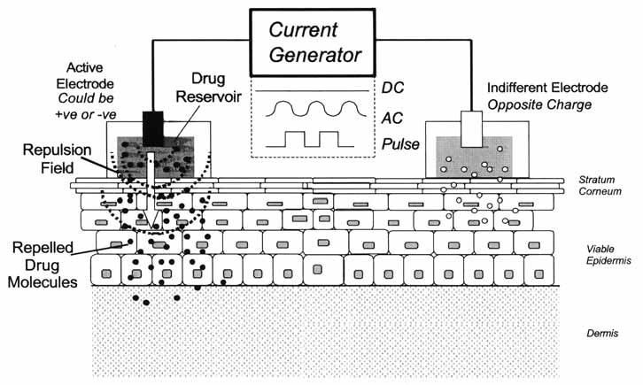
Iontophoresis & electrochemotherapy
Mali B et al; Antitumor effectiveness of electrochemotherapy: a sys rev and meta-analysis;
Eur J Surg Oncol. 2013 Jan
Notes:
Iontophoresis is a method of delivering drugs to a body site. With a low-level electrical current, iontophoresis repels drug ions through the skin into underlying tissue for local Tx of extensive neoplasms. Systemic review verified an >50% increased of efficacy of bleomycin & cisplatin.

Slide 17
Deep tissue injury
(decubitus ulcers)
PROVEN EFFICACY WITH:
(1) palmic 0.8 Hz, 300– 600 μA, monophasic tid
(2) palmic (50 V 80Hz for 10 min, then 50 V 8Hz for 10 min, tid),
(3) palmic 150 V, 100 Hz, 100 μs for 45 min, q48hr x4weeks
(4) AC (7–10 mA, 40 Hz) vs. (monophasic 0.6 mA)
(5) high volatage (up to 500V) monophasic palmic, 1-125 Ηz, 5-200μs, 2-2,5A
Zhao M, et al. (2006) Electrical signals control wound healing through PDI-3-OH
kinase-gamma and PTEN. Nature 442
Kawasaki L, et al; The mechanisms and evidence of efficacy of ES for healing DTI: a sys rev;
Wound Rep Regen. 2014 Mar;22(2):161
A Polak, et al; High-Voltage PES in Wound Treatment; Adv Wound Care 2014 Feb 1;3(2)
Notes:
Transepithelial potential retains epithelial functions. An injury eliminates it, causing attraction of healing cells and molecules. Galvanic sensing of local cells triggers message release. Electric field application accelerates healing processes.

Slide 18
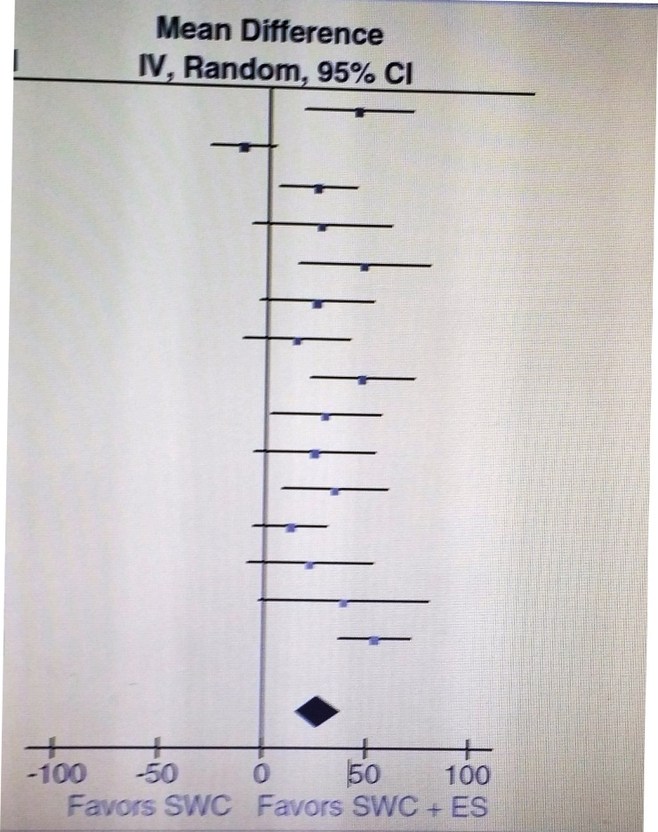
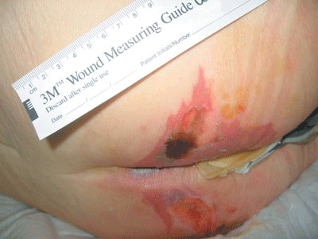
Increasing local tissue reperfusion: Deep tissue injury (decubitus ulcers)
Notes:
In this meta- analysis (2013) with strict criteria, 15 high quality RCT w ≥20 wounds were included. This forest plot reviews standard wound care w/wo ES. ES in the right is favored.

Slide 19
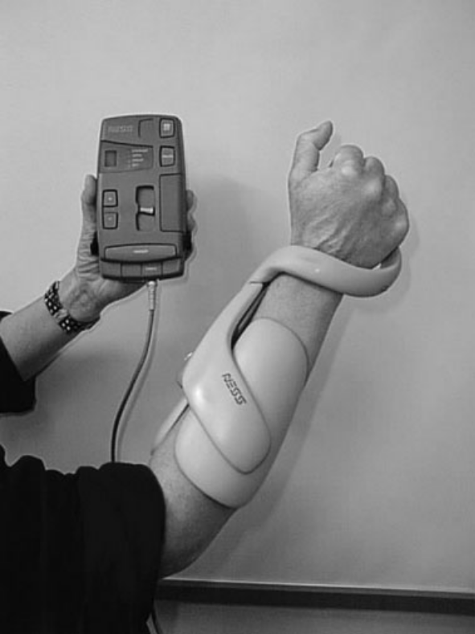
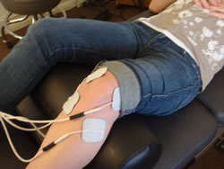
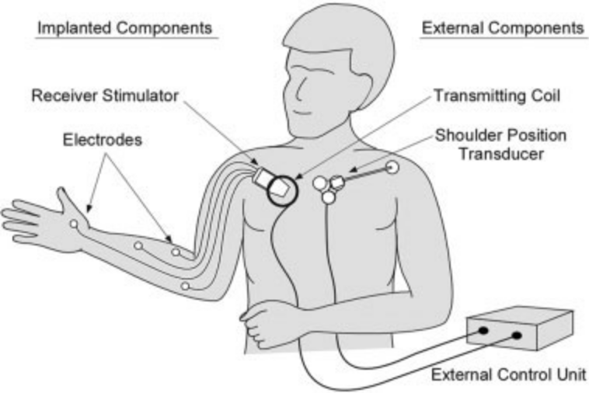
Muscle re-education
Pinto S et al; Breathing new life into treatment advances for
respiratory failure in ALS; Neurodeg Dis Manag. 2014;4(1)
Crameri RM et al (2007). Myofibre damage in skeletal muscle:
effects of ES vs voluntary contraction. The J Phys 583(Pt 1)
Notes:
-EMS assists LE function in various ways in pts w chronic neurological conditions.
-in SCI: 5 transcutaneous electrodes built into the exoskeleton stimulate specific muscles to provide coordinated hand opening and closing
-the picture on the bottom is a neuroprosthesis for SCI pts

Slide 20
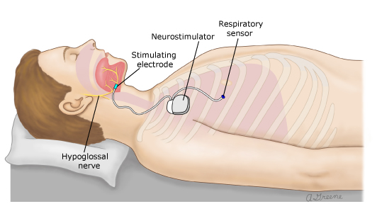
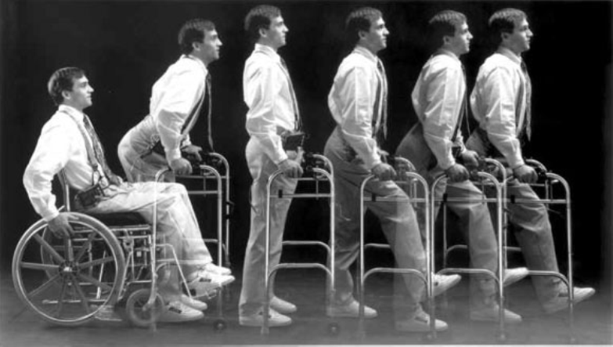
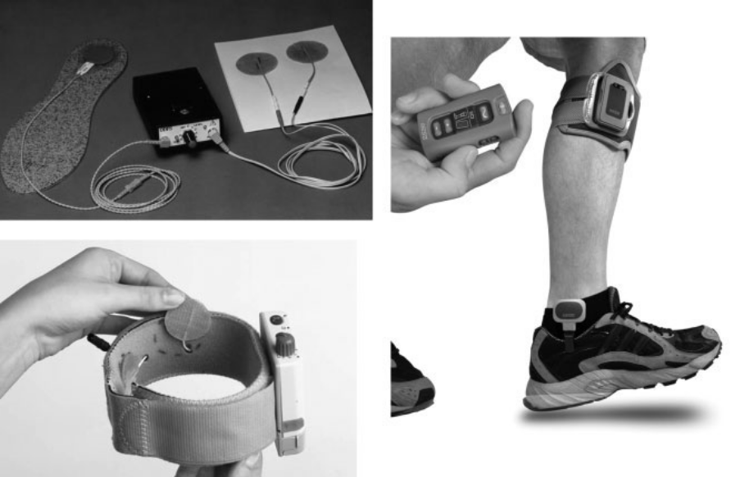
For sleep apnea
Strollo PJ..et al (2014). Hypoglossal-Nerve
Stimulation for OSA; N.En.J.Med, 370(2)
Notes:
An implantable stimulator of the hypoglossal nerve causes tongue protraction and pharyngeal opening dilatation during sleep, remarkably &safely improving OSA and its complications.
And another multichannel neuroprosthesis for SCI pts, assisting posture and gait; and another (FDA-approved) dropped-foot neurostimulator in the right.

Slide 21
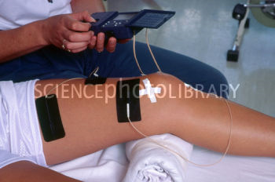
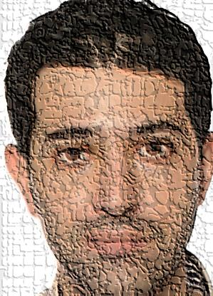
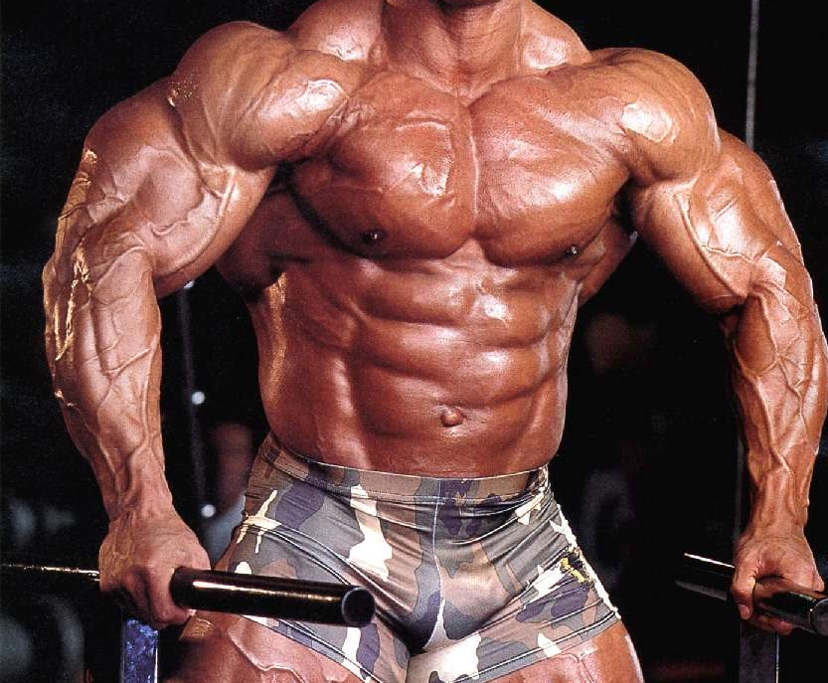
Notes:
The way we apply electrodes; and a nice figured colleague of you, not sure who he is. See? EMS!

Slide 22
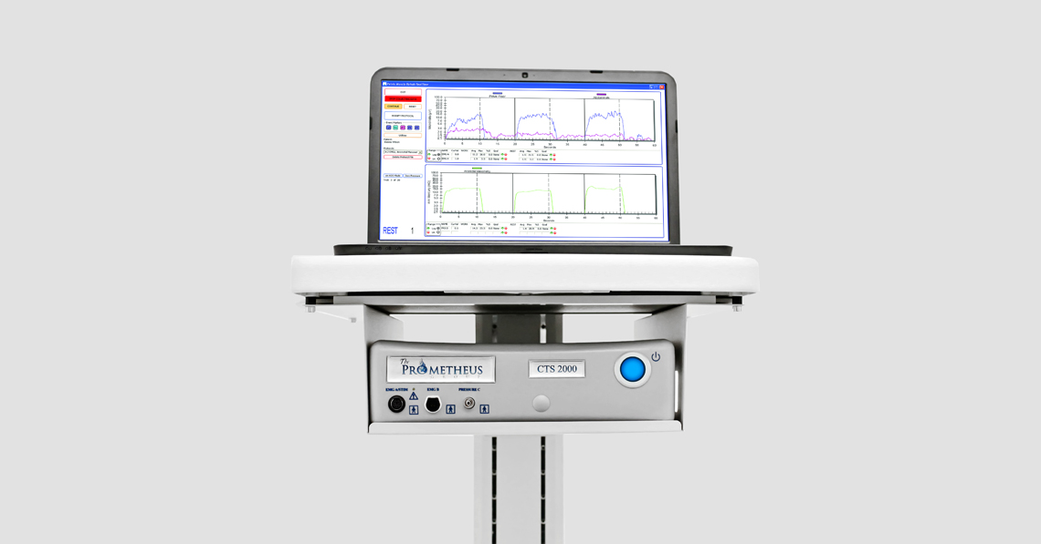
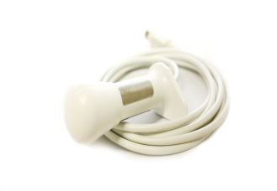
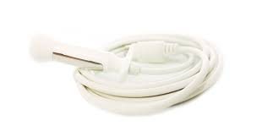
Other uses
In diaphragm dysfunction (e.g.. ALS, SCI):pacing
GERD/ Retractable emesis (ES of LES)
Bowel incontinence (73% episode reduction, 17% remarkable complications, reversible)
Pelvic floor dysfunction
Idiopathic tremor (ES of antagonist muscles)
Bó AP, et al; On the use of fixed-intensity FEMS for attenuating essential tremor; Artif Organs. 2014 Nov;38.
PJC Vieira, et al; NMES improves clinical and physiological function in COPD patients; RespMed(2014) 108
Starr JA et al; Outcomes of a comprehensive nonsurgical approach to pelvic floor rehab for urinary Sx,
defecatory dysfunction, pelvic pain; Female Pelvic Med Reconstr Surg; 2013 Sep-Oct;19(5):260-5.
Notes:
Other ems applications relevant to the chronically ill are shown. The 1st 3 are implantable, and FDA approved. Then, pelvic floor dysfxn, meaning GI/GU/sexual Ssx related to pelvic muscles. U of Missouri, Columbia, in 681 women, used intrarectal/ intravaginal/ abdominal wall ES of 50, 100 or 200Hz. A total of (5-8) 30’ session, had 60-90% efficacy in a highly selected sample.

Slide 23
Further evidence of EMS having systemic effects: cytokine/ myokine release
TGFβ-1, stromelysin-2, growth-regulated alpha protein, β2-microglobulin, somatotropin, IL-2, IL-7, IL-8, IL-15, IL-31, Neurotrophin-4, Granulocyte chemotactic protein 2, TNF-receptor superfamily member 8, IGF-binding protein 3, myonectin, IL-6, VEGF, IL-7, IL-15, leukemia inhibitory factor, angiopoietin-related protein 4, fibroblast growth factor 21, myostatin....
Raschke J et al (2013); Identification and Validation of Novel Contraction- Regulated Myokines Released from Primary Human Skeletal Muscle Cells;
PLoS ONE 8(4): e62008
Pedersen BK et al; Muscle as an endocrine organ: focus on muscle-derived Il-6. Physiol Rev 88: 1379-1406, 2008
Notes:
This slide is just a glance into the fact that EMS has proven effects beyond the stimulating muscles; which secrete hormones and cytokines/ myokines

Slide 24
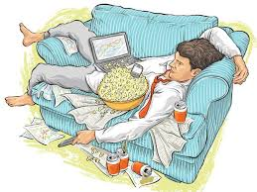
Exercise: facts
The most critical measure of preventive health after smoking cessation.
Guidelines in Canada & Australia mention that it is essential in 1 & 2 prevention of >25 chronic Dx, i.e. avoidance of deaths related to:
1/3 of coronary
1/4 -1/5 of CVA, OP#, Ca colon, HTN, DM2
other: Ca breast, falls, functionality condition of M/skeletal system, mobility, psychological wellness, obesity
>2/3 of individuals older than 15 perform less than recommended physical activity (e.g. ~30’/d of moderate).
70% adults:
No Exercise!
Warburton, DE et al (2007). Evidence-informed
physical activity guidelines for Canadian adults;
Can. J. Pub Health 98
Notes:
EMS is triggered by exogenous stimuli, but the subsequent phenomena are similar to exercise, which has been investigated more extensively. It is the most critical health measure after smoking cessation. Guidelines in Canada & AU mention that it is essential in prevention of >25 serious Dx. Exercise could lead to avoidance of 1/3 of coronary deaths, ¼ of stroke &OP# deaths, etc. These numbers are extreme!

Slide 25
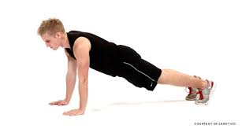
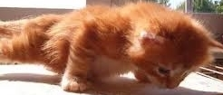
Pleotropic effects:
in cardiovascular, exercise induces new vessel formation, mobilizes EPCs; also affects blood levels of hormones (GH, sex steroids, cortisol, insulin), cytokines (VEGF), immune, free radicals,
... > all body systems
Notes:
Exercise has all these beneficial effects but which are the underlying acute mechanisms? They are probably pleotropic: hormonal, cytological, humoral, immune...you name it! with various names, mostly unknown. But exciting! So here is a possible cornerstone: endothelial progenitor cells, EPCs. What they are? They are circulating cells, originating from BM, that may translocate to areas of vascular injury and by self- reproduction or paracrine action induce vessel healing; EPCs represent regeneration potential

Slide 26
PARENTHESIS. Endothelial progenitor cells
-breaking news of the last 2 decades in medicine?
Originate from bone marrow
Derive from more undifferentiated stem cells
Circulate in blood in extremely low numbers
Attach to tissues injured by any cause, and:
Contribute to repair and regeneration, by self-reproduction &/or paracrine action (VEGF, SDF-1α, eNOS, IGF-1, HGF, Ang-1, SDF-1^{α} ...)
Express surface antigens:CD34/45-/133, VEGFR2..
Definition highly debatable/ variable
However they stimulate Ca-genesis (?)
CV protection factors cause an ↑
Notes:
A glance at profile of the EPCs... (they increase with CV protection f’s)

Slide 27
How circulating EPC & their function ↑ in exercise
-regulation of activity of matrix metalloproteinases (enzymes which, through degradation of extracellular matrix regulate EPC attachment to bone marrow)
-reduction of: radical oxygen species, xanthine oxidase, NADPH- oxidase
-elevation of NO levels and of the receptors of SDF- 1a (CXCR4) as well as of the protein kinase B > approximation of EPC towards the marrow vasculature >
>numerical & functional ↑
-Hypoxia inducible factors > ↑ genes > agiopoietin-1, ICAM-1, PDGF, IGF, SDF, VEGFA, FGF, glycolytic enzyme, erythropoietin > EPC mobilization.
- VEGF↑ and its receptors, as well as via antiangiogenic factors like endostatin, thrombospondin-1, tissue inhibitors of matrix metalloproteinases, angiostatin, vasohibin, stimulating vascular remodeling > EPC-induced angiogenesis and or vasculogenesis and angial remodeling in tissues like skeletal muscle and myocardium
Notes:
The mechanism may be complex, let’s move forward...

Slide 28
PARENTHESIS. Endothelium: a protagonist in tissue regeneration
Our age is the age of our endothelium
Enorchestrator of most physiologic and pathologic body functions
Local factors define tissue-specific biologic and morphologic eterogenicity
Endothelium is the main target and the major fighter in disease
Organogenesis- oxygenation- nutrition- vasomotion- coagulation- defense-…
Sepsis/MODS, inflammation- metastasis- vascular Dx- COPD- diabetes- renal failure- hepatic failure- ICUAW-TBI …
Hence, its regeneration processes signify smooth recovery from disease and serve as a health state indicator.
Endothelial progenitor cells: putative central role on regeneration
KA Hajjar; The endothelium: A primer; UpToDate 2015
Notes:
Endothelium regeneration equals body regeneration, in health & disease, for many reasons; and EPCs may be an axial underlying mechanism

Slide 29


National and Kapodistrian University of Athens
First Critical Care Department “Evangelismos” General Hospital
Acute Effects & Safety of EMS in ICU: EPC Mobilization
C. Stefanou; G. Mitsiou; E. Karatzanos; E. Angelopoulos; S. Dimopoulos; C. Routsi; S. Nanas
From a distance we are instruments marching in a common band.
Russel C, Peters C; Endothelial cells, angiogenesis and vasculogenesis; stemcell, 2013, Jan
T Morishita; et al; Number of EPC in PVD as a marker of severity and association with
pentraxin-3, malondialdehyde-modif LDL and MMP-1; J ather thromb 2012 Vol:
Werner N, et al. EPC and cardiovascular outcomes. N Engl J Med 353: 999–1007, 2005.
A Angelidi, et al; EPC as a cardiometabolic RF marker in prediabetes; Hormones, 2014
Tecilazich F, Dinh T, Pradhan-Nabzdyk L, Leal E, Tellechea A, et al. (2013) Role of EPC and
Inflammatory Cytokines in Healing of Diabetic Foot Ulcers. PLoS ONE 8(12): e83314.
Moschetta M et al; ROle of EPC in cancer progression; Biochim Biophys Acta.2014 Au
Publication pending
Notes:
We do have evidence that exercise exerts regenerative effects by multiple mechanisms, including EPC mobilization from BM. Since EMS ALSO has evidently demonstrated systemic effects, we investigated whether EMS acutely mobilizes EPCs; and studied safety indices, like vital signs/ CV derangements, and CK (an index of tissue damage). Here is us; and is a team work...

Slide 30

Study population, criteria
Inclusion : mechanically ventilated septic 18-80 year old for >72 hr
Exclusion: obesity, pregnancy, LE/ pelvic/ spinal fracture, burn, severe edema, VTE, admission Dx muscular or peripheral neural disease, icuaw/ stay ≥ 20d, implanted ICD, premortal state, CVVHD/F, ongoing transfusion, endocranial HTN, technical limitation /personnel inconvenience , chemotherapy/ myelotoxicity
Symmetrical biphasial pulses
400 μs, ramp-up 1.5s,
ramp-down 0.8s,
I= maximal tolerated:
Ρ1 : 75Hz 6s on/ 21s off,
Ρ2 =45Hz 5s on / 12s off
Notes:
The criteria for inclusion and exclusion; and the two current protocols we used and compared to each other after randomization. Blood sample and measurements took place just before and after a 30’ems session.

Slide 31
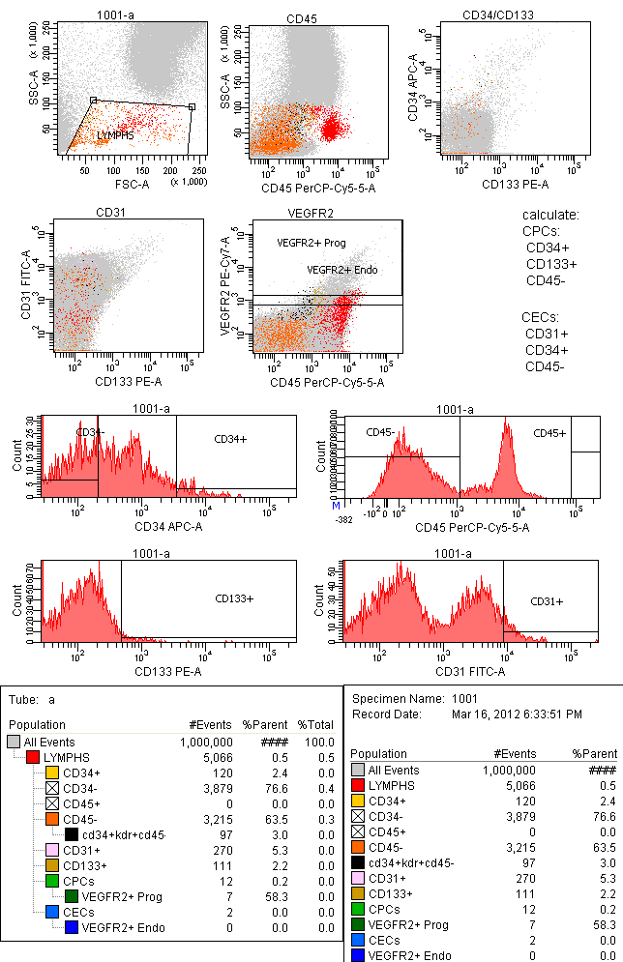
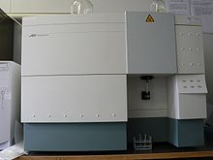
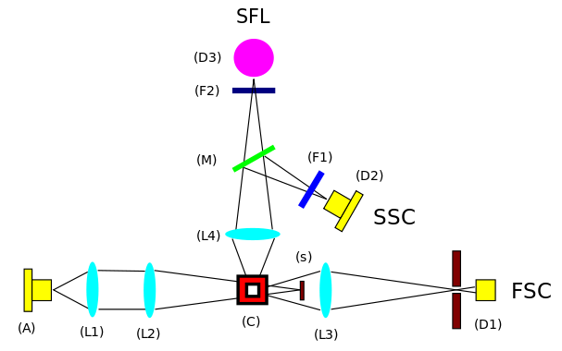
FLOW CYTOMETRY
CD133, CD45-, CD34
Other: BP, HR, T, R, SaO2, ScvO2, pO2, pCO2, pcvCO2, pain/SE,
Bx: LA, CK, CKMB, PCT, CRP, Tn, HCO3-, LDH, BNP, creat.
Statistics: paired t-test/ ANOVA, Ρ~0.05. spss-20. Q/so
Notes:
We used these surface indices, per the Massachusetts protocol, to identify the EPCs with flow cytometry

Slide 32

Synopsis of method
Evaluation on ICU admission
Randomization to one/2 P’s.
Blood sampling before and just post EMS
Flow chart
173
All admissions considered during study period
-...
No consent
-...
No inclusion criteria present
Exclusion criteria present
=33 pts(24Μ) underwent ems (PR1: 14; PR2: 19) day~#7(SD=3):
11 on steroids (groupS) / 22 not on steroids (groupA).
Notes:
We recruited 33 patients, of whom 11 were on steroids

Slide 33
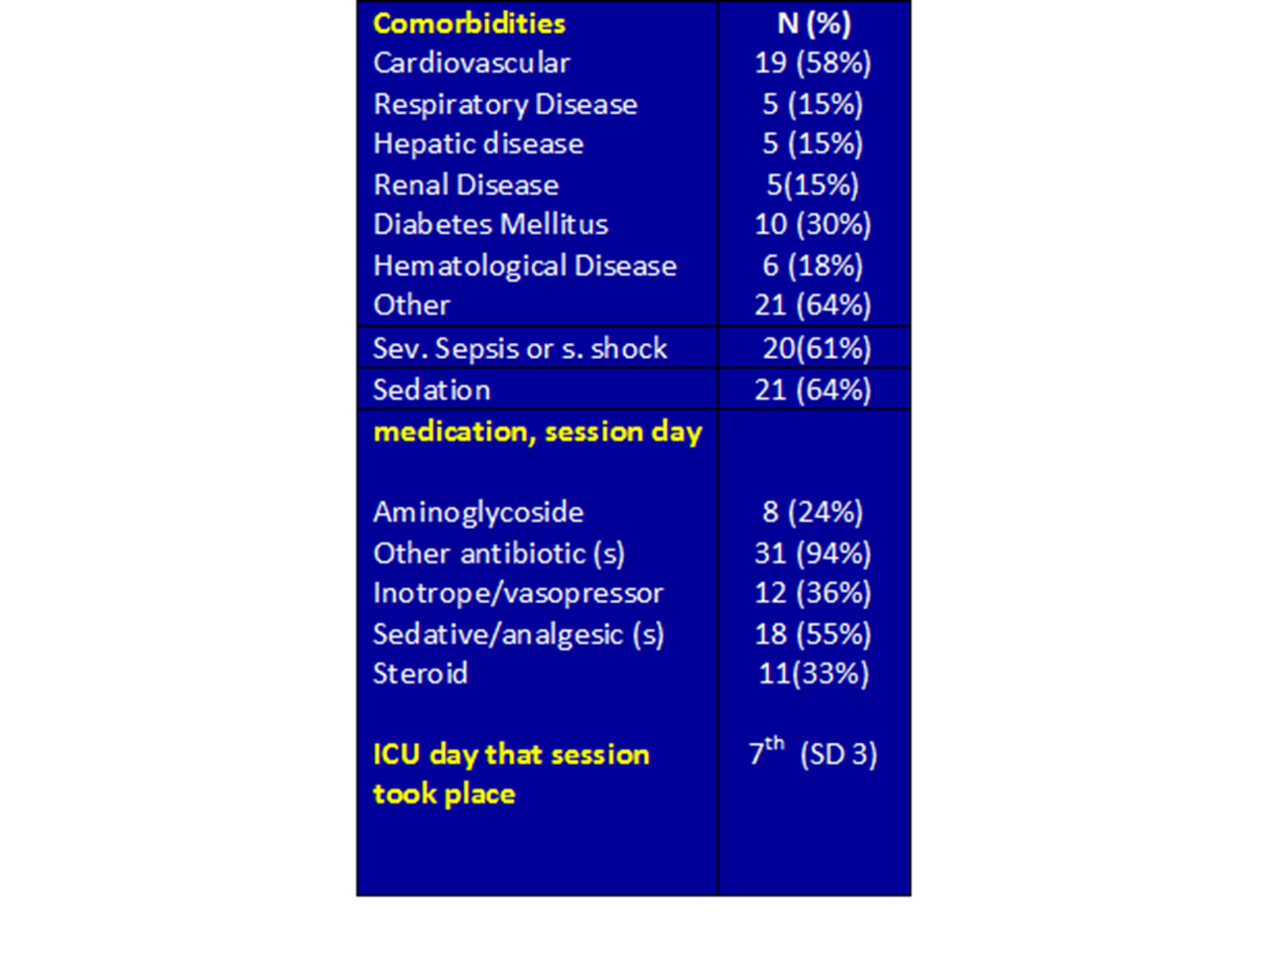
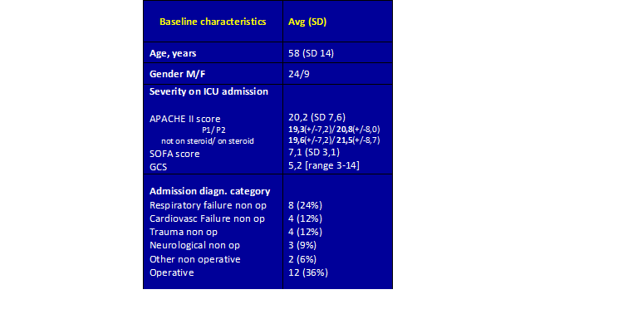
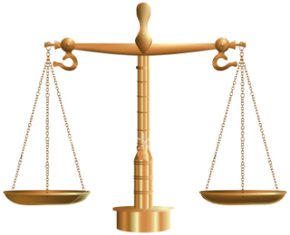
Baseline characteristics of sample
1/2…
Notes:
Baseline pt characteristics, which were balanced in the 2 protocols...

Slide 34
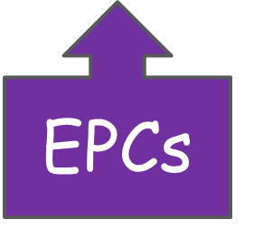
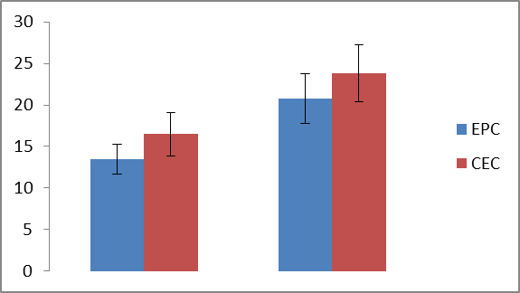
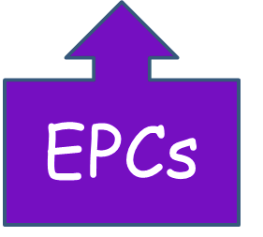
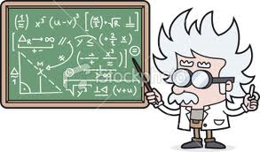
Results
Overall change
post
pre
 | Before EMS | After EMS
EPC | 13.5±1.8 | 20.8±3.0
CEC | 16.5±2.6 | 23.8±3.4
EPCs
P~0.01
During ems: pain (N=2), ↕ABG, VBG, T, EKG.
↑ BP by 20-60mmHg (or ↓ΝΑ) & ICP 0-2mmHg
Notes:
EPCs, in blue color, rose v.significantly, regardless the Protocol or max current used. Pts on steroids did not mobilize EPCs, as expected, likely because steroids are BM suppressants and EPCs derive from BM. No hemodynamic derangements, ECG, intracranial pressure or cardiac enzyme changes occurred.

Slide 35

conclusions - Key Messages
A 30 min EMS session acutely mobilized EPC in septic ICU patients not on steroids.
Mobilization was similar in two current protocols; and not related to F or Imax.
No cardiovascular derangements or cardiac marker changes occurred.
Biochemical, CEC and physiological changes were in the same direction as exercise.
No disease severity correlation with EPC levels or EPC mobilization was found.
An important inference might be that, EPC mobilization could be a fundamental underlying mechanism of the regenerative effects of and similarities between EMS and exercise. Steroids, as marrow suppressants, could hinder mobilization.
Insight to pathophysiology and clinical relevance.
The basic question is: Does this EMS-induced EPC mobilization lead to a better prognosis due to regeneration?
No RCTs/ no hard endpoint studies ($, time,..)
Hence mechanism exploration is useful in setting weak indications
Notes:
So EMS has systemic regenerative impact, like exercise. It was safe.

Slide 36
Safety!
Electric shock, burns, bruises, irritation, pain, fatigue
>> use GEL, alternate site/ frequency; ‘motor point’
Interference with electric devices (PM, ICDs, insulin pumps..).
contraindicated: Over eyes (^IOP); Transcerebrally; On the front neck (acute hypotension or laryngospasm); across a thoracic diameter; On broken skin; Over malignancy; Directly over spine; pt with ICDs/PM/arrhythmia/seizures; pregnancy; site with risk of bleed/Fx/postsurgical...
NO use in health clubs, beauty/skin, for body building.
Long-term effects are not known.
www.accessdata.fda.gov/cdrh_docs/reviews/k122566.pdf
Notes:
EMS induces histological changes& muscle damage more than exercise, due to the synchronus, topographically limited fiber stimulation; causing pain, being the main limitation. Other SE are, Electric shock, burns, bruises, irritation, fatigue. It is contraindicated in pts with ICDs or PM and situations shown.

Slide 37
SUMMARY: EMS ROLE IN PALLIATIVE/REHAB [1/2]
Ppx /retardation of disuse atrophy; icuaw
Relaxation of muscle spasms
Complementary in analgesia; Migraines, HA.
Deep tissue injury/ post surgical DVT
Muscle re-education; & increasing ROM
Incontinence/ pelvic floor dysfunction/ Sx
Special populations: OSA, iTremor, CHF, Ca (iontophoresis), depression, GERD/N/V, DP
REGENERATION
Werner N, et al. EPC and cardiovascular outcomes. N Engl J Med 353: 999–1007, 2005.
A Angelidi, et al; EPC as a cardiometabolic RF marker in prediabetes; Hormones, 2014, 13(2):244-251
Tecilazich et al. (2013) Role of EPC and Inflammatory Cytokines in Healing of Diabetic Foot Ulcers. PLoS ONE 8(12): e83314.
Notes:
And here is a summary of its multiple roles in PC.

Slide 38

What said:
A. Introduction: about. Technical facts.
B. Established & investigational uses/ evidence.
C. EMS & exercise; Tissue regeneration & EPCs.
D. Own research.
E. Safety
ems: an essential tool in PC!
Q?
Notes:
EMS increasingly attracts interest in medicine, and PC&R is a hot area; ...AND am ready 4 your Qs now, but please, feel free to contact me and I will respond promptly and provide practical guidance

Slide 39
Literature stefanouchristos@hotmail.com
Maffiuletti,et al. (2010) Physiological and methodological considerations for the use of NMES. Eur J Appl Phys, 110(2), 223–234.
Gobbo, M., Maffiuletti, ... (2014). Muscle motor point identification is essential for optimizing NMES use; J Neuroegin Reh 11(1), 17
Routsi, V.. et al. EMS prevents CIPNM: a randomized parallel intervention trial, Critical Care, vol. 14, no. 2, p. R74, 2010
de Jonghe B, Lacherade J... et al: ICUAW: risk factors and prevention. Crit Care Med 2009, 37:S309–315.
Sillen MJ, Speksnijder, et al. (2009), Effects of NMES of muscles of ambulation in patients with CHF or COPD: Chest 136: 44–61.
Abdellaoui A, Prefaut, et al: Skeletal muscle effects of EMS after COPD exacerbation: a pilot study. Eur Respir J 2011, 38:781–788.
Maffiuletti N.. et al (2013); NMES for preventing skeletal-muscle weakness and wasting in critically ill: a syst rev. BMC, 11(1), 137.
Chest. 2005 Aug;128(2):958-69; Emerging strategies in the prevention of VTE in hospitalized medical patients; Spyropoulos AC.
Cohen, A. T., et al (2007). VTE in Europe. The number of VTEs, morbidity, mortality. Thromb Haemost, 98, 756.
B.J Broderick et al; A pilot evaluation of NMES-based methodology for prevention of venous stasis; Med. Eng.& Physics 32 (2010).
Kopetzky CD. Wien Med Wochenschr; Combined compression and EMS; 1994;144(10-11):238-42
M. Izumi, et al; Prevention of Venous Stasis in the Lower Limb by TENS; Eur J Vasc Endovasc Surg (2010) 39, 642e645.
Lobastov KV et al; Haemodynamic and clinical efficacy of EMS of the venous outflow in prev of postop VTE; Ang Sosud Khir. 2013;19(2)
Nicolaides, A. N., et al. Prevention and treatment VTE-International Consensus Statement. Intnl Angio (2013): 111-260.
Review of Medical Physiology, 24th edition, William F. Ganong (2013)
Bó AP, et al; On the use of fixed-intensity FEMS for attenuating essential tremor; Artif Organs. 2014 Nov;38(11):984-91.
PJC Vieira, et al; NMES improves clinical and physiological function in COPD patients; Respiratory Medicine (2014) 108, 609e620
Karavidas A, et al (2013); FEMS improves endothelial function and clinical and emotional status in CHF patient; Am Heart J 166(4), 760–767.
Hofstoetter US et al; Modific spasticity by TC spinal cord stimulation in individuals with incomplete SCI; J Spin Cord Med. 2014
Mali B et al; Antitumor effectiveness of electrochemotherapy: a sys rev and meta-analysis; Eur J Surg Oncol. 2013 Jan;39(1):4-16
Wilkenfeld AJ. Review of ES, botulinum toxin, and their combination for spastic drop foot. J Rehabil Res Dev. 2013;50(3):315–26.
Notes:
very few among the innumerable articles related to this presentation; feel free 2email!

Slide 40
Literature stefanouchristos@hotmail.com
22. Strollo PJ..et al (2014). Hypoglossal-Nerve Stimulation for OSA; N.En.J.Med, 370(2), 139–149
23. Zhao M, et al. (2006) Electrical signals control wound healing through PDI-3-OH kinase-gamma and PTEN. Nature 442: 457–460
24. Kawasaki L, et al; The mechanisms and evidence of efficacy of ES for healing DTI: a sys rev; Wound Rep Regen. 2014 Mar;22(2):161
25. A Polak, et al; High-Voltage PES in Wound Treatment; Adv Wound Care 2014 Feb 1;3(2):104-117
26. Pinto S et al; Breathing new life into treatment advances for respiratory failure in ALS; Neurodeg Dis Manag. 2014;4(1):83-102
27. Crameri RM et al (2007). Myofibre damage in human skeletal muscle: effects of ES vs voluntary contraction. The J Phys 583(Pt 1), 365–380.
28. www.accessdata.fda.gov/cdrh_docs/reviews/k122566.pdf
29. Starr JA et al; Outcomes of a comprehensive nonsurgical approach to pelvic floor rehab for urinary Sx, defecatory dysfunction, pelvic pain; Female Pelvic Med Reconstr Surg; 2013 Sep-Oct;19(5):260-5.
30. Raschke J et al (2013); Identification and Validation of Novel Contraction- Regulated Myokines Released from Primary Human Skeletal Muscle Cells; PLoS ONE 8(4): e62008
31. Warburton, DE et al (2007). Evidence-informed physical activity guidelines for Canadian adults; Can. J. Pub Health 98
32. Sarto P et al (2007). Effects of Exercise Training on EPC in Patients With CHF. J of CHF, 13(9), 701–708.
33. 34. Pedersen BK et al; Muscle as an endocrine organ: focus on muscle-derived Il-6. Physiol Rev 88: 1379-1406, 2008.
35. KAHajjar; The endothelium: A primer; UpToDate 2015
36. Russel C, Peters C; Endothelial cells, angiogenesis and vasculogenesis; stemcell, 2013, Jan
37. T Morishita; et al; Number of EPC in PVD as a marker of severity and association with pentraxin-3, malondialdehyde-modif LDL and MMP-1; J ather thromb 2012 Vol: 19
38. Werner N, et al. EPC and cardiovascular outcomes. N Engl J Med 353: 999–1007, 2005.
39. A Angelidi, et al; EPC as a cardiometabolic RF marker in prediabetes; Hormones, 2014, 13(2):244-251
40. Tecilazich F, Dinh T, Pradhan-Nabzdyk L, Leal E, Tellechea A, et al. (2013) Role of EPC and Inflammatory Cytokines in Healing of Diabetic Foot Ulcers. PLoS ONE 8(12): e83314.
41. Moschetta M et al; ROle of EPC in cancer progression; Biochim Biophys Acta.2014 Aug;1846(1):26-39
42. www.fda.gov/medicaldevices/safety/alertsandnotices/tipsandarticlesondevicesafety/ucm229468.htm
43. Zeng C, et al; ES for pain relief in knee OA: systematic review and network meta-analysis; Osteoarthritis Cartilage.2015 Feb;23(2):189-202.

