Slide 1
Climate Change and Global Food Security in the Face of Other Stressors: The Challenges for Agricultural Transformation, Adaptation and Conservation
Christopher R. Bryant, Geography, University of Montreal, Quebec & School of Environmental Design, University of Guelph, Ontario Christopher.robin.Bryant@gmail.com, Tel: 519-846-1361
Antonia D. Bousbaine, Geography, Laboratory Laplec, University of Liege, Belgium
Chérine Akkari, PhD student, Geography and Environmental Management, University of Waterloo, Waterloo, Ontario, Canada
Oumarou Daouda, Programme Analyst, Senior Technical Advisor Conservation & Sustainable Mgt of Transboundary Wetland LTLT Project, United Nations Development Programme (Republic of Congo)
Kénel Delusca, Team Leader for a European Union Climate Change Project in Haïti
Terence Epule Epule, Post-Doctoral Research Fellow/Lecturer, Geography, McGill University
Mamadou A. Sarr, Researcher, Centre de Suivi Écologique, Dakar, Sénégal
Charles Drouin-Lavigne, M.Sc Géographie, Consultant (Sustainable Development, Environment, Impact Studies)
World Congress on Climate Change, Valencia, Spain, October 25, 2016

Slide 2
Plan
1. Climate Change and Food Security (cf. The United Nations’ Framework Convention on Climate Change, to which Canada is a signatory, identifies agriculture – including food production – as an important vulnerable area (UNEP, 1994; UNFCC, 2006))
2. Multiple Stressors Affecting Agricultural Production
3. Adaptation of Agriculture to CCV
4. Challenges of Agriculrtural Production near and in Cities that are Growing
5. Food Security
6. Conclusions

Slide 3
1. Climate Change and Food Security
Food Security
  Volume (local, national, global markets, & in relation to specific segments of the population – poor, some of the older population, ...) – CCV impacts upon agriculture & agricultural yields
  Human health
    More than 795 million people still suffer from hunger & malnutrition
  Environmental externalities (e.g. water pollution)
In certain countries & regions, these impacts can be multiplied many times because food production resources, notably farmland, are already vulnerable because of drought conditions. E.g. Ethiopa, Sahel countries

Slide 4
2. Multiple Stressors Affecting Agricultural Production (see Figure 1)
In investigating the effects of climate change on human activities such as agriculture & food production:
Must appreciate the multiple stresssors agricultural activities must contend with
Why? Because of their differential impact on farmers’ (and peasants’) priotities
Implies farming does not necessarily adapt or change to CCV in the same way in different countries or even different regions in the same country

Slide 5
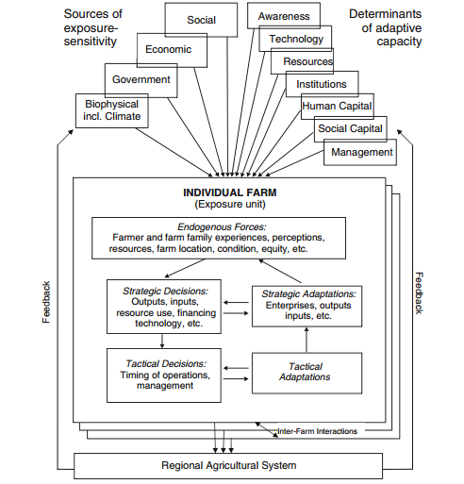
Figure 1: Multiple stressors affecting agricultural production.
Source: Reid, S. et al. (2007). Vulnerability and adaptation to climate risks in Ontario agriculture. Mitig Adapt Strat Glob Change (12): 609-637.

Slide 6
3. Adaptation of Agriculture to CCV (see Figure 2)
Many large cities surrounded by high quality farmland resources in temperate climates (e.g. in much of North America & Western Europe)
A rapidly emerging reality – the differential impact of Climate Change & Variability (CCV) on farming in different areas
  & the need for appropriate agricultural adaptation to CCV
In many developed countries, appropriate adaptation can maintain food production levels even though crop composition may have to change
Adaptation of agriculture poses its own challenges, including the appropriate roles of governments at all levels, farm associations, private companies & consumer groups

Slide 7
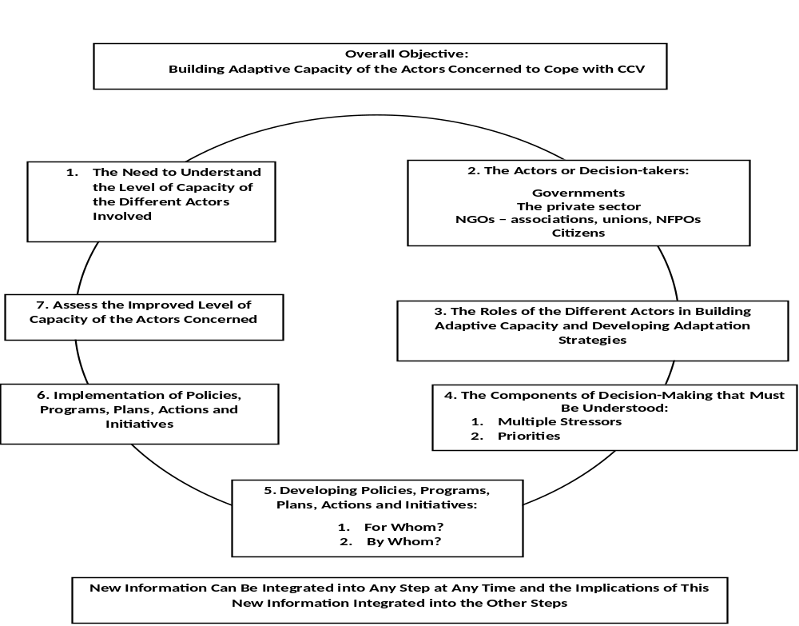
A schematic diagram showing the basic components of adaptation
Figure 2: The roles of governments and other actors in adaptation to climate change and variability: The examples of agriculture and coastal communities. AIMS Environmental Science, 2016, Vol. 3, Issue 3 : 326-346. Bryant, C.R. et al.

Slide 8
4. Challenges of Agricultural Production in Developed Countries near and in Cities that are Growing
Farmland resources, including climate (temperate climates), are good to very good, even after the effects of climate change & variability (CCV) are taken into account
Competition from other countries & regions
A multitude of regulations
Farming near these cities also often face continued urbanization pressures., e.g. in Canada, the U.S., the European Union (e.g. France, Belgium, the Netherlands, the U.K.)
Urbanization pressures
  Actual urban development (suburbs, less dense non-farm development in periurban areas
  Potential urban development (which can be seen in land use plans a long time in advance of actual development & where development zones may have already been purchased by developed years ahead ... but many citizens do not know what is likely to happen)
    Raises issues of how to modify plans over time as circumstances change ...

Slide 9
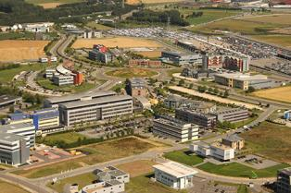
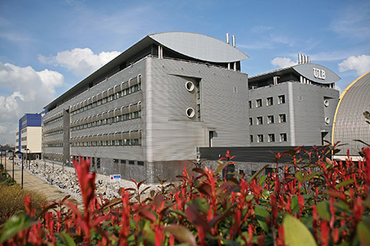
Examples of agricultural land in or close to urban & industrial development zones
Source: notreregion.be
Developed by the intercommunal IGRETEC, the business parks in the region of Charleroi and South Hainaut include over 650 companies active in numerous economic sectors (aeronautics and space, food, health, information and communications technologies, transport & logistics, ...). They represent nearly 1000 hectares dedicated to economic activity.

Slide 10
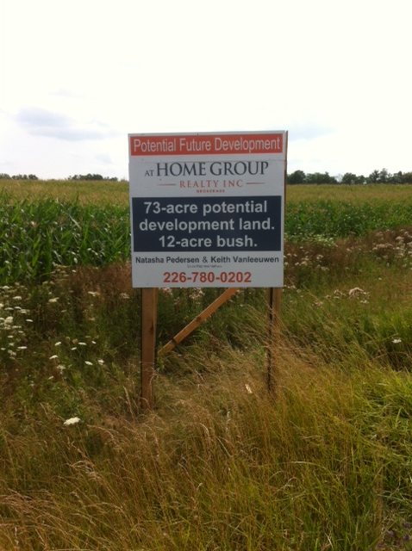
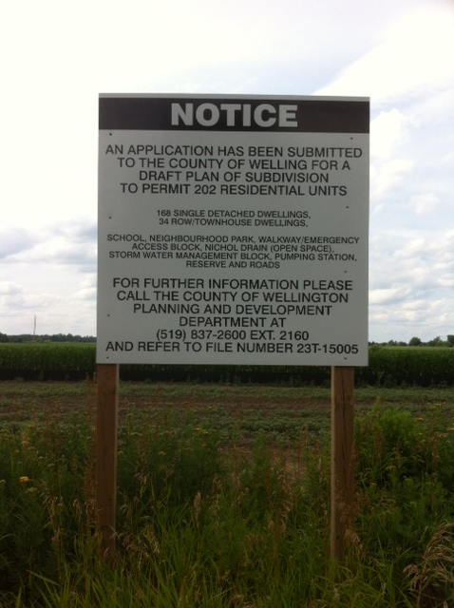
Plot of good quality agricultural land in the eastern periurban area of Kitchener, SW Ontario. A notice suddenly appears to advertise the land for potential development.
Centre Wellington Township, SW Ontario. Top quality agricultural land, with a recent appearance of a sign to indicate an application has been submitted for a subdivision development, to many people’s amazement. Zoned for subdivision development and bought by a developer some 10 years ago.

Slide 11
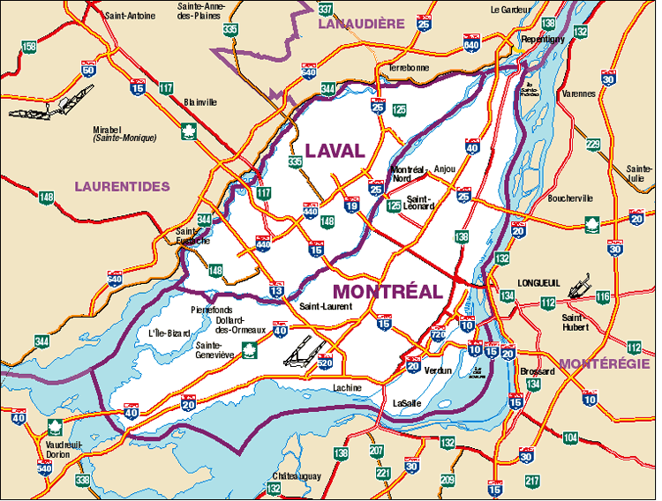
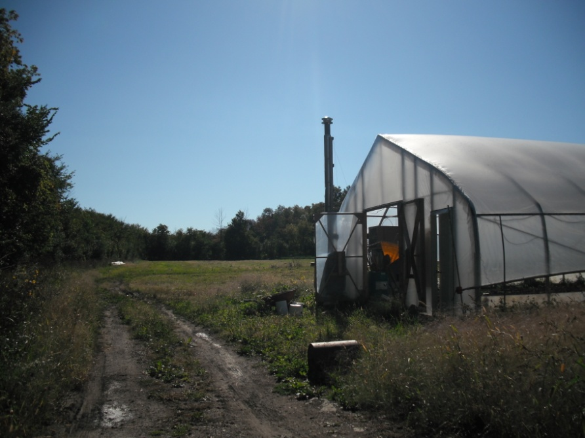
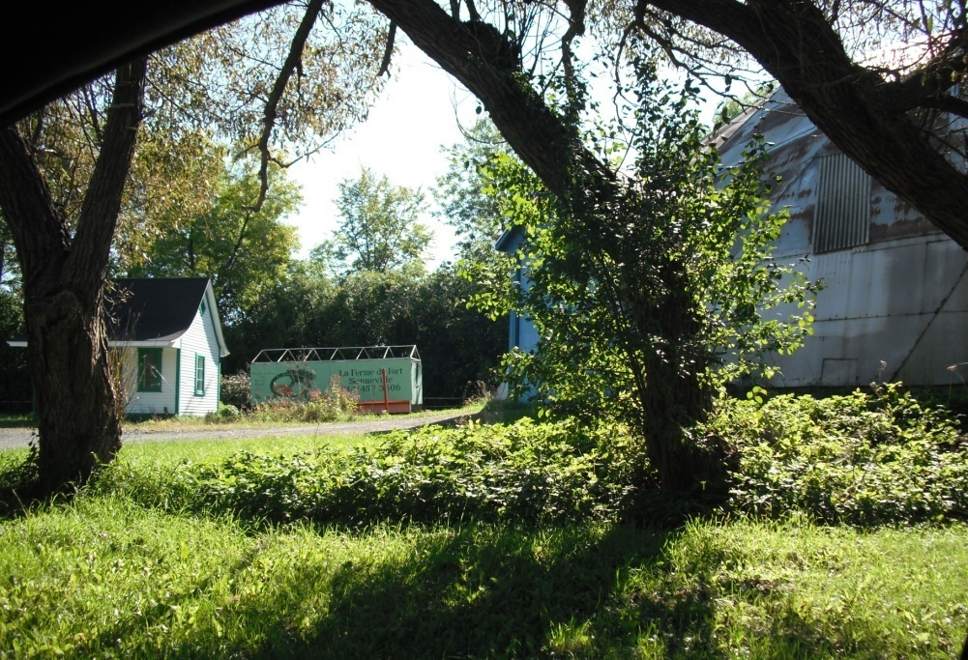
Managing new forms of sustainable agriculture
The importance of linkages between farmers & consumers (e.g. Food Belt around Liège, consumer networks – improving non farmers’ understanding of farming)
Small scale producers on urban & suburban market places (e.g. Senneville & St Anne de Bellevue)

Slide 12
5. Food Security
An increasingly important concern for some population segments in cities
  A growing emphasis on local and regional sources of food for these cities & different population segments
  Also the concerns over the forms of agriculture (e.g. in relation to environmental & human health issues related to productivist agricultures)
  In addition, because of how CCV impacts these agricultures in many cases, maintaining the farmland resource can also contribute to resolving some food security probems for some developing countries
Ensuring that these agricultural territories near cities in developed countries can contribute to food security locally & globally:
Major challenges for agriculture :
  These agricultures must be transformed (NB The barrier posed by continued gov’t support of productivist agriculture
  Agriculture must adapt to CCV (we also have to make sure that adaptation & mitigation are complementary; & not contradictory to each other)
  Recognizing the importance of cumulative impacts

Slide 13
6. Conclusions
The challenges of maintaining & improving food security are significant
These challenges have become more significant in the face of Climate Change & Variability
The implications of our presentation are multiple:
CCV makes it much more important to conserve & protect good farmland resources from different forms of urban development
But conservation of farmland resources through land use planning (including farmland protection legislation) is not in itself adequate
In addition, it is necessary to integrate (strategic) development planning to achieve sustainable agricultural production
As the context & various parameters change over time, it would be wise to systematically revise earlier decisions regarding urban & industrial development incorporated into earlier land use plans (while recognizing the difficulties this involves because of the importance attached in many countries to supporting actors who invest in development in zones already contained in approved official land use plans)

Slide 14
TACKLING CCV TO MAKE AGRICULTURE CONTRIBUTE SUBSTANTIALLY TO FOOD SECURITY THEREFORE INVOLVES:
  Agricultural Transformation
  Adaptation to CCV (as seen above, this is neither simple nor linear nor can the same strategies be parachuted into every territory ...).
  Though vulnerability reduction & adaptation practices (measures or strategies in other words) are not the same for all sectors of production, & can be even contradictory sometimes, it is very important to recognize that both climatic and non-climatic factors are important in the process of adaptation to CCV.)
  Conservation
I.E.
ATAC!

