Slide 1

EXTRACELLULAR MATRIX-
ASSISTED CELL VIABILITY
Christopher A. Bradley, Ph.D.
Cell & Stem Cell Research
OMICS Conference
March 23-25, 2015
Chicago, IL

Slide 2
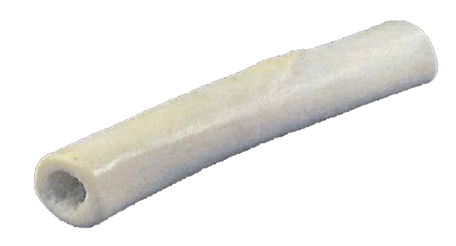
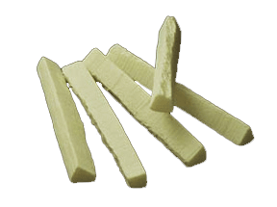
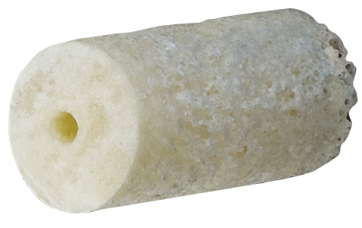
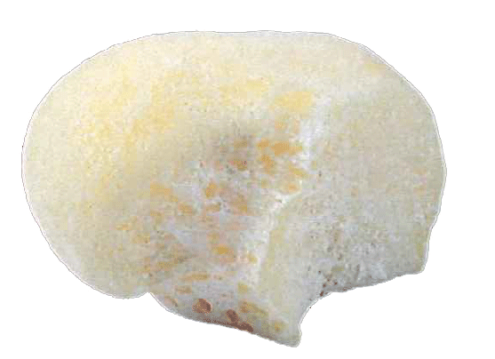
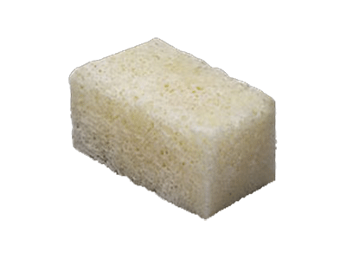
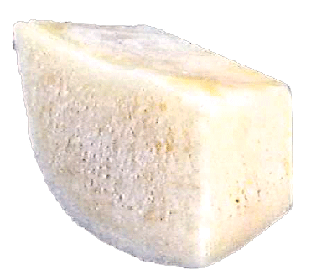
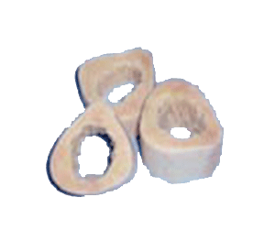
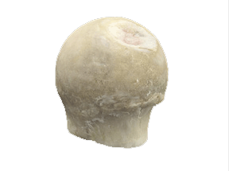
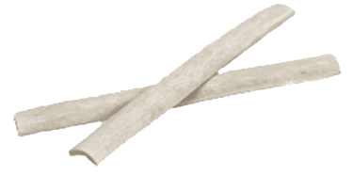
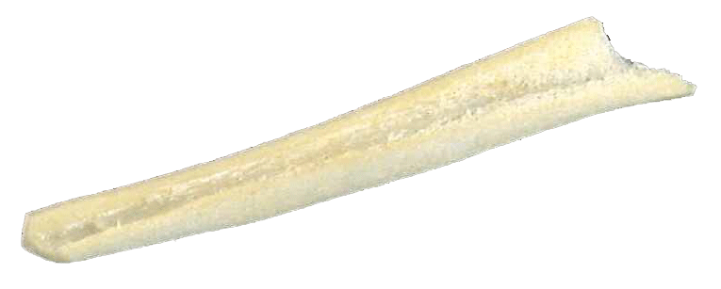
Allografts-Я-Us

Slide 3
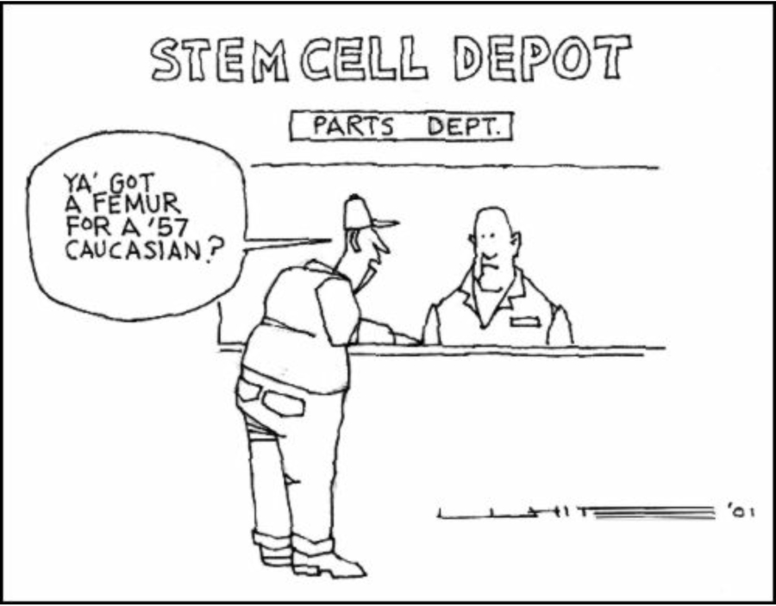

Slide 4
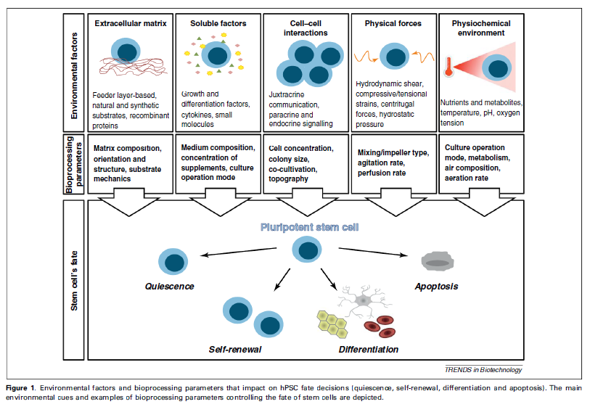
Sera M, et al. (2012) Process engineering of human pluripotent stem cells for clinical application. Trends in Biotechnology 30: 350-359.

Slide 5
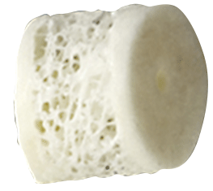
Building the next generation of infused allografts
native
extracellular
matrix
adipose-derived
mesenchymal
stem cells
faster surgical
recovery
better
regenerative
properties
autologous
traditional bicortical dowel allograft
growth
factors
optimized
nutrient
composition
Next Generation
Allografts

Slide 6


Burning Questions
How to define the culture media that will enhance propagation
and promote differentiation from isolated stem cells?
How to enrich for stem cells and promote healing in transplanted allografts?
How to “wake up” the stem cells once derived from tissues?

Slide 7
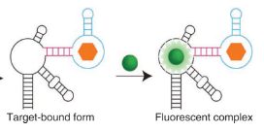
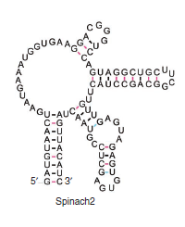
Chimeric RNA Aptamers for Sensing Metabolites
= metabolite
chimeric aptamer recognizes specific metabolite
and fluoresces upon binding
by using different colors for two related metabolites,
the ratio of color signals can be simultaneously measured
and the status of the stem cell can be determined
RNA aptamer
= fluorescent dye
Grant Title: Optimization of New Fluorescent Dyes for Monitoring the Metabolic State of Stem Cells
PI: Dlakic M; Co-PIs: Dratz EA and Sullivan PA.
Funding sources: Montana Board of Research and Commercialization Technology (MBRCT) and
Lattice Biologics, Inc.
Paige JS, Thinh N-D, Song W, and Jaffrey SR (2012)
Fluorescence imaging of cellular metabolites with RNA.
Science 335: 1194.

Slide 8
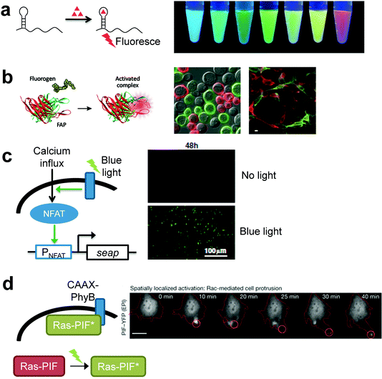
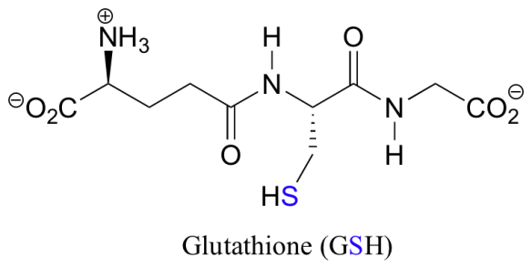
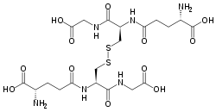
Applied fluorescent aptamer technology
Example: Determining redox status of the cells
Method: Measure the metabolites of oxidized reduced glutathione (GSH) and its oxidized form glutathione disulfide (GSSG)
GSH
alter nutrient composition
of media to favor stem cells
primed for transplantation
High redox balance (↑GSH/GSSG)
favors proliferation of
undifferentiated stem cells
Low redox balance (GSH/↑GSSG)
favors differentiation
GSSG

Slide 9
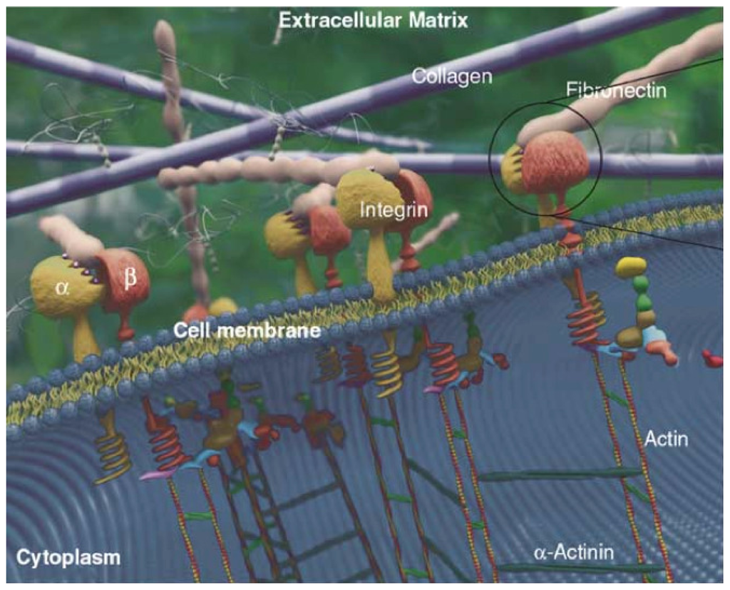
Tissue structure
Substrate for cell adhesion
Reservoir of signalling molecules
Cell migration
Cell proliferation
Differentiation
Complexity of the ECM

Slide 10
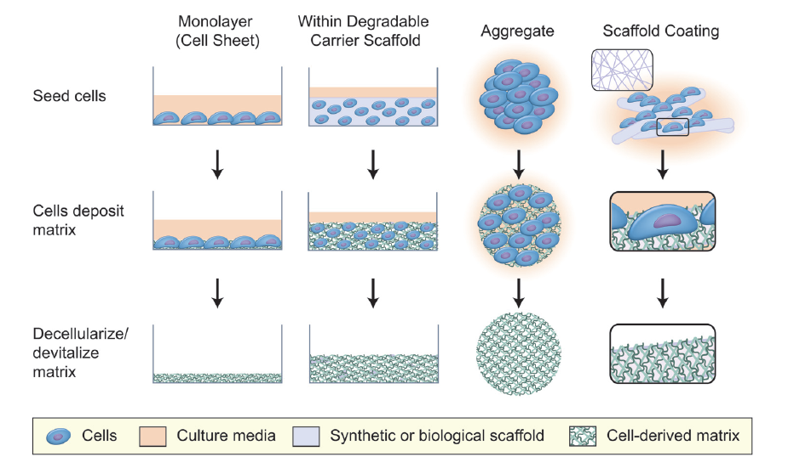
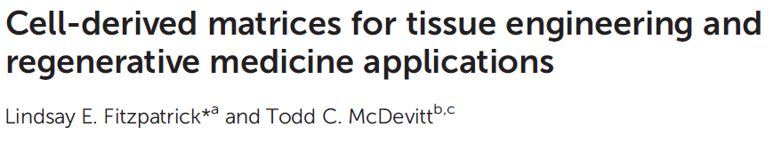


Slide 11
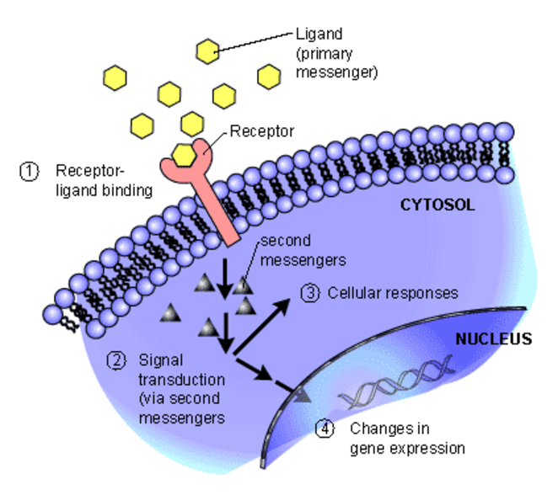


Properties of the ECM
reservoir of
signalling molecules
tissue structure
substrate for
cell adhesion
cell
proliferation
cell
migration
differentiation
BMPs
growth factors

Slide 12
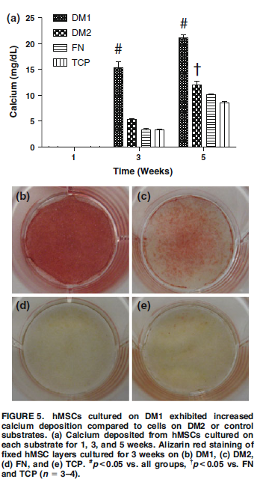
Optimization of growth conditions of hMSCs
to favor osteogenic differentiation
Cells cultured in SM media then decellularized/demineralized leaving DM (decellularized matrix)
DM1 = 15 days, 21% O₂
(normoxia)
DM1
DM2
DM2 = 6 days, 5% O₂
(hypoxia)
FN = fibronectin
FN
TCP
TCP = tissue-culture plastic
Alizarin red staining of hMSC
3 week cultures
(calcium deposition)
SM = αMEM + 50 μg/ml A2P
Variables:
culture duration
oxygen tension
cell density
media type
Decaris ML and Leach JK (2011) Design of experiments to engineer cell-secreted matrices for directing osteogenic differentiation. Ann Biomed Eng 39: 1174-85.

Slide 13
Effects of stem cell-derived ECM on MSCs
homogenized and transferred DMs exhibit a potent ability to enhance osteogenic
differentiation that is comparable to DMs deposited on a substrate
Decaris ML, et al. (2012) Transferable cell-secreted extracellular matrices enhance osteogenic differentiation. Acta Biomateriala 8: 744-752.
alteration of environmental culture conditions during matrix deposition affects
the capacity of DMs to modulate cell fate
Decaris ML and Leach JK (2011) Design of experiments to engineer cell-secreted matrices for directing osteogenic differentiation. Ann Biomed Eng 39: 1174-85.
extending progenitor cell multipotency to higher passage numbers in vitro
Chen XD (2010) Extracellular matrix provides an optimal niche for the maintenance and propagation of mesenchymal stem cells. Birth Defects Res C Embryo Today 90: 45-54.
restoring the functional capacity of cells harvested from older subjects to a state similar to that of their younger counterparts
Sun Y, et al. (2011) Rescuing replication and osteogenesis of aged mesenchymal stem cells by exposure to a young extracellular matrix. FASEB J 25: 1474-85.

Slide 14
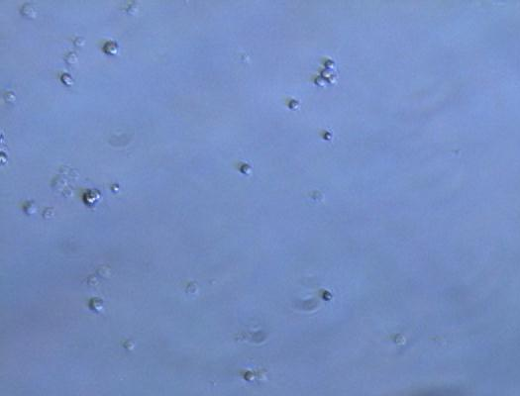
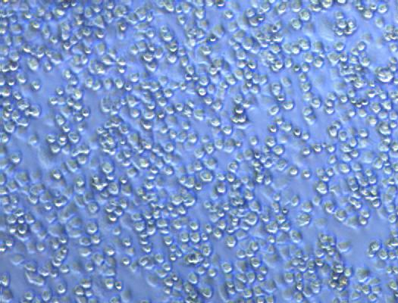
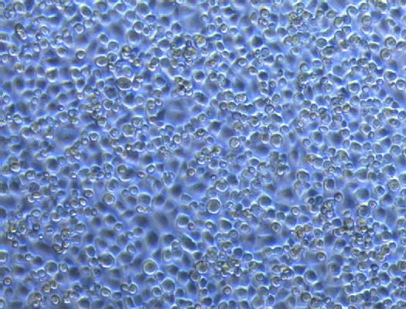
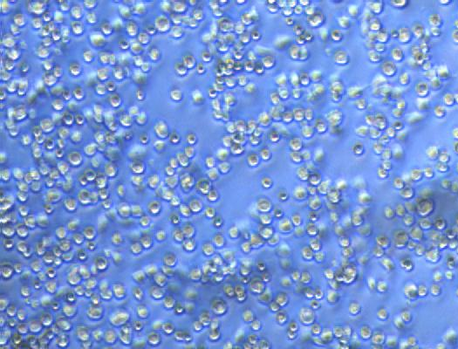
Fibronectin and its domains stimulate
global translation in RCJ3.1 C5.18 cells
GST
V-GST
**One-way ANOVA used for comparisions
between adhesion substrates and found
to be significant (p<0.05).
rat pFn
III10-GST
C5.18 line is derived from RCJ 3.1 cells but restricted to chondrocyte lineage
Bradley CA and Peters JH (2009)
unpublished results.

Slide 15
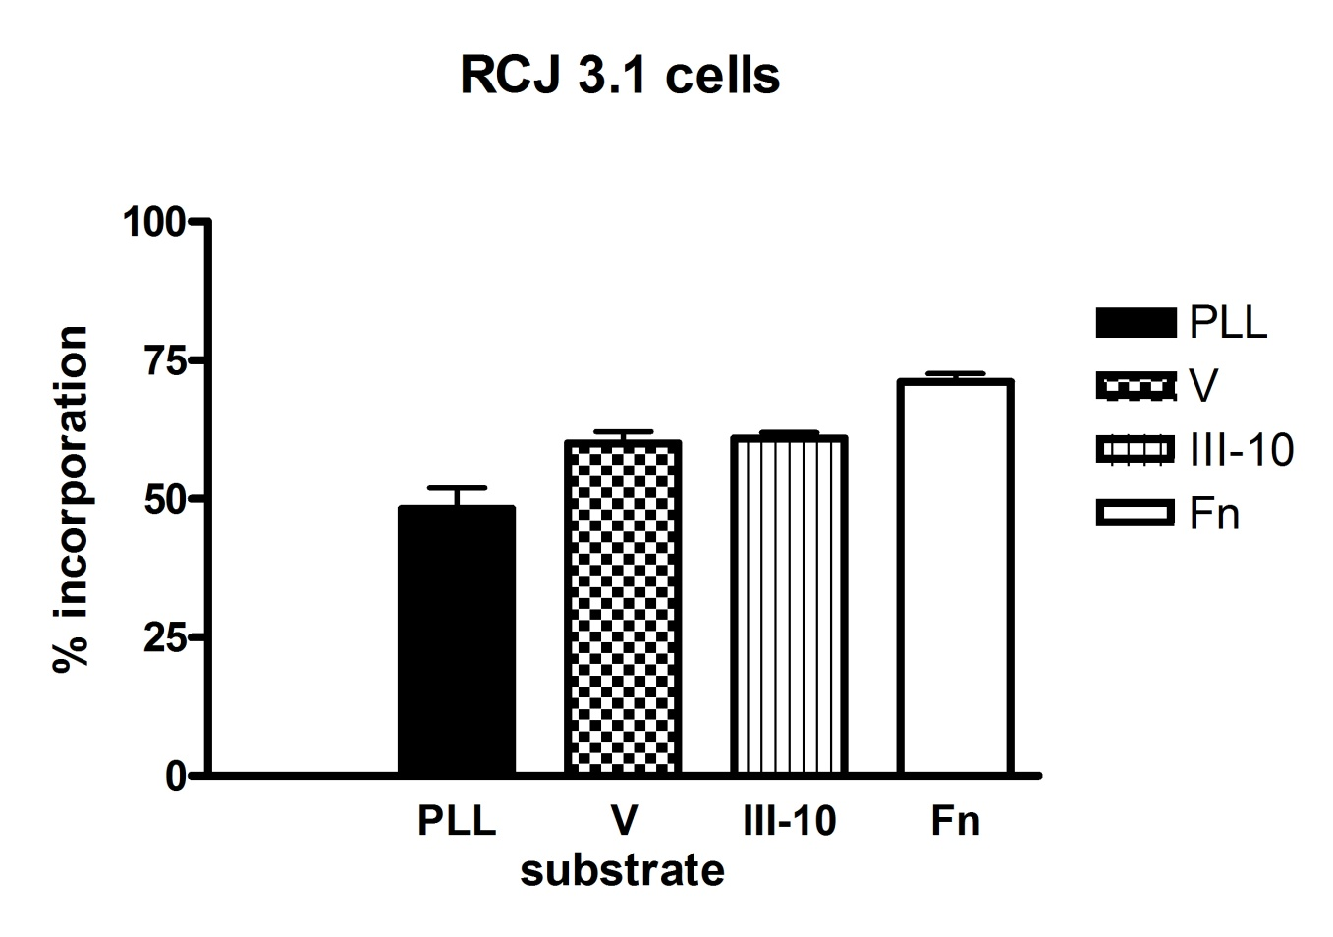
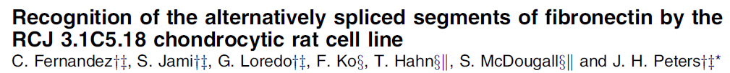

RCJ3.1 MSCs show lower global translation adhered to
poly-L-lysine vs ECM components
Attachment of MSCs
is necessary but not
sufficient to stimulate
global translation
(n = 3)
RCJ 3.1 mesenchymal stem cell line, derived from fetal rat calvarium
See further studies in…
Bradley CA and Peters JH (2009)
unpublished results.

Slide 16
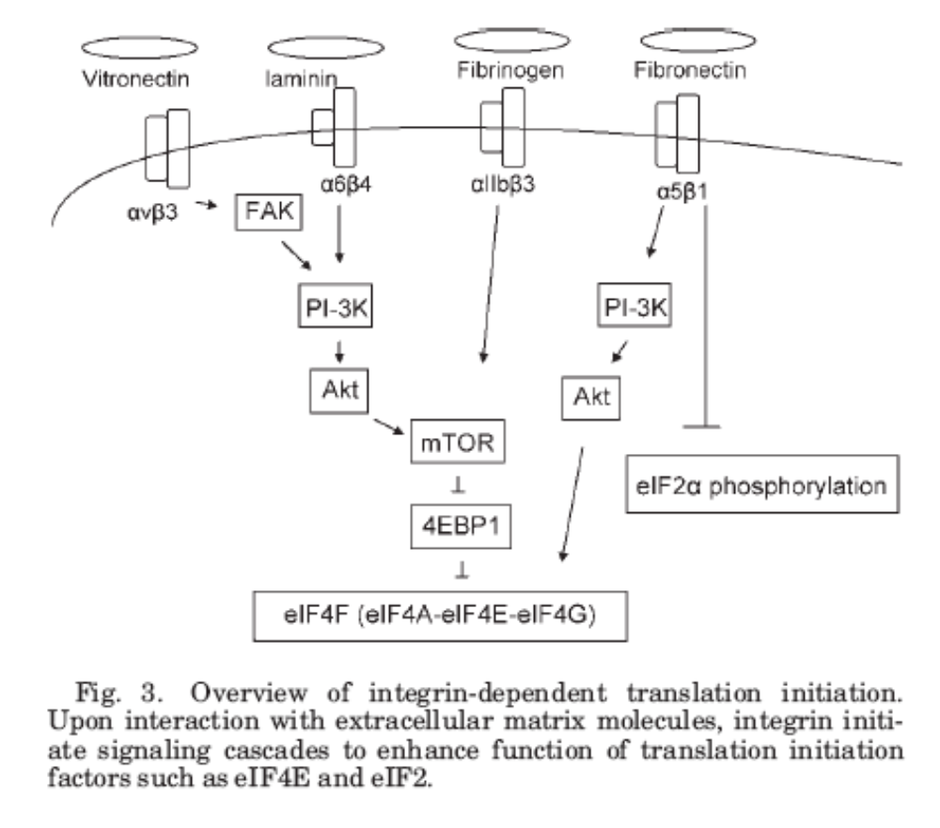
integrin-dependent translational control
III-10-region
V-region
fibronectin
and splice
variant domains
α2β1
αvβ3
?
Figure modified from Chung J and Kim TH (2008) Integrin-dependent translational control:
implication in cancer progression. Microscopy Res & Technique 71: 380-386.

Slide 17
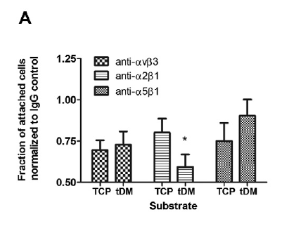
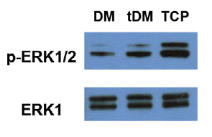
Blocking abs to α2β1 integrin reduce
hMSC – ECM attachment
TCP = tissue culture
plastic
differentiation
favored over
translation
tDM = transferred
decellularized
matrix
hMSC attachment and activation of intracellular pathways
Proof-of-concept: Cell-secreted ECM coatings need not be deposited directly onto a material surface, but can instead be transferred from one to another, while still
retaining their instructive potential.
Decaris ML, et al. (2012) Transferable cell-secreted extracellular matrices enhance osteogenic differentiation. Acta Biomateriala 8: 744-752.

Slide 18
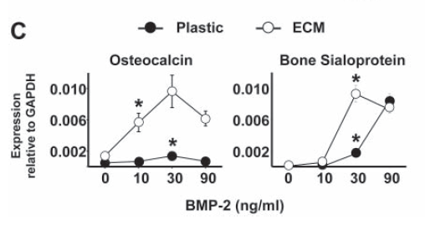
MSCs cultured on marrow stromal-cell derived ECM show enhanced reponsiveness to BMP-2
RT-PCR of osteoinductive genes
Lai Y, et al. (2010) Reconstitution of marrow-derived
extracellular matrix ex vivo: A robust culture system
for expanding large-scale highly functional human
mesenchymal stem cells. Stem Cells & Development 19:
1095-1107.

Slide 19
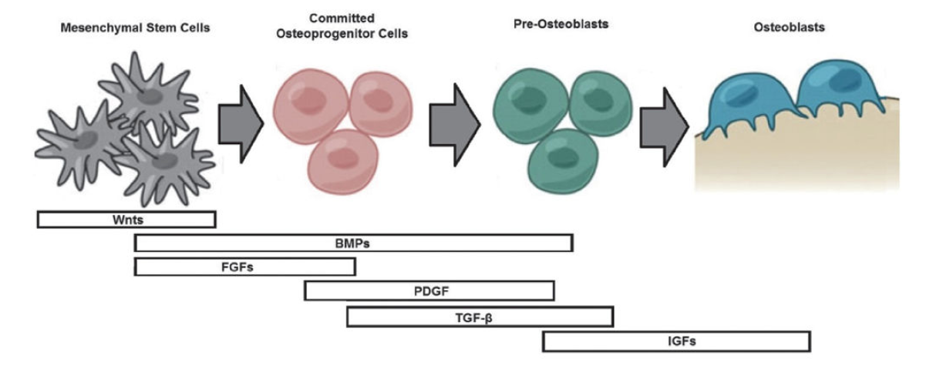
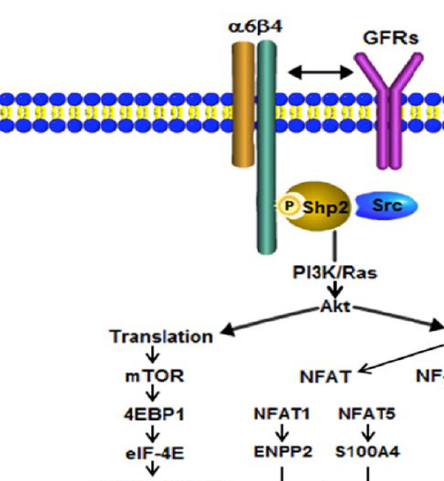
Synergistic
Approach to
Bone Healing
BMP-2 and other growth factors are retained in
decellularized bone allografts
Components of the ECM bind α6β4 integrin
Translation of VEGF is stimulated by α6β4 integrin binding¹
Osteoinductive and angiogenic factors
(BMP-2 and VEGF, respectively) can have a synergistic
effect on bone mineralization²
VEGF
Korneeva, NL, et al. (2010) Mnk mediates integrin
α6β4-dependent eIF4E phosphorylation and translation of VEGF mRNA. Mol Cancer Res 8: 1571-8.
Polo-Corrales L, et al. (2014) Scaffold design for bone regeneration. J NanoSci Nanotechnol 14: 15-56.
Figure adapted from Soung YH, et al. (2011) Role of α6β4 integrin in cell motility, invasion, and metastasis of mammary tumors. Curr Protein Pept Sci 12: 23-9.

Slide 20
Strategy for engineering
Next-Generation Allografts
Use existing decellularized allografts
Alter growth conditions of MSCs to produce custom ECMs
  Integrin ligand expression
  Vascularization
Incorporate engineered ECM into allograft
Produce next-generation allografts with superior healing properties
  Better engraftment and retention of stem cells
  Retained cells are primed for proliferation
  Differentiation of appropriate tissue type is enhanced
  Healing times are accelerated

