Slide 1

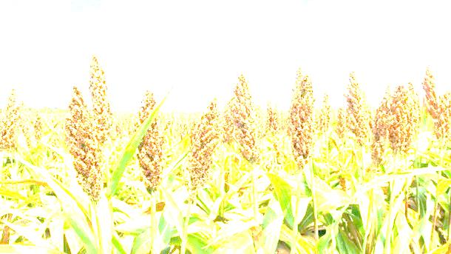
Impact of food processing on metabolic profile and nutritional value of Sorghum
School of Food Science and Nutrition
Christine Bösch
Food Technology Conference - London 2015

Slide 2
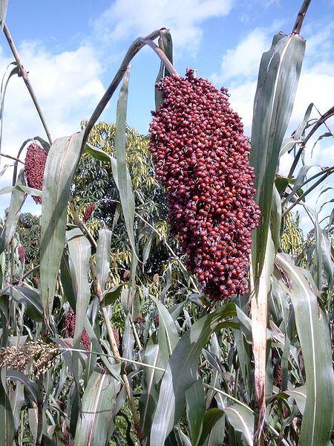
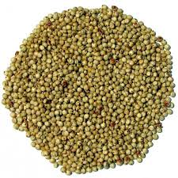
Sorghum
Sorghum biolor (L. Moench)
One of the worlds oldest cultivated crops
Worldwide cultivation
5th most cultivated cereal after maize, rice, wheat and barley (FAO 2013)
Adapted to low input agricultural systems
Drought and heat resistant
Feed and food purpose
Important staple food, especially in food insecure regions such as some sub-Sahara countries

Slide 3
Sorghum in human nutrition
Sorghum provides significant quantities of energy, protein, minerals and phytochemicals to the human diet
Water and labour-intensive pre-processing required to make nutrients available for human organism
  germination, soaking, boiling & fermentation

Slide 4
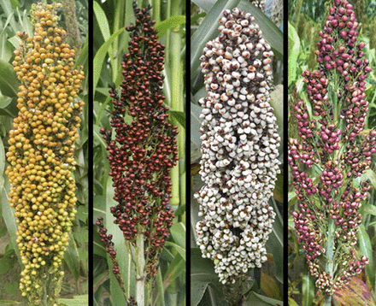
Different varieties of Sorghum
The genetic basis of pericarp colour and other flavonoid pigmentation traits in sorghum.
Morris et al. (2013) PNAS

Slide 5
Aims and objectives
Impact of modern food processing technologies on nutritional quality and metabolite profile in Sorghum
  How does microwave assisted preparation affect the bioactive content in comparison to traditional techniques (boiling, fermentation)
  How is starch digestibility affected by processing?
  How is trace element bioavailability affected?
Relationship between impact of processing and Sorghum pigmentation

Slide 6
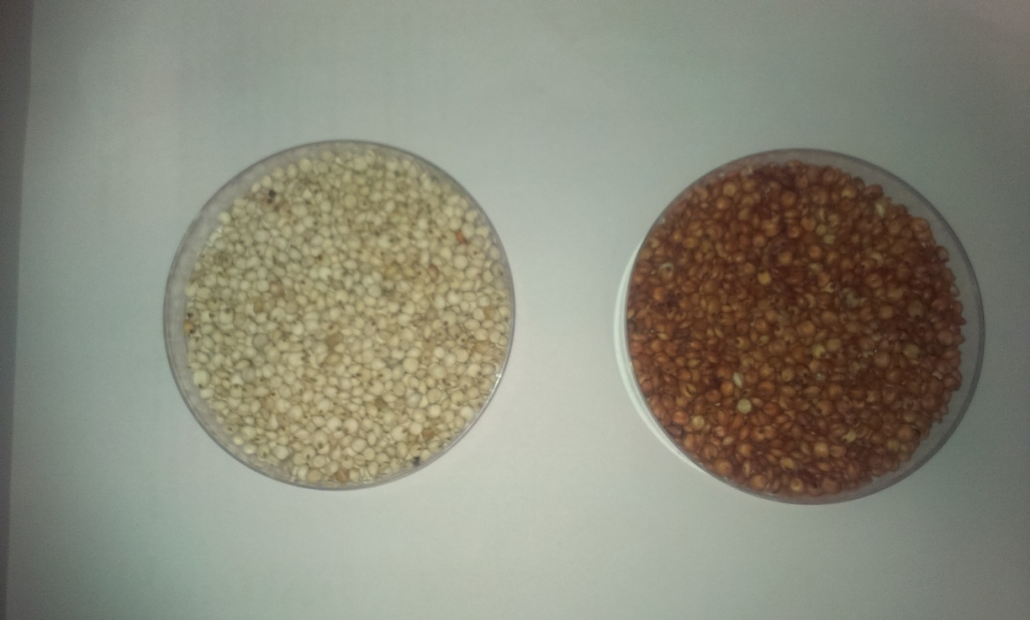
Experimental design
Different white and red cultivars from Uganda and Nigeria
Grains: Purified and milled
Fermentation
Microwaving
Boiling
Porridge: Dried and grinded
Bioactives
Starch digestibility
Trace elements
Notes:
Shown is the main part (an overview) of the procedures to prepare the grains to flour and subject those flours to the different processing methods.
Fermentation: 3day traditional fermentation (pH3.5)
Microwaving: 1min 800W?
Boiling: xmin at 100C
Resulting slurries/porridges were dried and grinded to yield fine powder which was (a) extracted with solvents to extract the polyphenol fractions, (b) starch digested to analyse the digestibility of different Sorghum preparations and (c) dry ashed or in vitro digested to provide details about trace element availability (Zn and Fe).
This presentation will focus on the bioactives and trace elements in Sorghum.

Slide 7
Total polyphenol content in Sorghum
Folin assay in 1%HCl/Methanol extracts
Large differences depending on country of origin and pigmentation
Boiling and microwaving lead to reduction in total polyphenols

Slide 8
Bioactivity: Antioxidant properties
ABTS (TEAC) assay in 1%HCl/Methanol extracts
“Bioactivity” largely depends on pigmentation and country of origin
Boiling and microwaving lead to reduction

Slide 9
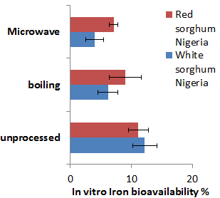
Iron bioavailability in Sorghum
Soluble trace elements after digestion of processed/unprocessed flour preparations
Iron bioavailability lower in processed samples
Availability of Iron higher in red Sorghum varieties

Slide 10
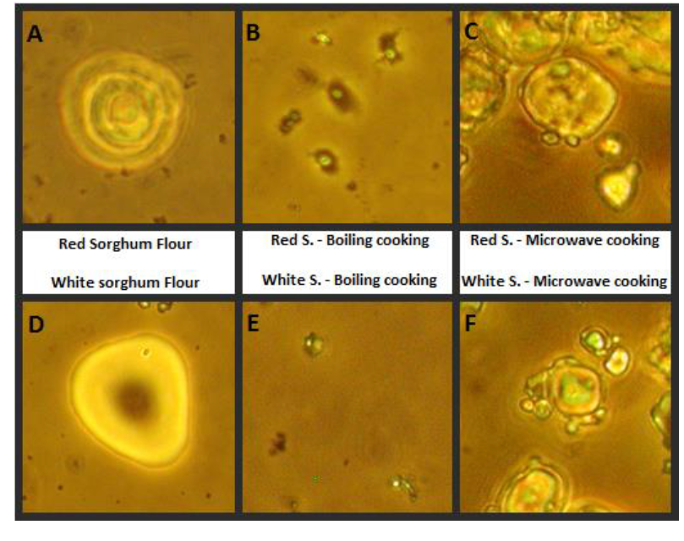
Starch digestibility in Sorghum varieties
Starch digestibility
Starch structure
Boiling resulted in higher in vitro starch digestibility compared to microwaving
Notes:
Starch digestibility was assessed in two sorghum varieties (red and white pigmented). Porridge was prepared by boiling or microwaving in water and then treated with digestive enzymes in vitro in a system that mimics gastric and intestinal digestion. The results indicate that both porridges had similar moisture contents, but boiled porridges presented slightly, but statistically significantly, higher in-vitro starch digestibility compared to the microwaved samples (figure 3). These effects could be due to differences in starch structure (figure 4), this was explored using small angle and wide angle x-ray scattering (SAX-WAX) (data not shown). We have applied for beam time in Diamond to look at the effect on microwaving on starch structure at the nanoscale (in collaboration with Prof. M. Rappolt).
Figure 4. Sorghum starch granules observed under the light microscope (high contrast), showing the large granules in raw flours which appear to diminish/disappear during boiling, but remain quite intact during microwaving.

Slide 11
Summary
Total polyphenol content and bioactivity are largely depending on origin/pigmentation of Sorghum varieties
Boiling and microwaving do reduce polyphenol content and bioactivity whereas fermentation retains higher polyphenol levels
Microwaving does not seem to have a positive impact on parameters investigated

Slide 12
Present and future research activities
  Polyphenol composition
    Different cultivars/growth conditions might result in variations in polyphenols
    Variations due to processing, in particular fermentation
  Fermentation: Standardisation of fermentation conditions
  Starch digestion: Particle size and fermentation
  Impact of Sorghum polyphenols on glucose metabolism
  Bioactivity of grain proteins and peptides

Slide 13

Acknowledgements
Collaborations
Dr Caroline Orfila, University of Leeds
Dr Nik Watson, University of Nottingham
Dr Yusuf Byaruhanga, Makere University, Uganda
Mr John Kizito, Uganda
Ms Bridget Igbetar, Nigeria
Funding
Grant from Africa College, University of Leeds

