Slide 1
Temperature Fluctuation
Effects on
Plastic Surgery Trauma Volumes at Level 1 Trauma Center
CHRISTINA CHEUNG, BS; NATHAN KLUDT, MD; MICHAEL S. WONG, MD
2015 Global Pharma Summit: August 10-12

Slide 2
About OMICS Group
OMICS Group is an amalgamation of Open Access Publications and worldwide international science conferences and events. Established in the year 2007 with the sole aim of making the information on Sciences and technology ‘Open Access’, OMICS Group publishes 500 online open access scholarly journals in all aspects of Science, Engineering, Management and Technology journals.
OMICS Group has been instrumental in taking the knowledge on Science & technology to the doorsteps of ordinary men and women. Research Scholars, Students, Libraries, Educational Institutions, Research centers and the industry are main stakeholders that benefitted greatly from this knowledge dissemination. OMICS Group also organizes 500 International Conferences annually across the globe, where knowledge transfer takes place through debates, round table discussions, poster presentations, workshops, symposia and exhibitions.

Slide 3
OMICS International Conferences
OMICS International is a pioneer and leading science event organizer, which publishes around 500 open access journals and conducts over 500 Medical, Clinical, Engineering, Life Sciences, Pharma scientific conferences all over the globe annually with the support of more than 1000 scientific associations and 30,000 editorial board members and 3.5 million followers to its credit.
OMICS Group has organized 500 conferences, workshops and national symposiums across the major cities including San Francisco, Las Vegas, San Antonio, Omaha, Orlando, Raleigh, Santa Clara, Chicago, Philadelphia, Baltimore, United Kingdom, Valencia, Dubai, Beijing, Hyderabad, Bengaluru and Mumbai.

Slide 4
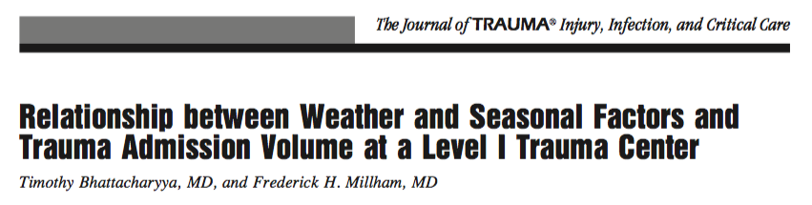
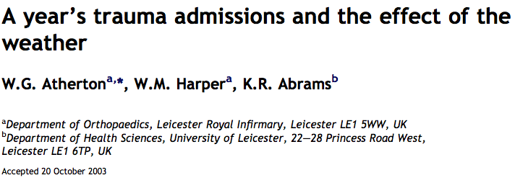
Background Information
Department of Surgery
Division of Plastic Surgery
Prior studies strong correlation between trauma and temperatures
Plastic Surgery?
Notes:
According to a study at Boston’s Trauma I Medical Center,
there is a strong correlation between maximum daily temperatures and trauma admissions
An Orthopedics study in the UK showed a statistically significant dependence on
maximum and minimum temperatures for both pediatric and total admissions
Seeing a strong correlation between the trauma volumes in other medical specialties and temperature, we sought to study the effects of temperature on
Plastic surgery trauma volumes.

Slide 5
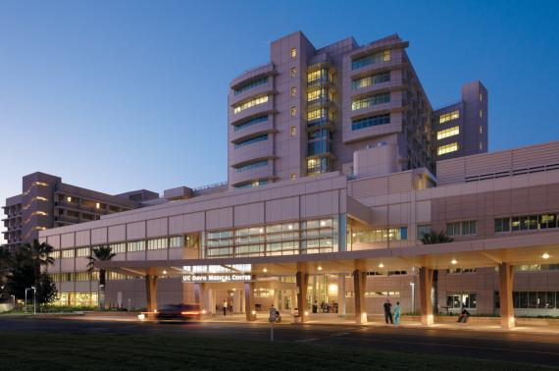
Materials & Methods
Department of Surgery
Division of Plastic Surgery
Retrospective Study:
  July 2008 to July 2013
  3055 Electronic Medical Records
  Maxillofacial and Hand Traumas
  UC Davis Medical Center
  Data: Mechanism, Dates, Age, Gender
Notes:
we did this by conducting a 5-year retrospective review of 3055 records of Hand and Maxillofacial Trauma Consults to our service
Mechanism of injury, dates, and Demographic information were extracted from Electronic Medical Records

Slide 6

Materials & Methods
Department of Surgery
Division of Plastic Surgery
National Oceanic and Atmospheric Administration
  Monthly Climatological Summary
  Mean Maximum Temperature
    Location: Sacramento Executive Airport
Notes:
Mean Maximum temperature data from Sacramento Executive Airport was gathered from the National Oceanic and Atmospheric Administration

Slide 7
Hypothesis
Department of Surgery
Division of Plastic Surgery
As temperatures increases,
  Hand & maxillofacial consults will increase
  Most consults will occur on weekends
  Young adult males will be most prevalent
  Aggressive behavior will increase
Notes:
We hypothesized that as temperature increases, the number of hand and maxillofacial consults will increase, the majority of the consults will occur on the weekends, young adult males will make up the majority of the trauma consults and aggressive behavior will increase

Slide 8
Trauma and Temperature
Department of Surgery
Division of Plastic Surgery
R= 0.58
P-value < 0.001
Notes:
To answer our first question, does increased temperature result in increased number of consults, we plotted temperature and number of consults over time.
As you can see, as you move from Summer 2008 through Summer 20013, there are temperature peaks every summer. You can also see, as you look at the consults, these also peak every summer.
Doing statistical analysis with Pearson Correlation and a Paired Two Tail T test, we found there is a strong positive correlation between Temperature and Number of Consults with a P value less that 0.001, consistent with our hypothesis. (draw tattnetion)
Animate this (three separate graphs)
In order to study the effect of temperature on mechanisms of injury, a census of the different mechanisms was complied for the high temperature months and compared to the low temperature months

Slide 9
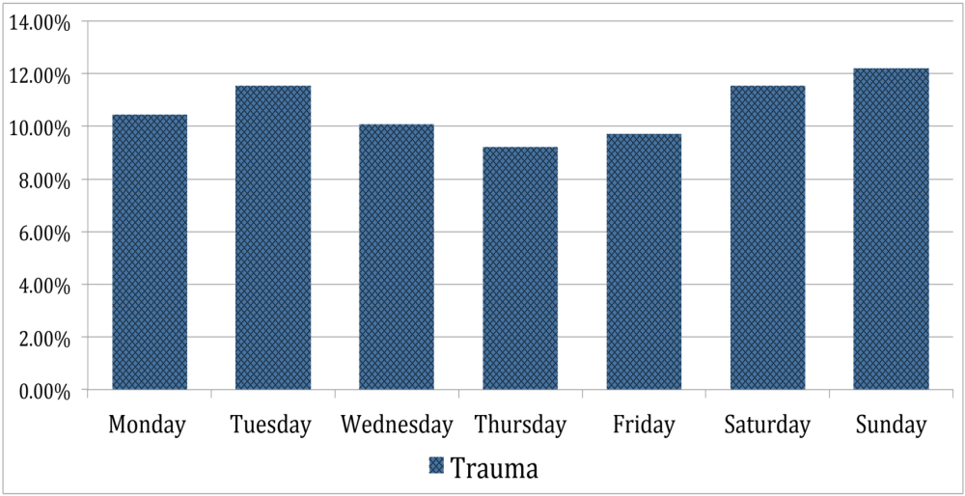
Weekly Distribution
Department of Surgery
Division of Plastic Surgery
P-value < 0.001
Notes:
To answer our second question, we plotted trauma volume on the Y-axis and days of the week on the x-axis. From our data, you can see the three highest volume days occurred on Monday through Wednesday.
(draw attention to Monday through Wednesday)

Slide 10
Gender Distribution
Department of Surgery
Division of Plastic Surgery
P-value < 0.001
Notes:
To answer our third question, we plotted number of patients divided between males in blue and females in yellow against age along the x-axis. You can see that more than 1/3 of the trauma consults were Early Adult Males followed by middle aged males.
(emphasis)

Slide 11
High and Low Temps
Department of Surgery
Division of Plastic Surgery
Notes:
In order to study the effect of temperature on mechanisms of injury, a census of the different mechanisms was complied for the high temperature months and compared to the low temperature months

Slide 12



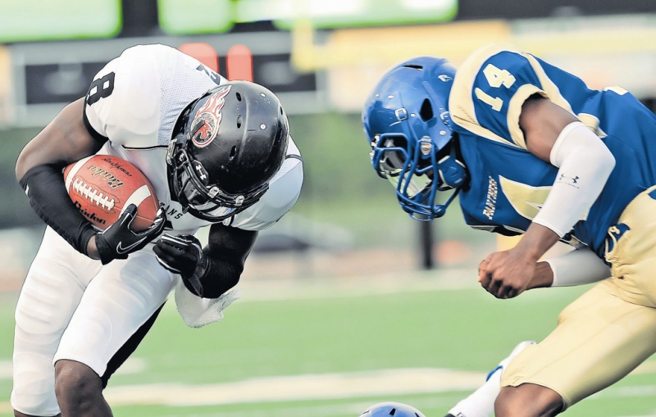

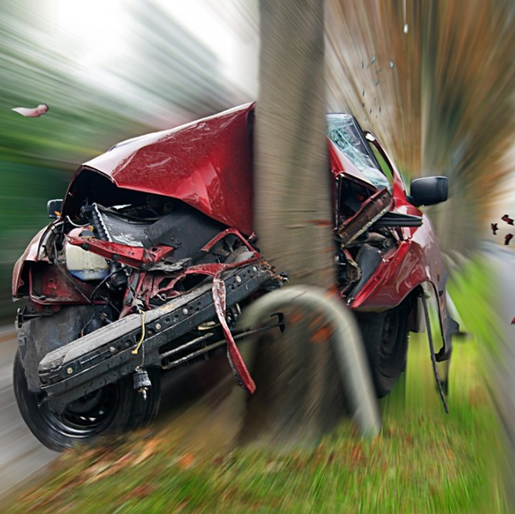
Mechanisms of Injury
Department of Surgery
Division of Plastic Surgery
Fall Accidents
Aggressive Behavior
Industrial Accidents
Sport Related Injuries
Animal Related Injuries
Transportation Accidents
Notes:
The common mechanisms of injury were due to fall accidents, aggressive behavior (which included assaults and altercations), industrial accidents, sport related injuries, animal related injuries and transportation accidents(including MVA, auto vs peds, bicycle accidents)
(animate)

Slide 13
Mechanisms Breakdown
Department of Surgery
Division of Plastic Surgery
 | High Temperature Months (%) | Low Temperature Months (%)
Transportation | 34 | 24
Aggressive Behavior | 25 | 26
Fall | 16 | 15
Animal Related | 6 | 10
Non Trauma | 14 | 20
Industrial Accidents | 3 | 4
Sport Related Injuries | 2 | 1
Notes:
During these high temperature months, the majority of the plastic surgery consults were due to transportation injuries followed by aggressive behavior
Comparing the high temperature month’s results to the low temperature months, Transportation related injuries decreased by 10% from 34% to 24%, while aggressive behavior remained essentially the same (25% vs 26%). Therefore transportation related injuries appear to be more temperature dependent.

Slide 14
Conclusion
Department of Surgery
Division of Plastic Surgery
Strong correlation between temperature and trauma
Highest volume consult days: Saturday - Sunday
Majority of consults: Adult Males
Aggressive behavior not found related to temp
Notes:
In conclusion, consistent with prior trauma admission studies, there is strong correlation between temperature and the number of trauma consults for maxillofacial and hand injuries seen by the Plastic Surgery service.
the highest volume consult days were Monday through Wednesday.
With The majority of these trauma consults being young adult and middle aged males
Such implications will be useful for planning, staffing and resource management during the hot summer months

Slide 15
Let us meet again..
We welcome you all to our future conferences of OMICS International
7th Annual Global Pharma Summit
On
June 20-22, 2016 at New Orleans, USA
http://american.pharmaceuticalconferences.com/

Slide 16
Acknowledgements
Department of Surgery
Division of Plastic Surgery
Thank You

