Slide 1

Quantifying metabolic fluxes in cancer and stem cells
An integrative approach monitoring metabolic reprogramming
Christin Zasada
Kempa Lab - Integrative Proteomics & Metabolomics
Notes:
Thank you very much for the kind invitation to present my studies to investigate the regulation of metabolic flux in stem and cancer cells.
In the next minutes I would like to present the strategy colleagues and I developed to combine experiments and theory to quantify metabolic fluxes.

Slide 2
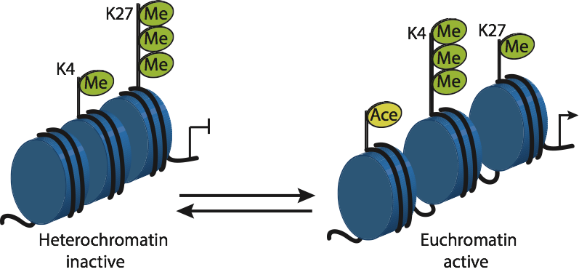
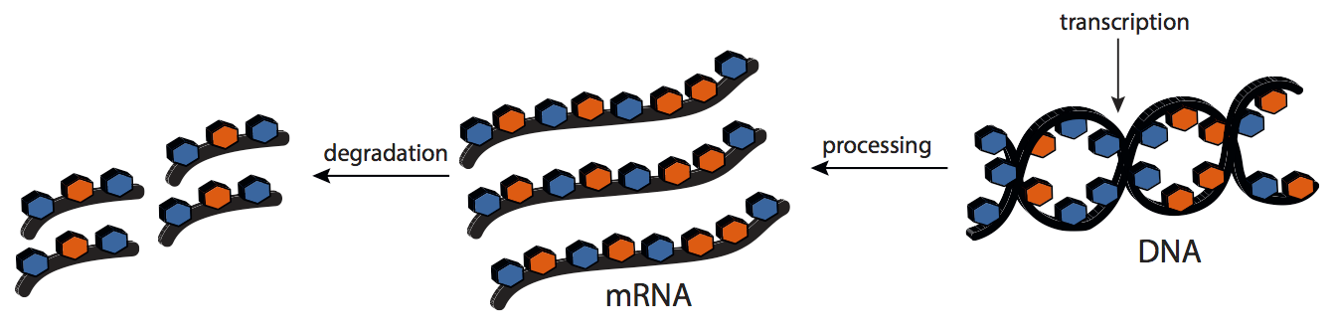
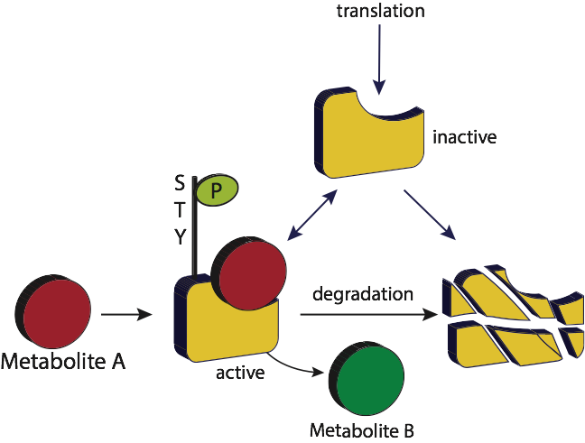
Genome-regulatory code
Genomics
three billion DNA base pairs
Transcriptomics
2 % of the genome
Proteomics
20’000 - 25’000 protein-coding
genes
Metabolomics
~ 5 000
Notes:
If we want to understand a certain disease like cancer or phenotype of a cell we have to acknowledge all level of biological information - called the genome regulatory code.
The status of methylation defines which parts of the DNA are accessable for transcription and can be processes to mRNA and afterwards translated into proteins, that themselves

Slide 3
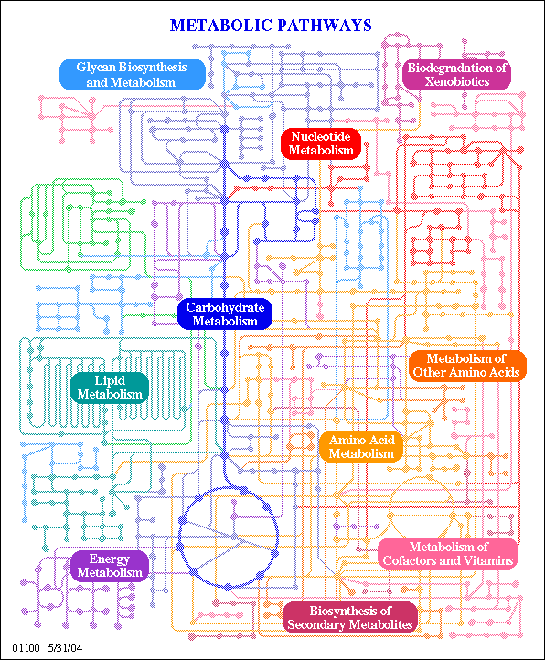
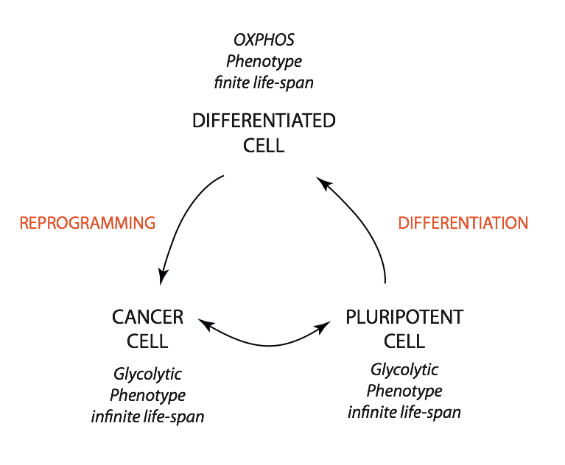
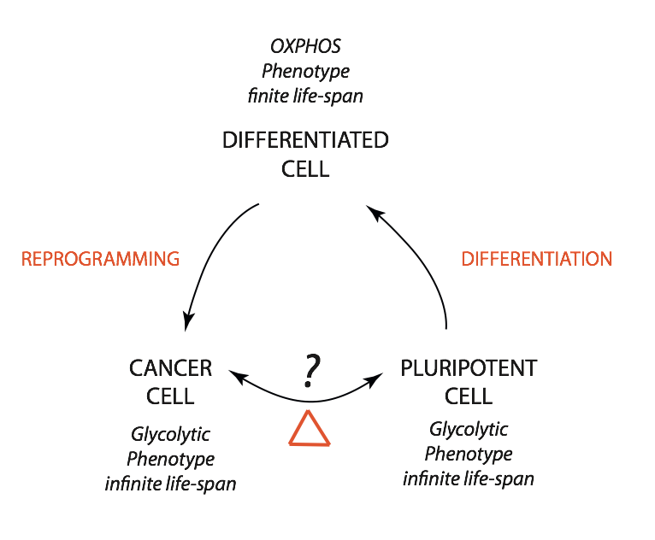
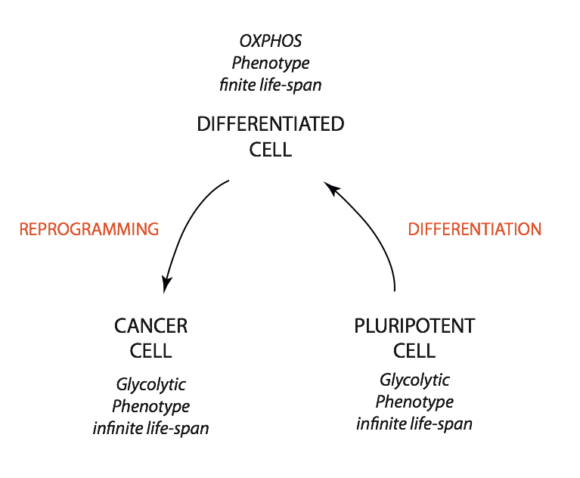
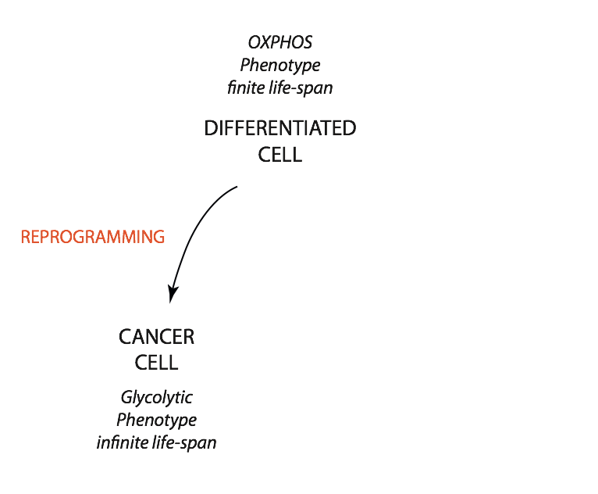
Reprogramming of metabolism
oncogenic regulation
carbon re-routing
hypoxia
Warburg effect
mitochondrial
activity
nutrient
availability
regulation CCM enzymes
www.kegg.org

Slide 4
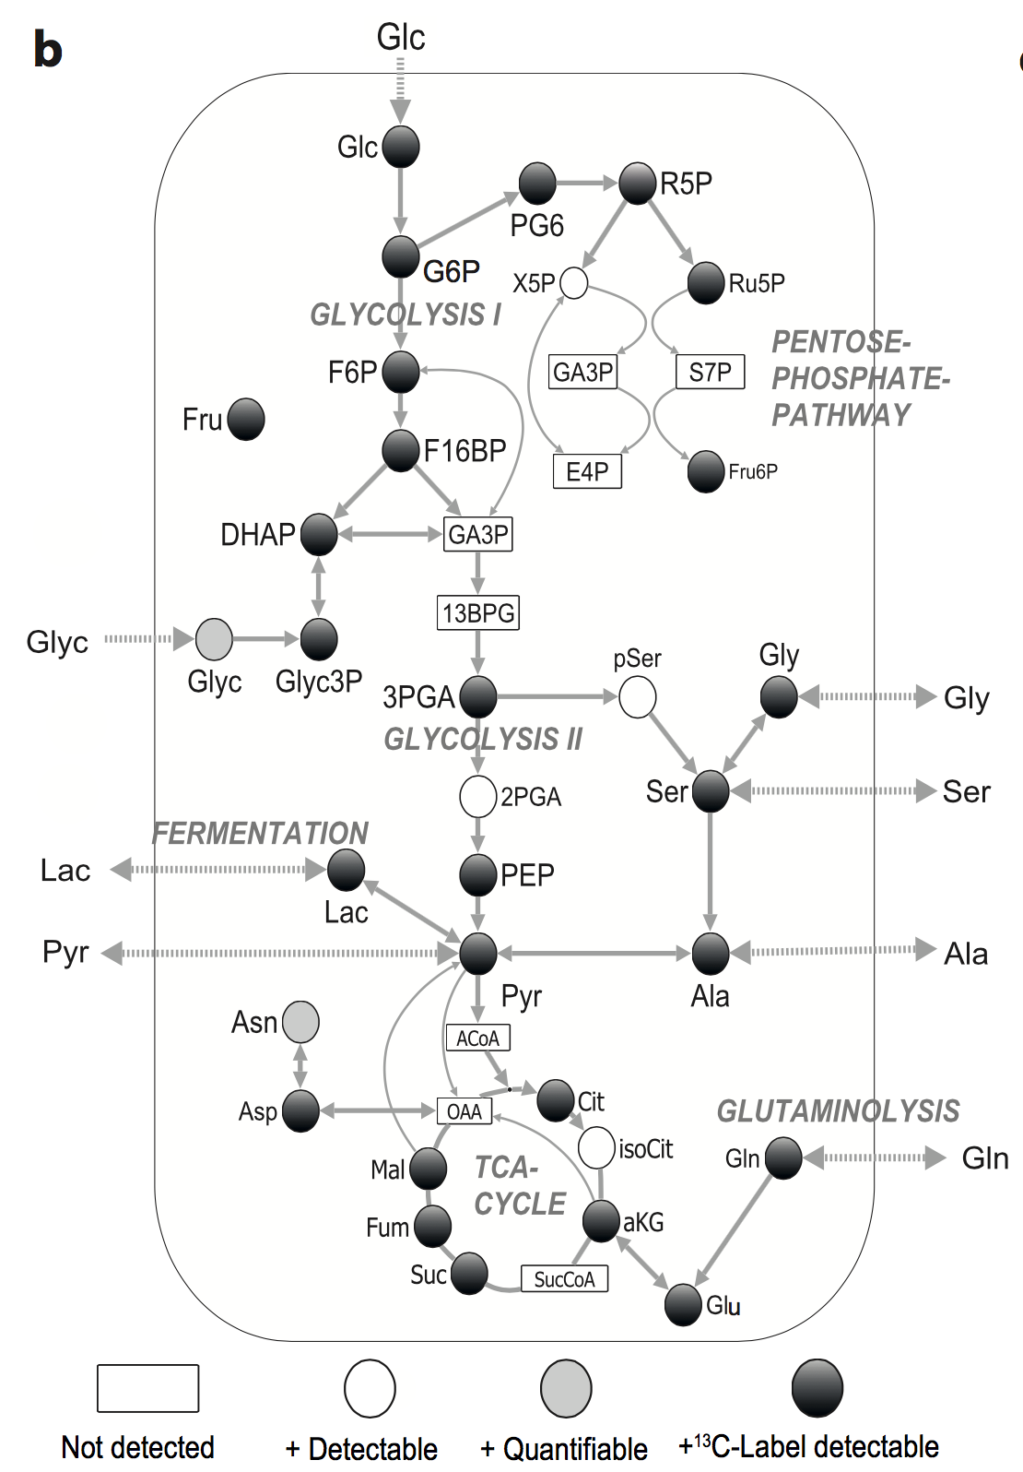
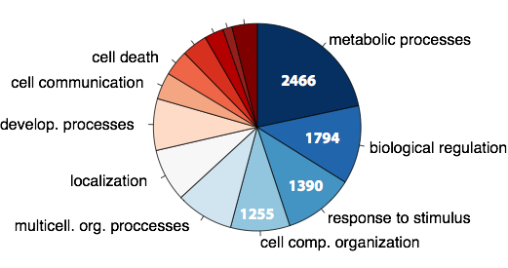
Quantitative information turns functional
Proteomics
LC-MS/MS
label-free, SILAC quantification
~ 3500 proteins
pulsed stable isotope resolved
metabolomics (pSIRM)
GC-MS approach
identification
~ 100 metabolites
absolute quantification
~ 40 metabolites
application of stable isotopes
—> time-resolved
—> position-specific
—> indirect measurement of flux

Slide 5
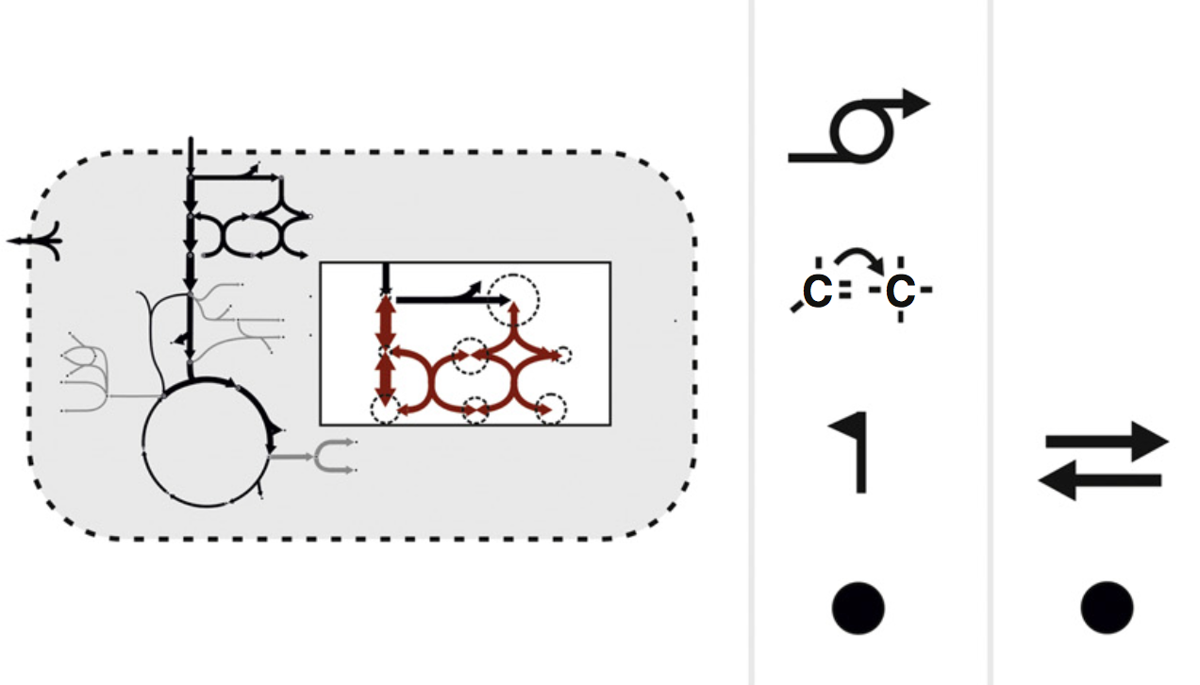
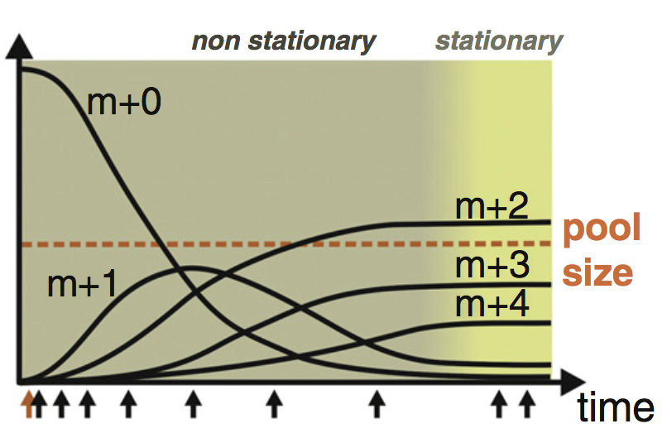
Non-stationary metabolic flux analysis
in cooperation with Katharina Nöh
and Sebastian Niedenführ
Forschungszentrum Jülich GmBH
Input
Output
Flux information
metabolic steady &
isotopic non-stationary
Time courses for:
Glucose
Glutamine
Model parameter
168 labeling data point
5 measured rates
14 measured pool sizes
Pathways coverage
Glycolysis
TCA-Cycle
Pentose-Phosphate Pathway
Glutaminolysis
Amino acid synthesis
Biosynthesis
Niedenführ S, Nöh K, Wiechert W
Current Opinion in Biotechnology 2015, 34:82–90

Slide 6
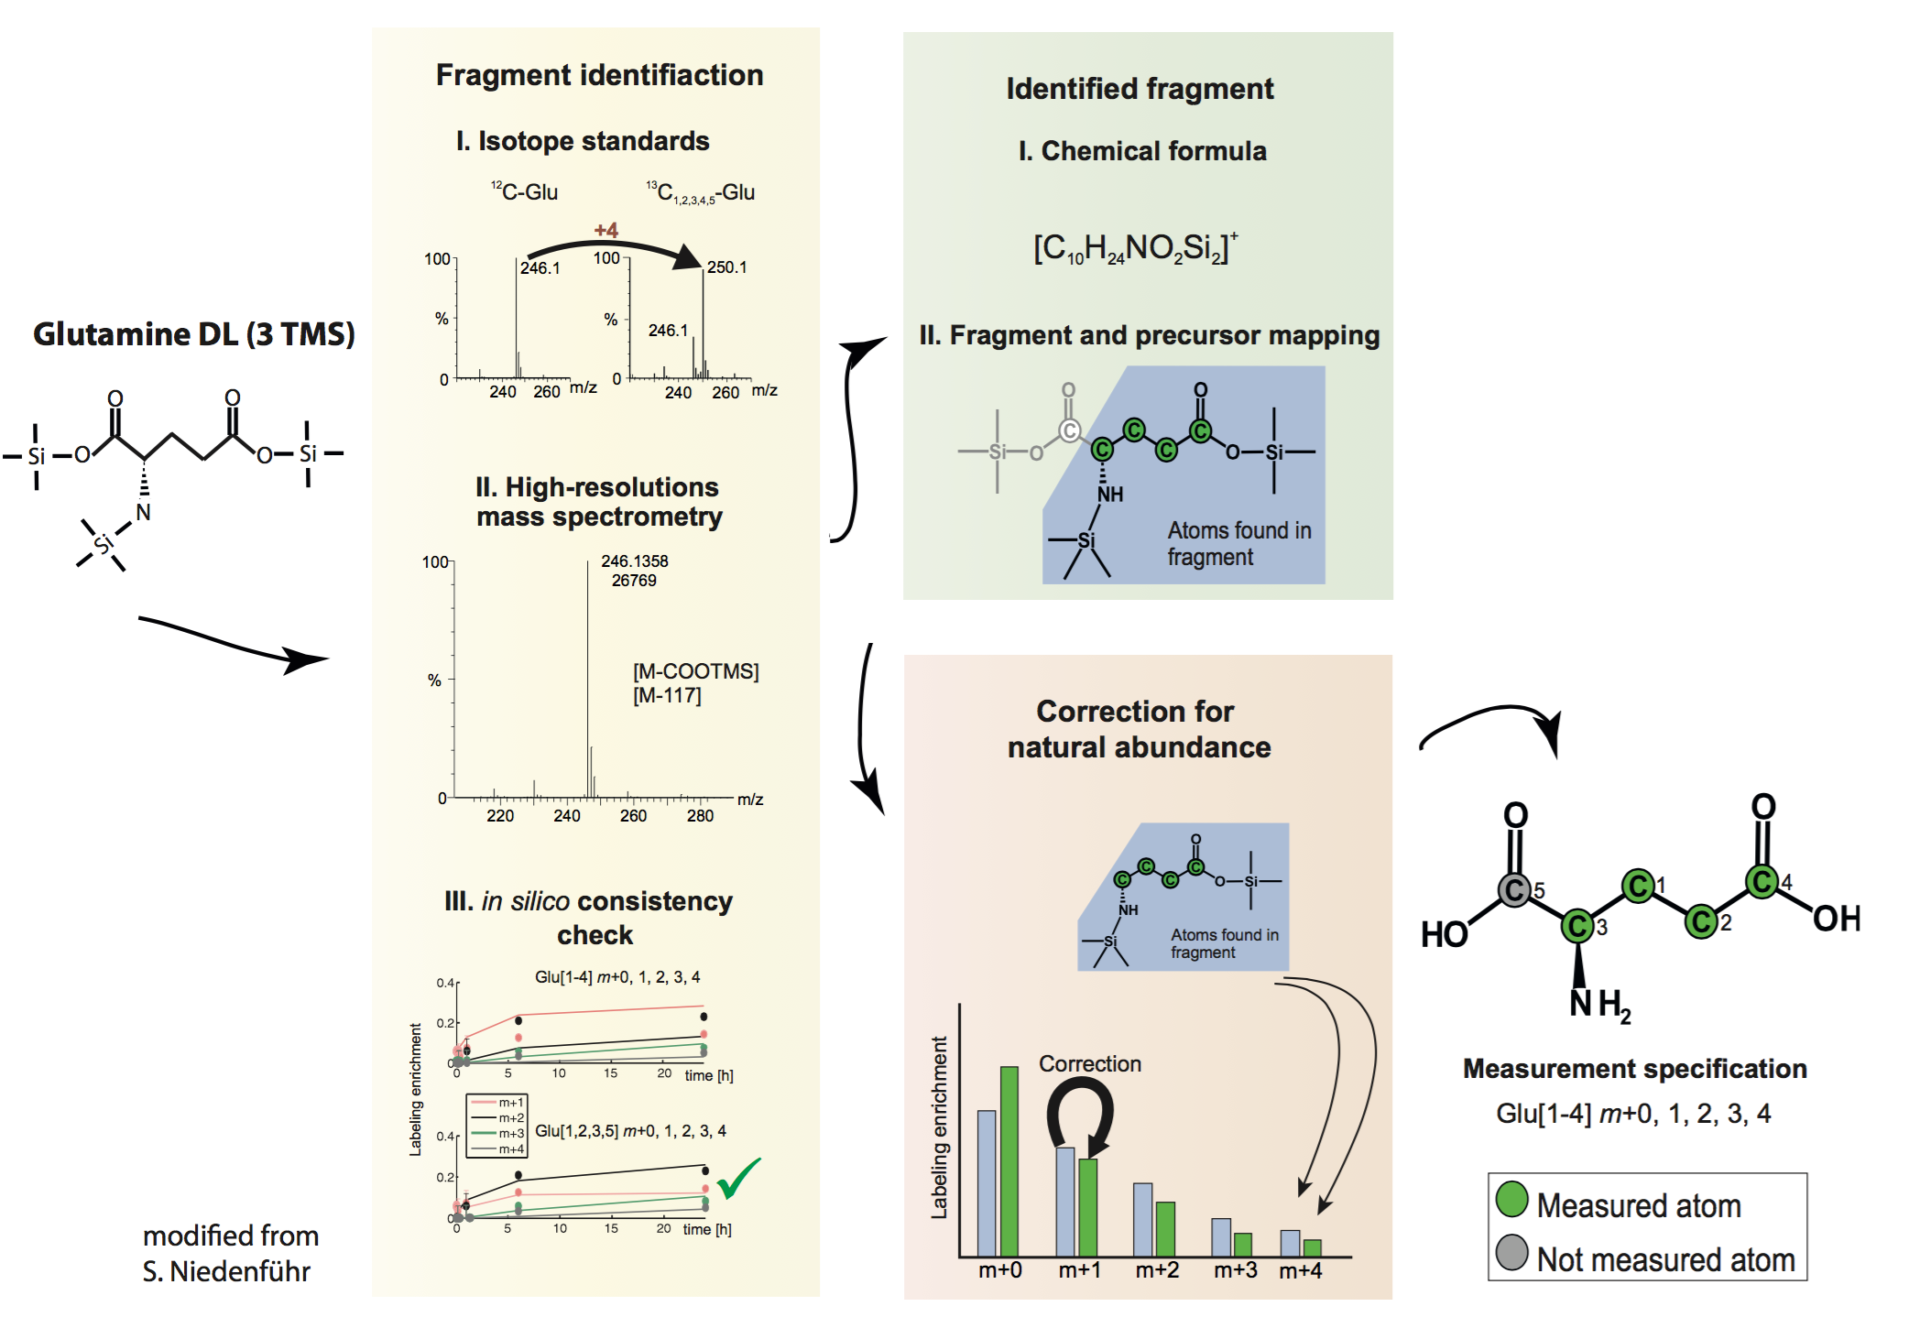
GC-MS fragment mapping to molecule level

Slide 7
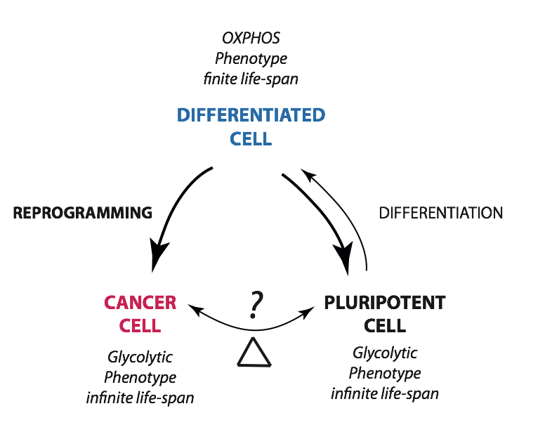
Monitoring metabolic reprogramming - experimental setup
HFF1
¹³C-Glucose
NFH2
iPSC
DF
¹³C-Glutamine
BJ1
¹³C-Pyruvate
hESC
hESC-DF
Proteomics
MDA-MB231
in cooperation with R. Bucowiecki and A. Prigione (MDC, Berlin, Germany)

Slide 8
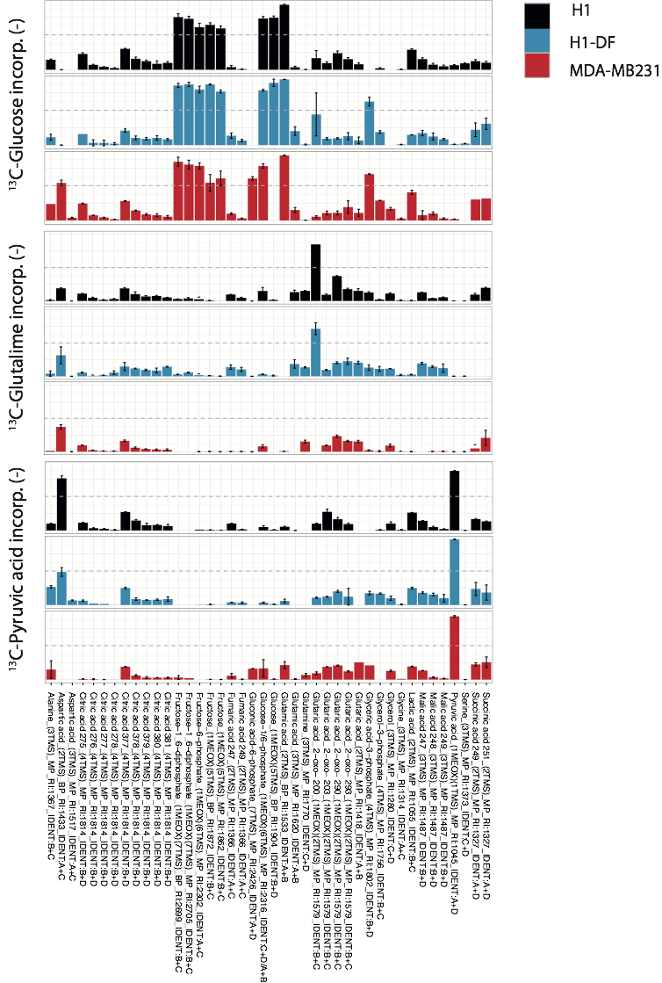
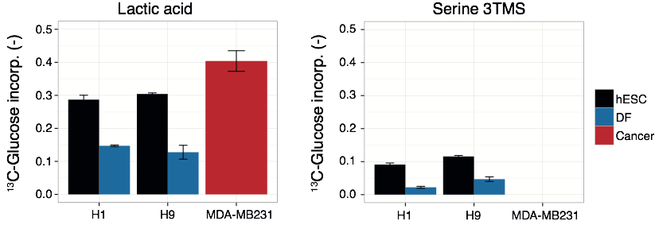
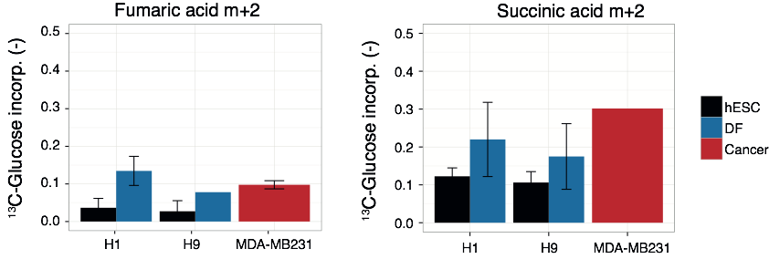
Re-arrangement of carbon fate

Slide 9
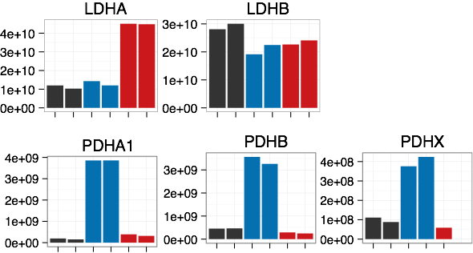
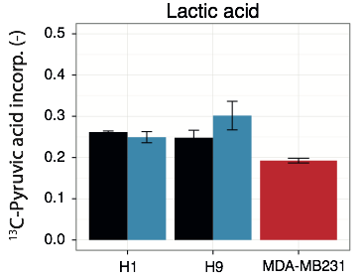
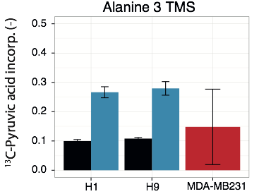
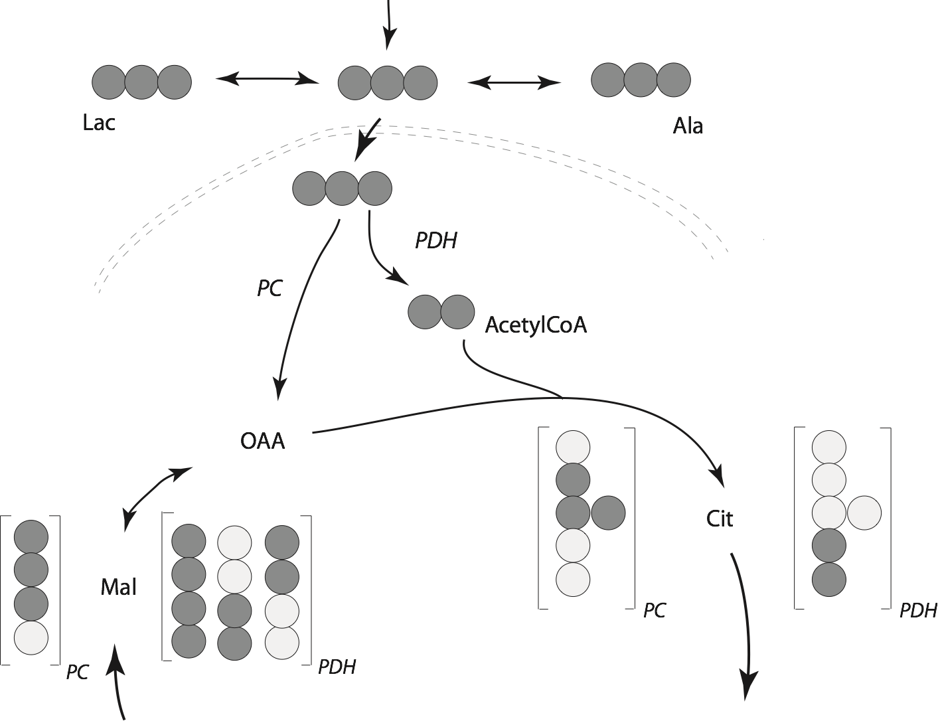
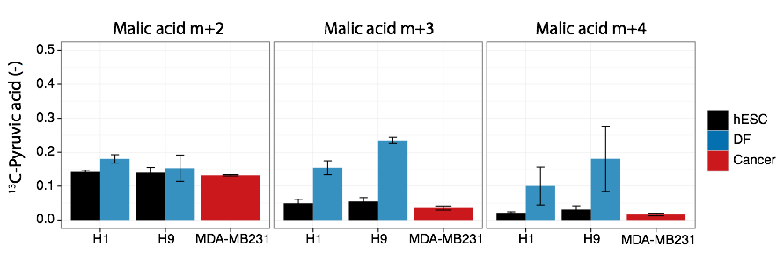
Routing of ¹³C-Pyruvic acid
LFQ Int
Notes:
The carbon-resolved and position-specific analysis provides insights how nutrients are shuttled into different pathways.
the routing of 13c-pyr is interesting due to its hub between glycolysis and tcacyle
Enzyme activities define the number of labeled carbons that are incorporated into the intermediates.
the conversion of pyr to oaa shuttle three carb13 into malic acid, whereas PDH transports two carb13 via acetyl coA in the cycle.
Because of the cycling and symmetry of metabolites we end up with two or four labeled carbons.
we observe an elevated activity of both enzymes in the derived fibroblasts.
This example demonstrates the need of computational modeling of the metabolic flux - just be hand and eye we cannot interfere the metabolic flux alone.

Slide 10
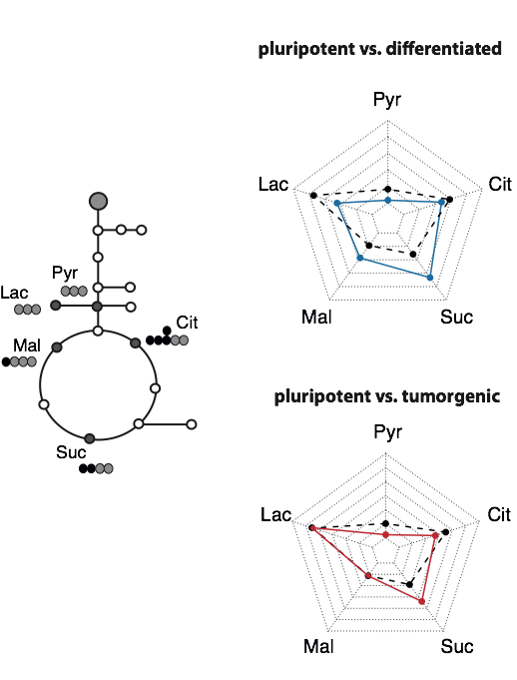
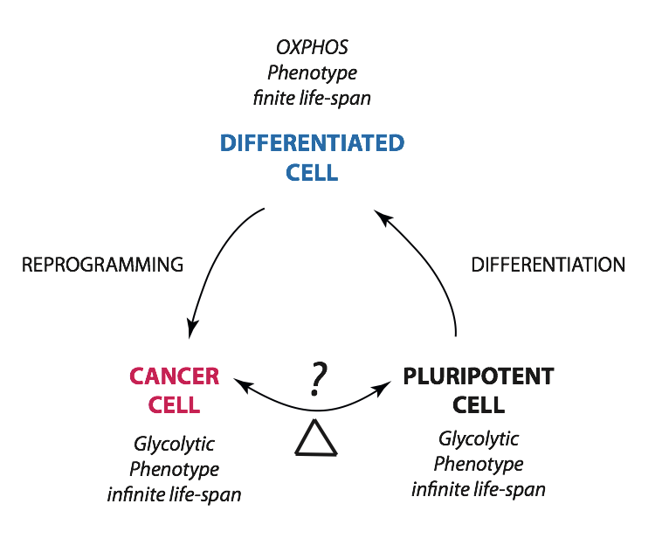
Summary
Notes:
Now I already want to summarize our approach
I hope that I convinced you that with the application of 13C-substrates we are able to monitor the metabolic reprogramming.
That radar charts summaries the fate of 13C-glucose into five key metabolites comparing pluripotent and differentiated or cancer cells.
I showed you data that confirm the aerobic glycolysis occurring in CC and stem cells and the elevated activity of the tea cycle.
Currently the data is integrated into the computational model I introduced to you. The metabolic flux maps will give us further insights and a more detailed understanding how cells meet their requirements on precursor or cofactor synthesis.

Slide 11
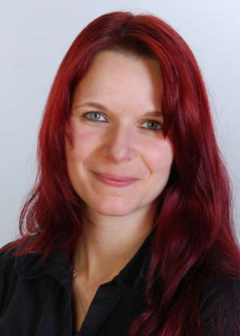
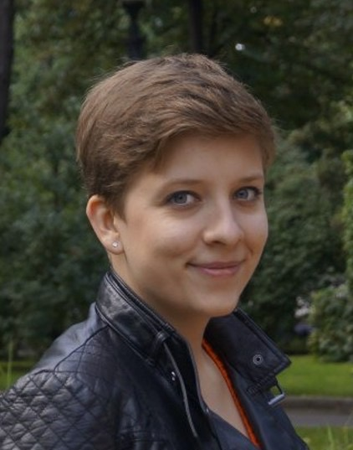


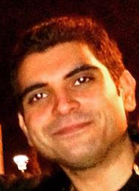


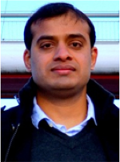
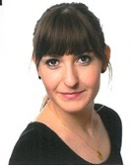

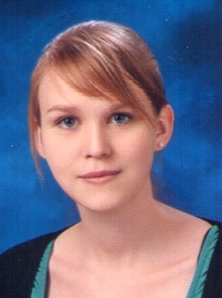
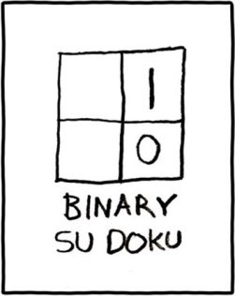
Acknowledgments
Alessandro Prigione
Raul Bukowiecki
MDC Berlin-Buch, Germany
Katharina Nöh
Sebastian Niedenführ
Forschungszentrum Jülich
Germany
… thank you for your attention

