Slide 1
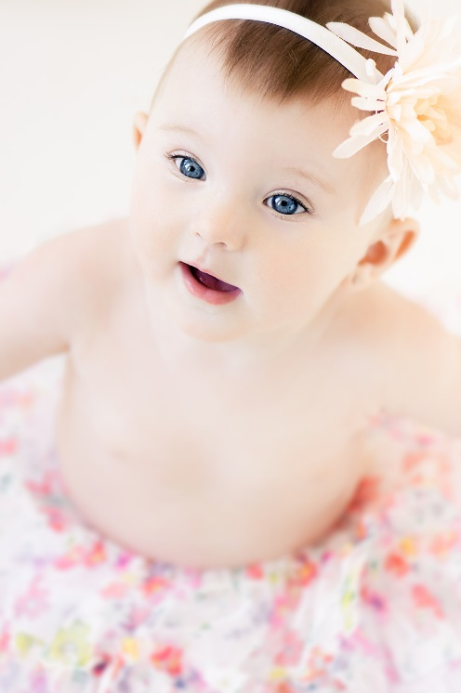


Mass Spectrometry Approaches for Translational Research: From Biomarker Discovery to Clinical Applications
Christiane Auray-Blais, LL.M., Ph.D.
Sherbrooke, Quebec, Canada
International Summit
Current Trends in Mass Spectrometry
New Orleans, LA
July 13 2015

Slide 2
Outline
 Rationale for Mass Urine Screening of:
- Creatine synthesis and transport disorders
- Triple H syndrome
- OTC deficiency
 Screening feasibility
 UPLC-MS/MS methodology developed
- Method validation
- Quality controls
 Conclusions

Slide 3
Rationale for Screening these 5 disorders:
 Creatine synthesis & transport disorders
 Triple H Syndrome
 OTC Deficiency

Slide 4
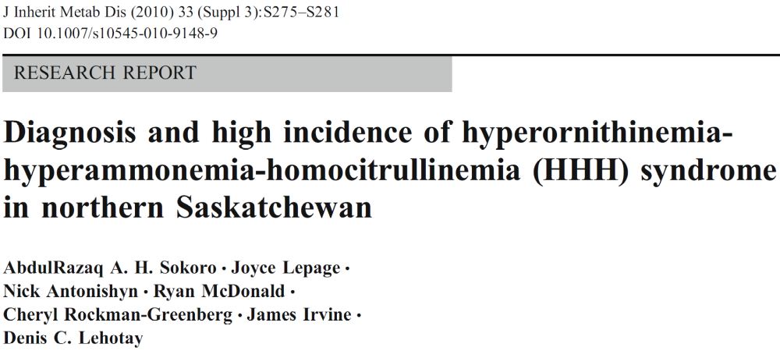
Triple H Syndrome

 Clinical symptoms: Developmental delay, hepatic
dysfunction, growth retardation  Non specific
 Missed diagnosis in DBS  Normal at 2 days of age

Slide 5
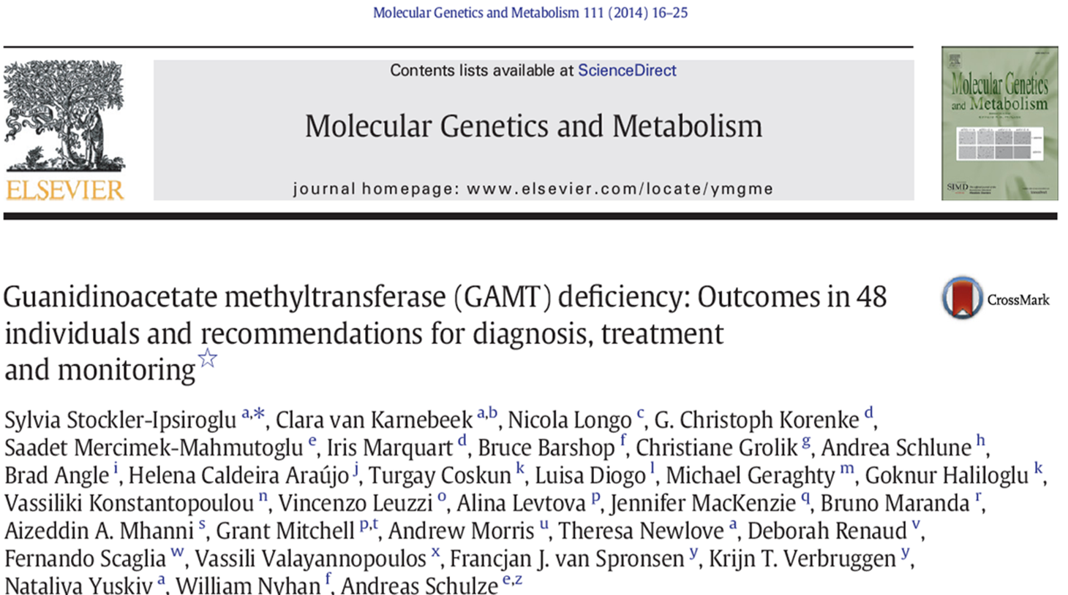
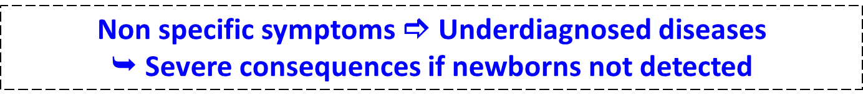
Why Screen for Creatine Disorders?
 Prevalence
  - Up to 3% of male with mental retardation
  - 1-2 cases identified per year in Quebec through metabolic
  investigation
 One form (GAMT) treatable with early intervention
- 48 patients investigated (Sylvia Stockler et al., MGM, 2014)
 Progressive mental retardation (~PKU), language &
speach disabilities, epilepsia, autism traits,
hyperactivity, failure to thrive

Slide 6

Prevalence - OTC
1: 14 000  Brusilow et Maestrie, 1996
1: 70 000 Italy  Dionisi-Vici et al., 2002
1: 62 000 Finland  Keskinen et al., 2008
1: 77 000 Australia  Balasubramaniam et al., 2010
Women are often underdiagnosed

Slide 7
New Opportunities for Urine Screening
 Triple H urine screening
  -  Orotic acid and  uracil
 OTC screening by urine
  - Same biomarkers as Triple H
  - No reliable biomarker available in blood by MS/MS
 Creatine disorders
  - A unique opportunity for an evaluation study

Slide 8
Evaluation Research Project: Summary
Increase the number of diseases detected by the Mass Urine Screening Program
● Creatine synthesis and transport disorders (3)
- Arginine-glycine amidinotransferase deficiency (AGAT)
- Guanidinoacetate methyltransferase (GAMT)
- Creatine transporter deficit
● Disorders of ornithine
metabolism (2)
- Triple H Syndrome
- Ornithine transcarbamylase deficiency (OTC)
Feasibility & Importance
Methodology developed
● UPLC-MS/MS
● Validation of method
● Preliminary reference values
● ERNDIM & patient samples
● Determine the incidence
● Early detection
● Treatment available

Slide 9
Integration Into the Existing Mass Urine Screening Program
Urine samples collected on filter paper at 21 days of age (500 samples/day)
5 cm urine filter paper disc
Same eluates
using UPLC-MS/MS
NH₄OH 0.01M elution of samples
Creatine synthesis & transport disorders
Disorders of ornithine metabolism
TLC chromatography analysis
Urea cycle disorders
Organic acidurias
Disorders of aminoacid metabolism and transport
5-year evaluation
project

Slide 10
Feasibility to Screen at 21 Days of Age

Slide 11
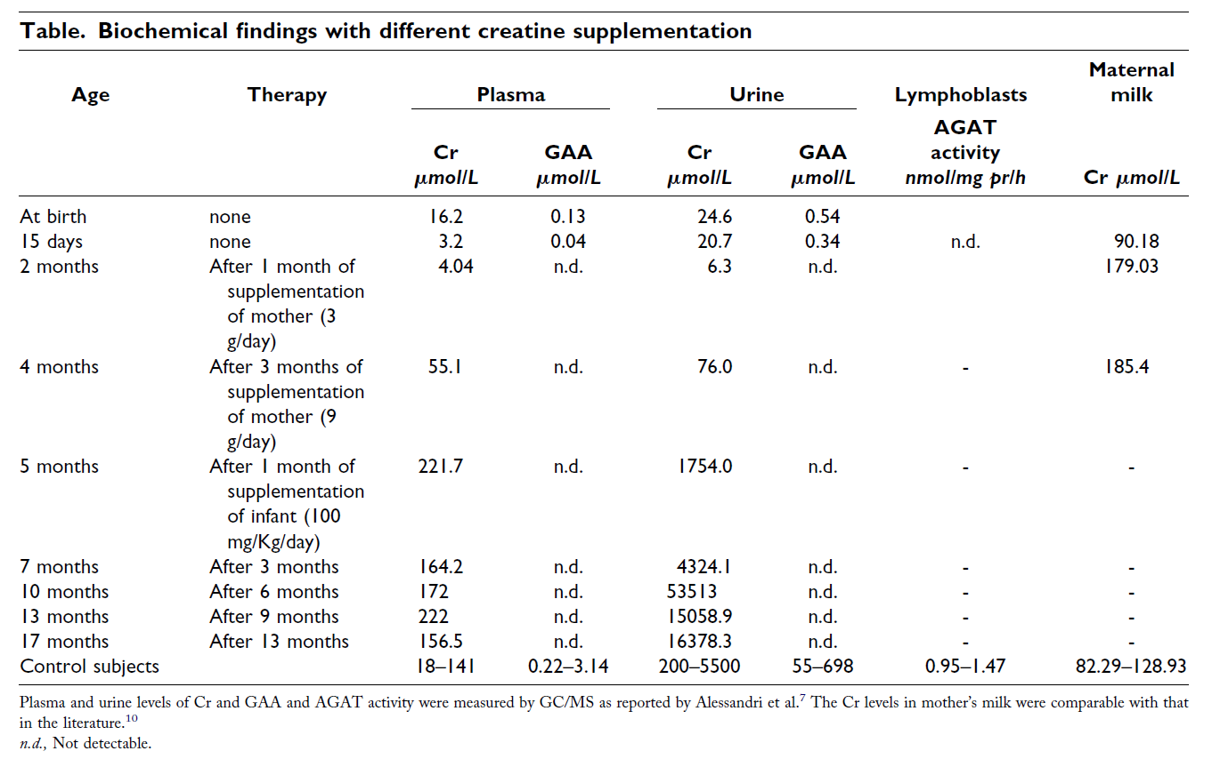
Deficit in Arginine-Glycine Amidinotransferase (AGAT)
Patient detected at 15 days   Creatine and  Guanidinoacetate levels in urine
Battini et al., J Pediatr 2006;148:828-30

Slide 12
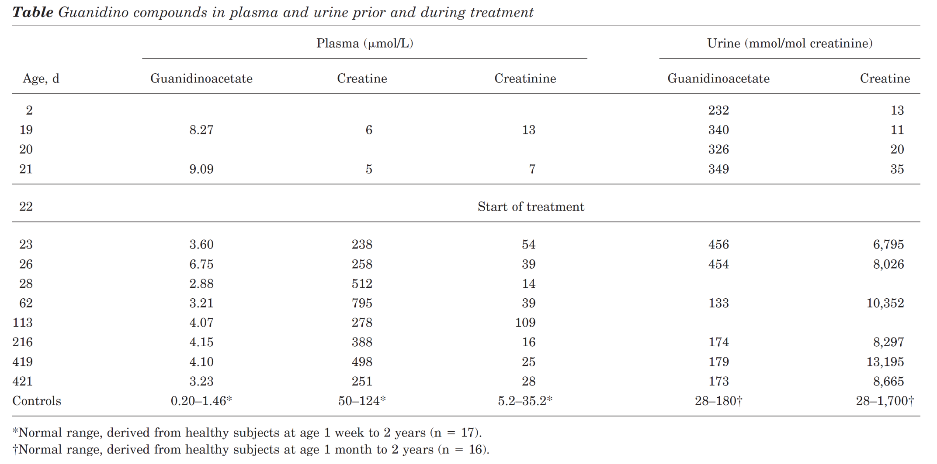
Deficit in Guanidinoacetate Methyltransferase (GAMT)
In urine, GA is already slightly increased since the second day of life, whereas creatine is below
the normal range. In the third week of life, the GA increase in urine is even more pronounced"
Schulze et al., Neurology 2006;67:719-721

Slide 13
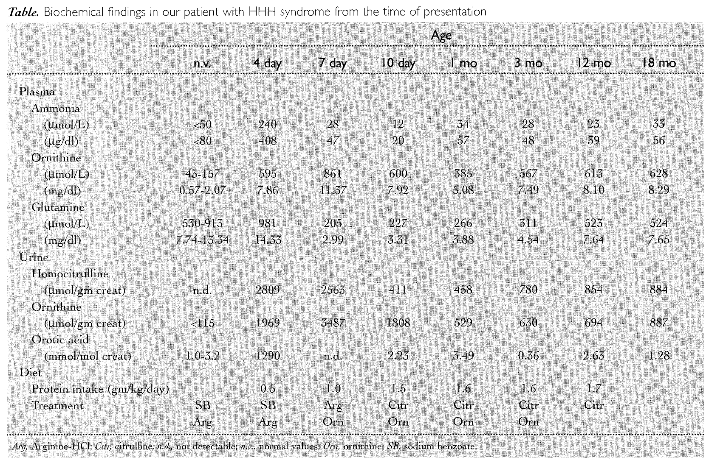
Triple H Syndrome
At 4 days of life, orotic acid in urine was highly 
Zammarchi., et al. J Pediatr 1997;131:440-3

Slide 14
Importance of Early Treatment

Slide 15
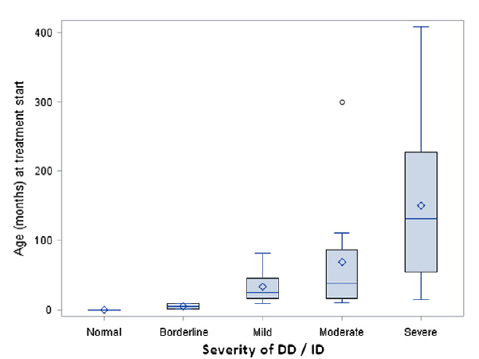
Importance of Rapid Intervention and Treatment (GAMT)
DD/ID: Developmental Delay/Intellectual Disability
Developmental Delay/Intellectual Disability (DD/ID)
Stockler, Sylvia et al, MGM 2014

Slide 16
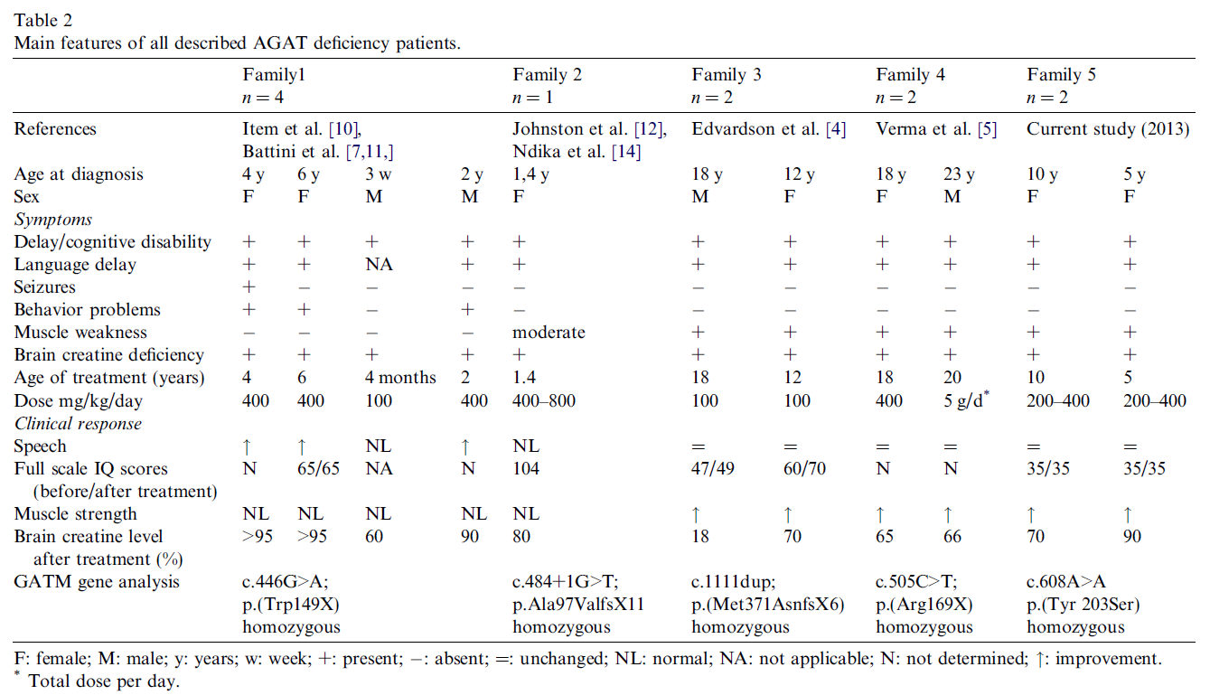
Deficit in Arginine-Glycine Amidinotransferase (AGAT)
“This case supports the view that AGAT deficiency is a curable metabolic disorder.
At the age of 18 months, the patient had normal growth parameters and developmental quotients, whereas his affected relatives, at the same age, already showed a severe delay in somatic growth and psychomotor development, associated with hypotonia and autistic-like behavior.“
Nouioua et al., Neuromuscular Disorders 2013; 23:670-674; Battini et al., J Pediatr 2006;148:828-30

Slide 17

UPLC-MS/MS Method Developed
for Newborn Mass Urine Screening
for 5 Disorders

Slide 19
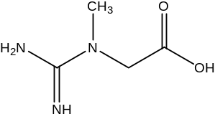
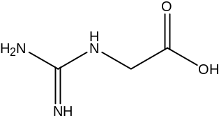
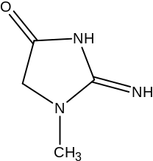
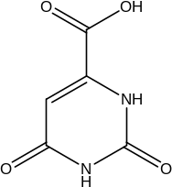
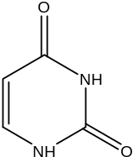
5-Year Research Evaluation Project
Multiplex UPLC-MS/MS  2 min/sample
Creatine
Guanidinoacetate
Creatinine
Orotic Acid
Uracil
Neonatal Screening:
 AGAT   GAMT 
 Creatine Transport Def. 
 Triple H Syndrome 
 OTC deficiency 
Creatine
Guanidinoacetate
Creatine
Guanidinoacetate
Creatine
Orotic acid
Uracil
Orotic acid
Uracil
Auray-Blais C, et al., Clin Chim Acta, 436, 249-255, 2014

Slide 20
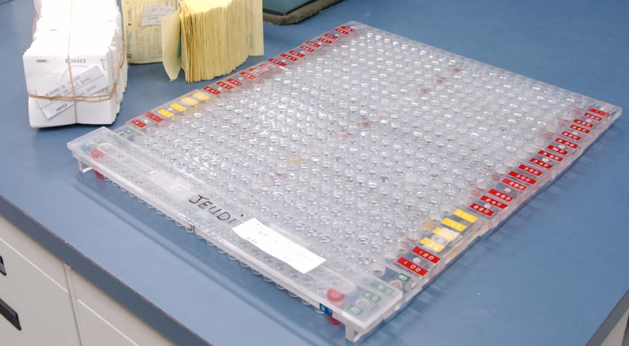
Processing Samples  Phase 1
PHASE 1
Urine filter paper samples
 Same as existing Urine Screening Program
Auray-Blais, et al, JIMD, 30:515–521, 2007

Slide 21
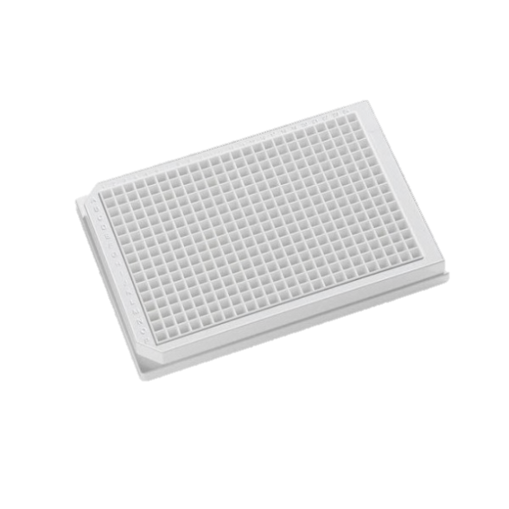
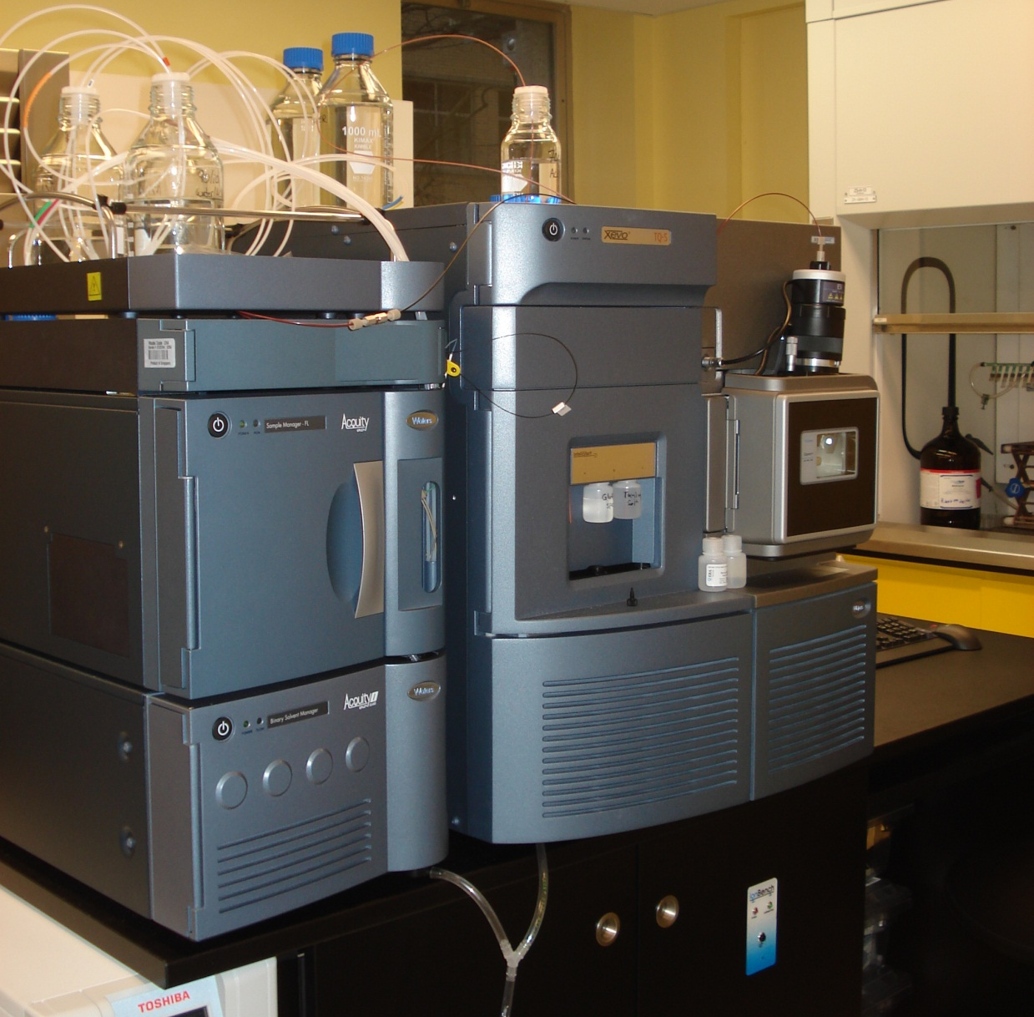
Processing Samples
PHASE 2
384 well-plates or sampler:
 Add 20 μL urine eluate from Newborn Screening Program
 Add 20 μL 5 Internal standards
 Add 250 μL dilution solution (ACN:MeOH, 75:25)
 Centrifuge & inject 2 μL  UPLC Xevo TQ-S (Waters Corp.)
 Analysis time = 2 min/sample
Analysis of creatine/creatinine
Analysis of guanidinoacetate/creatinine
Analysis of orotic acid/creatinine
Analysis of uracil/creatinine
Creatine synthesis and
transport disorders
Triple H Syndrome & OTC
Auray-Blais C, et al., Clin Chim Acta, 436, 249-255, 2014

Slide 22
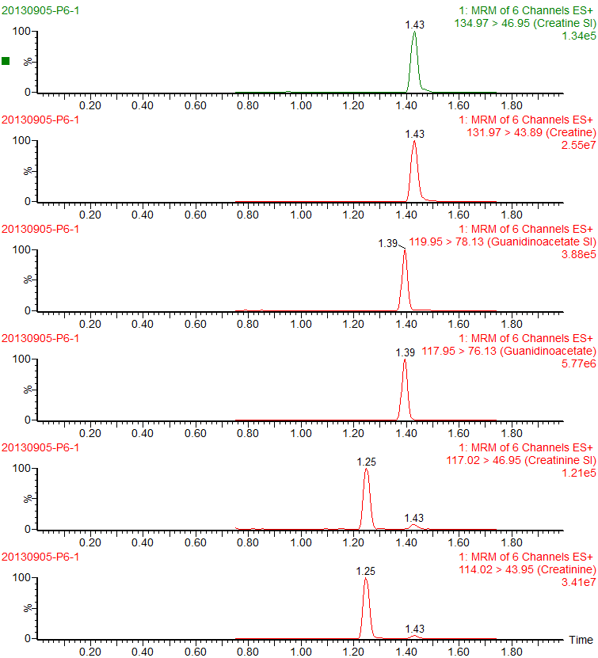
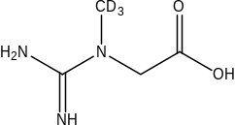

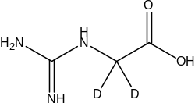
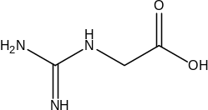
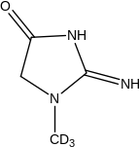

Chromatograms – ESI (+) Mode
Deuterated Creatine (IS)
Creatine
Deuterated GA (SI)
Guanidinoacetate
Deuterated Creatinine (IS)
Creatinine
Auray-Blais C, et al., Clin Chim Acta, 436, 249-255, 2014

Slide 23
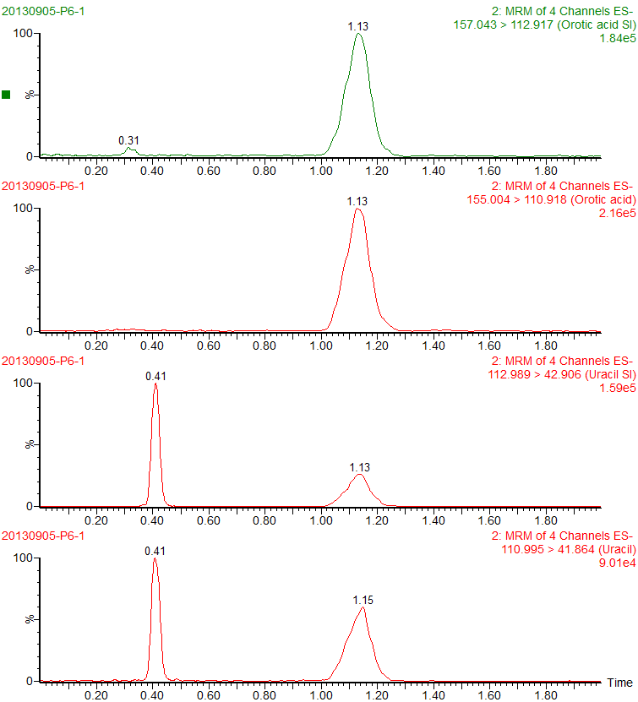
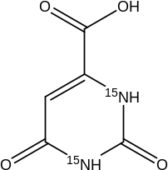
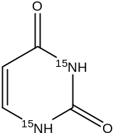
Chromatograms – ESI (-) Mode
Orotic acid-¹⁵NH (IS)
Orotic acid
Uracil-¹⁵NH (IS)
Uracil
Auray-Blais C, et al., Clin Chim Acta, 436, 249-255, 2014

Slide 24
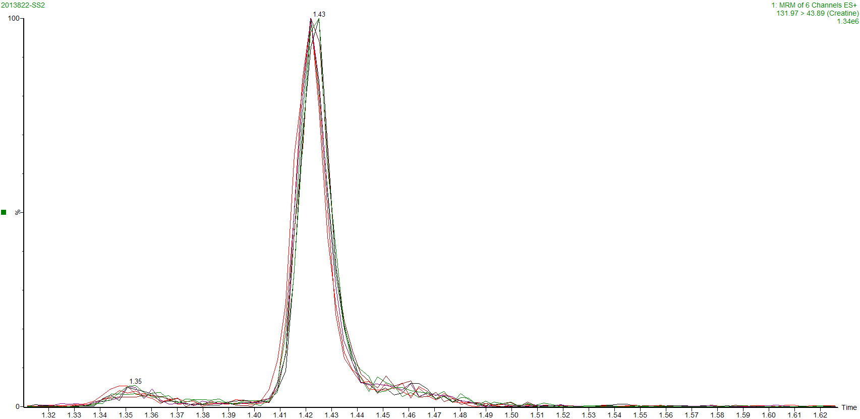
Reproducibility  Retention Time for Creatine: 7 injections
Auray-Blais C, et al., Clin Chim Acta, 436, 249-255, 2014

Slide 25
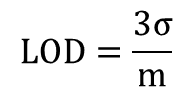
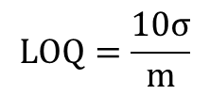


Limits of Detection (LOD) & Quantification (LOQ)
LOD & LOQ
 | LOD (μM) | LOQ (μM)
Uracil | 1.3 | 4.4
Guanidinoacetate | 1.6 | 5.5
Creatinine | 6.3 | 20.9
Creatine | 1.0 | 3.4
Orotic acid | 0.3 | 1.0
$$LOQ=\frac{10σ}{m}$$
$$LOD=\frac{3σ}{m}$$
$$m =slope of calibration curve$$
$$σ =SD (n=8)$$
Recovery
 | Theoretical Concentration (μM) |  |  | Recovery (%)
 | QC1 | QC2 | QC3 | QC1 | QC2 | QC3
Uracil | 3.5 | 25 | 42 | 96 | 98 | 91
Guanidinoacetate | 35 | 160 | 290 | 97 | 87 | 91
Creatinine | 150 | 800 | 1500 | 95 | 95 | 91
Creatine | 75 | 450 | 850 | 95 | 98 | 90
Orotic acid | 1.5 | 8 | 18 | 91 | 92 | 93
Auray-Blais C, et al., Clin Chim Acta, 436, 249-255, 2014

Slide 26
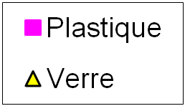
Adhesion  Glass and Plastic
Uracil
Creatine
Area
Area
Number of transfers
Number of transfers
Creatinine
Orotic acid
Area
Area
Number of transfers
Number of transfers
Guanidinoacetate
Plastic
Glass
Area
Number of transfers

Slide 27
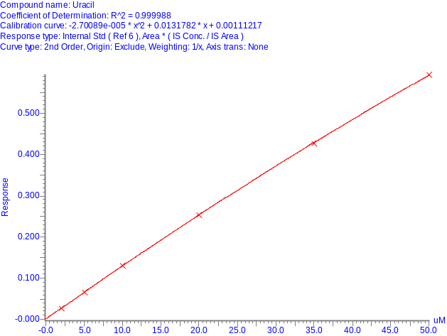
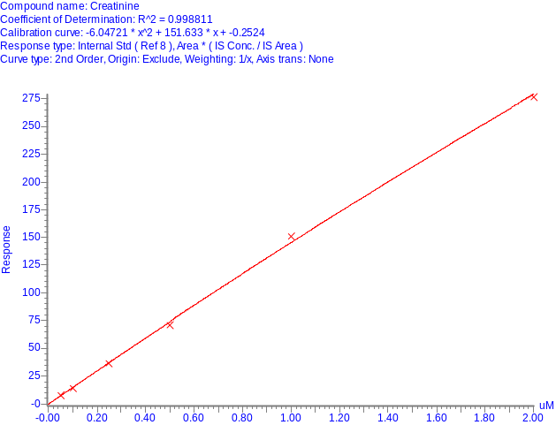
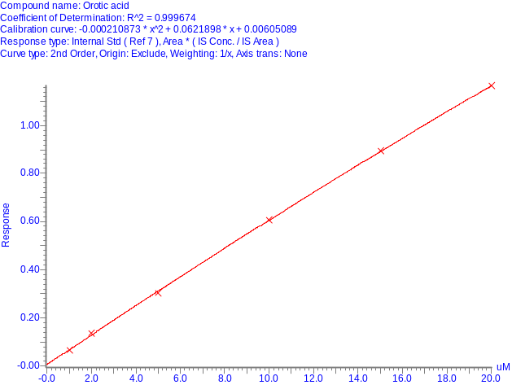
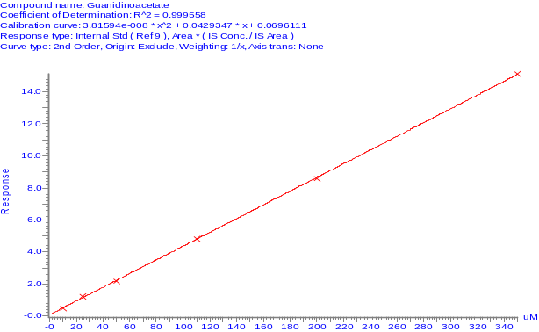
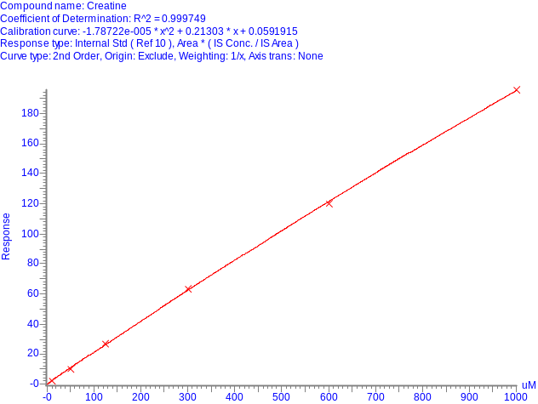
Linearity  7 Stds for Each Calibration Curve
Uracil - Range: 2-50 μM
R²= 0.999988
Creatinine - Range: 0.05-2 mM
R²= 0.998811
Orotic acid - Range: 1-20 μM
R²= 0.999674
Response
Response
Response
Concentration (μM)
Concentration (mM)
Concentration (μM)
Guanidinoacetate - Range: 10-350 μM
R²= 0.999558
Creatine - Range: 10-1000 μM
R²= 0.999749
Response
Response
Concentration (μM)
Concentration (μM)
Acceptable → R²>0.995
Auray-Blais C, et al., Clin Chim Acta, 436, 249-255, 2014

Slide 28
Intraday Validation Assays (n=5)
Accuracy and Precision
 | Theoretical Concentration (μM) |  |  |  | Precision (% CV) |  |  |  | Accuracy (% Biais)
 | QC1 | QC2 | QC3 | QCP | QC1 | QC2 | QC3 | QCP | QC1 | QC2 | QC3 | QCP
Uracil | 3.5 | 25 | 42 | N/A | 14.7 | 4.7 | 2.1 | 5.1 | 6.4 | 0.1 | 0.4 | N/A
Guanidinoacetate | 35 | 160 | 290 | N/A | 10.7 | 4.7 | 5.6 | 1.9 | -4.2 | -0.5 | -5.5 | N/A
Creatinine | 150 | 800 | 1500 | N/A | 4.7 | 5.7 | 13.6 | 4.0 | -7.7 | -5.5 | -7.5 | N/A
Creatine | 75 | 450 | 850 | N/A | 4.3 | 5.4 | 8.4 | 4.2 | -5.8 | -0.3 | -0.7 | N/A
Orotic acid | 1.5 | 8 | 18 | N/A | 4.2 | 2.2 | 4.0 | 11.5 | -9.8 | -6.0 | -4.8 | N/A
QC1 → Low QC
QC2 → Medium QC
QC3 → High QC
QCP → Control Urine
Auray-Blais C, et al., Clin Chim Acta, 436, 249-255, 2014

Slide 29
Interday Validation Assays (n=5)
Accuracy and Precision
 | Theoretical Concentration (μM) |  |  |  | Precision (% CV) |  |  |  | Accuracy (% Biais)
 | QC1 | QC2 | QC3 | QCP | QC1 | QC2 | QC3 | QCP | QC1 | QC2 | QC3 | QCP
Uracil | 3.5 | 25 | 42 | N/A | 11.9 | 2.8 | 5.1 | 11.8 | -2.2 | 0.6 | -1.6 | N/A
Guanidinoacetate | 35 | 160 | 290 | N/A | 5.6 | 5.8 | 10.1 | 2.1 | 3.0 | 3.1 | -1.3 | N/A
Creatinine | 150 | 800 | 1500 | N/A | 3.6 | 3.6 | 6.5 | 7.8 | -3.0 | -6.1 | -10.5 | N/A
Creatine | 75 | 450 | 850 | N/A | 8.8 | 2.4 | 8.2 | 5.2 | -1.8 | -0.7 | -1.8 | N/A
Orotic acid | 1.5 | 8 | 18 | N/A | 7.8 | 3.9 | 4.3 | 2.5 | -1.5 | -0.1 | -1.7 | N/A
QC1 → Low QC
QC2 → Medium QC
QC3 → High QC
QCP → Control Urine
Auray-Blais C, et al., Clin Chim Acta, 436, 249-255, 2014

Slide 30
Urinary Creatinine Comparison
Spectrophotometric (Jaffee method) vs LC-MS/MS
Auray-Blais C, et al., Clin Chim Acta, 436, 249-255, 2014

Slide 31
ERNDIM
External Quality Assurance Program

Slide 32
Results  ERNDIM Comparison
Orotic acid
ERNDIM no | LC-MS/MS Auray-Blais μmol/L | Mean Labs (n=~100) | Standard deviation
127 | 0.8 | 1.3 | -0.5
128 | 66.5 | 69.9 | -0.3
129 | 35.5 | 37.0 | -0.4
130 | 105.1 | 104.0 | 0.1
Guanidinoacetate
ERNDIM no | LC-MS/MS Auray-Blais μmol/L | Mean Labs (n=~100) | Standard deviation
127 | 28.2 | 33.7 | -1.05
128 | 95.7 | 105.0 | -0.51
129 | 65.8 | 68.0 | -0.24
130 | 138.3 | 139.0 | -0.04
Auray-Blais C, et al., Clin Chim Acta, 436, 249-255, 2014

Slide 33
Results  ERNDIM Comparison
Creatine
ERNDIM no | LC-MS/MS Auray-Blais μmol/L | Mean Labs (n=~100) | Standard deviation
127 | 37.3 | 38.4 | -0.05
128 | 362.4 | 348.0 | 0.21
129 | 191.0 | 191.0 | 0.00
130 | 545.8 | 505.0 | 0.53
Creatinine
ERNDIM no | LC-MS/MS Auray-Blais μmol/L | Mean Labs (n=~100) | Standard deviation
127 | 2.9 | 3.0 | -0.35
128 | 10.0 | 9.9 | 0.28
129 | 6.2 | 6.5 | -0.76
130 | 11.6 | 13.5 | -2.35
Auray-Blais C, et al., Clin Chim Acta, 436, 249-255, 2014

Slide 34
Results  ERNDIM Comparison
Uracil
ERNDIM no | LC-MS/MS Auray-Blais μmol/L | Mean Labs (n=~100) | Standard deviation
173 | 67.9 | 62.2 | 0.65
174 | 14.6 | 14.0 | 0.15
175 | 116.8 | 107.0 | 0.65
176 | 256.8 | 257.0 | -0.01
Auray-Blais C, et al., Clin Chim Acta, 436, 249-255, 2014

Slide 35
Stability Assays
1) Eluted urine samples
 Stability:
- 24 h at room temperature
- 5 days at 4°C (±20% variability)
2) On filter paper
 Stability for 20 days:
- room temperature
- 4°C
- -20°C (±20% variability)
Auray-Blais C, et al., Clin Chim Acta, 436, 249-255, 2014

Slide 36
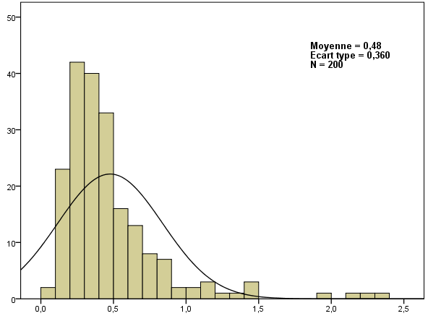
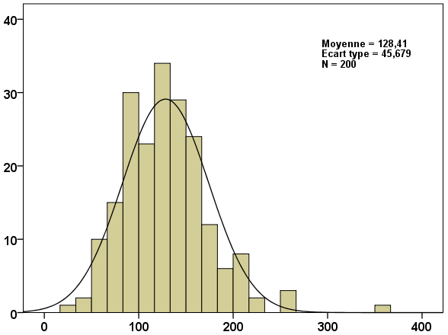
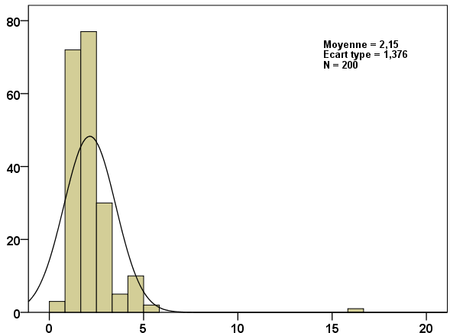
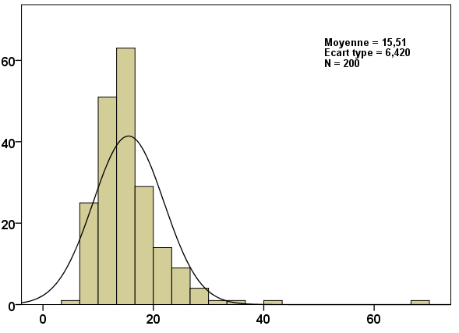
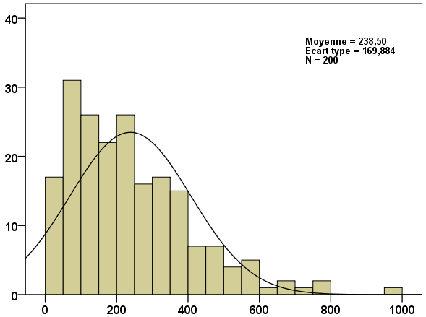
Urinary Distribution  200 Newborns at 21 days of age
Creatinine
Guanidinoacetate
Orotic acid
Mean = 0.48
SD= 0.36
Reference values (m±3σ) = 0 - 1.56
Mean = 128.41
SD = 45.68
Reference val. (m±3σ)= 0 - 265
Mean = 2.15
SD= 1.38
Reference values (m±3σ) = 0 - 6
Number of Newborns
Number of Newborns
Number of Newborns
Concentration (mmol/L)
Concentration (μmol/mmol creatinine)
Concentration (μmol/mmol creatinine)
Uracil
Creatine
Mean = 15.51
SD= 6.42
Reference values (m±3σ) = 0 - 35
Mean = 283.50
SD= 169.884
Reference values (m±3σ) = 0 - 748
Number of Newborns
Number of Newborns
Concentration (μmol/mmol creatinine)
Concentration (μmol/mmol creatinine)
Auray-Blais C, et al., Clin Chim Acta, 436, 249-255, 2014

Slide 37
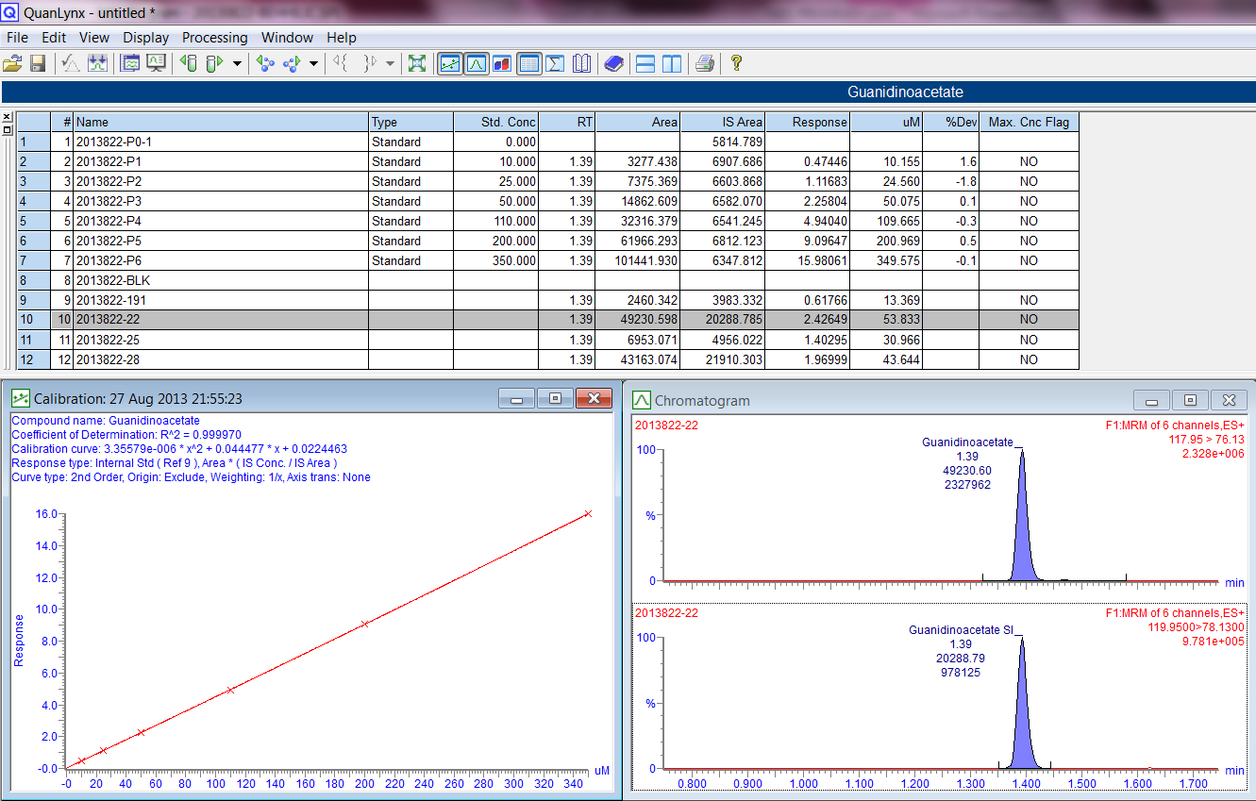
QuanLynx (MassLynx) Interpretation of Results
Auray-Blais C, et al., Clin Chim Acta, 436, 249-255, 2014

Slide 38
Urine Analyses  Confirmed Cases by UPLC-MS/MS
Gender | Age (Years) | Disorders | Uracil | GA | Creatine | Orotic a. | GA/creatine
 |  |  | μmol/mmol | μmol/mmol | μmol/mmol | μmol/mmol
M | 2 | CRTR | 74 | 59 | 2583 | 1 | 0.02
M | 2 | GAMT | 79 | 863 | 97 | 3 | 8.87
Reference values |  |  | 0-30 | 4-220 | 6-1500 | 0-4
F | 6 | GAMT | 34 | 1051 | 19 | 3 | 54.12
M | 8 | HHH | 125 | 16 | 386 | 31 | 0.04
M | 10 | OTC | 101 | 6 | 50 | 10 | 0.12
M | 13 | GAMT | 9 | 391 | 59 | 1 | 6.68
Reference values |  |  | 0-30 | 3-112 | 17-720 | 0-4
F | 22 | HHH | 63 | 8 | 29 | 7 | 0.28
Reference values |  |  | 0-20 | 3-112 | 11-560 | 0-1
Reference values according to:
Asai., et al. Petriatrics International 2000;42:499-503
Young., et al. Current Protocols in Human Genetics 2007;17.3.1-17.3.18
Auray-Blais C, et al., Clin Chim Acta, 436, 249-255, 2014

Slide 39
Conclusions
Importance of early detection after birth:
- Early treatment;
- Alter the progression of disease;
  - Genetic counselling offered;
  - Urine specimens collected: non invasive;
   Feasibility of detection of all 5 disorders:
  - From existing urine samples;
  - Simple, rapid, efficient and robust method;
  - Validated method: linearity, interday and intraday variation, LOD,
  LOQ, reproducibility, recovery, stability;
  - Short method: 2 min allowing mass screening;
   Major advantages for newborns
  - Screening allows early diagnosis to prevent severe, irreversible clinical manifestations and leads to efficient treatment

Slide 40
Fabry Disease
Metabolomic Study

Slide 41
Fabry disease
⇨ X-linked lysosomal storage disorder (Xq21.3)
⇨ α-galactosidase A deficiency (600 mutations)
⇨ Storage of glycosphingolipids (mainly Gb₃ & lyso-Gb₃)
⇩
Biological fluids
Different organs: kidneys, heart, eyes
Vascular endothelium
⇨ Onset: may present in childhood or early adolescence
⇨ Clinical manifestations:
- Ventricular hypertrophy
Death - Cerebrovascular complications
- Renal insufficiency
- Angiokeratomas

Slide 42
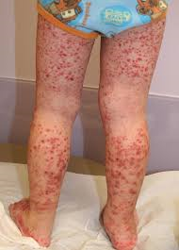
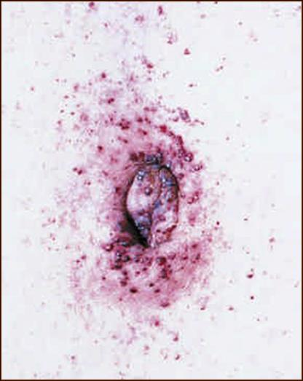
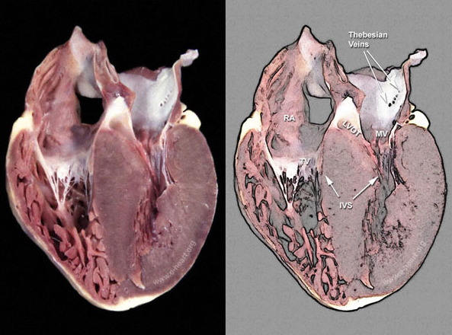
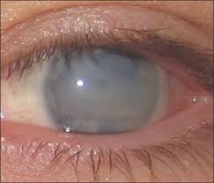
Fabry Disease
Signs and symptoms
Angiokeratomas
Cardiomyopathy
Corneal opacity

Slide 43
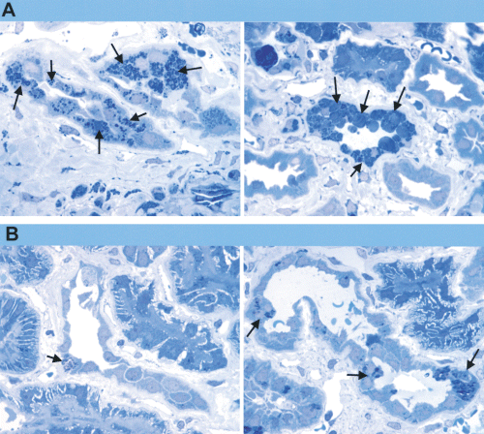

Enzyme replacement therapy
Gb₃ clearance from peritubular capillary endothelium
Pre-treatment
(11 months)
Post-treatment
(Thurberg BL, Kidney International (2002) 62, 1933–1946)

Slide 44
Aims of Metabolomics in Biomedical Research
 Biomarker discovery
 Structural characterization of metabolites
 Understanding the biochemistry of diseases
Notes:
44

Slide 45
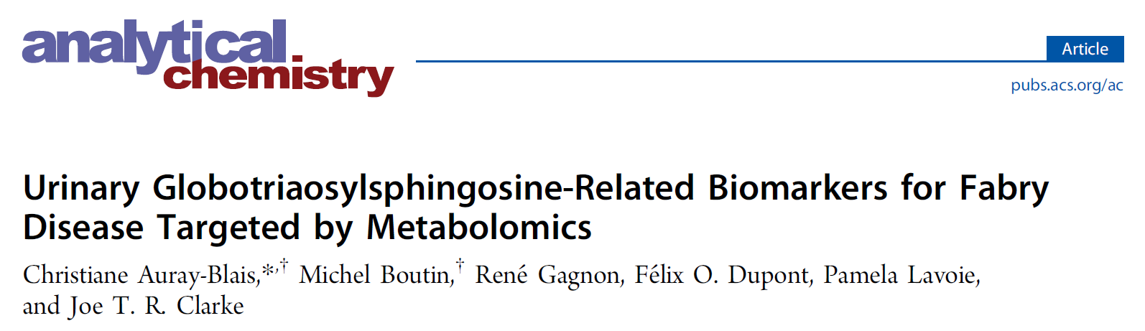
Metabolomic Study for Fabry Disease
Targeting Basic Molecules
Anal. Chem. 2012, 84, 2745−2753

Slide 46
Patients & Controls  Urine Samples
Fabry disease patients Controls
Untreated
♂ ♀ ♂ ♀
18 45 23 36
63 Patients 59 Controls
(1–78 y) (2–59 y)
Auray-Blais C, et al. Anal. Chem. 2012; 84(6): 2745–2753

Slide 47
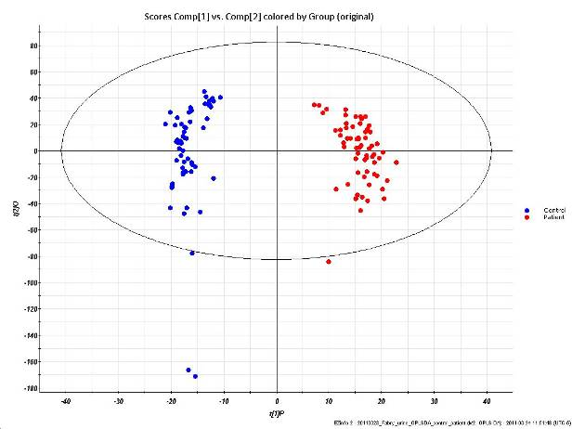
Urine Score-plot
 Untreated Fabry Patients vs Controls
Untreated Fabry patients (n=63)
Controls (n=59)
Auray-Blais C, et al. Anal. Chem. 2012;84(6):2745-53

Slide 48
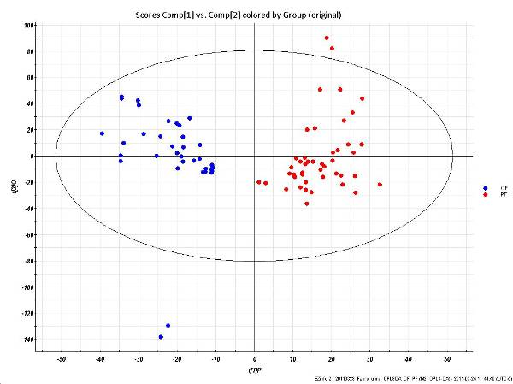
Urine Score-plot  Untreated Female Fabry Patients vs Female Controls
Untreated Female Fabry patients (n=45)
Female Controls (n=36)
Auray-Blais C, et al. Anal. Chem. 2012;84(6):2745-53

Slide 49
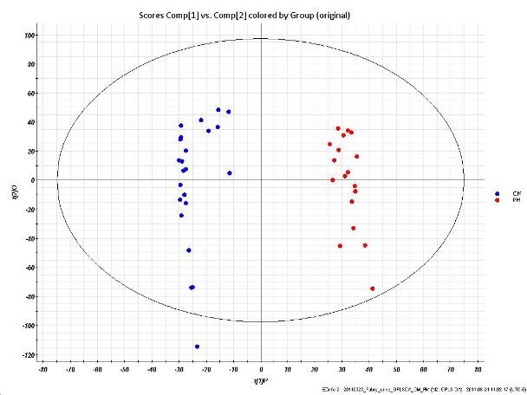
Urine Score-plot  Untreated Male Fabry Patients vs Male Controls
Untreated Male Fabry patients (n= 18)
Male Controls (n= 23)
Auray-Blais C, et al. Anal. Chem. 2012;84(6):2745-53

Slide 50
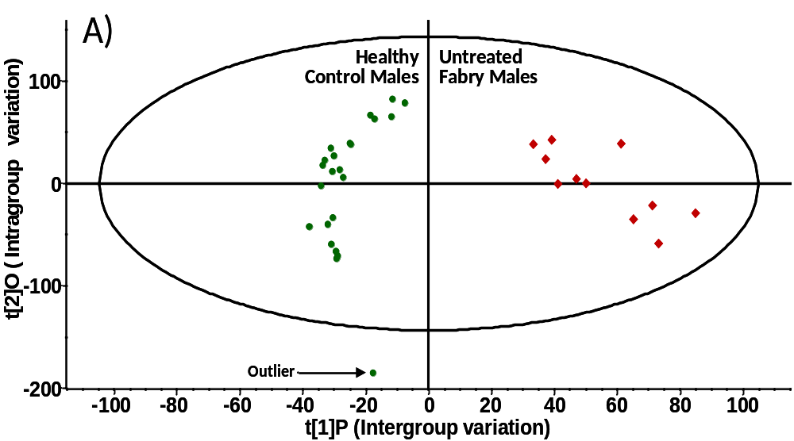
OPLS-DA Score Plot Using UPLC-ESI-Tof-MS Metabolomic Analysis of Fabry Urine Samples
Untreated Fabry males (n=11): ◆
Healthy control males (n=23): 
Auray-Blais C, et al. Anal. Chem. 2012; 84(6): 2745–2753

Slide 51
S-plot – Correlation in Function of the Covariance
for Metabolites Discriminating 2 groups
Lyso-Gb₃ + 7 other markers
Auray-Blais C, et al. Anal. Chem. 2012; 84(6): 2745–2753

Slide 52

MS² Mass Spectra
Lyso-Gb₃ & Related Analogues in Urine
Sphingosine
100
Lyso-Gb₃
282
Gal
m/z 786
Sphingosine
786
Glc
Gal
%
264
163
300
426
444
462
606
624
768
0
100
Lyso-Gb₃
254
Sphingosine (-28)
(-28) (-C₂H₄)
m/z 758
%
236
Relative abundance
758
272
398
416
434
578
740
0
596
Sphingosine (-2)
100
Lyso-Gb₃
(-2) (H₂)
280
m/z 784
-Gal
784
%
262
-Glc
-Gal
163
298
424
442
460
604
622
766
0
586
100
150
200
250
300
350
400
450
500
550
600
650
700
750
800
m/z
Auray-Blais C, et al. Anal. Chem. 2012; 84(6): 2745–2753

Slide 53

Lyso-Gb₃ and Related Analogues
Urine and Plasma
Auray-Blais C, et al. Anal. Chem. 2012: 84: 2745–2753
Dupont FO, et al. Curr Med Chem. 2013; 20: 280–288

Slide 54


Slide 55




UPLC Tof-MS Urine analysis
Relative quantification
1.2 X Lyso-Gb₃
9.8 X Lyso-Gb₃
1.6 X Lyso-Gb₃
Auray-Blais C, et al. Anal Chem. 2012; 84(6): 2745–2753

Slide 56




UPLC Tof-MS Urine analysis
Relative quantification
0.6 X Lyso-Gb₃
17 X Lyso-Gb₃
8.4 X Lyso-Gb₃
14 X Lyso-Gb₃
Auray-Blais C, et al. Anal Chem. 2012; 84(6): 2745–2753

Slide 57

Urinary Distribution (%) Lyso-Gb₃
& 7 Analogues in 164 Fabry Patients
Lavoie P, et al. Anal Chem. 2013; 85(3): 1743–1752

Slide 58
Fabry Patients  Cardiac Variant Mutation p.N215S
Urine Samples
*
Patient | Gender | Age | ERT | Gb₃ | Lyso-Gb₃ | Lyso-Gb₃ (-28) | Lyso-Gb₃ (-12) | Lyso-Gb₃ (-2) |  | Lyso-Gb₃ (+14) | Lyso-Gb₃ (+16) | Lyso-Gb₃ (+34) | Lyso-Gb₃ (+50)
 |  | years |  | μg/mmol | pmol/mmol
1 | F | 14 | No | 6 | 0 | 0 | 16 | 0 | 0 |  | 21 | 26 | 38
2 | F | 16 | No | 5 | 0 | 3 | 11 | 4 | 8 |  | 34 | 25 | 28
3 | M | 1 | No | 7 | 0 | 13 | 66 | 9 | 25 |  | 96 | 134 | 90
4 | M | 3 | No | 22 | 0 | 0 | 110 | 0 | 39 |  | 104 | 98 | 84
5 | M | 13 | No | 8 | 0 | 6 | 60 | 6 | 14 |  | 75 | 57 | 81
5 | M* | 15 | Yes | 0 | 0 | 0 | 41 | 0 | 0 |  | 61 | 38 | 66
6 | M | 53 | No | 8 | 16 | 1 | 77 | 14 | 32 |  | 227 | 116 | 97
Reference children |  |  |  | 0-25 | 0 | 0 | 0 | 0 | 0 |  | 26 | 22 | 83
Reference adults |  |  |  | 0-25 | 0 | 0 | 0 | 0 | 0 |  | 17 | 14 | 55
Auray-Blais C, et al. Clin Chim Acta. 2015; 438: 195–204

Slide 59


Biomarkers for Fabry Disease
Urinary Gb₃
32 Urinary Gb₃ analogues/isoforms
8 Methylated
Urinary Gb₃ isoforms
Urinary & plasma
lyso-Gb₃
Fabry Patients

Complete Profile
Evaluation
7 Urine & plasma lyso-Gb₃ analogues

Slide 60
Conclusions
 Relative quantification of lyso-Gb₃ & analogues is important for: detection, diagnosis, monitoring response to therapy
 Lyso-Gb₃ analogues offer the possibility to detect Fabry patients with late onset variants where Gb₃ & lyso-Gb₃ are normal
 There is a metabolic pathway between Gb₃ & lyso-Gb₃
 Urine Lyso-Gb₃ analogues at m/z +16, +34 correlate with LVMI in patients with a cardiac variant mutation (Taipei)

Slide 61


Acknowledgements
All Fabry patients
Provincial Newborn Urine Screening Program
- Jocelyne Therrien
- Diane Galipeau
- Claude Alie
- Sylvie Duplessis
- Jean Béliveau
Mass Spectrometry Research Team:
  - Pamela Lavoie
  - Michel Boutin
- Mona Abaoui
Philippe Provençal
Mélanie Fortin
Myriam Turgeon
CFDI Team in Canada

Slide 62
Acknowledgements
 Shire
 Waters
 Genzyme, A Sanofi Company
 Canadian Institutes of Health Research (CIHR)
 “La Fondation du CHUS Inc.”
 “La Fondation des Étoiles”
Notes:
62

Slide 63

Sherbrooke Medical Centre (CHUS)
Faculty of Medicine and Health Sciences

