Slide 1
STEM CELLS ROLE IN THE BODY
A new understanding of disease formation
Christian Drapeau
STEMTech International

Slide 2






Stem Cell Theory of Repair

Slide 3
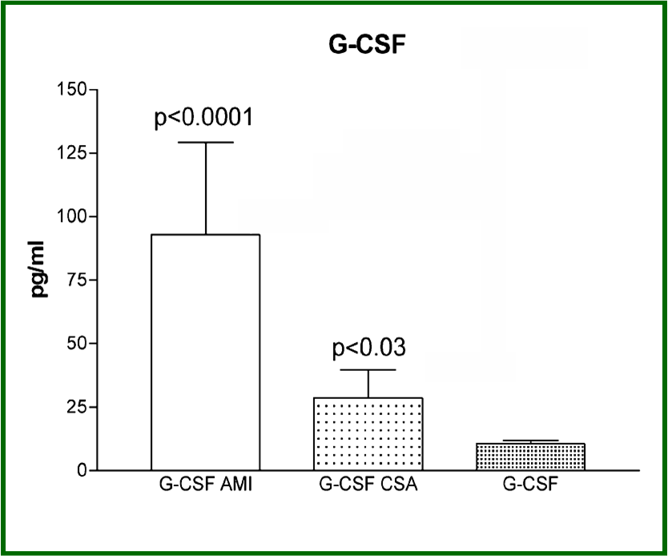
Affected tissues release G-CSF
Leone et al., Int. J Cardiol. 111(2):202-8, 2006.

Slide 4
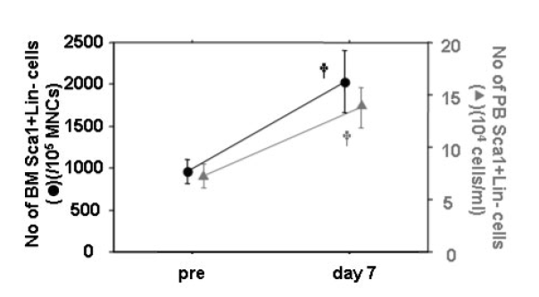
Injury & SC Mobilization (fracture)
J. Cell. Physiol. 215: 234–242, 2008.

Slide 5
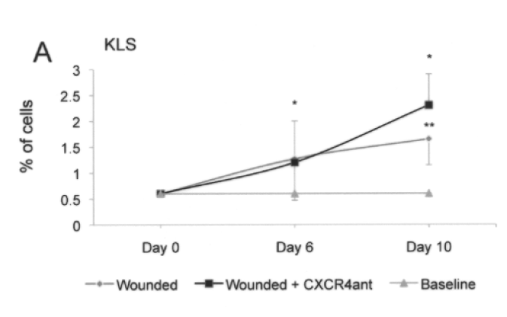
Injury & SC Mobilization (wound)
Cell Transplantation 19:1369–1381, 2010

Slide 6
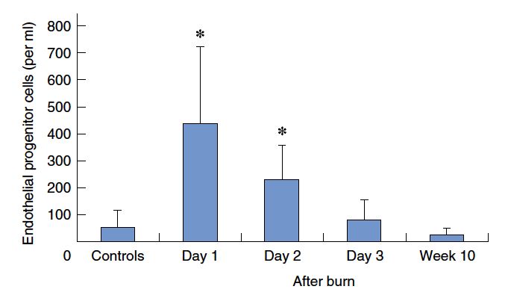
Injury & SC Mobilization (burn)
British Journal of Surgery 2008; 95: 244–251

Slide 7


Stem Cell Theory of Repair

Slide 8
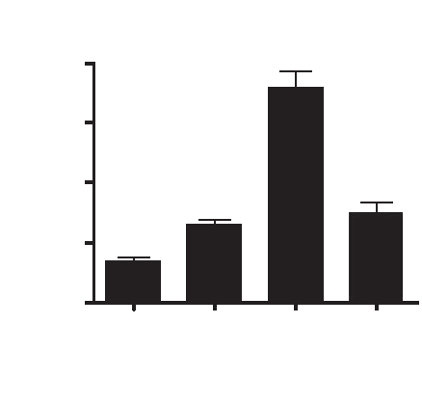
Affected tissues release SDF-1
0.100
0.075
SDF-1 (ng/mg protein)
0.050
0.025
0.000
Control 48h 72h 96h
Left Ventricle
Abbott et al., Circulation 110(21):3300-5, 2004.

Slide 9
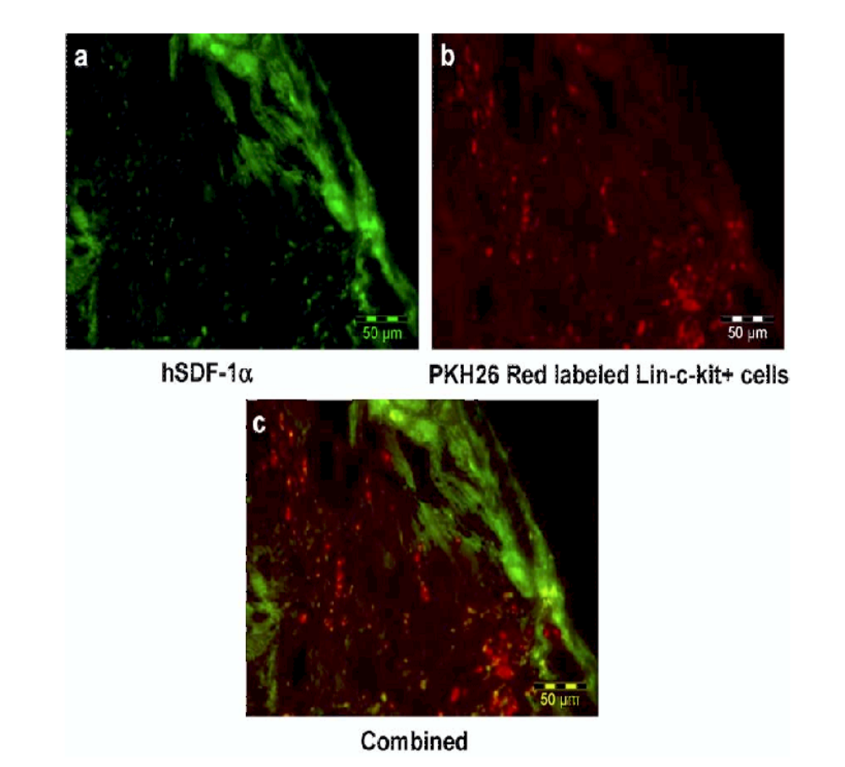
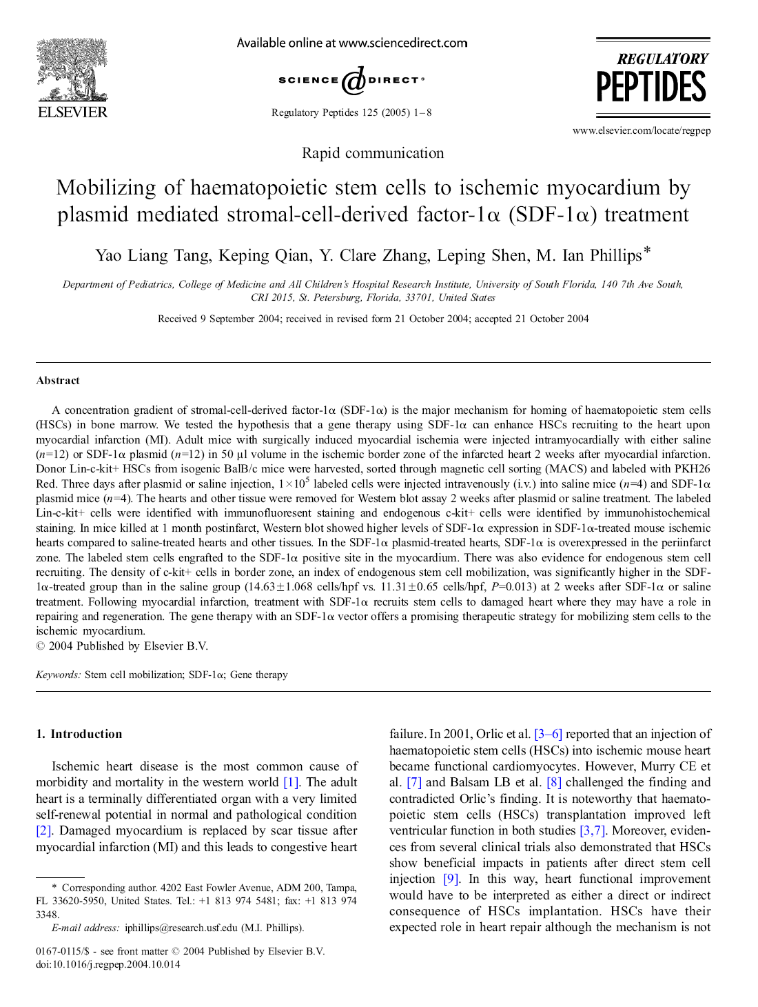
Affected tissues release SDF-1
Tang et al., Reg. Peptides 125:1-8, 2005.

Slide 10
Stem Cell Theory of Repair

Slide 11
Endogenous Stem cells Mobilization
A novel therapeutic approach
Animal models

Slide 12
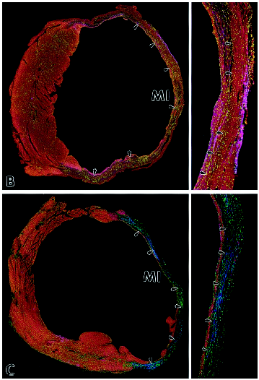
Acute Myocardial Infarction
After 27 days…
In control animals:
Scar tissue in ventricular wall
No new blood vessels
17% survival (83% fatality)
Cardiovascular health
  poor ejection fraction
  low systolic pressure
Ligation of coronary artery
Injection of cytokines that release SC for 8-10 days
In experimental animals:
Renewal of ventricular wall
Functional new blood vessels
73% survival (27% fatality)
Cardiovascular health
  normal ejection fraction
  normal systolic pressure
Orlic et al., PNAS 98(18):10344–10349, 2001.

Slide 13
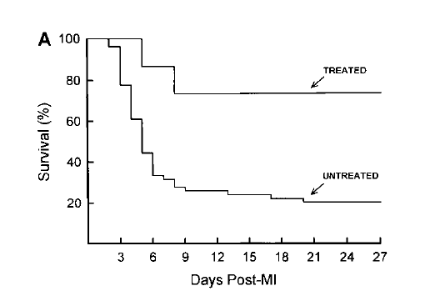
Acute Myocardial Infarction
Orlic et al., PNAS 98(18):10344–10349, 2001.

Slide 14
Diabetes

Slide 15
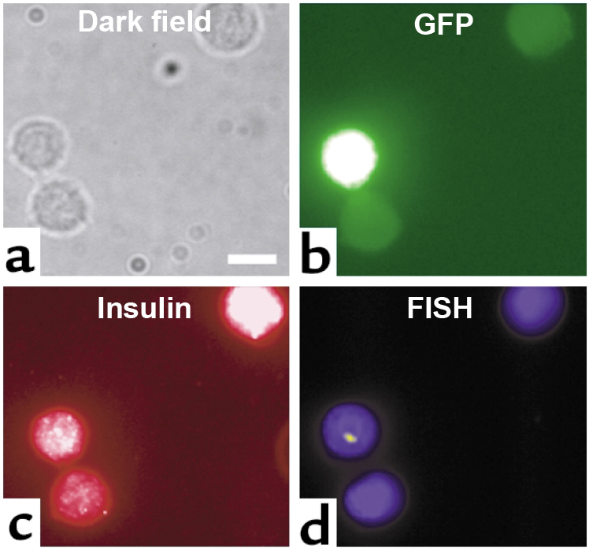
Diabetes
Transcribed insulin gene
Produces insulin
Originate from donor
Ianus et al., J. Clin. Invest. 111(6), March 2003

Slide 16
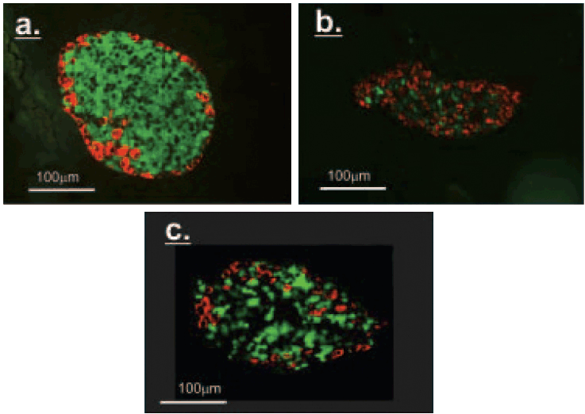
Diabetes
STZ
Normal
STZ + TMO
Hasegawa et al., Endocrinology 148(5), May 2007

Slide 17
Stem Cell Theory of Repair

Slide 18
Stem Cell Theory of Repair & Renewal

Slide 19
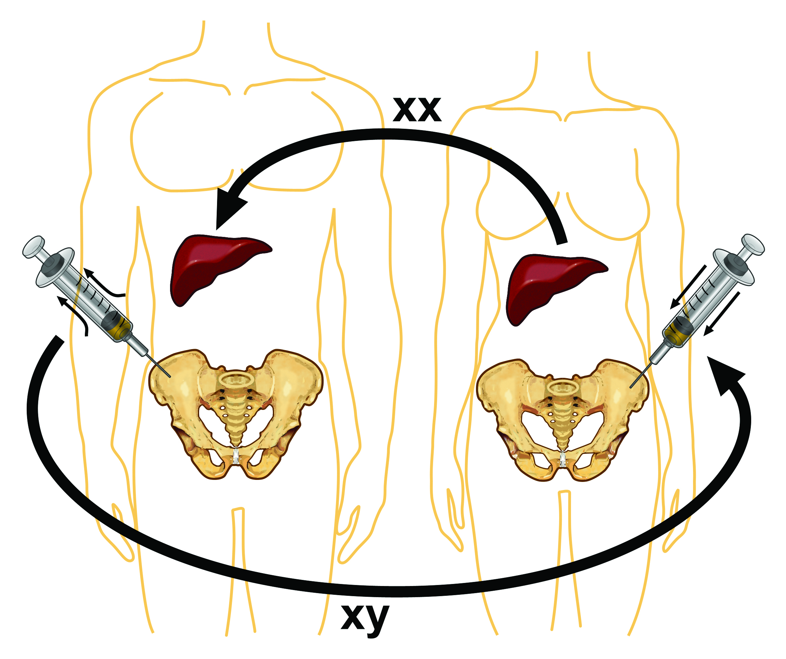
Stem Cell Theory of Renewal & Repair
Brain
Heart
Liver
Skin
Gut
Intestine
Lung
Pancreas
Muscles
Kidneys
Blood vessels

Slide 20
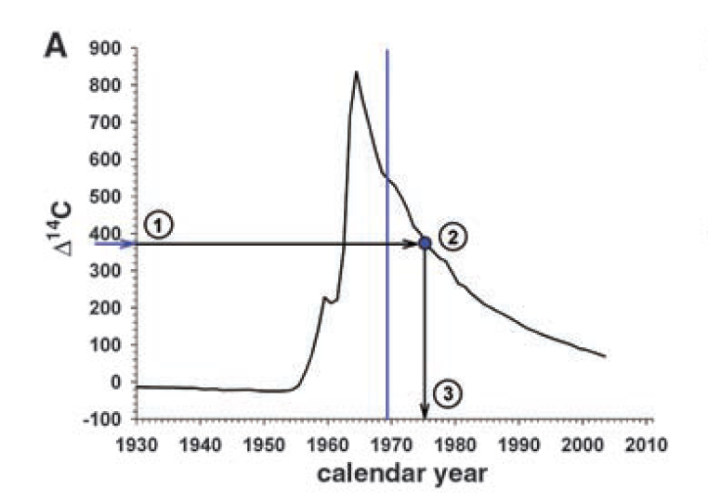
Renewal in the Heart
Olaf Bergmann, et al., Science 324, 98 (2009)

Slide 21
Stem Cell Theory of Renewal
Genetics
Past injuries
Environmental toxins
Lifestyle
Diet
Ability to rest
Physical Stress
Emotional Stress
Cellular Loss
Tissue Renewal

Slide 22
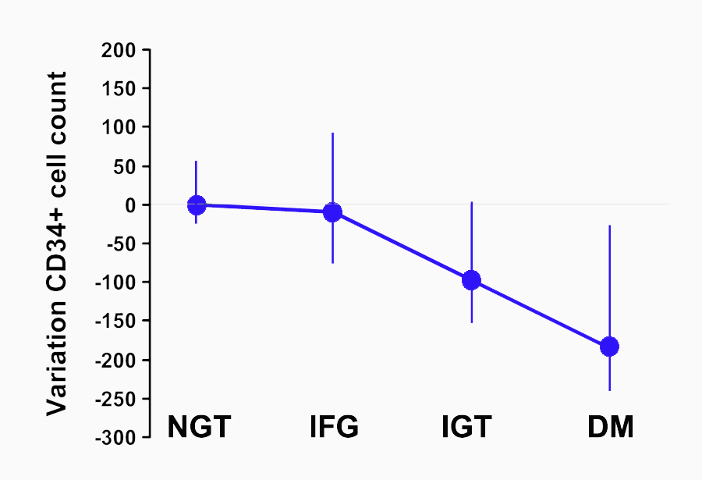
Number of PBSC - Diabetes
Diabetes Care, May 2010 33 (5): 1097-1102

Slide 23
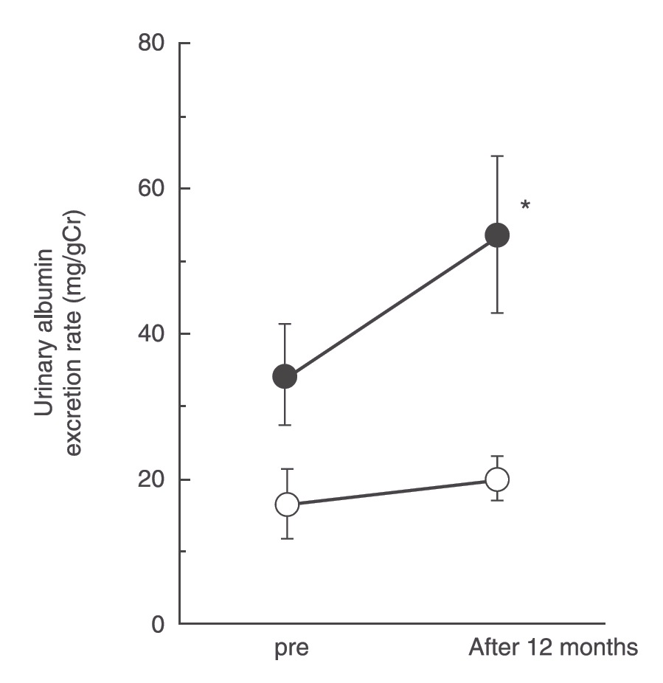
Diabetic nephropathy
Lowest quartile of CD34+ cell number
Highest quartile of CD34+ cell number
Diabetic Medicine 2009, 26: 171–1733
Notes:
Methods We measured circulating CD34+ cell numbers in 85 Type 2 diabetic patients aged 40–70 years with normo- and microalbuminuria and determined the association with urinary albumin excretion rate (UAER).

Slide 24
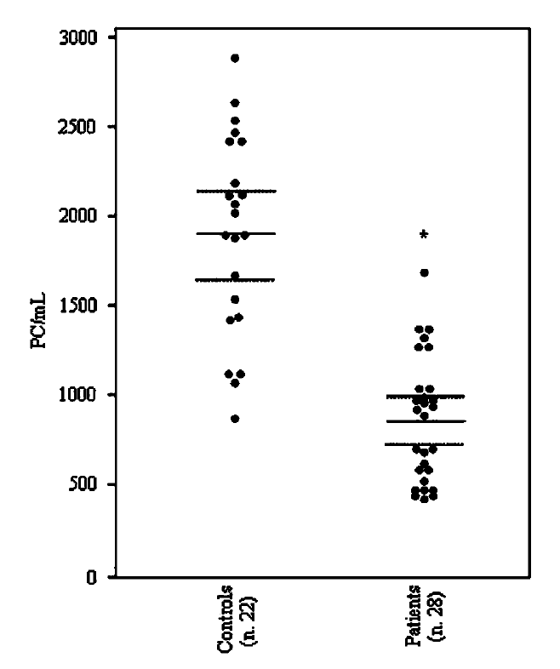
Erectile dysfunction
The number of PCs in peripheral blood of patients affected by ED were significantly reduced with respected to controls (862.47 ± 345.1 vs 1903.57 ± 558.6, P< 0.001). Mean PC values were not different between ED patients with (793.47 ± 310.1) and without (922.37 ± 372.8) cardiovascular risk factors.
International Journal of Impotence Research (2005), 1–3

Slide 25
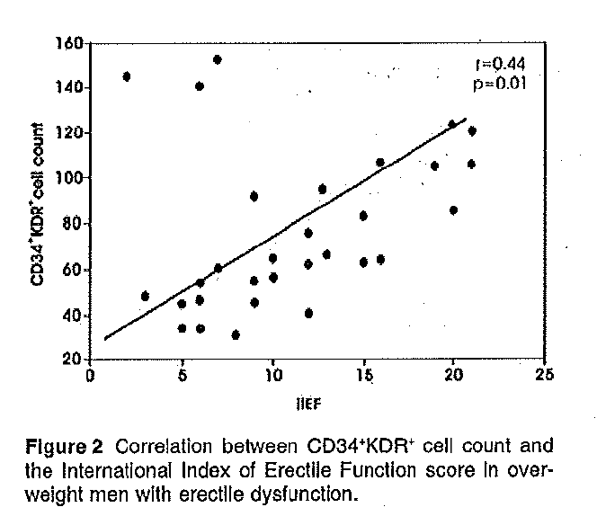
Erectile dysfunction
J Sex Med 2009, 6:107-114

Slide 26
COPD
Eur Respir J 2006; 27: 529–541
Notes:
Study: Circulating CD34+ cells were studied in 18 patients with moderate-to-severe COPD and 12 controls, at rest and after endurance exercise.

Slide 27
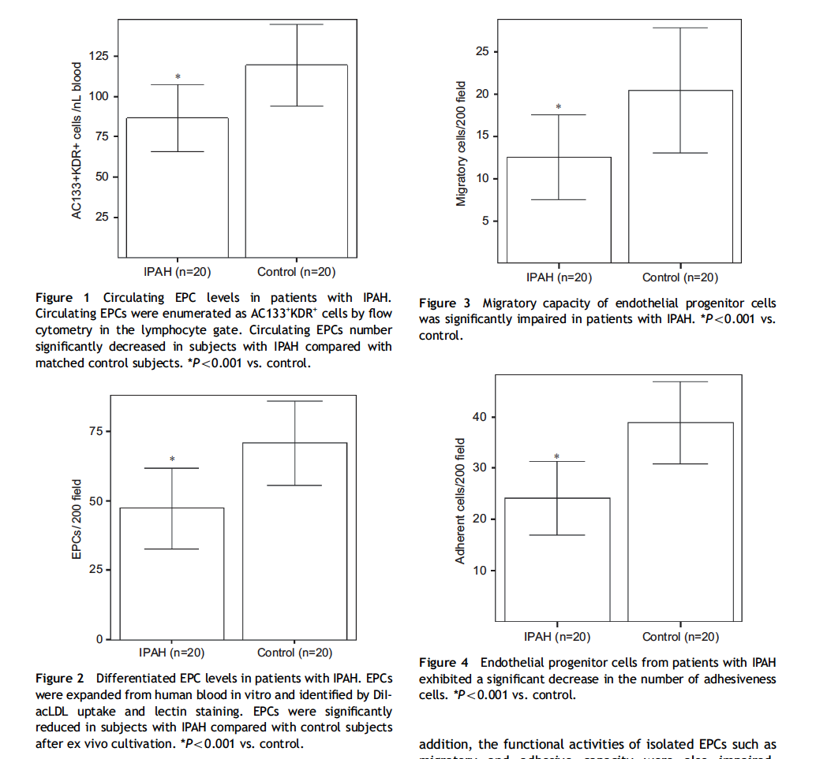
Idiopathic PAH
Respiratory Medicine (2008) 102, 1073–1079
Notes:
Study: EPCs were isolated and cultured from patients with IPAH (n= 20) and matched healthy volunteers (n=20). Circulating EPC numbers (AC133+KDR+ cells) as well as migratory and adhesive activity were assessed.

Slide 28
Idiopathic PAH
Respiratory Medicine (2008) 102, 1073–1079

Slide 29
Idiopathic PAH
Respiratory Medicine (2008) 102, 1073–1079

Slide 30
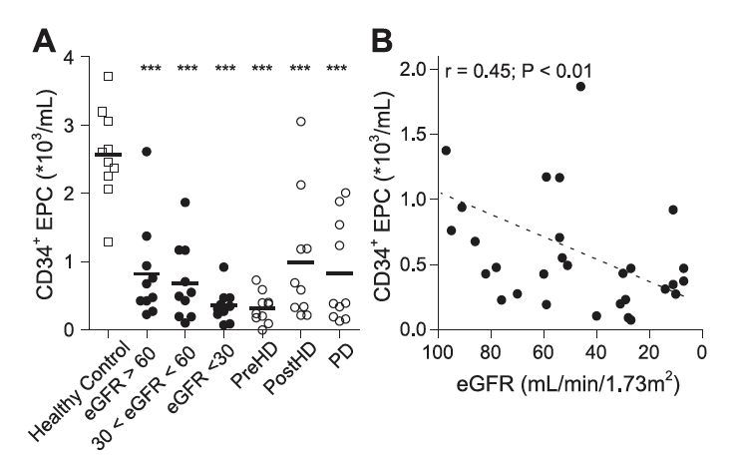

Renal failure
AJP-Renal Physiol. 2009; 296: F1314–F1322
Notes:
Study: In a cross-sectional prospective study, 50 patients with varying degrees of CKD, including 20 patients undergoing dialysis and 10 healthy controls, were included. Circulating EPC were quantified by flow cytometry based on expression of CD14 and CD34.

Slide 31
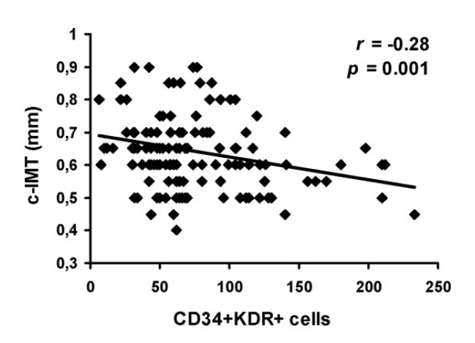
Atherosclerosis
Stroke. 2006; 37:2277-2282.
Notes:
Carotid intima-media thickness (IMT) and levels of circulating EPCs were quantified in 137 healthy subjects.

Slide 32
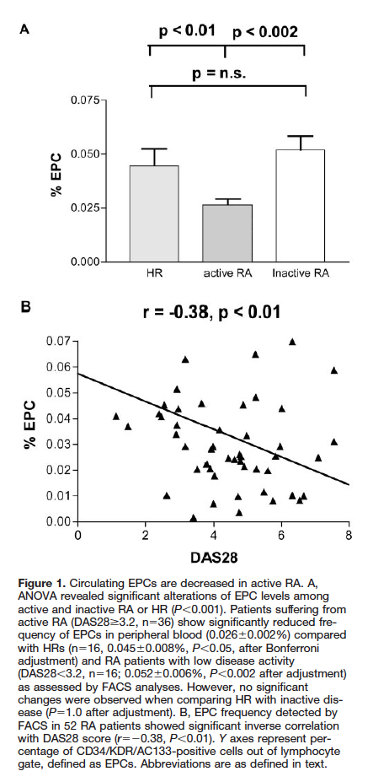
Arthritis
EPCs were significantly decreased in RA patients suffering from active disease (DAS > 3.2) compared with those from HRs.
Circulation. 2005;111:204-211
Notes:
Study: EPCs (CD34/KDR/AC133) were determined in 52 RA patients and in 16 healthy referents (HRs) by FACS analysis. Patients were divided into groups characterized by active disease (n=36) and low disease activity (n=16).

Slide 33
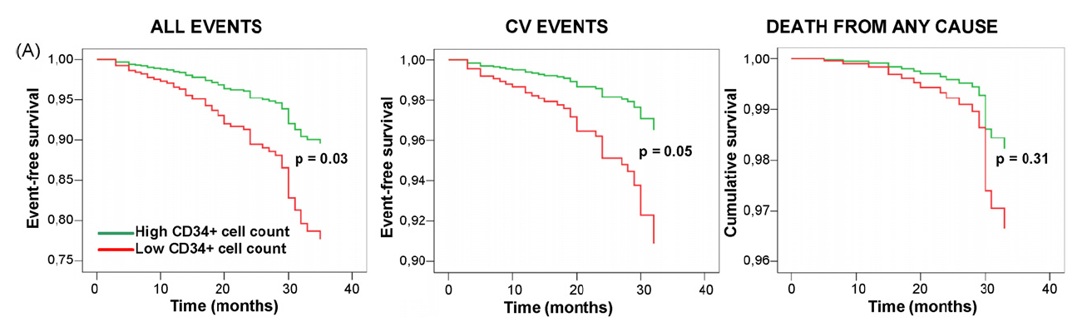
Metabolic syndrome
Atherosclerosis 207 (2009) 213–219
Notes:
Progenitor cells were counted using flow cytometry in 214 subjects with and without MetS.

Slide 34
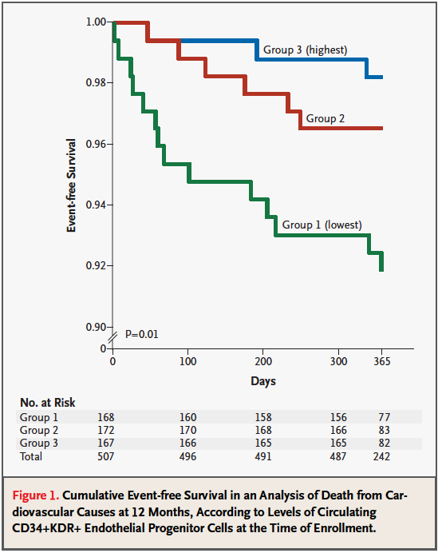
Cardiovascular risks
The level of CD34+ cells is one of the best predictors of cardiovascular health; the higher the number of circulating CD34+ cells, the greater the cardiovascular health.
New England Journal of Medicine, September 8, 2005

Slide 35
Conclusion
Deficiency in daily stem cell-based tissue repair could be an underlying cause of many degenerative diseases.
Endogenous stem cell mobilization could have a wide application in the prevention and treatment of diseases, as well as recovery from surgery.
The number of circulating stem cells could be a marker for overall health/morbidity.

Slide 36
THANK YOU

