Slide 1
The clinical utility of The Lifestyle Questionnaire—Weight Management
Presentation by Chris Anderson, PhD

Slide 2

Background
In the U.S. more than 2/3rd of adults are overweight or obese and 6.5% are considered extremely obese (Ogden et al., 2014)
Weight regain following weight loss has become the norm (wing et al., 2006)
Interventions to improve multiple long-term behavior changes are needed (Johnson et al., 2008 & Wing et al., 2001)

Slide 3

Counseling and Obesity
Despite the recommendation to “offer intensive counseling and behavioral interventions to promote sustained weight loss for obese adults (U.S. Preventive Services Task Force, 2004)”, fewer than ½ of obese patients receive weight loss counseling from primary care providers (Kraschnewski et al., 2013).
Primary Care Physicians cite time-restraints, discomfort with counseling, and pessimism that people can change habits, as reasons for reduced counseling (Yarnall et al., 2003 & Foster, 2003)

Slide 4
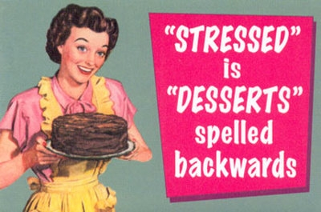
Behaviors associated with Weight Status
Physical activity levels (Jakicic, Wing, & Winters-Hart, 2002)
Fast food consumption (Phelan et al., 2006)
Finding opportunities to increase physical activity (taking the stairs; Andersen et al., 1999)
Higher levels of depression (McGuire et al., 1999)
Emotional eating (McGuire et al., 1999)
Binge eating (McGuire et al., 1999)
daily self-weighing (Wing et al., 2006)

Slide 5
Goals of The Original Lifestyle Questionnaire—Weight Management
Produce a questionnaire helpful for patients and clinicians to quickly identify behavioral patterns and to create weight management plans likely to result in success.
Create a “Lifestyle score” to track patient’s emotional/behavior changes from week-to-week.
Include questions related to body image, eating disordered behavior, and motivation for change.

Slide 6
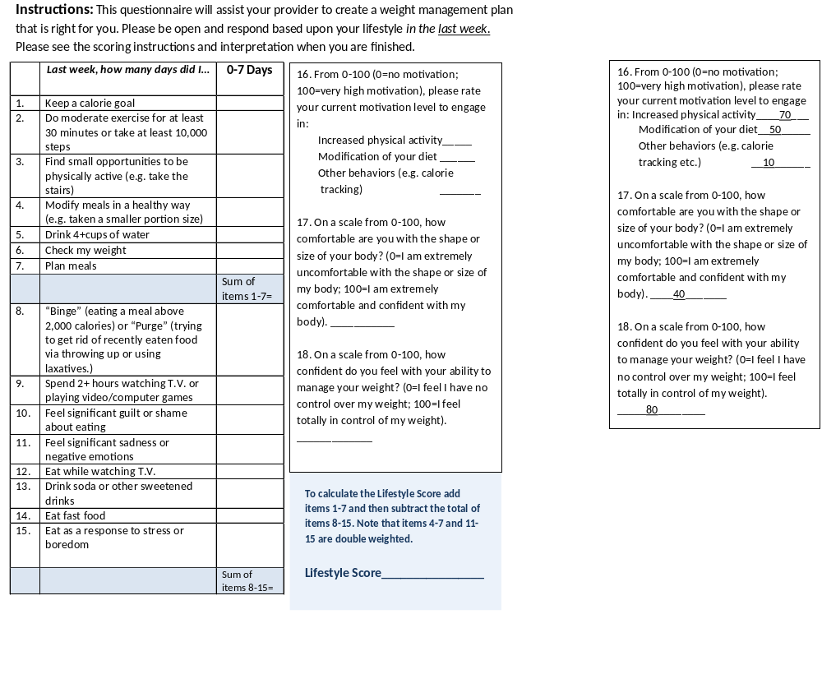

Slide 7
Case Study: Mr. W.
Mr. W. was a 55 y.o. married Caucasian male who had been denied placement on an organ transplant list due to his obesity status and inability to lose weight in past attempts—needed to lose 25 lbs. for placement.
  Mr. W. completed the Lifestyle Questionnaire at intake and identified several behaviors he would be willing to work on changing.
  Both Mr. W. and his wife presented as friendly and insightful and his wife commented,“this is the first time that anybody has actually showed us how to lose weight.”
  Mr. W. was seen for two 30-minute appointments over two months with this writer (who had finished the rotation) and was well on his way to being placed on the transplant list (had lost 20lbs).

Slide 8
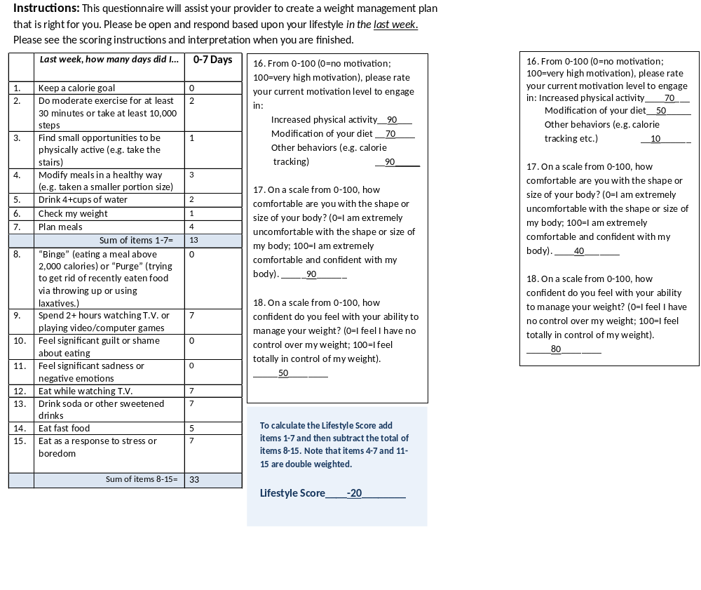
Mr. W.

Slide 9
Case Study: Mr. S.
50 y.o. single, Caucasian Male referred for weight management on the recommendation of his PCP that he lose weight due to his progression towards diabetes.
Mr. S. experienced obsessive compulsive disorder (OCD)
  Secondary symptoms of his OCD included: Body dysmorphia, Caffeine addiction & h/o exercise addiction.
Completed the Weight Management Questionnaire at intake and was seen for 4 sessions of psychotherapy
Since his lifestyle appeared adequate for weight loss, session time was devoted towards his psychological health and body dissatisfaction.

Slide 10
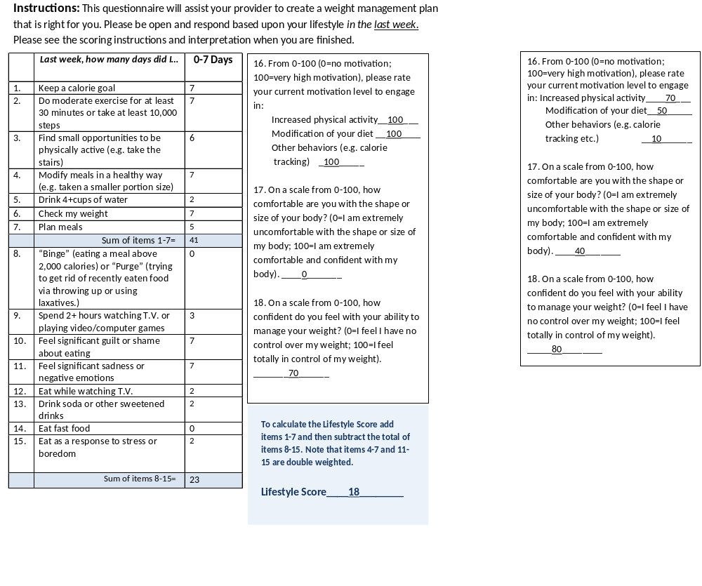
Mr. S.

Slide 11
Statistical Properties: Method
A sample of 277 college students completed the Lifestyle Questionnaire as well as a questionnaire regarding their weight history.
Participants were asked if they had been gaining, maintaining, or losing weight recently and if they were trying to lose weight.
Items were dropped that did not show associations with weight loss or where there was significant overlap with other items.
Research questions:
1.Will significant behavioral/emotional differences from the Lifestyle Questionnaire exist between individuals gaining, maintaining, or losing weight?
2. Will the Lifestyle Score discriminate between people gaining, maintaining, or losing weight?

Slide 12
Unweighted Scores by Group
N=273
n=57
n=177

Slide 13
Differences Between Successful and Unsuccessful Groups—Healthy Behaviors
Days
per Week
*

Slide 14
Differences Between Successful and Unsuccessful Groups II—Unhealthy Behaviors
Days per week

Slide 15

Differences Between Groups with Weighted Items
Mean Lifestyle
Score

Slide 16
Weight Trajectories by Score Groups of Those Trying to Lose Weight
Weight Trajectory by Score Groups | % of people losing weight. | % of people maintaining their weight. | % of people gaining weight.
Scores lower than zero n=24 | 0% | 63% | 37%
Scores between 0-29 n=19 | 22% | 56% | 22%
Scores above 30 n=14 | 86% | 7% | 7%

Slide 17
Those Not Trying to Lose Weight
Weight Trajectories by Score Groups | % of people losing weight. | % of people maintaining their weight. | % of people gaining weight.
Scores lower than zero n=18 | 5% | 68% | 27%
Scores between 0-29 n=129 | 13% | 69% | 18%
Scores above 30 n=29 | 44% | 54% | 2%

Slide 18
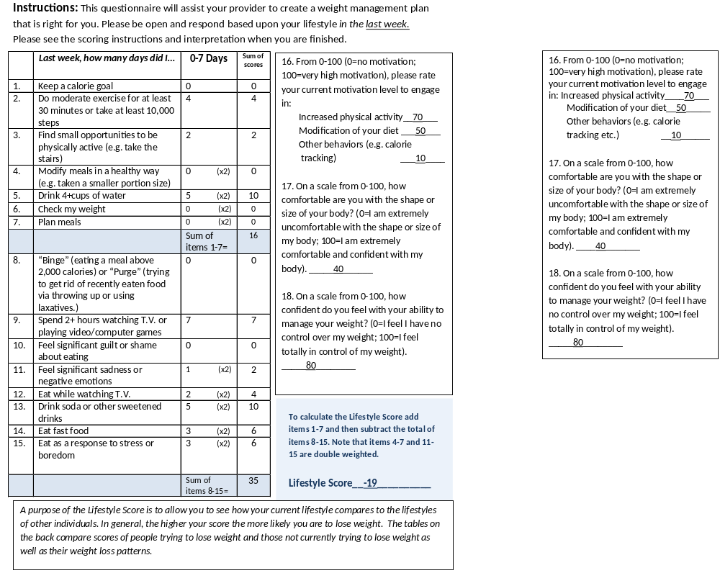
Case Example

Slide 19
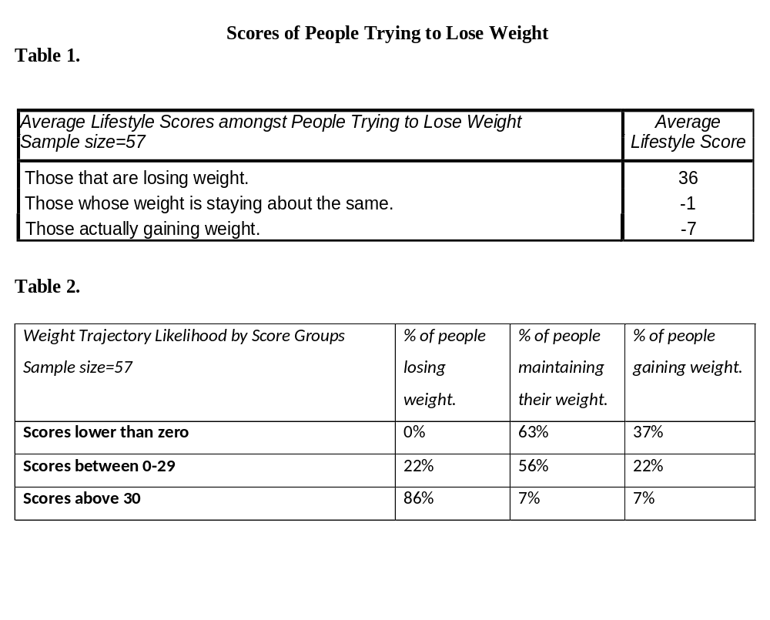

Slide 20
Discussion
The Lifestyle Questionnaire—Weight Management can be a helpful tool to create productive counseling sessions with patients.
The Lifestyle score may be useful to raise patients’ awareness of their likelihood to lose or gain weight.
The score can also be tracked weekly to promote multiple long-term behavior changes.

Slide 21
Discussion (Continued)
Future research designs on the Lifestyle Questionnaire will:
  expand the sample size.
  sampling different populations.
  employing causal research models.
  use more sophisticated weight trajectory tracking.
The Questionnaire will also be available in an app soon to help outpatients with self-monitoring of behaviors.
Contact info to receive more information: canderson430@gmail.com; or andersch@uvu.edu

Slide 22
References
Andersen, R. E., Wadden, T. A., Bartlett, S. J., Zemel, B., Verde, T. J., & Franckowiak, S. C. (1999). Effects of lifestyle
activity vs structured aerobic exercise in obese women: a randomized trial. Jama, 281(4), 335-340.
Foster, G. D., Wadden, T. A., Makris, A. P., Davidson, D., Sanderson, R. S., Allison, D. B., & Kessler, A. (2003). Primary
care physicians’ attitudes about obesity and its treatment. Obesity research, 11(10), 1168-1177.
Gunn, W. B., & Blount, A. (2009). Primary care mental health: A new frontier for psychology. Journal of clinical
psychology, 65(3), 235-252.
Hill, J. O., Wyatt, H., Phelan, S., & Wing, R. (2005). The National Weight Control Registry: is it useful in helping deal
with our obesity epidemic?. Journal of Nutrition Education and Behavior, 37(4), 206-210.
Jakicic, J. M., Wing, R. R., & Winters-Hart, C. (2002). Relationship of physical activity to eating behaviors and weight
loss in women. Medicine & Science in Sports & Exercise.
Johnson, S. S., Paiva, A. L., Cummins, C. O., Johnson, J. L., Dyment, S. J., Wright, J. A., ... & Sherman, K. (2008).
Transtheoretical model-based multiple behavior intervention for weight management: effectiveness on a population basis. Preventive medicine, 46(3), 238-246.
Kraschnewski, J. L., Sciamanna, C. N., Stuckey, H. L., Chuang, C. H., Lehman, E. B., Hwang, K. O., ... & Nembhard, H. B. (2013). A silent response to the obesity epidemic: decline in US physician weight counseling. Medical care, 51(2), 186-192.
Ogden, C. L., Carroll, M. D., Kit, B. K., & Flegal, K. M. (2014). Prevalence of childhood and adult obesity in the United
States, 2011-2012. Jama, 311(8), 806-814.
Phelan, S., Wyatt, H. R., Hill, J. O., & Wing, R. R. (2006). Are the eating and exercise habits of successful weight losers
changing?. Obesity, 14(4), 710-716.
U.S. Preventive Services Task Force. USPSTF Recommendations. Available at: http://www.uspreventiveservicestaskforce.org/uspstopics.htm.Accessed February 22, 2015.
Wing, R. R., Goldstein, M. G., Acton, K. J., Birch, L. L., Jakicic, J. M., Sallis, J. F., ... & Surwit, R. S. (2001). Behavioral
science research in diabetes lifestyle changes related to obesity, eating behavior, and physical activity. Diabetes care, 24(1), 117-123.
Wing, R. R., & Phelan, S. (2005). Long-term weight loss maintenance. The American journal of clinical nutrition, 82(1),
222S-225S.

Slide 23
References II
Wing, R. R., Papandonatos, G., Fava, J. L., Gorin, A. A., Phelan, S., McCaffery, J., & Tate, D. F. (2008). Maintaining large weight losses: the role of behavioral and psychological factors. Journal of Consulting and Clinical Psychology, 76(6), 1015.
Wing, R. R., Tate, D. F., Gorin, A. A., Raynor, H. A., & Fava, J. L. (2006). A self-regulation program for maintenance of
weight loss. New England Journal of Medicine, 355(15), 1563-1571.
Yarnall, K. S., Pollak, K. I., Østbye, T., Krause, K. M., & Michener, J. L. (2003). Primary care: is there enough time for
prevention?. American journal of public health, 93(4), 635-641.

