Slide 1

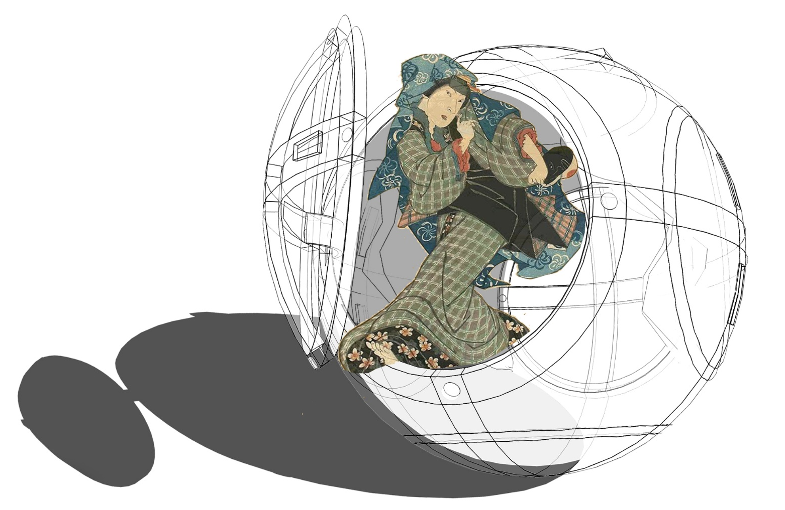

Doomsday Rehearsal
Architecture for Pre-Disaster Learning &
2020 Tokyo Olympics the Year of Disaster Prevention Global Classroom
Master Dissertation (Master of Architecture )
  Environmental challenge & Research Map
  Feasibility and research structure alignment
  Idea implementation (architectural in demonstration)
  Reflection & Question
Choon yong Heng
Graduate Architect, HASSELL Studio
Cyong@hassellstudio.com
CURTIN UNIVRSITY / School of Built Environment
Master of Architecture (2017 Graduate)

Slide 2
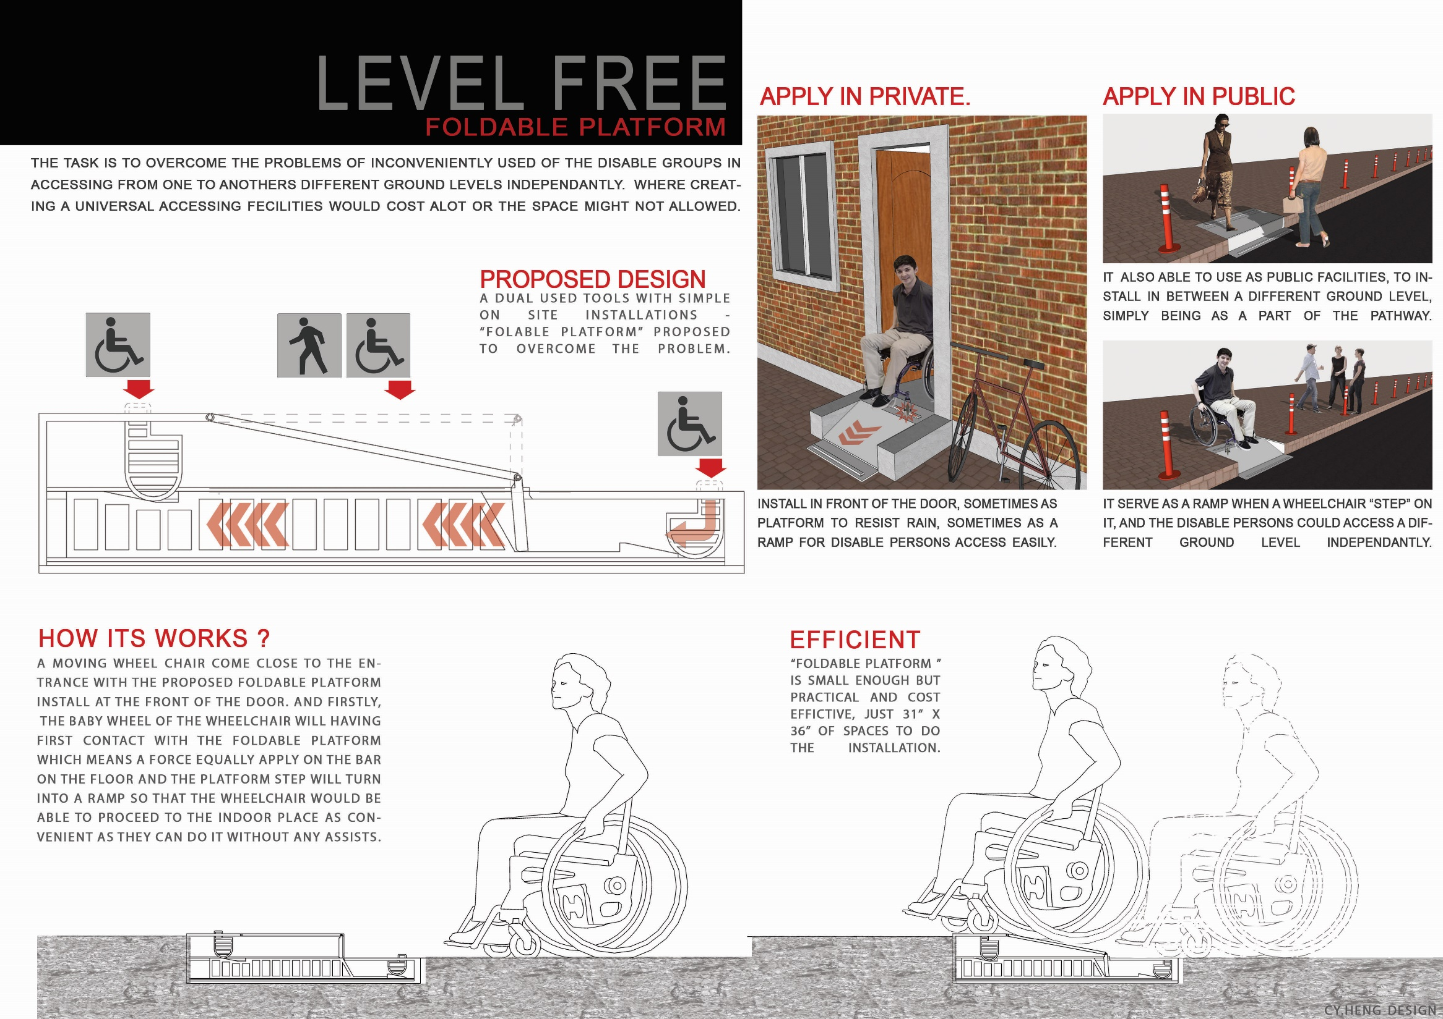


School of Built Environmen
Choon Yong HENG
Cyong@hessellstudio.com

Slide 3
DOOMSDAY + REHEARSAL
School of Built Environment
REAL TIME TRAINING
IN
HAZARDOUS SIMULATION
an early practice towards hazardous simulations in a safe and controlled environment.

Slide 4
Today’s takeaways
School of Built Environment
Address problems that leads opportunities to author's research intention
Aware of opportunities and realization
  seeking exposure & opportunity for multi-disciplinary collaborations
Looking at 2020 Tokyo Olympic and disaster prevention , then address available strategies to enable architecture to intervention within this research field.
    provocative, positive, celebrate & benchmark

Slide 5
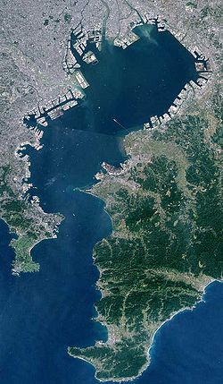
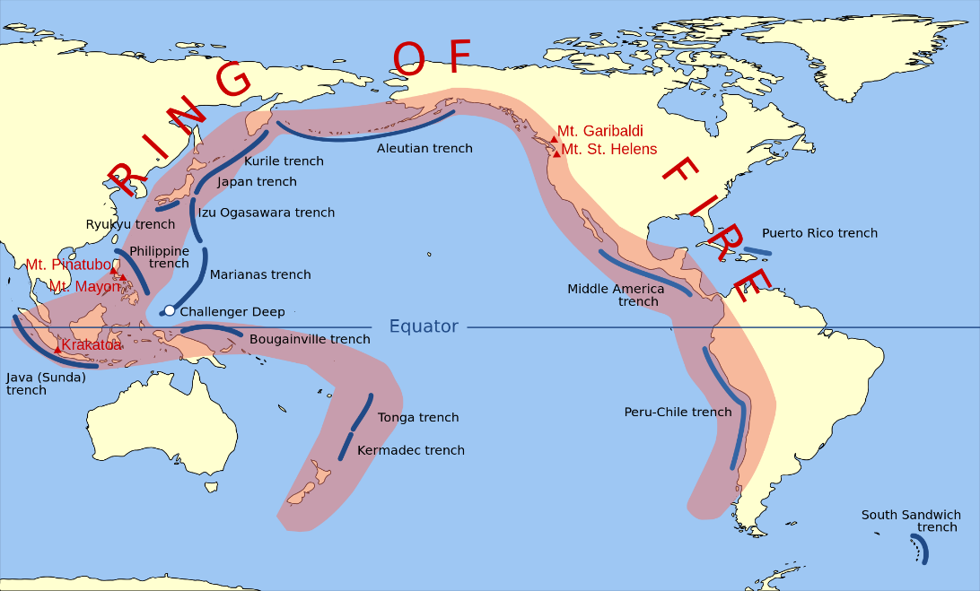
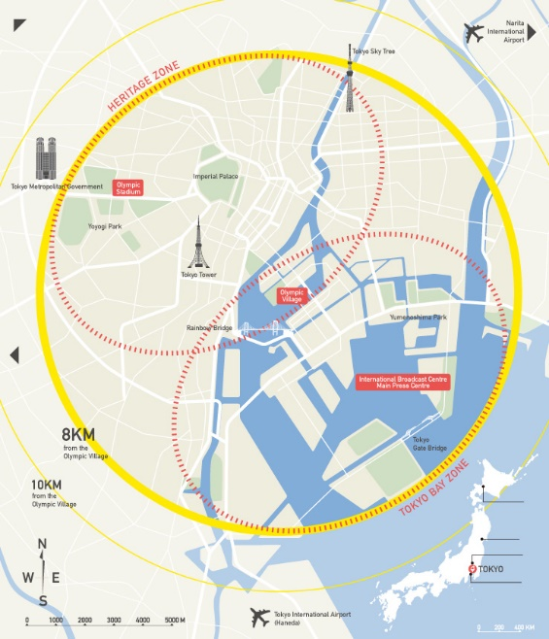
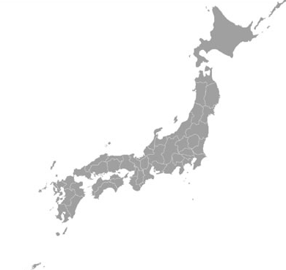
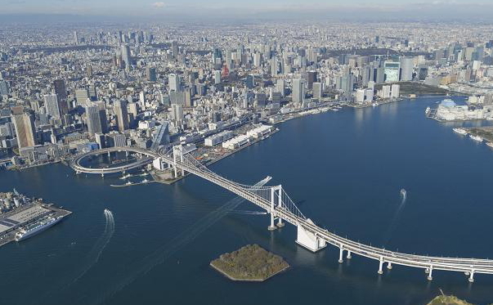
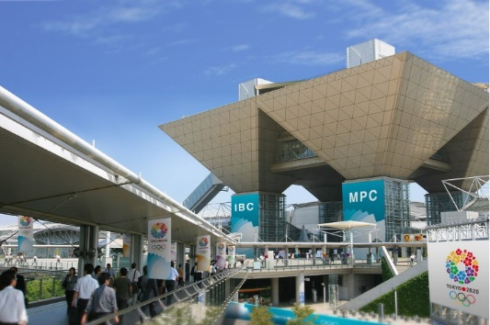
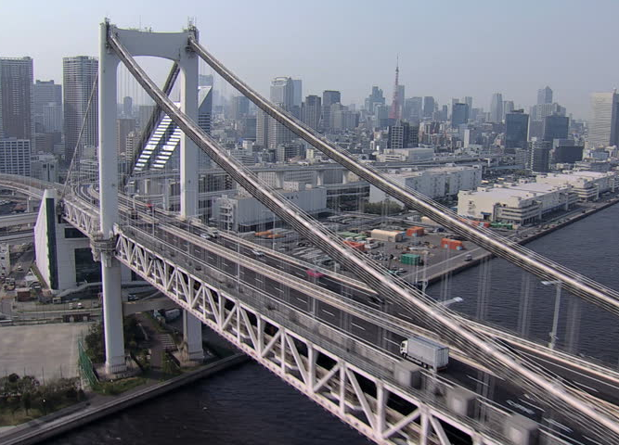

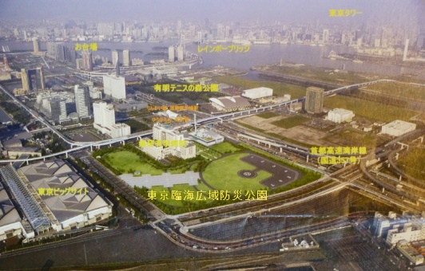
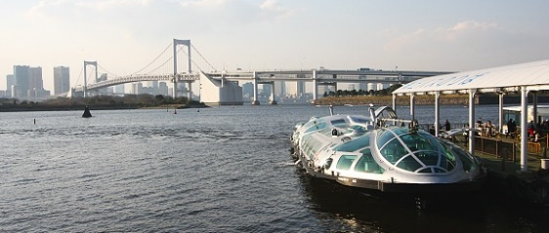
JAPAN, TOKYO
School of Built Environment
2020
TOKYO
OLYMPIC

Slide 6

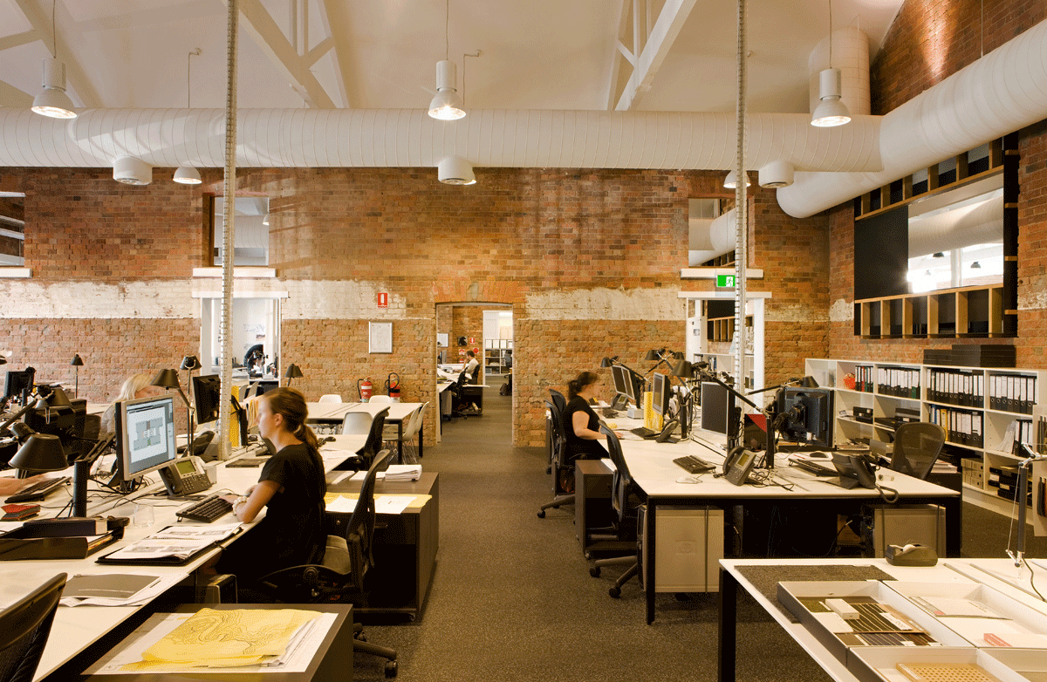
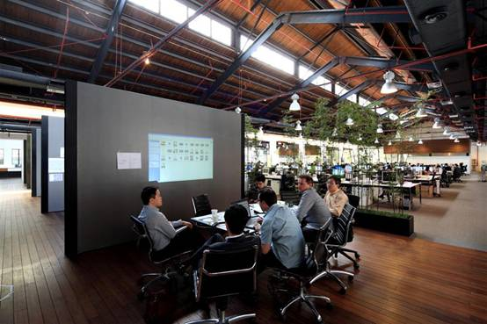
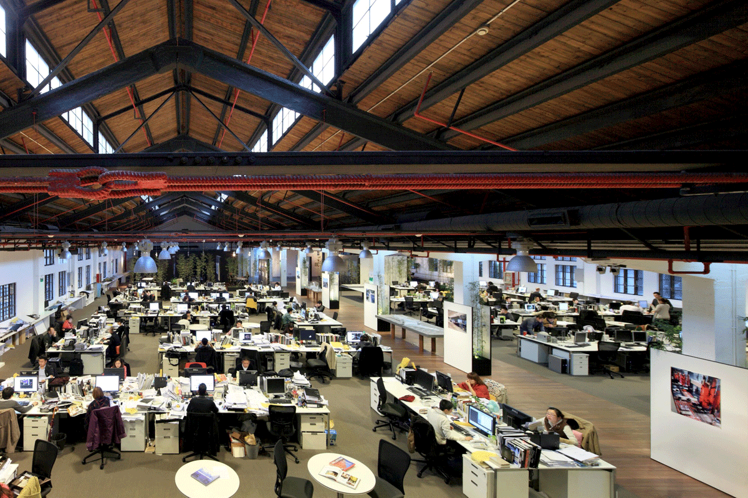
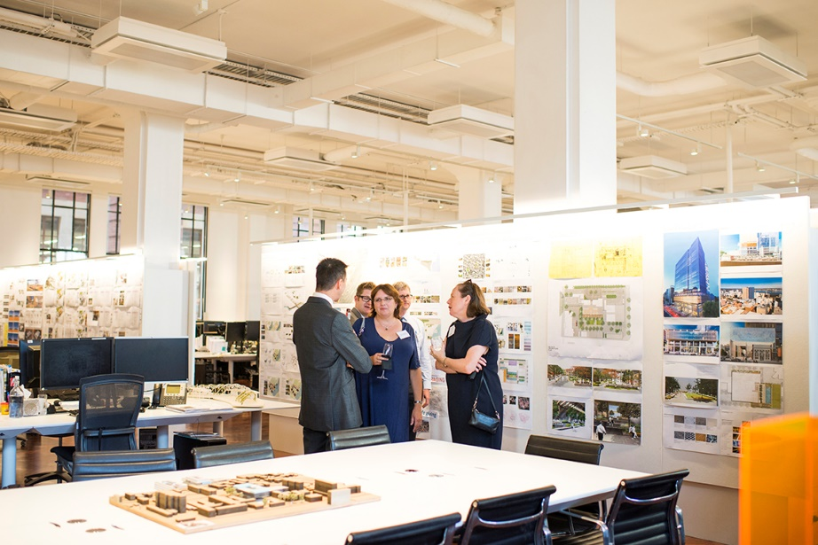
School of Built Environment
USER EXPERIENCE
PRACTICALITY
AESTHETICS

Slide 7

School of Built Environment
life are vulnerable when threatened by the devastating nature.
Source: Dr.Satnam Tsurutani

Slide 8
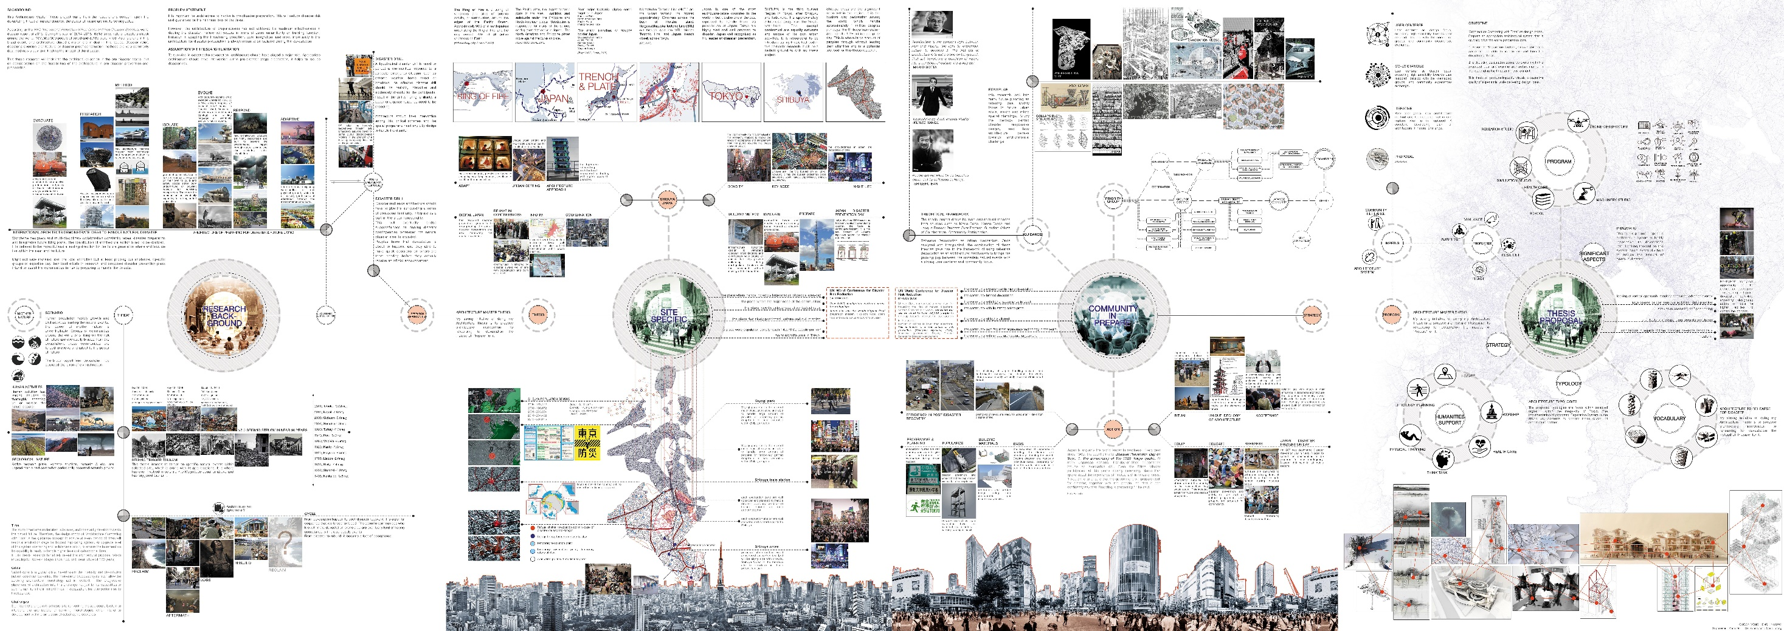
Research Map
School of Built Environment
Cy Heng, (Nov, 2016) Doomsday Rehearsal-Master of Architecture, Master Dissertation

Slide 9
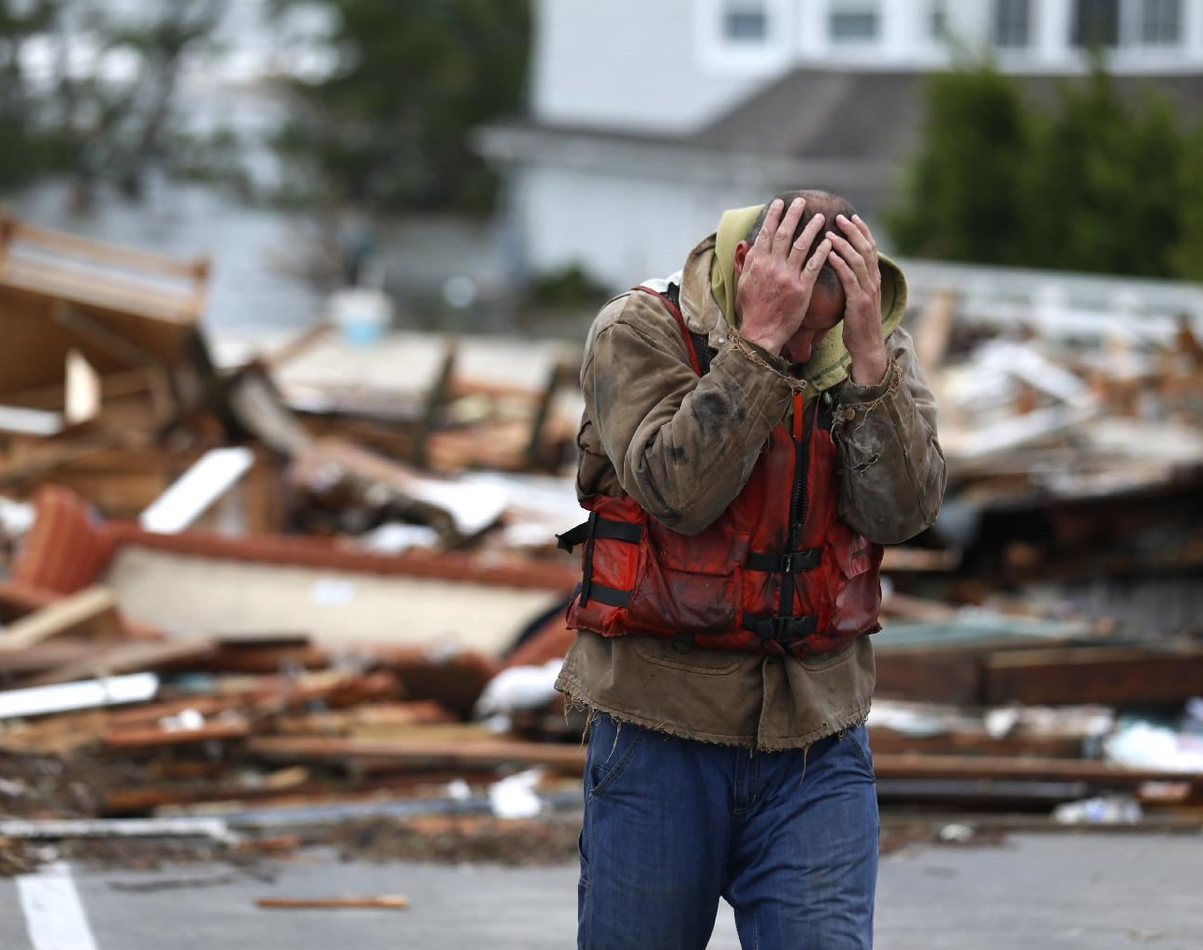
Environmental Challenge
School of Built Environment
hazards are mostly unpredictable.
science and technology have the limitation, there is no perfect solution to combat devastation.
disaster prevention learning is difficult to penetrate into the ‘geographic safe zone’
not everyone developed a good sense of disaster surviving skills, citizens always have high expectation on disaster aid. (Physically and mentally not ready)
Cy Heng, (Nov, 2016) Doomsday Rehearsal-Master of Architecture, Master Dissertation

Slide 10
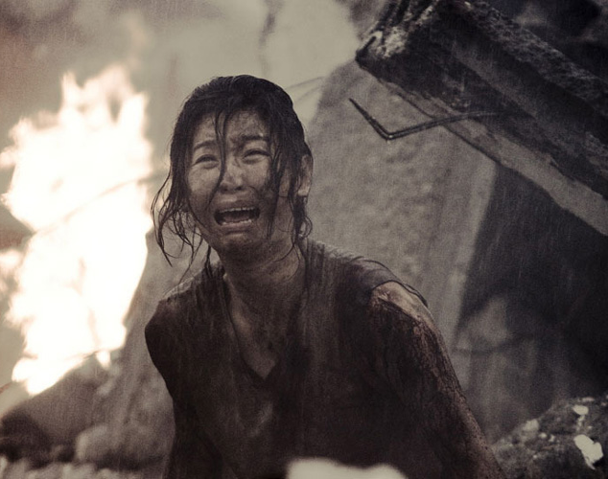
Failing in Respond
School of Built Environment
lack of sense of basic aid will worsen the degree of injury due to help.
shortage of aid support and higher demand on relief expenditure.
the vulnerable groups that completely exposed and left unprotected.
high chance of post-disaster mental illness.
Cy Heng, (Nov, 2016) Doomsday Rehearsal-Master of Architecture, Master Dissertation

Slide 11
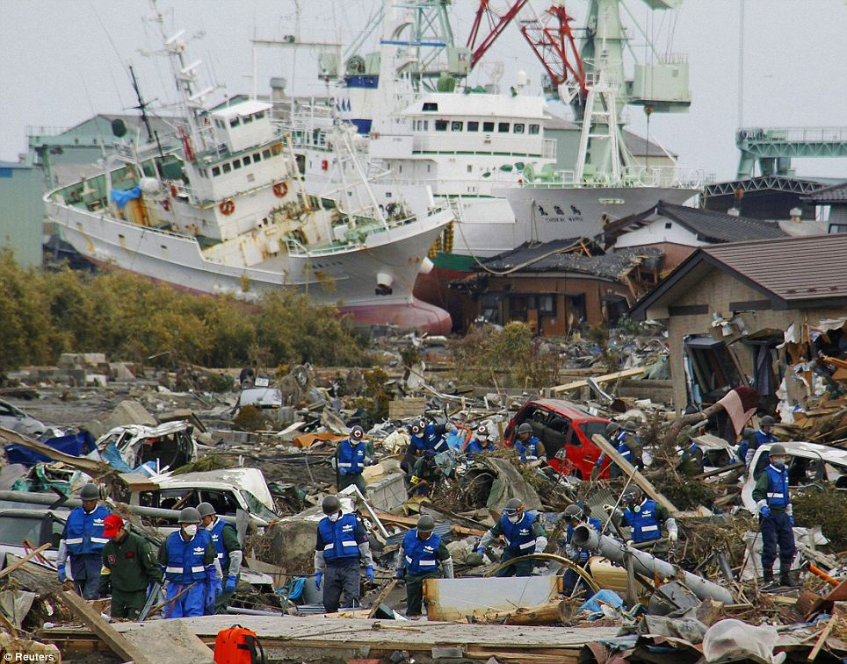
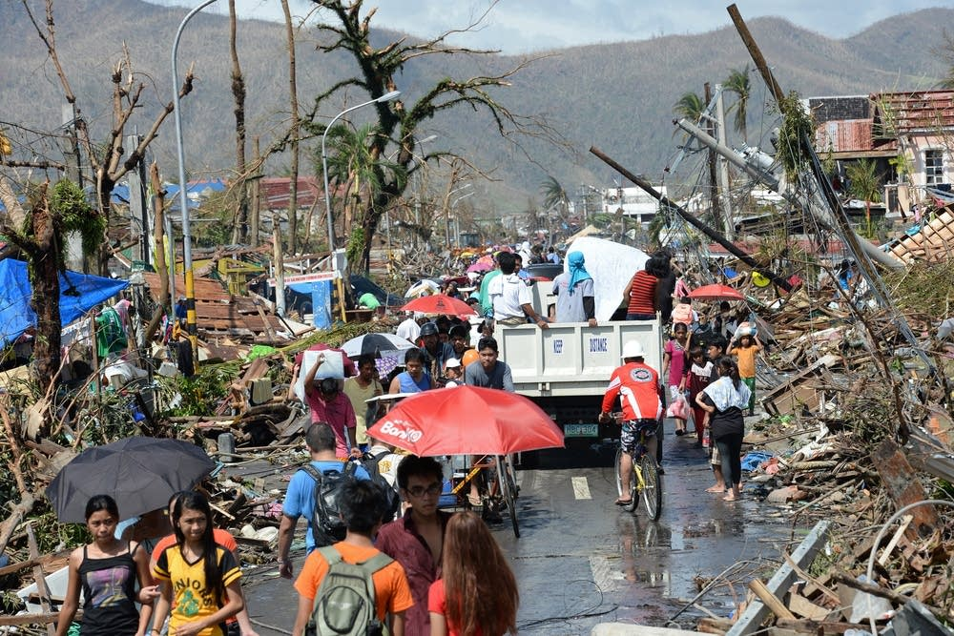
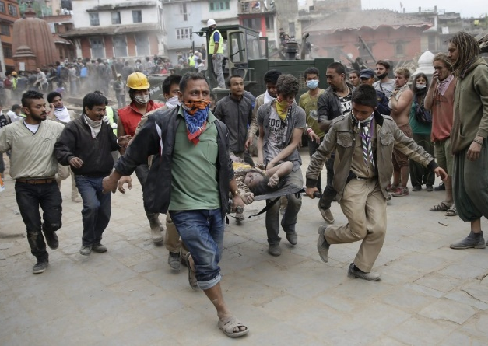
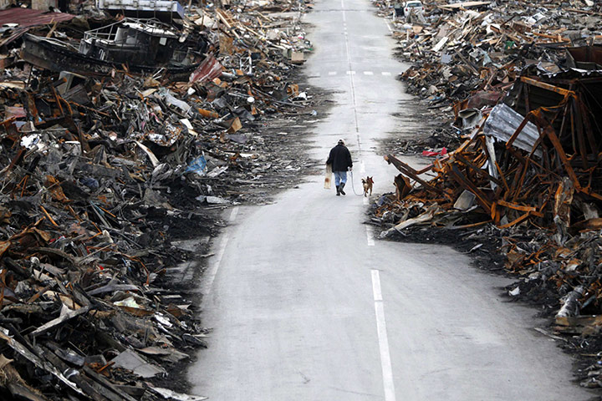
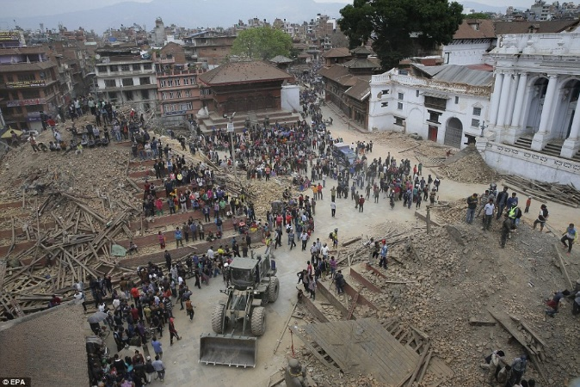
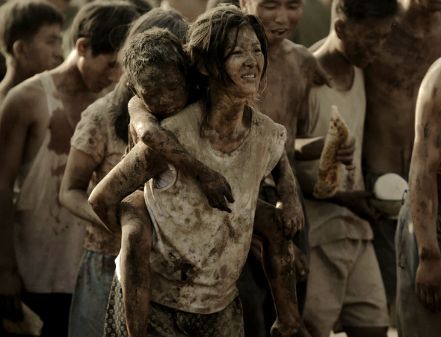
DEVASTATION
School of Built Environment

Slide 12
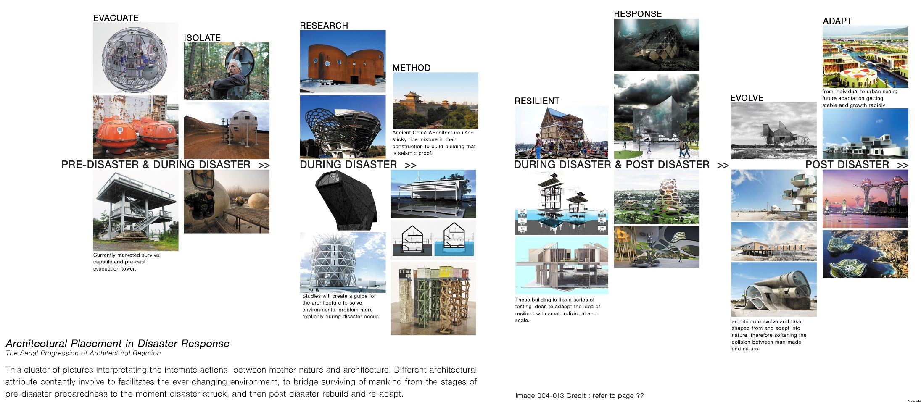
School of Built Environment
Cy Heng, (Nov, 2016) Doomsday Rehearsal-Master of Architecture, Master Dissertation

Slide 13
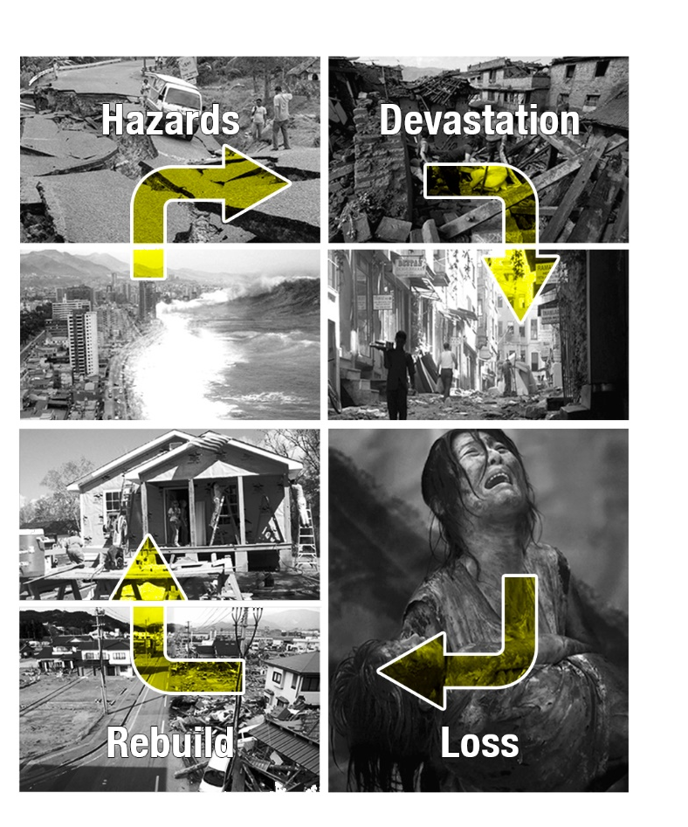
The Cycle of Problem
School of Built Environment
the power of the mother nature is not allowed to be challenged. It's uncertain level of threat to our homeland causing our loss and constantly rebuilt. When we're recovering and there might be always another waves of devastation are reaching us soon. This is the ‘Cycle’ and we can only accept the truth.
This research established from there to express my concerned of this helplessness matter.

Slide 14
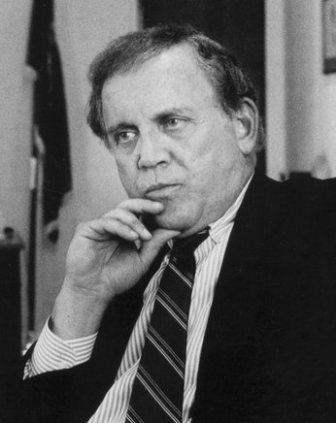
School of Built Environment
‘if you have major disaster involving hundreds of thousands or in this case million of peoples , whether it be a natural disaster or an act of terrorism, the first 72 hours are going to be totally chaotic no matter what you plan to do.” (Warren Rudman, 2014)

Slide 15
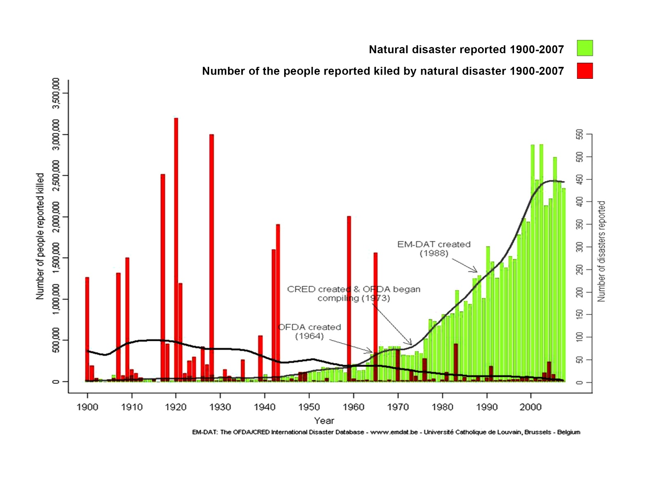
School of Built Environment
Capacity to handle hazards has increase: technology, education and international awareness improved which means countries are more able and set up to cope. (Geog.W, 2015)
Source: OFDA/CRED, EM-DAT (2015) Centre for Research on the Epidemiology of Disasters (CRED)_Emergency Events Database_Université catholique de Louvain, Brussels Belgium.

Slide 16

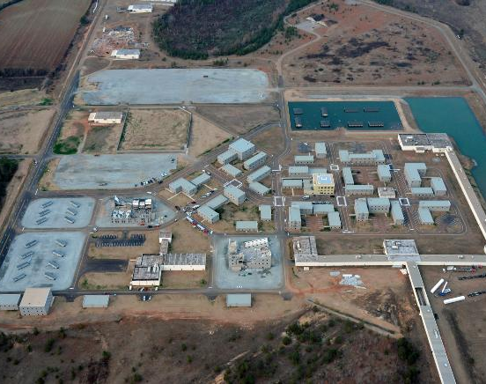
Precedent 1
School of Built Environment
Precedent 2
Tokyo Rinkai Disaster Prevention Park
Guardian Centers of Georgia Perry
Source:Rinkai Disaster Prevention Park https://blogs.yahoo.co.jp/whfsc363/GALLERY/show_image.html?id=65107321&no=14
Source:GC Guardian Centre
https://guardiancenters.com/

Slide 17
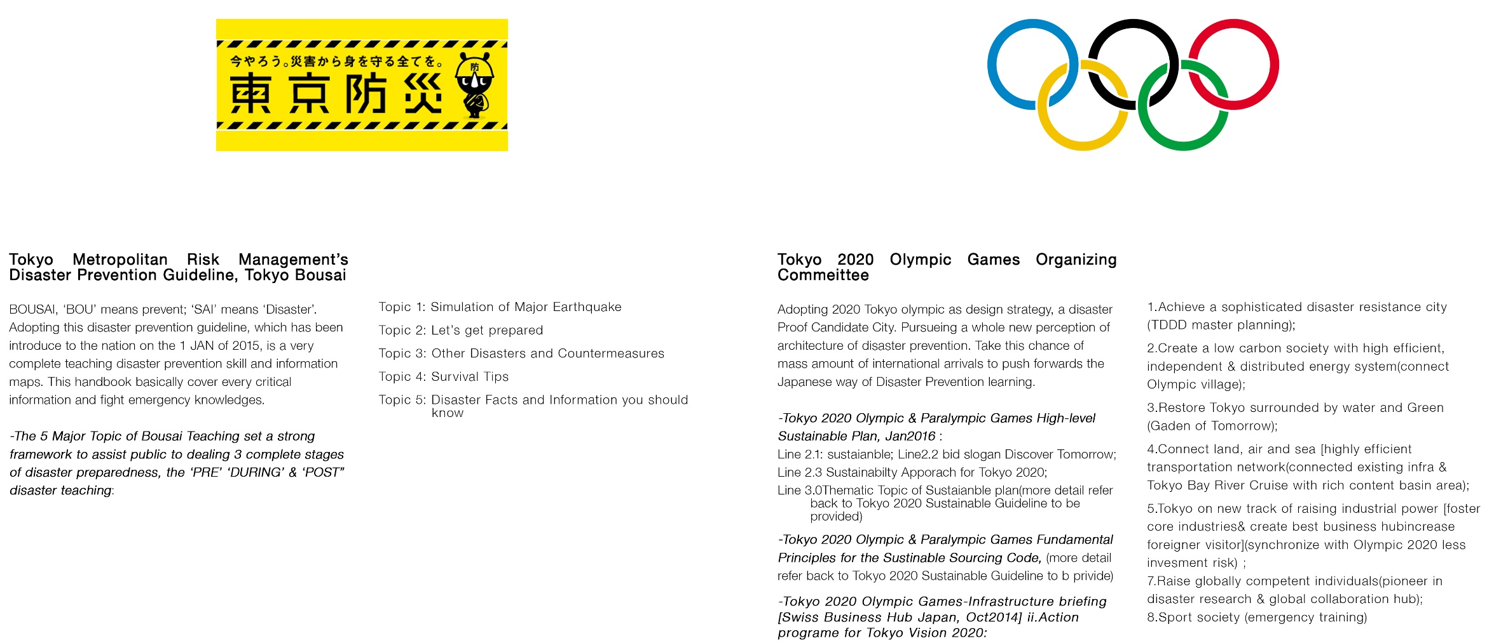
Feasibility & Research tructure alignment
School of Built Environment

Slide 18
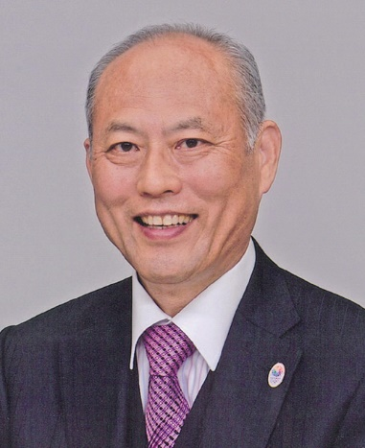
Tokyo Disaster Prevention Plan
-Becoming the World’s Safest, Most Secure City-
School of Built Environment
Risk management is the year 2020 as one end point, this plan (Tokyo Disaster Prevention Plan) wothe practice of envisioning the worst case scenario, then ensuring everything possible is done to prepare. Taking risk backwards from there to lay out a clear road map for need to be done. (Yoichi Masuzoe-Governor of Tokyo, 2014)

Slide 19
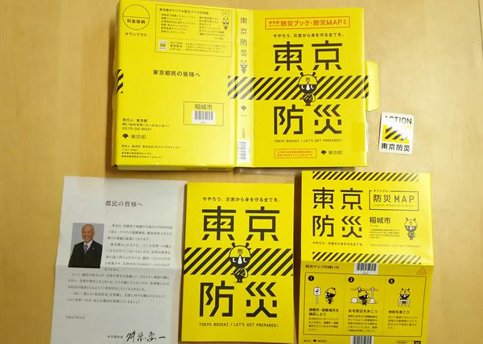
Feasibility & Research tructure alignment
School of Built Environment
implement emergency preparedness education as a compulsory school learning and living knowledge.
designated platform to widely spread an appropriate disaster prevention education.
once in a right time to advocate disaster awareness and prevention.
Source:Tokyo Metropolitan Government (2015) Disaster Preparedness Tokyo /Tokyo Bousai-http://www.metro.tokyo.jp/ENGLISH/GUIDE/BOSAI/

Slide 20
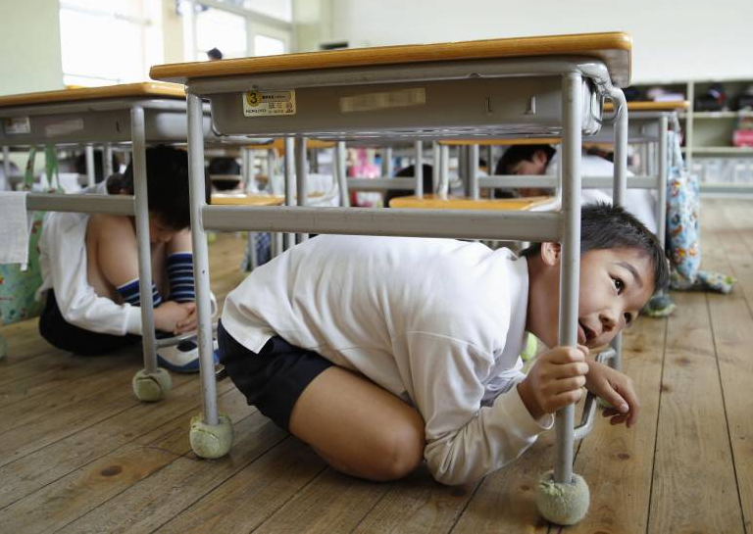
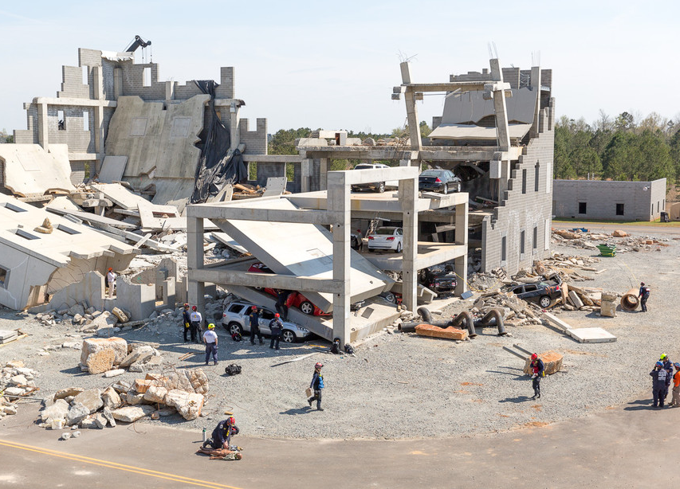
Awareness
School of Built Environment
1st September Disaster Prevention Day (防災の日 bousai no hi).
proactive learning in action, familiarity in hazardous condition to minimize the possible of cause danger from our daily surrounding.
Rehearsal (practice in action)
designated platform to develop common safety knowledge & interact and understand the role of aid
practice make perfect.

Slide 21
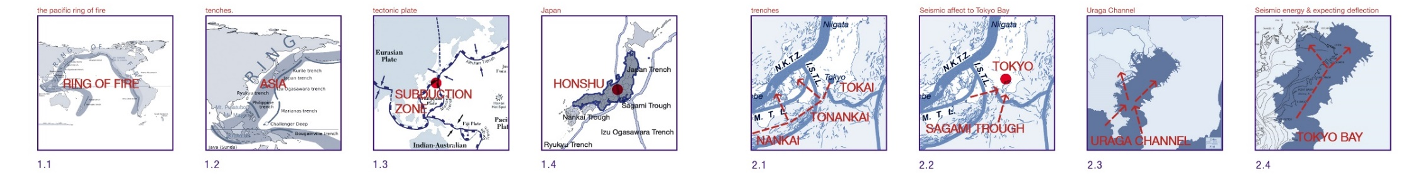
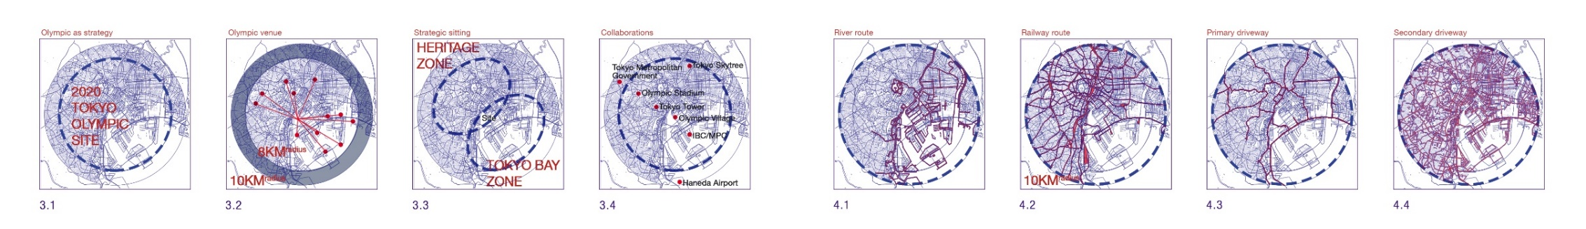
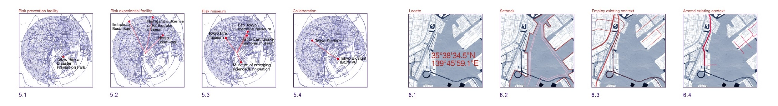
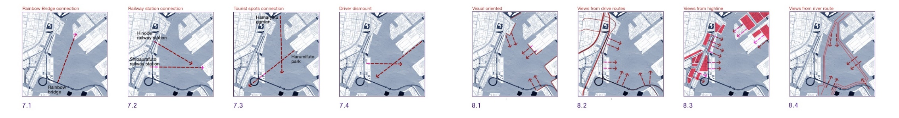
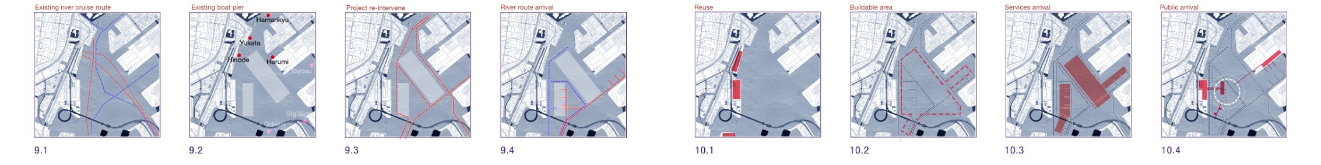
Doomsday
Rehearsal
Outcome(Phase 1)
Bousai
Re-introduction
School of Built Environmen
Choon Yong HENG
Cyong@hessellstudio.com

Slide 22
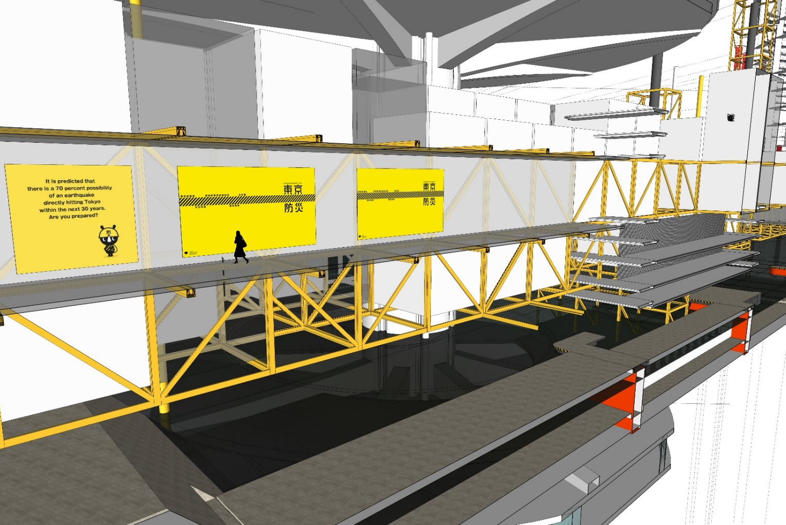
Hypothesis
School of Built Environment
peoples design ‘safe architecture’ then architecture design ‘safe people’. (vise versa)
architecture are capable to bring disaster prevention education, research, and disaster prevention training together.
architect create immersive experience and enable great knowledge penetration.
gather and catalyze knowledge transition and allowed research expression.
Cy Heng, (Nov, 2016) Doomsday Rehearsal-Master of Architecture, Master Dissertation

Slide 23
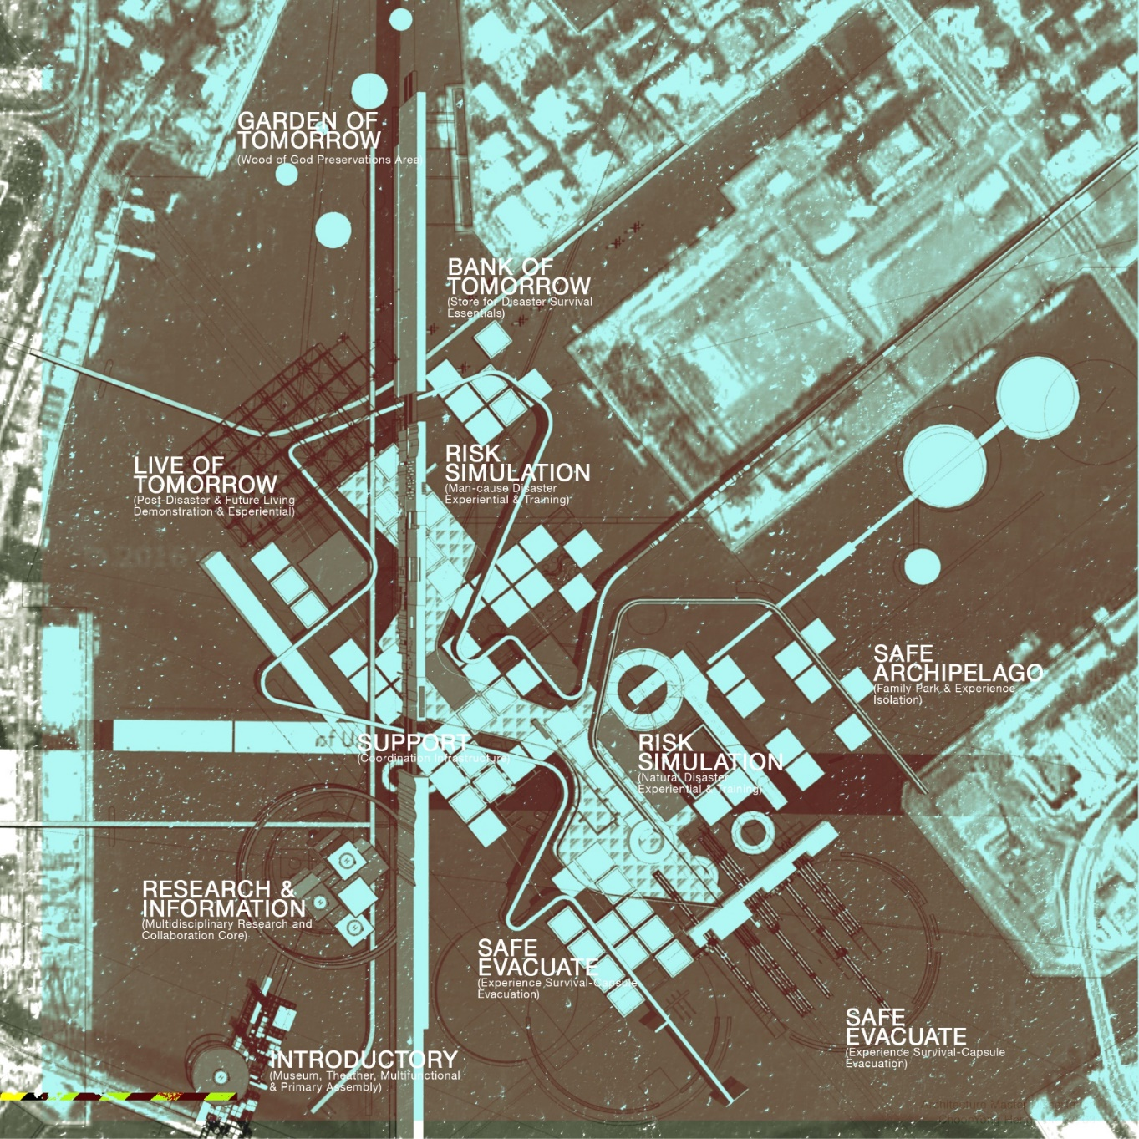
Hypothesis
School of Built Environment
2020 Tokyo Olympics as the Year of Disaster Prevention Global Classroom.
unique and effective disaster prevention learning experience & information exchange.
celebrate 2020 Tokyo Olympic in another level high up and thematically significant.
“A Disaster Proof Candidate City” & “ Discover tomorrow”
Cy Heng, (Nov, 2016) Doomsday Rehearsal-Master of Architecture, Master Dissertation

Slide 24
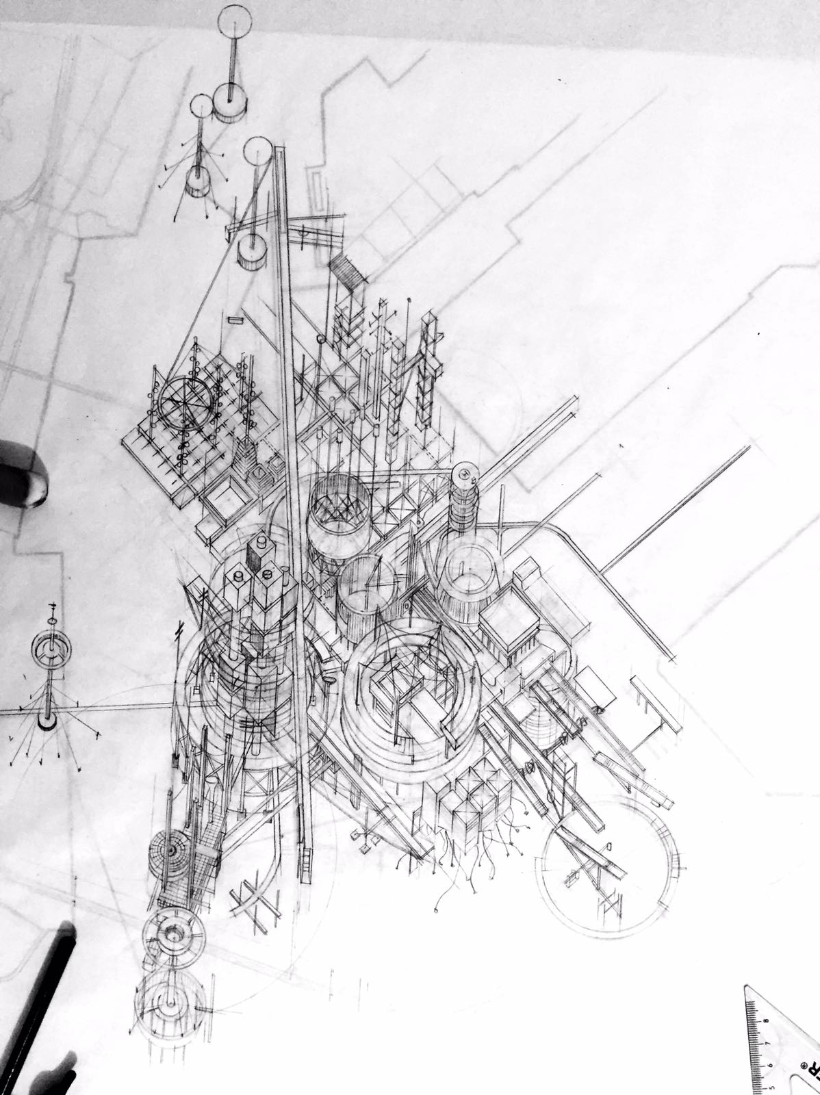
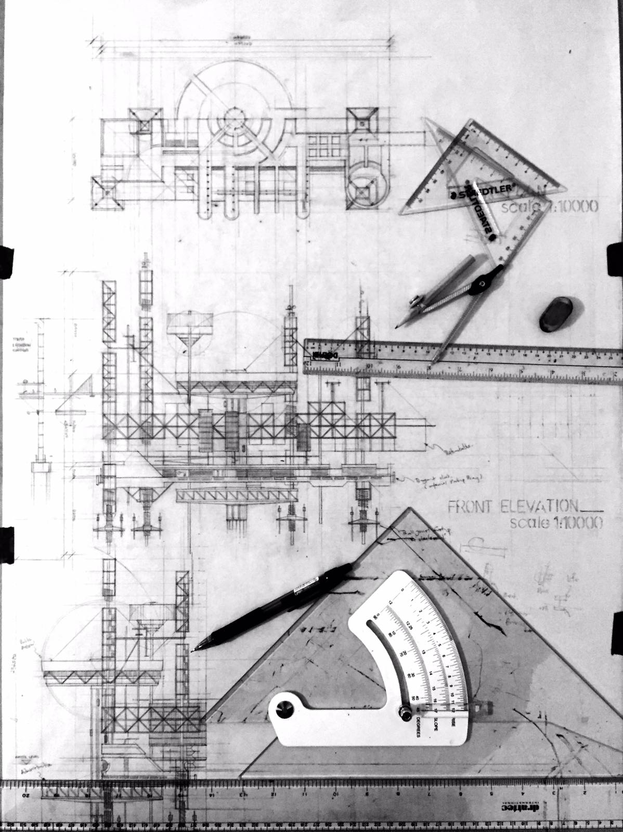
Doomsday
Rehearsal
Methodology
Design expression
School of Built Environmen
Choon Yong HENG
Cyong@hessellstudio.com

Slide 25
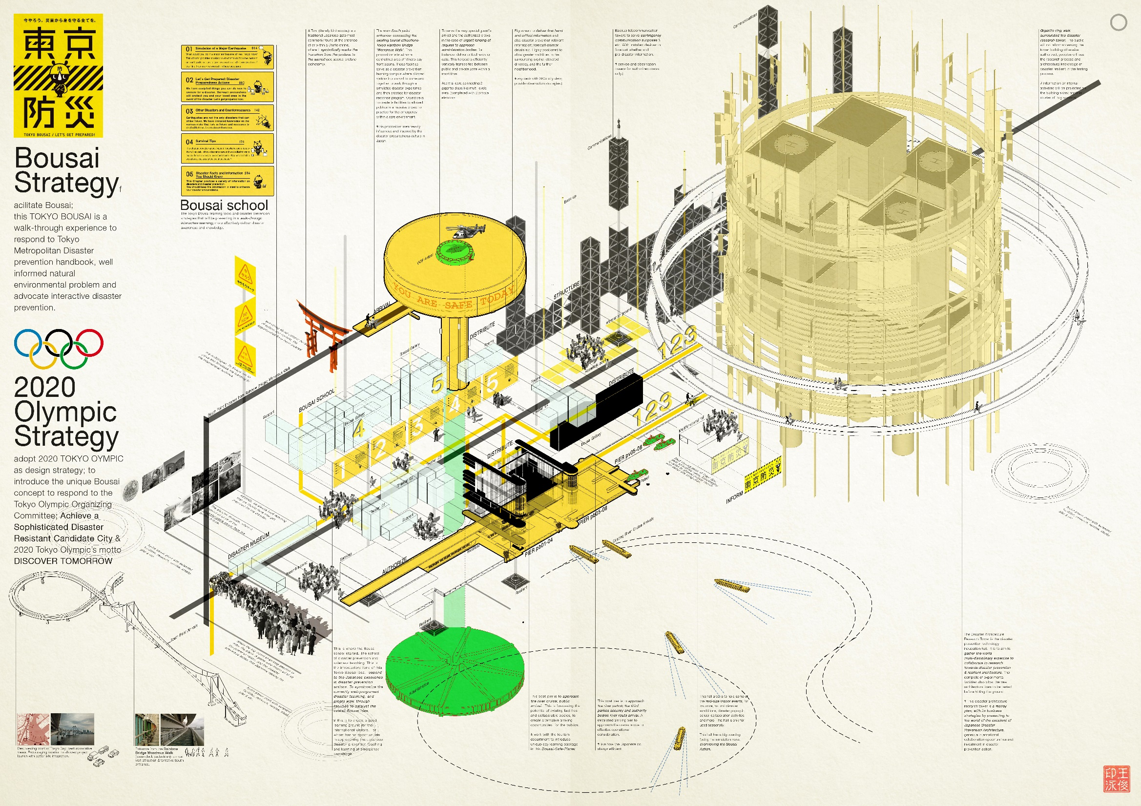
Doomsday
Rehearsal
Outcome(Phase 1)
Bousai
Re-introduction
School of Built Environmen
Choon Yong HENG
Cyong@hessellstudio.com

Slide 26
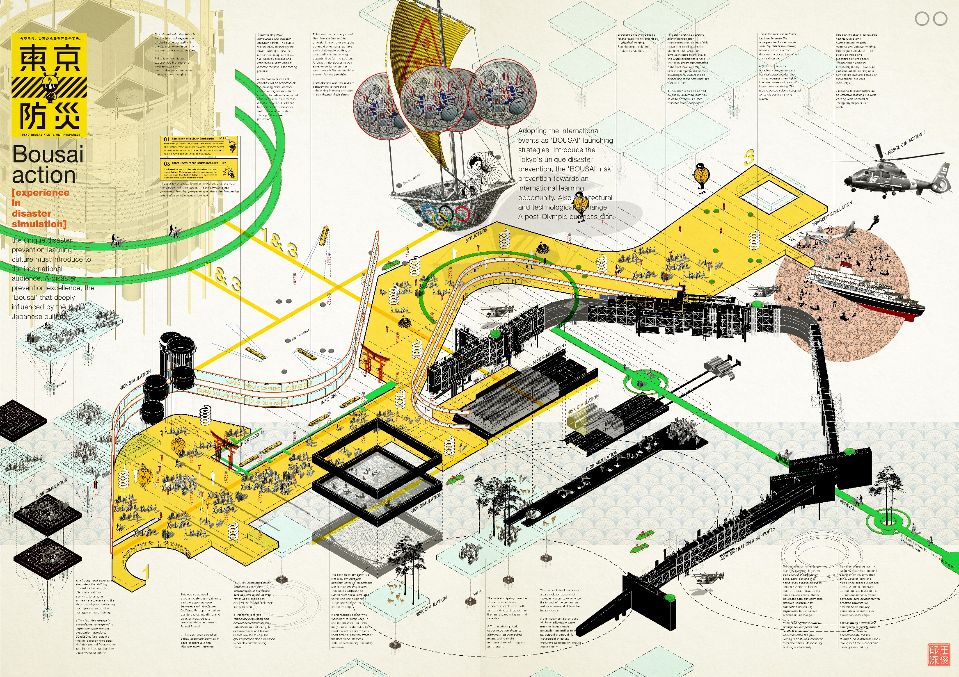
Doomsday
Rehearsal
Outcome(Phase 2)
Bousai Experience
School of Built Environmen
Choon Yong HENG
Cyong@hessellstudio.com

Slide 27
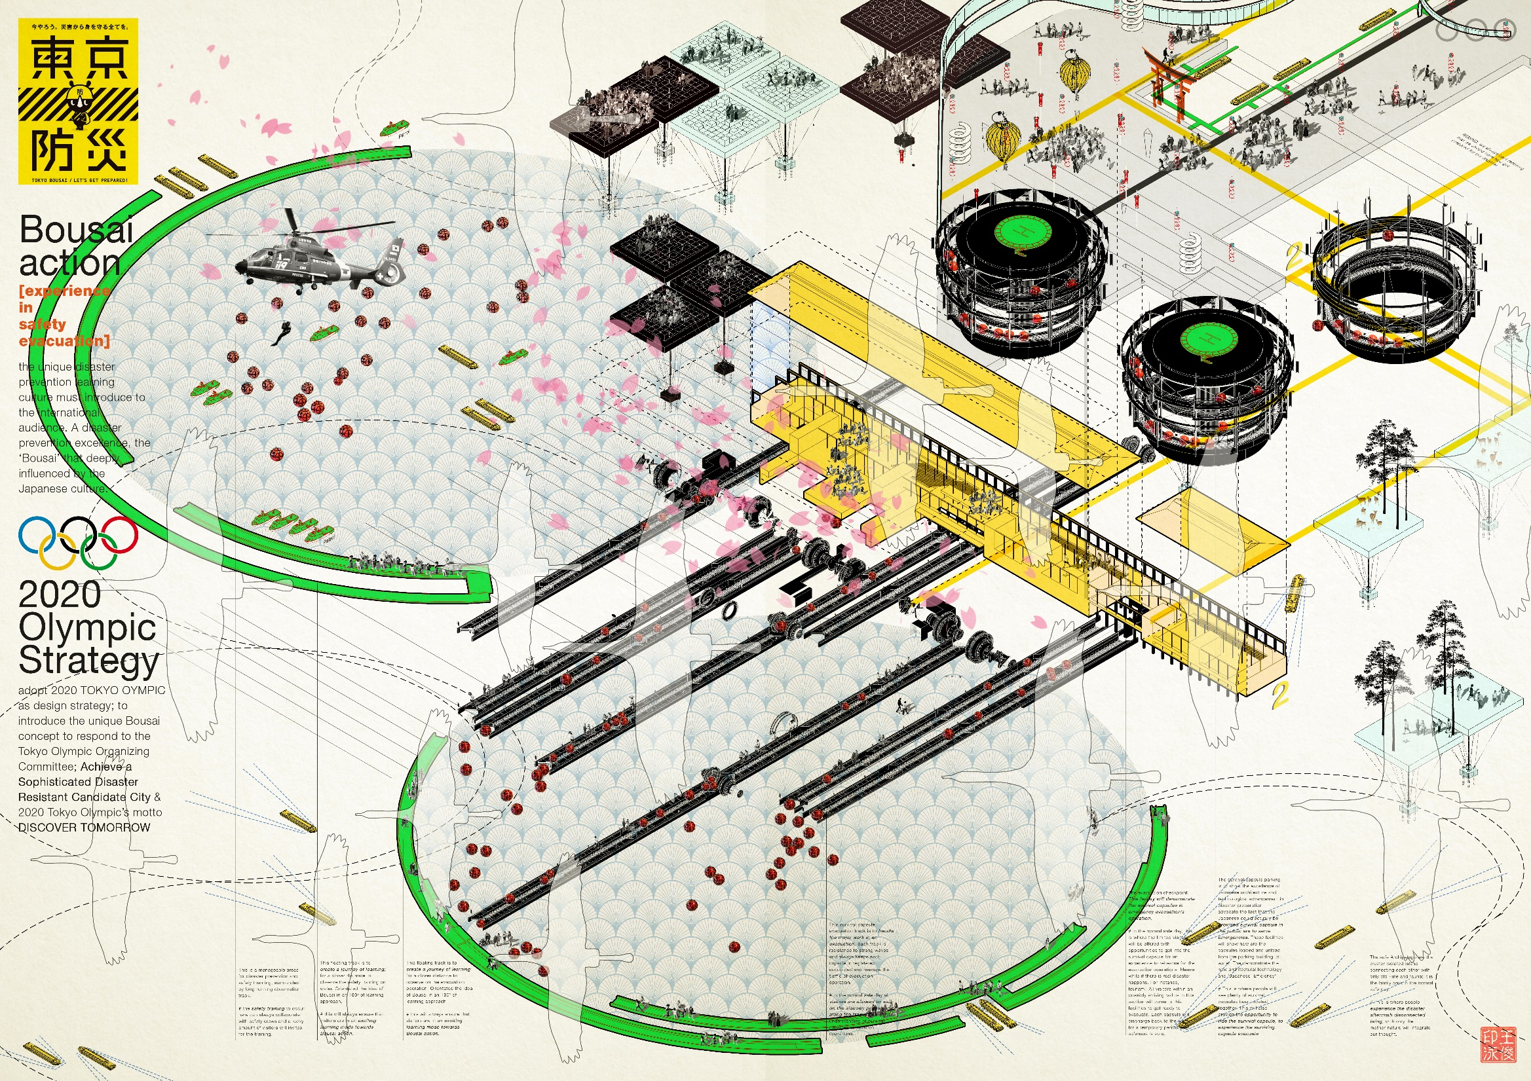
Doomsday
Rehearsal
Outcome(Phase 3)
Bousai
Safety Training
School of Built Environmen
Choon Yong HENG
Cyong@hessellstudio.com

Slide 28
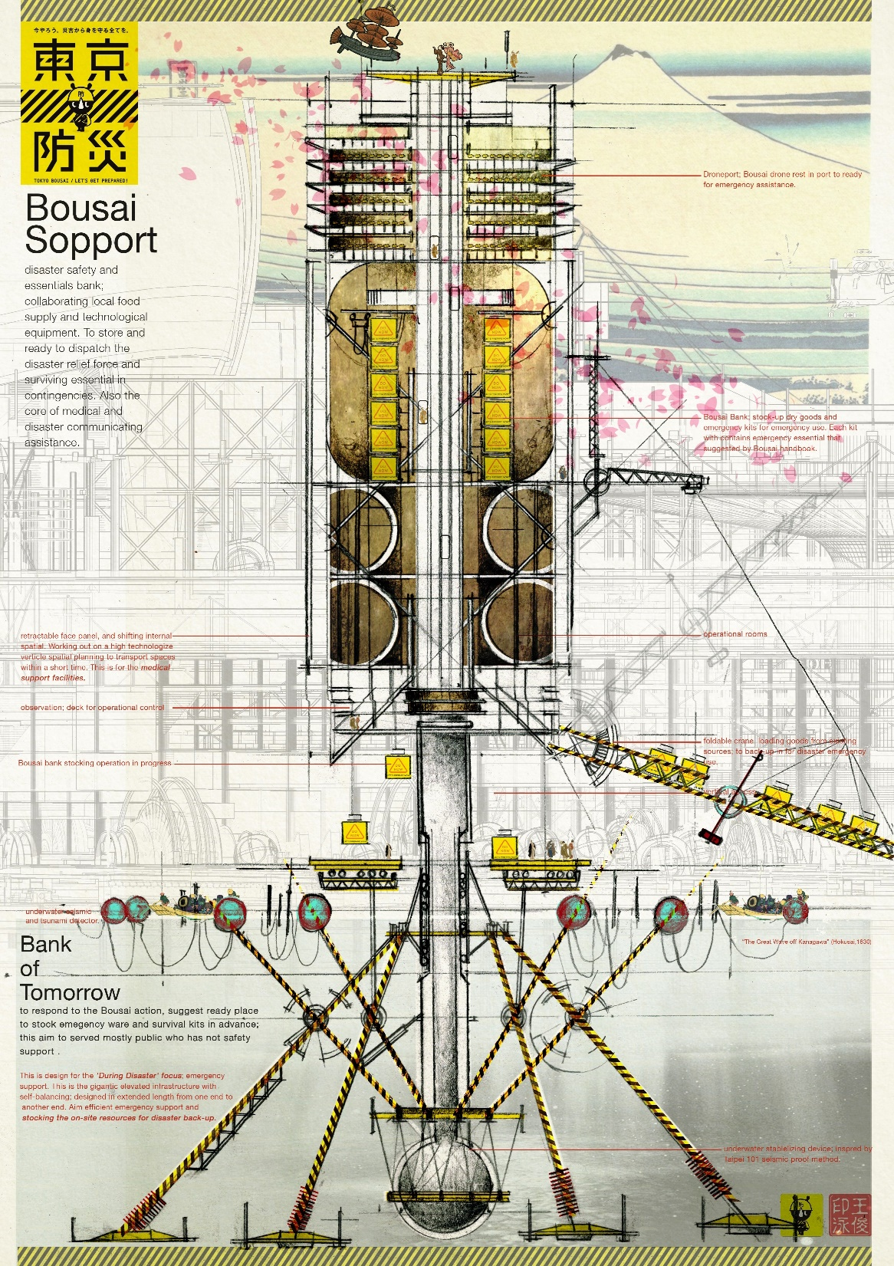
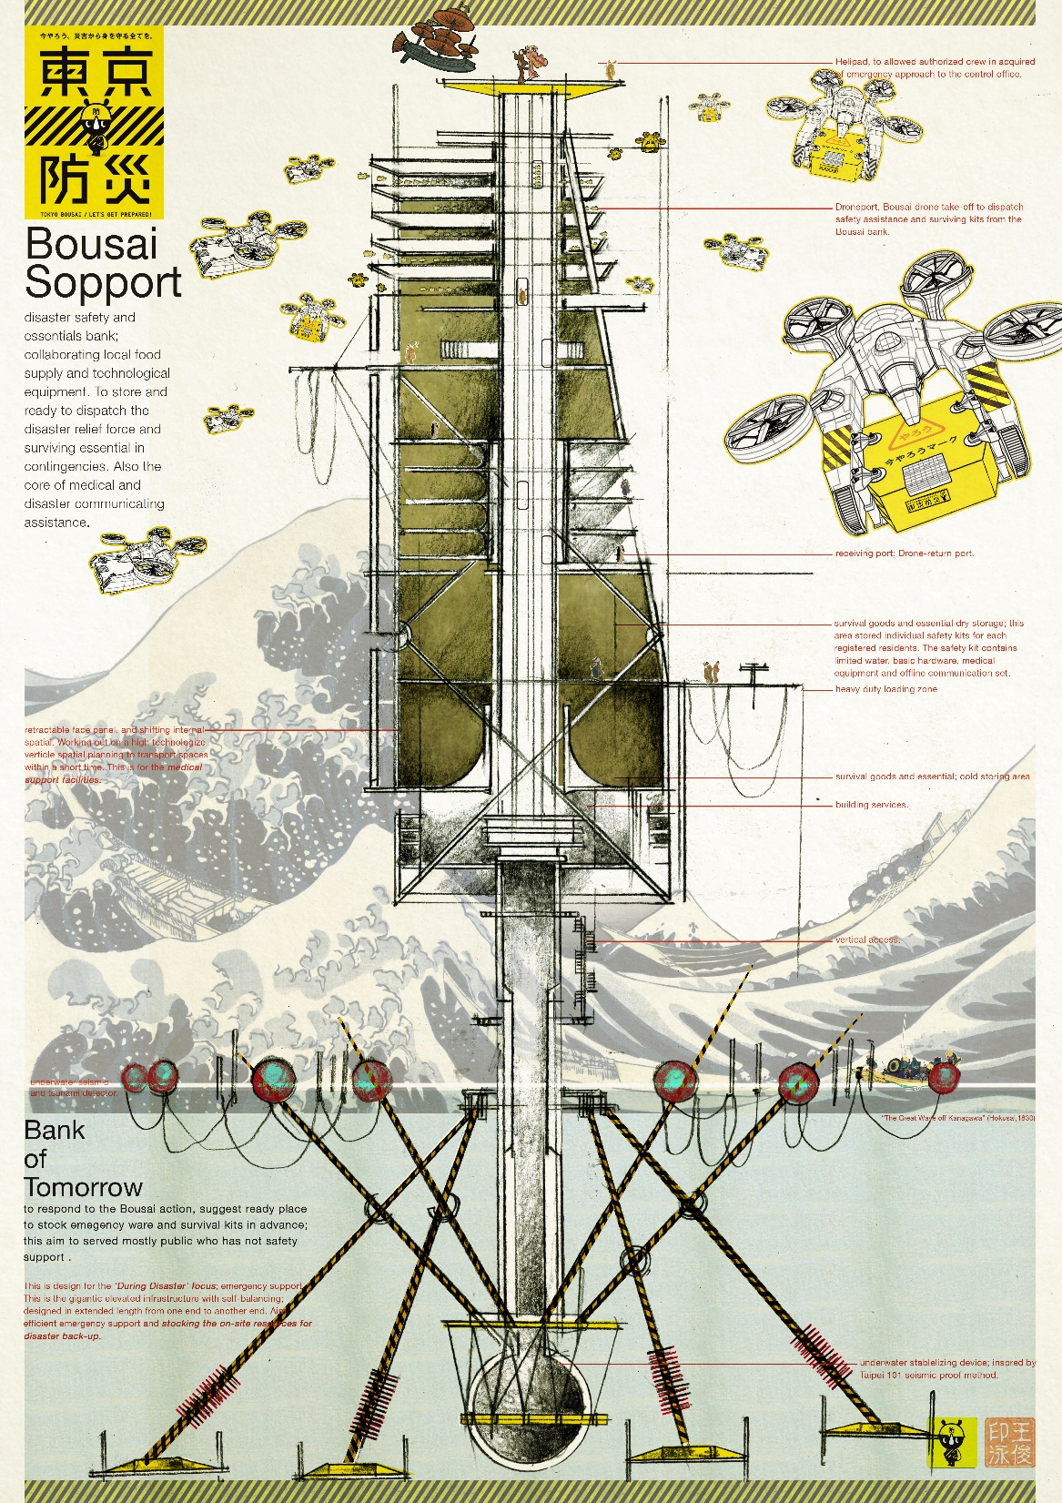
Doomsday
Rehearsal
Outcome(Phase 4)
Bousai
Safety Training
School of Built Environmen
Choon Yong HENG
Cyong@hessellstudio.com

Slide 29
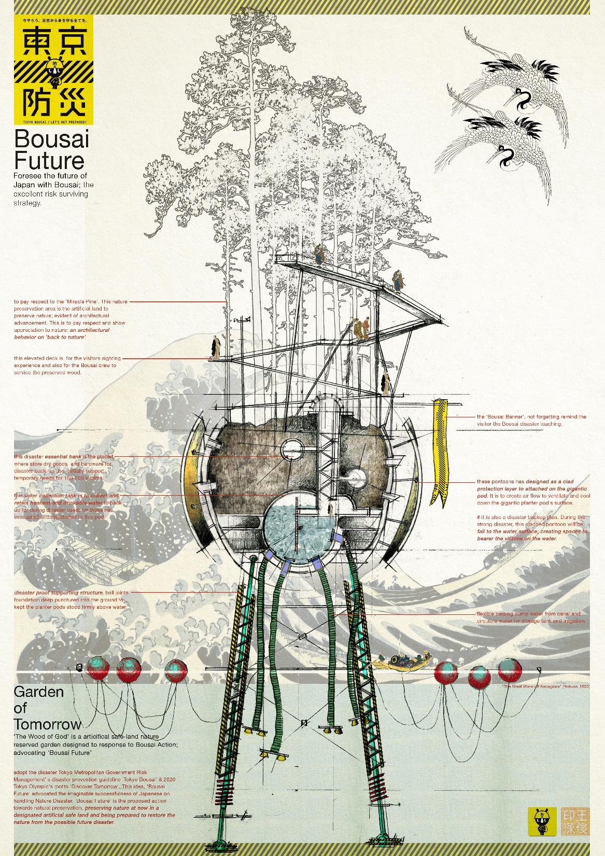
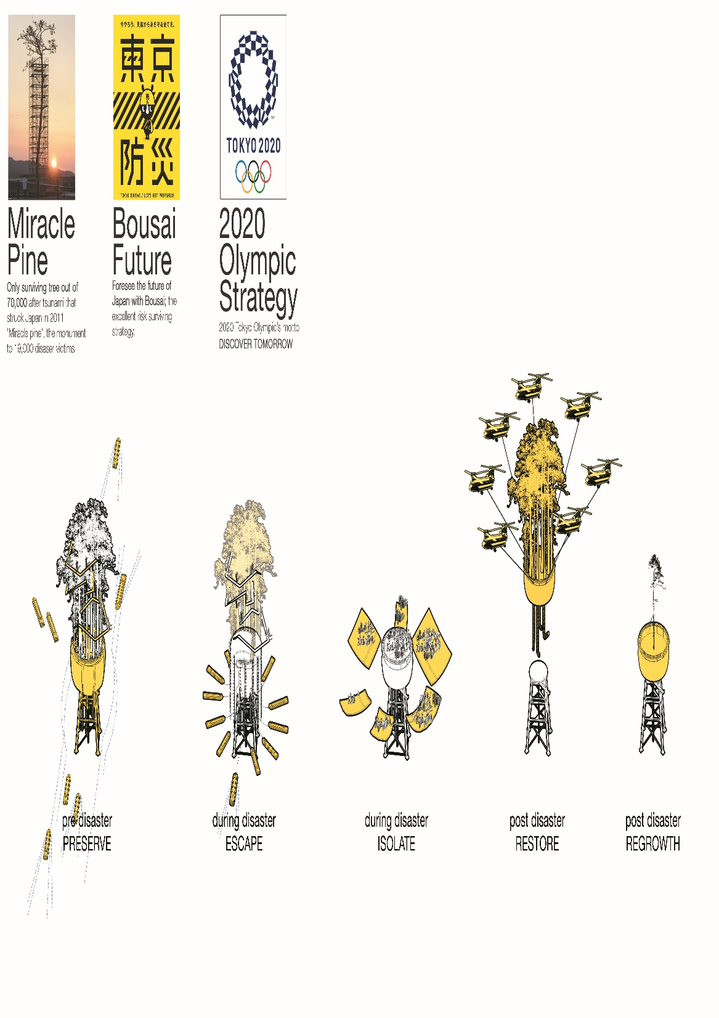
Doomsday
Rehearsal
Outcome(Phase 5)
Bousai
Safety Training
School of Built Environmen
Choon Yong HENG
Cyong@hessellstudio.com

Slide 30

School of Built Environment
There is no harm in hoping for the best as long as you’re prepared for the worst
(Stephen King, 1982)

Slide 31


Doomsday
Rehearsal
Outcome
School of Built Environmen
Choon Yong HENG
Cyong@hessellstudio.com

Slide 32

WHAT do we looking forwards?
School of Built Environment
familiarity in reacting contingencies (scalable reaction)
  contingency decision (from individual to the crowd)
  everyone have the ability on giving basic aid and helps
pre-disaster education to expect a significant result in reducing disaster casualties.
global synchronization of disaster awareness, in regardless of geographical context.
Cy Heng, (Nov, 2016) Doomsday Rehearsal-Master of Architecture, Master Dissertation

Slide 33
School of Built Environment
Tokyo Disaster Prevention Plan (Dec 2014)
In the midst of these efforts, Tokyo was selected to host the 2020 Olympic and Paralympic Games, While the success of the games is of course important, it is also important that Tokyo take advantages of this opportunity to achieve its goal of becoming the greatest city in the world. Disaster preparedness measures are one of the foundation on which a city’s safety and security are built. (TMG, 2014)

Slide 34
Reference
School of Built Environment
Tokyo Metropolitan Government (2015) Disaster Preparedness Tokyo /Tokyo Bousai
Janette K, Erik C, Micheal O (2015) The Underdome Guide to Energy Reform. Chapter 4, Risk pg144 – pg176.
TOCOG, JOC (2016) Tokyo 2020 Olympic and Paralympic Games Fundamental Principles for the Sustainable Sourcing Code. pg4.
TOCOG, JOC (2016) Tokyo Olympic and Paralympic Games High-Level Sustainability Plan pg1 - pg11.
Swiss Business Hub Japan (2014) Tokyo 2020 Olympic Games –Infrastructure Briefing pg3 – pg8.
http://blog.omy.sg/chrispytine/2010/07/27/aftershock-a-guaranteed-tear-jerker/ -by Chrispytine; 27JUL2010
https://www.quora.com/Why-are-Indians-so-wrongly-depicted-in-Hollywood-movies- by Rob Carnevale; 2012
Tokyo Metropolitan Government (2015) Disaster Preparedness Tokyo /Tokyo Bousai-http://www.metro.tokyo.jp/ENGLISH/GUIDE/BOSAI/
OFDA/CRED, EM-DAT (2015) Centre for Research on the Epidemiology of Disasters (CRED)_Emergency Events Database_Université catholique de Louvain, Brussels Belgium.
Cy Heng, (Nov, 2016) Doomsday Rehearsal-Master of Architecture, Master Dissertation
Rinkai Disaster Prevention Park-https://blogs.yahoo.co.jp/whfsc363/GALLERY/show_image.html?id=65107321&no=14
https://guardiancenters.com

