Slide 1
Enterovirus 71: Candidates for Vaccines and Antivirals
Chit Laa Poh* and Isabel Ng
Sunway University, Bandar Sunway, Kuala Lumpur
Malaysia

Slide 2
Enterovirus 71: Candidates for Vaccines and Antivirals
Clinical Manifestations of Enteroviruses
Enteroviruses Clinical symptoms
Poliovirus 1 to 3 Paralysis
Coxsackievirus A5, A6, A8, A10, A16 Hand, Foot & Mouth
Enterovirus 71 Disease (HFMD)
Enterovirus 68 Respiratory Disease
Coxsackievirus A24, EV70 Acute hemorrhagic
conjunctivitis
Coxsackievirus B3 Myocarditis

Slide 3
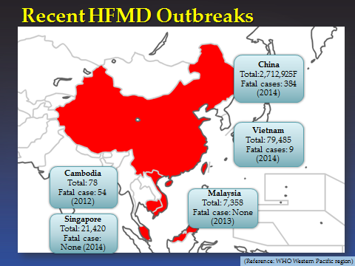
Enterovirus 71: Candidates for Vaccines and Antivirals

Slide 4
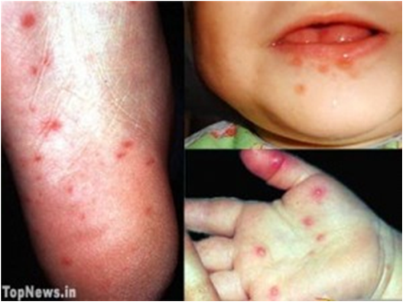
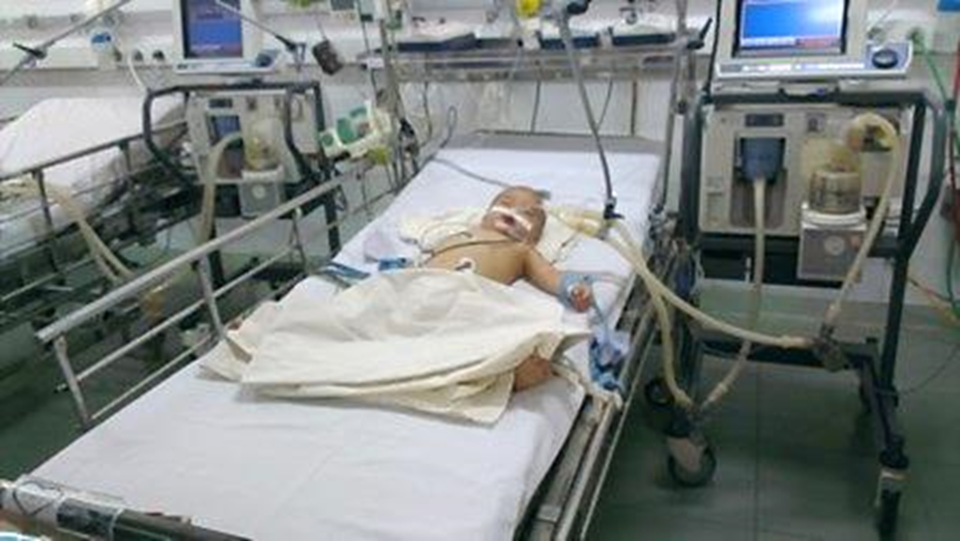
Enterovirus 71 (EV71)
Mild symptoms
High fever, vomiting, rashes & ulcers in the mouth, commonly affecting children & infants (<5 years old).
Severe symptoms
Aseptic meningitis, acute flaccid paralysis
Brainstem & cerebellar encephalitis, leading to cardiopulmonary failure & death.

Slide 5
Clinical Management
Currently, no approved Vaccine to prevent or Antiviral to treat HFMD.
Clinical management : Supportive
Uncomplicated HFMD/Herpangina – Paracetamol, adequate fluid intake.
Aseptic Meningitis/Brainstem encephalitis-Paracetamol, oxygen and IVIG and vital signs monitoring.
HFMD with Autonomic Nervous System(ANS) Dysregulation stage-Judicious intravenous fluid therapy, IVIG, Milrinone or Dobutamine.
HFMD with Cardiopulmonary Failure- Judicious intravenous fluid therapy, mechanical ventilation, Milrinone, Dobutamine, IVIG

Slide 6
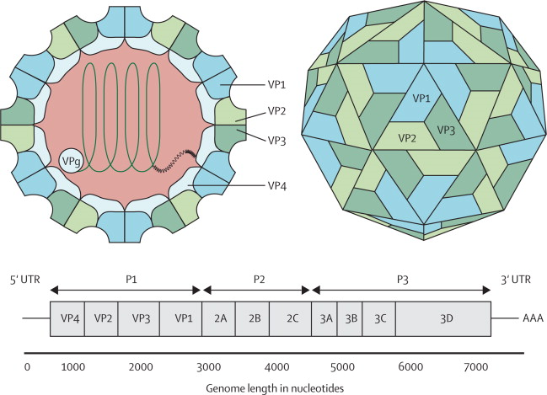
Enterovirus 71

Slide 7
Genotypes and Subgenotypes of Enterovirus 71 (EV-A71)
Genotype A- Prototype BrCr strain (1970)
Genotype B - 5 subgenotypes
B1, B2, B3, B4 and B5.
Proposed new Genotypes B 6 and B7
Novel B0 circulating in Netherlands (1963-1967)
Genotype C- 5 subgenotypes
C1, C2, C3, C4 and C5.
Proposed new subgenotype C6
Proposed Genotype D- C4b (D1a) and C4a (D1b)
Nucleotide sequence divergence between Genotypes - 17-22% (Avg. 18.99%)
Nucleotide sequence divergence for inter-subgenotypes is 12%
Nucleotide sequence divergence for intra-subgenotype is 3.9%

Slide 8
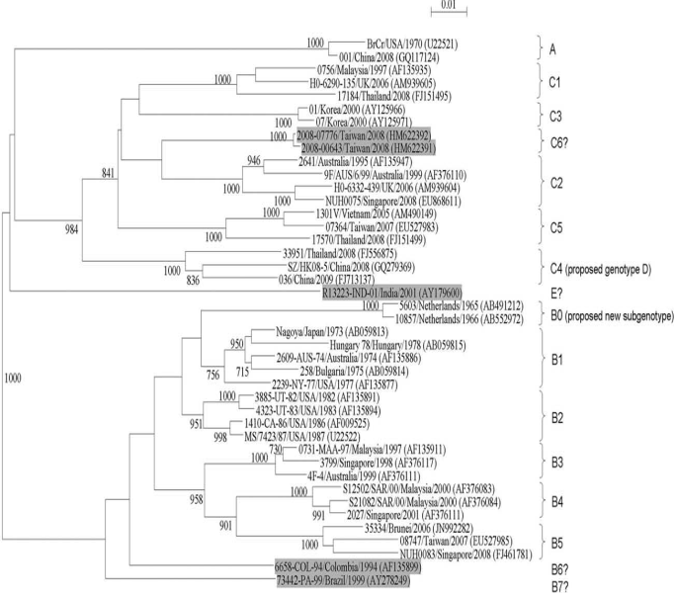
Phylogenetic Tree of EV-A71

Slide 9

Distribution of EV71 genotypes throughout the world from 1997 to 2010
 | 1997 | 1998 | 1999 | 2000 | 2001 | 2002 | 2003 | 2004 | 2005 | 2006 | 2007 | 2008 | 2009 | 2010
Malaysia | C1,C2,B3,B4 | C1 | C1, B4 | B4,C1 |  | C1, B4 | B5,C1B4 |  | B5,C1 | B5
Singapore | B3,B4 | B3,C1 | B3 | B4, B5 | B4 | B4,C1 |  |  |  | B5 |  | B5, C2
Taiwan |  | B3,C2,C4 | B4 | B4 | B4, C4 | B4,C4 | B4 | C4 | C4 | C5 | B5,C5 | B5, C4, C5 | B5 | C4
Japan | C2,C4B3,B4 | C2 | C2 | C2,B4 | C2 | B4,C2,C4 | C4,C1B5, B4 | C4 |  | C4 | C4
China | C2 | C4 | B3,C1C4 | C1, C4 | B4, C4 | C1, C2,C4 | C2, C4 | C4 | C2,C4 | C2,C4 | C2,C4 | A,B5C2, C4 | C2, C4 | C2, C4
Vietnam |  |  |  |  |  |  |  |  | C1,C4C5
Australia |  | C2 | B3,C2 | B4,C1 | B4,C1 | C1 | C1 | C4
Korea |  |  |  | C3 |  |  | C4 |  |  |  |  |  | C2, C4
Holland | C1,C2 |  | C2 | C2 | C1 | C1, C2 |  | C1,C2 | C1, C2 |  | C1, C2 | C2
United Kingdom | C2 | C1, C2 | C2 | C1 | C1 | C1 |  | C1 | C1 | C1,C2 |  | C2
Kung YA, et al. (2014). Update on the development of enterovirus 71 vaccines. Expert Opin Biol Ther. 14:1455–1464.

Slide 10
Inactivated Vaccines against EV71
Organizations | Cell lines and EV71 vaccine strain | Clinical trials
 |  | Dosage (µg of EV71 antigen) | Population target | Current status
NHRI (Taiwan) | Vero cell & EV71 B4 sub-genotype (GMP-certified) | 5 and 10 | Young adults 20-43 y(60) | Phase 1 completed
Sinovac (China) | Vero cell & EV71 C4 sub-genotype | 1 | young children and infants 6-35 mo(10,245) | Phase 3 completed
Beijing Vigoo (China) | Vero cell & EV71 C4 sub-genotype | 0.8 | young children and infants 6-35mo(10,077) | Phase 3 completed
CAMS (China) | Human diploid cell KMB-17 & EV71 C4 sub-genotype | 0.25 | young children and infants 6-71 mo(12,000) | Phase 3 completed
Inviragen (Singapore) | Vero cell & EV71 B3 Sub-genotype | 0.3 and 3 | Young adults(36) | Phase 1 completed
Kung YA, et al. (2014). Update on the development of enterovirus 71 vaccines. Expert Opin Biol Ther. 14:1455–1464.
Notes:
http://www.sinovac.com/?optionid=786&auto_id=705 (papers of Sinovac). China govt has contributed USD 9.4 mil to set up pdtn facilities for Sinovac.

Slide 11
Key Features of Three EV71 vaccines
Vaccine Producer Beijing Vigoo Sinovac Biotech IMB, CAMS
Trial population 10245 10007 12000
Age (month) 6-35 6-35 6-71
Dosing 320 U 400U 100U
Immunization 0, 28 days 0, 28 days 0,28 days
Adjuvant Alum 0.18 mg Alum Alum
Viral strain FY7VP5/AH/CHN/2008 EV71 strain H07 An EV71 strain
(genotype C4a) (genotype C4a) (genotype C4a)
Seroconversion 91.7% (day56) 88.1(day56) 100%(day56)
VNA(GMT) 92(1y) 191(1y) 170(4 wk)
Vaccine Efficacy 90.0% 94.8% 97.4%
(EV71-Associated
HFMD
Vaccine Efficacy 80.4% 88.0% No data
(EV71-related
Disease)
The Chinese reference standard is 421.1U/µg. Seroconversion – 4 fold increase in baseline NT
Reference : Chong P, Liu CC, Chow YH et al.(2014) Review of Enterovirus Vaccines. CID.

Slide 12
Inactivated EV71 Vaccine
Require at least one booster dose as the NtAb titre decreased 50% after 6 months.
The anti-EV-A71 VNA of 1:16 is associated with protection against HFMD caused by EV-A71.
Protection against HFMD associated disease requires VNA of 1:32.
1year VNA 99% (>1:8) & 92%(>1:16)
Did the EV71 inactivated vaccine elicit antibody responses that cross-neutralized different EV71 sub-genotypes? Vaccinated with a C4a vaccine.
Zhang et al.(2014) showed that the VNA titres raised against C4a were higher against subgenotypes B4, B5, C2 and C5 than C4a.

Slide 13
Formalin-inactivated EV71 vaccine induced Cross-Neutralizing Antibodies in Taiwan
Phase I clinical Trial
Sixty adults were vaccinated with an inactivated EV71 sub-genotype B4 strain.
Induce strong cross-neutralizing antibody responses in >85% of vaccinees against sub-genotypes B1, B5, C4a.
Weak response against C4b and no VNA against C2.
Research focus on:
Cross protection against various pandemic strains
Monitor changes of EV71 epidemic strains
Chou,AH, Liu,CC and Chang JY et al.(2013) PLoS One 8(11): e79783

Slide 14
Disadvantages of Inactivated Vaccine
Inactivated vaccines only initiate humoral immunity and lacks cellular immunity (CD8⁺ T cells) responses
Research indicates that cellular immunity and not humoral immunity determines the clinical outcome of EV71 infections (Chang et al., 2006).
In most of the fatal cases, there were lower levels of cytokines & interferons (TNF-α, Th1 & IL-6).
There was no difference in the level of VNA titers between mild, severe and fatal cases.
Chang, et al. (2006). Status of cellular rather than humoral immunity is correlated with clinical outcome of enterovirus 71. Ped Res. 60:466–471.
Notes:
Fatal (severe cases with pulmonary edema)

Slide 15
Challenges for Inactivated Vaccine Registration
An ideal EV-A71 vaccine should be :
Inexpensive, safe, compatible with large scale production, easy to administer and acceptable by the parents.
Companies in the Asia Pacific lack the experience and expertise to take a new vaccine from research to product launch.
Data on culture medium and production systems are unavailable.
Roller bottle and cell factory technologies are easy to implement but labor intensive.

Slide 16
Manufacturing and Cost
Large scale production :
Explore the use of bioreactors, microcarriers and perfusion technology which could increase cell growth and virus yield.
Implement efficient downstream chromatographic purification step/s.
Routine immunization with a 70% efficacious EV-A71 vaccine which is sold at below USD25 per dose in developing countries.
Reference: Chong P, Liu CC, Chow YH et al. (2014)Review of Enterovirus vaccines. CID.

Slide 17
Monitoring Vaccine Safety and Applicability after Market Entry
No reported severe cases of vaccine related diseases and immune-pathological responses in Phase III trials involving over 30,000 infants and children.
Safety profiles need to be further evaluated in Phase IV clinical trials following market entry.
Selection and applicability of the current vaccine strain
(Current epidemic strains -C2, C4,C5, B4 and B5). Emerging new genotypes?
Co-administration with other EPI vaccines containing Poliovirus, Bordotella pertussis, Haemophilus influenza type B, diphtheria toxoid and tetanus toxoid to see the interactions between EV-A71 vaccine and other EPI vaccines in future clinical trials.

Slide 18
Future Perspective of EV-A71
Vaccine Research
HFMD caused mainly by CV-A16 and EV-A71.
Number of severe cases and deaths caused by CV-A16 are lower than EV-A71.
HFMD in China :10,714,237 survivors and 3046 deaths (2008-2014), with a fatality rate of 0.03%.
The FI-EV-A71 vaccine is ineffective against CVA16.
There is a push to develop a bivalent EV-A71 and CVA-16 vaccine.
However, there is need to carry out molecular epidemiological analysis .
Xu showed that in Shanghai, China (May 2010-April, 2011)
EV-A71 (63.8%), CA10 (9.0%), CA6(8.3%), CA16(6.9%),CA12(2.4%) and CA4(1.4%)

Slide 19
Future Perspective of EV-A71
Vaccine Research
For the FI-EV-A71 vaccine, there is a need to implement international standardization of vaccine quality control under WHO guidance.
NIFDC and National Institute for Biological Standards and Control(NIBSC) to develop EV-A71 vaccine quantitative standards for :
Neutralizing antibodies
Antigens
Cross-protective effects of vaccines –current genotypes and future epidemic strains
Relationship of genotype classification and antigenicity

Slide 20
Future Perspective of EV-A71
Vaccine Research
Virus Like Particles as EV-A71 vaccine
Zhang et al.(2015) reported high yield production of recombinant VLPs of EV-A71(150mgVLP/L)by Pichia pastoris.
Higher yield than VLPs produced by baculovirus/insect cell expression system (64.3 mg/L). Overall cost of insect cell culture is high.
Neutralizing titre of baculovirus formulated with CFA/IFA adjuvants is 1/160.
Neutralizing titre of the FI-EV-A71 formulated in alum is 1/640.
Some companies are currently evaluating the commercial potential of VLPs of EV-A71.

Slide 21
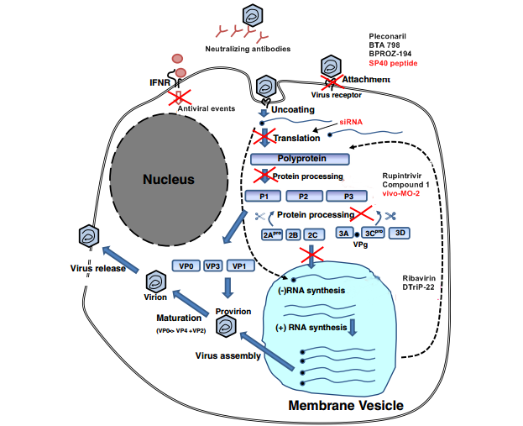
Development of Potential Antivirals

Slide 22
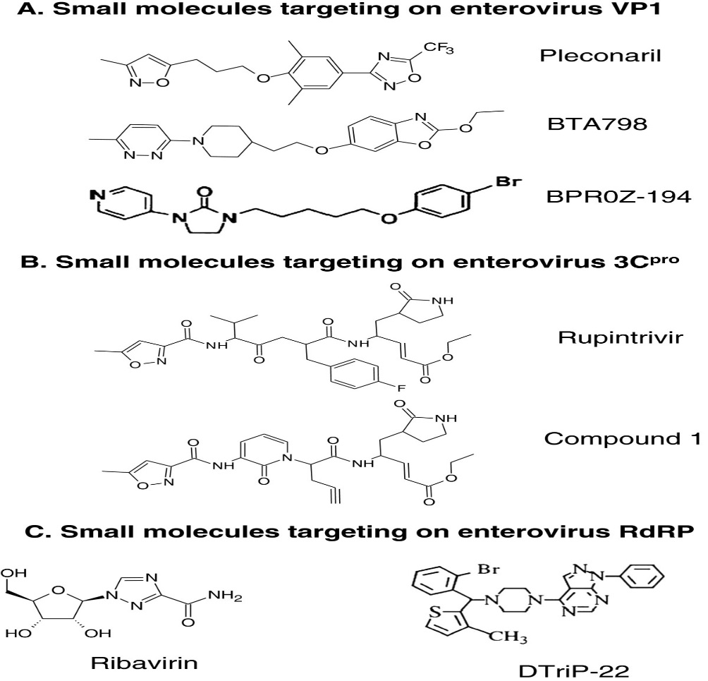
Potential Antiviral Agents

Slide 23
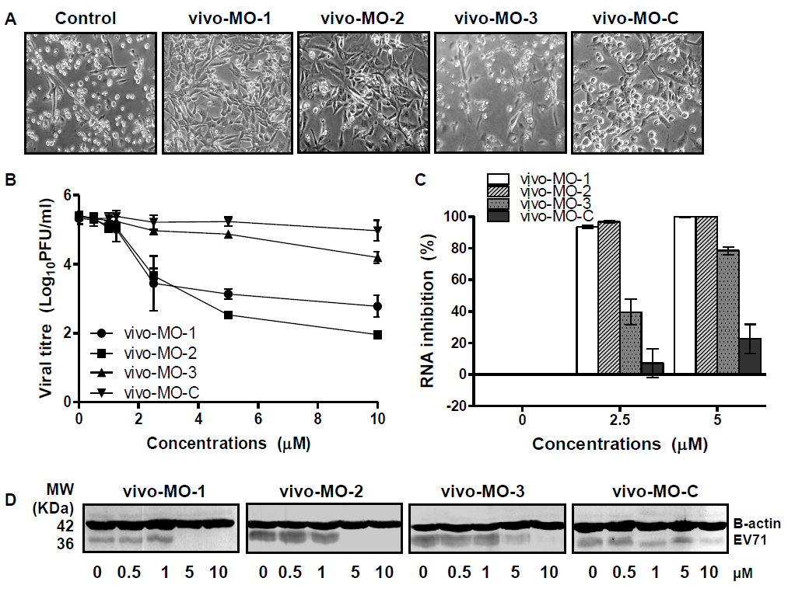
Development of Vivo-Morpholino Oligomers against EV-A71

