Slide 1


Activated glucocorticoid signaling promotes acinar-to-ductal metaplasia and Kras^{G12D} -driven tumorigenesis in pancreas
Chia-Ning Shen, Ph.D.
Genomics Research Center
Academia Sinica
Email: cnshen@gate.sinica.edu.tw

Slide 2
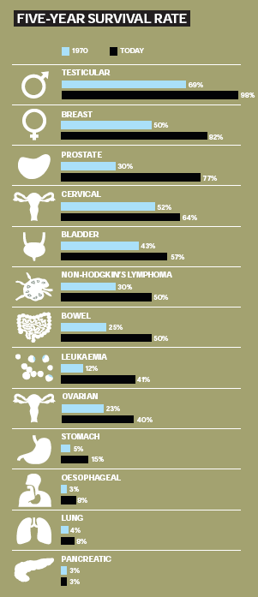
Pancreatic cancer
Deaths from Pancreatic caner rank 4th ~5th in most developed countries
The overall five years survival rate was less than 6% , localized cancer was 17%, regional cancer was 7%, distant cancer was 2% ; the survival rate had not been significantly improved in past 20 years
At the time of diagnosis, more than one half of pancreas cancer was metastasized
In order to either detect pancreatic cancer earlier or treat pancreatic cancer in more efficient ways, several issues may be needed to address:
How are pancreatic ductal adenocarcinoma developed
What are the key factors affecting development of pancreatic ductal adenocarcinoma
Nat Rev Gastroenterol Hepatol. (2009) 6:699-708; New Eng J Med (2010) 362:1605-1617; Biochimica et Biophysica Acta 1815 (2011) 44–64
Notes:
2

Slide 3
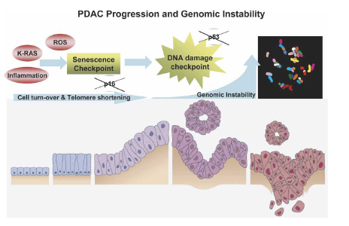
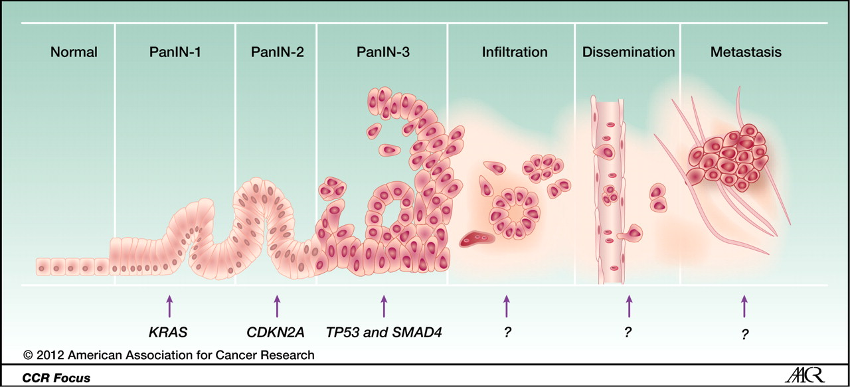
Pancreatic intraepithelial neoplasia(PanIN) & progression of ductal adenocarinoma(PDAC)
Nat Rev Gastroenterol Hepatol. (2009) 6:699-708; New Eng J Med (2010) 362:1605-1617; Nat Rev Cancer (2010) 10:683–796;

Slide 4
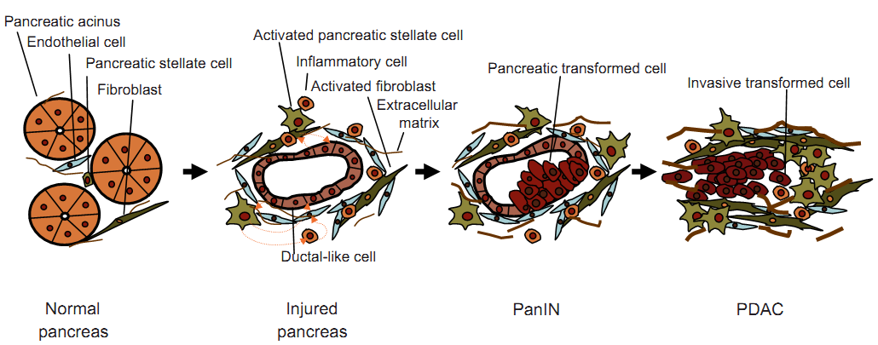
Pancreatic intraepithelial neoplasia(PanIN) & progression of ductal adenocarinoma(PDAC)
Metastasis
Relapse
Normal pancreas
Inflammatory ductal reprogramming
PanIN
Invasive PDAC
Iacobuzio-Donahue C A et al. Clin Cancer Res 2012;18:4257-4265
Notes:
Model of the progression from a normal cell to metastatic pancreatic cancer. (Based on an original illustration by Bona Kim.)‏

Slide 5
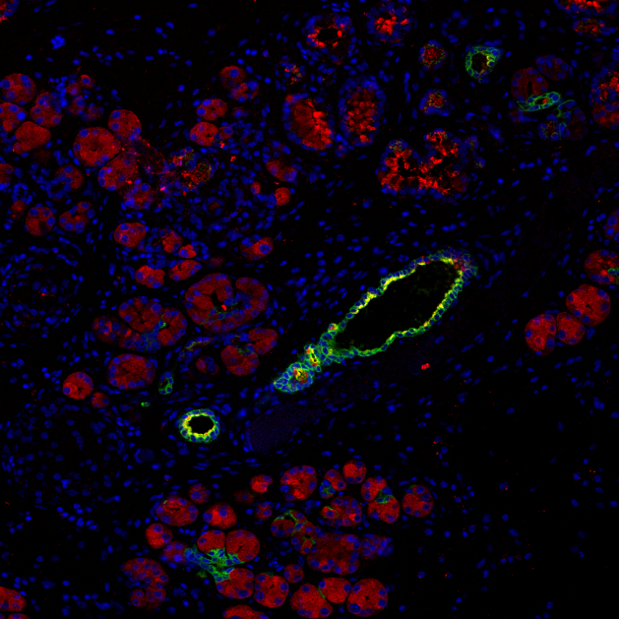
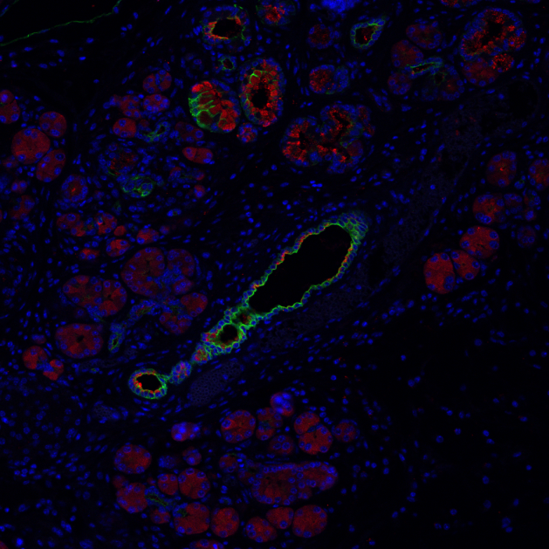
Pancreatic intraepithelial neoplasia(PanIN) & progression of ductal adenocarinoma(PDAC)
Metastasis
Relapse
Normal pancreas
Inflammatory ductal reprogramming
PanIN
Invasive PDAC
The concept of acinar-to-ductal metaplasia was initially established by identification of the ductal marker expressed in cells of acinar origin (Parsa et al., 1985)
Acinar-to-ductal metaplasia is described as an initiating event in the formation of pancreatic ductal adenocarcinoma (Meszoely et al., 2001).
In pancreatic cancer progression, the acinar-to-ductal metaplasia was observed frequently (Schmid, 2002)
Pancreatitis triggered acinar-to-ductal metaplasia
DBA / Amy
CK19 / Amy

Slide 6
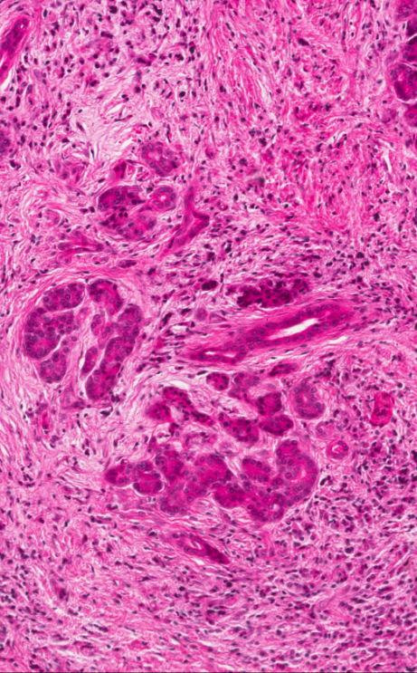
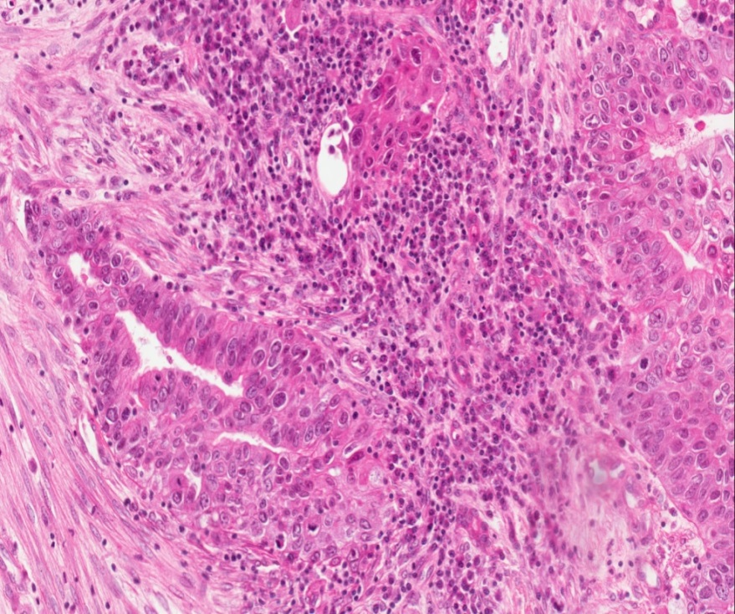
Pancreatic intraepithelial neoplasia(PanIN) & progression of ductal adenocarinoma(PDAC)
Metastasis
Relapse
Normal pancreas
Inflammatory ductal reprogramming
PanIN
Invasive PDAC
To determine whether the key regulator triggering ductal reprogramming during pancreatitis is a key mediator for PanIN leading to PDAC ?
What is the key regulator of ductal reprogramming?
Pancreatitis
PanINs
Invasive Carcinoma

Slide 7
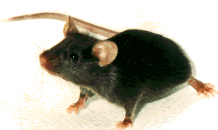
Mouse model for monitoring the progression from a normal cell to metastatic pancreatic cancer
Metastasis
Relapse
Normal pancreas
Inflammatory ductal reprogramming
PanIN
Invasive PDAC
Acinar
LSL-KrasG12D
Elas
CreER
pCAGGS
loxp-βgal-loxp-EGFP (LSL-Luc)
Insulin-producing beta
Kir6.2
CreERT2
Ductal
CK19
CreERT2
p53 KO
TAM or 4OHT
Cerulein (CCK agonist)
Elas-CreER:LSL-KrasG12D(p53+/-)

Slide 8
Mouse model for monitoring the progression from a normal cell to metastatic pancreatic cancer
Metastasis
Relapse
Normal pancreas
Inflammatory ductal reprogramming
PanIN
Invasive PDAC
Normal pancreas
Ductal reprogramming
PanIN
Notes:
Model of the progression from a normal cell to metastatic pancreatic cancer. (Based on an original illustration by Bona Kim.)‏

Slide 9
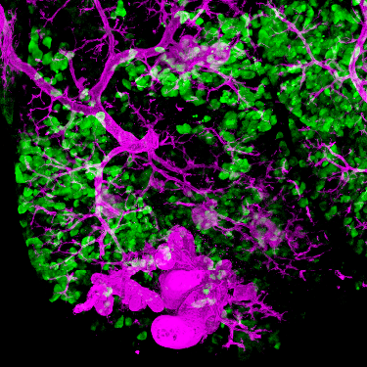
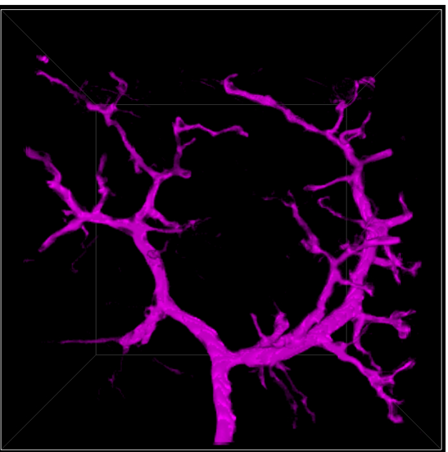
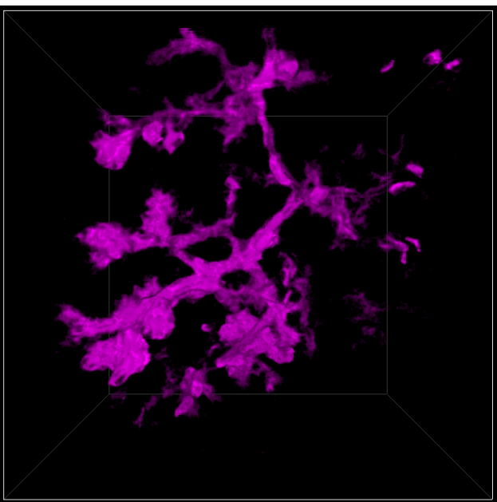
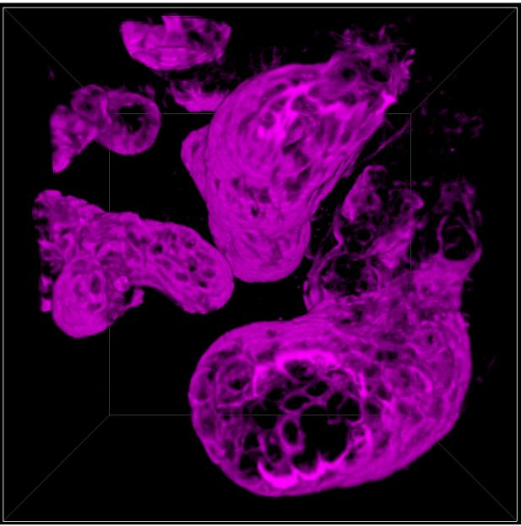
Mouse model for monitoring the progression from a normal cell to metastatic pancreatic cancer
Metastasis
Relapse
Normal pancreas
Inflammatory ductal reprogramming
PanIN
Invasive PDAC
Normal pancreas
Ductal reprogramming
PanIN
Notes:
Model of the progression from a normal cell to metastatic pancreatic cancer. (Based on an original illustration by Bona Kim.)‏

Slide 10
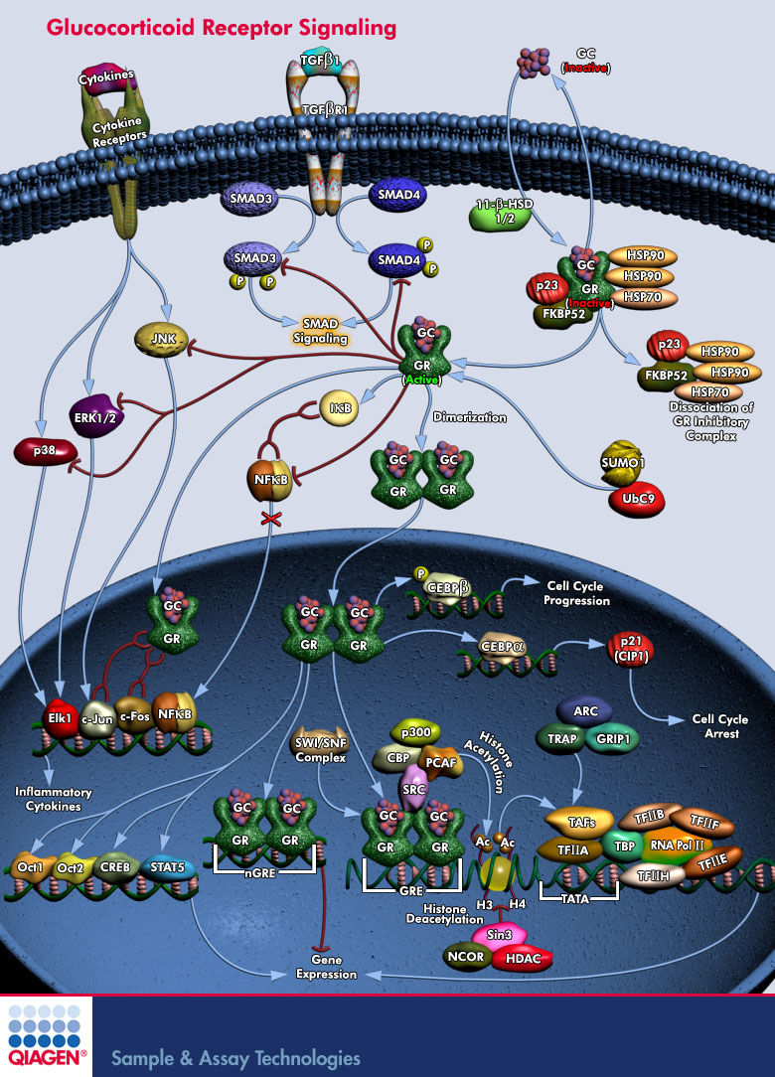
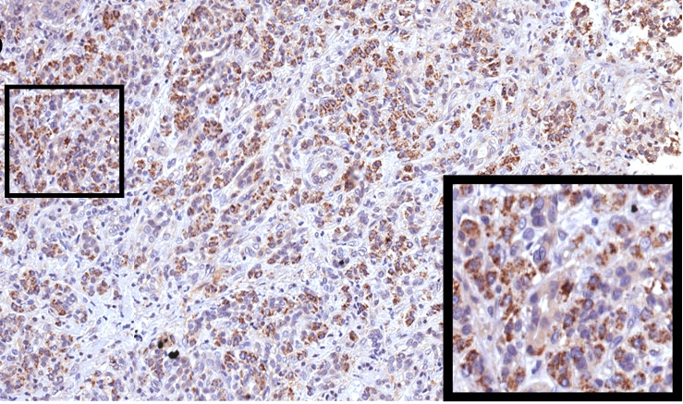
Glucocorticoid, pancreatitis & development of Pancreatic cancer
Cortisol was highly elevated in the initial stage of pancreatitis (Muller et al., 2006). We also found patients of pancreatitis has increased level of glucocorticoid receptor .
GR expression in patients of chronic pancreatitis
Notes:
而

Slide 11
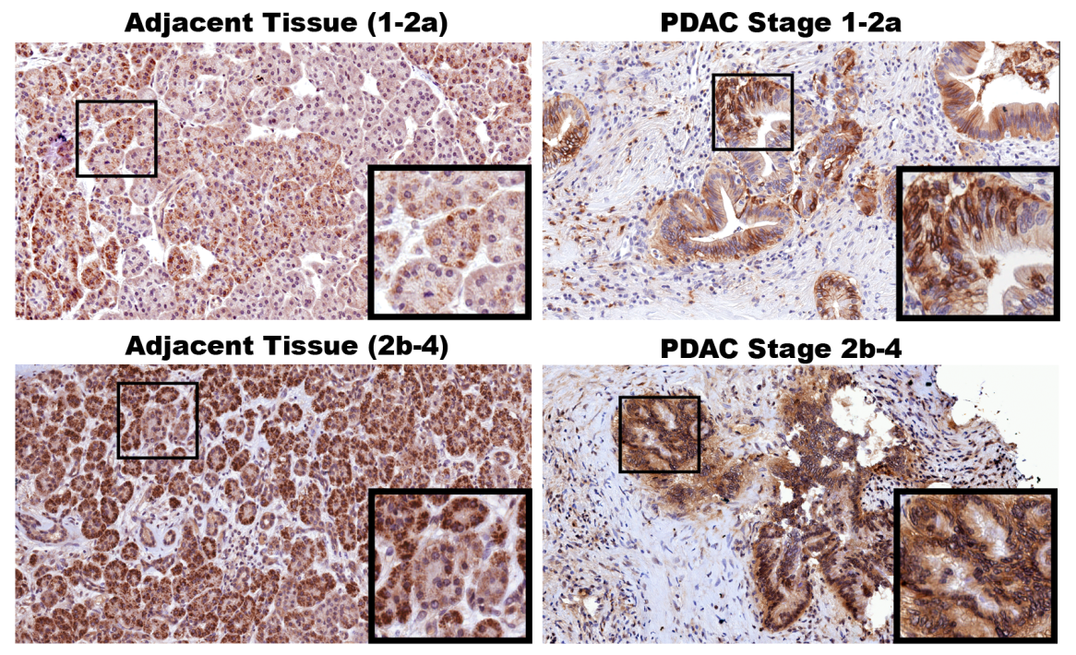
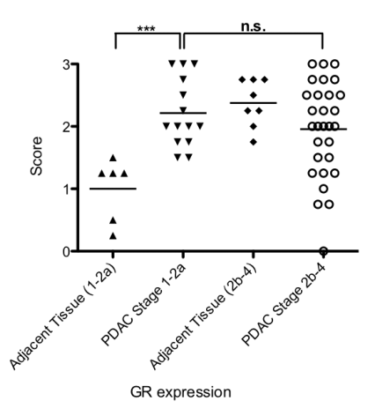
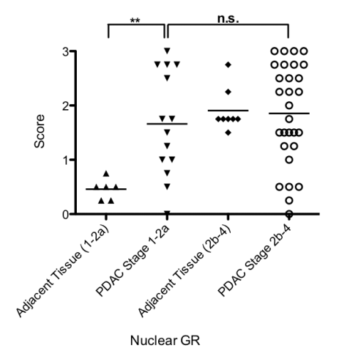
Glucocorticoid, pancreatitis & development of Pancreatic cancer
Cortisol was highly elevated in the initial stage of pancreatitis (Muller et al., 2006). We also found patients of pancreatitis has increased level of glucocorticoid receptor .
Glucocorticoid treatment induced resistance to chemotherapy of gemcitabine and cisplatin in established cell lines, resected tumors, and pancreatic carcinoma xenografts on nude mice. We also found nuclear GR can be identified in PDAC patients.
Notes:
而

Slide 12
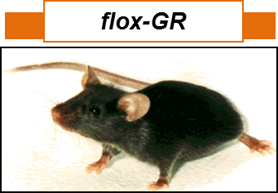
Glucocorticoid, pancreatitis & development of Pancreatic cancer
Metastasis
Relapse
Normal pancreas
Inflammatory ductal reprogramming
PanIN
Invasive PDAC
LSL-KrasG12D
Elas
CreER
p53 KO
TAM or 4OHT
Cerulein (CCK agonist)
Elas-CreER:LSL-KrasG12D(p53+/-)

Slide 13
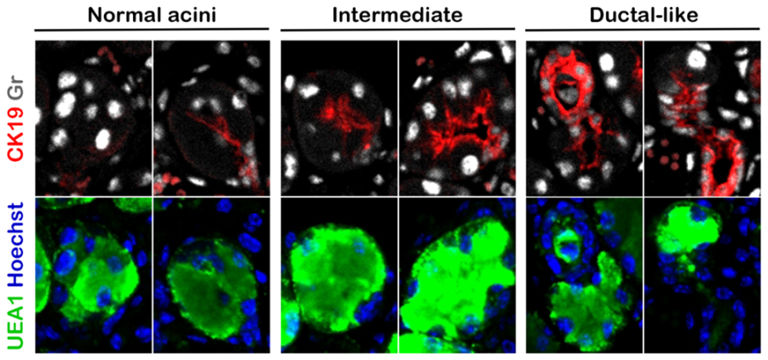
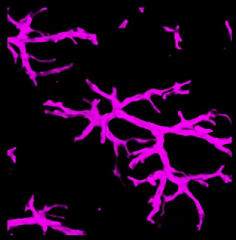
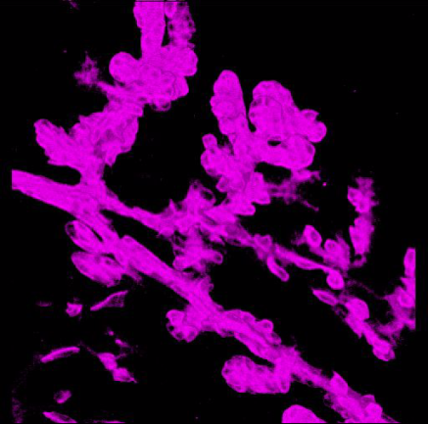
Expression of nuclear glucocorticoid receptor in pancreatitis
Metastasis
Relapse
Normal pancreas
Inflammatory ductal reprogramming
PanIN
Invasive PDAC
Birth
Sacrifice
chronic pancreatitis induction
Day 0
Day 33
Day 35
Day 37
Day 39
TAM or 4OHT
Cerulein
Elas-CreER:f/fGR

Slide 14
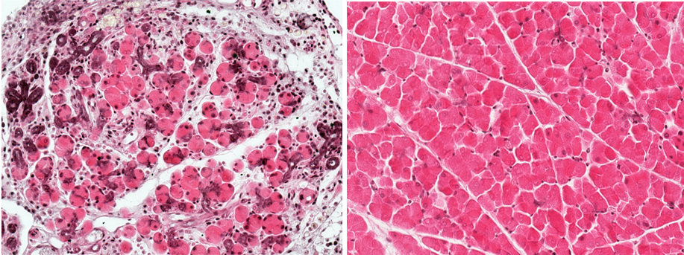
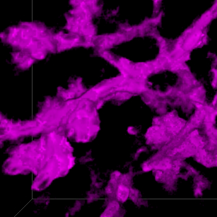
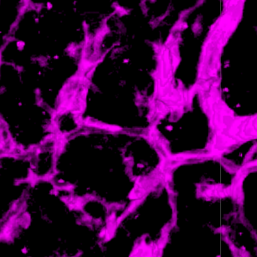
Expression of nuclear glucocorticoid receptor in pancreatitis
Metastasis
Relapse
Normal pancreas
Inflammatory ductal reprogramming
PanIN
Invasive PDAC
GR ^{+/+} CP3w
GR ^{-/-} CP3w
Birth
Sacrifice
chronic pancreatitis induction
Day 0
Day 33
Day 35
Day 37
Day 39
TAM or 4OHT
Cerulein
Elas-CreER:f/fGR

Slide 15
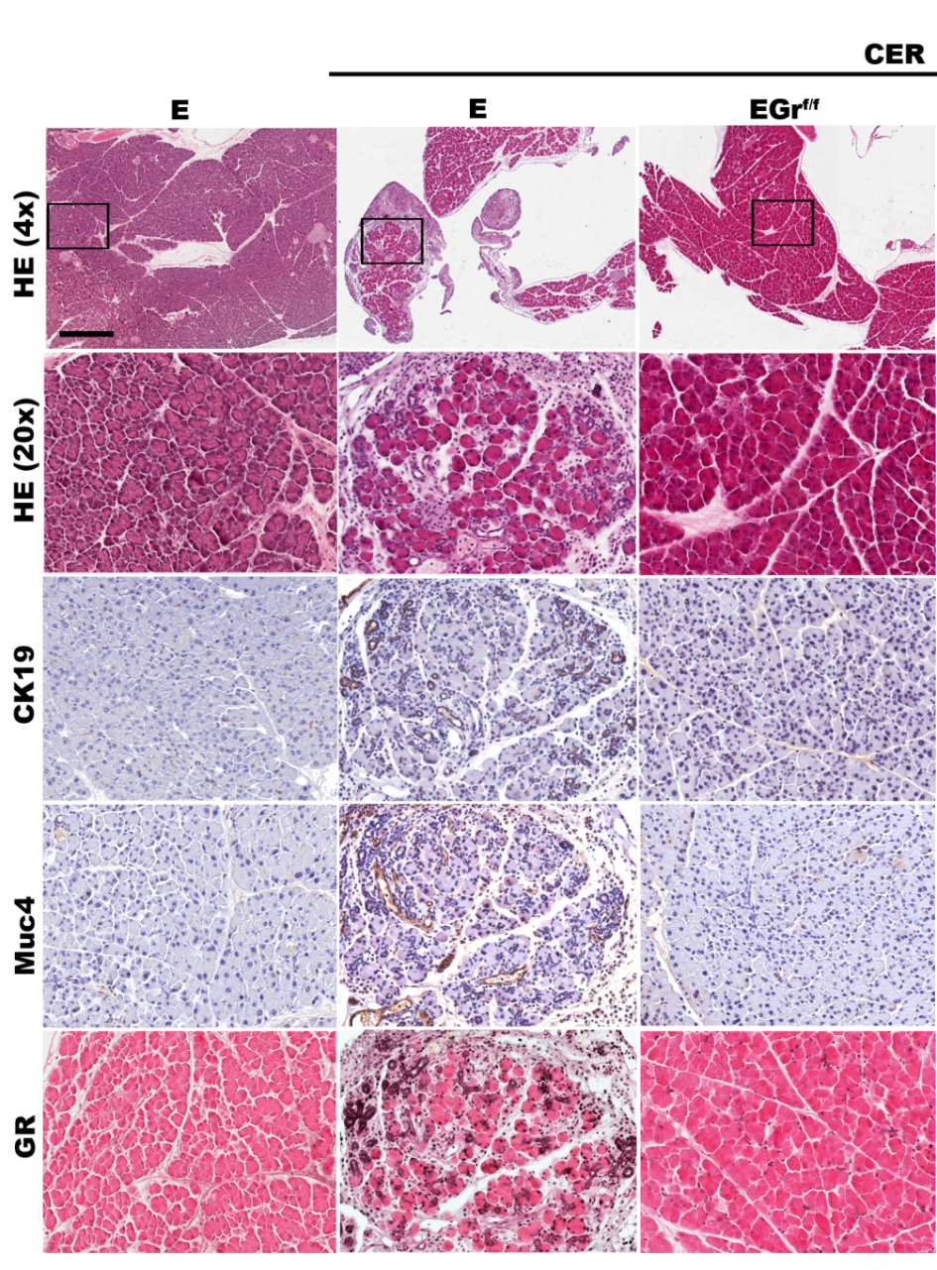
Expression of nuclear glucocorticoid receptor in pancreatitis
Birth
Sacrifice
chronic pancreatitis induction
Day 0
Day 33
Day 35
Day 37
Day 39
TAM or 4OHT
Cerulein
Elas-CreER:f/fGR
Su , Lin et al., 2014 unpublished observation (蘇建彰 IBC/PhD student)

Slide 16
Pancreatitis enhanced progression of pancreatic neoplasia
Metastasis
Relapse
Normal pancreas
Inflammatory ductal reprogramming
PanIN
Invasive PDAC
LSL-KrasG12D
Elas
CreER
2mg TAM
Sacrifice
2mg TAM
2mg TAM
Birth
2mg TAM
chronic pancreatitis induction
TAM or 4OHT
Day 0
Day 33
Day 35
Day 37
Day 39
Cerulein
Elas-CreER:LSL-KrasG12D

Slide 17
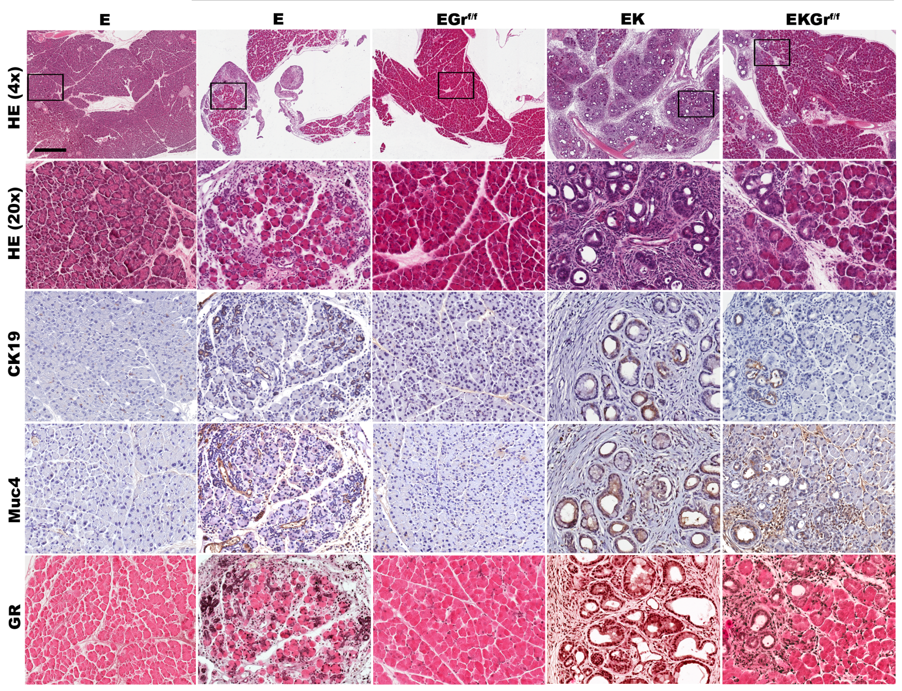
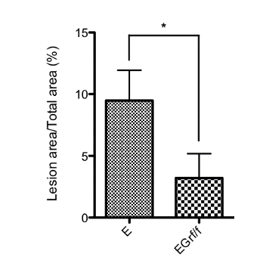
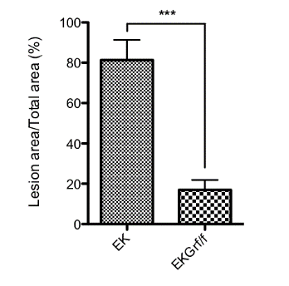
Activated glucocorticoid receptor mediated pancreatitis-/KrasG12D-driven carcinogenesis

Slide 18
Activated glucocorticoid signaling can trigger KrasG12d-driven neoplasia
Metastasis
Relapse
Normal pancreas
Inflammatory ductal reprogramming
PanIN
Invasive PDAC
LSL-KrasG12D
Elas
CreER
2mg TAM
Sacrifice
2mg TAM
2mg TAM
Birth
2mg TAM
Dexamethasone injection
TAM or 4OHT
Day 0
Day 33
Day 35
Day 37
Day 39
Dex
Elas-CreER:LSL-KrasG12D

Slide 19
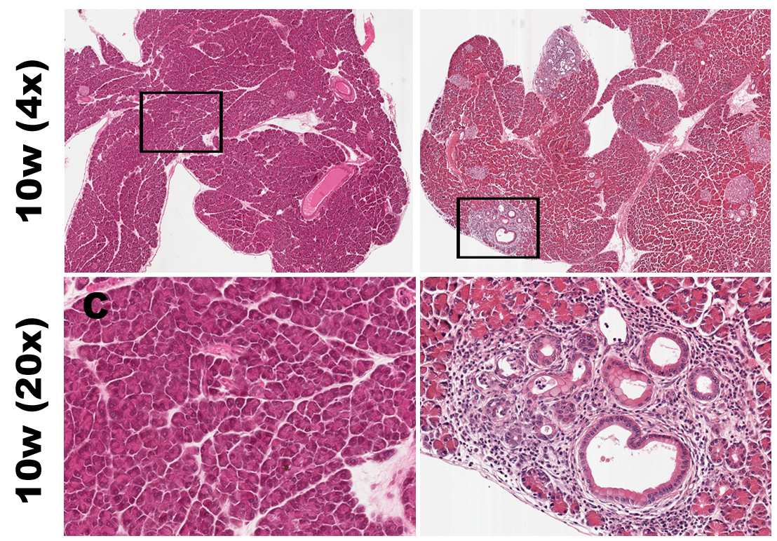
Activated glucocorticoid signaling can trigger KrasG12d-driven neoplasia
Metastasis
Relapse
Normal pancreas
Inflammatory ductal reprogramming
PanIN
Invasive PDAC
LSL-KrasG12D
Elas
CreER
Dex treated
TAM or 4OHT
Dex
Elas-CreER:LSL-KrasG12D

Slide 20
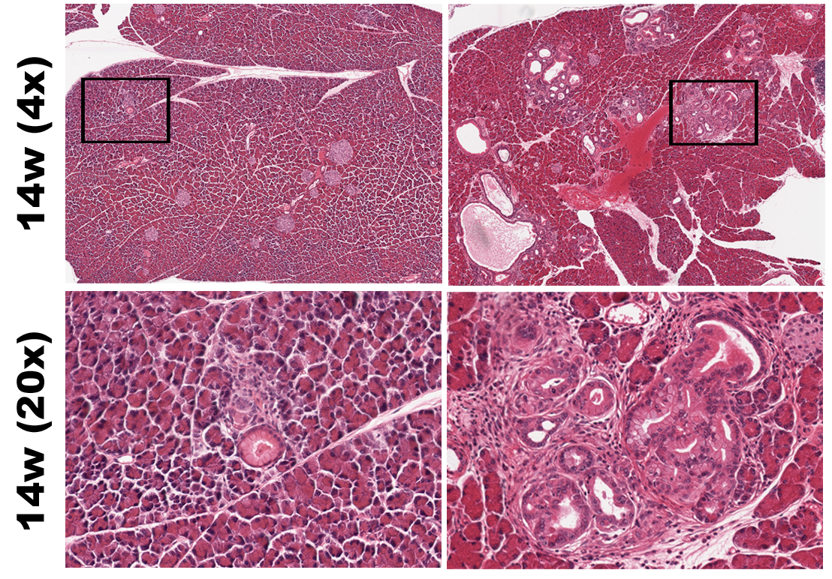
Activated glucocorticoid signaling can trigger KrasG12d-driven neoplasia
Metastasis
Relapse
Normal pancreas
Inflammatory ductal reprogramming
PanIN
Invasive PDAC
LSL-KrasG12D
Elas
CreER
Dex treated
TAM or 4OHT
Dex
Elas-CreER:LSL-KrasG12D

Slide 21
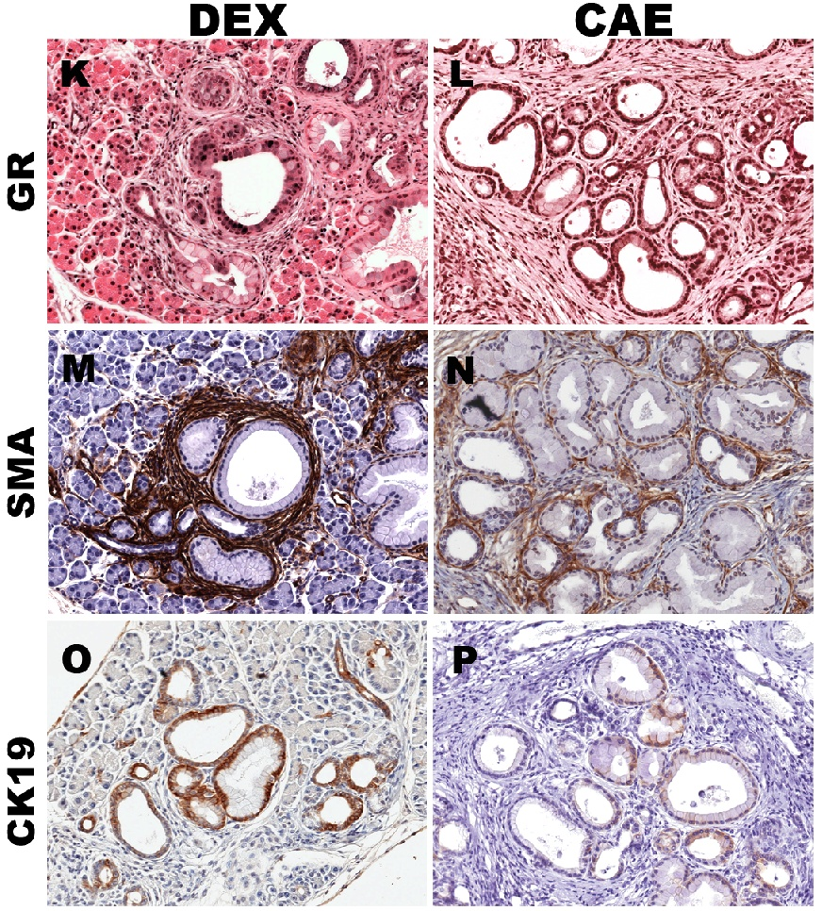
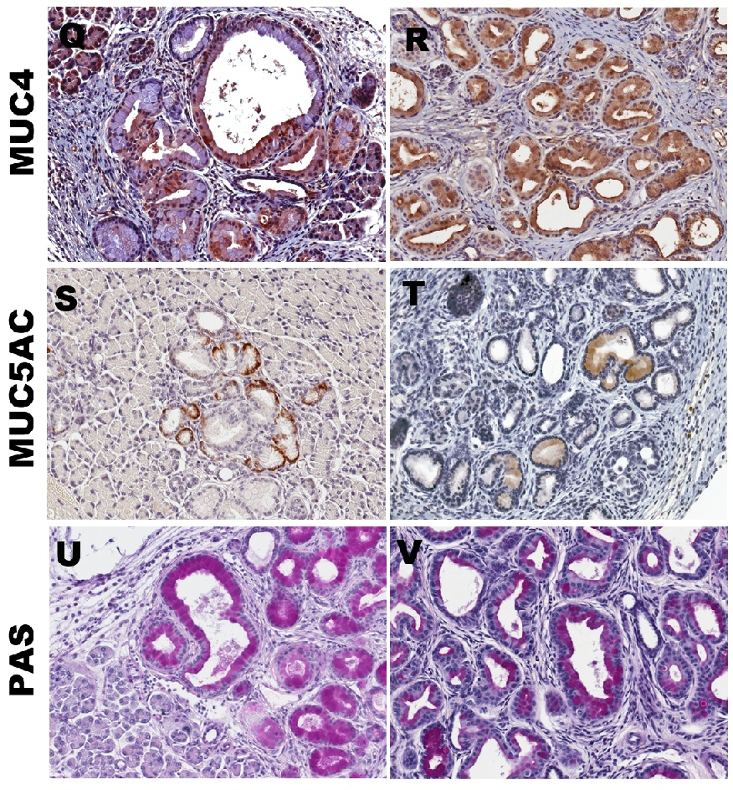
Activated glucocorticoid signaling can trigger KrasG12d-driven neoplasia

Slide 22
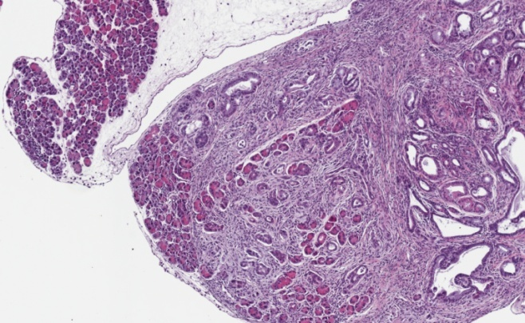
Activated glucocorticoid signaling can trigger KrasG12d-driven PDAC
Metastasis
Relapse
Normal pancreas
Inflammatory ductal reprogramming
PanIN
Invasive PDAC
LSL-KrasG12D
Elas
CreER
TAM or 4OHT
p53 KO
Dex
Elas-CreER:LSL-KrasG12D(p53+/-)

Slide 23
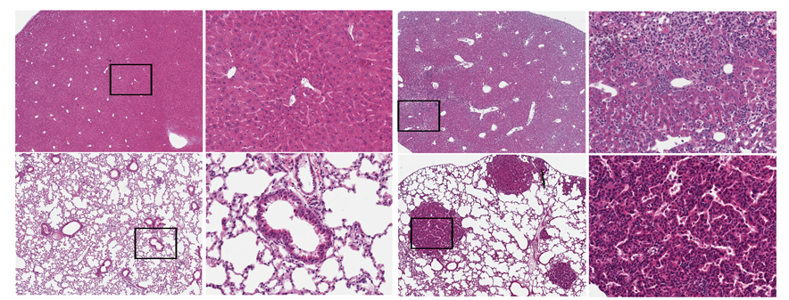
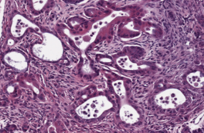
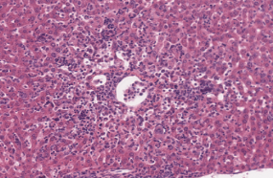
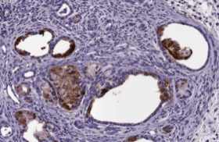
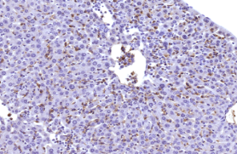
Activated glucocorticoid signaling can trigger KrasG12d-driven PDAC
Metastasis
Relapse
Normal pancreas
Inflammatory ductal reprogramming
PanIN
Invasive PDAC
EKP+DEX
Invasive Ca
Metastatic Ca
Liver metastasis
H&E
Globo H
Lung metastasis

Slide 24
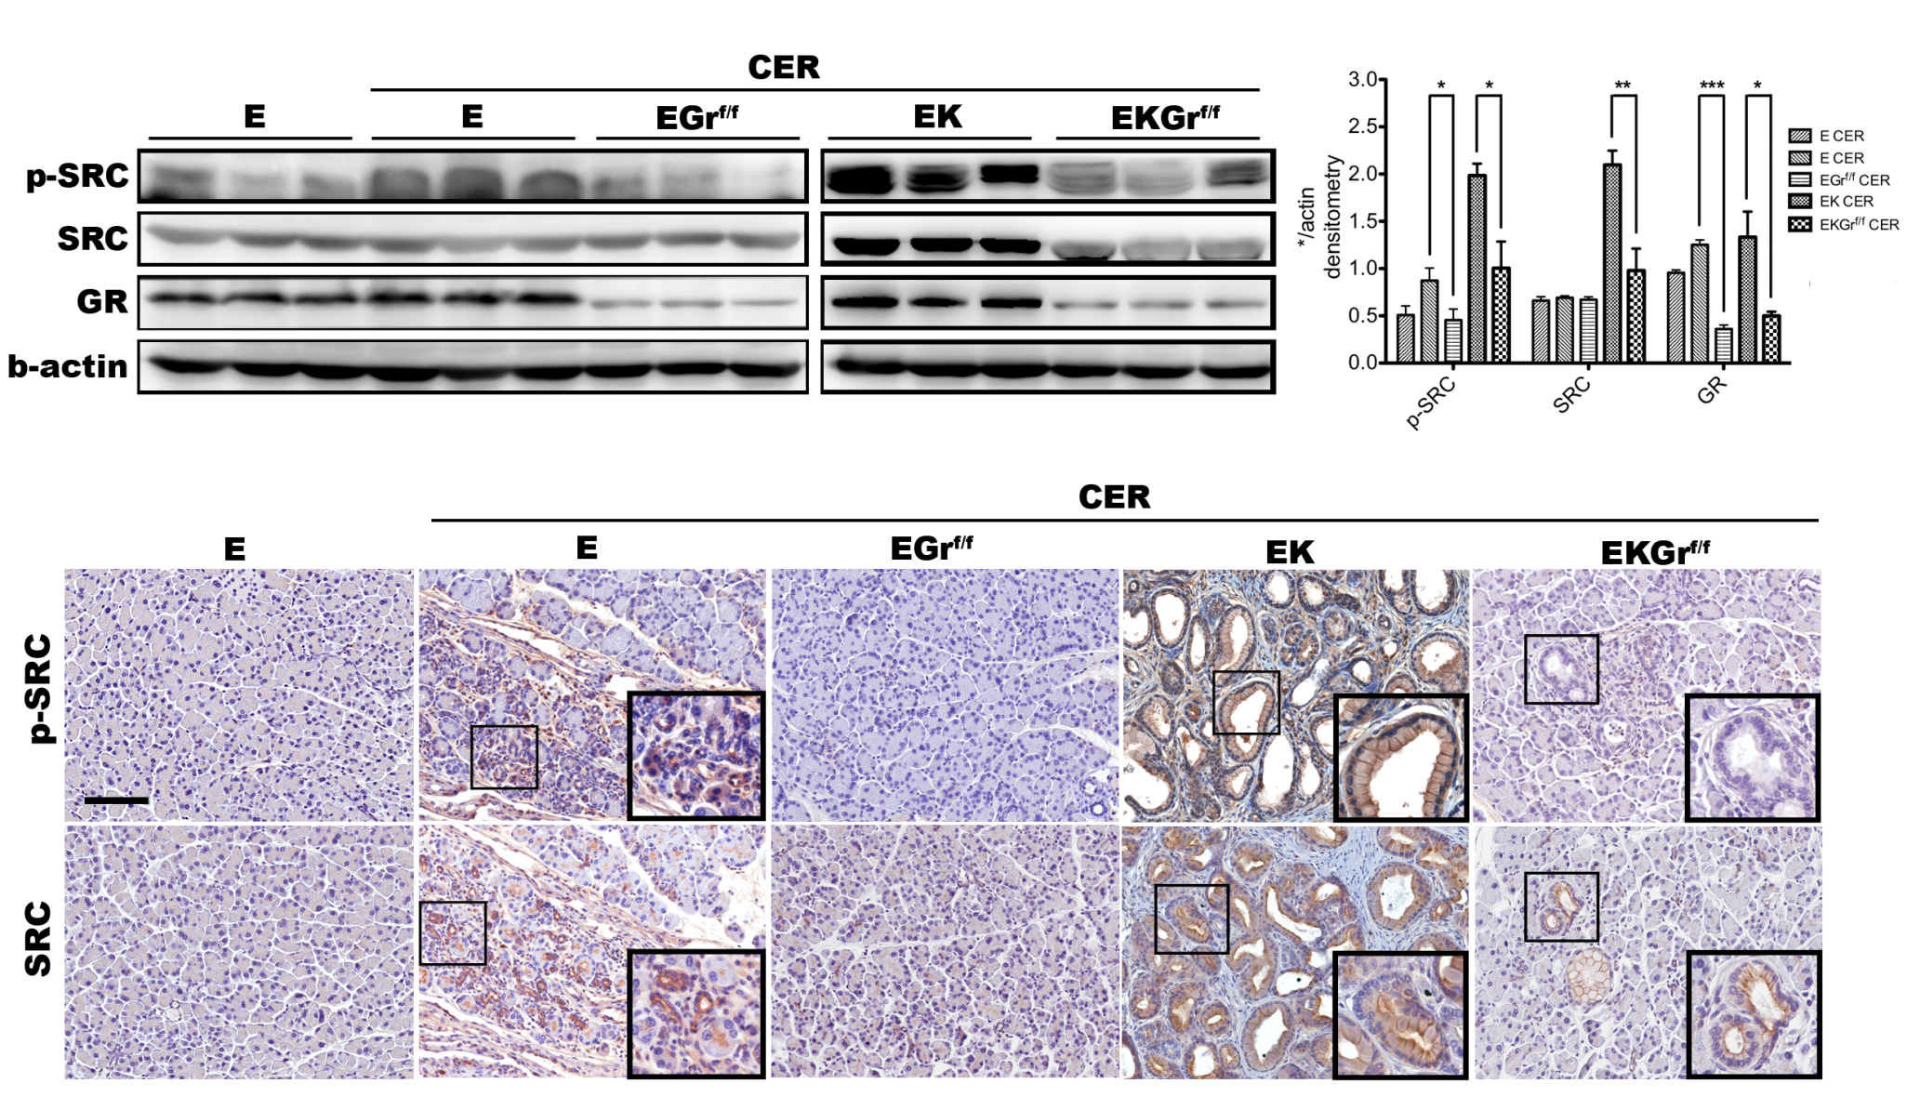
Pancreatitis promoted Kras^{G12D}-driven carcinogenesis via activation of Src signaling

Slide 25
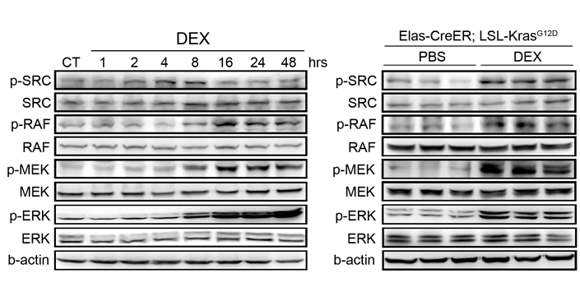
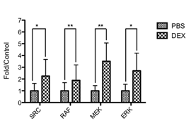
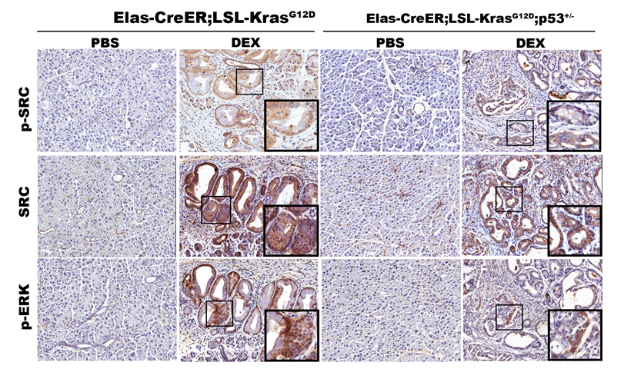
Activation of c-Src mediates neoplasia development promoted by glucocorticoids
Notes:
25

Slide 26
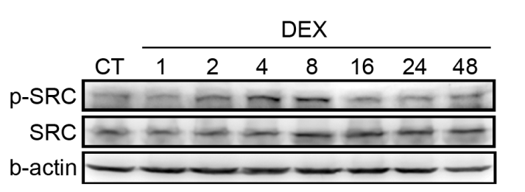
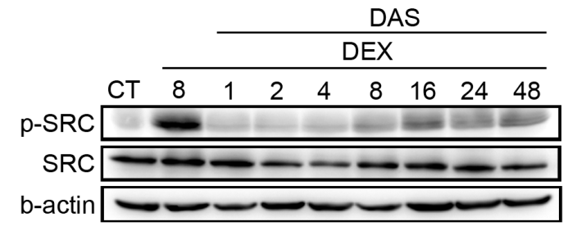
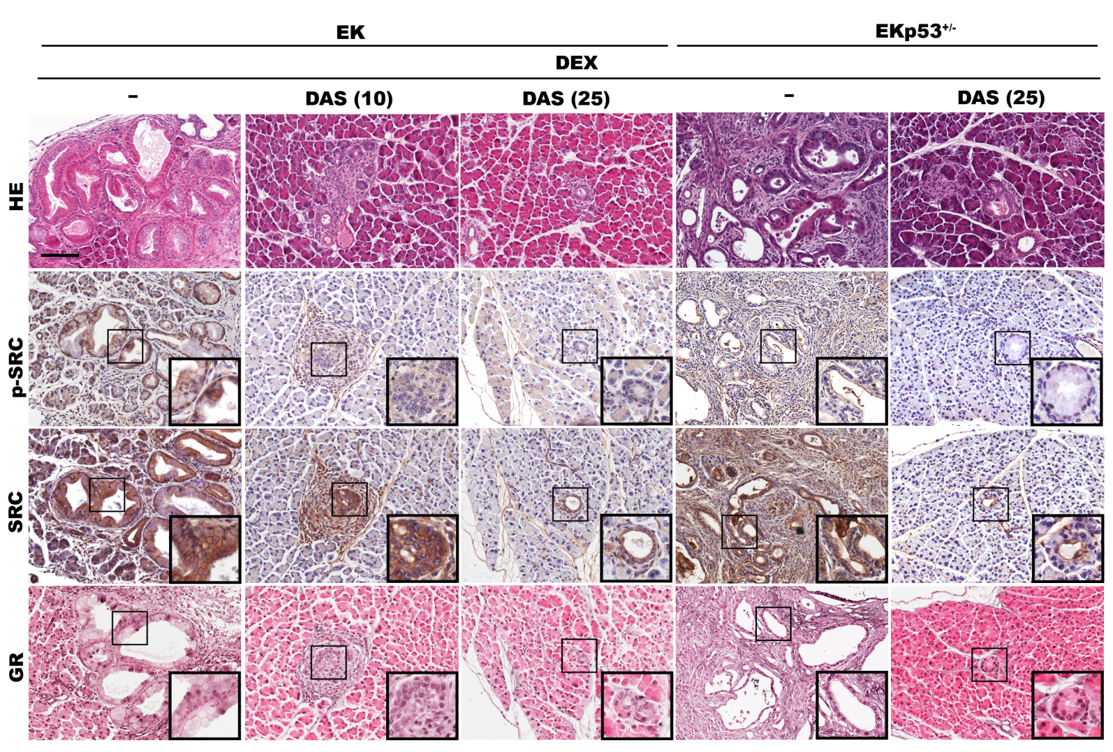
Src inhibitors suppressed KrasG12D-driven carcinogenesis promoted by glucocorticoids

Slide 27
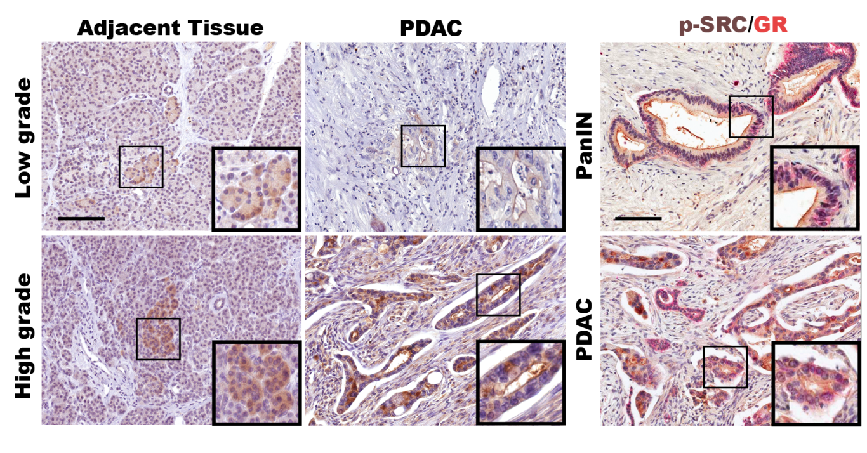
Activatated c-Src was associated with nuclear GR in PDAC patients

Slide 28
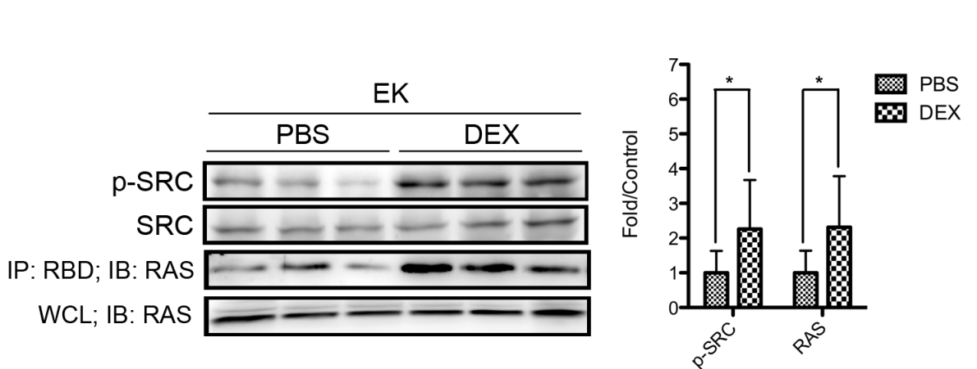
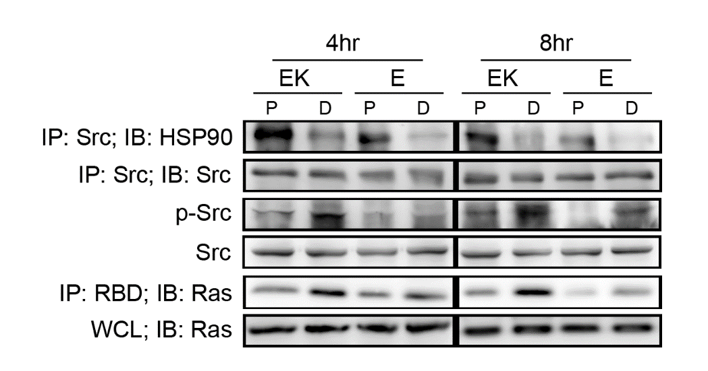
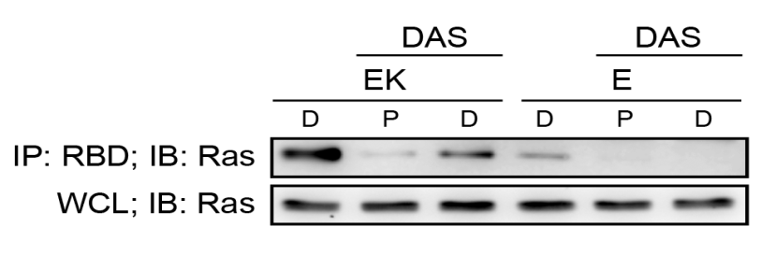
Glucocorticoids activated c-Src pathways & further evaluated Ras activity
Ras activity assay revealed that Ras activity was significantly increased accompanied by c-Src activation in DEX treatment.
Co-Immunoprecipitation of Src and HSP90 indicated that Src was dissociated from HSP90 in DEX treatment suggesting that DEX treatment induced Src activation through HSP90 releasing.

Slide 29
Summary
Observation of GFP-positive PanIN tissues indicated that neoplastic cells were directly transformed from KrasG12D expressing acinar cells
Activation of GR pathway is not only the key step in acinar cell reprogramming, and it is also the key mediator in Kras-driven pancreatic carcinogenesis.
Pancreatitis
GR Activation
ADM
Src Activation
(Src dissociated from HSP90/GR complex)
Ras activity↑ (Kras mutation)
MAPK↑
Development of pancreatic neoplasm

Slide 30


Acknowledgements
GR in ADM and Kras-driven carcinogenesis
Chien-Chang Su, Pei-Yu Lin , Wan-Yu Mao
*Collaborators
Drs. Yi-Ming Shyr, Tien-Hua Chen (VGH, Taipei)
Dr. Tong Tang (NTHU, 3D tissue imaging)
Dr. Tayler Jacks (MIT, LSL-Kras mice)
Dr. Günther Schütz (DKFZ, floxed-GR)
Dr. Kuo-I Lin (GRC, p53 KO mice)
Dr. Guoquian Gu (Vanderbilt U, CK19-CreER)
Dr. Shih-Chieh Hung (IBMS, foxed-PP2A)
Dr. I-Ching Wang (NTHU floxed FoxM1)
*Funding support
Academia Sinica, NHRI & MOST
Notes:
30

