Slide 1


Biorefinery for Biofuel Production
Dr. Chenyu Du
University of Huddersfield
University of Nottingham
27th August, 2015

Slide 2
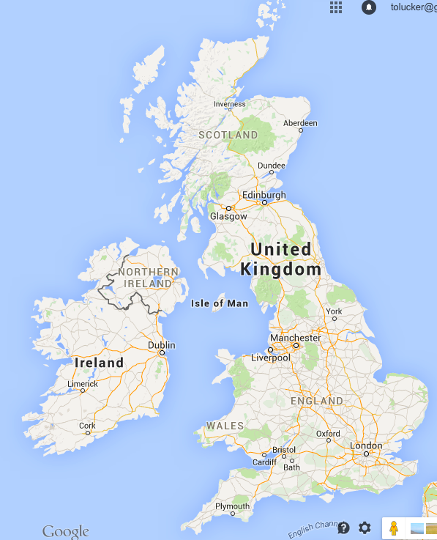
University of Huddersfield
Huddersfield
Manchester
Nottingham

Slide 3
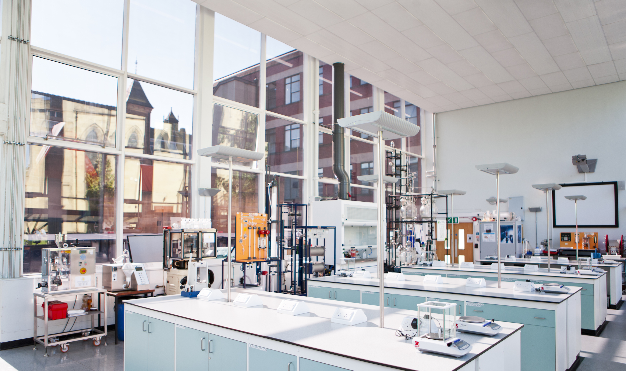
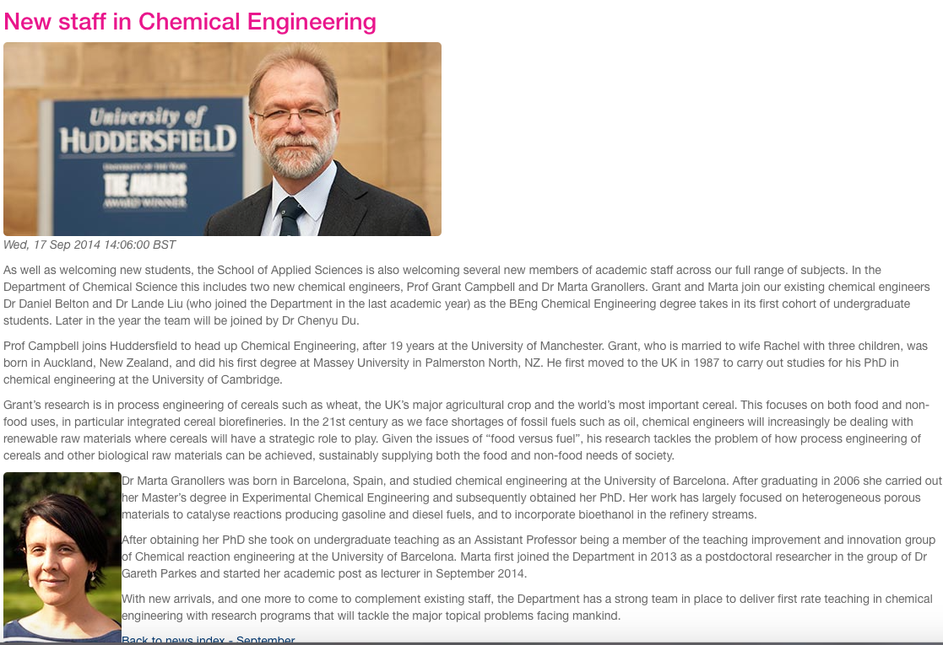
University of Huddersfield

Slide 4
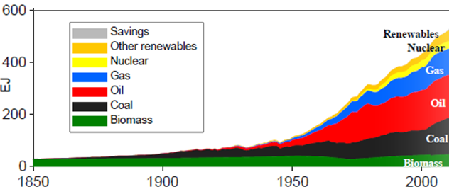
21st Century Challenges
Climate change
Energy security
Fossil fuels
(coal + oil + gas)
Over 80%!!!
Notes:
Nowaday, we enjoy much higher quality of life benefit from recently technology development. However, we also have to face a number of challenges. For example, energy crisis and environmental problems that have attracted more attentions recently.

Slide 5
Programme LACE:
Lignocellulosic Conversion To Ethanol
Life Cycle Analysis (Bath, Nottingham)
Farm Adapt (Nottingham)
Digestion Screen
Fungal
Enzyme
Discovery
Novel Yeast
Strains
Chemical and Physical
Disruption
Fermentation
Social and Ethical Dimensions (Nottingham, Surrey)
5
Value of Award: £6.8m BBSRC and Industrial Funding
Notes:
5

Slide 6
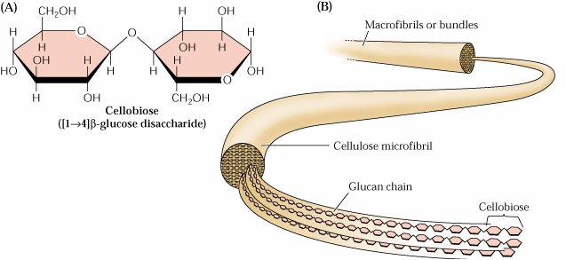
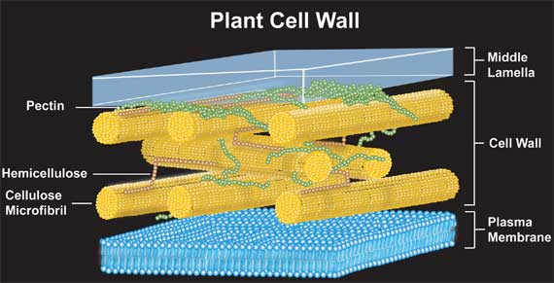
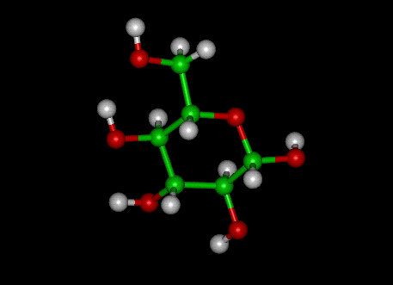
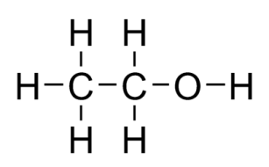
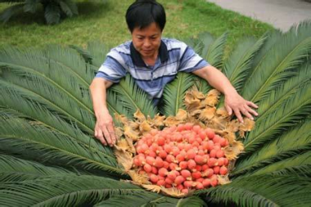
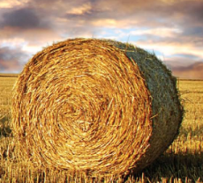
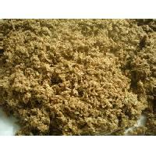
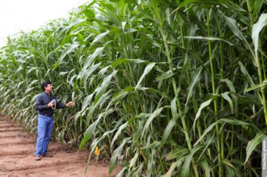
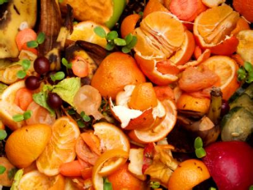
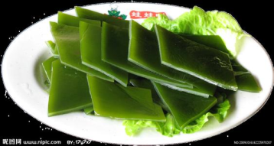
Programme LACE:
Lignocellulosic Conversion To Ethanol
Deconstruction
Hydrolysis
Fermentation
A. niger
Acid
Yeast
T. reesei
Alkali
Viability
Activity
Tolerance
MW
Mechanism
Breeding
Bio
Application
Mechanism
Notes:
5-羟基甲基糠醛

Slide 7
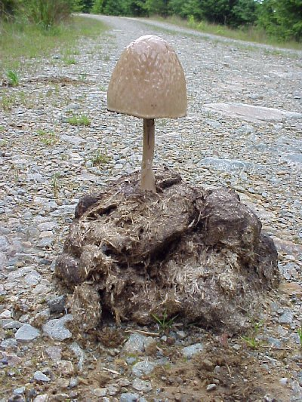


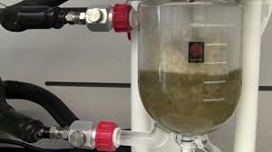
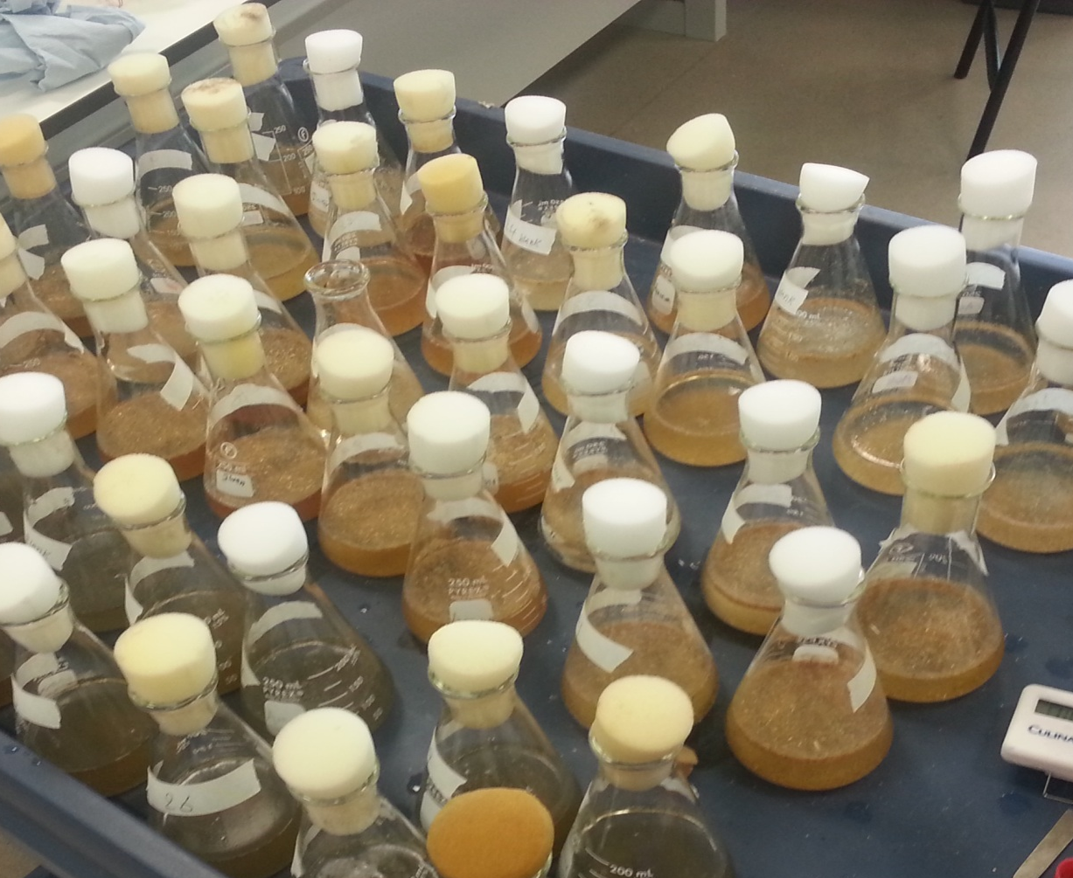
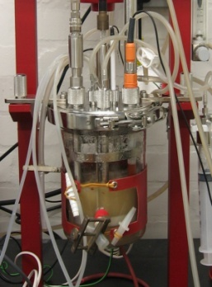
Biorefinery for bioethanol
Cellulase hemicellulase
Wheat straw
Ethanol
Pretreatment
Cellulase production
Acid-pretreatment
Hydrolysis
Yeast fermentation
Notes:
e
7

Slide 8
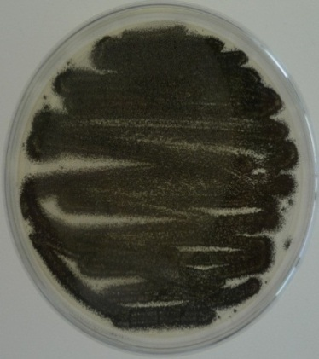
Biorefinery for bioethanol
Cellulase hemicellulase
Wheat straw
Ethanol
Bio-Pretreatment
Cellulase production
Bio-pretreatment
Hydrolysis
Yeast fermentation
Notes:
e
8

Slide 9
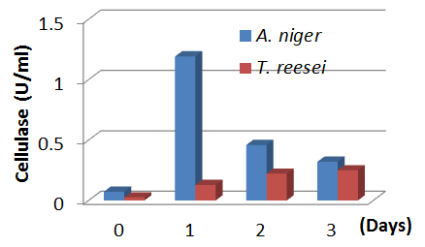
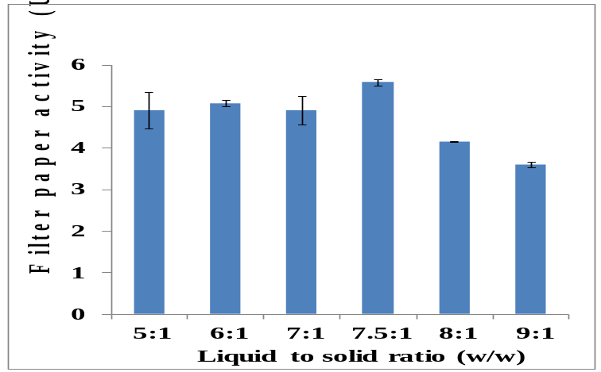
Biological Pretreatment
Two fungi for cellulase production:
  Aspergillus niger
  Trichoderma reesei
Moisture content
Enzyme extraction
D | Stirrer | Blender
1 | 1.10±0.01 | 4.33±0.38
3 | 5.57±0.07 | 9.51±1.64
5 | 4.52±0.13 | 5.55±0.54

Slide 10
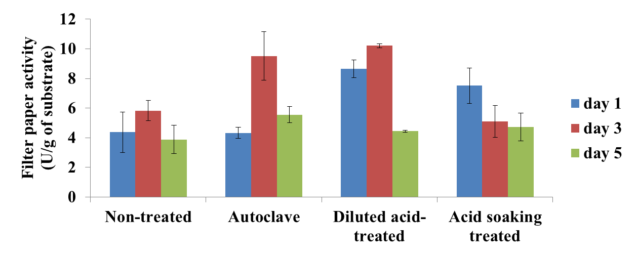
Substrate Modification
Substrate modification | Chemical | Temperature (˚C) | Time (min)
Non-treated | - | - | -
Autoclave | H₂O | 121 | 15
Diluted acid-treated | 1% H₂SO₄ | 121 | 30
Acid soaking-treated | 1% H₂SO₄ | 50 | 30
Notes:
In this experiment, the wheat straw was autoclaved before the inoculation. The autoclave not only sterilized the substrate, but also modified the wheat straw morphology, which could be considered as a mild hydrothermal pretreatment of the wheat straw. In this study, two other wheat straw modification methods, diluted acid and acid soaking, were investigated with the aim to improve fungal growth and cellulase production. These results were then compared with fermentations using autoclaved wheat straw and crude (non-modified) wheat straw.
the diluted acid and acid soaking modified wheat straw resulted in high enzyme activity at day 1. This may be due to the dilute acid and acid soaking removing the hemicellulose exposing cellulose to A. niger. However, both diluted acid and acid soaking modified wheat straw led to low cellulase at day 5. In the diluted acid experiment, the enzyme activity dropped to 4.43 U/g at day 5. The reduction in nutrient supplement may be the cause of the decrease of the cellulase activity
Surprisingly, A. niger was able to produce a significant amount of cellulase (5.83 U/g) using non-treat wheat straw (Table 2). This indicated that a cost effective biorefining process could be developed based on only crude wheat straw. For the diluted acid modified wheat straw, the highest cellulase activity was 10.2 U/g at day 3. However, it cannot be shown as significantly difference from autoclaved wheat straw at α = 0.05. Therefore here we used the autoclaved wheat straws as the substrate for enzyme production due to the diluted acid modification does require chemical agents and corrosive resistant equipment.

Slide 11
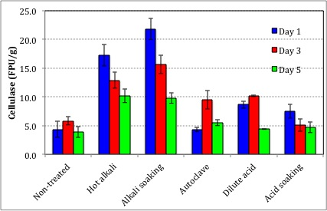
Alkali Based Modification
Substrate modification | Chemical | Temperature (˚C) | Time
Hot alkali treated | 1% NaOH | 121 | 30 mins
Alkali soaking-treated | 1% NaOH | 40 | 24 hours

Slide 12
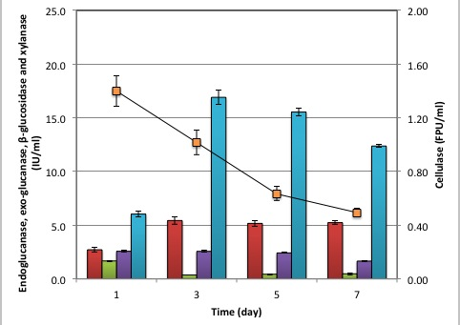
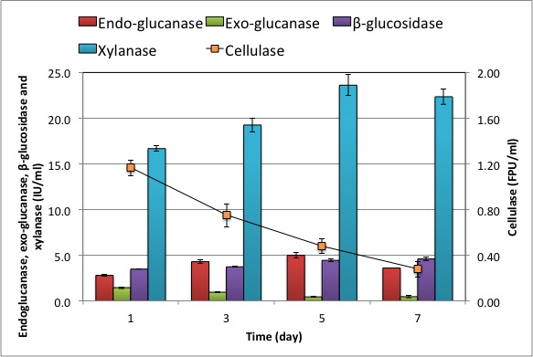
Individual Enzymes
Alkali soaking modification
Hot alkali modification

Slide 13
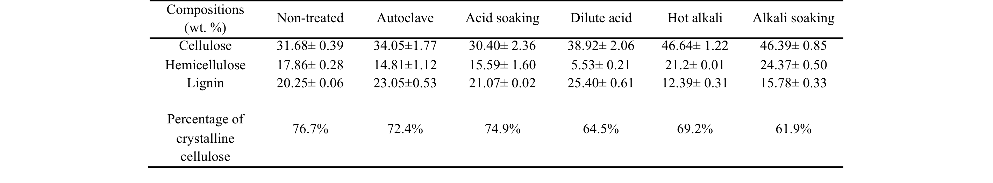
Cell Wall Composition
Alkali soaking modified wheat straw
  Low lignin content,
  High cellulose content,
  Low crystallinity

Slide 14


Impact of Source of Cellulase
a
c
b
lignocellulose substrate for saccharification assay
straw
willow
straw
willow
sources of enzymes
14
straw
willow

Slide 15
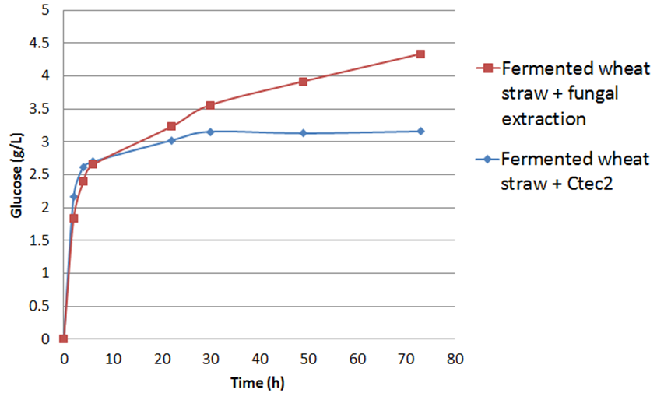
Enzymatic Hydrolysis
Ctec2: Novozyme
commercial enzyme
Notes:
After the solid state fungal fermentation, the fungal extract (enzyme solution) was collected and used as the cellulase solution for the enzymatic hydrolysis of the fermented wheat straw, at 150 rpm 50˚C for 73 h. we investigate wheat straw hydrolysis catalyzed by both the commercial cellulase Ctec2 and the fungal extract (from the SSF using autoclaved wheat straw, 0.5% YE with mineral. Two substrates, fermented wheat straw and autoclaved wheat straw were compared in order to investigate the impact of SSF itself .
The graph shows glucose concentration profile of wheat straw hydrolysed by fungal extract and commercial enzyme.
In the first 22 hours, no significant difference was observed between these experiments. Glucose was released with a fast speed , especially at the first 6 hours. Then the hydrolyses using Ctec2 stopped glucose generation, resulting in around 3.13 g/L glucose. Meanwhile, the hydrolyses using the fungal extract continued until around 4.3 g/L (using fermented wheat straw) glucose were liberated into the hydrolysates. These results suggested that although the fungal extract had a lower detected cellulase activity (1.8 U/ml), it performed the same or even better than the Ctec2 solution. This may be due to the fact that the A.niger fungal extract contained a wide range of enzymes other than cellulase, e.g. xylanase,pectinase,amylase,mannanase.These enzymes assisted the function of cellulase by removing the obstacles of the cellulose hydrolysis reactions
Another possible explanation could be that the fungal extract was freshly produced and was excreted by the A. niger grown on the wheat straw. The enzyme composition of the fungal extract might then be tailored for functionality against wheat straw. In comparison with the autoclaved wheat straw, the fermented wheat straw led to higher sugar yields, indicating the fermented wheat straw is a more suitable substrate for the enzymatic hydrolysis.

Slide 16
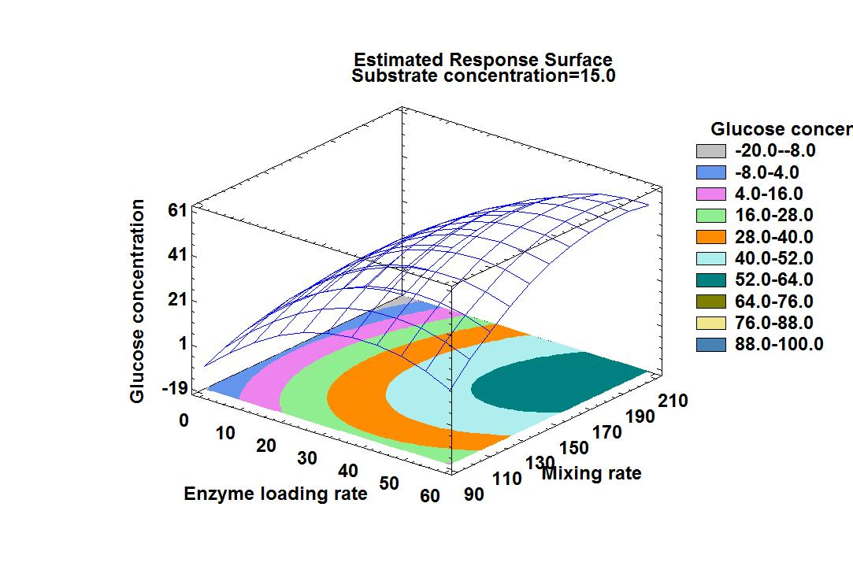
Latest Hydrolysis Result
Glucose concentration ~ 60 g/L in wheat straw hydrolysate

Slide 17
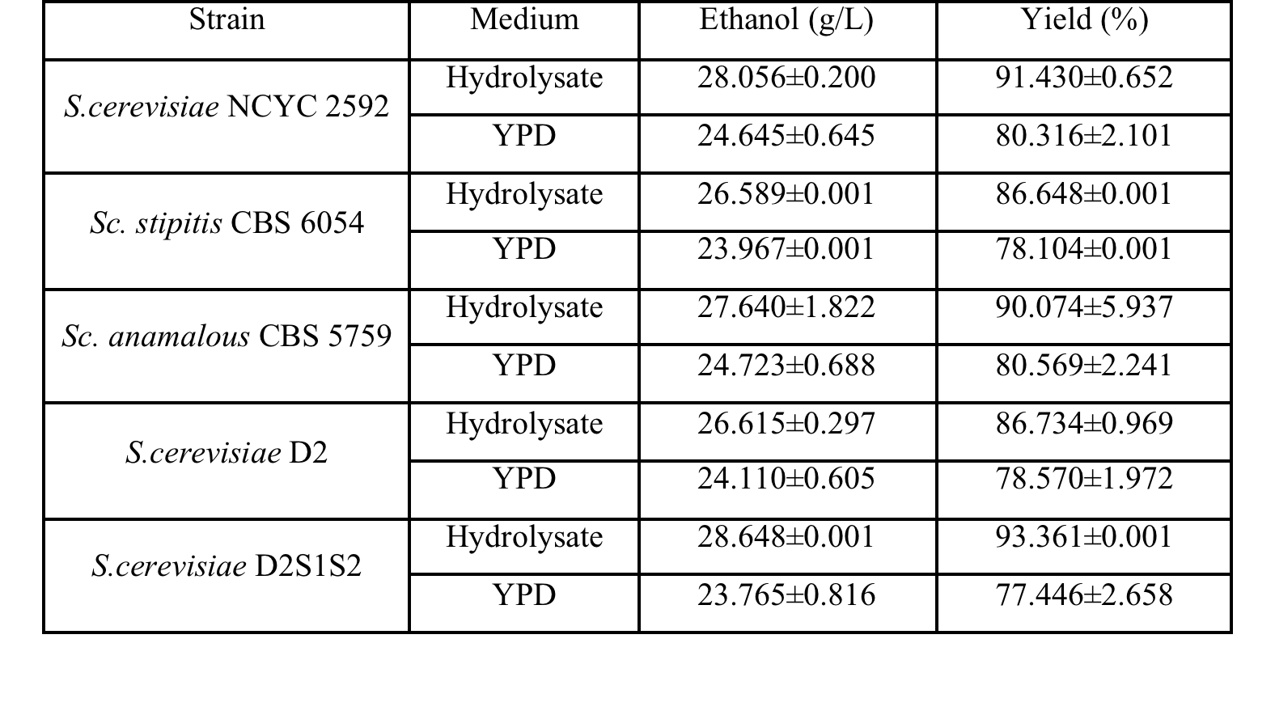
Yeast Fermentation
Notes:
YE
Peptone
Dextrose

Slide 18
Summary
High amount of cellulase produced from solid state fungal fermentation
  Alkali soaking, 24 hours, 23 FPU/g
Biological pretreatment reduced wheat straw recalcitrance
A hydrolysate of 60 g/L glucose generated
Good bioethanol yield achieved (93.4% theoretical yield)

Slide 19
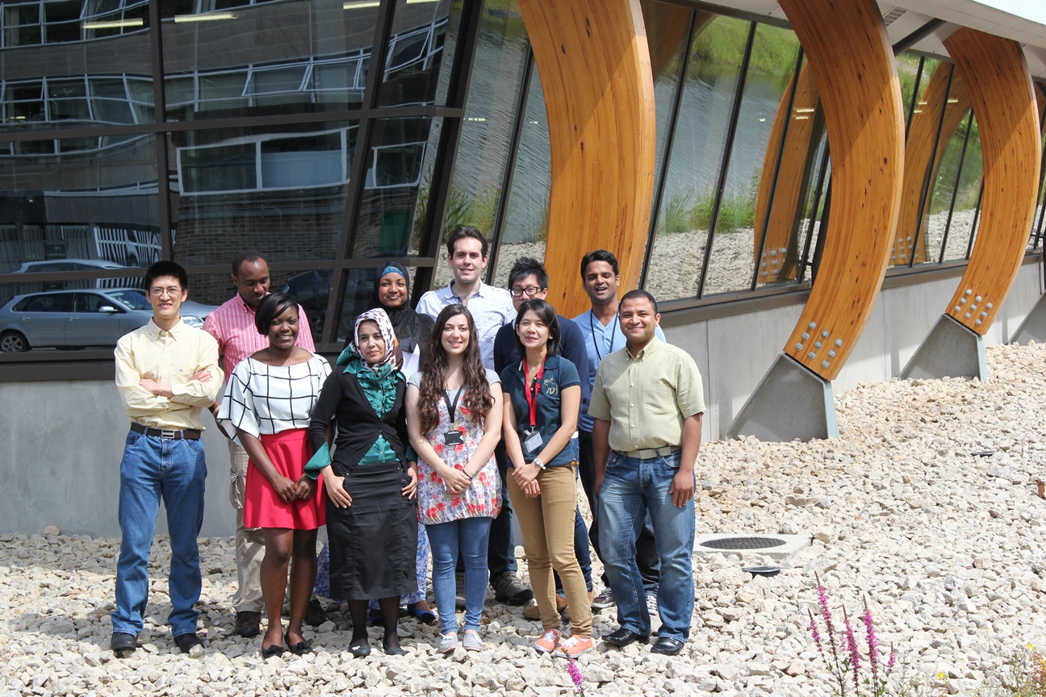
Acknowledgement

Slide 20











Acknowledgement
FORMAN HARDY CHARITABLE TRUST

