Slide 1
Ulcerative Colitis (UC)-Associated Colorectal Cancer (CRC) Patients Who Receives Colorectal Surgery More Likely Receive Blood Transfusion Than Crohn’s Disease (CD)-Associated CRC Patients- A Propensity Match Study
Cheng Zhang MD, PH.D, FACG
Inflammatory Bowel Disease Program,
Division of Gastroenterology, Hepatology, & Nutrition
The Ohio State University Wexner Medical Center
Columbus, OH, USA

Slide 2
Background
Inflammatory bowel disease (IBD) is associated with an increased risk of colorectal cancer (CRC).
Risks of CRC in IBD patients increases with duration of disease.
Pathophysiology of development of CRC in IBD is probably different than in sporadic CRC.
The prognosis of CRC in IBD patients is controversial.
IBD is associated with poor outcomes of surgery for diverticular disease, however, the outcomes of colorectal surgery in IBD-associated CRC was unknown.
Adherence to national surveillance guideline for CRC in IBD patients was poor.

Slide 3
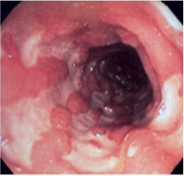
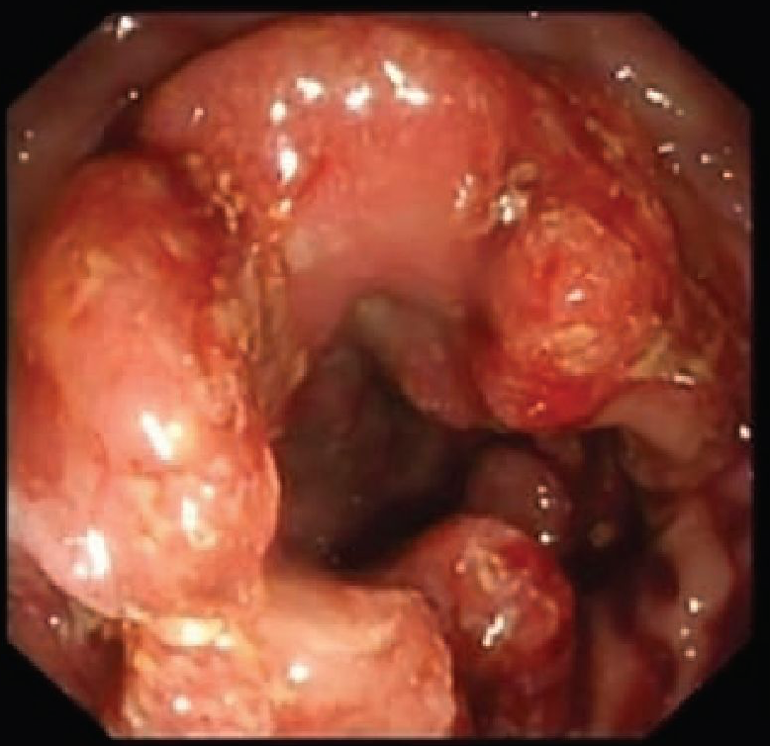
Aims
To compare the health care resource utilization, particularly the requirements of blood transfusion, between Ulcerative colitis (UC)- and Crohn’s disease (CD)-associated CRC who receives colorectal surgery

Slide 4
Methods
Study Design: A cross-sectional study
Data Source: The Nationwide Inpatient Sample (NIS) database
(2008-2012)
Patients Selection: UC, and CD, and colorectal cancer (CRC)
were identified using appropriate ICD-9-CM
codes.
Primary Outcomes:
Requirements of blood transfusion.
Secondary Outcomes:
The location of cancer.
The surgery location

Slide 5
Statistical Analysis
Healthcare outcomes: Propensity match analysis using McNemar’s tests.
Cancer Location and surgical location: Multivariate regression models
SAS 9.3, Cary, NC.

Slide 6
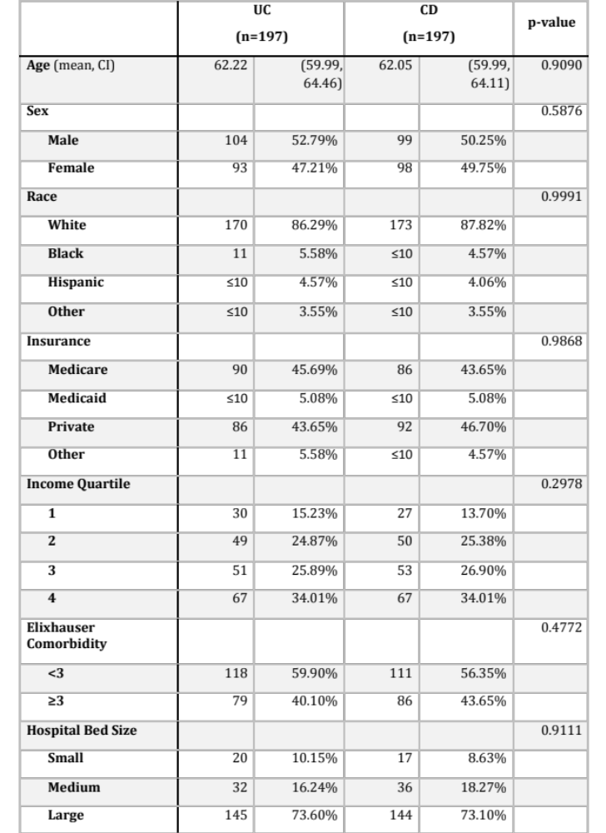
Matched patients’ characteristics

Slide 7
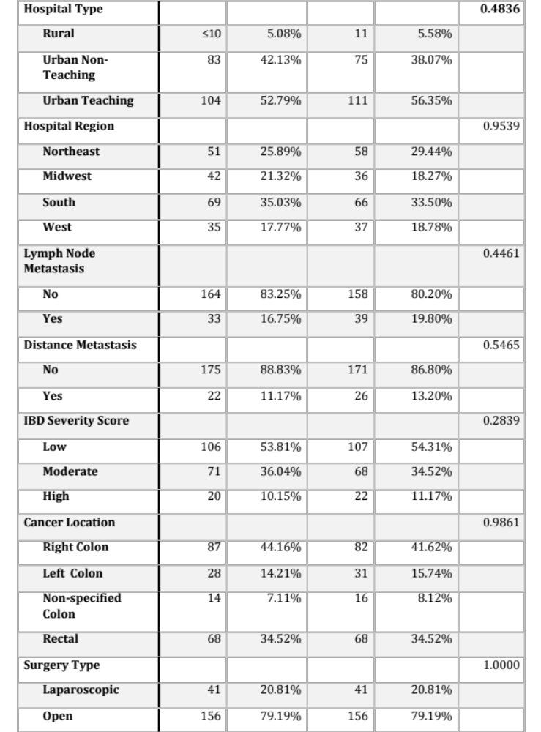
Matched patients’ characteristics

Slide 8
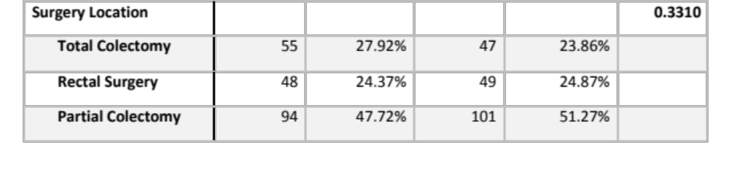
Matched patients’ characteristics

Slide 9

Outcomes
UC-associated CRC patients who receive colorectal surgery more likely
receive blood transfusion when compared with CD-associated CRC patients.

Slide 10
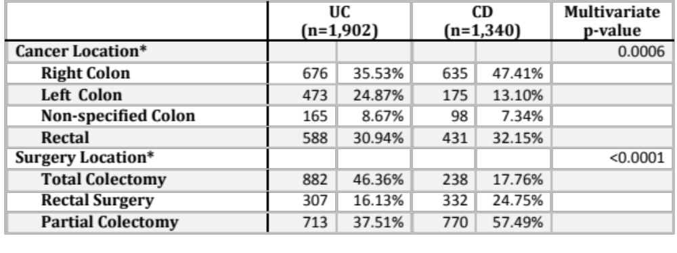
Cancer Location and Surgery Location
*Adjusted for age, gender, race, insurance, income, Elixhauser score, hospital size, type, and region.

Slide 11
Limitations
Large database analysis- Coding errors.
The NIS database does not provide information of the stage of cancer.
Whether patients have received chemotherapy, radiation therapy, or immunosuppressants was unknown

Slide 12
Conclusions
Colorectal surgery in UC-associated CRC patients has been associated with higher health care resource utilization, including blood transfusion, when compared with CD-associated CRC .
The location and type of colorectal surgery are also different between UC- and CD-associated CRC.
This study suggested that the surgical treatment for UC- and CD-associated CRC is different and therefore, care of IBD-associated CRC around colorectal surgery should be treated differently between UC and CD patients.

