Slide 1

Load Bearing Clip Angle Design
2nd World Congress and Exhibition on Construction and Steel Structure
September 22-24, 2016 Las Vegas, Nevada, USA
By:
Dr. Cheng Yu, Professor
Mohamad Yousof, Graduate Student
Mahsa Mahdavian, Graduate Student
Department of Engineering Technology
AISI COS COFS Meetings
September 23, 2016

Slide 2
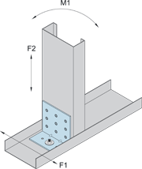
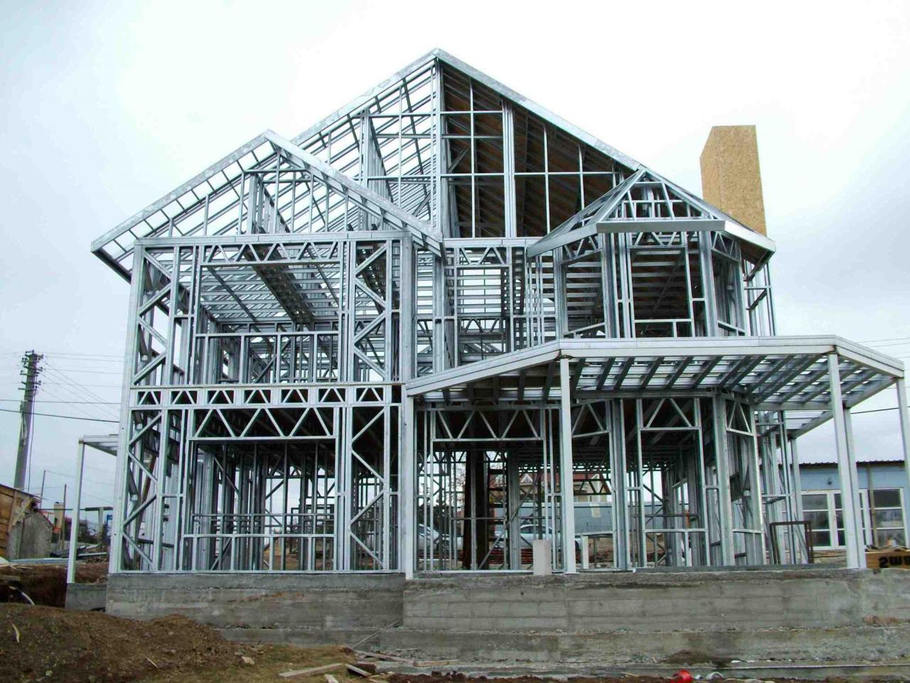
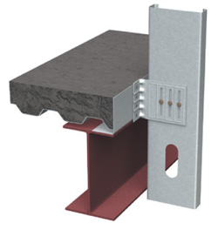
Cold-Formed Steel Structures and Clip Angle Connectors

Slide 3
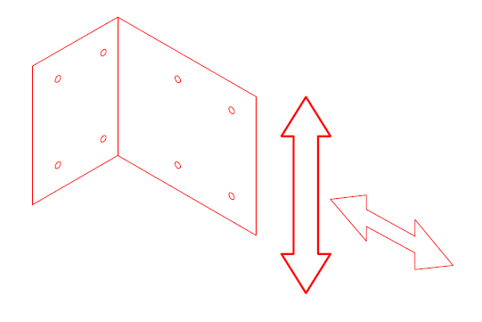
Research Objectives
Transverse shear capacity of the cantilevered leg.
Axial compression capacity of the cantilevered leg.
Pull-over strength on fasteners of the anchored leg.

Slide 4
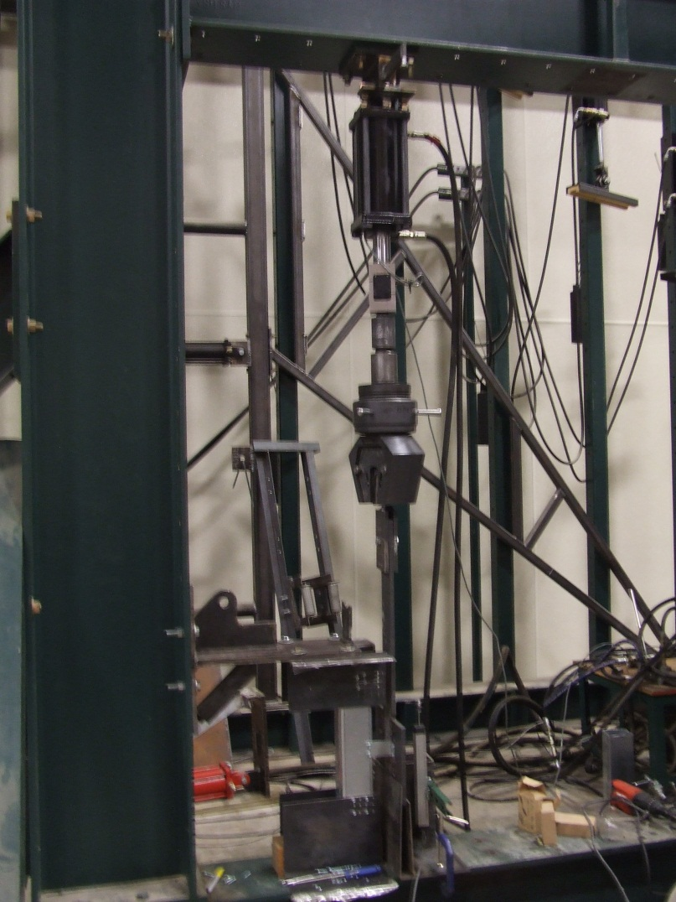
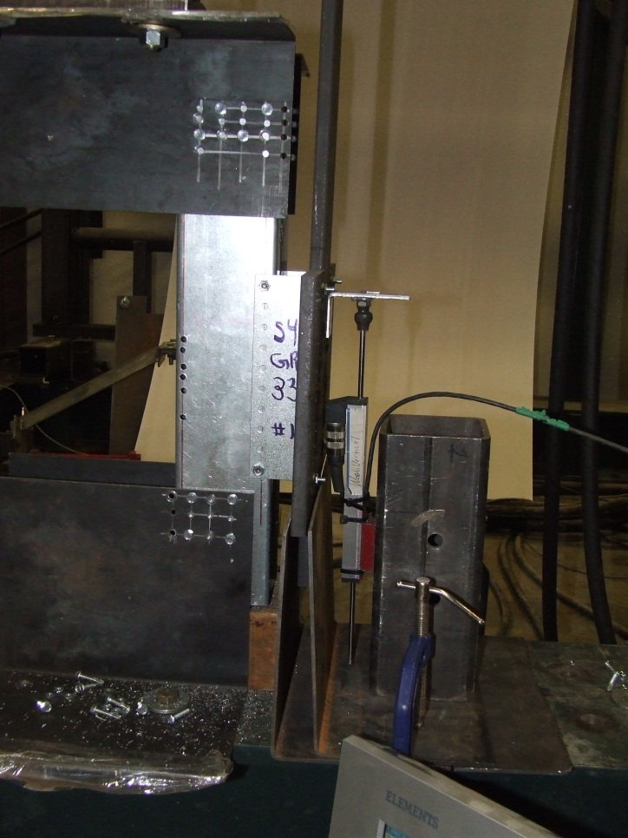
Task 1: Shear Capacity
Test Setup
Hydraulic
cylinder
½” thick strap
2-Stud column
Load cell
Clip angle
Disp. sensor
Load strap
Stud column
Lateral supports

Slide 5
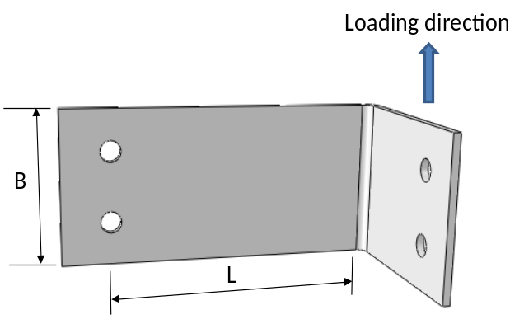
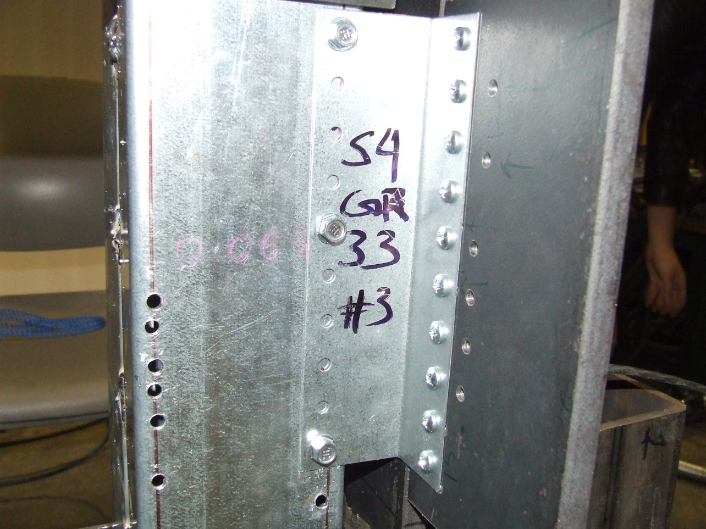
Scope 1: Shear Capacity
Test Setup
N0. 10 BHSC Screws
#14 Screws

Slide 6
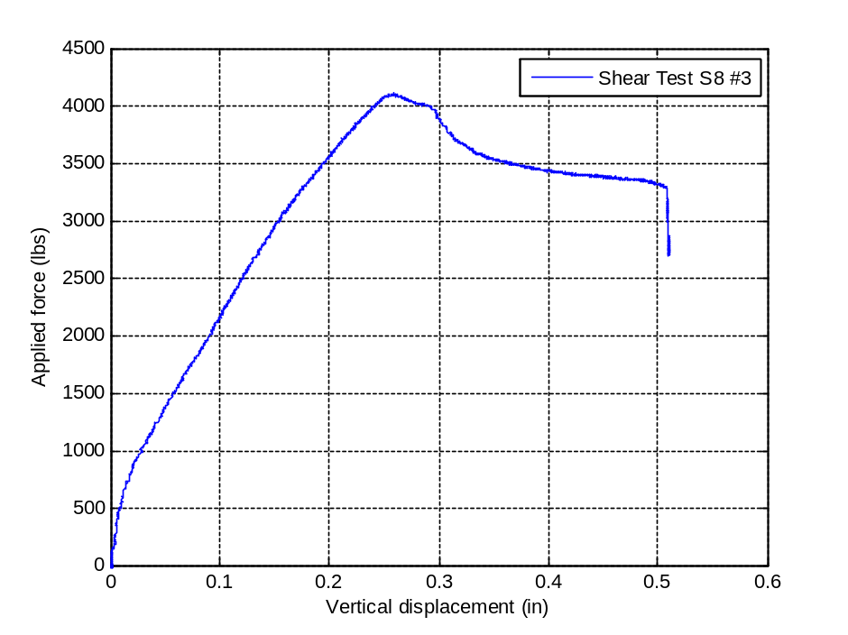
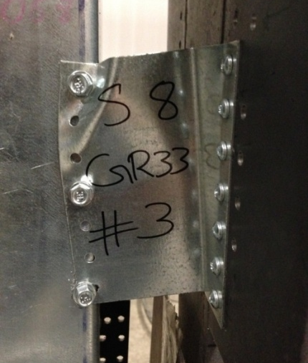
Local buckling failure

Slide 7
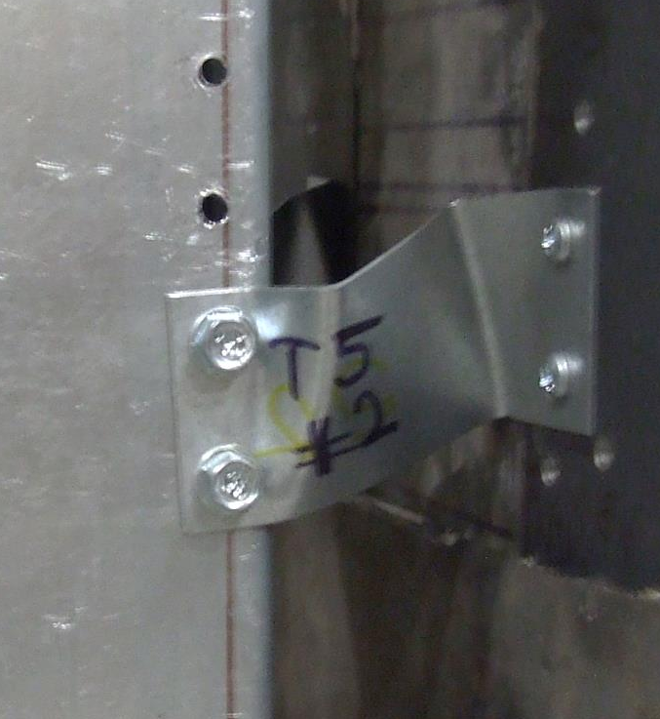
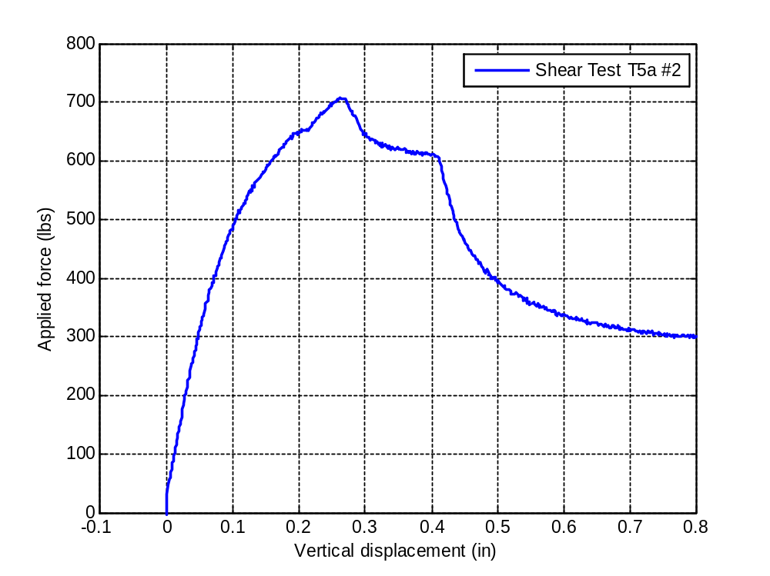
Lateral-torsional buckling failure

Slide 8
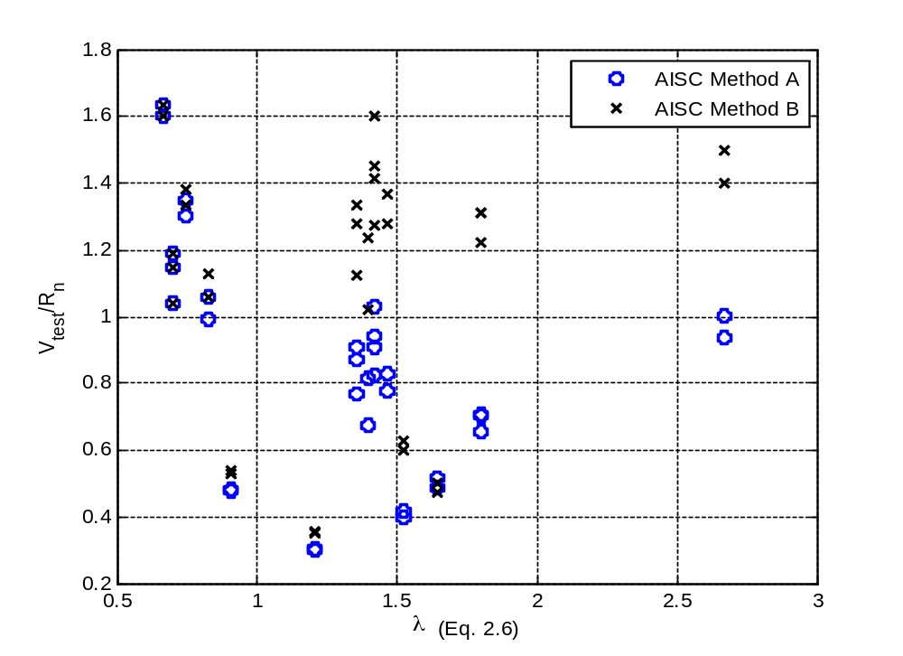
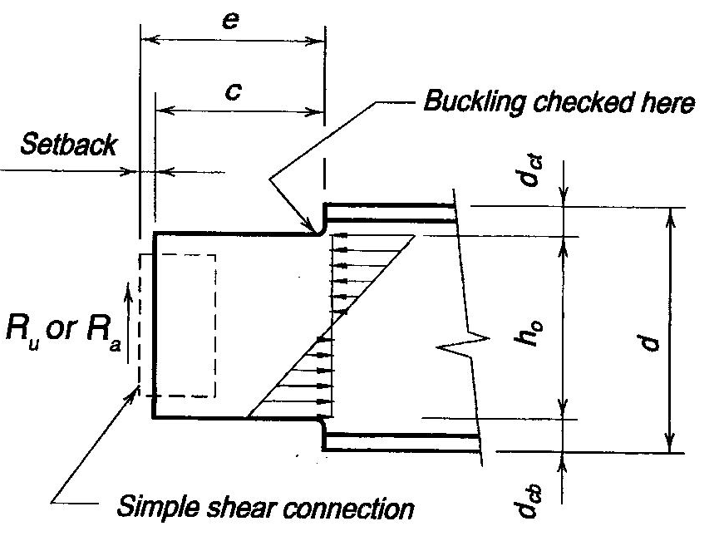
Shear Test Results Compared with AISC Design
Total 33 shear tests
Vest / Vn
 | Method A | Method B
Mean | 0.550 | 1.110
St. Dev. | 0.491 | 0.385
COV | 0.893 | 0.346

Slide 9
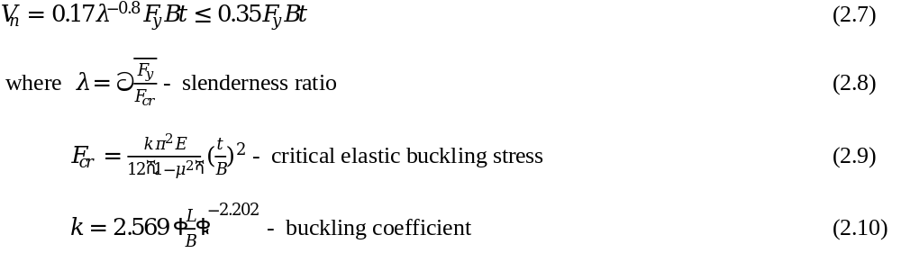
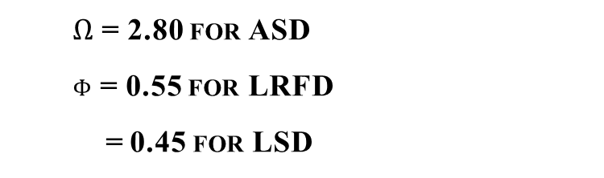
Proposed Shear Design
Nominal shear strength for cantilevered leg of a clip angle
$Ω$ = 2.80 for ASD
$ϕ$ = 0.55 for LRFD
= 0.45 for LSD
New method based on Direct Strength Method concept

Slide 10
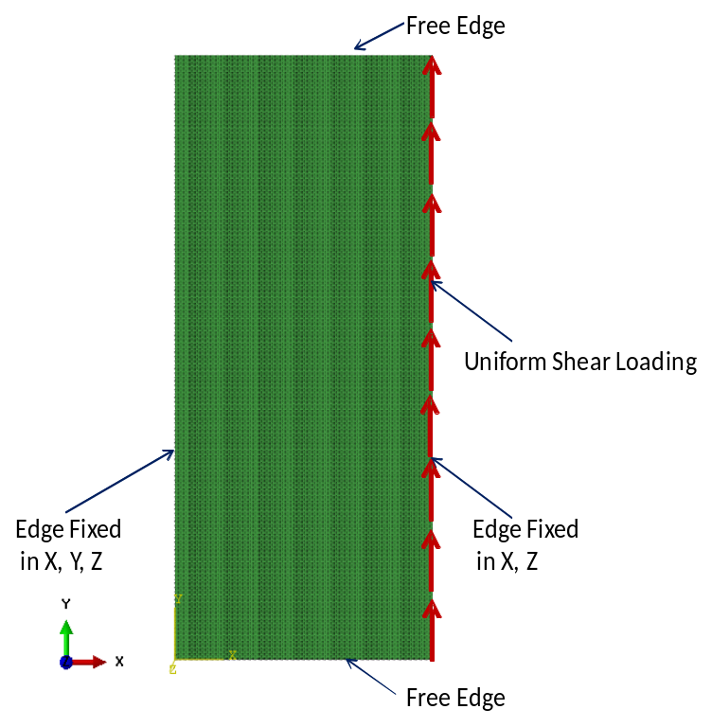
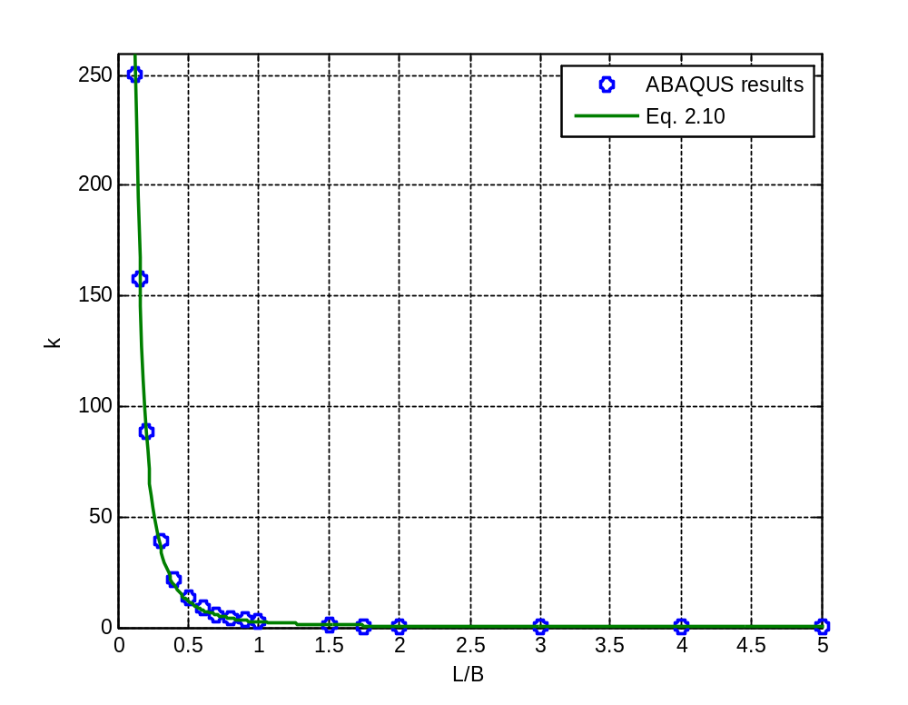
Elastic Buckling Solution
R² = 0.9992

Slide 11
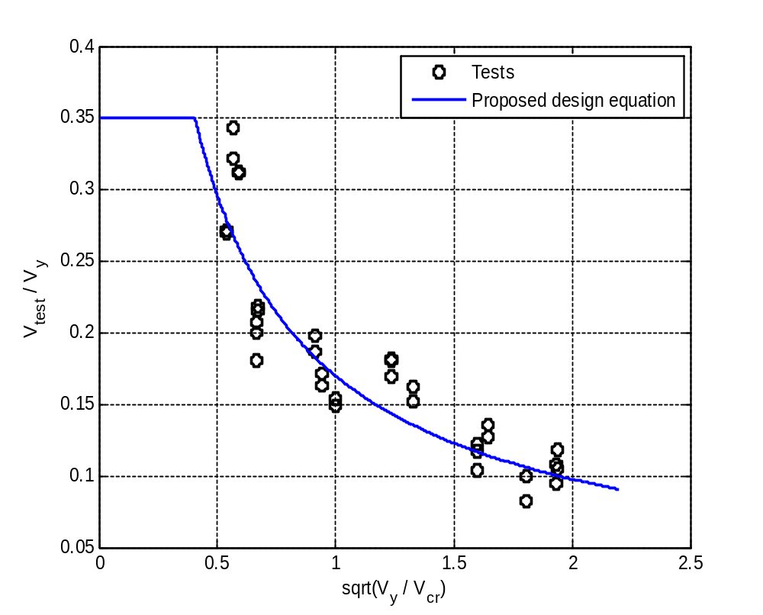
Proposed Design Method Compared with Test Results
R²=0.956

Slide 12
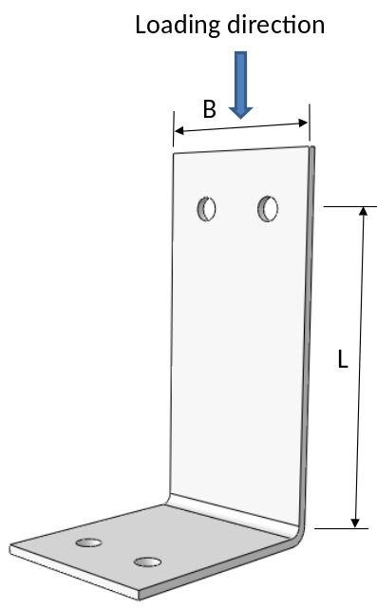
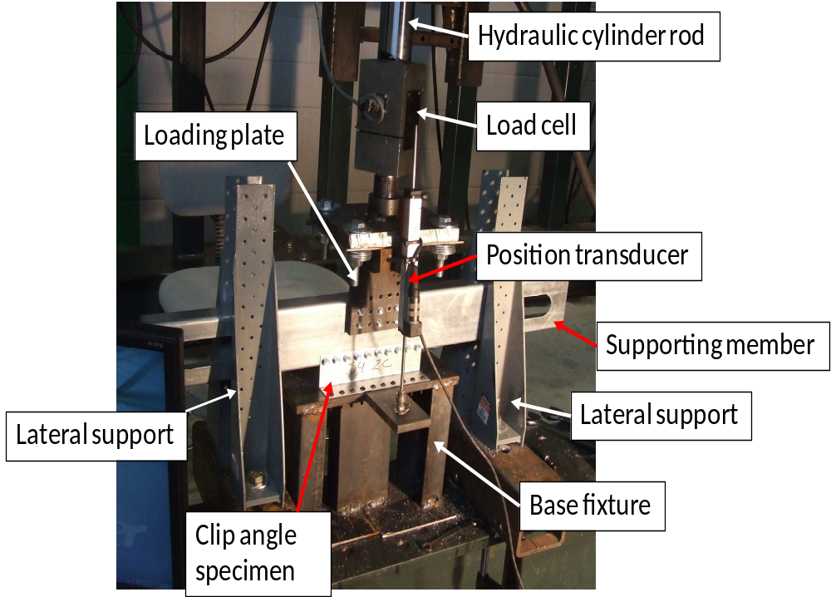
Task 2: Compression Capacity
Test Setup

Slide 13
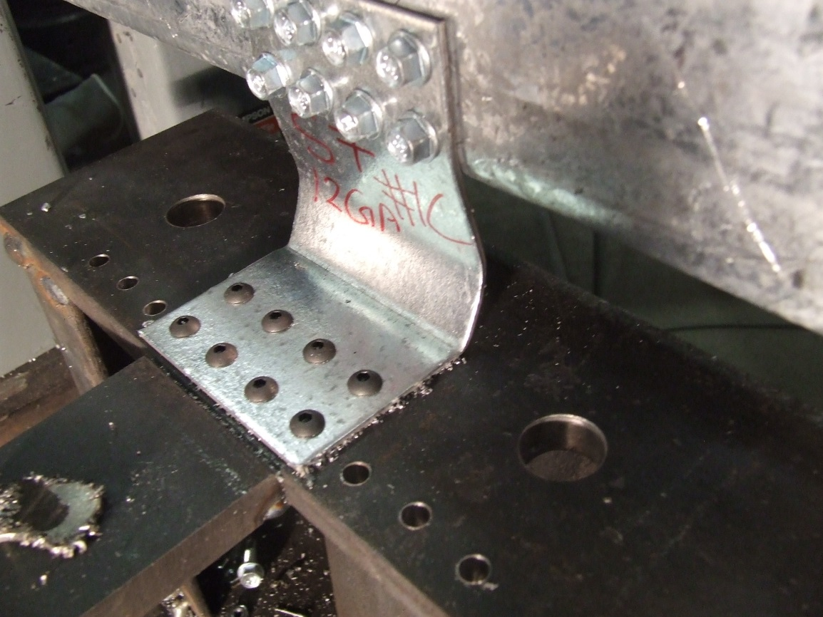
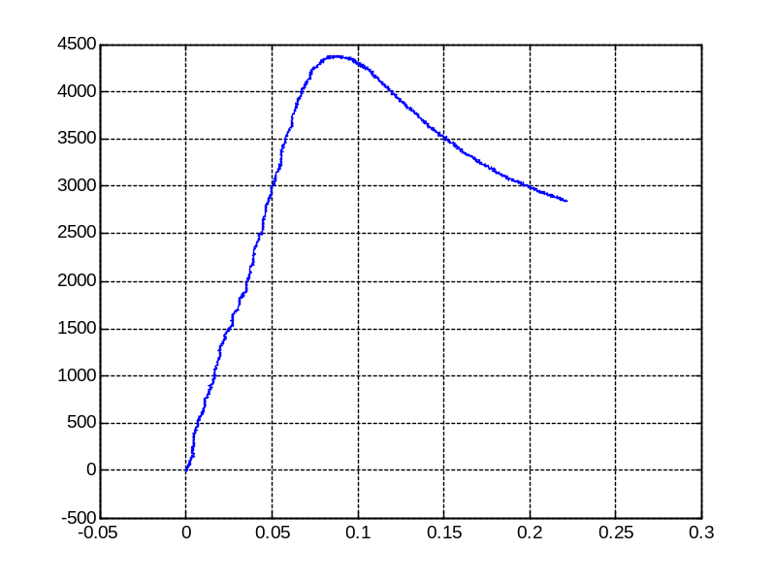
Compression Tests
S7 -12ga

Slide 14
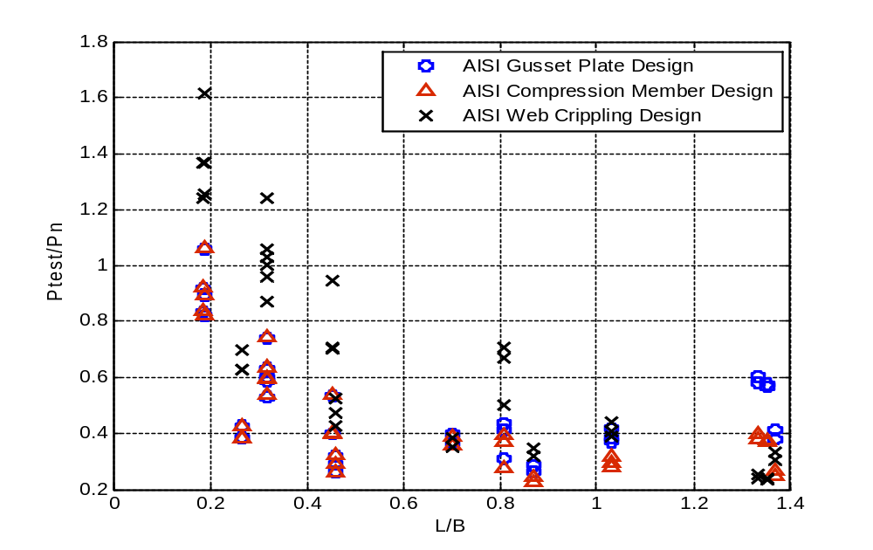
Test Results Compared with AISI Design Methods
AISI S214 – Gusset Plate Design
AISI S100 – Compression Member Design
AISI S100 – Webcrippling Design
Total 36 tests

Slide 15
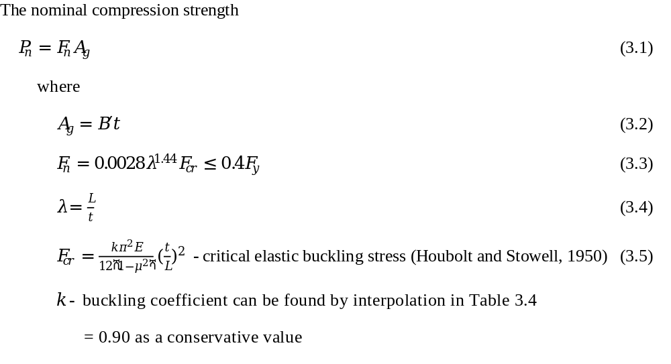
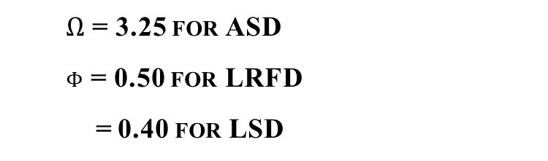
Proposed Compression Design Method
1/8” deformation limit met
$Ω$ = 3.25 for ASD
$ϕ$ = 0.50 for LRFD
= 0.40 for LSD
New method based on AISI/AISC column design theory and use
elastic buckling solutions of plate column

Slide 16
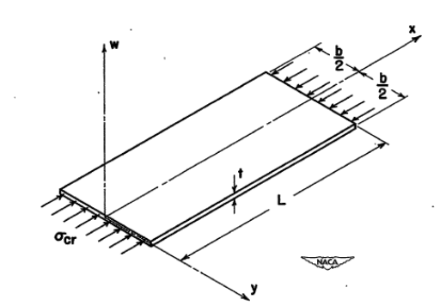
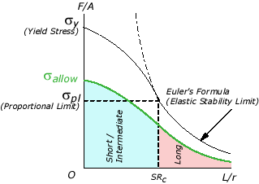
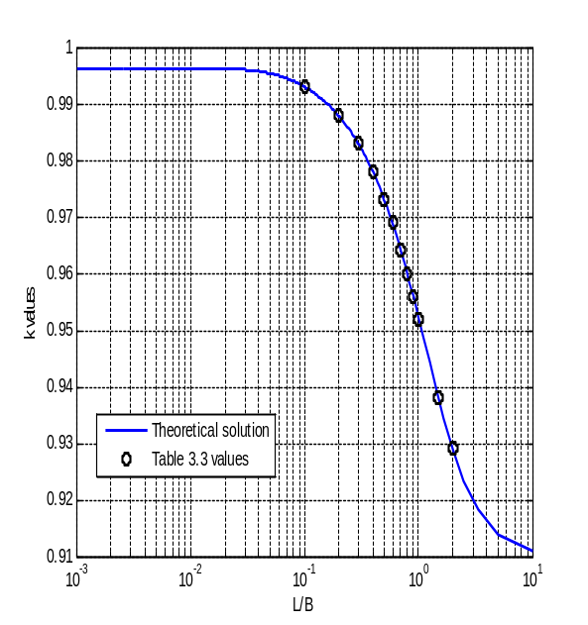
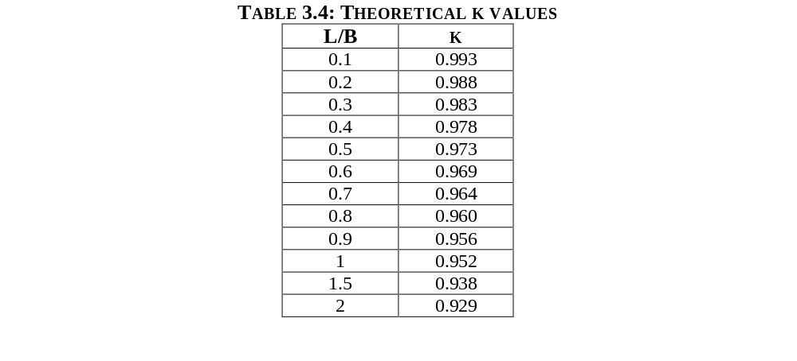
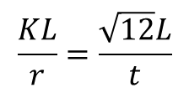
Proposed Compression Design Method
New method based on AISI/AISC column design theory and use
elastic buckling solutions of plate column
KL/r
Houbolt, J. C., Stowell, E. Z. (1950). “Critical Stress of Plate Columns” Technical Note 2163, National Advisory Committee for Aeronautics, Washing, DC, August 1950.
$$\frac{KL}{r}=\frac{\sqrt{12}L}{t}$$

Slide 17
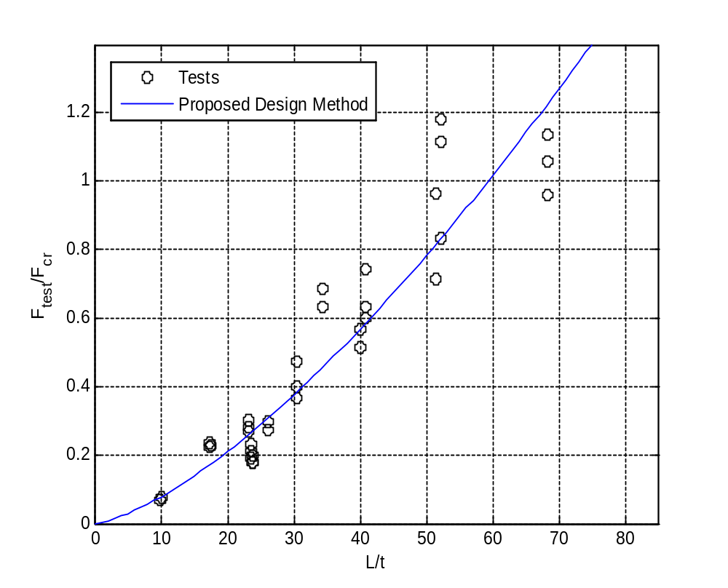
Comparison with Test Results
R²=0.909

Slide 18
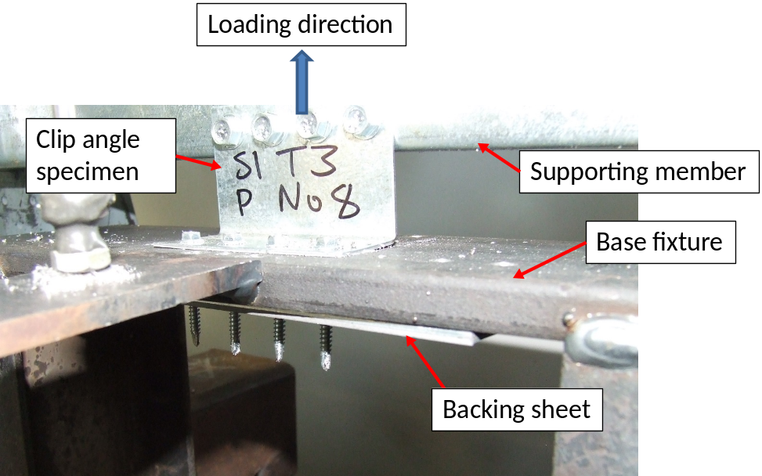
Task 3: Tension/Pull-Over Strength
Test Setup
A total of 38 valid tests

Slide 19
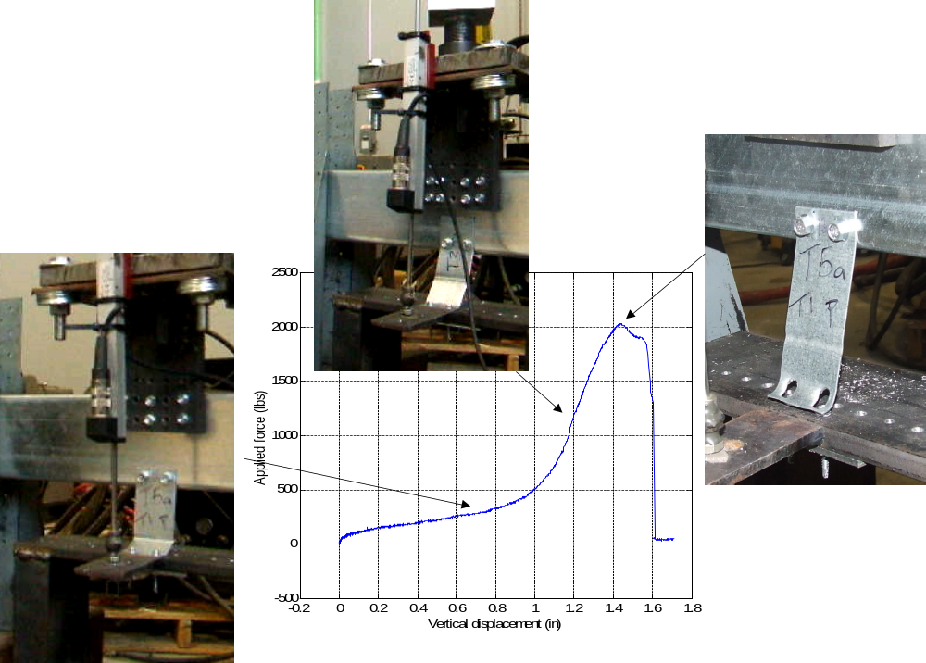
Typical Behavior

Slide 20
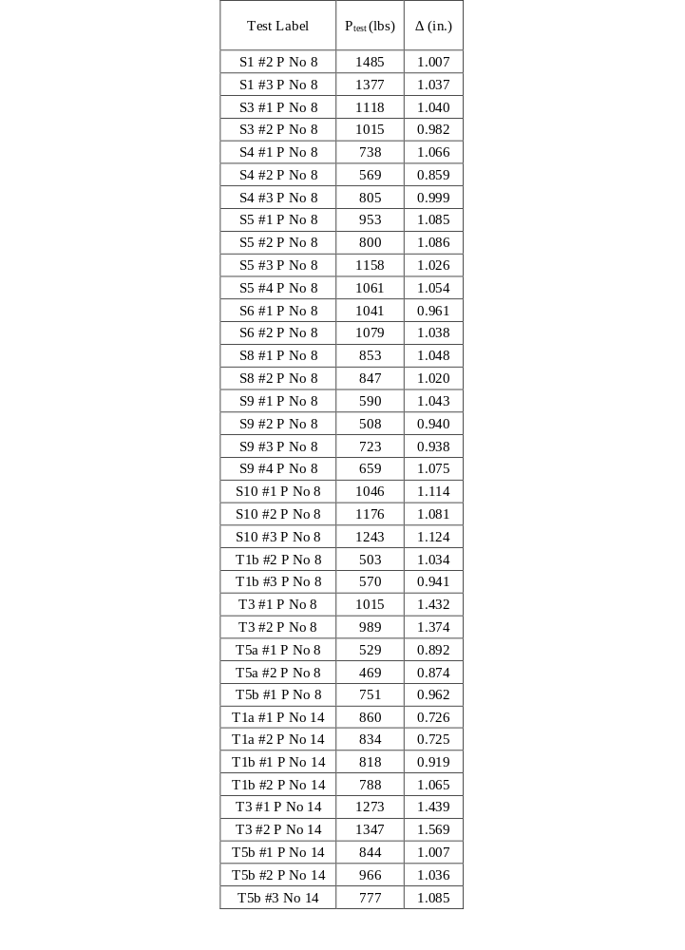


Pull-Over Test Results
A total of 38 valid tests
AISI existing design
$$P_{aisi}={1.5t}_{1}d_{w}^{′}F_{u1}$$
$$t_{1}d_{w}^{′}F_{u1}$$
Ptest/Paisi
Mean | 0.503
St. Dev. | 0.109
COV | 0.217

Slide 21
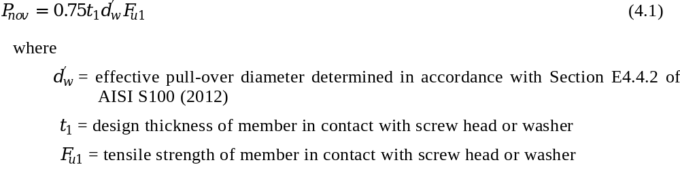
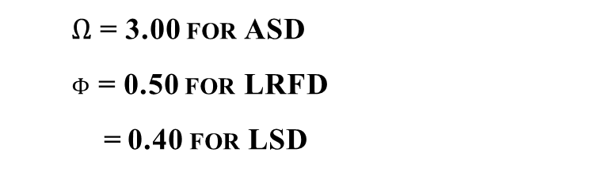
Proposed Design Method
Proposed nominal pull-over strength of screws used in clip angles
$Ω$ = 3.00 for ASD
$ϕ$ = 0.50 for LRFD
= 0.40 for LSD

Slide 22
Conclusions
Existing AISI and AISC design methods do not have reasonable perditions to the clip angle’s strength in three limit states.
New design methods were developed:
  Shear Strength without Consideration of Deformation
  Shear Strength with Consideration of Deformation
  Compression Strength
  Pull-Over Strength of Screws
A target reliability index of 3.5 was used for determining the LRFD, LSD resistance factors and the ASD safety factors according to ICC-ES AC261.

Slide 23
Acknowledgements
Funding Agent: American Iron and Steel Institute
Material Donation: Simpson Strong-Tie, HILTI
Technical Advising: AISI Project Monitoring Task Group
UNT undergraduate students:
Derrick Nathan
Emmanuel Velasco
Tom Kalisky

