Slide 1

Large scale mapping of human plasma CF-glycoproteome via HCD and ETD fragmentation
Speaker: Cheng Ma Ph. D
Georgia State University
08-29-2016

Slide 2
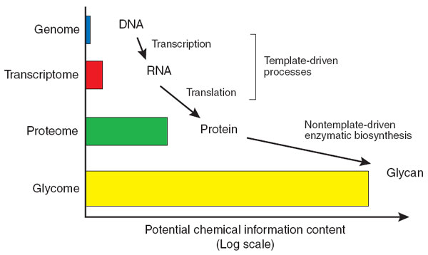
Omes - Structural Diversity Foundation
It is estimated that 50% of proteome are glycosylated.
Glycoproteome
20,000-25,000 genes
∼ 100,000 transcripts
Glycosylation
Post-translational Modification
(PTM)
∼ 1,000,000 proteins
magnitude order of proteome
Turnbull JE, et al. Nature Chemical Biology. 2007,3:74 – 77
Transforming Glycoscience: A roadmap for the future. 2012
Mann M, et al. Nat Biotechnol. 2003,21(3):255-61
Apweiler R, et al. Biochim Biophys Acta. 1999,1473(1):4-8

Slide 3
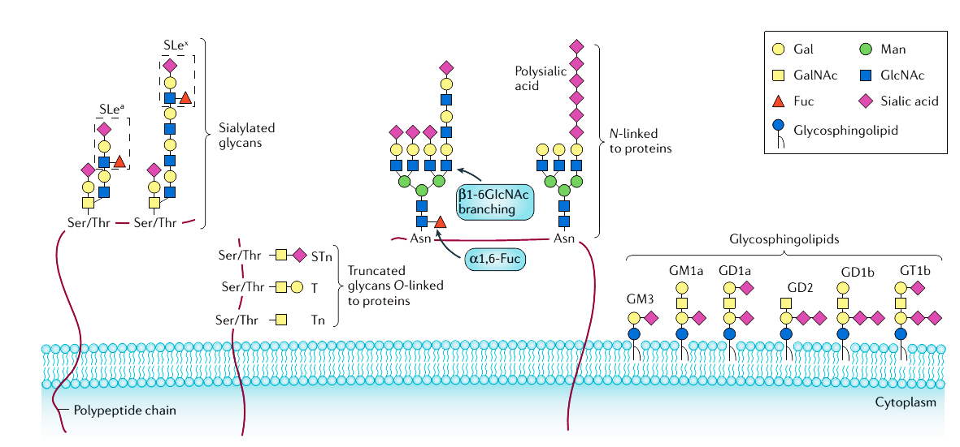
Important tumour-associated glycans
SLe^{x} and SLeª ↑
terminal α2,6 sialylation in N/O-glycan ↑
α2,8 linked polysialic acid ↑
β1-6GIcNAc branching ↑
α1,6-Fucosylation ↑
↑ Overall sialylation
↑ Glycan size
Pinho, S. S., & Reis, C. A. (2015). Nat Rev Cancer.

Slide 4
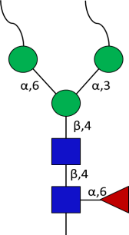
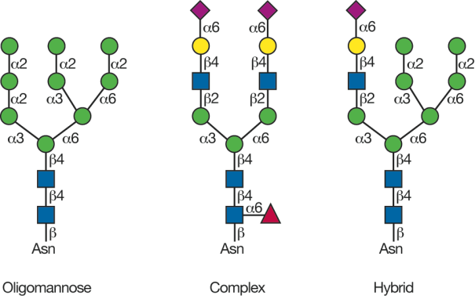

What is core-fucosylation?
Core focosylation is a kind of N-glycosylation that α-1,6 fucose link to innermost GlcNAc

Slide 5
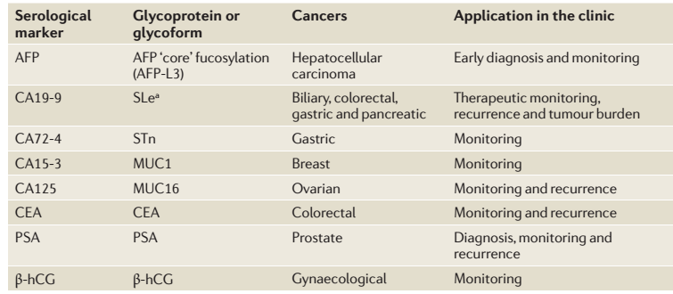
Examples of serological markers with clinical applications

Slide 6
The Research Significance of CF-glycoproteins:
CF-proteins are associated with types of cancer
Liver cancer
Noda, K., Miyoshi, E., Gu, J., Gao, C. X.,Relationship between elevated FX expression and increased production of GDP-L-fucose, a common donor substrate for fucosylation in human hepatocellular carcinoma and hepatoma cell lines. Cancer Res. 2003, 63, 6282 – 6289.
Noda, K., Miyoshi, E., Uozumi, N.,High expression of α-1-6 fucosyltransferase during rat hepatocarcinogenesis. Int. J. Cancer 1998, 75, 444 – 450.
Noda, K., Miyoshi, E., Uozumi, N., Yanagidani, S.,Gene expression of α1–6 fucosyltransferase in human hepatoma tissues: a possible implication for increased fucosylation of α-fetoprotein. Hepatology 1998,28, 944 – 952.
Block, T. M., Comunale, M. AMehta, A. S. Use of targeted glycoproteomics to identify serum glycoproteins that correlate with liver cancer in woodchucks and humans. Proc. Natl. Acad. Sci. U. S. A. 2005, 102, 779 – 784.
Pancreatic cancer
Okuyama, N, Nakano, M.,Fucosylated haptoglobin is a novel marker for pancreatic cancer: a detailed analysis of the oligosaccharide structure and a possible mechanism for fucosylation. Int. J. Cancer, 2006, 118, 2803 – 2808.
Barrabés, S., Pagès-Pons, L., Radcliffe, C Glycosylation of serum ribonuclease 1 indicates a major endothelial origin a reveals an increase in core fucosylation in pancreatic cancer, Glycobiology, 2007, 17, 388 - 400.
Lung cancer
.Geng, F., Shi, B. Z., Yuan, Y. F., Wu, X. Z. The expression of core fucosylated E-cadherin in cancer cells and lung cancer patients: prognostic implications, Cell Res. 2004, 14, 423 - 433.
Ovarian cancer
Saldova, R., Rudd, P. M. Ovarian cancer is associated with changes in glycosylation in both acute-phase proteins and IgG, Glycobiology, 2007, 17, 1344 - 1356.
Prostatic cancer
Tabarés, G., Radcliffe, C. M., Barrabés, S., Ramírez, M., Aleixandre, R.N., Different glycan structures in prostate-specific antigen from prostate cancer sera in relation to seminal plasma PSA. Glycobiology, 2006, 16, 132 - 145.

Slide 7
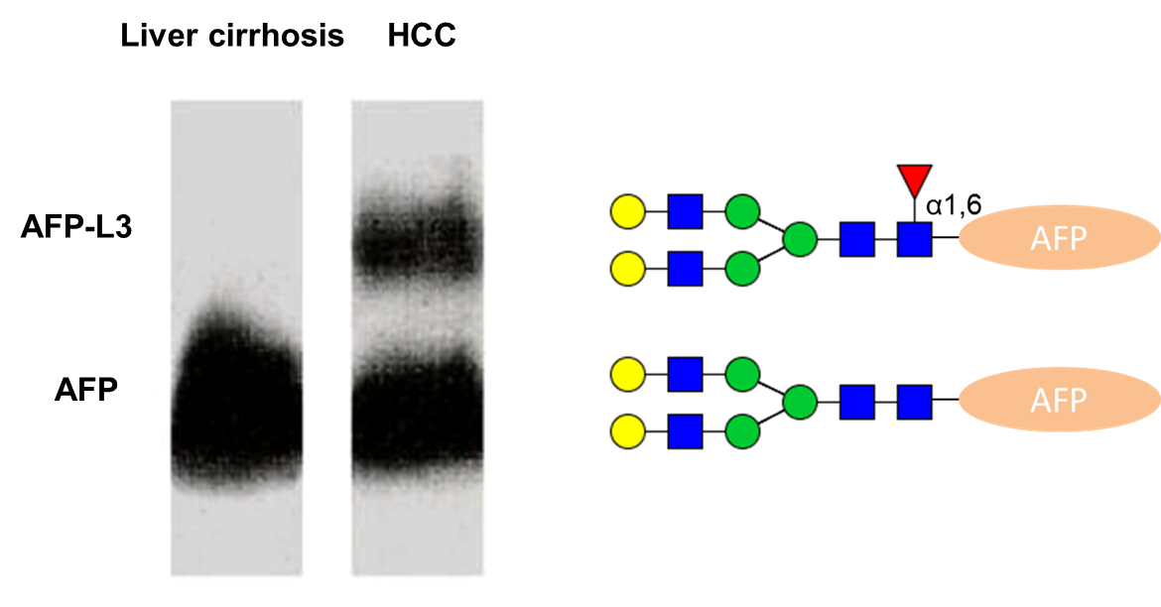
Core-fucsoyaltion of AFP-L3 increase in human liver cancer serum
AFP-L3
AFP-L1
Lentil lectin (LCA) affino-electrophoresis shows that core-fucosylated alpha-fetoprotein (AFP-L3) is expressed in hepatocellular carcinoma (HCC). The AFP-L3 positive rate was ~60% in AFP-producing HCC, but was <5% in chronic liver diseases.
Scand J Immunol. 1981 Jul;14(1):15-20.

Slide 8
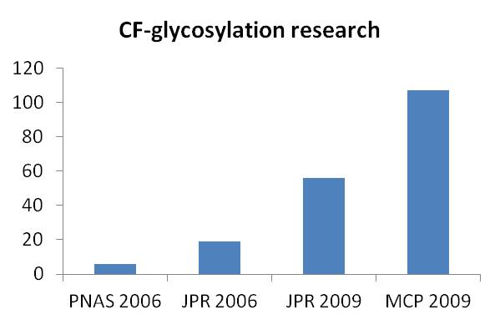
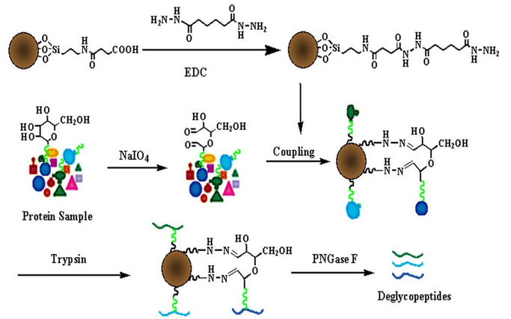

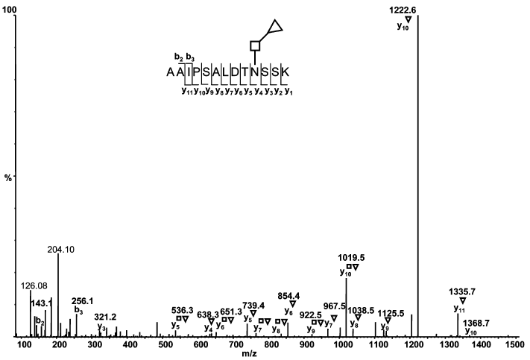

The problem of CF-proteins analysis
International efforts on CF glycoproteins
How to enrich CF-glycoprotein/peptides?
How to identify CF-glycosylation site with MS?
How to analyze CF-glycopeptide spectrum?
VS
PNGase F
Endo F3

Slide 9
How to analyze core-fucosylation?
1. Glycoprotein enrichment
2. Glycan simplification
3. MS-based CF-glycorptein analysis
4. Databases and bioinformatics platforms
5. CF-glycoprotein quantification

Slide 10
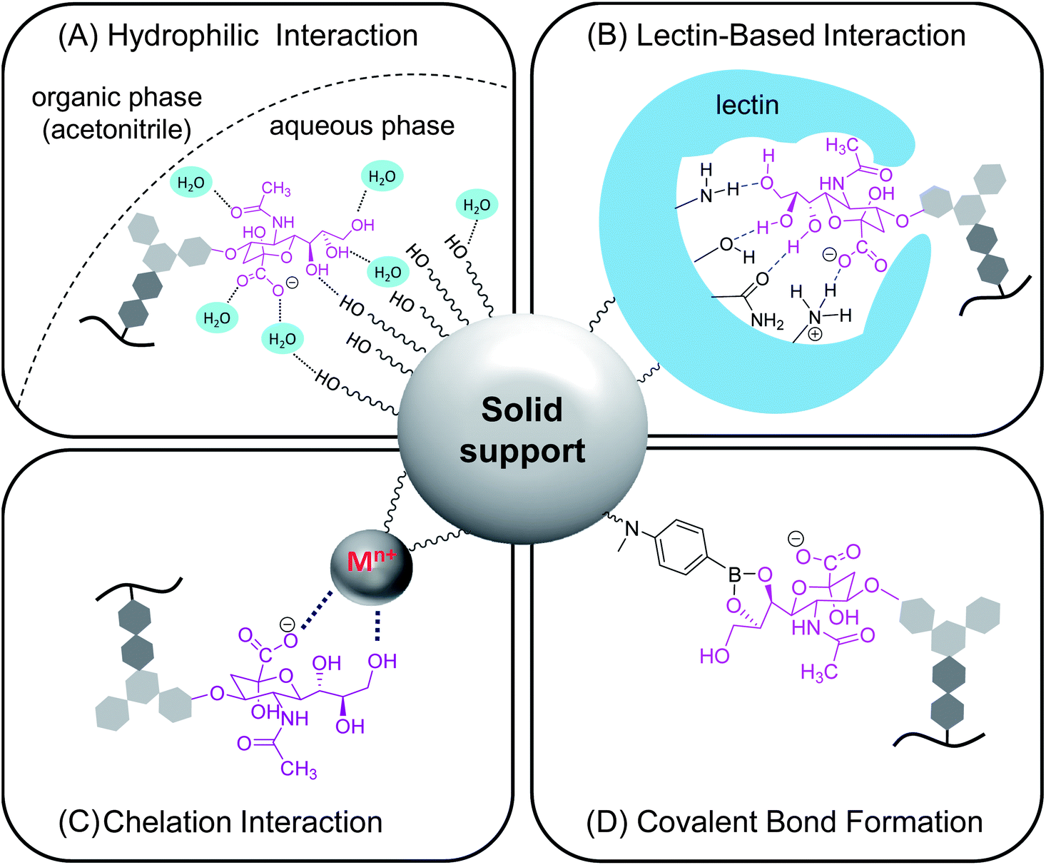
Glycan or glycoprotein enrichment

Slide 11
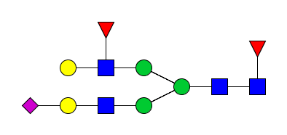





Lectin enrichment
AAL
LCH, AOL
RCA
WGA
L-PHA
SNA
Fucose
SA
Mannose
Galactose
GlcNAc

Slide 12
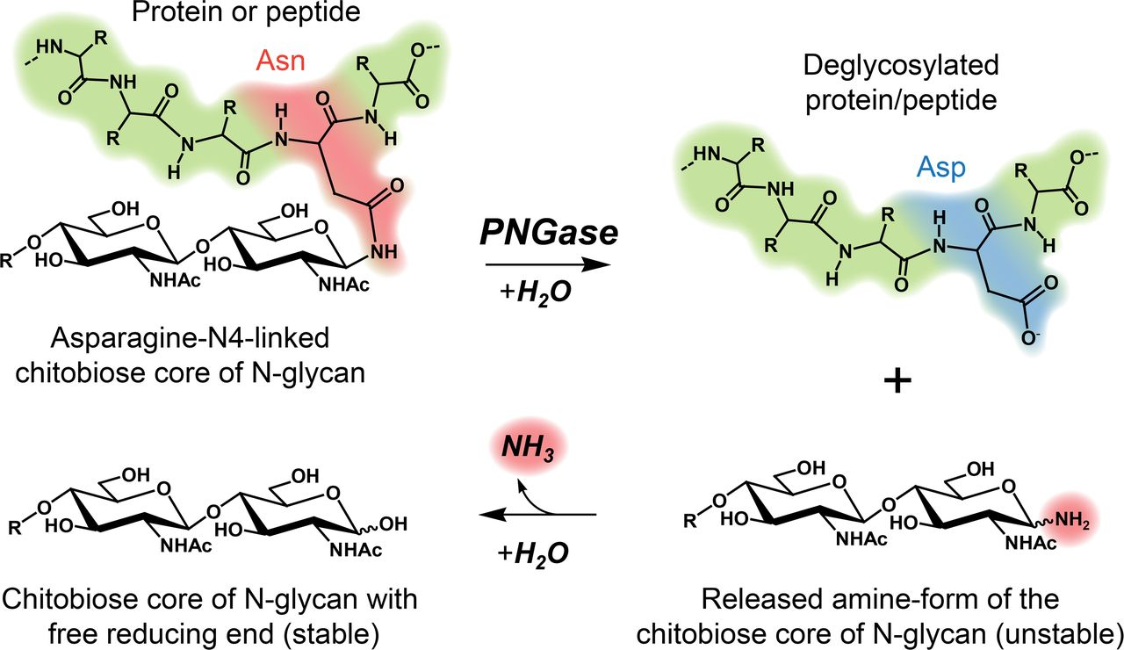
Glycan releasing

Slide 13
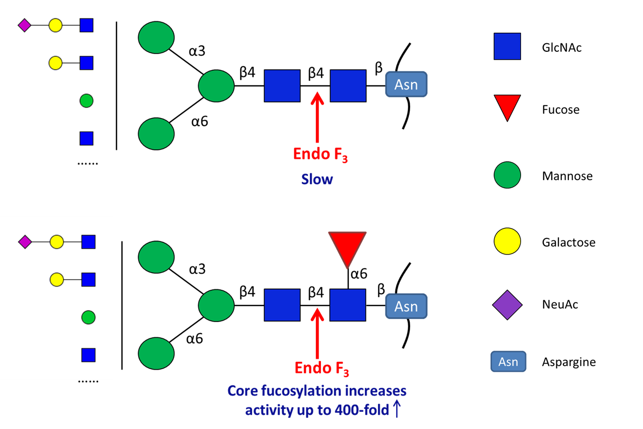
Glycan releasing
Endo F3 is able to cleave biantennary and triantennary with or without core-fucosylation. Endo F3 cleaves non-fucosylated glycoproteins at a slow rate. However, the presence of core fucose increases the Endo F3 activity by up to 400-fold faster than glycoprotein lacking fucose.

Slide 14
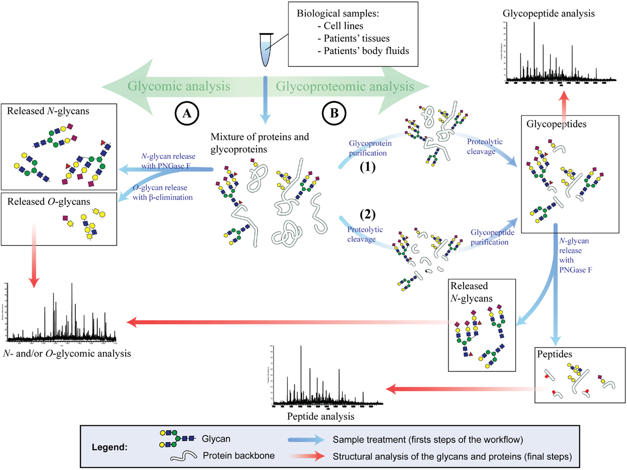
MS based glycomics and glycoproteomics analysis

Slide 15
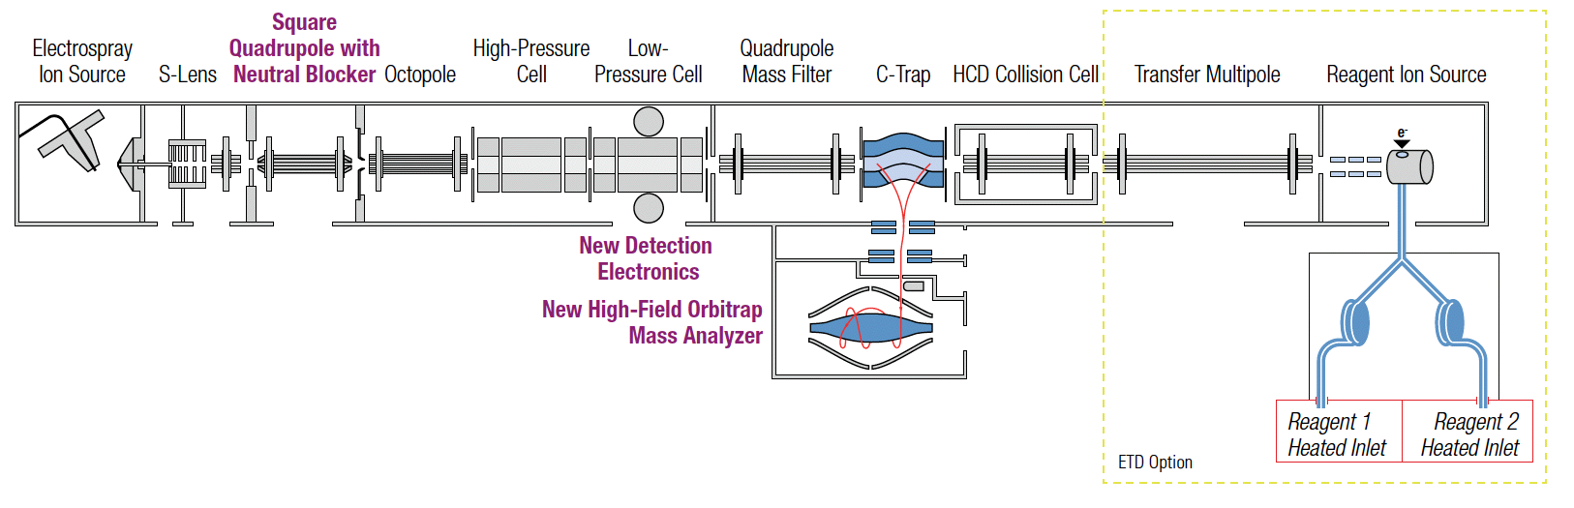
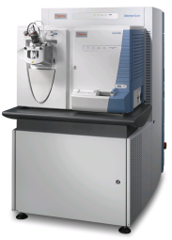
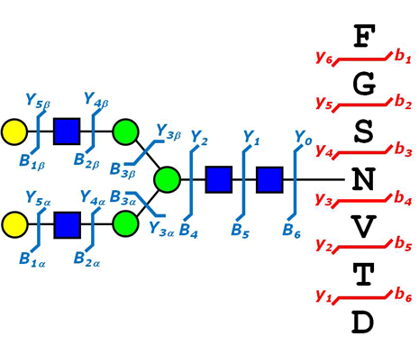
Different fragmented mode in glycoprotein analysis
Collision-induced
dissociation (CID)
Higher-energy collisional
Dissociation (HCD)
Electron-transfer dissociation
ETD enabled the elucidation of glycosylation sites by maintaining the glycan-peptide linkage
CID/HCD enabled the identification of glycan structure and peptide backbone.

Slide 16
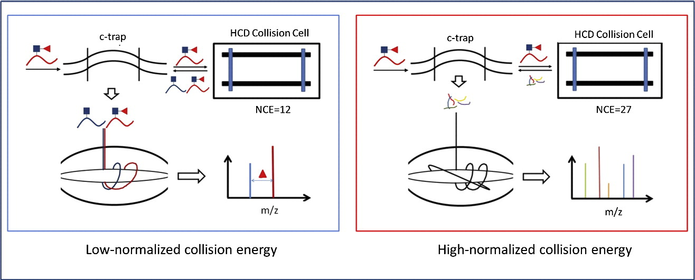
A precise approach in large scale core-fucosylated glycoproteins identification with low- and high-normalized collision energy
Principle
Cheng Ma, J. Proteomics, 2014

Slide 17
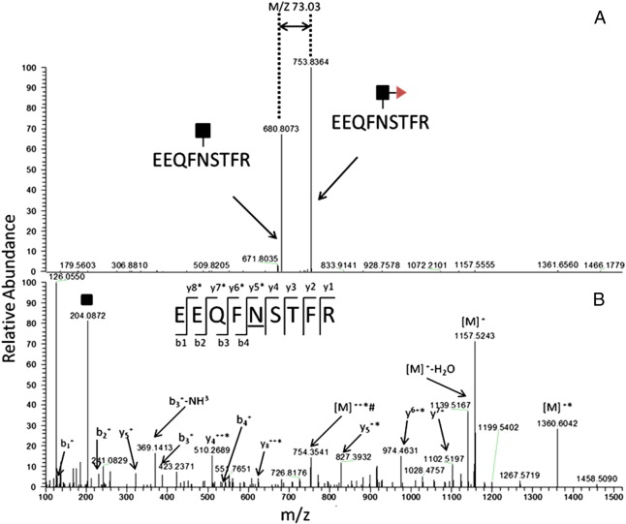
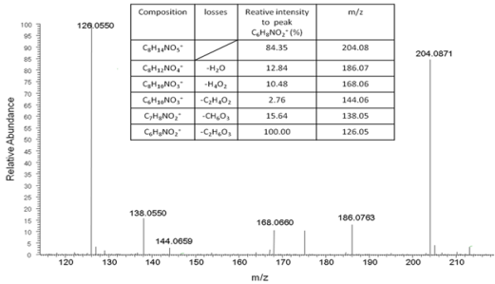
A precise approach in large scale core-fucosylated glycoproteins identification with low- and high-normalized collision energy
[M]-[M(NL)]=146/n (N=1, 2, 3)
Low
Neutral loss peaks and their precursor ions could be observed as the two highest peaks in the MS/MS spectra
Diagnostic ions: GlcNAc (m/z=204.08), 186.08, 168.07, 144.07, 138.05 and 126.05
Based on this result, a software package was developed in-house for the selection of partially deglycosylated CF-glycopeptides
High
Cheng Ma, J. Proteomics, 2014

Slide 18
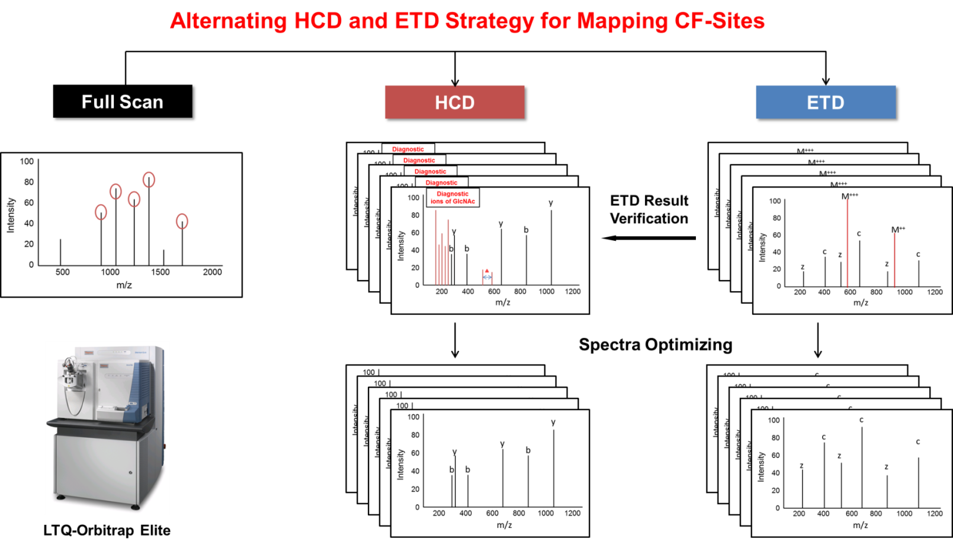
Large scale mapping of human plasma CF-glycoproteome via HCD and ETD fragmentation
Cheng Ma, J. Proteomics, 2016

Slide 19
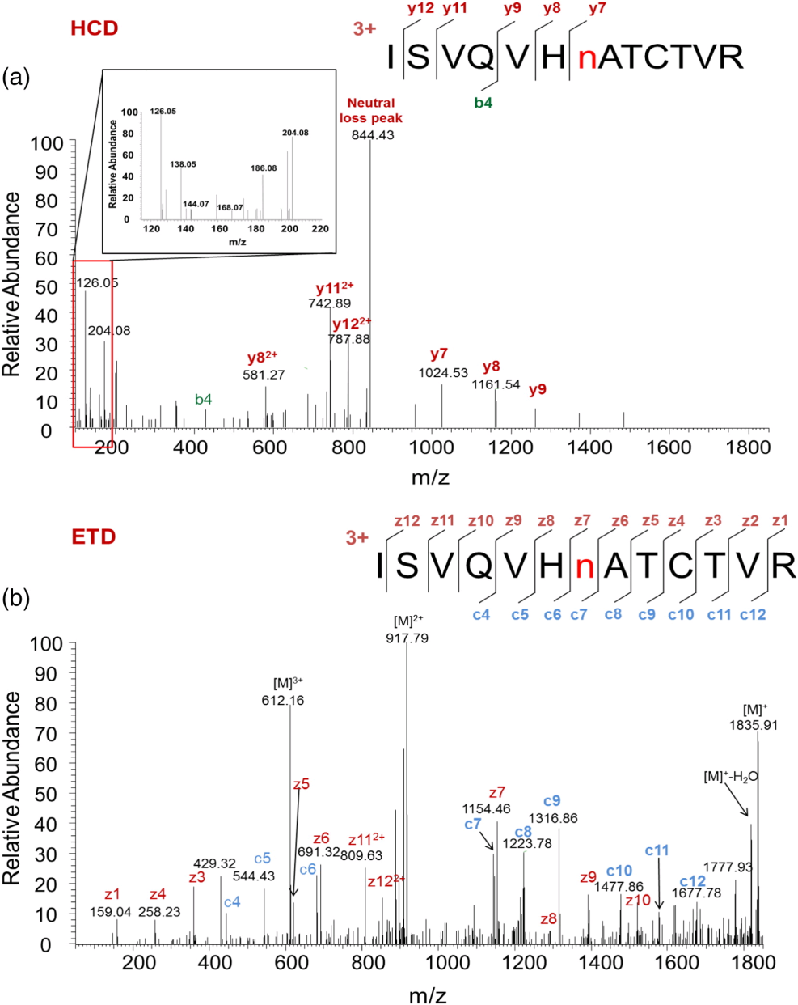
HCD and ETD spectra of ISVQVHnATCTVR
From the HCD spectrum, the fragment ions are lack because of the strong neutral loss peak of precursor ion and diagnostic ions of GlcNAc.
ETD enabled the elucidation of CF-glycosites by maintaining the glycan-peptide linkage.
Cheng Ma, J. Proteomics, 2016

Slide 20
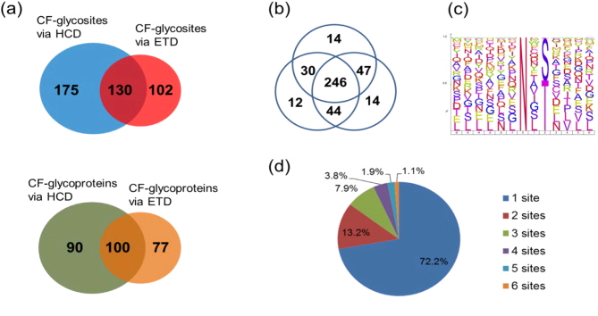
Large scale mapping of human plasma CF-glycoproteome via HCD and ETD fragmentation

Slide 21
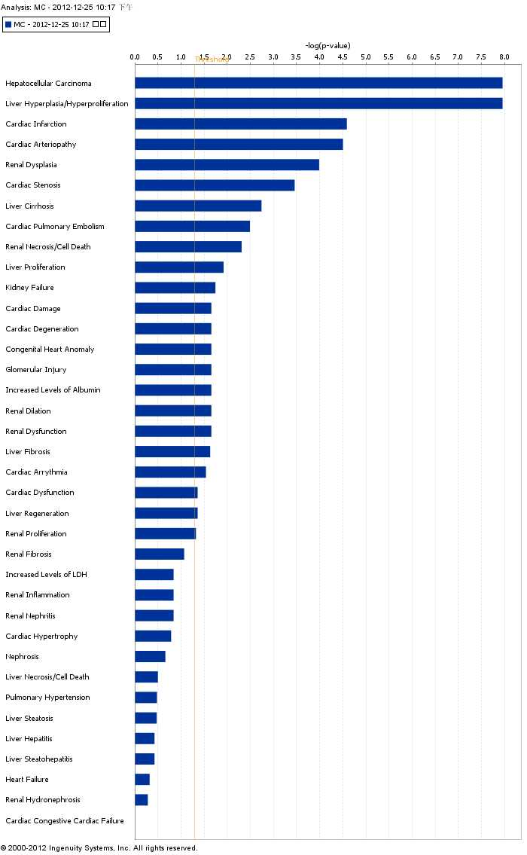
Biological functions of CF proteins with IPA analysis
HCC
Biological function | P-value | Number
Cancer | 6.07E-16- 2.72E-03 | 71
Organismal Injury and Abnormalities | 3.58E-12- 1.43E-03 | 16
Neurological Disease | 1.05E-11- 2.03E-03 | 18
Psychological Disorders | 1.05E-11- 2.03E-03 | 22
Inflammatory Response | 3.47E-11- 1.75E-03 | 36

Slide 22
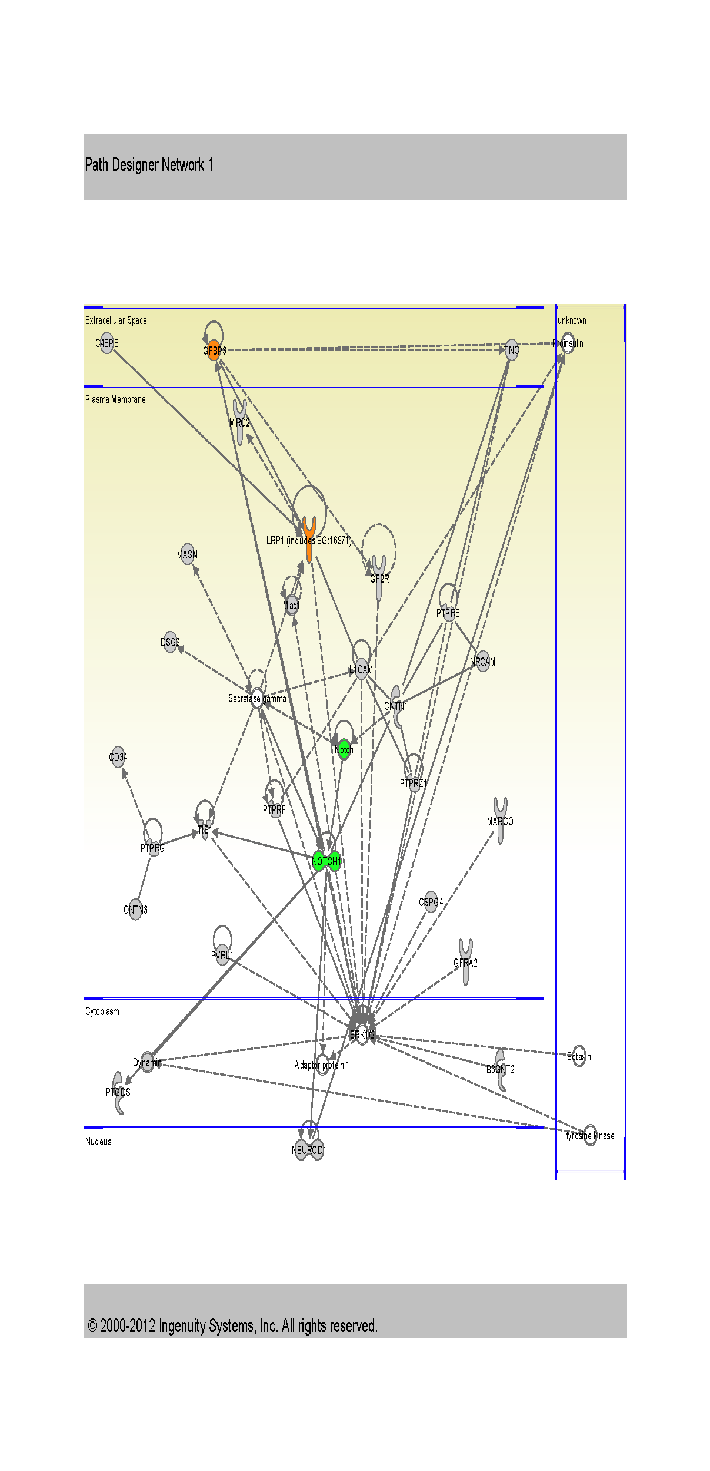
CF modified pathway
1st enriched pathway:
Cellular Movement, Nervous System Development and Function, Cellular Assembly and Organization
27 of 35 gene were CF modified
ingenuity pathway analysis

Slide 23

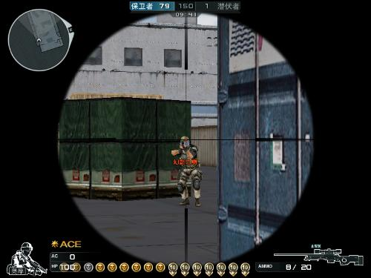
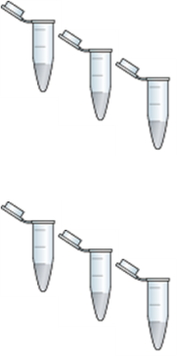
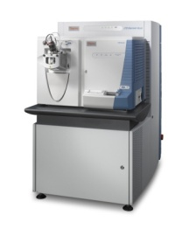
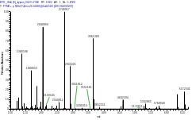

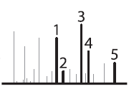
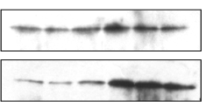
Label-free Quantitative Proteomics of CF-glycoproteins in Liver Cancer Patients’ Serum
6 Normal human serum
Profiling-based
RPLC.
6 HCC human serum
Selection of Target
Proteins
Database
Notes:
In this work, we built up a lable-free quantitative strategy for biomarker discovery in human HCC serum
The normal serum and HCC serum were come from 6 persons,respectively. The strategy were accordance with part2 and we verified with western blot and Target-HCD.

Slide 24
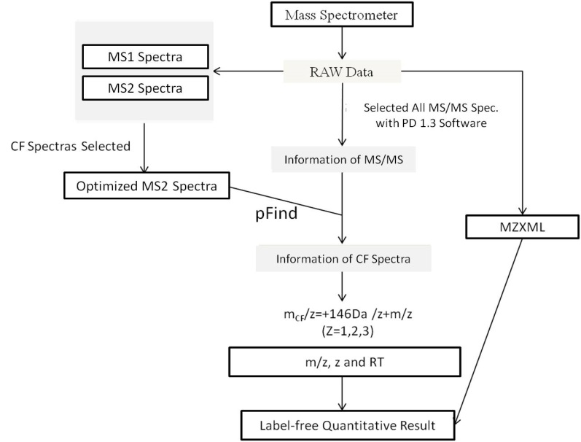
Label-free Quantitative Proteomics of CF-glycoproteins in Liver Cancer Patients’ Serum
Establishment of non data-depentent
label-free quantitative method
Notes:
Further, we developed a label-free quantitative research for markers discovery in the normal and hepatocellular carcinoma (HCC) human serum, and discovered a number of high expression of core fucosylated protein. Except for α-fetoprotein (AFP) and Golgi Protein 1 (GP 73), α-1-antitrypsin (α1AT), ICAM-2 were also showed change in CF-glycosites level between normal and HCC serum. Futher, some high-expression CF-proteins were certified with western-blot, target-HCD. High-level expression of CF-proteins in HCC human serum provide a valuable biomarker reference for clinical research, and this research strategy also provides an important approach for biomarker screening in other cancers.

Slide 25
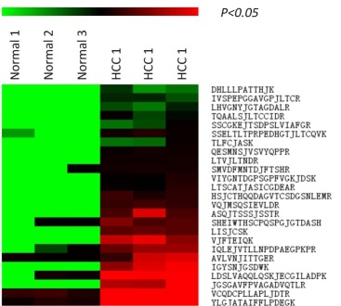
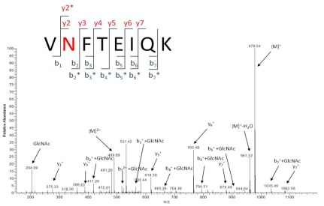
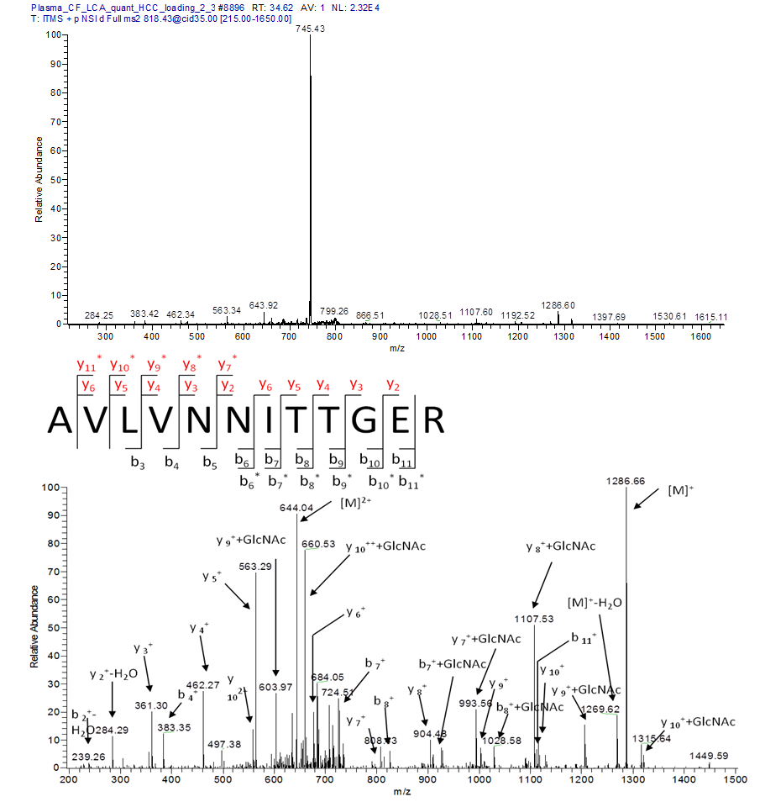
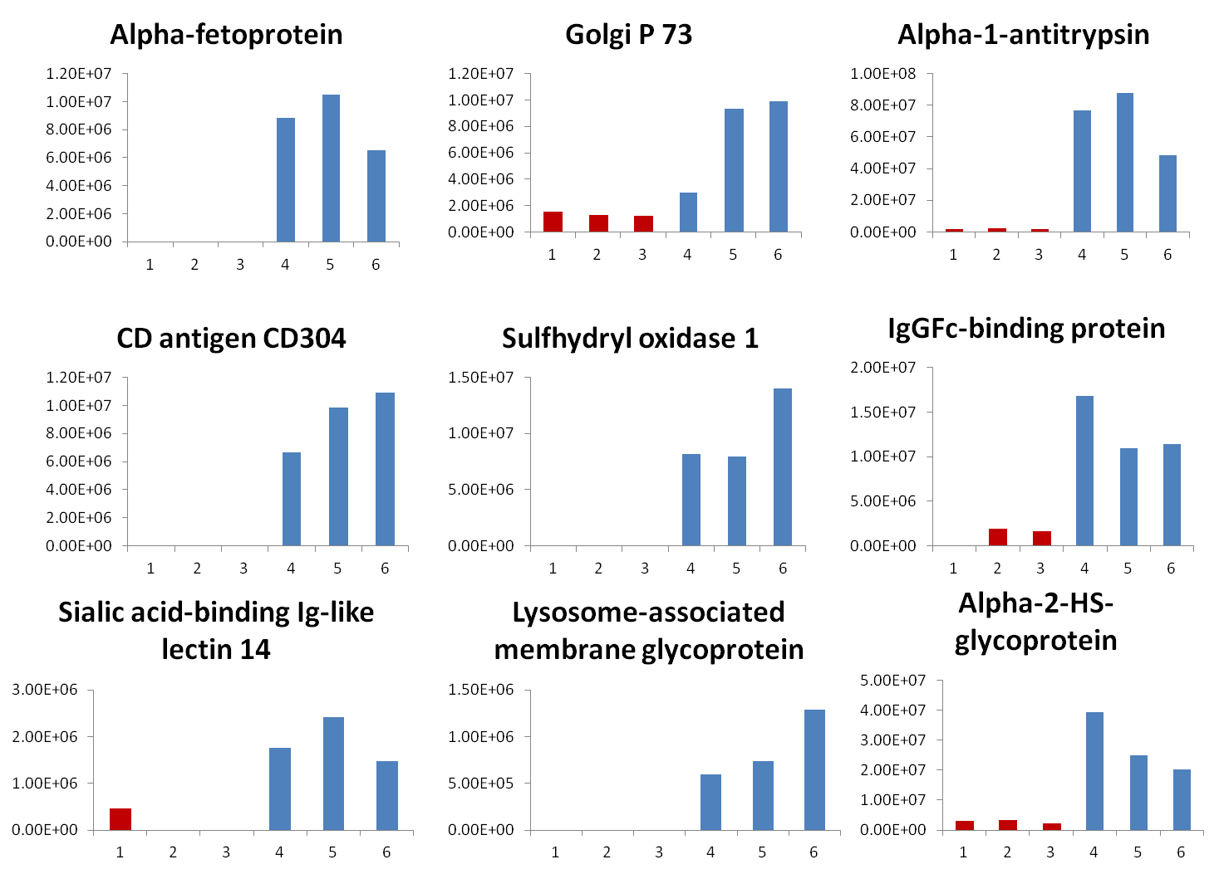
A total of 26 over expression CF-glycopeptides was identfied from HCC
In preparation

Slide 26
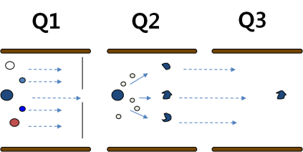
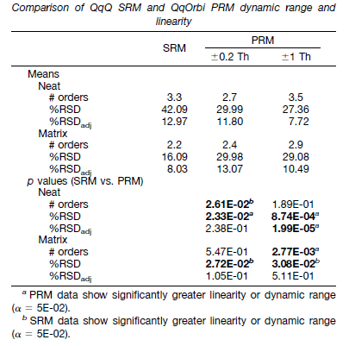

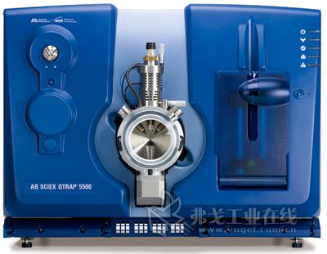
Large-scale Verification of CF-proteins
VS
Target-HCD has good linear range with MRM
Target-HCD has good reproducibility with MRM
Target-HCD has high resolution in MS1 and MS2
Amelia C et al MCP 2012
Notes:
In the verification test of CF-proteins,we chose Target-HCD method. Compared with MRM, Target-HCD also has good linear range ;Target-HCD also has good reproducibility with MRM which has been proved by artcile of MCP; Target-HCD has high resolution in MS1 and MS2

Slide 27
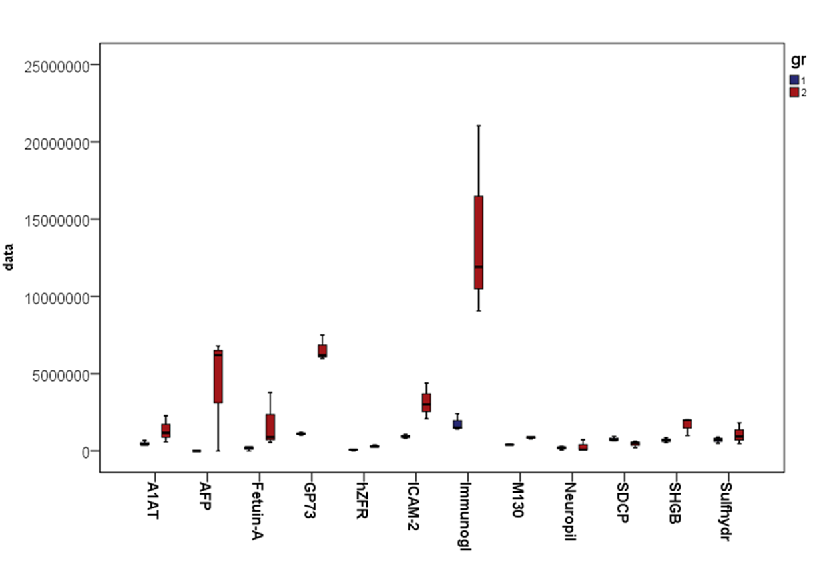
Verification of CF-proteins in HCC with target-HCD
Eleven high-expressed CF-proteins were found by Target - HCD experiment and they are consistent with the results with label free quantificaiton result
Notes:
11 high expressed CF-proteins were found by Target-HCD experiment and they are consistent with the results of lable-free.Such as GP73 ICAM-2 and SHGB

Slide 28
Summary
We built up a precise strategy of mapping core fucosylated glycoproteins for human plasma and identified 357 CF-glycosites on 209 CF-proteins in normal human plasma.
We developed a label-free quantitative strategy for biomarker discovery in human HCC serum and found 26 up-regulated CF-proteins, including the well-known biomarker---α-fetoprotein(AFP) and Golgi protein-73 (GP73).

Slide 29
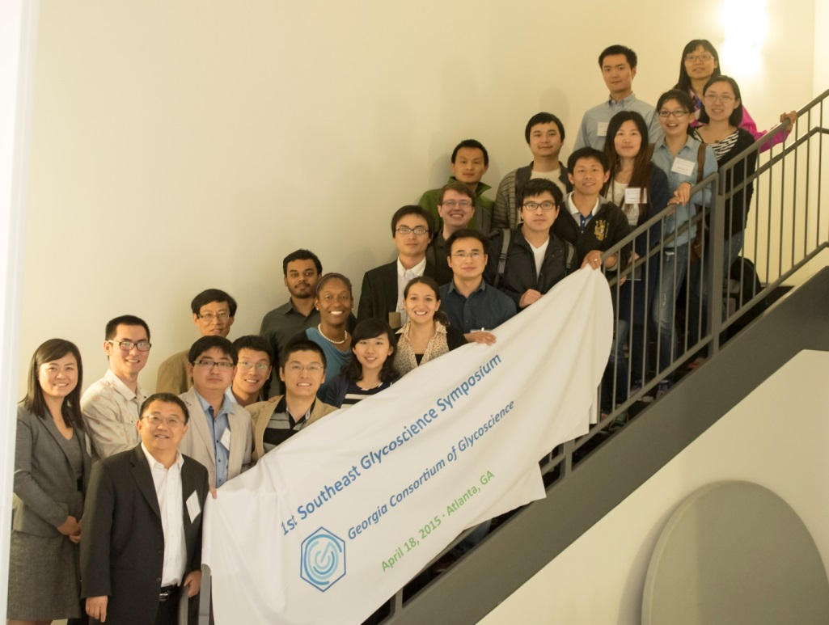
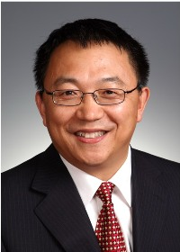
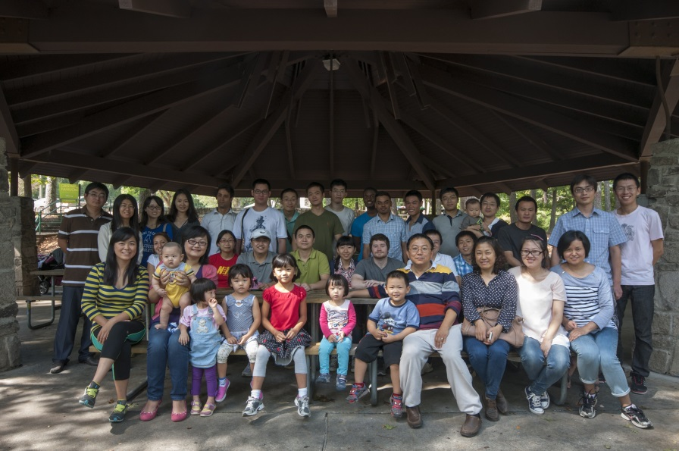
Acknowledgement
1ST Southeast Glycoscience Sympasium GSU April, 2015
Graduate Students
Liuqing Wen
Xu (Megan) Li
Qing Zhang
Shukkoor Kondengaden
Zhigang Wu
Hailiang (Joshua) Zhu
Cong (Jack) Xiao
Garrett Edmunds
Kuan Jiang
Yuxi Guo
Ding Liu
He Zhu
Shanshan Li
Angie Calderon
Christopher Gibbons
Olawale Micheal Oluwadahunsi
Aishwarya Parameswaran
Ebtesam Abdullah Gashash
Research Scientist
Lei Li
Yunpeng Liu
Cheng Ma
Postdoctoral Fellows
Wanyi Guan
Jun Zhou
Xuefeng Cao
Madhusudhan Gadi
Jiajia Wang
Varma Saikam
www.gcg.gsu.edu
The Wang Lab BBQ
October 6, 2013
Atlanta, USA
Wang LAB website:
http://lithium.gsu.edu/faculty/PWang/people.html

Slide 30
Question?

