Slide 1
Clinical Development of Biosimilars:
Overcoming Challenges
Charu Manaktala _{M.D.}
Senior Medical Director
Strategic Drug Development, Quintiles
3rd International Conference and Exhibition on Biowaivers, Biologics & Biosimilars,
Hyderabad, India,
27th-29th October 2014

Slide 2
Agenda
Biosimilars: How are they different
Challenges in Clinical Development
Quintiles for Biosimilars

Slide 3
Biosimilars: How are they different

Slide 4
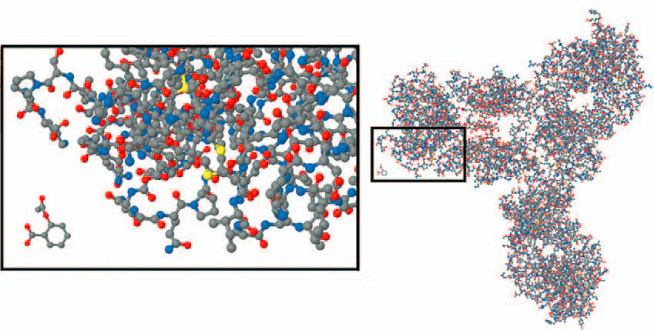
Biosimilars: How are they Different
Comparing Monoclonal Antibody and Aspirin Molecule
Small Molecule Generics | Biosimilars
Identical copies (i.e., same qualitative and quantitative composition) | No identical copies- just highly similar
Proof of quality and bioequivalence | Full quality dossier + comparability data
No substantial clinical data required | Appropriate pre-clinical & clinical comparability data (abbreviated vs. NCE/NBE)
Source: Kozlowski S, Woodcock J, Midthun K, Sherman RB. Developing the Nation’s Biosimilars Program.NEJM: 2011; 365 (5): 385-388.

Slide 5
Biosimilars Development: Basic Principles
Robust quality comparability data and thorough knowledge of reference product first step in establishing biosimilarity. May require multiple iterations in early-stage development.
Clinical
trials
PK/PD
Validation
Nonclinical
Biological
characterization
Analytics
Design specifications
Physicochemical
characterization
Process
development
Source: McCamish M and Woollett G. The state of the art in the development of biosimilars. Clin Pharmacol Ther 2012; 91(3):405–417.

Slide 6
Biosimilars Development: Basic Principles
Step-by-step sequential development, evaluating residual uncertainity at end of each step, designing next step accordingly,
Totality of evidence, case by case risk based approach tailored to individual product
Always prudent to have a dialogue with regulators early in development
Clinical
S & E trials
Clinical PK/PD
Non-clinical
Biological
characterization
Physicochemical
characterization

Slide 7
Challenges in Clinical Development

Slide 8
Key Challenges in Biosimilars Clinical Development
Extent of clinical data requirement
Clinical pharmacology studies
  Confirmatory PK/PD studies
Immunogenicity
Choice of reference products, designing global programs
Choice of indication/ study population
Study design
Study end-points
Extrapolation of clinical data across indications
Accessing patients for biosimilars clinical trials
Establishing interchangability

Slide 9
Extent of Clinical Program
Tough Balancing Act
Increasing development time and expense
Risk of missing out significant differences vs. reference product

Slide 10
Extent of Clinical Program
Determined by Reference Product:
Nature and complexity
(Extent of) clinical experience, how well is PK, PD, MoA understood, accepted surrogate markers of clinical efficacy
Safety issues, including risk of immunogenicity, consequences of immunogenicity (e.g. suppressing endogenous protein)
Determined by Biosimilar Product:
Robustness of quality comparability data, residual uncertainty at the end of quality and pre-clinical comparability studies

Slide 11
Extent of Clinical Program
Parameter | Filgrastim | Epoetin | Rituximab
Clinical Experience | Extensive | Extensive | 15 years +
MoA, PK | Well understood | Well understood | Yes, not fully
Routes of Administration | SC, IV | SC, IV | IV infusion, SC (recent)
Indications | Multiple | Multiple | Multiple
Surrogate Marker for Clinical Efficacy | ANC | Hb | -
Immunogenicity | No significant risk | Low incidence, severe consequences | 1.1 to 23%, across indications
Clinical Requirements | Limited | Extensive | Extensive

Slide 12
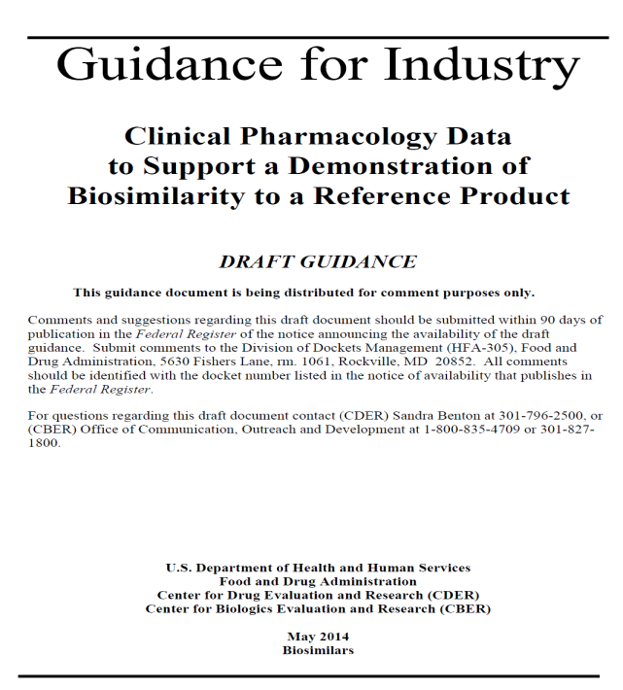
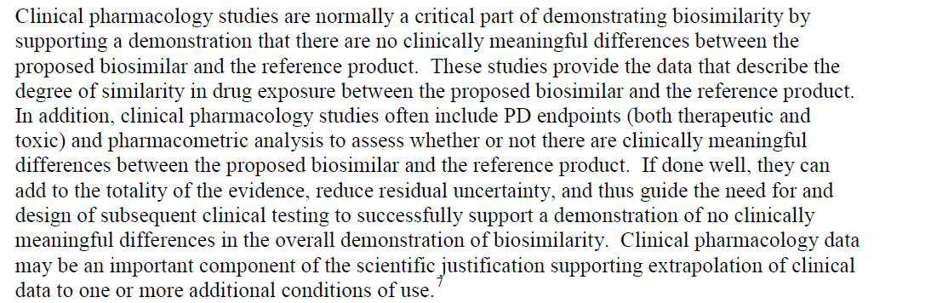
Clinical Pharmacology Studies

Slide 13
Clinical Pharmacology Studies
Type of clinical pharmacology studies appropriate for the given biologic:
Healthy volunteers or patients
Cross over or parallel group
Single dose or multiple dose
Route of administration
Dose: therapeutic range, ascending linear portion of dose-response curve
PK parameters- equivalence criteria
PD end-points- single, multiple parameters, equivalence criteria

Slide 14
Confirmatory Pharmacokinetic/ Pharmacodynamic (PK/PD) Studies
Could replace evidence for comparable efficacy in select cases
Possible only when pre-requisites met:
  PK & PD of Reference biologic well characterized
  At least 1 PD marker validated as clinical efficacy surrogate
  Relationship between dose/exposure, relevant PD marker(s) and response/efficacy established
Where feasible, may be regulator’s preferred option due to better sensitivity
Some examples:
  Euglycemic clamp studies for biosimilar insulins (& insulin analogues)
  Absolute neutrophil count and CD34+ cell count for biosimilar filgrastim
Robust comparability on CMC and in vitro functional assays and comprehensive clinical PK & PD study(ies) characterizing exposure as well as multiple pharmacodynamic parameters (both therapeutic and toxic): address additional safety & immunogenicity requirements post approval

Slide 15
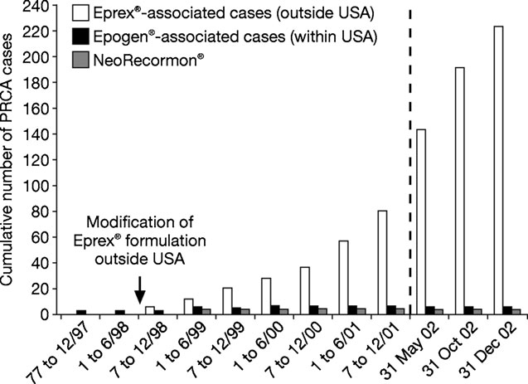
Immunogenicity
Case Study 1
Significant increase in incidence of antibody mediated PRCA between 1998-2003
CKD patients, 1 particular brand
of EPO through SC route
(other 2 brands unaffected)
Breakdown of natural immune tolerance & formation of neutralizing antibodies against recombinant & endogenous EPO
SC route contraindicated → reduction in incidence of PRCA
Source: Schellekens H. Factors influencing the immunogenicity of therapeutic proteins. Nephrol Dial Transplant 2005; 20: vi3–vi9

Slide 16
Immunogenicity
Case Study 1
Coincided with a “minor” change in formulation: replacement of HSA (stabilizer) with glycine + polysorbate 80 in 1998
Possible triggers:
  ? Micelle formation from polysorbate 80 and epoietin alfa
  ? Leachates from rubber stoppers breaking B-cell tolerance via an adjuvant effect
  ? Increased levels of aggregates during storage (within specifications)
Immunogenicity is difficult to predict, can result from “minor” variations, can have serious consequences

Slide 17
Immunogenicity
Case Study 2
Clinical trial of biosimilar epoetin in CKD anemia patients, SC administration
2 of 337 randomized patients developed neutralizing antibodies to EPO, both on biosimilar
Study terminated
Root cause traced to increased tungsten exposure in PFS
Case Study 3
Somatropin biosimilar, initial clinical studies showed high incidence of anti-hGH and anti-HCP antibodies (~ 60% subjects).
No clinical consequences: similar growth recorded in children with and without antibodies.
Root cause traced to increased HCP levels. Additional purification steps introduced.

Slide 18
Immunogenicity
Immunogenicity can be demonstrated only in human studies, of adequate size and duration
Extent of data, duration and timing of study(ies) depends up on :
  Analytical similarity between reference product and proposed biosimilar
  Known incidence & clinical consequences of immune response for reference product
Evaluate immunogenicity in sensitive populations
Evaluate for both occurrence of antibodies, as well as clinical consequences

Slide 19
Questions?

Slide 20

Choice of Reference Product
Comparability exercise requires:
All studies comparative against RMP
RMP authorized in MA jurisdiction
RMP authorized on basis of complete dossier
Same RMP throughout development

Slide 21
Choice of Reference Product: Global Development Programs
Possible to employ Reference product from another jurisdiction for some studies
  EMA Draft Guideline on Similar Biological Medicinal Products, CHMP/437/04Rev1 (May 2013)
  US FDA Guidance for Industry Scientific Considerations in Demonstrating Biosimilarity to a Reference Product (Feb 2012)
Pre-requisites:
  Analytical studies & at least 1 human PK/PD study against local Reference
  Establish acceptable bridge between different References
  Duration/ extent of marketing experience

Slide 22
Choice of Reference Product: Global Development Programs
Pre-requisites (continued):
  Product approving regulatory authority with similar scientific & regulatory standards
  Relationship between license holders in different jurisdictions, manufactured in same facilities
  Manufacturing facility approving regulatory authority with similar scientific & regulatory standards
Have a dialogue with regulators beforehand

Slide 23
Choice of Reference Product: Global Development Programs
3 way comparative physico-chemical & biological characterization studies
3 way comparative PK & PD studies
2 way comparative clinical safety & efficacy study
Establish Comparability Across Reference Products

Slide 24
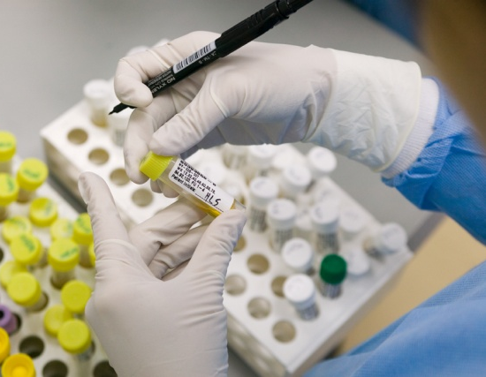
Extrapolation of Clinical Data Across Indications
Possible to have biosimilar licensed for more indications than those evaluated in development program. Scientific justification based on:
MoA in each indication
  Target/ receptor(s) for each activity
  Binding, dose-response, pattern of molecular signaling
  Relation between product structure & target/receptor(s) interactions
  Location and expression of target/ receptor(s)
PK and bio-distribution in different patient populations
Expected toxicities in different patient populations

Slide 25
Extrapolation of Clinical Data Across Indications
INFLIXIMAB BIOSIMILAR EMA APPROVAL
Approval of 1st mAb biosimilar in EU. Extrapolation granted across different TAs!
“Based on the robust comparisons of the physicochemical and in vitro and ex vivo biological analyses, Inflectra was considered biosimilar to the reference product Remicade. These data, in combination with clinical data demonstrating pharmacokinetic and therapeutic equivalence in rheumatology conditions, allow for extrapolation to all other indications of Remicade. In addition, the Applicant will conduct a randomised, double-blind, parallel-group comparative study between Inflectra and Remicade in patients with active Crohn’s disease.”

Slide 26
Extrapolation of Clinical Data Across Indications
INFLIXIMAB BIOSIMILAR HEALTH CANADA APPROVAL
“The sponsor requested authorization for all of the indications and uses currently authorized to Remicade. Remicade is currently authorized for indications and uses in rheumatoid arthritis, ankylosing spondylitis, psoriatic arthritis, plaque psoriasis, Crohn's disease, and ulcerative colitis. Comparability between Inflectra and the reference product was established based on comparative chemistry and manufacturing studies, and comparative non-clinical studies. ........
The indications for psoriatic arthritis and plaque psoriasis were granted on the basis of similarity and the absence of meaningful differences, between Inflectra and the reference product, in product quality, mechanism of action, disease pathophysiology, safety profile, dosage regimen and on clinical experience with the reference product. Scientific rationales submitted by the sponsor were found to be adequate to support extrapolation to the indications and uses pertaining to psoriatic arthritis and plaque psoriasis; however, extrapolation to indications and uses pertaining to Crohn's disease and ulcerative colitis could not be recommended due to differences between Inflectra and the reference product, that could have an impact on the clinical safety and efficacy of these products in these indications. .....”

Slide 27
Extrapolation of Clinical Data Across Indications
Indication | Remicade Label | Biosimilar Label- EMA | Biosimilar Label- HC | Biosimilar Studies
Rheumatoid Arthritis (RA), adults, DMARD non-responders | √ | √ | √ | √
RA, adults, severe active, DMARD naive | √ | √ | √ | χ
Adult Crohn’s Disease | √ | √ | Χ | Χ
Paediatric Crohn’s Disease | √ | √ | Χ | Χ
Ulcerative Colitis | √ | √ | Χ | Χ
Paediatric Ulcerative Colitis | √ | √ | Χ | Χ
Ankylosing Spondylosis | √ | √ | √ | √
Psoriatic Arthritis | √ | √ | √ | Χ
Psoriasis | √ | √ | √ | χ

Slide 28
Questions?

