Slide 1
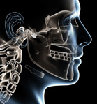

Conservative protocol for Ameloblastoma
Charles P. Sia, DMD, PDipDS (OS), MDS (OMS)
Department of Oral and Maxillofacial Surgery
Gullas Medical Center
University of the Visayas, Philippines

Slide 2
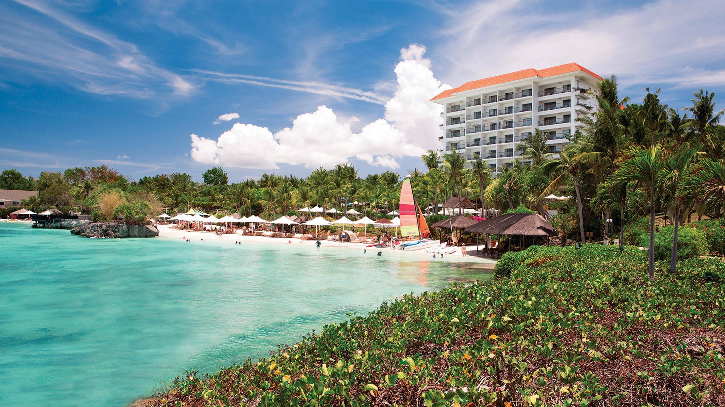

Slide 3
Standard treatment modalities
Cystic
Enucleation + modalities
Resection with margins
Solid
Segmental resection + reconstruction
Peripheral
Resection with margins

Slide 4
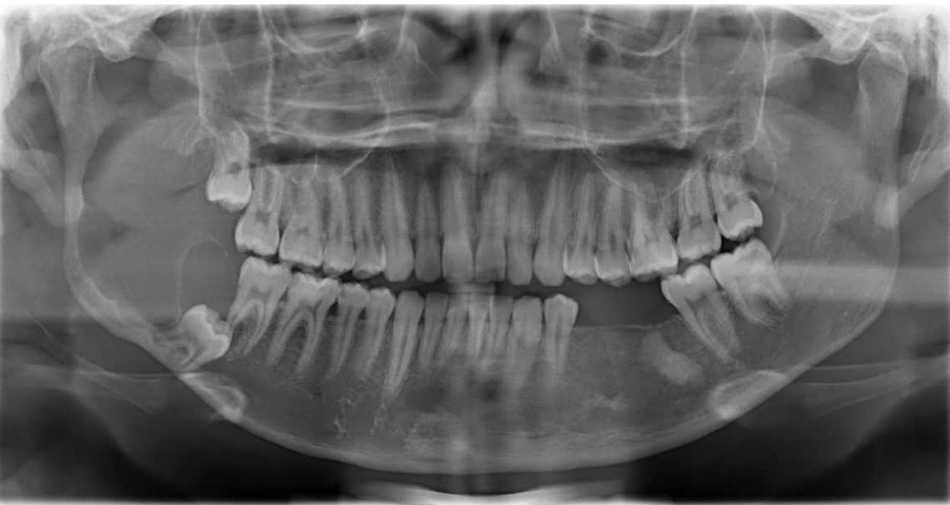
Literature
Cystic
20% - 40%
Solid, Multilocular
60% - 90%
Peripheral
15%

Slide 5
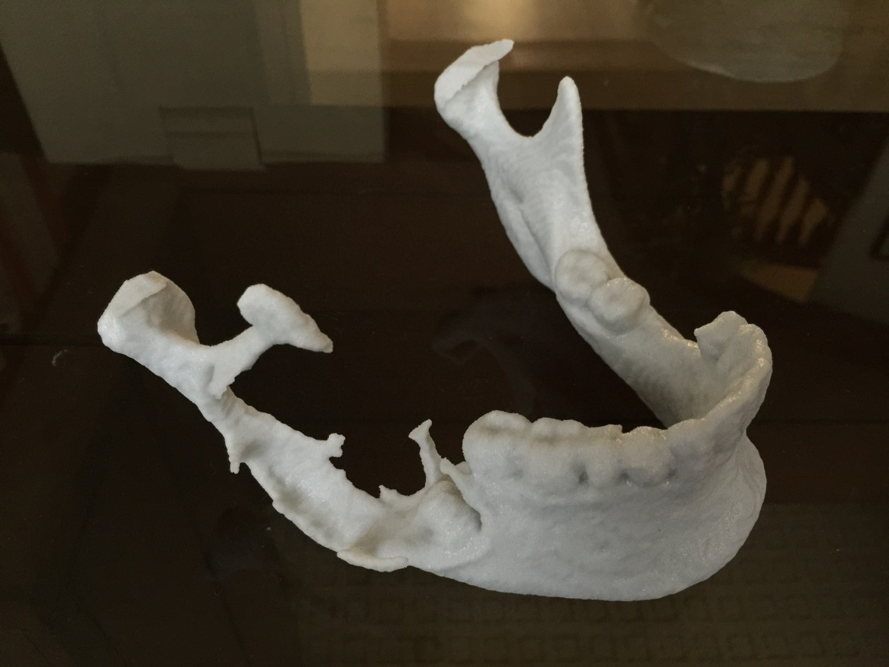
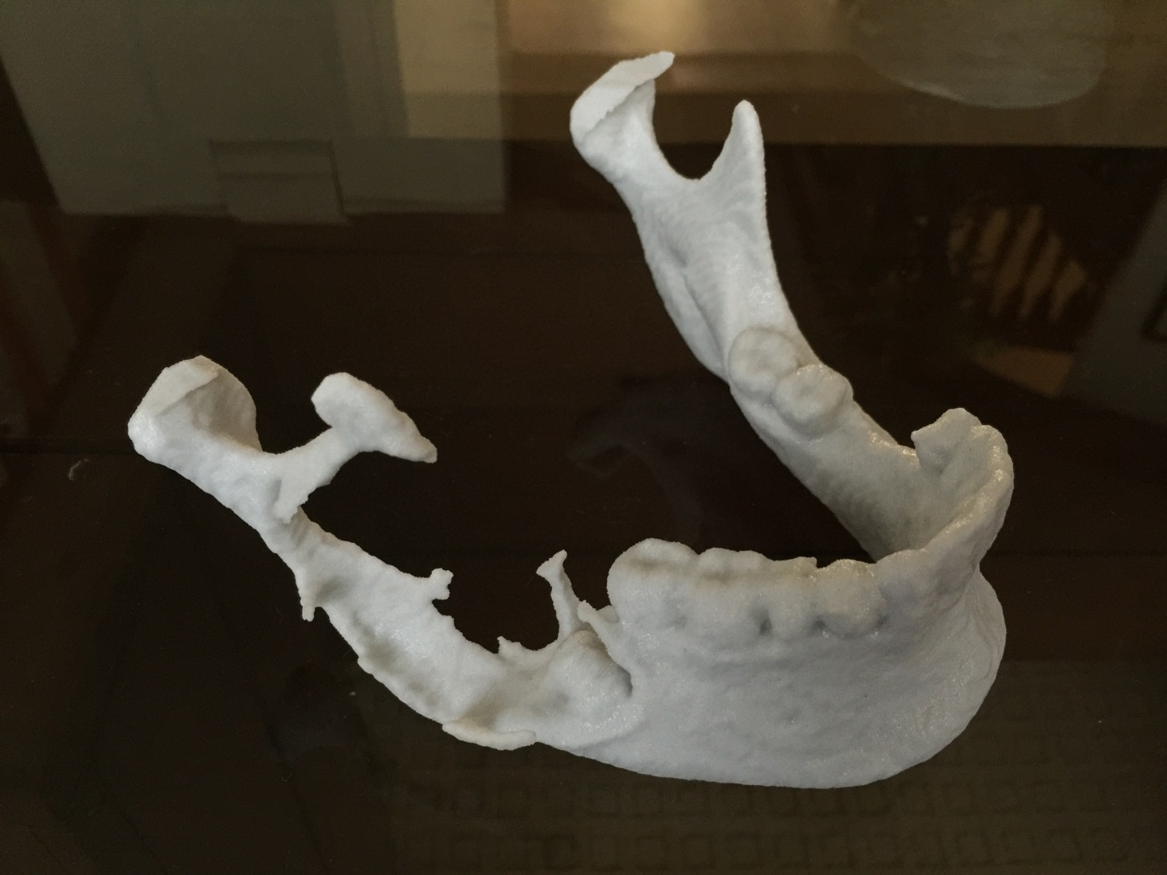
Other modalities
Peripheral ostectomy
Cryosurgery
Carnoy’s solution
Radiotherapy
Staged surgical treatment

Slide 6
Conservative protocols done
Enucleation
Enucleation, peripheral ostectomy
Enucleation, peripheral ostectomy , Carnoy’s Solution
Enucleation, peripheral ostectomy, 5% 5FU

Slide 7
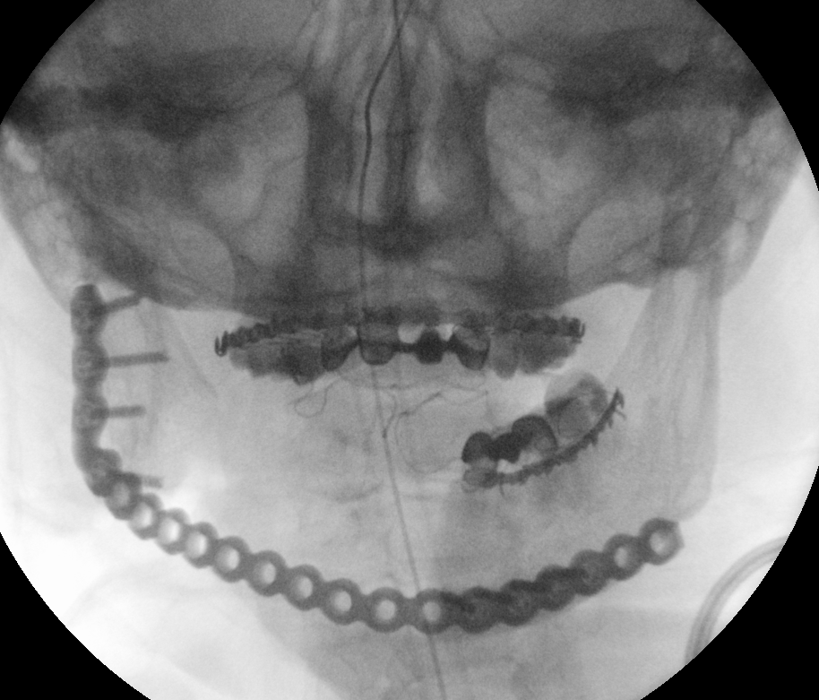
Current treatment modalities done
No treatment
Resection
Resection, reconstruction plate
Resection, Free flap

Slide 8
Why develop such protocol?

Slide 9
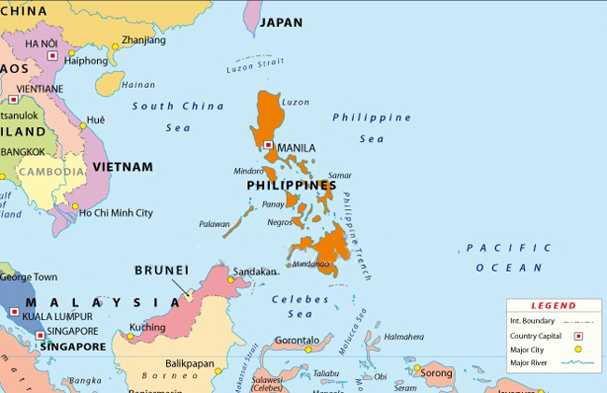

Slide 10
Philippines as a developing nation
Patient-care economics
Government healthcare coverage
Other government agencies
Foundations
Third Party, Private funding

Slide 11
Philippines as a developing nation
Trained surgeons (ORL, Maxfac, Plastics, GS)
Enhancement for microvascular flap training
Need more surgeons to undergo training
Government subsidy for free flap surgeons is inadequate
Nursing care for free flap patients

Slide 12
Development of such treatment
Inadequate trained free flap surgeons
Inadequate team for free flap surgery
Insufficient free healthcare coverage
Minimum wage-earners have impossible capability to afford procedure (eg. recon plate cost, total hospital cost)

Slide 13
Criteria
Ameloblastoma by histopathology
Continuity of bone (at least 1 viable wall)
Notes:
I look at the Histopathology and CT

Slide 14
Criteria
Chosen treatment of choice
Checked on economic status (adequate for review)
Notes:
I look at the Histopathology and CT

Slide 16
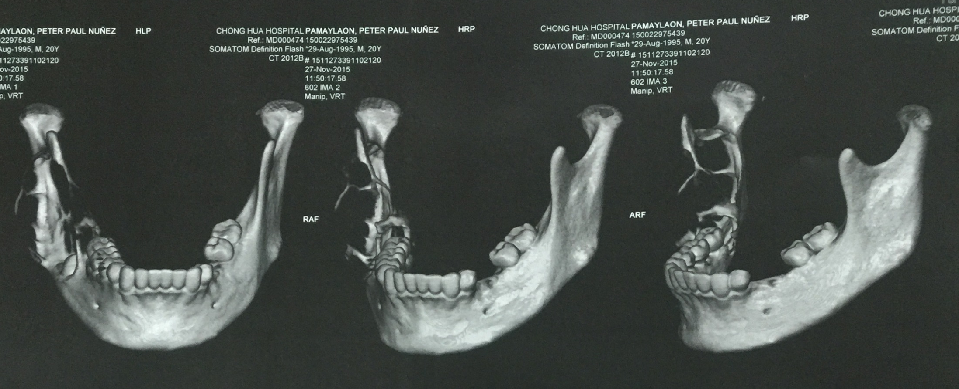

Slide 17
Protocol
Complete enucleation
Peripheral ostectomy
  Identify bone penetration, invaginations
Soft tissue dissection
Prepare adequate bony and soft tissue access for post operative dressing
Notes:
I look at the Histopathology and CT

Slide 18
Protocol
IMF, guiding elastics
Soft diet
Notes:
I look at the Histopathology and CT

Slide 19
Dressing
Irrigation with CHG, Debridement
Direct application of 5% 5-FU Topical
Packed gauze impregnated with 5% 5-FU Topical
Void defect filled with antibiotic impregnated gauze
Changed every 5 days until bone deposition
Notes:
I look at the Histopathology and CT

Slide 20
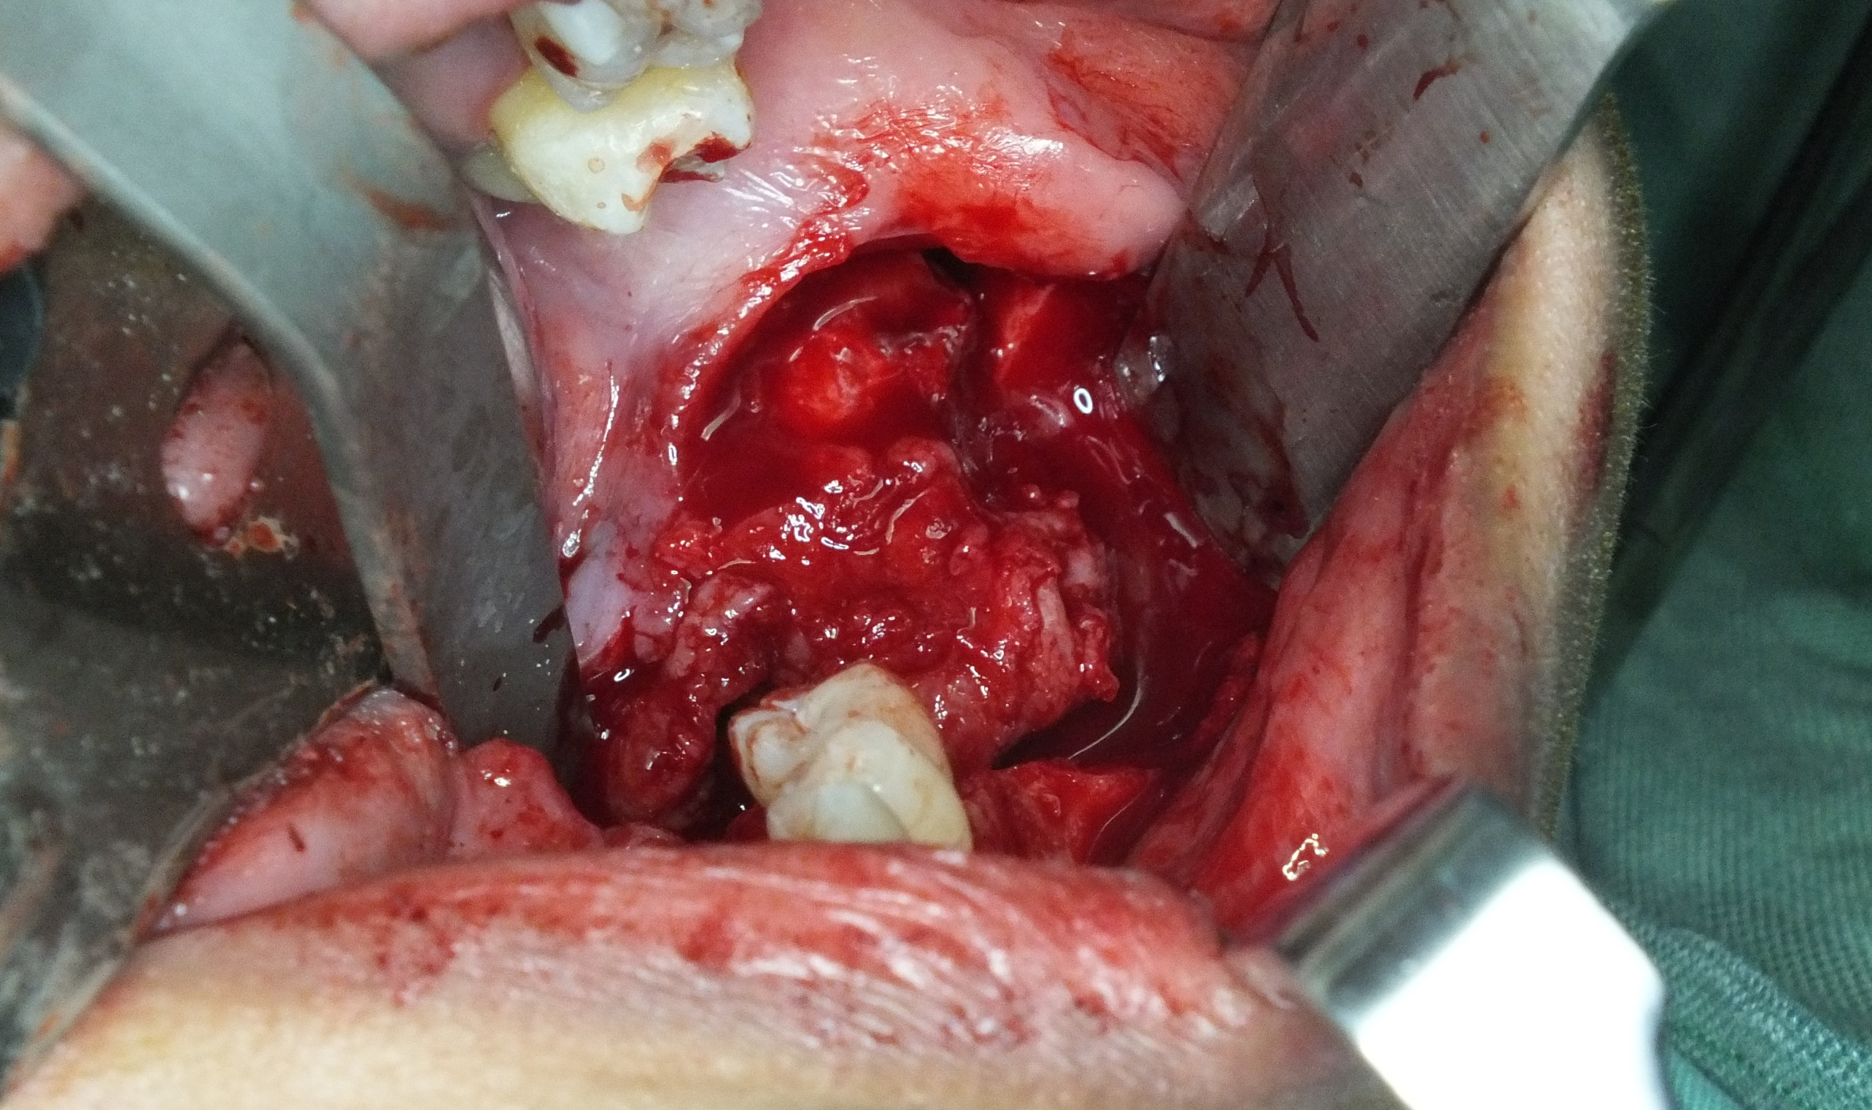

Slide 21
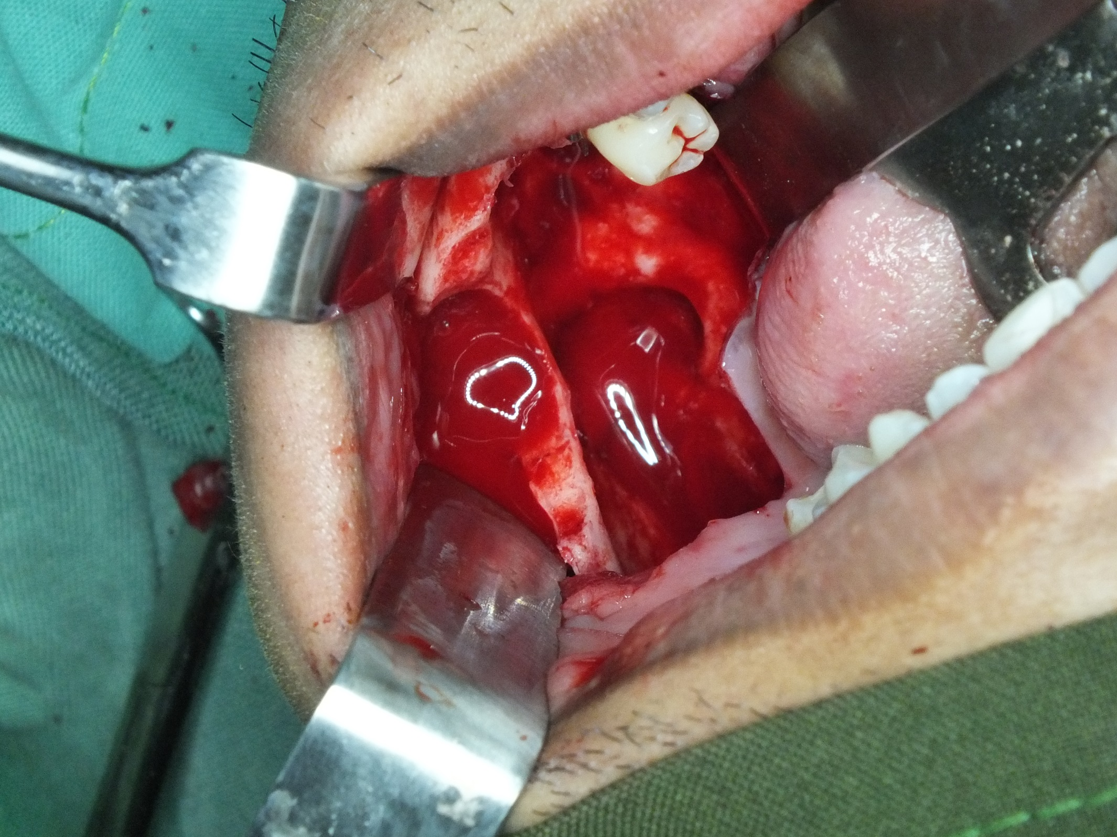

Slide 22
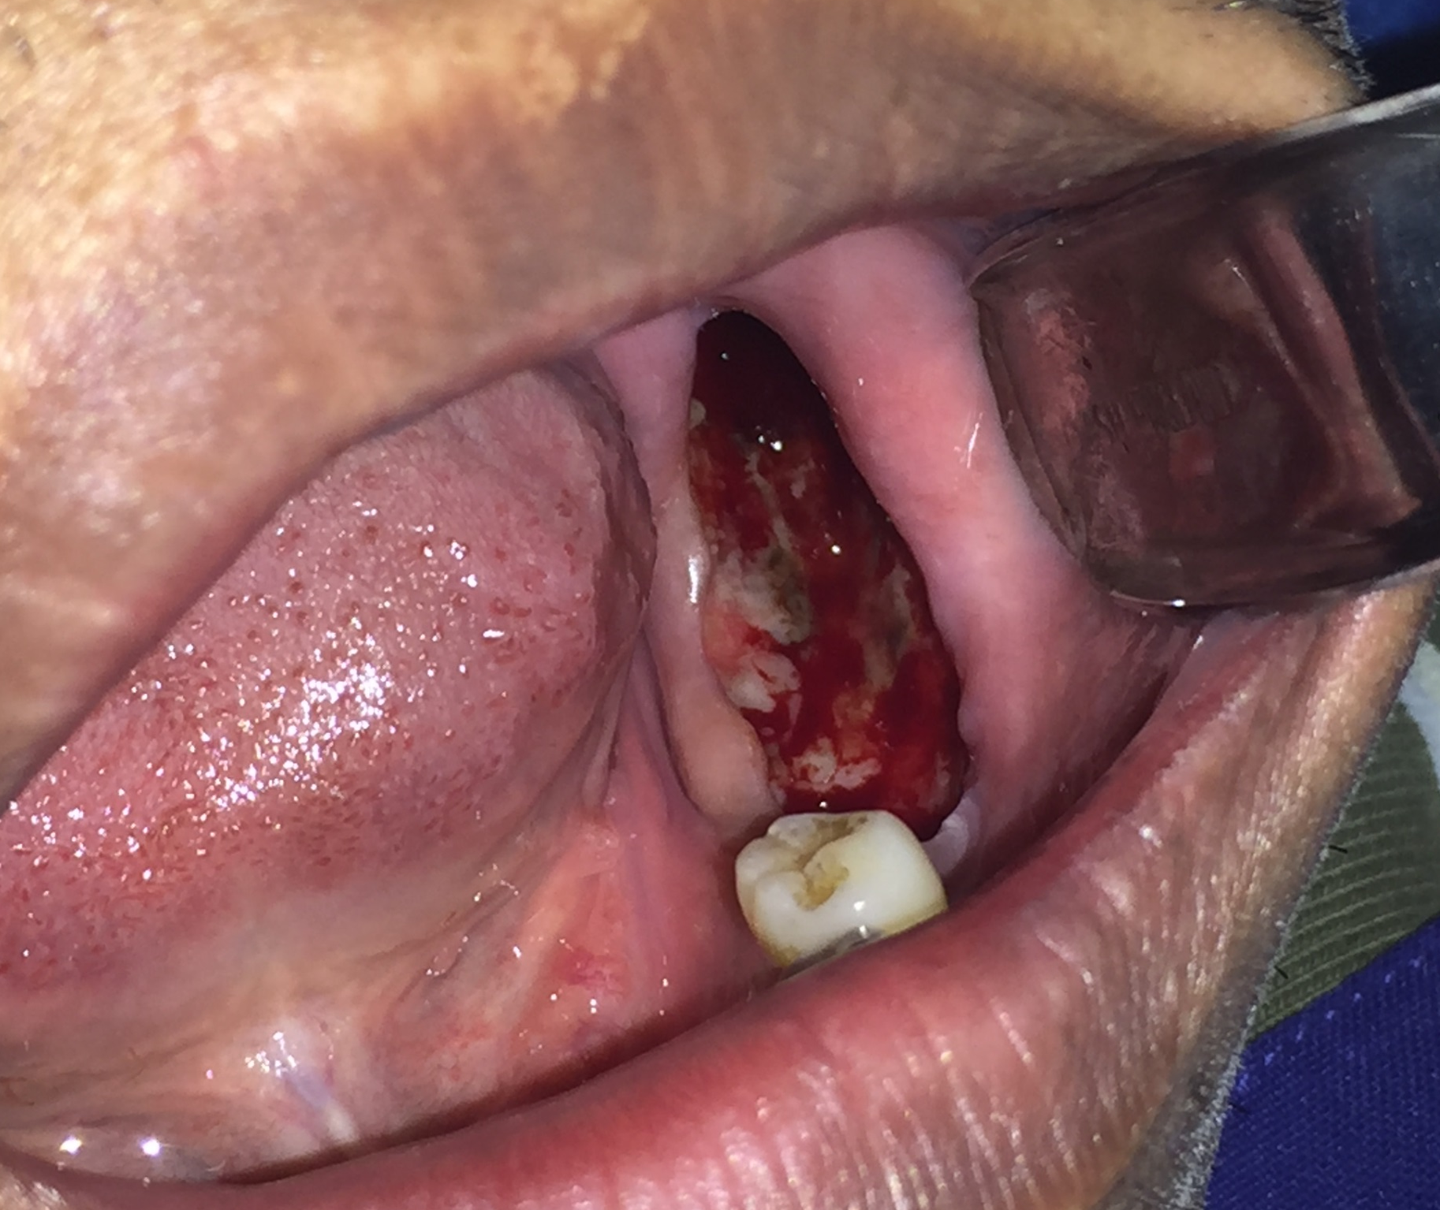

Slide 23
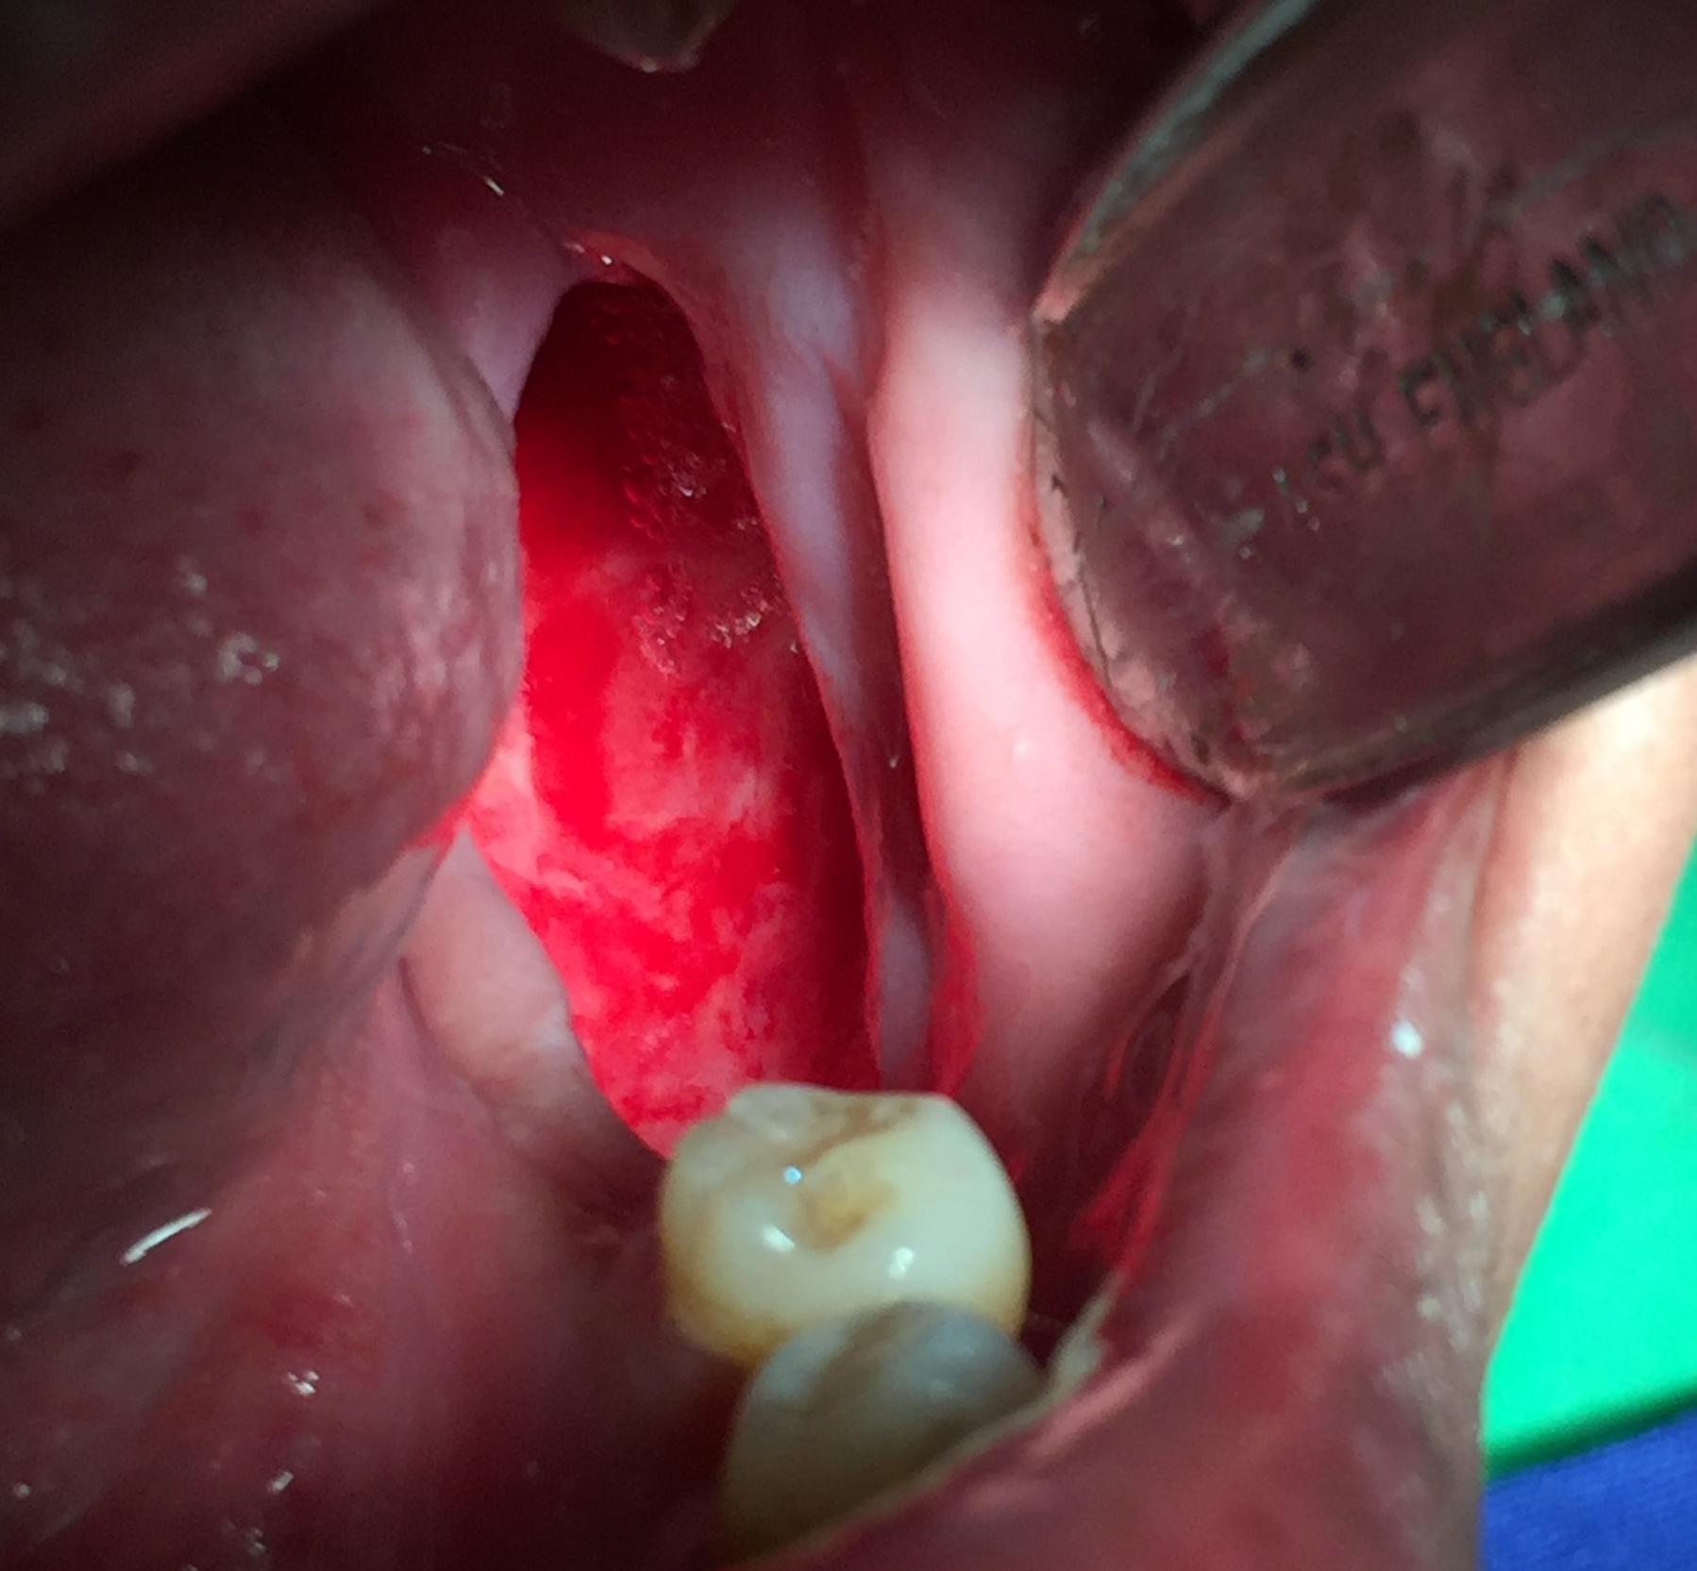

Slide 24
Considerations
Easy access to cavity for dressing application
Consider intermaxillary fixation for near fracture cases
IMF screws, dental brackets, arch bars in large defects (possible IMF or guide elastics)
Notes:
I look at the Histopathology and CT

Slide 25
Results
Total of 114 mandible cases on follow up
2 operators
16 years as longest review
Notes:
I look at the Histopathology and CT

Slide 26
Results
2 / 114 = 1.7% local recurrence
2 / 114 = 1.7% pathologic fracture
26 / 114 = 23% mild sensory deficit po 1 yr
Notes:
I look at the Histopathology and CT

Slide 27
Results
17 / 114 = 15% residual facial asymmetry
Normal values, CBC, LRFT yearly
Notes:
I look at the Histopathology and CT

Slide 28
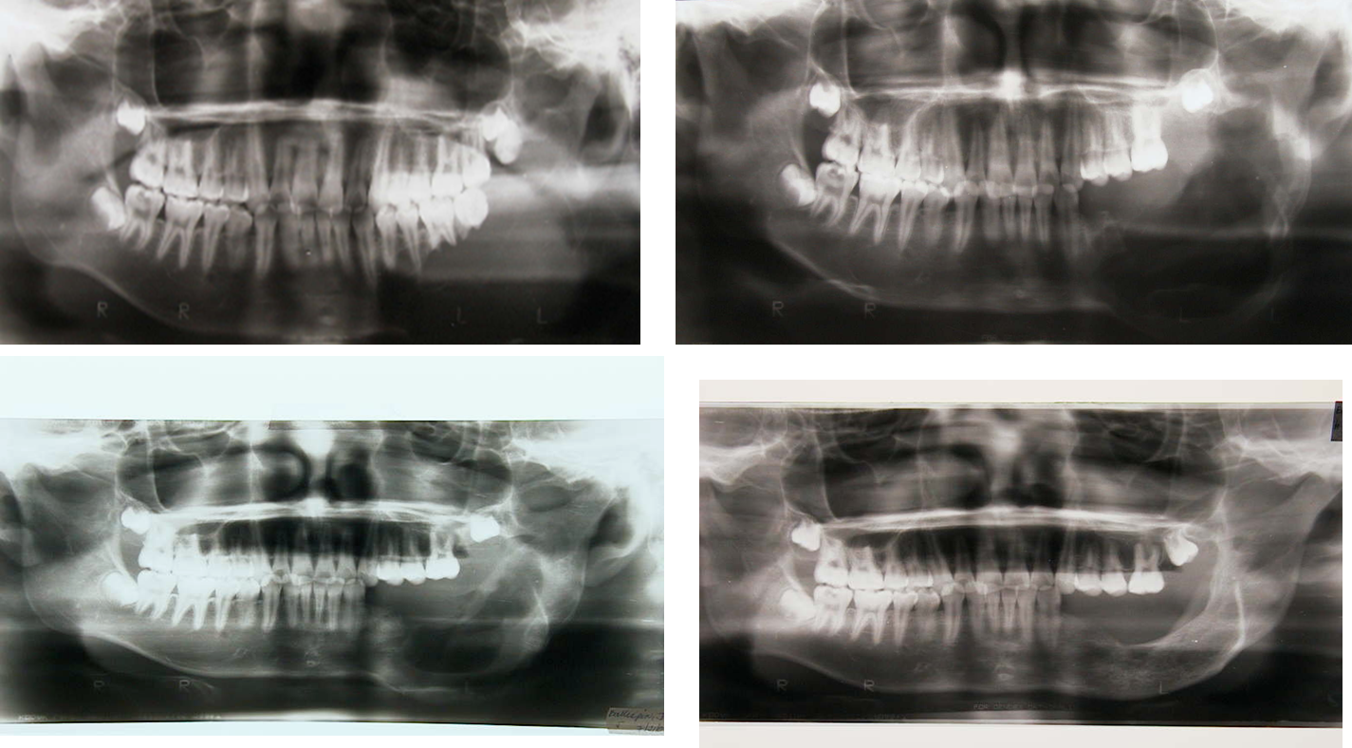

Slide 29
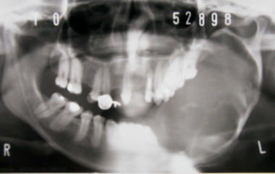
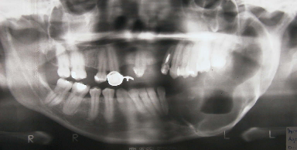
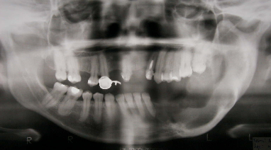
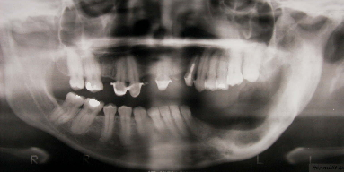
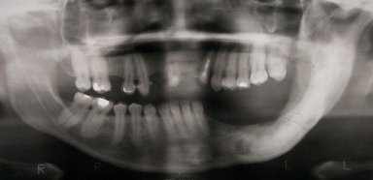

Slide 30
Adverse effects
Mild burning sensation
IAN sensory deficit
  Progressive recovery
Notes:
I look at the Histopathology and CT

Slide 31
Conclusion
Acceptable results at given follow up period
Long-term follow up compliance needed
Consider economic capability
Notes:
I look at the Histopathology and CT

Slide 32
Conclusion
Access to cavity is utmost importance
Long-term follow up for recurrence rate assessment and possible complications
Notes:
I look at the Histopathology and CT

Slide 33

Acknowledgement
Roberto M. Pangan, DMD, MD, PhD
Clinical Associate Professor
Department of Otorhinolaryngology
Philippine General Hospital
University of the Philippines

Slide 34

Thank you for your attention
charles.sia@hotmail.com

