Slide 1
About OMICS Group
OMICS Group International is an amalgamation of Open Access publications and worldwide international science conferences and events. Established in the year 2007 with the sole aim of making the information on Sciences and technology ‘Open Access’, OMICS Group publishes 400 online open access scholarly journals in all aspects of Science, Engineering, Management and Technology journals. OMICS Group has been instrumental in taking the knowledge on Science & technology to the doorsteps of ordinary men and women. Research Scholars, Students, Libraries, Educational Institutions, Research centers and the industry are main stakeholders that benefitted greatly from this knowledge dissemination. OMICS Group also organizes 300 International conferences annually across the globe, where knowledge transfer takes place through debates, round table discussions, poster presentations, workshops, symposia and exhibitions.

Slide 2
About OMICS Group Conferences
OMICS Group International is a pioneer and leading science event organizer, which publishes around 400 open access journals and conducts over 300 Medical, Clinical, Engineering, Life Sciences, Phrama scientific conferences all over the globe annually with the support of more than 1000 scientific associations and 30,000 editorial board members and 3.5 million followers to its credit.
OMICS Group has organized 500 conferences, workshops and national symposiums across the major cities including San Francisco, Las Vegas, San Antonio, Omaha, Orlando, Raleigh, Santa Clara, Chicago, Philadelphia, Baltimore, United Kingdom, Valencia, Dubai, Beijing, Hyderabad, Bengaluru and Mumbai.

Slide 3
United States Strategic Metals during World War II
Dr. Charles D. Ross
Longwood University

Slide 4
U.S. Strategic Metals during World War II
Introduction
Strategic Metals: 2013 vs. 1941
Other Strategic Materials During the War
Aluminum
Uranium and Plutonium
Summary

Slide 5
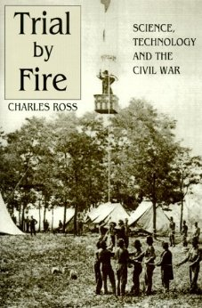

Slide 6


Slide 7


Slide 8
Some Modern Strategic Metals
Cobalt
Gallium
Indium
Germanium
Lithium
Magnesium
Niobium
Platinum Group Metals (Platinum, Paladium)
Rare Earths
Tantalum
Tungsten
Vanadium

Slide 9
Some WWII Strategic Metals
Copper
Lead
Iron
Nickel
Aluminum*
Uranium*
Plutonium*
*New to WWII

Slide 10
Some Other Critical
World War II Materials
Food
Coal
Oil
Rubber

Slide 11
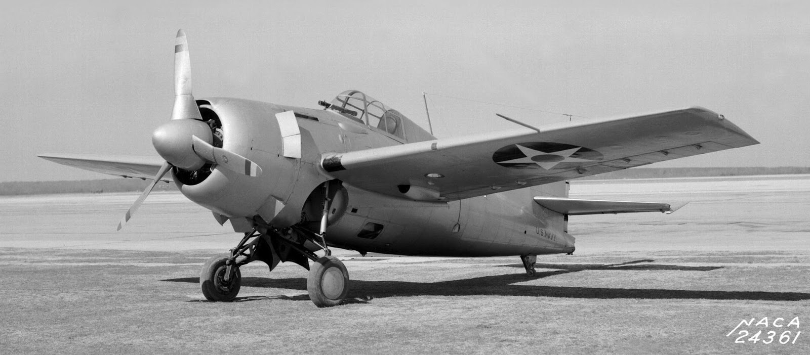
Aluminum in WWII

Slide 12
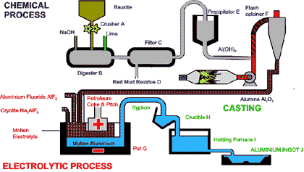
http://www.world-aluminium.org/production/

Slide 13
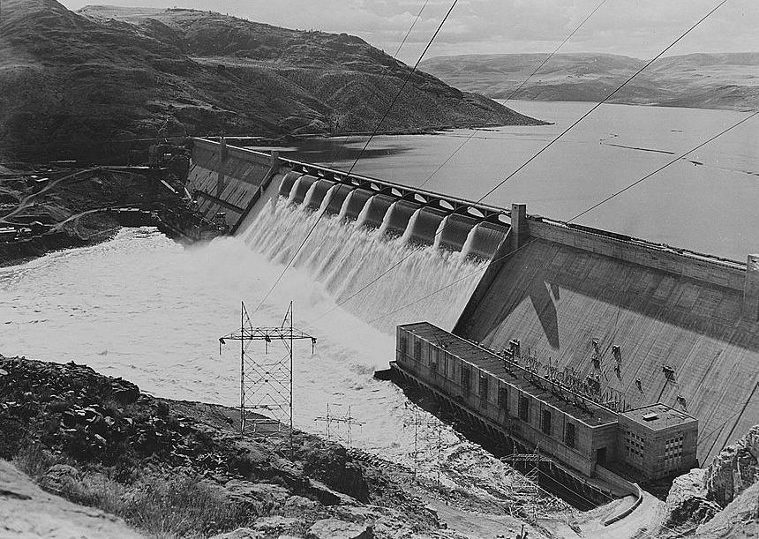
Grand Coulee Dam

Slide 14
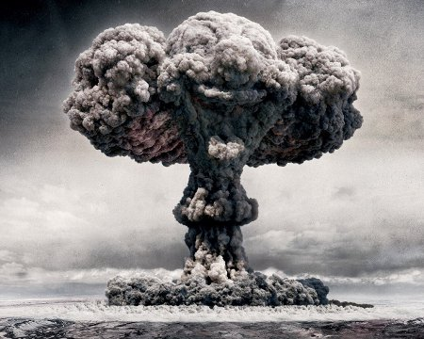
Uranium and Plutonium in WWII
Trinity Test, July 16, 1945

Slide 15
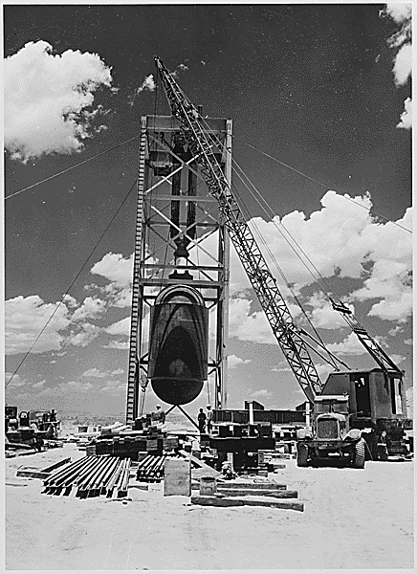
Manhattan Project

Slide 16
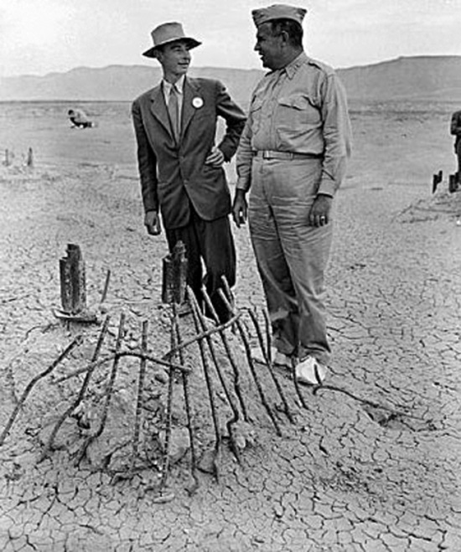
Dr. Robert Oppenheimer, Gen. Leslie Groves

Slide 17
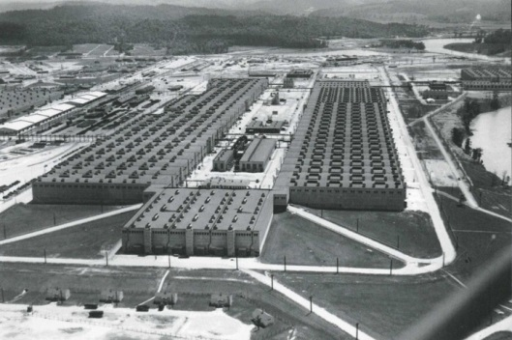
Oak Ridge, K-25 Plant

Slide 18
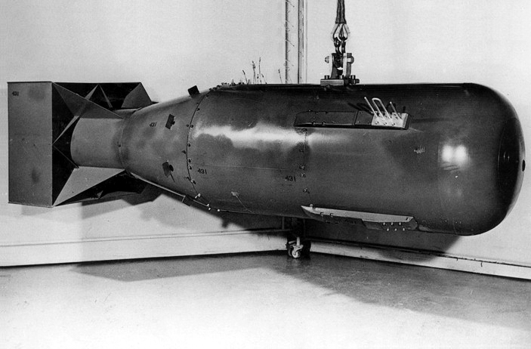
“Little Boy”

Slide 19
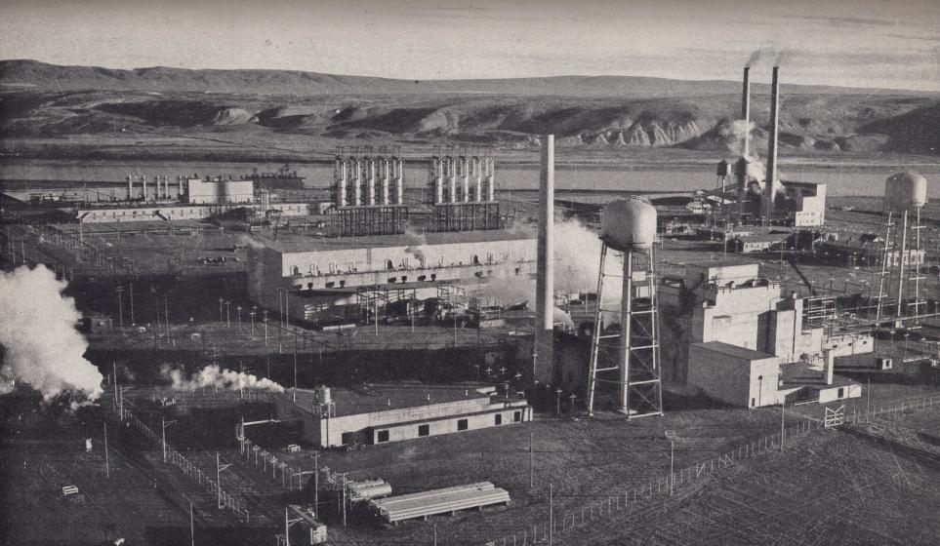
Hanford, Washington Plutonium Plant

Slide 20
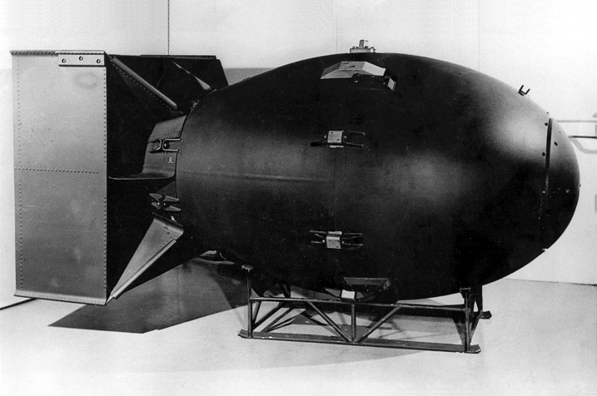
“Fat Man”

Slide 21
Let Us Meet Again
We welcome you all to our future conferences of OMICS Group International
Please Visit:
http://materialsscience.conferenceseries.com/
Contact us at
materialsscience.conference@omicsgroup.us
materialsscience@omicsgroup.com

