Slide 1



Healthcare does Hadoop:
An Academic Medical Center’s Five-Year Journey
Charles Boicey, MS, RN-BC, CPHIMS
Chief Innovation Officer
Clearsense

Slide 2
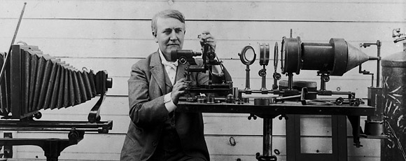
The doctor of the future will give no medicine, but instead will interest his patients in the care of human frame, in diet, and in the cause and prevention of disease.
Thomas Edison (1847 – 1931)

Slide 3
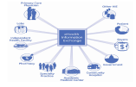

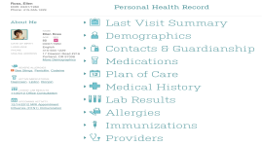
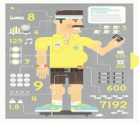

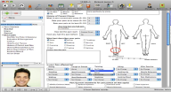
PHR Centric Health
HIE
Modern HDP
EMR

Slide 4

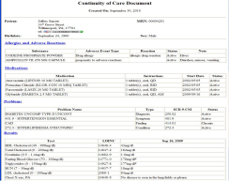



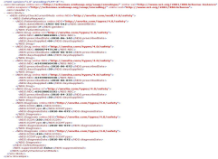

Early Days - 2010
Naveen Ashish, PhD

Slide 5
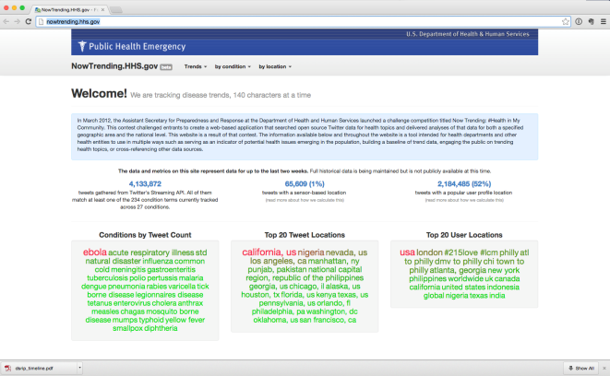
NowTrending 2012

Slide 6
Current Environment
Electronic Medical Record
  Not designed to process high volume/velocity data
  Not intended to handle complex operations
    Such as:
      Anomaly detection
      Machine learning
      Building complex algorithms
      Pattern set recognition
  Enterprise Data Warehouse
  Suffer from a latency factor of up to 24 hours
  The EDW serves all of the following retrospectively as opposed to in real time
  Clinicians
  Operations
  Quality and research

Slide 7
Big Data = Interoperability
Big Data Ecosystem that Supports:
  Hadoop (HDFS)
  Hbase
  Hive
  Pig
  MapReduce
  Mahout
  MongoDB (NoSQL)
  Neo 4j (Graph Database)
  Relational Data Base
  R
  Spark
  Storm
  Weka

Slide 8
Big Data = Complete Data
The Electronic Medical Record is primarily transactional taking feeds from source systems via an interface engine
The Enterprise Data Warehouse is a collection of data from the EMR and various source systems in the enterprise
In both cases decisions are made concerning data acquisition
A Big Data system is capable of ingesting and storing healthcare data in total and in real time

Slide 9
Modern Healthcare Data Platform
A healthcare information ecosystem built on “Big Data” technologies should:
  Be capable of serving the needs of clinicians, operations, quality and research
  And should do so in real time and in one environment
Should be:
  Able to ingest all healthcare generated data both internal and external in native format
Should be:
  A platform for advanced analytics such as early detection of sepsis & hospital acquired conditions
  Be enabled to predict potential readmissions
  Leverage complex algorithms and be a machine learning platform

Slide 10
Architecture Guiding Principles
Architecture to minimize encumbrance on IT staff
Ability to store all healthcare date in native form and complete
Use of supported open source code
Ensure architectural compatibility with commercial applications

Slide 11
Infrastructure
Low Cost of Entry & Scalable
  Open Source
  Commodity Hardware
    UCI Hadoop Ecosystem
      10 nodes
      5 terabytes
    Yahoo Hadoop Ecosystem
      60K nodes
      160 petabytes
Cloud Ready

Slide 12
Data Sources
Legacy Systems
  Print to Text or Delimited String
All HL7 Feeds (EMR source systems)
All EMR Initiated Data (Stored Procedures)
Device Data (in one minute intervals)
Physiological Monitors (HL7)
Ventilators (HL7)
Smart Pumps
Social Media (POC)
Healthcare Organization Sentiment Analysis
Patient Engagement
Home Monitoring (POC)
Real Time Location System (RFID)
Hospital Sensors

Slide 13
Newer Data Sources
External Streaming Device Data
Wearables
Home Devices
Social Media
Geographic Information System (GIS) Data
Omic Data
Open Data
  www.data.gov
Adverse Drug Event
  www.researchae.com
Internet of Things (IoT)
  Telematics
  5G

Slide 14
Use Cases
Legacy System Retirement
Patient Condition Changes
  RRT
Early Sepsis Detection
Environmental Response
Real Time Nursing Unit Utilization
  Staffing and Resource Allocation
Social Media Sentiment Analysis
Research
  Cohort Discovery
  Data Science
Clinician Aware Applications
Patient Monitoring External to Traditional Healthcare Setting
Event Driven Care & Real Time Quality Monitoring
Personal Health Record

Slide 15
Future Use Cases
Ventilator Management
  Vent dashboard in EMR
Hospital Acquired Infections (HAI)
VTE Surveillance
Sensium Vitals Digital Patch
Patient-Generated Data
  Home Devices (Scale, Vital Signs, Glucose)
  Exercise & Diet (Fit Bit, Jawbone, Nike)
Combining Phenotype Data with Genotype Data
Patient Threat Analysis
Edge and Vertices Analysis
  Patient caregivers and outcomes

Slide 16
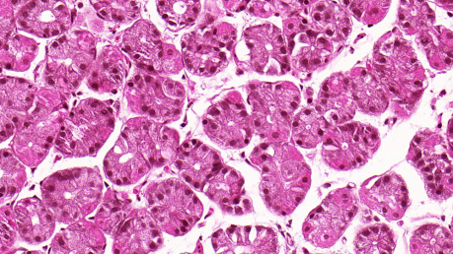
Imaging Analytics
NIH Funded U24 Grant
Joel Saltz, PhD
  This project is to develop, deploy, and disseminate a suite of open source tools and integrated informatics platform that will facilitate multi-scale, correlative analyses of high resolution whole slide tissue image data, spatially mapped genetics and molecular data for cancer research.

Slide 17
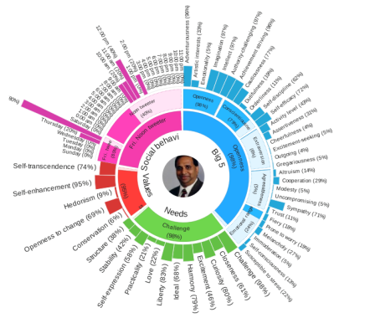
Patient Persona
Surveys
Questionnaires
Clinic Notes
External Sources
  IoT
  Social Media
  Credit
  Telemetrics

Slide 18
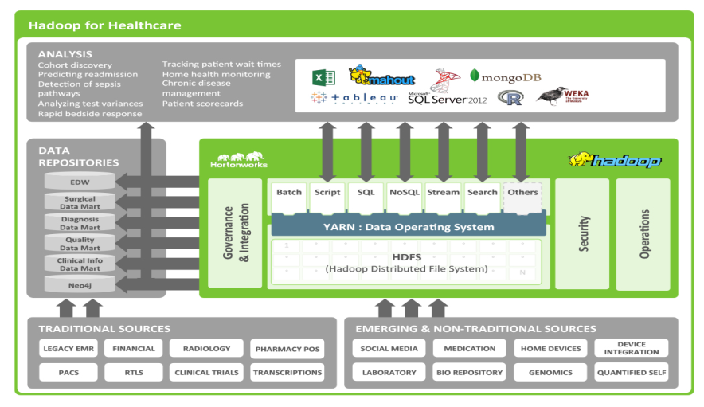

Slide 19
FOSS Driven Protean
Is a centrally-hosted, instrumented “Smart and Connected” platform servicing real time business event streams using high-speed MPP Compute and Storage Grids
Primarily based on the concepts and principles of Event Driven Architecture (EDA), Complex Event Processing (CEP) and Multi-Agent-Systems (MAS)
Support for high speed data ingestion - Structured and Unstructured (Textual)
Core Advanced Analytics enabled through Model Building, Data Mining and Machine Learning techniques (Supervised and Unsupervised)
Context modeling creation across Time-Space-Value dimensions
Enables creation of a Central Enterprise Data Refinery to enable “Source of Truth” for transactional information within the Healthcare Enterprise

Slide 20
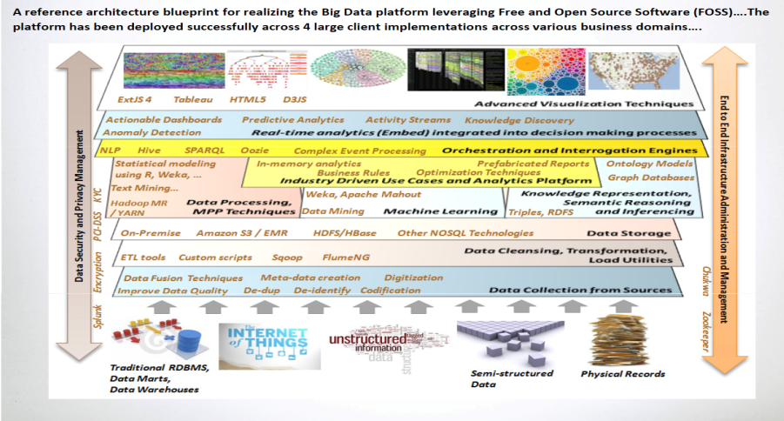

Slide 21

FHIR – The “Public API” for Healthcare?
FHIR = Fast Health Interoperability Resource
  Emerging HL7 Standard (DSTU 2 soon)
  More powerful & less complex than HL7 V3
ReSTful API
  ReST = Representational State Transfer – basis for Internet Scale
  Resource-oriented rather than Remote Procedure Call (nouns > verbs)
  Easy for developers to understand and use
FHIR Resources
  Well-defined, simple snippets of data that capture core clinical entities
  Build on top of existing HL7 data types
  Resources are the “objects” in a network of URI reference links
Huff, S., McCallie, D HIMSS 2015

Slide 22

SMART Platform – Open Specification for Apps
“Substitutable Medical Apps”
  Kohane/Mandl – NEJM (2009)
A SMART App is a Web App
  HTML5 + JavaScript
  Remote or embedded in EHR
  URL passes context & FHIR li nk
EHR Data Access via FHIR
OAuth2 / OIDC for security
Huff, S., McCallie, D HIMSS 2015

Slide 23













Some SMART Hotbeds
Huff, S., McCallie, D HIMSS 2015

Slide 24
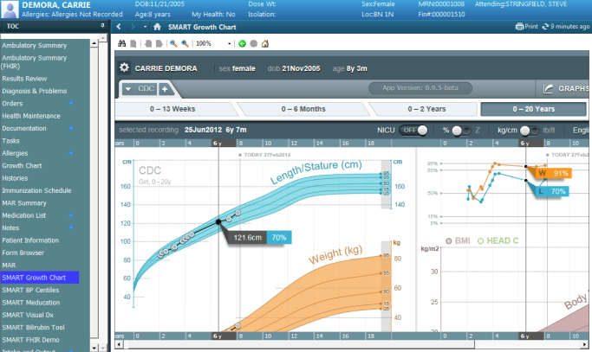
Boston Childrens: SMART Growth Chart
Huff, S., McCallie, D HIMSS 2015

Slide 25
DSRIP
8 billion dollar grant (Medicaid waiver) from CMS to NY State
  25% reduction over five years in avoidable hospitalizations and ER visits in the Medicaid and uninsured population
  Collaborative effort to implement innovative projects focused on
    System transformation
    Clinical improvement
    Population health improvement

Slide 26
5 Year Goals
Create integrated Suffolk County care delivery system for 387K lives anchored by safety net providers
Engage partners across the care delivery spectrum to create a countywide network of care
After five years, transition this network to an ACO which will contract with insurance providers on an at risk basis

Slide 27
Suffolk Care Collaborative IT Architecture
Suffolk County Providers
Stony Brook Medicine
EMRs or clinical Information System
EMRs or clinical Information System
Suffolk County PPS Population Management Tools
Registries | Care Plans | Workflow | Med Adherence | Mobility
Suffolk County PPS Patient Portal
eForms | Patient Wellness | Alerts | Mobile Monitoring | Patient Education | Clinical Records | Collaboration
Clinical Data for Patient Care
Suffolk County Big Data Platform
Predictive Analytics | Event Engine | Structured Data | Financial Data | Legacy Data
Machine Learning | NLP | Unstructured Data | Wearables Data | Social Data
Anomaly Detection | Rules | Device Data | HL7/CCD | Open Data
Suffolk county PPS Master Patient Index (MPI)
Suffolk county PPS Health Information Exchange (HIE)
E-HNLI RHIO (HIE)

Slide 28
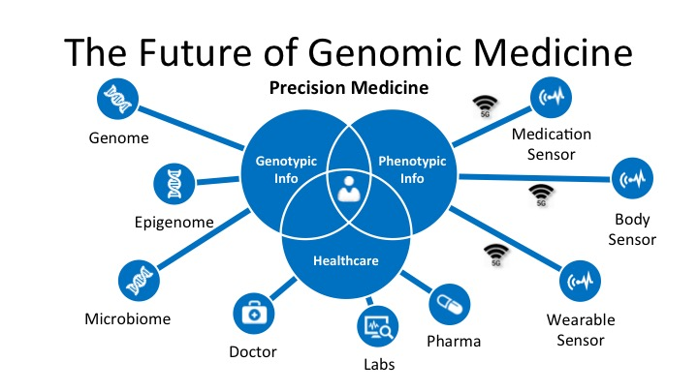
Gavin Stone, edico genome 5G Summit May, 14, 2015

Slide 29
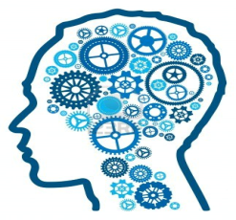
New Team Members
Data Scientist
Developers
Cognitive and Behavioral Psychology
User Experience
Human & Computer Interaction
  Devices
  Wearables
Patients & Family

Slide 30
Trends: Big Data
Definition: Evolving
Creation & Management: Distributed and augmented
Information Governance: Shared
Meaningful Analysis: Beyond PnL, Reporting, Connections, Correlations, Pattern Recognition, Machine Learning, Natural Language Processing
Business Requirements: Blank Page; We don’t know what we want we will figure it out once we look at the data, the data will lead the way, AKA, Data Science

Slide 31
Trends: Healthcare
Content Analytics – Suggestive Analytics* – Prescriptive Analytics
Imaging Analytics
Moving Analytics out of the EMR Environment
Graph Data Mart
  Edge and Vertices Analysis
Omic & Phenotype Combines
Sentiment Analysis
Dale Sanders

Slide 32
Takeaways
Underpinning platforms may change but concept is here to stay, abstract where possible.
Machine learning will lead to the evolution of Data Science and eventual use of AI in Healthcare.
Get used to source now, ask questions later: Healthcare evolves with data and it is not a point in time construct any longer.
Get used to working with constant change, disruptive trends and something new that will make your “frameworks” obsolete.

Slide 33

Contact Me @
Charles Boicey
cboicey@uci.edu
charles.boicey@stonybrookmedicine.edu
cboicey@clearsense.com
1+904-373-0831
@N2InformaticsRN

