Slide 1
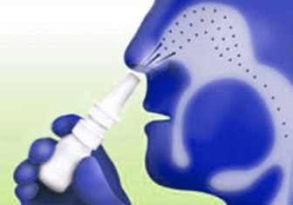
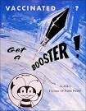
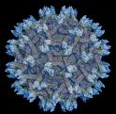
Unique IL-4R antagonist and IL-13Ra2 adjuvanted pox viral vector-based HIV vaccines
HIV/AIIDS & Mucosal Vaccines
Charani Ranasinghe
Molecular Mucosal Vaccine Immunology Group
John Curtin School of Medical Research
Australian National University

Slide 2
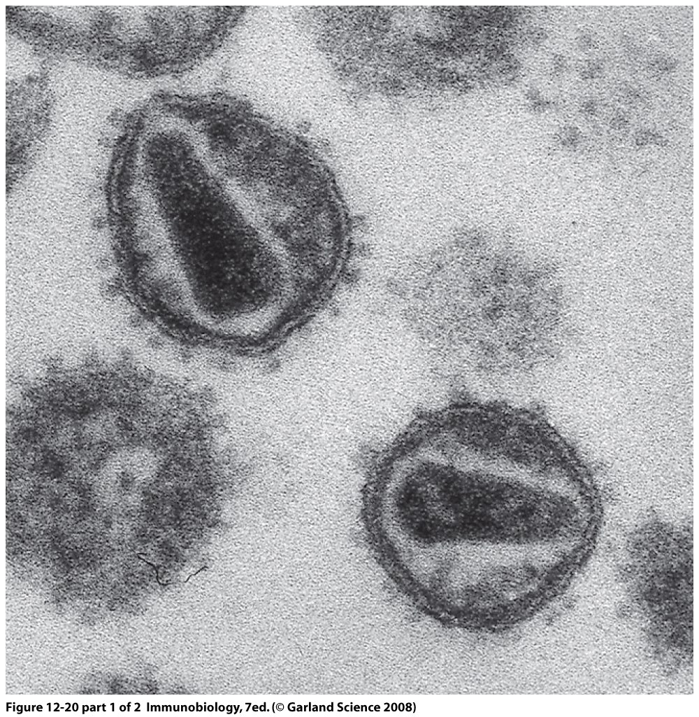
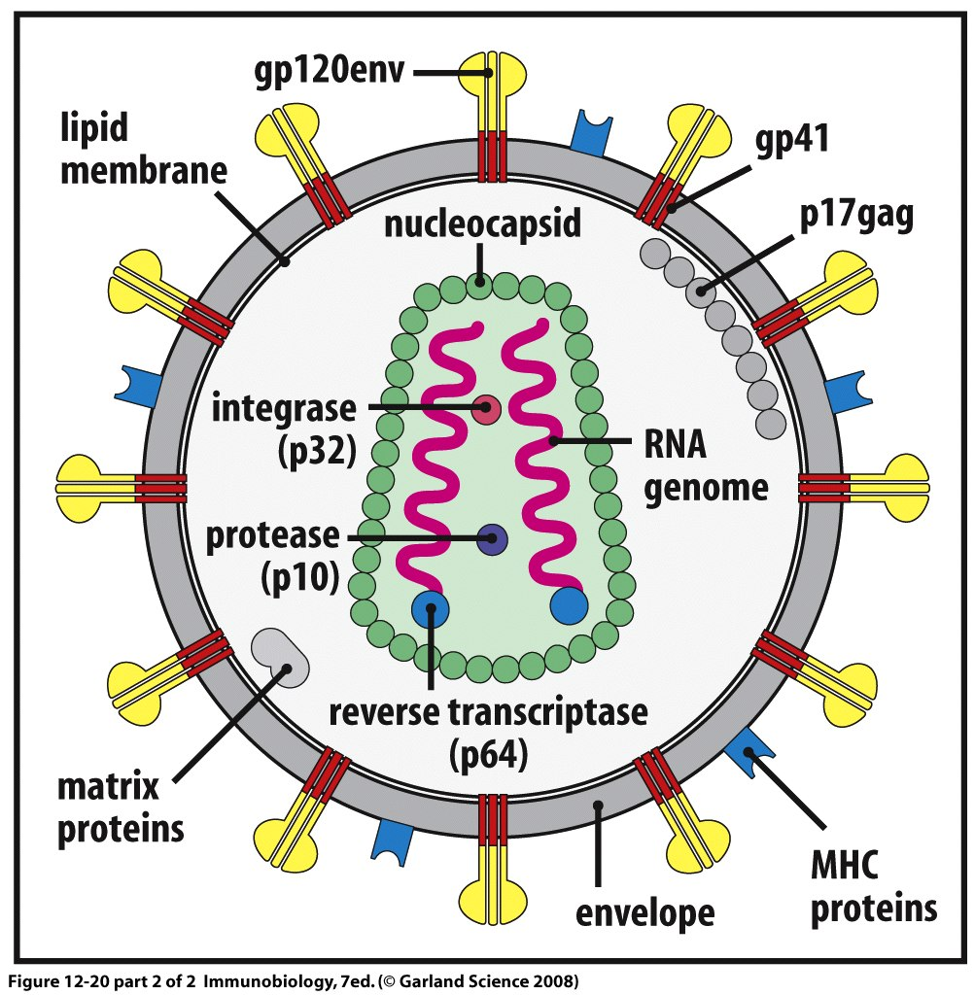
HIV - Human immunodeficiency virus
30 years have passed since the discovery of the virus, yet no vaccine is available
Single stranded RNA virus
Transmitted as an enveloped virus & this structure makes it difficult to design vaccines

Slide 3
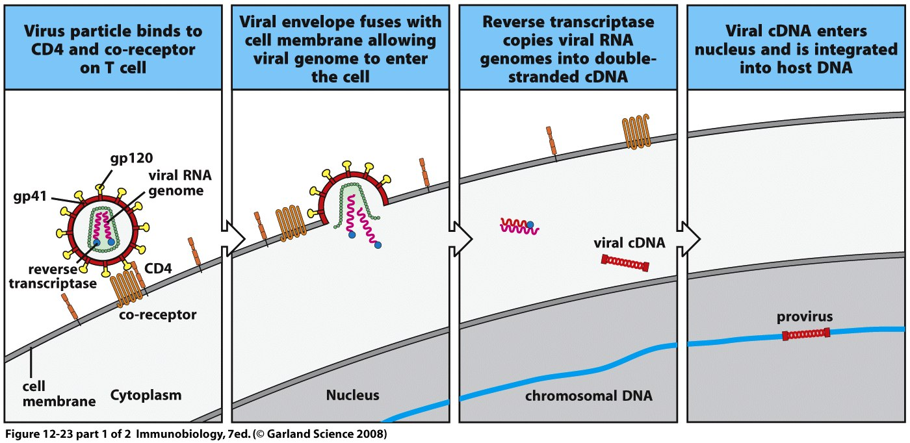
HIV infects CD4+ T cells and integrates into
the host DNA
After entry into cell, the viral RNA is converted to DNA by a virally encoded protein

Slide 4
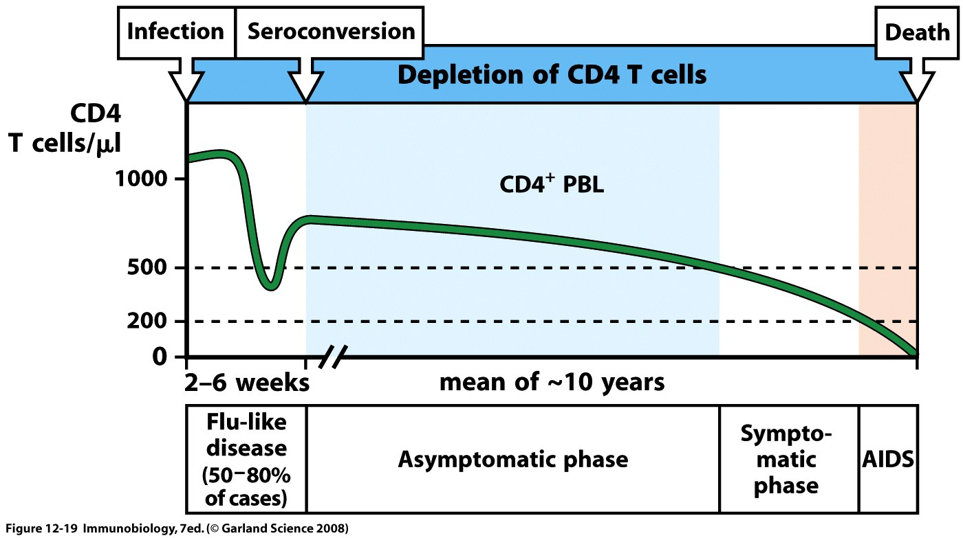
When CD4+ T cell numbers decline below a critical level, cell-mediated immunity is lost, and slowly the body becomes more susceptible to other infections

Slide 5
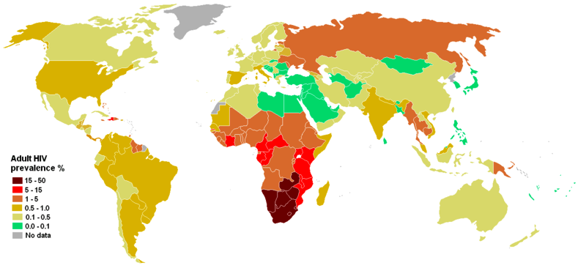
Global HIV/AIDS estimates
Today, 35.3 million people are living with HIV/AIDS
2.4 million are children & there are about 17 million orphans
Since 1981, 36 million people have died
2012 ~ 1.6 million HIV/AIDS deaths
2012 ~ 2.7 million new infections
10 infections every minute
95% of new infections in developing countries

Slide 6
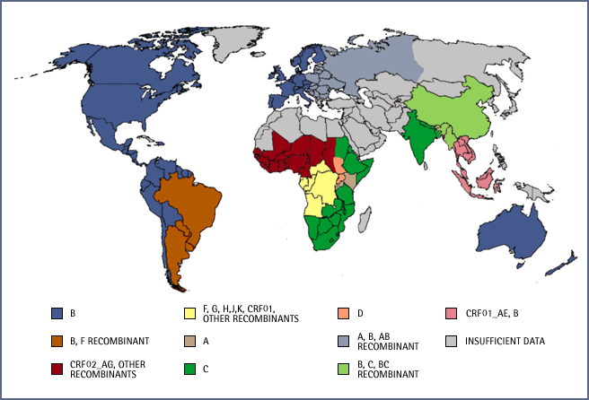
HIV-1 subtypes A to K distribution
Due to the existence of different subtypes developing a universal vaccine is a very difficult task

Slide 7
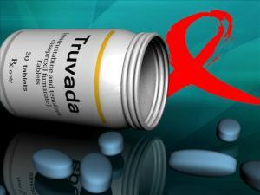
0% cure for HIV
The only treatment method currently available is LIFE LONG anti-retroviral drug treatment
World needs an HIV/AIDS vaccine
CR

Slide 8
Pitfalls
HIV vaccines current status
Even though very promising results have been observed in animal models, most of the systemic HIV vaccine trials (vaccines delivered to the blood compartment/ intra muscular vaccination) have elicited poor immune out comes in humans.
  Many rDNA prime boost trials including Sydney rDNA/rFVP trial 2003
  Merck STEP Ad vaccine trial 2007
  Thai RV144 trail - 31% success
Notes:
NO mucosal HIV-1 vaccine trial has been conducted

Slide 9
Why & How?
  Understand “why” are these vaccines failing
  What are the correlates of protective immunity in humans
  Develop better vaccine strategies to enhance both systemic & mucosal immunity
  “How” do these new vaccines work?
CR
CR Oct 2013
Notes:
NO mucosal HIV-1 vaccine trial has been conducted

Slide 10
Why mucosal vaccine for HIV-1 ?
Virus is 1st encountered at mucosae, the genito-rectal tissue
Gastro-intestinal tract, is a major site of virus replication and CD4+ T cell depletion
Immunity at these sites therefore, is crucial to prevent virus dissemination and offer protection against HIV
Mucosal Vaccines

Slide 11
intranasal
Oral
intrarectal
intravaginal
DeRose Kent Ranasinghe 2014
Novel approaches and strategies for biologics, vaccines and cancer therapies.

Slide 12
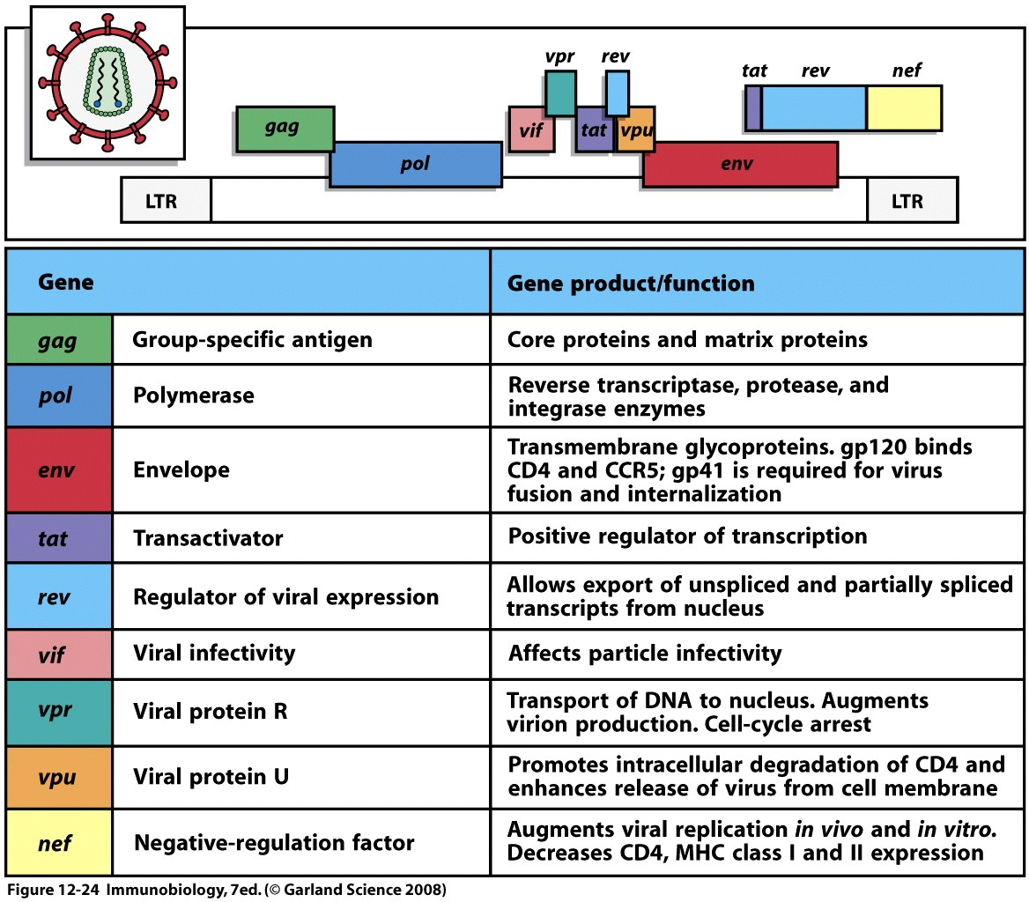
HIV gag pol env genes are used in our vaccines
Notes:
9 genes, we work on the main 3 genes

Slide 13
Recombinant pox viral vector-based vaccine construction
HIV gag/pol/env
Recombinant fowlpox virus (rFPV) - priming vaccine
HIV gag/pol
Recombinant vaccinia virus (rVV) or Modified Vaccinia Ankara (rMVA) - booster vaccine
Not to scale

Slide 14
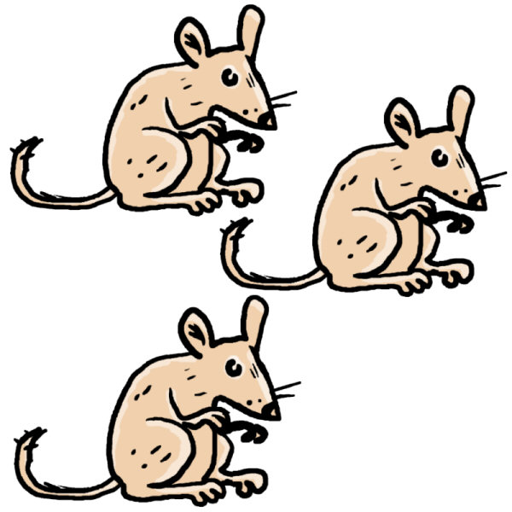
HIV prime-boost vaccination
2W
1W – 3 months
Prime HIV-FPV
10^7 pfu
Boost HIV-VV
10^7 pfu
Evaluate immunity
Pure systemic – i.m./i.m.
Pure mucosal – i.n./i.n.
Combined mucosal/ systemic - i.n./i.m.

Slide 15
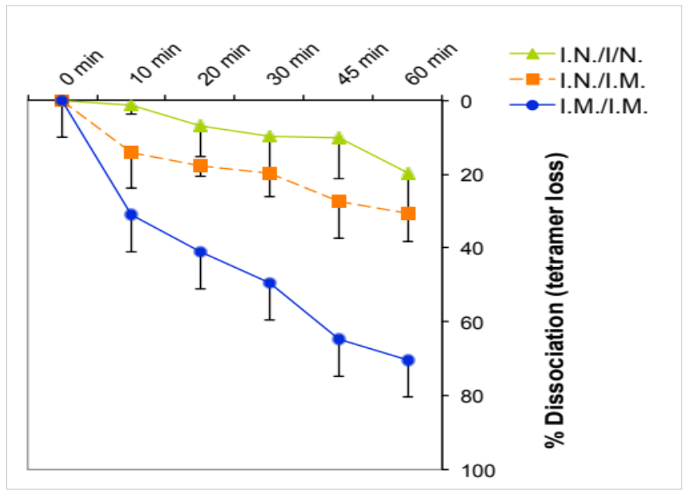
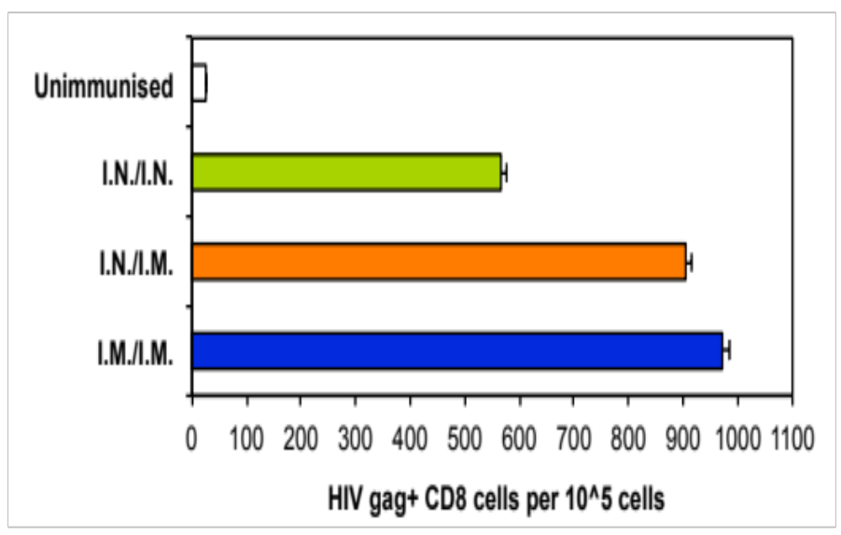
Mucosal vaccination induces high quality CD8 T cells
Magnitude evaluated using HIV-specific tetramer staining
Quality evaluated using tetramer dissociation
i.n FPV-HIV./i.m. VV-HIV prime-boost vaccination induces both high magnitude and quality systemic and mucosal CD8 T cells
i.n. = intranasal, i.m. = intramuscular, FPV = fowl pox, VV- vaccinia virus (or Modified vaccinia Ankara)
Ranasinghe et al Vaccine 2006
Ranasinghe et sl J. Immunol 2007

Slide 16
What is important?
Quantity /magnitude
or
Quality
Unfortunately, we believe that looking for the “QUANTITY” of immune response has been the major cause for the disappointing outcomes of many of the vaccine trials.

Slide 17
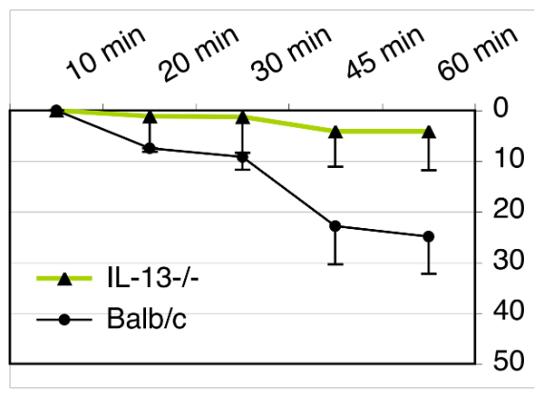
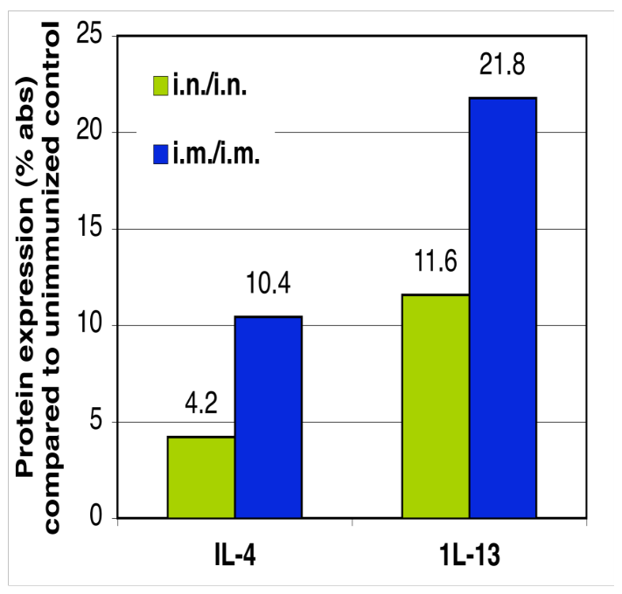
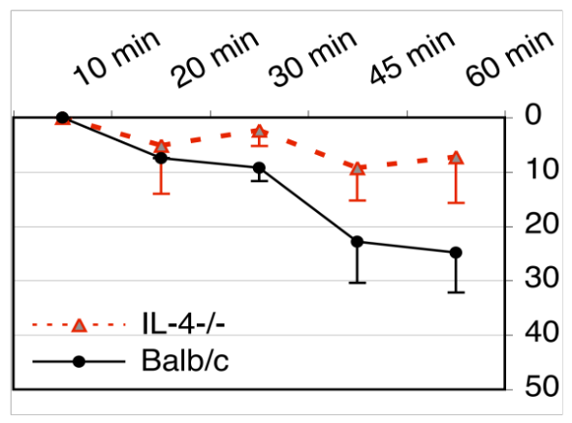
Induction of high quality HIV-specific CD8 T cells following mucosal vaccination correlates with lower expression of IL-4/IL-13 by CD8 T cells
IL-4/13 expression by HIV-specific T cells measured by single cell analysis and antibody arrays
IL-4 & IL-13 KO BALB/c mice induce high quality T cells evaluated using tetramer dissociation
P = 0.043
% Dissociation (tetramer loss)
P = 0.045
Absence of IL-4/IL-13 induces high avidity HIV-specific CD8 T cells
Ranasinghe et al Euro J Immunol 2009
Statistics were calculated using Student’s T-test
Notes:
17

Slide 18
Can we design a vaccine that can transiently block
IL-4 and /or IL-13?

Slide 19
Construction of novel recombinant pox viral vector-based vaccines that co-express IL-13Rα2 or IL-4R antagonist
Soluble IL-13Rα2 or IL-4R antagonist
HIV gag/pol/env
.
Recombinant fowlpox virus (rFPV) - priming vaccine
Soluble IL-13Rα2 or IL-4R antagonist
HIV gag/pol
Recombinant vaccinia virus (rVV) or Modified Vaccinia Ankara (rMVA) - booster vaccine
Ranasinghe et al Mucosal Immunology 2013; Jackson et al Vaccine 2014

Slide 20
Novel IL-13Rα2 adjuvanted vaccine will transiently sequester IL-13 in the cell milieu
IL-4
IL-13
IL-13Rα1
IL-4Rα
IL-4Rα
γc
IL-13Rα2m
TGF-β
STAT6
Ranasinghe et al Cytokine and Growth Factor Reviews 2014

Slide 21
Novel IL-4R antagonist adjuvanted vaccine will bind to IL-4R and transiently block IL-4/IL-13 signaling via the STAT6 pathway
IL-4
IL-13
IL-13Rα1
IL-4Rα
IL-4Rα
γc
IL-13Rα2m
TGF-β?
STAT6
Ranasinghe et al Cytokine and Growth Factor Reviews 2014

Slide 22

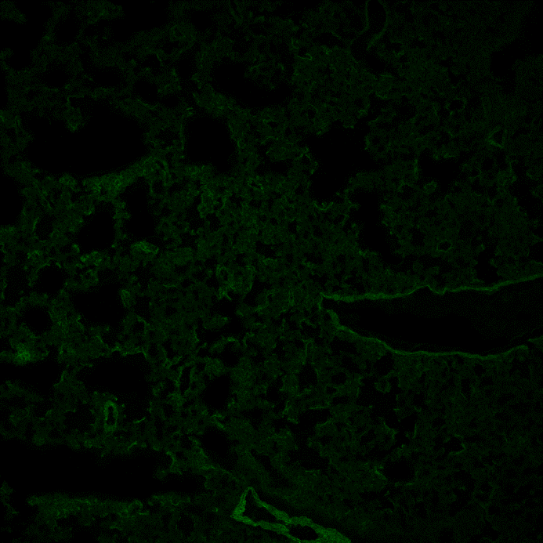
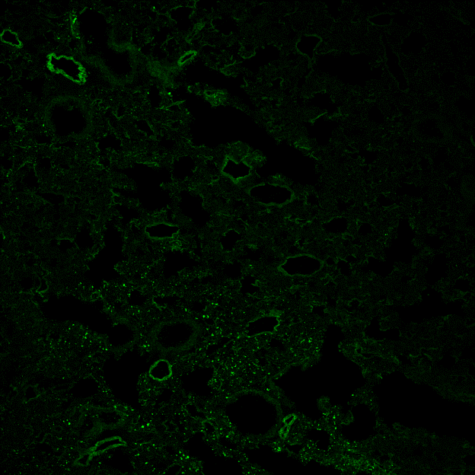
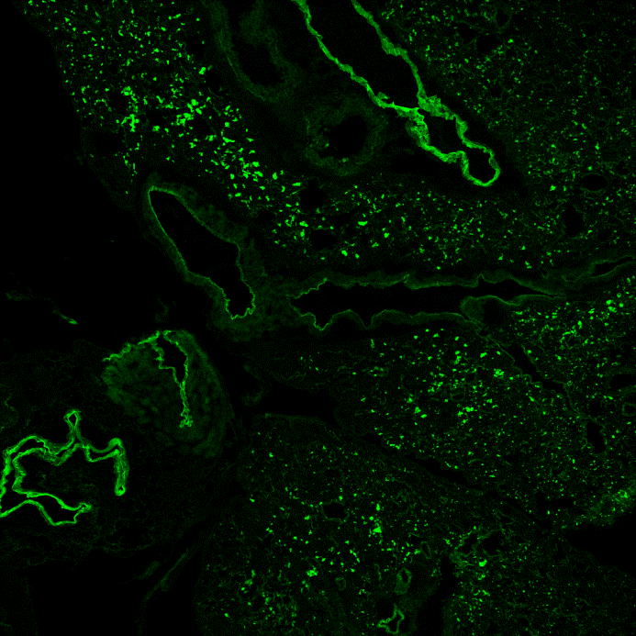
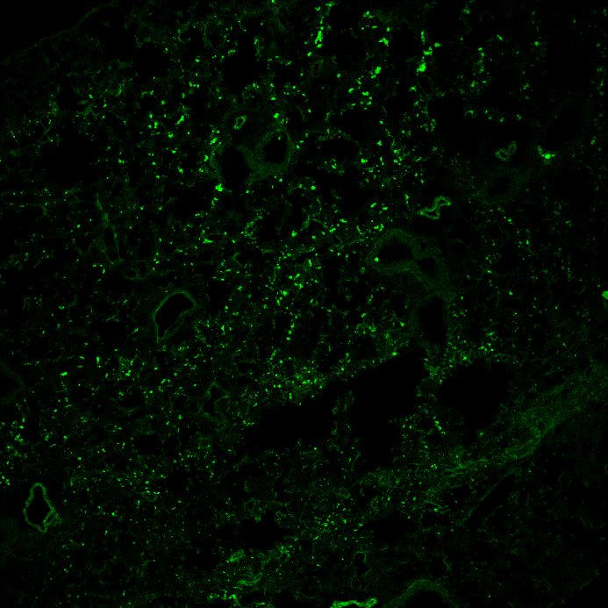
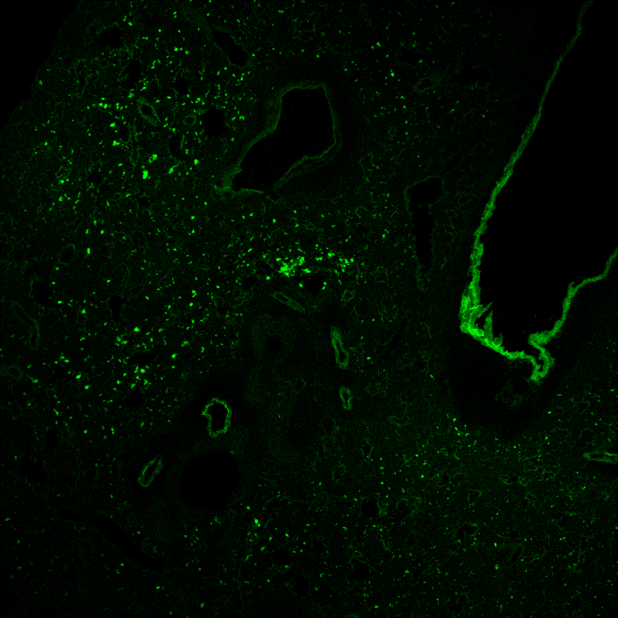
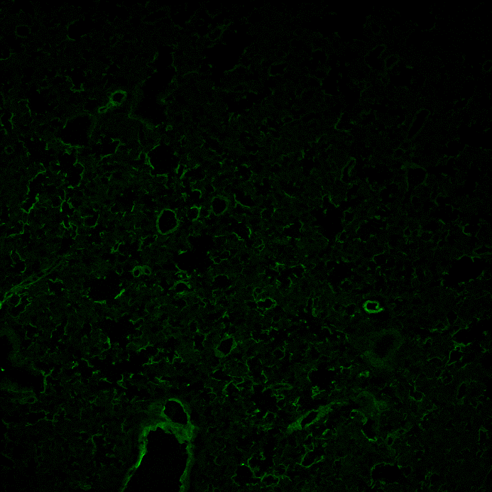
Following intranasal rFPV immunization peak antigen expression detected at 12h post vaccination
Control
6 hrs
12 hrs
24 hrs
48 hrs
96 hrs

Slide 23
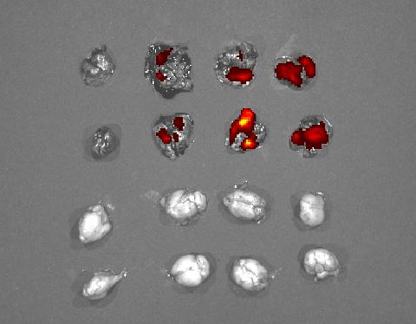
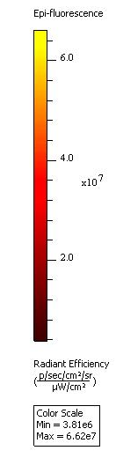
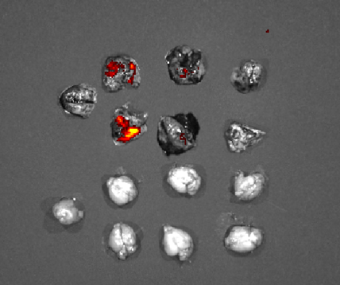

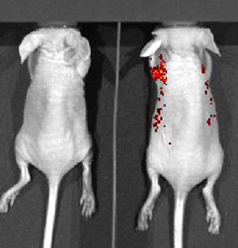

Nasal administration of rFPV vector-based vaccines do not cross the blood-brain barrier - Safe
Control
6h 12 h 24 h p.i
Control 48 h 72 h 96 h p.i
Lung
Brain
Townsend et al (in Prep)

Slide 24
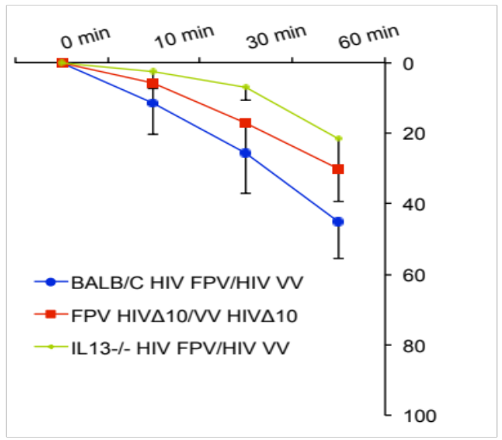
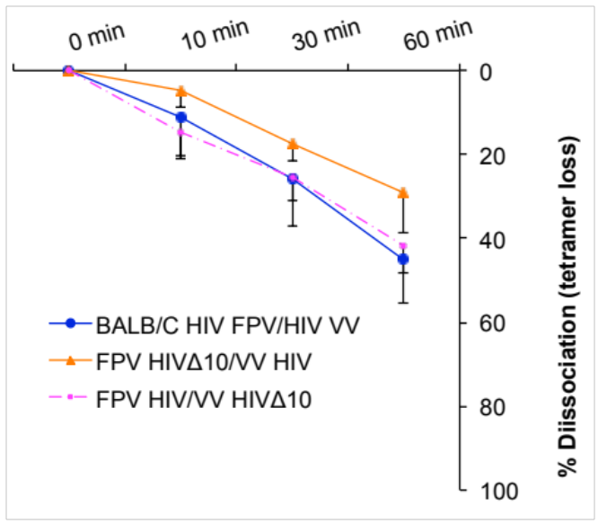
Novel IL-13Rα2 and IL-4R antagonost adjuvanted vaccines induce HIV-specific CD8 T cells of high avidity
**
*
***
Evaluation of quality/avidity 14 days post booster vaccination
Note: HIVΔ10 = IL-13Rα2
p = 0.0115 ** p = 0.0005 *** p = 0.0106
Inclusion of the inhibitor in the priming vaccination is crucial to induce high avidity T cells
Ranasinghe et al Mucosal Immunology 2013

Slide 25
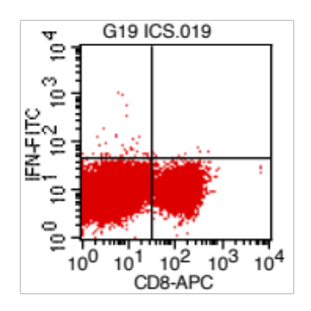
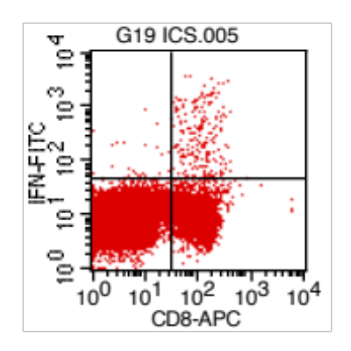
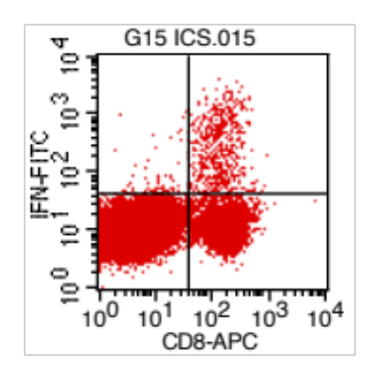
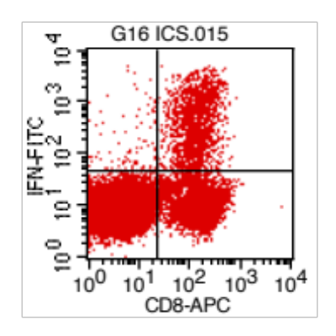
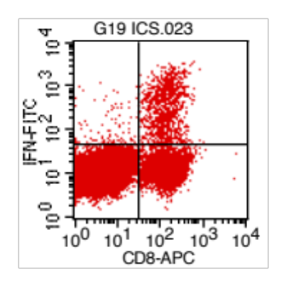
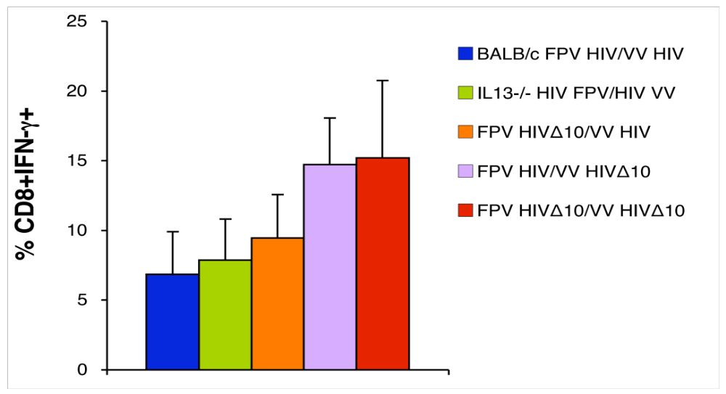
Vaccines that transiently block IL-4 and/or IL-13 in-vivo can enhance the magnitude of HIV-specific CD8+ T cell immunity
Booster only
0.1%
4.2%
6.1%
14.7%
14.2%
Ranasinghe et al Mucosal Immunology 2013

Slide 26
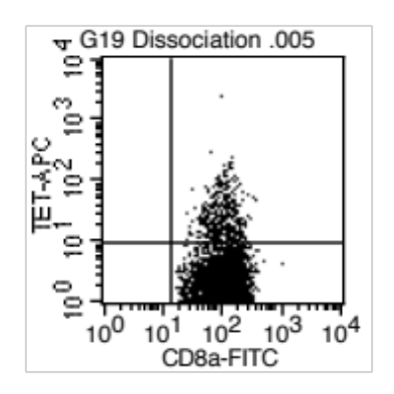
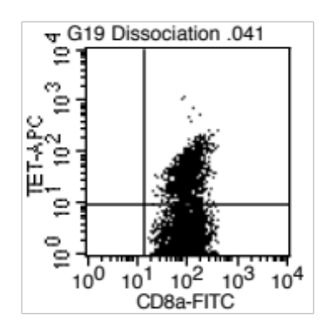
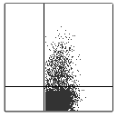
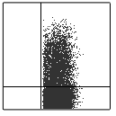
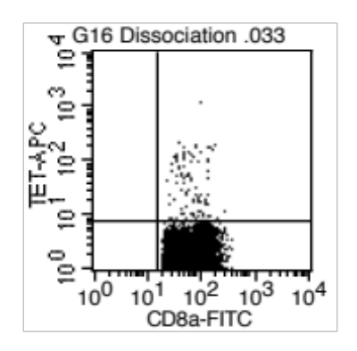
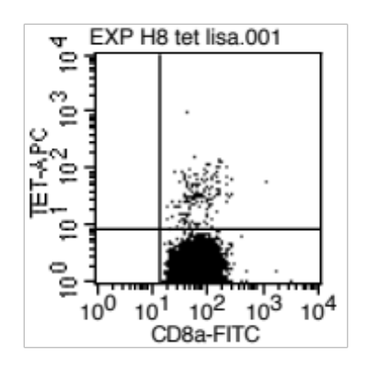
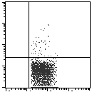
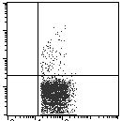
Novel adjuvanted vaccines delivered i.n. rFPV/i.m. rVV increase systemic and mucosal HIV-specific CD8 T cells
Systemic compartment
Mucosal compartment
Control
adjuvanted
adjuvanted
Control
5.8%
19.2%
8.42%
20.03%
lung
Spleen
0.66%
1.2%
iliac nodes –
genito-rectal immunity
HIV tetramer - APC
CD8+ FITC
1.0%
3.1%
Peyer’s
Patches -
gut immunity
Induction of enhanced immunity in the genito-rectal and gut mucosae will provide early protection against HIV infection.

Slide 27
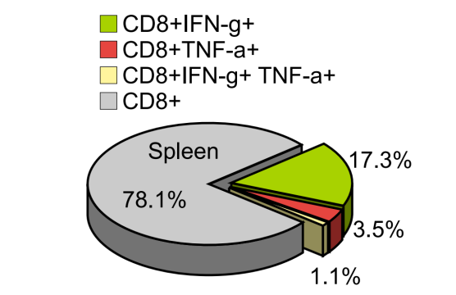
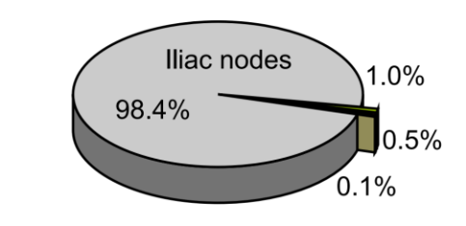
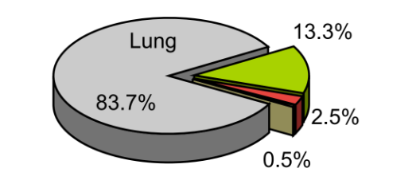
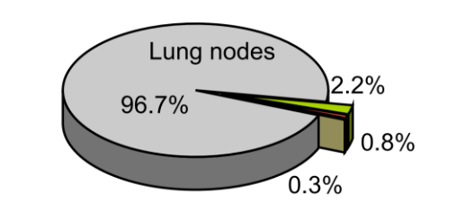
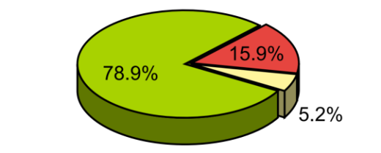
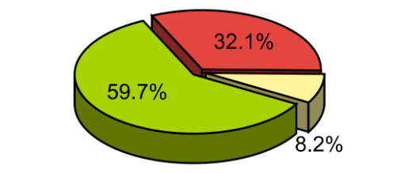
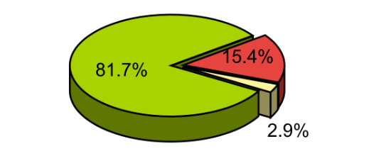









Novel vaccines can enhance both systemic & mucosal HIV-specific poly-functional CD8 T cell immunity
(i) FPV HIV∆10/ VV HIV∆10
(ii) FPV HIVVV HIV
Spleen Iliac nodes Lung Lung nodes
Ranasinghe et al Mucosal Immunology 2013

Slide 28


Novel IL-4/ IL-13 inhibitor vaccines induce HIV-specific killer T cells with broader cytokine/chemokine profiles – high quality
Control vaccine strategy
DNA-HIV/FPV-HIV prime-boost vaccine strategy that was tested in previous Sydney human clinical trial
IL-13 inhibitor vaccine
Ranasinghe et al Mucosal Immunology 2013

Slide 29

Both IL-13Rα2 and IL-4R antagonist adjuvanted HIV vaccines induce excellent CD8 T cell mediated protective immunity
*
*
*
- IL-4R antagonist
IL-13Rα2 adjuvanted
control
Both novel vaccines
P < 0.05 compared to control vaccination
Ranasinghe et al Mucosal Immunology 2013;
Jackson Worley Trivedi Ranasinghe Vaccine 2014

Slide 30
What about Gag and Env-specific B cell immunity?

Slide 31






Novel IL-4R antagonist vaccines induce Gag-specific antibody differentiation
IgG1
3 weeks
6 weeks
12 weeks
* 0.0567
IgG2a
* 0.0566
*** 0.0006
* 0.0256
* 0.0256
Note: IL-4R antagonist vaccine strategy induces both IgG1 and IgG2a compared to IL-13Rα2 adjuvanted vaccine. This suggest that the two vaccines use different pathways to induce B cell immunity
Jackson Worley Trivedi Ranasinghe Vaccine 2014
Statistics were calculated using Mann – Whitney U test

Slide 32
Can we also induce Env-specific antibodies following an Env booster immunisation strategy
3w 6w 9w 12w 20w blood collection post gp140 booster
2w
2w
i.n. prime
rFPV
gag/pol env
Euthanize animals
i.m. 1st booster
VV or MVA gag/pol
i.m. 2nd booster
Env gp140 Protein
Worley et al

Slide 33




Both IL-13Ra2 and IL-4R antagonist adjuvanted vaccines can induce good Env-specific IgG1 antibody immunity
6 weeks
3 weeks
9 weeks
12 weeks
Control = unadjuvanted vaccine
Worley et al

Slide 34


Vaccines induced Env-specific IgG1 responses of high avidity at 20 weeks post protein booster vaccination
6 weeks
20 weeks
*
Control = unadjuvanted vaccine
Worley, Ng et al (in prep)

Slide 35
How do these vaccines work, “the mechanisms” ?
Ranasinghe et al Mucosal Immunology 2013 ; Trivedi Jackson Ranasinghe Virology 2014

Slide 36





i.n. delivery of the novel vaccines recruit unique antigen presenting cell subsets to the the lung mucosae within the first 24h of vacciantion
FPV-HIV
FPV-HIV IL-13KO
FPV-HIV IL-13Rα2
FPV-HIV IL-4RC118
(IL-4R antagonist)
45.1%
61.4%
58.4%
73.5%
1.92%
2.25%
1.14%
1.03%
CD11b
CD103
MHCII⁺ CD11c⁺ CD11b⁺ CD103⁻ induce high avidity T cell repertoire
MHCII⁺ CD11c⁺ CD11b⁻ B220⁺ differentially regulated between the two vaccines
Ranasinghe et al Mucosal Immunology 2013 ; Trivedi Jackson Ranasinghe Virology 2014

Slide 37
Unique features of our novel i.n./i.m. combined mucosal/systemic HIV IL-4R antagonist adjuvanted vaccine strategy
Enhanced high quality/avidity mucosal & systemic HIV Gag-specific CD8 T cell immunity*
  HIV Gag-specific antibody differentiation (IgG1 and IgG2a*
  HIV Env-specific IgG1 following a second i.m. Env protein booster**
Induction of this triple action immunity clearly differentiates our vaccines from any HIV vaccine that has entered clinical trials
The immune responses induced by our vaccines are consistent with
  HIV controllers* and
  Antibodies providing partial protective efficacy in the RV144 trial**
The two novel vaccine strategies have high potential to contribute not only to a future HIV-1 vaccine but also other chronic mucosal infections where high avidity CD8 T and B cells are required for protective efficacy - Platform technology

Slide 38





Acknowledgements
Molecular Mucosal Vaccine Immunology Group:
Dr. Ronald Jackson
Annette Buchanan, Donna Woltering, Craig McArther, Sherry Tu
Lisa Pavlinovic, Megan Glidde,
Students: Danushka Wijsundara, Shubhanshi Trivedi, Jay Ravichandran, Zehyi Li, Matthew Worley, Megat Hamid, Alice Ng, David Townsand.
JCSMR/BRF: Kerong Zhang, Kerry McAndrew
JCSMR/MCRF: Harpreet Vohra, Mick Devoy, Catherine Gillespie
ANU Animal services staff; ANU TTO
Collaborators:
Dr. Robert Center - Burnet Institute;
Dr. David Boyle - CSIRO AAHL; Dr. John Stambas - Deakin Uni/ CSIRO AAHL
Prof. Alistair Ramsay - Louisiana Vaccine Centre, USA
Collaborators at the Melbourne University
The Gordon and Gretel Bootes Foundation

