Slide 1

About OMICS Group
OMICS Group International is an amalgamation of Open Access publications and worldwide international science conferences and events. Established in the year 2007 with the sole aim of making the information on Sciences and technology ‘Open Access’, OMICS Group publishes 400 online open access scholarly journals in all aspects of Science, Engineering, Management and Technology journals. OMICS Group has been instrumental in taking the knowledge on Science & technology to the doorsteps of ordinary men and women. Research Scholars, Students, Libraries, Educational Institutions, Research centers and the industry are main stakeholders that benefitted greatly from this knowledge dissemination. OMICS Group also organizes 300 International conferences annually across the globe, where knowledge transfer takes place through debates, round table discussions, poster presentations, workshops, symposia and exhibitions.

Slide 2
About OMICS Group Conferences
OMICS Group International is a pioneer and leading science event organizer, which publishes around 400 open access journals and conducts over 300 Medical, Clinical, Engineering, Life Sciences, Pharma scientific conferences all over the globe annually with the support of more than 1000 scientific associations and 30,000 editorial board members and 3.5 million followers to its credit.
OMICS Group has organized 500 conferences, workshops and national symposiums across the major cities including San Francisco, Las Vegas, San Antonio, Omaha, Orlando, Raleigh, Santa Clara, Chicago, Philadelphia, Baltimore, United Kingdom, Valencia, Dubai, Beijing, Hyderabad, Bengaluru and Mumbai.

Slide 3
EFFECTS OF SCR SYSTEM ON NOx REDUCTION IN HEAVY DUTY DIESEL ENGINE FUELLED WITH DIESEL AND ALCOHOL BLENDS
International Conference and Exhibition on Automobile Engineering
2015 Valencia, Spain
Ceyla OZGUR, Kadir AYDIN
Cukurova University, Department of Automotive Engineering , Adana, TURKEY

Slide 4
Contents
Introduction
Experimental Set up
Preparation of Fuel Blends
NOx Emissions
Conclusion
Acknowledgement

Slide 5
Introduction
Diesel engine is one of the major reason of air pollution like hydrocarbons (HC), carbon monoxide (CO), nitrogen oxides (NOx), particulate matter (PM) and other toxic species.
Diesel engine exhaust emissions consist mainly of high levels of nitrogen oxides (NOx), and its emission into the atmosphere is one of the main threats to the environment.
Due to growing concerns about protecting the environment and human health, the NOx emission standards from heavy duty diesel engines have been continuously tightened over the years throughout the world.

Slide 6
Introduction
Among the engine aftertreatment devices, a urea selective catalytic reduction (SCR) is one of the promising aftertreatment devices for the abatement of exhaust emissions, particularly for NOx pollutants. Relative to other alternative aftertreatment systems, the use of an SCR system can improve the economy of the engine together with the reduction of NOx emissions (Dieter et al., 2003).

Slide 7
Introduction
It is called ‘Selective’ because it does not reduces the excess oxygen which is typical to a lean exhaust in a diesel engine.
It involves mixing the exhaust air with a gaseous reagent, typically ammonia or urea, and passing the homogenous mixture over a bed of catalyst which causes the reaction to undergo completion at the air stream temperature.

Slide 8
Introduction
The NH3 selectively reacts with the NOx component in the gas stream without reacting with the O2 available in large excess.
The catalyst promotes the reduction of NOx with NH3 in the presence of O2 in the exhaust stream, forming nitrogen (N2) and water (H2O).

Slide 9
Introduction
For enhance the quality of the performance and combustion various fuel additives are currently used in the automotive industry. The most investigated additives are oxygenated fuel additives in terms of diesel combustion and emissions
Methanol, ethanol and butanol are preferred as fuels because they can be generated by fermentation of sugar from vegetable materials, like as corn, sugar cane, algae, and other plant materials compraising cellulose. Alcohol fuels have many advantages such as reduce particulate matter (PM), nitrogen oxides (NOx) and carbon monoxide (CO) emissions due to the additional oxygen in fuel.

Slide 10
Introduction
The aim of this study was to investigate the effects of alcohol fuel blends on NOx emissions of diesel engine, equipped with SCR system to further reduce the NOx emission.

Slide 11
Experimental Set Up
Exhaust emmission variations of diesel blends with alcohol additive was carried on a six cylinder, four-stroke, air-cooled turbocharger diesel engine with and without SCR system. A hydraulic dynamometer was used to determine the torque.

Slide 12
Experimental Set up
Table 1. The engine specifications
Brand | Cummins
Model | ISBE4+250B
Type | Electonic control system
Cylinder | 6
Bore/Stroke | 107/124 mm
Compression Ratio | 17.3
Aftertreatment | SCR
Displacement | 6700cc
Power | 184 kW@2500 rpm
Torque | 1020Nm @1500 rpm
Oil Cooler | Turbocharger & aftercooled

Slide 13
Experimental Set up
Table 2. Specifications of Dynamometer
Torque range | 0-1700 Nm
Speed range | 0-7500 rpm
Body weight | 45 kgf
Total weight | 110 kgf
Body diameter | 350 mm
Torque arm length | 350 mm

Slide 14
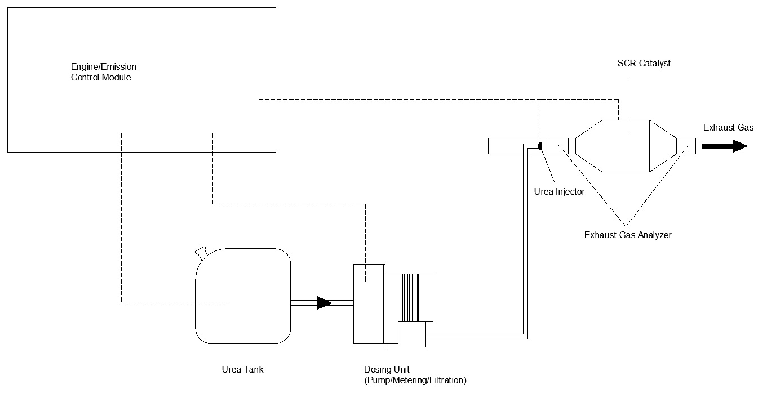
Experimental Set up
Figure 1. Shematic diagram of test unit

Slide 15
Experimental Set Up
AVL SESAM i60 Fourier Transform Infrared Spectroscopy (FTIR) device was used measuring of exhaust emissions. The fuel blends were tested between 1400 rpm to 2400 rpm with interval of 200 rpm in full load conditions.

Slide 16
Experimental Set up
Table 3. AVL SESAM i60 Fourier Transform Infrared Spectroscopy (FTIR)
Sampling rate | 1 scans per second (1 Hz)
Data rate | All measured gas components at 1 Hz
Spectral resolution | 0.5 cm-1
Measurement cell | Gas cell heated to 191°C
Response time | t10 to t90 within 1 s (fast response version within 300 ms)
Sample flow rate | 10 l/min per stream (20 l/min for fast response version)
Detector cooling | Liquid nitrogen 50ml/h
Zero/purge gas | Nitrogen/synthetic air. 0.6-1.5l/min
Compressed air | 5-6 bar rel. Max. 100l/min per FTIR stream

Slide 17
Experimental Set up
Table 4. Specifications of the Aqueous Urea for SCR
Name | Aqueous Urea Solution
Chemical Formul | (NH₂)₂CO.H₂O
Molecular weight | 60.06 g/mol
Urea Concentration in solution | 32.5%
Density @ 20ºC | 1.089 g/cm³
RI @ 20˚C | 1.3828
pH value | 9-11
Appearance | Colorless
Cristallization Temperature | -11 ºC
Alkalinity as NH₃ | 0.0002

Slide 18
Experimental Set up
Table 5. Specifications of the catalyst in Aftertreatment system
 | SCR
Diameter (m) | 0.2667
Length (m) | 0.3048
Cell Geometry | Honeycomb type square celled catalyst
Total Volume (L) | 17
Cell Density/in² | 400
Wall Thickness (mm) | 0.105

Slide 19
Preparation of Fuel Blends
The fuels used in the experiments are diesel, methanol, ethanol and butanol.
The fuel blends were prepared by mixing euro diesel at volumetric rates of 5, 10 and 15%.
Methanol-diesel blends specified as D95M5, D90M10 and D85M15.
Ethanol-diesel blends specified as D95E5, D90E10 and D85E15.
Butanol-diesel blends specified as D95B5, D90B10 and D85B15.

Slide 20
Preparation of Fuel Blends
Table 6. Fuel Properties of diesel, methanol, ethanol and butanol
Fuel Properties | Diesel | Ethanol | Methanol | Butanol
Density (kg/lt) | 0.833 | 0.788 | 0.793 | 0.810
Cetane Number | 61 | ~8 | 3.8 | ~25
Viscosity (cSt) | 2.7 | 1.078 | 0.5445 | 3.6
CalorificValue (kj/kg) | 45,100 | 26,900 | 20,100 | 33,100
Boiling Point | 180-360 | 78 | 64 | 118
Stoichiometric air fuel ratio | 15 | 8.9 | 6.7 | 11.2

Slide 21
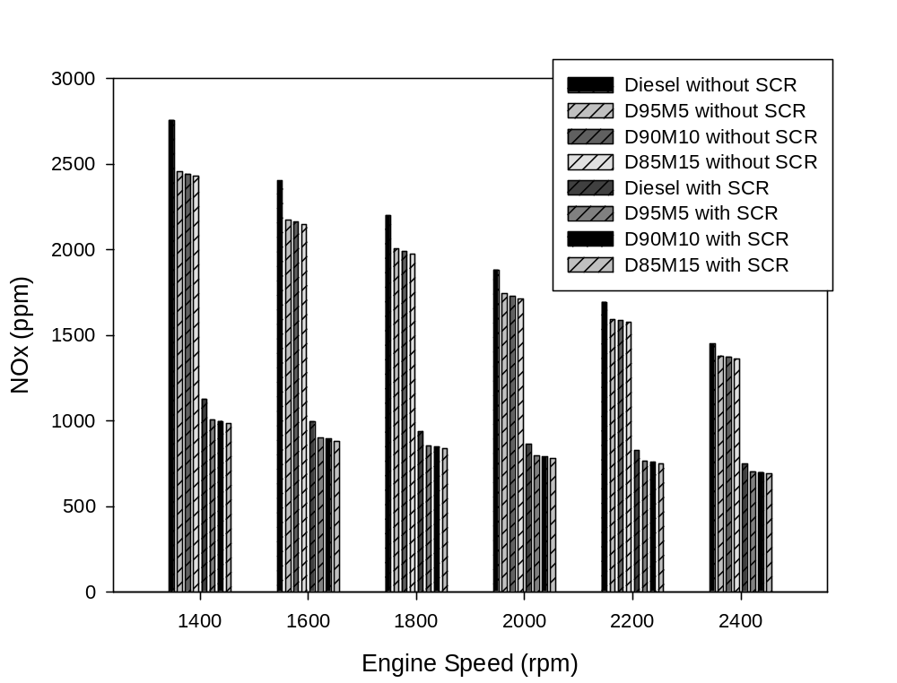
Figure 2. Investigation of (a) NOX (oxides of nitrogen) emission

Slide 22
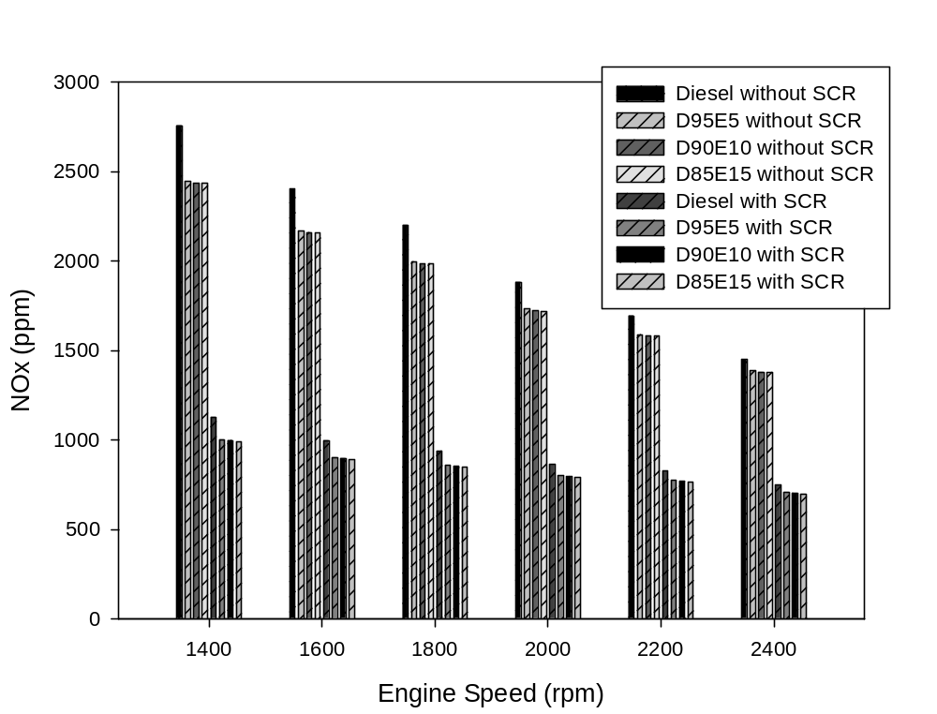
Figure 3. Investigation of (a) NOX (oxides of nitrogen) emission

Slide 23
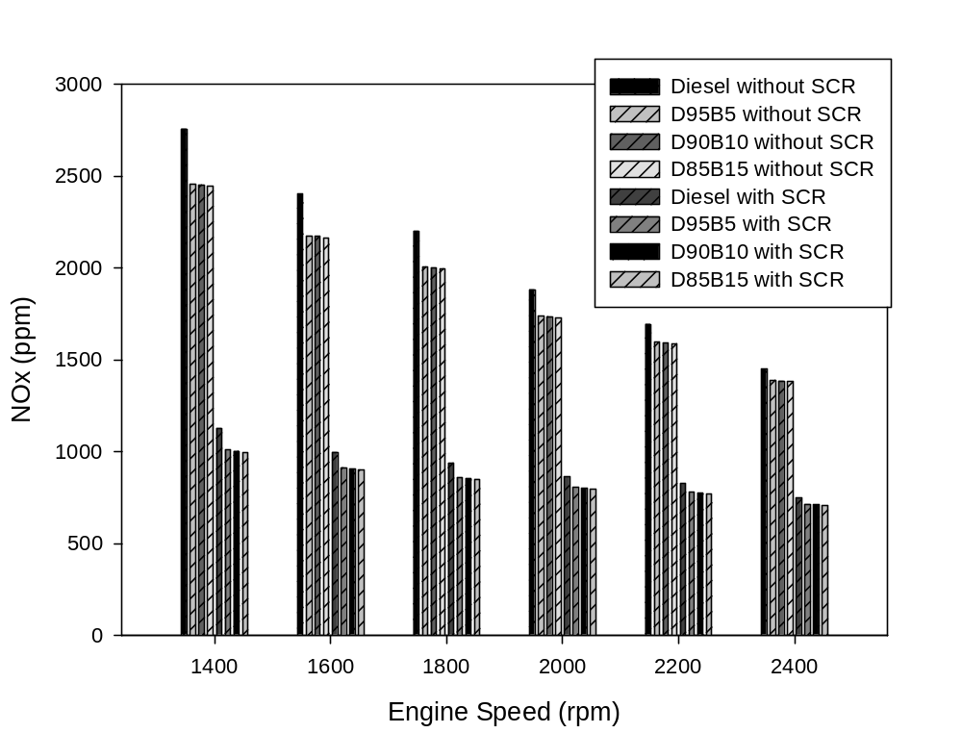
Figure 4. Investigation of (a) NOX (oxides of nitrogen) emission

Slide 24
NOx Emissions
When urea is injected in the exhaust manifold, the breakdown of urea [(NH2)2CO] into ammonia happens by virtue of two processes thermolysis and hydrolysis as shown below,
  (NH2)2CO + H2O →2NH3 + CO2
Precisely, the ammonia formed during the decomposition and hydrolysis process reacts with NO and NO2 in the tail pipe to from N2 and H2O. The reaction which governs the formation of end products, after urea injection, is as follows,
  2NH3 + NO + NO2 → 3H2O
Similar findings were reported by many researchers when using urea based SCR systems, emphasizing it as one of the prominent method to reduce NOX emission (Birkhold et al., 2006; Koebel et al., 2000).

Slide 25
Conclusion
Addition of ethanol, methanol and butanol decrease the NOx emissions with respect to neat diesel. The reason of the reduction may be due to the increasing oxygen content and lower cetane number of alcohol additives. Lower cetane number of ethanol, methanol and butanol blends precipitates to longer ignition delay, and leading possibly to higher combustion temperature during the premixed combustion mode.

Slide 26
Conclusion
The maximum reduction for diesel with the addition of SCR is 59%.
The average reduction in NOx for SCR for D100, D85M15, D85E15 and D85B15 is 42.6%, 46.45%, 45.9% and 45.5% respectively as compared with diesel fuel at full load.

Slide 27
ACKNOWLEDGEMENT
This work was supported by Republic of Turkey Ministary of Science, Industry and Technology 01146.STZ.2011-2 SAN-TEZ.

Slide 28
Thank You For Your Attention

