Slide 1
Human Bone Marrow Stem Cell Behavior on Biomimetic Nanofiber Composites for Tendon-Bone Interface Regeneration
Ece Bayrak, Burak Ozcan, Cevat Erisken
10th World Congress and Expo on
Cell & Stem Cell Research
New York, NY
March 21, 2018
Notes:
I would first like to thank the conference organizers for allowing us to present our research here today and I’d also like to thank my co-authors for their contribution to this research

Slide 2
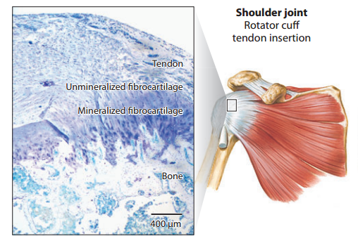
Tendon-to-Bone Interface
Injuries to rotator cuff often take place at the insertion, where a fibrocartilaginous transition is present (Iannotti et al., 1994; Benjamin&Ralphs, 1998)
Rotator cuff tears are the most common injuries of the shoulder
  Over 250,000 repairs anually in U.S. (Gulotta et al., 2009)
Successful repair is difficult with failure rates between 20% and 94% (Vitale et al, 2007; Galatz et al., 2004)
 | Tissue | Cells | Composition
1 | Tendon | Fibroblasts | Collagen type I,III
2 | Non-Mineralized Fibrocartilage | Ovoid Chondrocytes | Collagen type I, II Proteoglycans
3 | Mineralized Fibrocartilage | Hyperthropic Chondrocytes | Collagen type I, X
4 | Bone | Osteoblasts Osteocytes Ostoclasts | Collagen type I
Lu and Thomopoulos, 2013
Notes:
This study was motivated by the fact that rotator cuff tears are the most …..
One of the characteristics of interface tissue …..
Put the table (rotator cuff)……
Font size ……………

Slide 3
Rotator Cuff Tendon Repair
Mechanical strength of tendon-bone interface is determined partly by mineral compositions (Thomopoulos et al. 2003)
  Tendon tissue possesses weaker mechanical properties as compared to bone
  Mechanical properties change gradually at the interface
  Rotator cuff tears do not heal completely due to their complex anatomy and extended range of motion of the shoulder joint (Frank et al., 1997)
A better understanding of cell-material interactions is needed for scar-free healing of rotator cuff tears!
Notes:
Genin,thomopoulos tendon-bone interface ortak makale
Journal of biophysical properties (?)

Slide 4
Study Objectives and Hypothesis
Hypothesis:
A graded PCL scaffold incorporated with bioactive agents (TGF-β3, CTGF and nHA) can regulate the stem cells in terms of differentiation to form native-like interface tissue
Objectives:
Fabricate PCL-based, align scaffolds containing
  nHA, where concentrations of nHA change gradually
  TGF-β3 and CTGF
Characterize these scaffolds
Perform release of TGF- β3 and CTGF from nanofiber scaffolds
Evaluate stem cell behavior on the scaffolds
PCL(Polycaprolactone), TGF-β3(Transforming Growth Factor-β3, CTGF(Connective Tissue Growth Factor), nHA(nanoHyrdoxyapatite)

Slide 5
Rationale for ingredients
TGF-β3 was found to be upregulated during TB insertion development
CTGF was shown to be sufficient to differentiate mesenchymal stem cells into tendon specific cells
nHA is the major mineral component of bone tissue

Slide 6
Materials and Methods
Solution Preparation
PCL
  20% PCL (1g/5mL,Sigma, M_{w} 80.000) solution was prepared by using DMF/DCM with the volume ratio of 3:2 (vortex, overnight)
  PCL/nHA
    20% nHA (0.2g/5mL, Sigma) first dissolved in little amount of DMF (1h sonication), then added to PCL solution (1h sonication, 1h vortex)
    PCL/BSA/TGF-β3
      10% BSA (Sigma) added to 20% PCL solution (1h vortex)
      40 µL TGF-β3 (RayBiotech, Inc.) added (1h vortex)
      PCL/BSA/CTGF
      10% BSA (Sigma) added to 20% PCL solution (1h vortex)
      40 µL CTGF (RayBiotech, Inc.) added (1 h vortex)

Slide 7
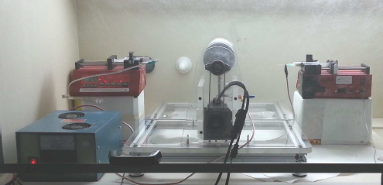

Materials and Methods
PCL/nHA Graded
PCL/TGFβ3 and PCL/CTGF Uniform Scaffold Fabrication
  Scaffolds were fabricated by multijet electrospinning of prepared solutions. Aligned fibers were obtained by using a rotating drum as the collector.
PCL-only (mL/h) | PCL-nHA (mL/h) | Total Flow rate (mL/h)
1.00 | 0.00 | 1.00
0.86 | 0.14 | 1.00
0.72 | 0.28 | 1.00
0.58 | 0.42 | 1.00
0.44 | 0.56 | 1.00
0.30 | 0.7 | 1.00
0.16 | 0.84 | 1.00
0.00 | 1.00 | 1.00
Groups
20%PCL/nHA
20% PCL / 10% BSA / TGF-β3
20% PCL / 10% BSA / CTGF

Slide 8
Materials and Methods
Scaffold Characterization
  Fiber Diameter (SEM and ImageJ, n=3)
  Pore size (SEM and ImageJ, n=3)
  Particle size (SEM and ImageJ n=3)
  Thermogravimetric Analyses (TGA, n=3)
  Mechanical properties at 5 mm/min (Instron, n=3)
  Release study (Raybiotech, n=3)
  EDS spectrum (SEM)
TGF-β3 and CTGF Release Study
  1x1 cm scaffolds were immersed in 1.5 mL PBS (n=3)
  PBS samples were collected in Days 3, 7, 14 and 28
  TGF-β3 and CTGF ELISA tests were performed (Thermo Scientific).

Slide 9
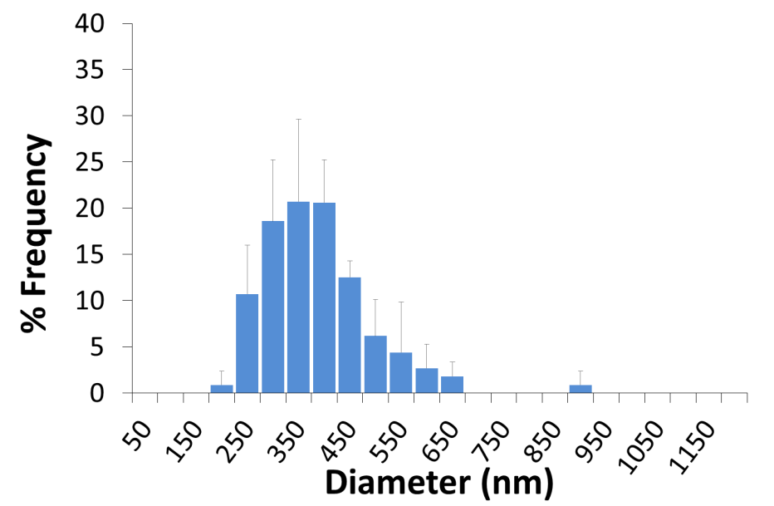
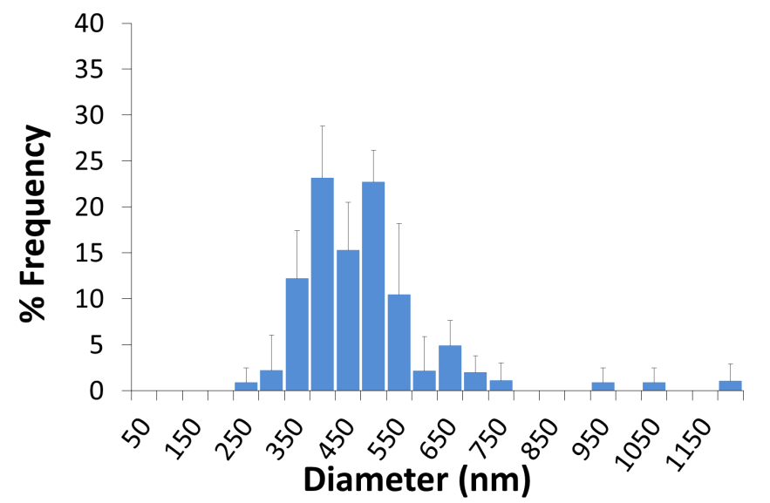
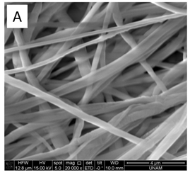
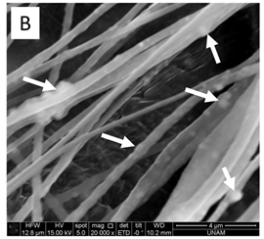
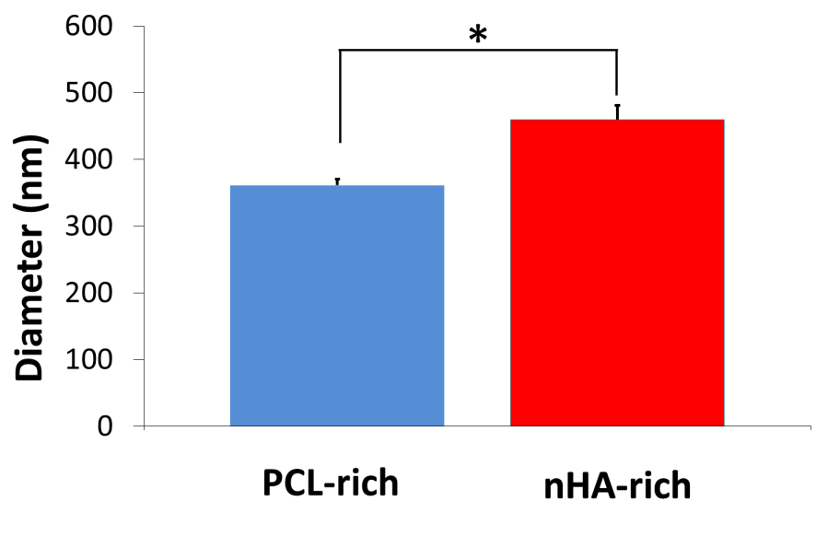
PCL/nHA Scaffold: Diameter Distribution
Diameter distribution of PCL-rich side
Diameter distribution of nHA-rich side
nHA-rich side
Avg: 459±241 nm
PCL-rich side
Avg: 361±179 nm
*p<0.05

Slide 10
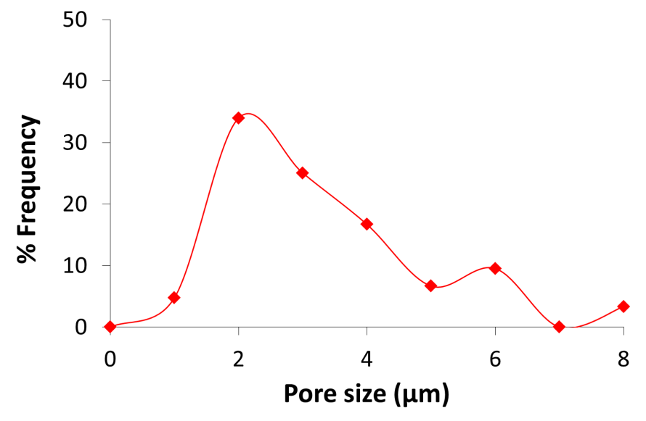
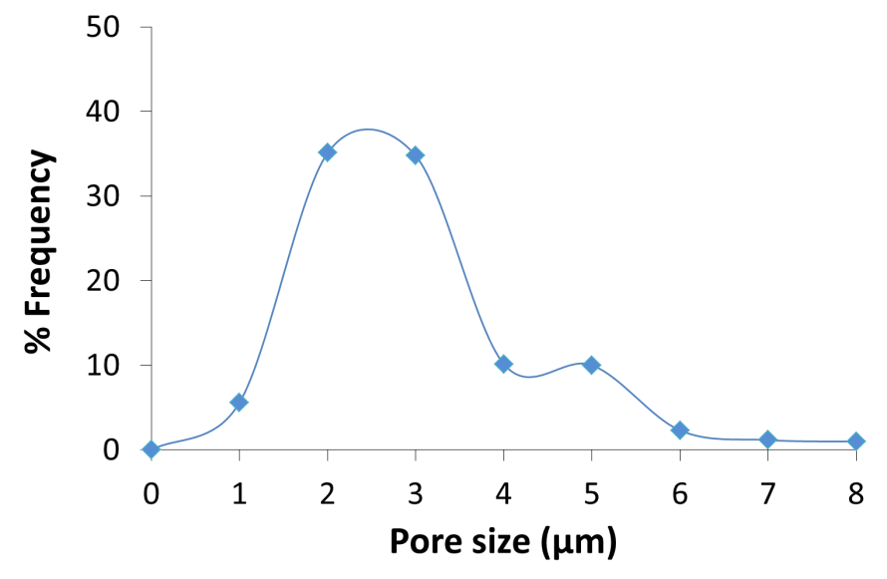
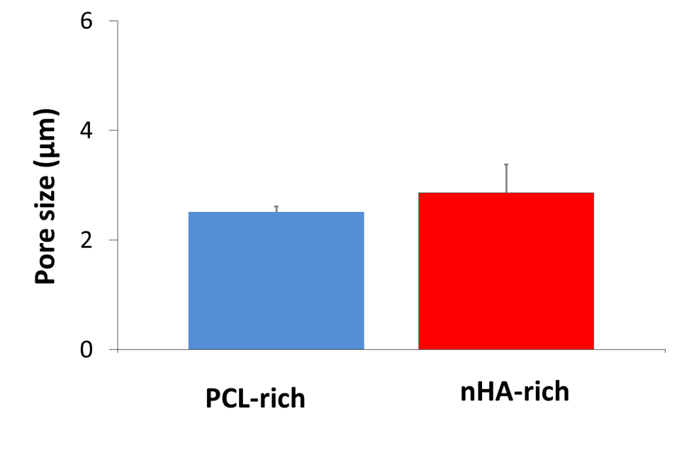
PCL/nHA Scaffold: Pore Size Distribution
Pore size distribution of nHA-rich side
Pore size distribution of PCL-rich side
nHA-rich side
Avg: 2.86±0.51 µm
PCL-rich side
Avg: 2.51±0.10 µm
Pore size comparison of PCL and nHA-rich sides

Slide 11
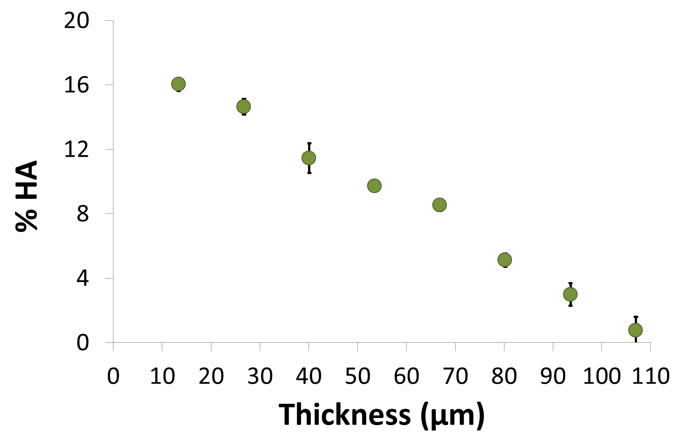
PCL/nHA Scaffold:
Thermogravimetric Analyses

Slide 12
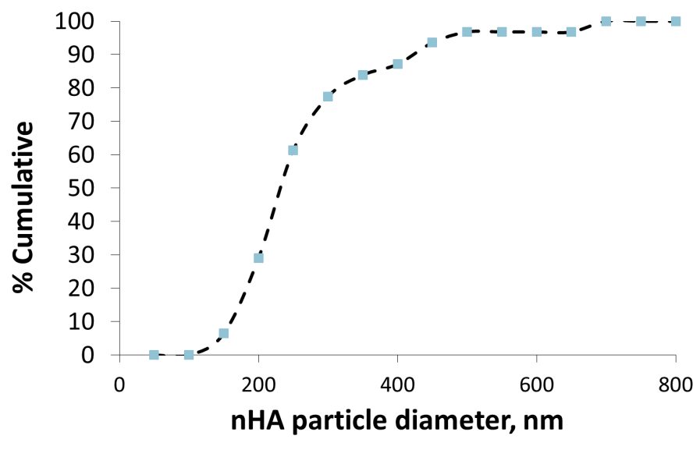
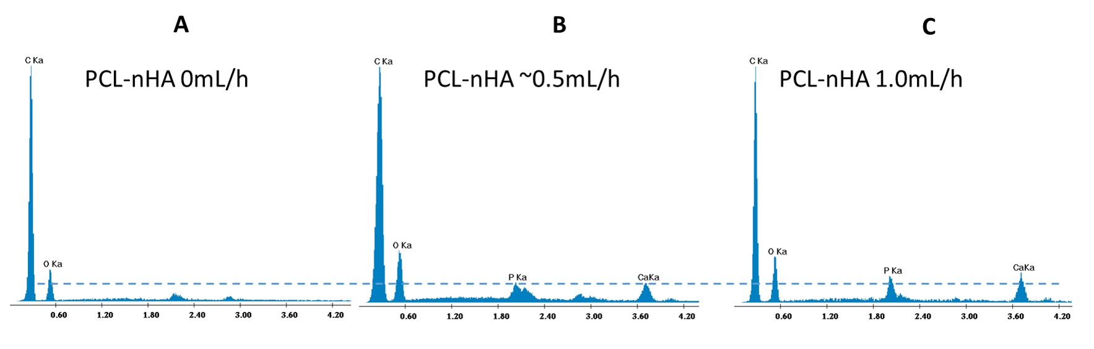
PCL/nHA Scaffold: Particle Diameter & EDS
Analyses
nHA particles are bigger than ≈ 100 nm
nHA particles are smaller than 800 nm

Slide 13
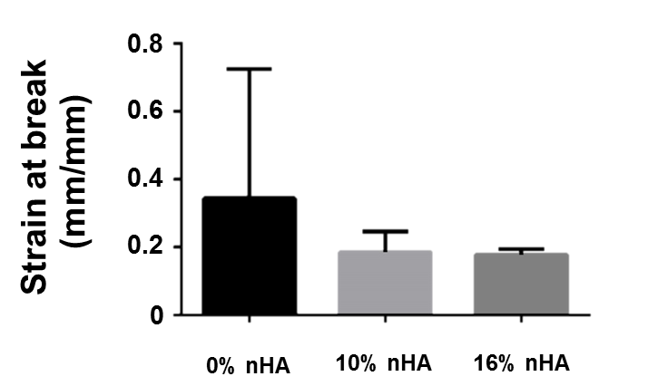
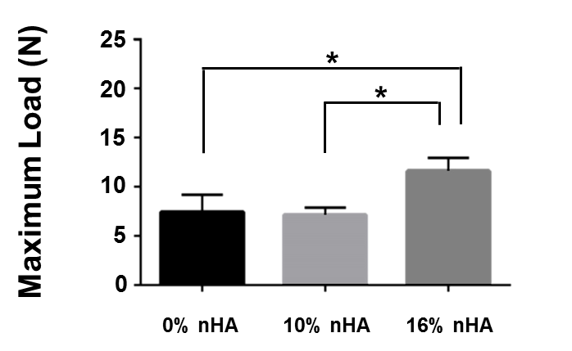
PCL/nHA Scaffold: Mechanical Properties
Notes:
Strain @ break uç verileri çıkar.

Slide 14
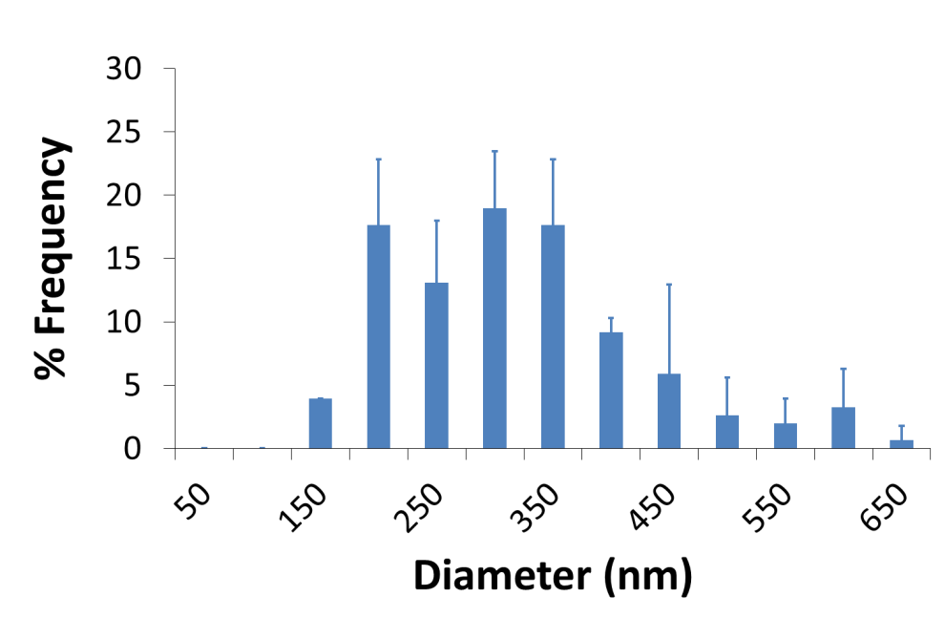
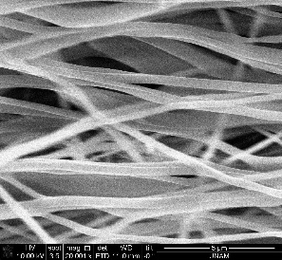
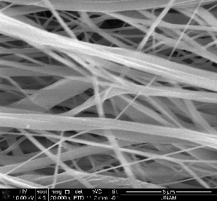
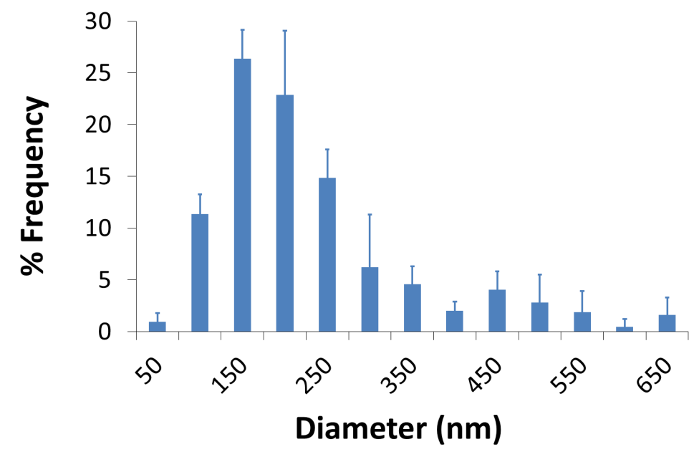
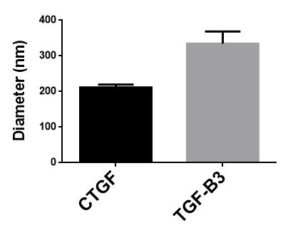
PCL/TGF-β3 and PCL/CTGF Scaffolds:
Diameter Distribution
PCL/BSA/TGF-β3
Avg: 334±386 nm
PCL/BSA/CTGF
Avg: 211±233 nm

Slide 15
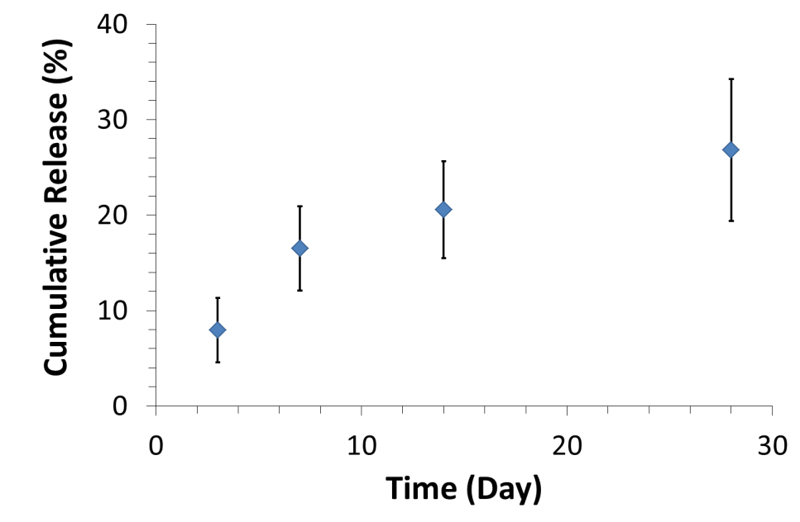
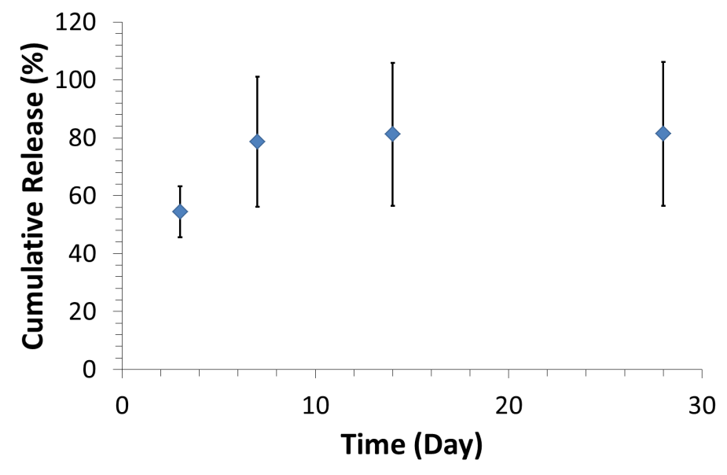
PCL/TGF-β and PCL/CTGF Scaffolds:
Release Study
CTGF Cumulative Release
TGF-β3 Cumulative Release

Slide 16
Graded Scaffolds
Graded Scaffolds and Cell Behavior

Slide 17
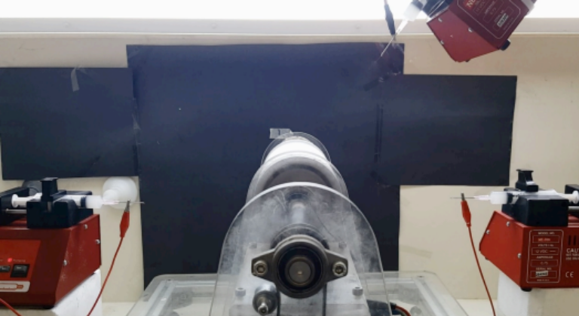
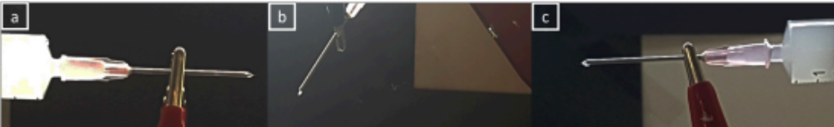
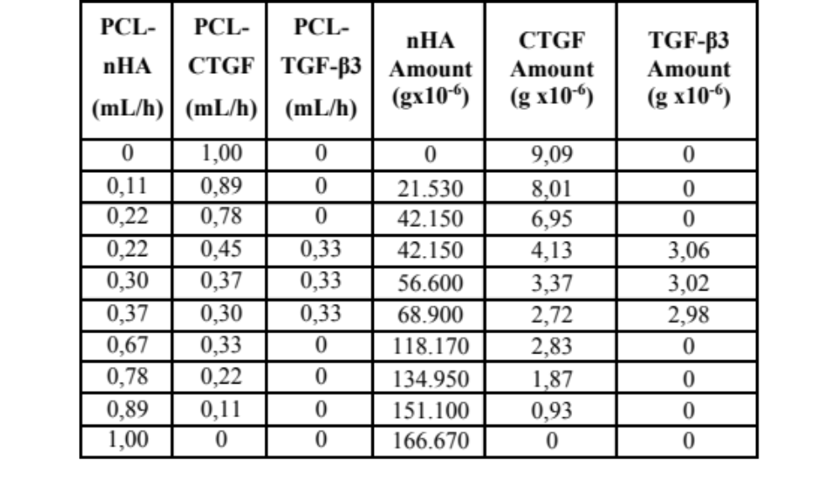
Graded PCL/CTGF/TGFb3/nHA Scaffold

Slide 18
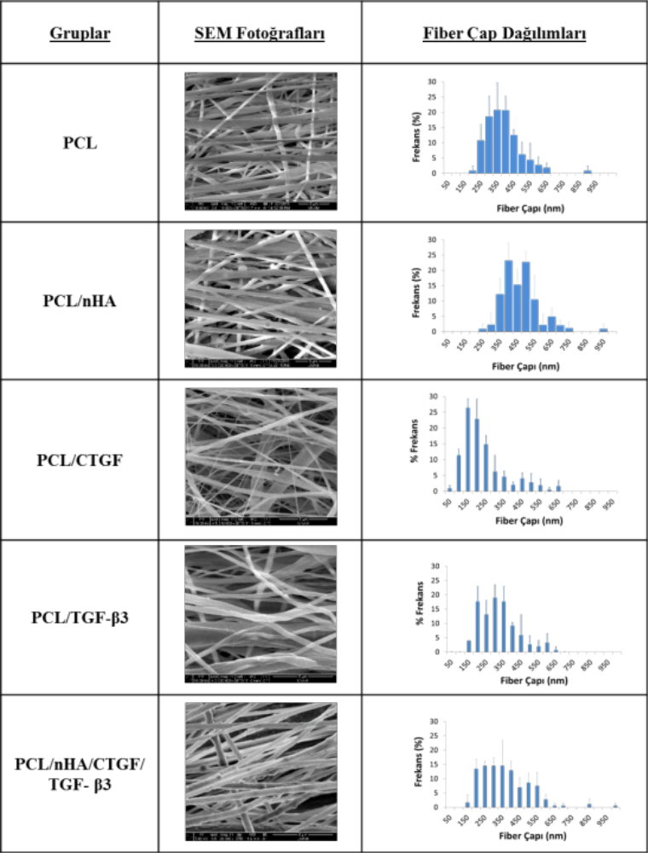
Graded PCL/CTGF/TGFb3/nHA Scaffold
Group
SEM Image
Diameter distribution
*
*

Slide 19
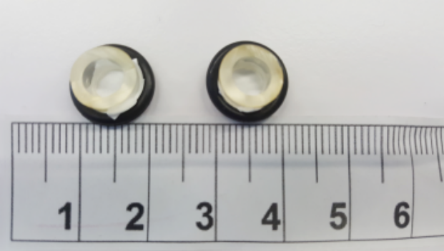
Graded PCL/CTGF/TGFb3/nHA Scaffold
hBMSC Behavior
Cell seeding: 20K cells/scaffold (Gift from GATA)
Medium: 1% FBS, 1% P/S, 1% NEAA, 0.1% AMP-B
Cell proliferation: EZQuant dsDNA Quantitation Kit
Total Collagen: Total Collagen Assay (Biovision, Alfagen)

Slide 20
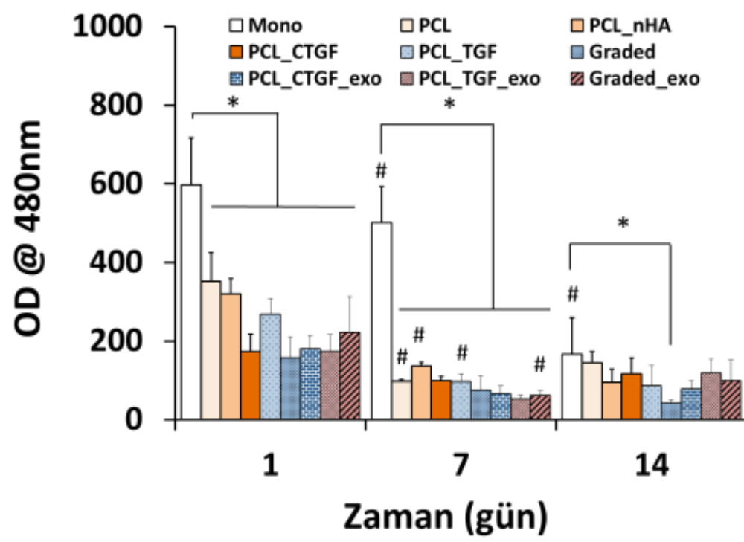
Graded PCL/CTGF/TGFb3/nHA Scaffold
hBMSC Proliferation
Time Point (day)

Slide 21
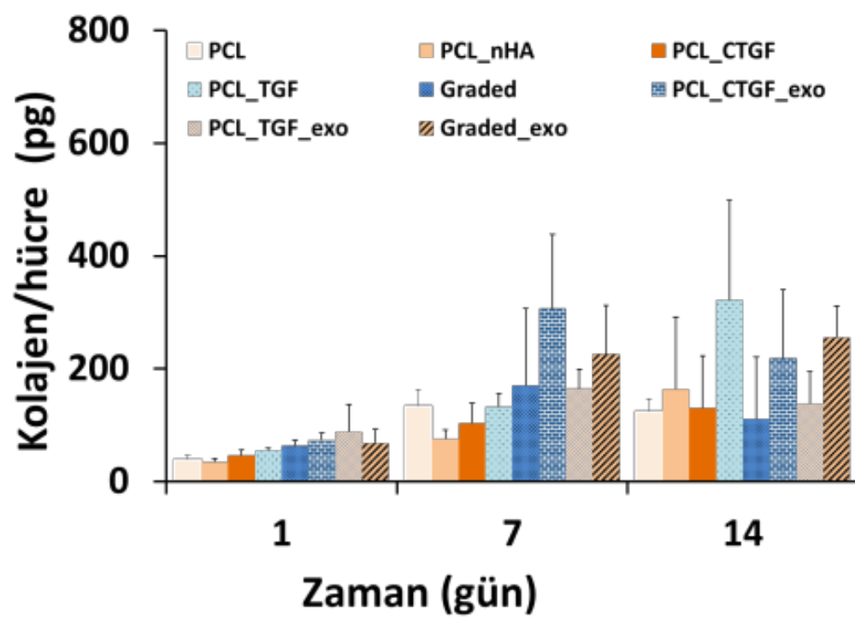
Graded PCL/CTGF/TGFb3/nHA Scaffold
Collagen/cell (pg)
Time Point (day)

Slide 22
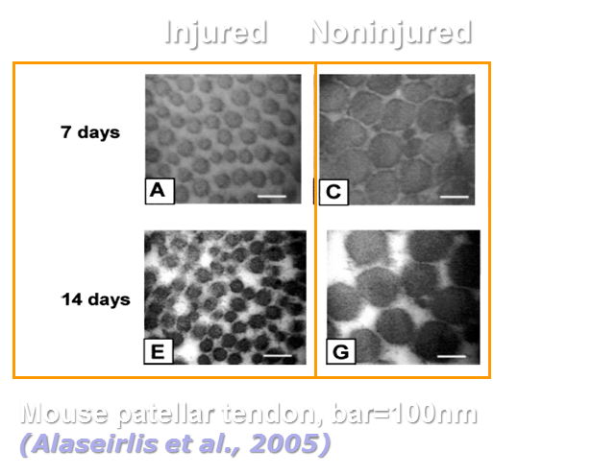
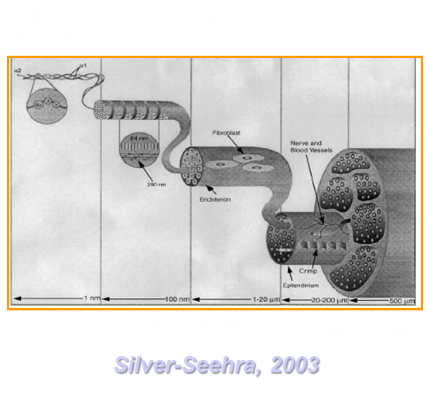
Discussion: PCL/nHA Scaffold
nHA-rich side
Avg: 459±21 nm
PCL-rich side
Avg: 361±9 nm
Mean fiber diameters are comparable with native tissue

Slide 23
Discussion: TGF-β3 and CTGF Release Study
According to Xu et. al., 2014, CTGF release is 8.7% on
Day 3 and 10.4% at the end of 1 month using PCL
In our study; 8.0% CTGF release on Day 3 and 26.8% at the end of 1 month period
According to Erisken et. al. 2008, TGF-β3 release is 9% at day 3 using PLGA.
In our study; a burst release withTGF- β3, 54.4% on the first three days and 81.4% relase at the end of one month

Slide 24
Discussion: Graded scaffolds
No difference between scaffold groups in terms of cell proliferation
No effect of scaffold type on collagen production

Slide 25
Conclusions & Future Directions
Scaffold incorporated with nHA:
Fiber diameter increased
Mechanical properties increased
No significant difference on pore size
Scaffold incorporated with growth factors:
No significant difference on diameter
Burst release of TGF-β3
Regular release pattern for CTGF
No effect on cell proliferation and collagen production
Future work:
Histology for location-dependent mineral deposition (Alizarin Red), GAG production (Alcian Blue) and Collagen production (Picrosirius red)

Slide 26
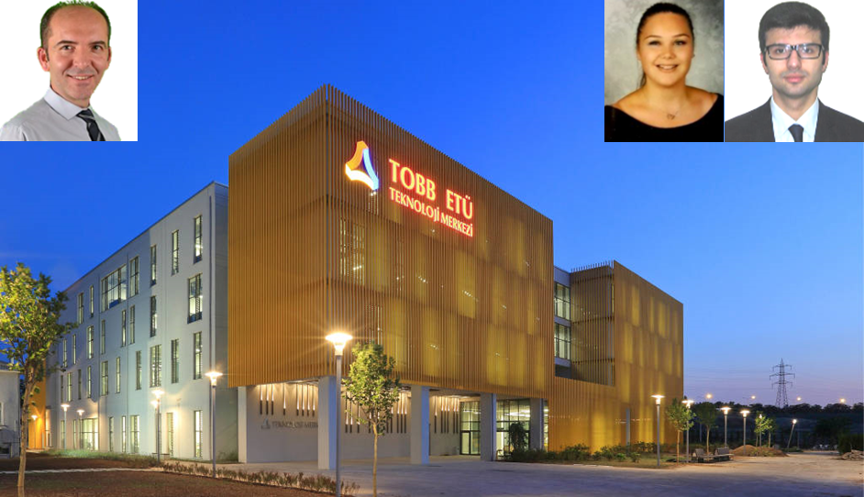
Acknowledgement
Funding resources
  The Scientific and Technological Research Council of Turkey (Project # :115C001)
  TOBB University of Economics and Technology
THANK YOU!

