Slide 1

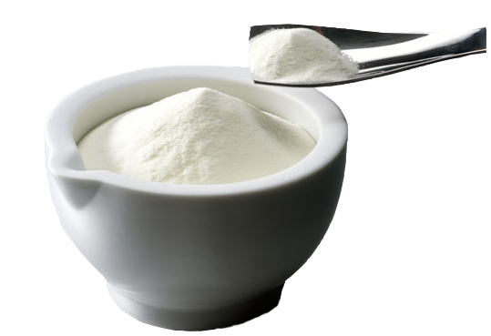

The Effects of Various Milk By-Products on Microbial Properties of Beef Patties
Mehmet GÜN, Cemalettin SARIÇOBAN, Hasan İbrahim KOZAN
† Faculty of Agriculture, Department of Food Engineering, Selcuk University, 42079, Konya, Turkey.

Slide 2

Introduction
Meat plays a very important role in
the diet by contributing quality protein, essential minerals and trace elements, and a range of B vitamins. In addition to its nutritive value, meat has also attractive sensory properties. Despite these facts, meat consumption has come under close scrutiny in recent years (BUCKLEY et al., 1995; ISSANCHOU, 1996).

Slide 3

Introduction
Lambert et al. (1991) reported that
the most significant factor causing
spoilage of meat was microbial growth. The presence of bacteria influences all meat sensory properties, including appearance, texture, odor and flavor.
Additionally, bacteria growth reduces product safety, which is of great concern to consumers of meat products (Prendergast, 1997). Generally speaking, during the refrigerated storage of meat, the maximum level that bacteria can grow to is 10⁷ - 10⁹ CFU/cm² (Borch et al., 1996).

Slide 4

Introduction
Therefore, bacteria counts are considered as a primary indicator of spoilage point, combined with off-odor, off-flavor and discoloration that are associated with high plate counts (Ayres, 1955; Sutherland et al., 1976)

Slide 5

Introduction
The initial bacterial level of meat
fluctuates depending on species and other factors, but usually is around 10² -10³ CFU/cm2 or gram (Jackson et al., 1992). The initial bacterial load is extremely important to meat shelf life (Lambert et al., 1991). Holding other factors constant, it is known that lower initial bacteria counts are associated with the longer shelf life of meat.

Slide 6
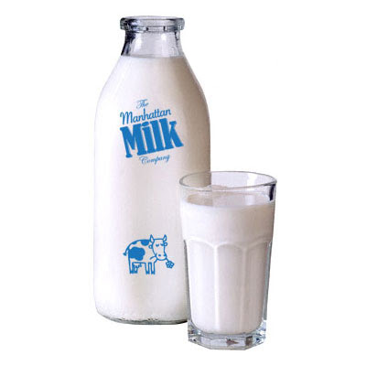
Importance of milk by-products
In milk industry, when some of dairy products are made, a certain quantities of by-products are separated as skim-milk, buttermilk, whey etc. Previously these by-products were using for animal feeding but recently they are industrially processed and have an important economical role for market. Also these materials have a nutritional importance thus milk industry has lately focused on recovering all materials of these by-products and making them suitable for human consumption.

Slide 7
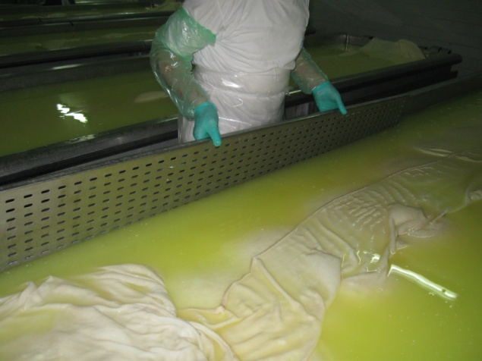
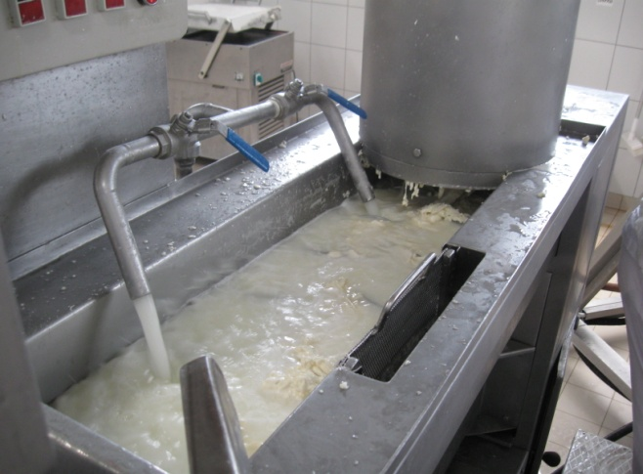
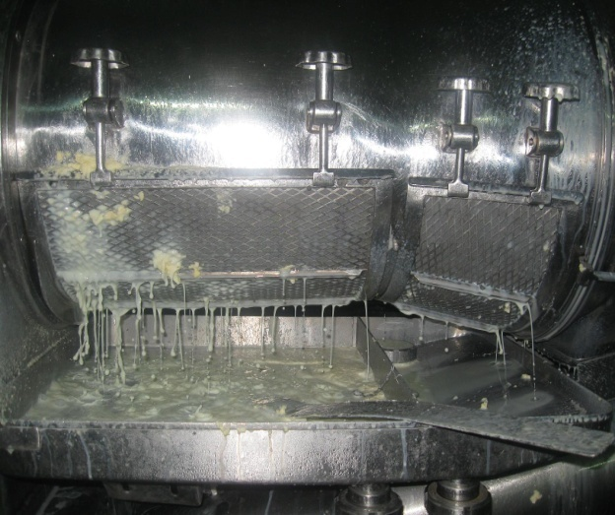
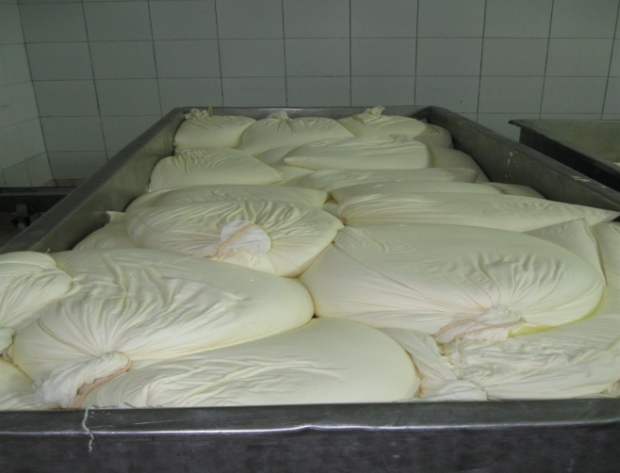
  Some of milk by-products
Whey,
Butter milk,
Drained yoghurt,
Protein concentrate,
Lactose,
..
..

Slide 8
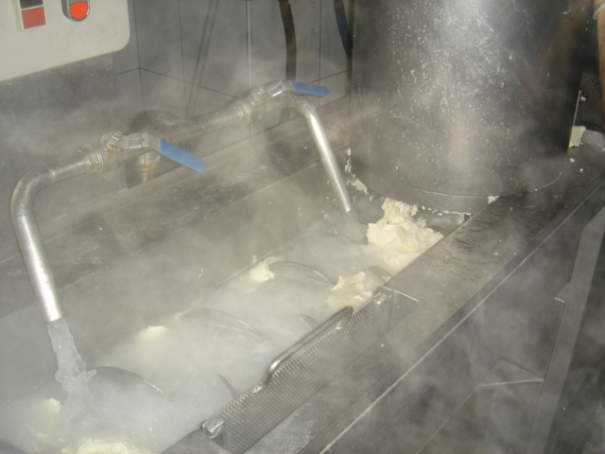
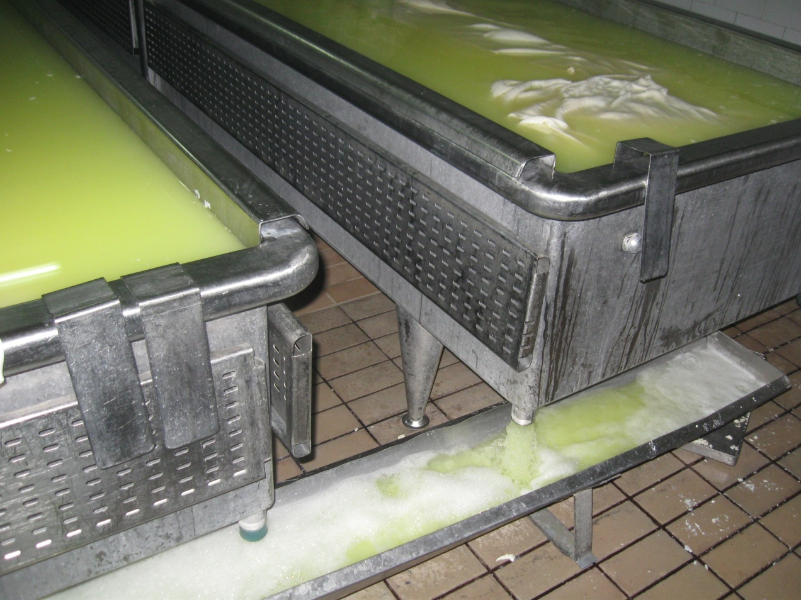
Boiling water enriched
with nutritional value
Whey Cheese

Slide 9

What is the main importance of the milk by-products
As it well known that dry matter portion of milk by-products is from 5% to 8,5%.
103 tons of protein, 158 tons of milk sugar, 15 tons of minerals are wasted because of milk by-product such as whey, buttermilk, lactose etc. in Turkey.
Milk by-products have a toxic effect for the environment especially for aquatic life and also they have a negative effect on the oxygen amount of the environment.
Financial factors..

Slide 10
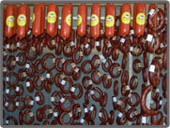
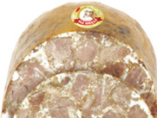
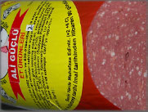
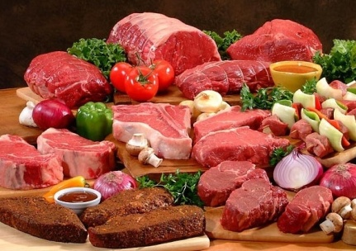
Using milk by-products in meat and meat products
The main aim of using milk by-products in meat and meat products is to improve the technological properties, rather than increasing the nutritional value of the product.
Milk by-products provide a great aroma. Also, they play an important role in stabilizing to meat and meat products because of protein amount of the milk by- products.

Slide 11
Aim of the study.
This study was conducted with the purpose of determining its effects of dairy by-products on some microbial properties of meatball. For this purpose, whey protein concentrate powder, buttermilk powder and lactose powder were used as dairy by-product.

Slide 12
Material and Method

Slide 13
Material:
Beef as boneless rounds was purchased from a local supermarket in Konya, Turkey. The beef were transported to the Instrumental Analysis Laboratuary of Food Engineering Department in Selcuk University under hygienic conditions and processed immediately upon arrival. After removing visible fat and connective tissue, the beef was cut into small pieces. To make the product homogeneous, beef pieces were cut into small cubes and minced with a meat grinder (Kitchenaid Classic Model K45SS, USA) using 8 mm (coarse) and 3 mm (fine) plates simultaneously to obtain ground beef.

Slide 14
Material;
The milk by-products were obtained from a milk and milk products production plant called as Enka Süt Company. For this study, whey protein concentrate powder (WPC 35), buttermilk powder and lactose powder were used. Several milk by-products were added in different combinations, (1, 2.5,5 %) for meatballs. pH, moisture, water activity and total mesophilic bacteria were measured. And protein, fat, ash and moisture contents of the raw materials were determined, too.

Slide 15
Method
Moisture (hot air oven), protein (Kjeldahl, Nx6.25), ash (muffle furnace) and fat (ether-extraction) contents were determined using standard methods of the AOAC (2003). Moisture (%) was determined by drying a 5 g sample at 105 ºC to constant weight. Protein (%) was analyzed according to the Kjeldahl method. Factor 6.25 was used for conversion of nitrogen to crude protein. Ash content (%) was determined by ashing at 550 ºC for 24 h. Fat content (%) was determined by using a Soxhlet fat extraction apparatus. For pH determination, the sample (10 g) was homogenized in 100 mL of distilled water for 1 min using a blender (Waring Commercial Blendor®, USA). Then, pH was measured using a pH meter (pH 315i/SET WTW, Germany) (Ockerman 1985).

Slide 16
Method
Meatball samples were analyzed for total aerobic mesophilic bacteria (TAMB). A 10 g aliquot of each meatball sample was aseptically obtained and transferred into a sterile stomacher bag. It was then homogenized with 90 mL of sterile 1.5 % peptone water in a Stomacher 400 (Mayo Homogenius HG 400V Stomacher, Italy) for 1.5 min. Aliquotes were serial diluted in peptone water and plated out following standard methodologies (Gerhardt et al., 1994). Total aerobic mesophilic microbial counts were determined on Plate Count Agar (PCA, Merck, Darmstadt, Germany) with plates incubated at 37 ºC for 2 days. Microbial colonies were counted and expressed as log₁₀ colony forming units (cfu)/g beef meat.

Slide 17
Results and Discussion

Slide 18
Results of the raw materials
The results of moisture, protein, fat, ash and pH of meatball samples used through for this research.
Analysis | Meatball | Buttermilk powder | Lactose | WPC 35
Moisture, % | 67 | 3.55 | 0.40 | 3.24
Protein, % | 18.70 | 26.10 | 0.13 | 35.10
Fat, % | 13.00 | 10.00 | 0.00 | 1.00
Ash, % | 1.15 | 7.86 | 0.12 | 5.18
pH | 5.86 | 6.80 | 6.50 | 6.55
Total aerobic mesophilic bacteria | 490000 | 15000 | 700 | 4000

Slide 19
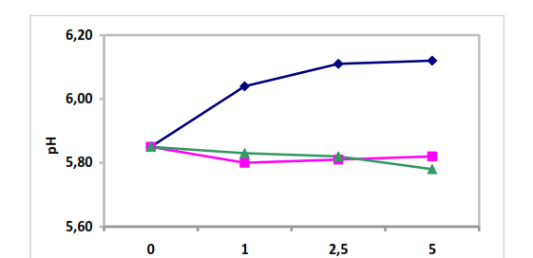
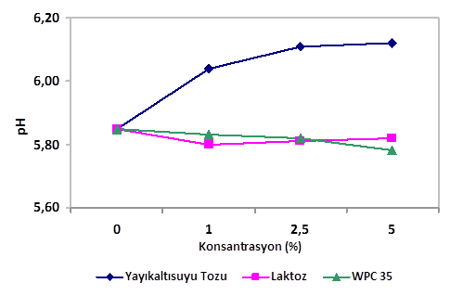
1. Results for pH
Figure 1.
Figure 2.
Concentration (%)
Buttermilk powder
Lactose
WPC 35

Slide 20
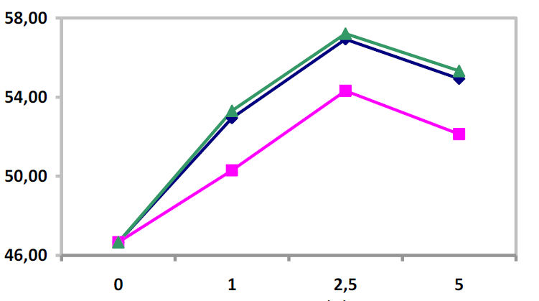
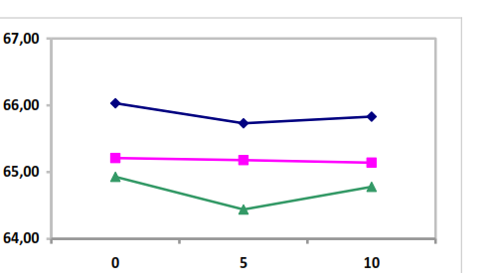
2. Results for moisture content
Figure 3.
Figure 4.
Moisture (%)
Moisture (%)
Concentration (%)
Storage (Day)
Buttermilk powder
Lactose
WPC 35

Slide 21
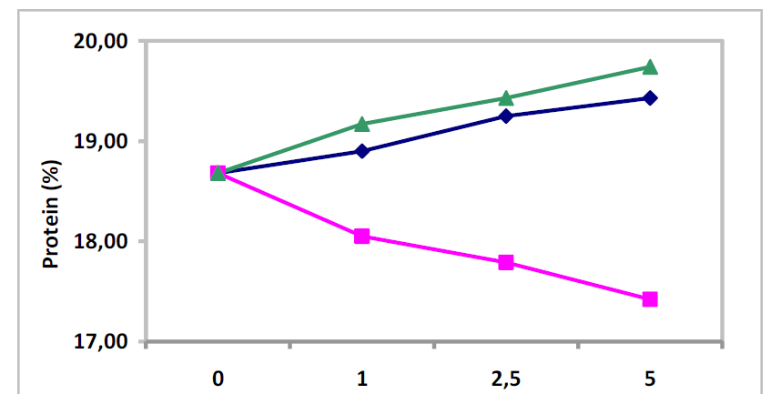
3.Results for protein (%)
Figure 5.
Concentration (%)
Buttermilk powder
Lactose
WPC 35

Slide 22
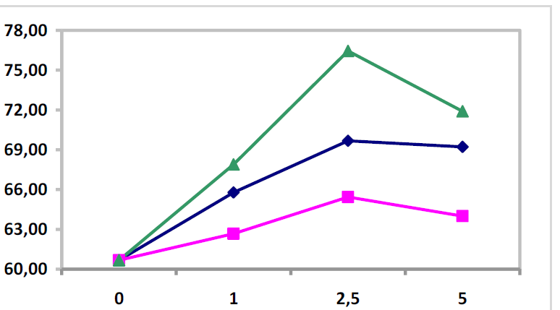
4.Results for water holding capacity
Figure 6.
Water holding capacity (%)
Concentration (%)
Buttermilk powder
Lactose
WPC 35

Slide 23
5.Results for water activity
The Effects of various milk by-products on water activity of beef patties is not statistically significant. Water activity values of the beef patty samples has been found with a range from 0.975 to 0.990.

Slide 24
The effects of various milk by-products on total mesophilic aerobic bacteria count of beef patties.
6.Results for total mesophilic aerobic bacteria
Samples | TMAB (log kob/g)
 | Day 0. | Day 5. | Day 10.
Control | 49.0±1.00 | 50.0±1.13 | 52.5±0.91
Buttermilk powder -%1 | 47.0±1.10 | 47.0±1.08 | 48.0±1.12
Buttermilk powder -%2.5 | 46.0±1.15 | 45.5±0.99 | 47.0±1.10
Buttermilk powder -%5 | 44.5±0.95 | 45.0±0.85 | 45.5±1.31
Lactose-%1 | 48.5±1.13 | 49.5±1.08 | 50.5±1.29
Lactose -%2.5 | 47.5±1.24 | 48.5±1.13 | 49.0±1.05
Lactose -%5 | 47.5±0.75 | 48.0±1.01 | 48.5±0.82
WPC 35-%1 | 46.5±0.82 | 46.5±0.96 | 47.5±0.70
WPC 35-%2.5 | 45.0±1.16 | 44.5±1.17 | 45.0±1.00
WPC 35-%5 | 43.5±1.21 | 42.5±1.00 | 43.5±0.62

Slide 25
As a result of our findings we detected that the highest number of bacteria was found in the control samples. It has been observed that the bacteria count is decreased with a pozitive correlation of milk by-product consantration. The minimum bacterial count was belonged to the 5% portion of WPC 35. It’s estimated that due to high water holding capacity of protein and lactose of milk by-products, the bacterial growth is limited. Also, bacterial growth has been increased during storage.

Slide 26
Thanks..

