Slide 1
Optimization of textural properties of predried and deep-fat-fried carrot slices as a function of process conditions
by Dr. Cem BALTACIOĞLU¹
Dr. Erkan KARACABEY² and Dr. Erdoğan KÜÇÜKÖNER²
¹ Food Engineering Deparment, Engineering Faculty, Niğde University, Niğde, Turkey
² Food Engineering Deparment, Engineering Faculty, Suleyman Demirel University, Isparta, Turkey

Slide 2
Outline
Introduction to Deep-Fat-Frying
Aim
What we did
What we obtained
Let’s Discuss it
Conclusion

Slide 3
Deep-Fat-Frying
Popular cooking method
  Especially for vegetables
    Carrot
Frying
  Using vegetable oil
  At high temperature levels
  For certain time

Slide 4
Deep-Fat-Frying
What is going on during deep-fat-frying?
  Type of dehydration process including simultaneous heat and mass transfer
    Rapid temperature raise
    Water molecules evaporate
    Increasing internal pressure of frying material
    Decreasing moisture content
    Case hardening
    Crust formation depending on frying material

Slide 5
Deep-Fat-Frying
Important points for evaluation of deep-fat-fried products
  Oil uptake
  Moisture content
  Textural properties
  Taste, flavor, aroma
  Surface color
  Shape, size etc.

Slide 6
Deep-Fat-Frying
Textural properties should meet the consumer expectations
  Texture is significant and determinative characteristic for fried products for consumer’s perception
  Vary depending on type of product

Slide 7
Deep-Fat-Frying
Factors affecting textural properties of final fried product
  Raw material
    Type
    Composition
  Preprocess
    Boiling
    Drying
    Other possible applications

Slide 8
Deep-Fat-Frying
Main project was about the control of oil absorption of fried carrot slices.
As a pretreatment, drying was performed to decrease the moisture content of carrot slices
There is a relation between initial moisture content of frying material and its final oil content.
Less moisture content resulted in limited oil absorption.

Slide 9
Deep-Fat-Frying
As a pretreatment,
  Conventional oven drying
  Microwave oven drying
  To decrease the moisture content of carrot slices

Slide 10
Deep-Fat-Frying
Factors affecting textural properties of final fried product
  Frying process
    Oil temperature
    Process time
    Frying material/Oil volume (w/v)

Slide 11
Outline
Introduction to Deep-Fat-Frying
Aim
What we did
What we obtained
Let’s Discuss it
Conclusion

Slide 12
Aim of the study
Main purpose of the current study as a part of main project was
  To evaluate the change of textural properties of deep-fat-fried product , initial moisture content was lowered by two different drying methods (conventional oven and microwave oven).
  To optimize the predrying and deep-fat-frying process conditions in terms of textural properties

Slide 13
Outline
Introduction to Deep-Fat-Frying
Aim
What we did
What we obtained
Let’s Discuss it
Conclusion

Slide 14
Material & Methods
Carrots were purchased from local producer’s orchard to avoid changes due to carrot type and environmental-climatic variations.
Stored @ +4ºC
Before process
  washed
  peeled
  sliced (slice thickness selected according to preliminary studies to determine consumer demands towards conventionally fried carrot slices)
  boiled for 90 sec in boiling water (~ 100ºC) (enough for enzyme inactivation)

Slide 15
How was carrot slice predried and fried?
Predrying
  Conventional oven
    Constant air flow (around 0.8 m/sec)
    temperature is adjustable (from 50ºC to 300ºC)
  Microwave oven
    Temperature is adjustable (from 30ºC to 100ºC)
Deep-fat-frying
  Industrial fryer
    Temperature is adjustable (from 50ºC to 200ºC)

Slide 16
Experimental Design
For optimization experimental design should be created using different tools including statistical based ones
For conventional predrying & frying
  Central Composite Design
    4 independent variables at 5 levels with 4 central points
For microwave predrying & frying
  Full Factorial Design
    3 independent variables at 3 levels

Slide 17
Coded & Real Values of Independent Variables of Conventionally Predrying & Deep-Fat-Frying
Independent Variable | Real/Coded Values of Variables
Drying Temperature (ºC) | 41 / -2 | 48 / -1 | 55 / 0 | 62 / 1 | 69 / 2
Weight Loss (%) | 10 / -2 | 12.5 / -1 | 15 / 0 | 17.5 / 1 | 20 / 2
Frying Temperature (ºC) | 120 / -2 | 135 / -1 | 160 / 0 | 165 / 1 | 180 / 2
Frying Time (sec) | 120 / -2 | 240 / -1 | 360 / 0 | 480 / 1 | 600 / 2

Slide 18
Experimental Design of Conventional Predrying & Deep-Fat-Frying
Run Order | Drying Temperature | Weight Loss | Frying Temperature | Frying Time
1 | -1 | -1 | 1 | 1
2 | 1 | -1 | -1 | 1
3 | 1 | -1 | 1 | 1
4 | 0 | 0 | 2 | 0
5 | 0 | 0 | 0 | -2
6 | 0 | 0 | 0 | 0
7 | 1 | 1 | -1 | 1
8 | -1 | 1 | 1 | -1
9 | 0 | 0 | 0 | 0
10 | -1 | 1 | -1 | -1
11 | -2 | 0 | 0 | 0
12 | 2 | 0 | 0 | 0
13 | -1 | -1 | 1 | -1
14 | -1 | 1 | -1 | 1
15 | 0 | 0 | -2 | 0
16 | 0 | -2 | 0 | 0
17 | -1 | 1 | 1 | 1
18 | 0 | 2 | 0 | 0
19 | 1 | -1 | -1 | -1
20 | 1 | 1 | 1 | 1
21 | -1 | -1 | -1 | 1
22 | -1 | -1 | -1 | -1
23 | 1 | 1 | 1 | -1
24 | 0 | 0 | 0 | 2
25 | 1 | 1 | -1 | -1
26 | 0 | 0 | 0 | 0
27 | 1 | -1 | 1 | -1
28 | 0 | 0 | 0 | 0

Slide 19
Coded & Real Values of Independent Variables of Predrying Using Microwave oven & Deep-Fat-Frying
Independent Variable | Real/Coded Values of Variables
Weight Loss (%) in Microwave Oven | 10/ -1 | 15/ 0 | 20/ 1
Frying Temperature (ºC) | 140 / -1 | 160 / 0 | 180 / 1
Frying Time (sec) | 200 / -1 | 350 / 0 | 500 / 1

Slide 20
Experimental Design of Microwave Predrying & Deep-Fat-Frying
Run Order | Weight Loss | Frying Temperature | Frying Time
1 | 0 | 0 | 0
2 | 1 | 1 | 1
3 | 1 | 0 | 0
4 | 1 | 0 | 1
5 | 0 | -1 | 1
6 | -1 | 1 | 0
7 | -1 | 1 | 1
8 | 0 | -1 | -1
9 | 0 | 1 | 0
10 | 1 | 1 | 0
11 | 0 | 0 | 1
12 | 1 | -1 | 1
13 | 1 | 0 | -1
14 | -1 | 0 | 0
15 | 1 | -1 | -1
16 | -1 | 0 | 1
17 | 1 | -1 | 0
18 | 0 | 1 | -1
19 | 0 | 1 | 1
20 | -1 | -1 | 1
21 | -1 | 1 | -1
22 | 1 | 1 | -1
23 | 0 | 0 | -1
24 | -1 | -1 | 0
25 | 0 | -1 | 0
26 | -1 | 0 | -1
27 | -1 | -1 | -1

Slide 21
Textural Properties
Predried and Fried Carrot Slices were subjected to texture analysis.
  TPA Analysis (cylindirical prob-30 mm diameter)
    hardness
    elasticity
    cohesiveness
    chewiness
  Cutting Hardness (LKB prob)
    cutting hardness

Slide 22
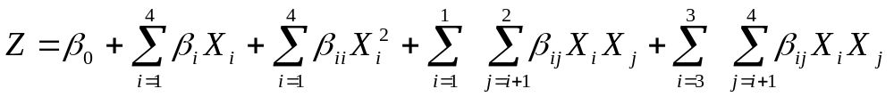
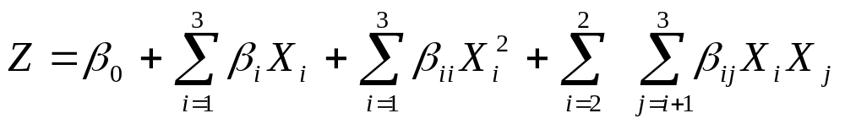
Optimization
Statistical method
  Response Surface Methodology
    Minitab Statistical Package Program
  Full Quadratic Model
    For conventional drying and frying
    For microwave drying and frying

Slide 23
Outline
Introduction to Deep-Fat-Frying
Aim
What we did
What we obtained
Let’s Discuss it
Conclusion

Slide 24
Textural properties measured for conventionally predried and fried carrot slices
Run Order | Hardness, g force | Elasticity | Cohesiveness | Chewiness | Cutting force, g force
1 | 494.10 | 7.25 | 0.77 | 2746.34 | 418.42
2 | 491.29 | 8.98 | 0.35 | 5223.12 | 762.95
3 | 747.02 | 7.35 | 0.35 | 7401.48 | 871.39
4 | 420.07 | 3.72 | 0.16 | 2519.88 | 401.29
5 | 2055.64 | 16.47 | 0.85 | 29136.72 | 1137.52
6 | 492.18 | 4.49 | 0.33 | 2001.03 | 662.77
7 | 836.92 | 6.53 | 0.69 | 11768.32 | 638.08
8 | 637.78 | 8.46 | 0.50 | 4370.96 | 785.44
9 | 374.93 | 4.13 | 0.17 | 3159.75 | 1065.72
10 | 1254.31 | 10.80 | 0.53 | 16388.11 | 925.73
11 | 1029.35 | 3.60 | 0.17 | 4554.69 | 1041.91
12 | 697.35 | 9.11 | 0.34 | 6673.15 | 941.92
13 | 1003.17 | 10.94 | 0.70 | 9427.18 | 736.27
14 | 1142.03 | 8.58 | 0.50 | 3288.18 | 667.85
15 | 2605.95 | 4.34 | 0.85 | 15615.83 | 855.06
16 | 699.12 | 7.43 | 0.51 | 4980.77 | 1236.99
17 | 605.08 | 2.98 | 0.13 | 3662.58 | 907.23
18 | 301.12 | 3.00 | 0.10 | 2300.00 | 888.83
19 | 2105.69 | 18.18 | 0.87 | 33048.78 | 1513.50
20 | 648.90 | 5.00 | 0.16 | 2950.00 | 413.10
21 | 1883.51 | 4.20 | 0.84 | 3196.26 | 950.37
22 | 2871.82 | 12.67 | 0.85 | 30828.77 | 1056.23
23 | 1204.07 | 8.37 | 0.51 | 9090.02 | 1017.36
24 | 597.44 | 6.68 | 0.61 | 5957.69 | 585.70
25 | 1248.08 | 16.20 | 0.70 | 21379.64 | 1228.83
26 | 132.02 | 0.00 | 0.30 | 1990.00 | 689.77
27 | 770.65 | 14.45 | 0.85 | 8535.15 | 992.32
28 | 1050.38 | 4.18 | 0.39 | 2376.30 | 846.08

Slide 25
Developed models and corresponding performance parameters of conventionally predried and fried carrot slice’s textural properties
Model coefficients | Hardness, g force |  | Elasticity |  | Cohesiveness |  | Chewiness |  | Cutting force, g force
Model Sabiti Etiketi | coefficient | p-value | coefficient | p-value | coefficient | p-value | coefficient | p-value | coefficient | p-value
intercept | 512.38 | * | 3.20 | * | 0.30 | ** | 2381.77 | ^{ns} | 816.09 | ***
DTemp | -208.60 | ^{ns} | 2.52 | * | 0.00 | ^{ns} | 2477.09 | ^{ns} | 65.83 | ^{ns}
WL | -298.84 | ^{ns} | -2.17 | * | -0.22 | ** | -2739.23 | ^{ns} | -117.84 | ^{ns}
FTemp | -841.22 | *** | -1.88 | ^{ns} | -0.23 | ** | -8594.12 | *** | -209.13 | *
FTim | -596.93 | ** | -5.73 | *** | -0.18 | * | -11599.20 | *** | -310.83 | ***
DTemp*Dtemp | 398.15 | ^{ns} | 4.91 | * | 0.05 | ^{ns} | 4474.96 | ^{ns} | 163.60 | ^{ns}
WL*WL | 34.92 | ^{ns} | 3.78 | ^{ns} | 0.10 | ^{ns} | 2501.42 | ^{ns} | 234.60 | ^{ns}
FTemp*Ftemp | 1047.81 | ** | 2.59 | ^{ns} | 0.30 | * | 7928.90 | * | -200.13 | ^{ns}
FTim*Ftim | 861.34 | * | 10.14 | *** | 0.52 | *** | 16408.25 | *** | 33.30 | ^{ns}
Dtemp*WL | 609.18 | ^{ns} | -2.15 | ^{ns} | 0.29 | ^{ns} | 2367.04 | ^{ns} | -241.94 | ^{ns}
FTemp*FTim | 501.39 | ^{ns} | 2.48 | ^{ns} | -0.15 | ^{ns} | 15876.63 | *** | 195.95 | ^{ns}
Regression | *** |  | *** |  | *** |  | *** |  | **
R² | 78.6 |  | 82.1 |  | 75.5 |  | 90.4 |  | 70.1
R²_{adj} | 66.0 |  | 71.6 |  | 61.1 |  | 84.7 |  | 52.5
Lack-of-fit | ^{ns} |  | ^{ns} |  | ^{ns} |  | ** |  | ^{ns}
*, p≤0.05; **, p≤0.01; ***,p≤0.001, ^{ns}: statistically non-significant DTemp: Drying temperature (ºC), WL: Weight loss (%), FTemp: Frying temperature (ºC), FTim: Frying time (sec)

Slide 26
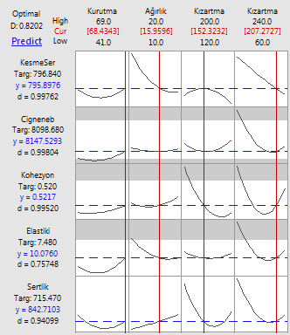
Optimal process conditions for desired values of corresponding responses of conventionally dried and fried carrot slices
Drying Temp Weight Loss Frying Temp Frying Time
Cutting force
Chewiness
Cohesiveness
Elasticity
Hardness

Slide 27
Textural properties measured for predried in microwave oven and fried carrot slices
Run Order | Hardness, g force | Elasticity | Cohesiveness | Chewiness | Cutting force, g force
1 | 1101.22 | 18.63 | 0.67 | 17980.71 | 896.39
2 | 169.63 | 0.86 | 0.28 | 57.62 | 1035.09
3 | 461.42 | 12.87 | 0.54 | 7185.23 | 776.04
4 | 138.97 | 1.79 | 0.43 | 37.61 | 466.35
5 | 559.64 | 3.29 | 0.38 | 2125.79 | 783.24
6 | 444.34 | 5.01 | 0.28 | 6841.00 | 713.91
7 | 163.89 | 2.07 | 0.17 | 134.72 | 928.47
8 | 2294.74 | 8.45 | 0.83 | 17203.22 | 1566.36
9 | 611.27 | 8.12 | 0.26 | 5055.00 | 723.34
10 | 771.65 | 4.30 | 0.26 | 2229.00 | 1123.72
11 | 176.15 | 6.96 | 0.39 | 4106.00 | 369.84
12 | 70.92 | 3.12 | 0.47 | 100.09 | 819.33
13 | 1382.92 | 9.01 | 0.83 | 7893.84 | 1571.29
14 | 1314.98 | 16.32 | 0.65 | 16307.72 | 935.99
15 | 2322.30 | 12.34 | 0.88 | 12394.11 | 1949.03
16 | 548.87 | 6.12 | 0.44 | 5892.00 | 493.61
17 | 1074.70 | 11.87 | 0.68 | 11387.37 | 1058.99
18 | 1088.61 | 16.10 | 0.66 | 12929.68 | 2050.40
19 | 171.18 | 2.98 | 0.37 | 225.24 | 1365.27
20 | 748.40 | 5.57 | 0.65 | 9155.67 | 958.91
21 | 1414.92 | 9.75 | 0.53 | 17158.30 | 1716.83
22 | 1040.12 | 4.12 | 0.34 | 5559.23 | 1182.99
23 | 1637.41 | 18.55 | 0.86 | 26248.23 | 1411.81
24 | 2257.98 | 10.10 | 0.86 | 17042.78 | 1118.68
25 | 896.79 | 16.07 | 0.67 | 13331.84 | 1073.59
26 | 2558.09 | 10.61 | 0.69 | 23273.52 | 2126.19
27 | 3537.92 | 5.60 | 0.89 | 13044.46 | 1926.10

Slide 28
Developed models and corresponding performance parameters of predried in microwave oven and fried carrot slice’s textural properties
Model coefficients | Hardness, g force |  | Elasticity |  | Cohesiveness |  | Chewiness |  | Cutting force, g force
Model Sabiti Etiketi | coefficient | p-value | coefficient | p-value | coefficient | p-value | coefficient | p-value | coefficient | p-value
intercept | 831.71 | * | 16.6182 | *** | 0.611766 | *** | 15062.0 | *** | 771.916 | ***
WL | -308.71 | *** | -0.6032 | ^{ns} | -0.024588 | ^{ns} | -3444.8 | *** | -51.993 | ^{ns}
FTemp | -438.211 | *** | -1.2822 | ^{ns} | -0.176086 | *** | -2533.1 | ** | -23.013 | ^{ns}
FTim | -807.187 | *** | -3.4305 | *** | -0.161492 | *** | -6326.1 | *** | -460.049 | ***
WL*WL | 186.000 | ^{ns} | -3.7132 | ** | -0.018118 | ^{ns} | -2373.2 | ^{ns} | 23.389 | ^{ns}
FTemp*Ftemp | 55.496 | ^{ns} | -3.9997 | ** | -0.087511 | * | -3993.0 | * | 222.179 | *
FTim*Ftim | 119.777 | ^{ns} | -4.4039 | ** | 0.020801 | ^{ns} | -2065.7 | ^{ns} | 326.656 | **
FTemp*FTim | 311.419 | ** | -0.8048 | ^{ns} | 0.031397 | ^{ns} | -330.8 | ^{ns} | 104.885 | ^{ns}
Regression | *** |  | *** |  | *** |  | *** |  | ***
R² | 90.96 |  | 74.5 |  | 85.4 |  | 82.9 |  | 78.7
R²_{adj} | 87.55 |  | 65.2 |  | 80.1 |  | 76.6 |  | 70.8
Lack-of-fit | ^{ns} |  | ^{ns} |  | ^{ns} |  | ^{ns} |  | ^{ns}
*, p≤0.05; **, p≤0.01; ***,p≤0.001, ^{ns}: statistically non-significant WL: Weight loss (%), FTemp: Frying temperature (ºC), FTim: Frying time (sec)

Slide 29
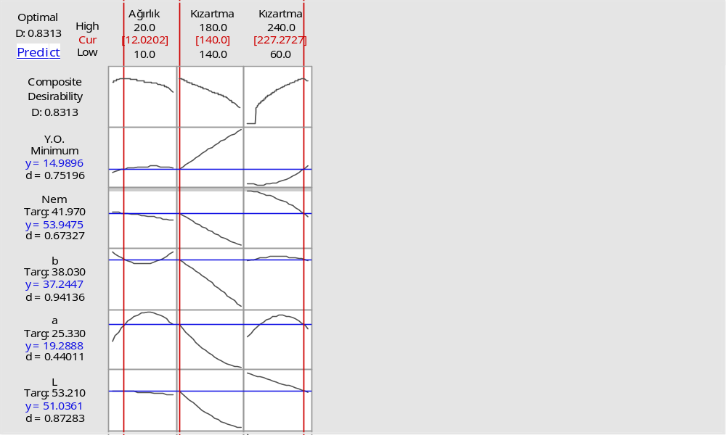
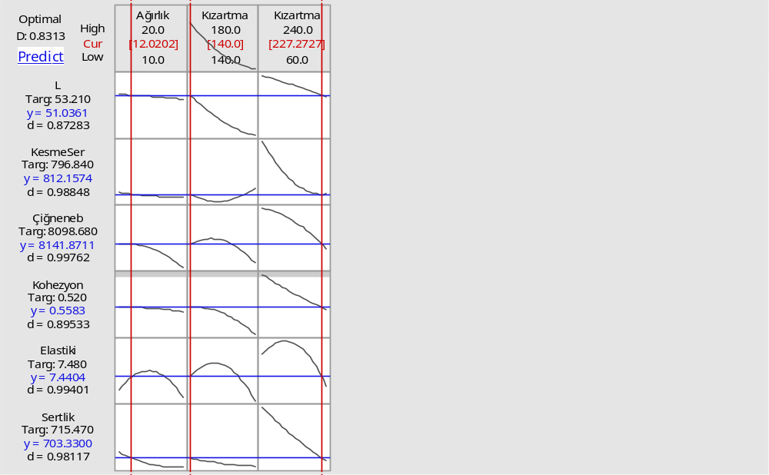
Optimal process conditions for desired values of corresponding responses of dried in microwave oven and fried carrot slices
Weight Loss Frying Temp Frying Time
Cutting force
Chewiness
Cohesiveness
Elasticity
Hardness

Slide 30
Outline
Introduction to Deep-Fat-Frying
Aim
What we did
What we obtained
Let’s Discuss it
Conclusion

Slide 31
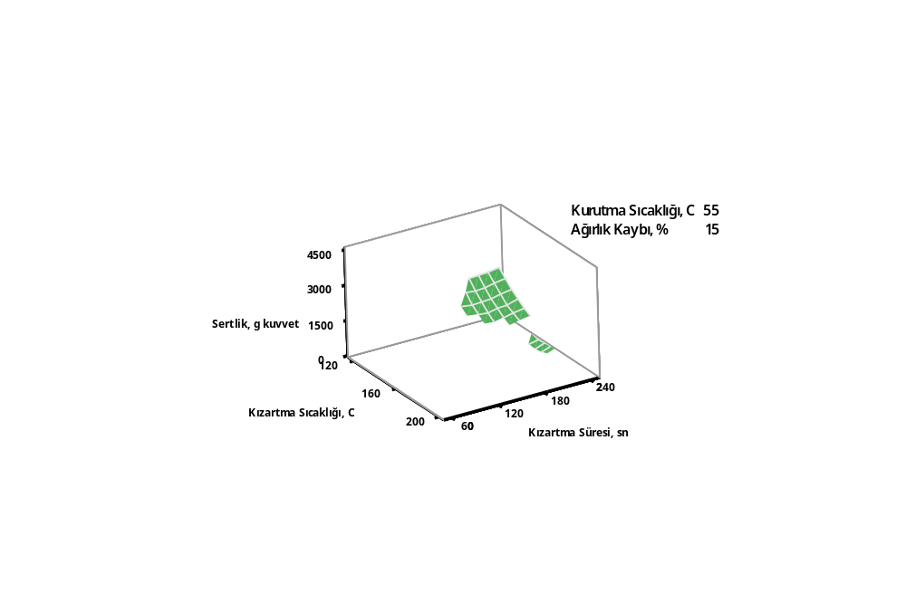
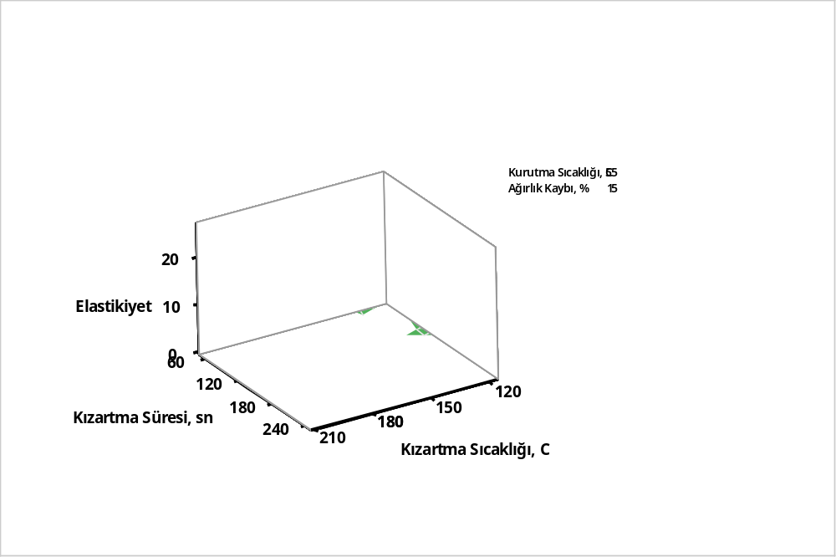
Drying temperature, 55ºC
Weight loss, 15%
hardness, g force
frying temperature, ºC
frying time, sec
Figure 1. Change of hardness of carrot slices conventionally predried and fried under effects of frying temperature and time
Drying temperature, 55ºC
Weight loss, 15%
elasticity
frying time, sec
frying temperature, ºC
Figure 2. Change of elasticity of carrot slices conventionally predried and fried under effects of frying temperature and time

Slide 32
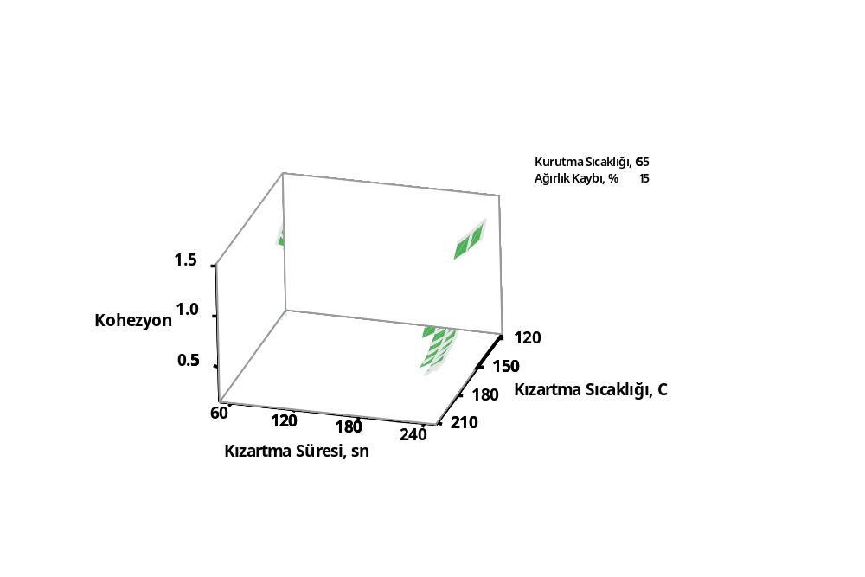
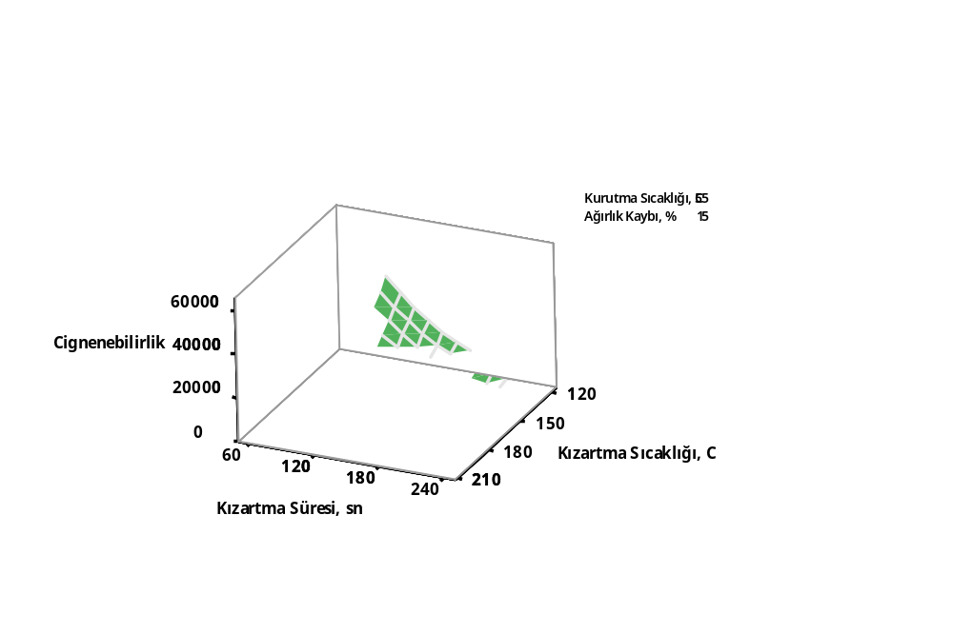
Drying temperature, 55ºC
Weight loss, 15%
cohesiveness
frying temperature, ºC
frying time, sec
Figure 3. Change of cohesiveness of carrot slices conventionally predried and fried under effects of frying temperature and time
Drying temperature, 55ºC
Weight loss, 15%
chewiness
frying temperature, ºC
frying time, sec
Figure 4. Change of chewiness of carrot slices conventionally predried and fried under effects of frying temperature and time

Slide 33
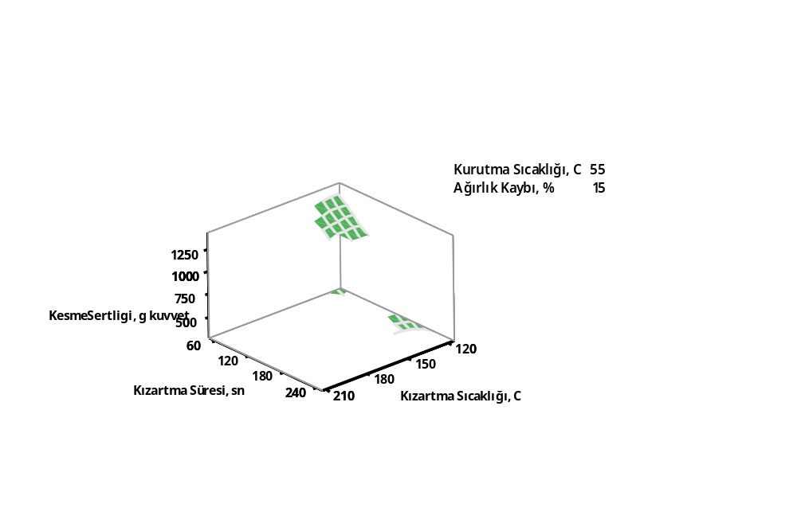
Drying temperature, 55ºC
Weight loss, 15%
cutting force,
g force
frying time, sec
frying temperature, ºC
Figure 5. Change of cutting force of carrot slices conventionally predried and fried under effects of frying temperature and time

Slide 34
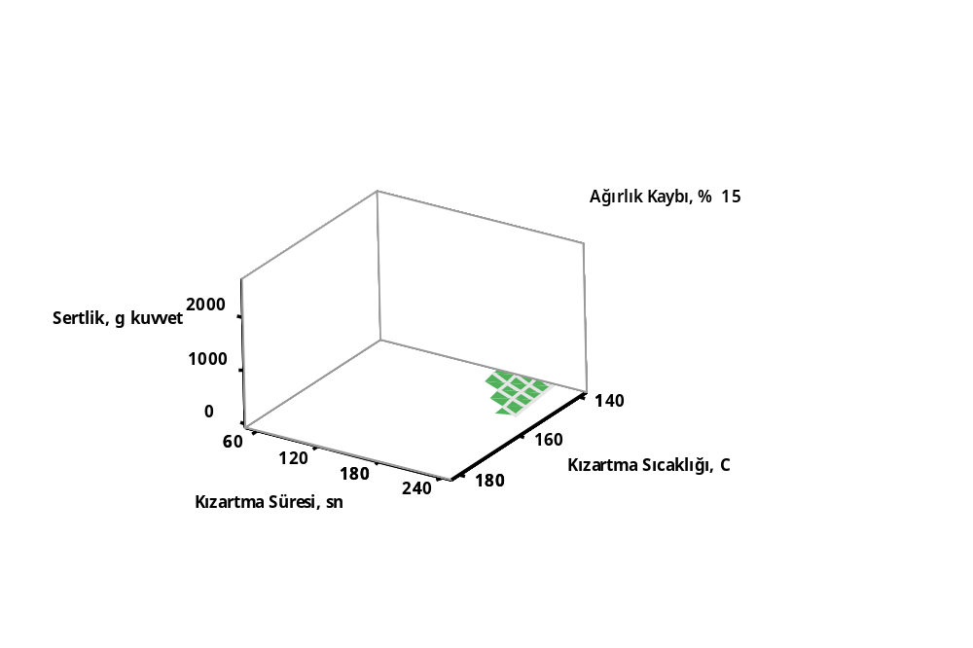
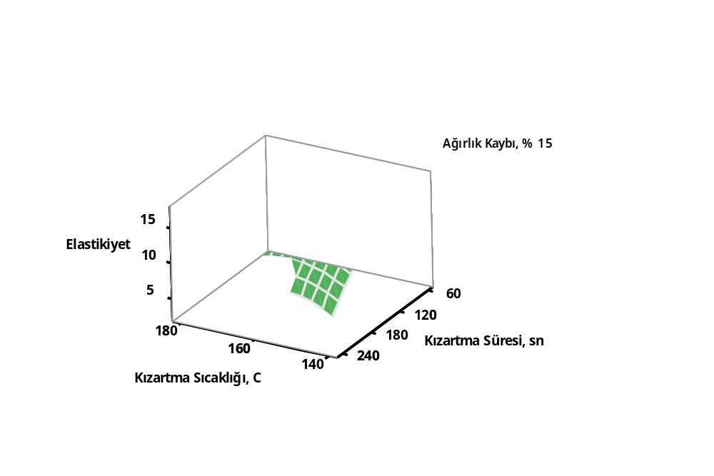
Weight loss, 15%
hardness, g force
frying time, sec
frying temperature, ºC
Figure 6. Change of hardness of carrot slices predried in a microwave and fried under effects of frying temperature and time
Weight loss, 15%
elasticity
frying temperature, ºC
frying time, sec
Figure 7. Change of elasticity of carrot slices predried in a microwave and fried under effects of frying temperature and time

Slide 35
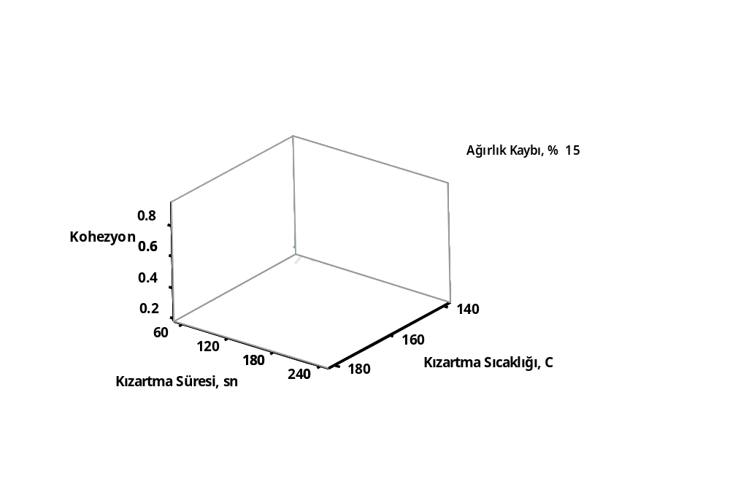
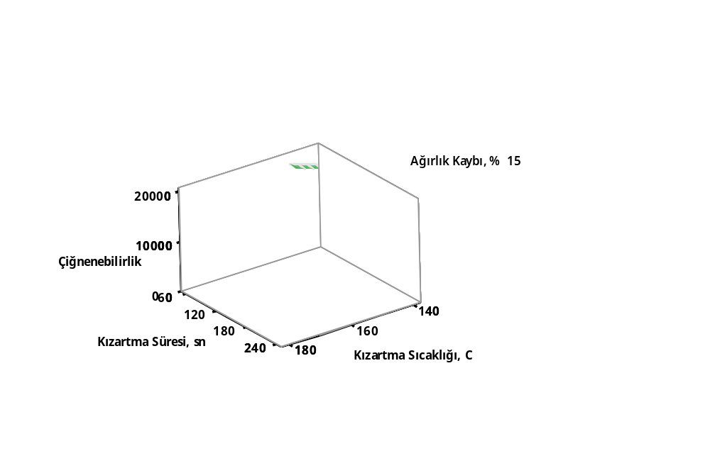
Weight loss, 15%
cohesiveness
frying temperature, ºC
frying time, sec
Figure 8. Change of cohesiveness of carrot slices predried in a microwave and fried under effects of frying temperature and time
Weight loss, 15%
chewiness
frying time, sec
frying temperature, ºC
Figure 9. Change of chewiness of carrot slices predried in a microwave and fried under effects of frying temperature and time

Slide 36
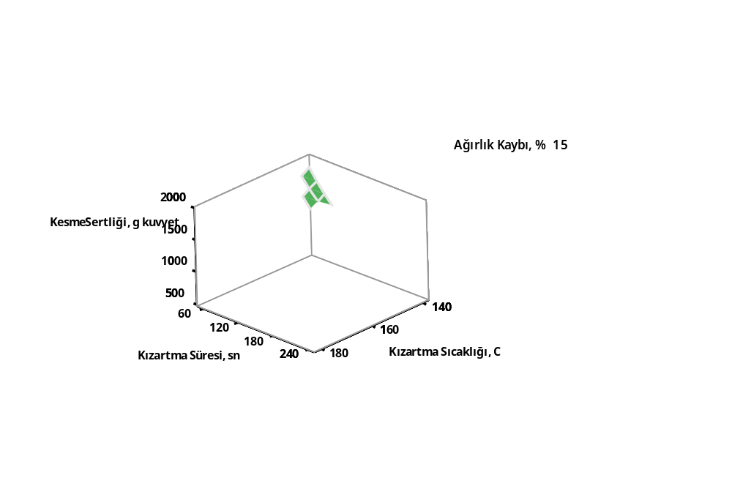
Weight loss, 15%
cutting force,
g force
frying time, sec
frying temperature, ºC
Figure 10. Change of cutting force of carrot slices predried in a microwave and fried under effects of frying temperature and time

Slide 37
Outline
Introduction to Deep-Fat-Frying
Aim
What we did
What we obtained
Let’s Discuss it
Conclusion

Slide 38
It could be suggested that
  Partial drying before frying is important pretreatment in terms of food characteristics.
  Texture is one of them and mainly affected by frying conditions and partially predrying ones.
  Weight loss is the main factor affecting textural properties of carrot slices during predrying carried according to both drying method in case of the range of parameters studied.
  Studied parameters ranges were not severe to modify textural properties of carrot slices, but its partial effects on moisture content directly affects further frying process, so indirectly textural properties.

Slide 39
Acknowledgements
Current study was financially supported by TUBITAK (Project No: 113R015).

Slide 40
Thank you for your attentions…

