Slide 1
Health Promotion and Life Course Dynamics: Transitions of Brazilian Elderly
Dr. Celia Caldas
Associate Professor
Rio de Janeiro State University

Slide 2
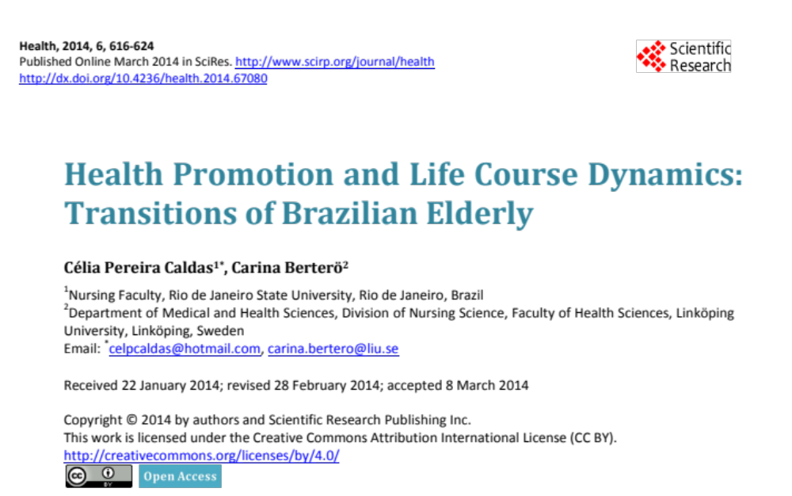

Slide 3
Introduction
Growing old is a life span transition. Retirement is a social and cultural transition. Both transitions may make older persons vulnerable.
Transition into old age seems to be about habitation; to take care of oneself and live independently as long as possible
Understanding life transitions is important to help people to achieve their developmental needs.
In examining transition experience, it may be useful for Health Promotion professionals to consider a client’s ability to deal with change and differences.

Slide 4
Objective
The aim of this study is to identify and describe the patterns of responses to life transitions of Brazilian retired older adults, eliciting their experiences of growing old.
The study spanned the period between the working life, retirement and old age.

Slide 5
Transitions Theory
(Afaf Meleis)
Meleis defined the goal of healthy transitions as mastering behaviors, sentiments, cues, and symbols associated with new roles.
The components of this theoretical framework are: types and patterns of transitions; properties of transition experiences; transition conditions: facilitators and inhibitors; patterns of response (process indicators and outcome indicators) and therapeutics.
This study analyzed each component, and the component “patterns of response” emerged as an important result.
The research question posed was: What were the patterns of responses to the transitions?

Slide 6
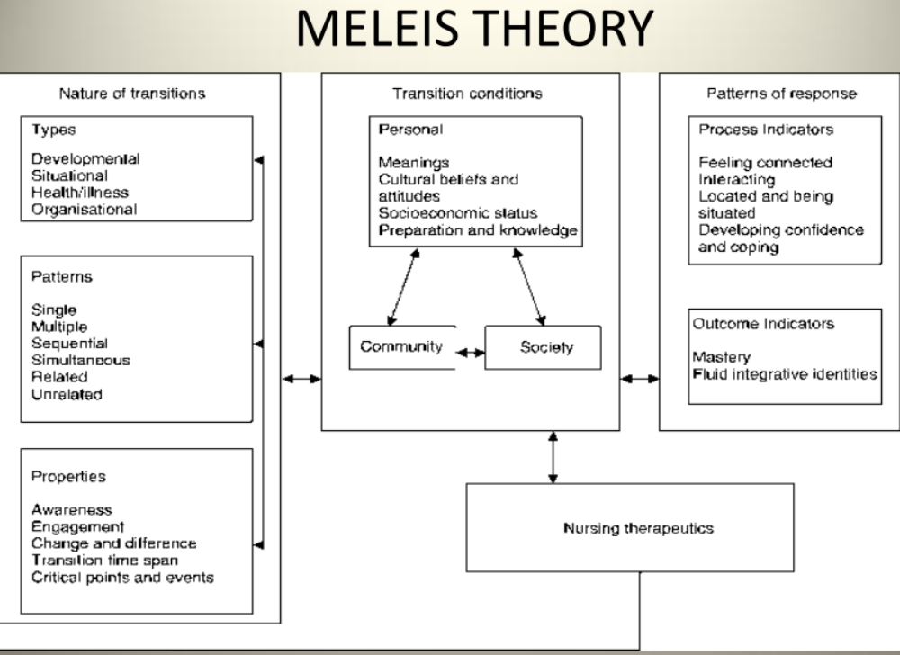

Slide 7
Method
Qualitative Study using narrative research Method and the framework of Transition Theory to guide the analysis
Eleven autonomous and independent persons, 64 - 82 years old, who were living in their own homes, agreed to participate in the study.
Qualitative interviews were conducted at a geriatric outpatient unit at Rio de Janeiro State University.

Slide 8
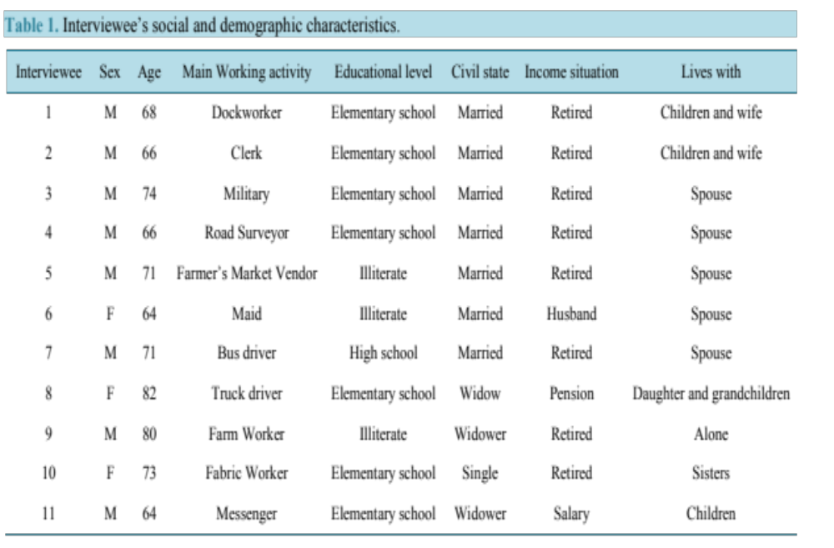

Slide 9
The Data Analysis
The transcripts were analyzed and interpreted using narrative research from a holistic-content perspective.
Analyzing the structure of a story reveals the individual’s personal construction of his or her evolving life experience.
The framework of transition articulated by Meleis was used to guide the analysis, resulting in identification of the “patterns of response”.
The analysis started with the identification of type (situational or developmental). From that the different patterns of response emerged, with their properties and conditions (facilitators and inhibitors).

Slide 10
RESULTS

Slide 11
The patterns of responses to life transitions were found to be structured around five turning points:
1- An event in childhood (Situational transition)
2- The first job (Developmental transition)
3- Moving to another place/house or another city (situational transition)
4- Starting a family (Developmental transition)
5- Retirement (Both types)

Slide 12
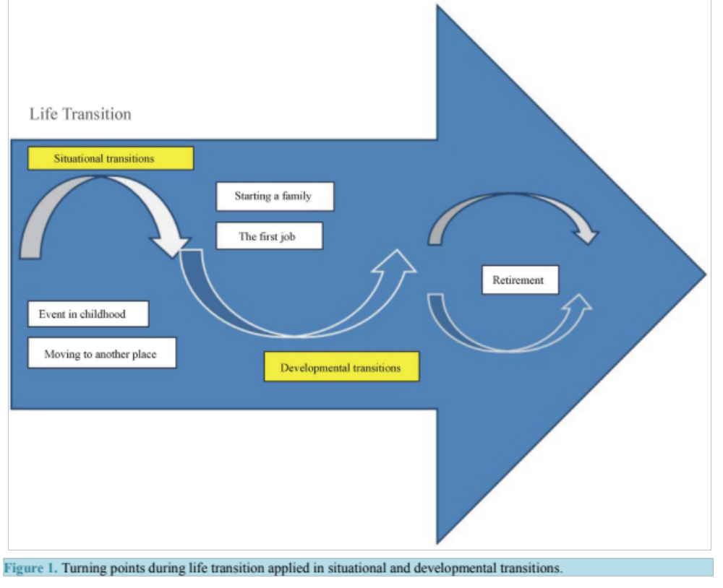

Slide 13
An Event in Childhood
What happened in childhood affected their entire life:
“Then my dad died and I had to work, and never stopped working until today.”
There were possibilities to have a better life after this turning point: “When I grew up, I managed to have a better life, no doubt about it. Let’s put it this way: a 180-degree turn”.
They had to assume an adult role very early and all of them were proud of having “opened their way”.

Slide 14
The First Job
Being a child worker meant being treated as a minor regarding decisions and payment, yet responsible for doing the work:
“One day I waited for payment time. Everybody got their payment. The boss asked me what I was waiting for and I said I was waiting for the payment. No, you have nothing to receive. How come? Your father has already taken it.”
They could improve their earnings if there were possibilities to study or be educated.
The responses and outcomes were clearly different when the working conditions enabled personal development or sense of belonging.

Slide 15
Moving to Another Place/House or Another City
Moving was connected to what happened in childhood but also to work opportunities.
Moving was a turning point, but also a response. Moving was found to be a response to parents passing away and to changing jobs.
Moving could be seen as an opportunity, and could open a way for something new and good.

Slide 16
Starting a Family
The need for stability and security not only
for starting, but also for raising a family.
This need guided all decisions they had to make through their lives until old age: “If I work, and fortunately have a salary, I can support my family, no matter what; if I don’t work, no politician will give me money. No government will give me money, my family will starve, will be in need, and this is not useful to anyone.”
Starting a family was a response and outcome a shift in social activities and in the quality of life: “After I was married, when we went out, we visited relatives. Then the children came, sometimes we went to the zoo, or... these things that we do, parks... always some activity.”

Slide 17
Retirement
A progressive loss of respect in the relationship with the younger colleagues:
“I had a good relationship with younger colleagues, but in the last five years in the company, some new employees appeared in the company that had no respect for the white hair or the knowledge of the older ones."
The importance of planning early for retirement:”
“I planned myself, for retirement... I earned less (as a retired person), but I was not bothered. I did not need to leave early for work and such. It was good for me, I had my savings to live on, I mean, I made a good deal retiring then...”
Some narrators did regret retiring. They missed working activities
The loss of physical health being one of the causes for retirement.
“senior work” should be adapted to their actual conditions, and they could advise young workers.

Slide 18
Retirement
Not being seen or respected as the senior person they are could lead to the response of retirement
The importance of being psychologically prepared, and their awareness of physical insufficiency.
Some men expressed a preoccupation with sexual performance and sexuality. Women reflected upon the changes in the household
All narrators recognized that they had gained at least some wisdom from their life experiences:
Engaging in old age meant to assume roles mainly related to housework, health care, or self-care

Slide 19
Retirement
For some people, old age was identified as a withdrawal from society, as a response.
For others, there are positive responses and consequential positive outcomes to old age:
“Today I do not consider myself old, because I wash, iron clothes, cook, wax the house. I have my activities, I go to the movies, take saunas, I jump rope, ride a bike... Old age, for now, is not a burden.”
A response to old age was being aware of biological and physical changes and limitations, but continuing life as normal even though some adaptations were made in activities and performance.

Slide 20
Conclusion
Bridges [13] states “every transition begins with an ending”.
The goal of Health Promotion should be to empower individuals at vulnerable points during the transition process, facilitating health outcomes.
Many older people feel environmentally disconnected throughout life.
Environment and social disconnectedness are vulnerabilities that can be addressed by health care providers during the life course and with people of all ages, particularly with frail older persons.

Slide 21
Transitions can be characterized as cultural adjustments.
Community support, socioeconomic status and knowledge are conditions that facilitate cultural adjustment.
This knowledge is important to inform Health Pro- motion practice, particularly when working with older persons living abroad.

Slide 22

ccaldas@uerj.br

Slide 23
^{References}
[1] Meleis, A.I., Sawyer, L.M., Im, E.O., Messias, D.K. and Schumacher, K. (2000) Experiencing Transitions: An Emerg- ing Middle-Range Theory. Advances in Health Promotion Science, 23, 12-28.
[2] Graefe, S., Van Dyk, S. and Lessenich, S. (2011) Altsein ist Später. Zeitschrift für Gerontologie und Geriatrie, 5, 299-305. http://dx.doi.org/10.1007/s00391-011-0190-5
[3] Hochheim, E. and Otto, U. (2011) Das Erstrebenswerteste ist, dass man sich so lange wie möglich selbst versorgt. Zeitschrift für Gerontologie und Geriatrie, 5, 306-312. http://dx.doi.org/10.1007/s00391-011-0191-4
[4] Uborsky, M.R., Lysack, C.L. and Van Nuil, J. (2011) Refashioning One’s Place in Time: Stories of Household Down- sizing in Later Life. Journal of Aging Studies, 25, 243-252. http://dx.doi.org/10.1016/j.jaging.2011.03.009
^{623C. P. Caldas, C. Berterö}
[5] Heaton, J. (2004) Reworking Qualitative Data. Sage Publications Ltd., London.
[6] Ritchie, J. and Lewis, J. (2003) Qualitative Research Practice. Sage Publications, London.
[7] Caldas C.P . (1997) Memória, Trabalho e V elhice: Um Estudo das Memórias de V elhos Trabalhadores. In: V eras, R.P ., Ed., Terceira Idade: Desafios para o Terceiro Milenio, Relume-Dumará, Rio de Janeiro, 121-142.
[8] Squires, A. (2008) Language Barriers and Qualitative Health Promotion Research: Methodological Considerations. In- ternational Health Promotion Review, 55, 265-273.
[9] Arizcum, M.A. (2011) The Right Message. Seprotec.
http://www.seprotec.com/index.php?option=com_docman&task=doc_view&gid=99&Itemid
[10] Lieblich, A., Tuval-Mashiach, R. and Zilber, T. (1998) Narrative Research: Reading, Analysis and Interpretation. Ap- plied Social Research Methods. Sage Publications, Thousand Oaks.
[11] Meleis, A.I. (2010) Transitions Theory. Springer Publishing, New York.
[12] Godfrey, M. and Townsend, J. (2008) Older People in Transition from Illness to Health: Trajectories of Recovery. Qu-alitative Health Research, 18, 939-951.
[13] Bridges, W. (2004) Transitions: Making Sense of Life’s Changes. Da Capo Press, Cambridge.
[14] Chang, S.O., Kim, J.H., Kong, E.S., Kim, C.G., Ahn, S.Y. and Cho, N.O. (2008) Exploring Ego-Integrity in Old Adults: A Q-Methodology Study. International Journal of Health Promotion Studies, 45, 246-256.
[15] Nicholson, C., Meyer, J., Flatley, M. and Holman C. (2012) The Experience of Living at Home with Frailty in Old Age: A Psychosocial Qualitative Study. International Journal of Health Promotion Studies, 50, 1172-1179.
[16] Squires, A. (2009) Methodological Challenges in Cross-Language Qualitative Research: A Research Review. Inter- national Journal of Health Promotion Studies, 46, 277-287.
[17] Temple, B. (2008) Narrative Analysis of Written Texts: Reflexivity in Cross Language Research. Qualitative Research, 8, 355-365. http://dx.doi.org/10.1177/1468794106093632

