Slide 1
Conference Series LLC Conferences
Conference Series LLC is a pioneer and leading science event organizer, which publishes around 500 open access journals and conducts over 500 Medical, Clinical, Engineering, Life Sciences, Pharma scientific conferences all over the globe annually with the support of more than 1000 scientific associations and 30,000 editorial board members and 3.5 million followers to its credit.
Conference Series LLC has organized 500 conferences, workshops and national symposiums across the major cities including San Francisco, Las Vegas, San Antonio, Omaha, Orlando, Raleigh, Santa Clara, Chicago, Philadelphia, Baltimore, United Kingdom, Valencia, Dubai, Beijing, Hyderabad, Bengaluru and Mumbai.

Slide 2



CARNITINE DEFICIENCY AS THE CAUSE OF HIGHER AMMONIA LEVELS
Cecilia Maldonado, PhD
Pharmaceutical Sciences Department
Universidad de la República
Uruguay

Slide 3
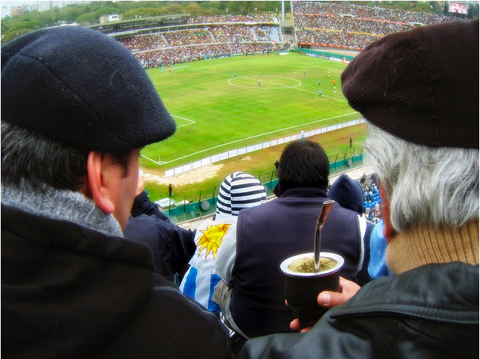


MAPS
  Football
  Mate
  Mujica
  Marijuana

Slide 4
SYNTOMATIC HYPERAMMONEMIA WITH CHRONIC OR ACUTE VPA ADMINISTRATION
Patient | Sex | Age (years) | Reason freatment | [VPA] mg/L | [NH₄⁺] μg/dL | Comment
1 | M | 26 | Epilepsy | 80 | 235 | Chronic treatment
1 | M | 26 | Epilepsy | ------ | 86 | Chronic treatment
2 | F | 16 | Epilepsy | 60 | 179 | Chronic treatment
2 | F | 16 | Epilepsy | 75 | 200 | Chronic treatment
3 | F | 37 | Bipolar disorder | 99 | 373 | Chronic treatment
3 | F | 37 | Bipolar disorder | ------ | 11 | Chronic treatment
4 | M | 54 | Psychiatric pathology | 568 | 511 | Acute ingestion
4 | M | 54 | Psychiatric pathology | 136 | 294 | Acute ingestion
4 | M | 54 | Psychiatric pathology | 69 | 50 | Acute ingestion
TI DPA – 50-100 mg/L.
NR NH₄⁺ - 25-94 μg/dL

Slide 5
AMMONIA
NH₄⁺ production
Protein catabolism
NH₄⁺ elimination
Hepatic disease
Renal disease
Medicines
Age?
Notes:
Ammonia is the main toxic electrolyte produced by our body as a byproduct of protein catabolism (oxidative deamination) in the intestine and muscle.
Its elimination is a fine equilibrium which may be altered by many factors, such as
liver and renal pathologies
age and
medication, among others
Ammonia is mainly eliminated through the urea cycle which has a prerequisite: the formation of carbamoil phosphate by means of carbamoil phosphate synthethase I (CPS I). This step controls urea formation rate, placing CPS I regulation as a key factor in ammonia elimination. This enzyme is allosterically regulated by N-acetylglutamate (NAG) which is synthesized using Acetyl-CoA and glutamate [12] and it can be inhibited by some drugs [13,14]. Any factor altering this cycle could result in hyperammonemia. In a study carried out by our research group with patients under valproic acid (VPA) treatment, we found higher ammonia levels related to higher VPA and 4-en-VPA concentrations, being the latter a toxic metabolite able to inhibit CPS I [15].

Slide 6
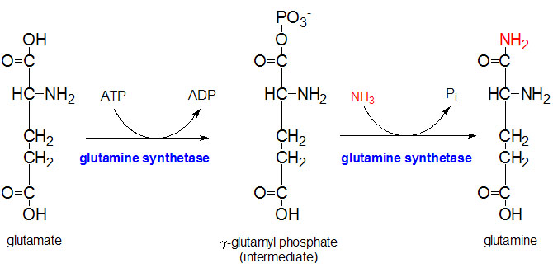
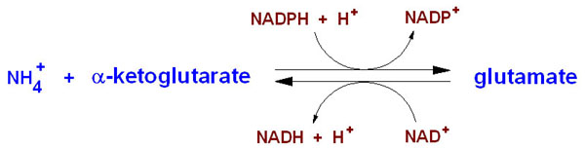
AMMONIA TOXICITY
MILD – DROWSINESS/CONFUSION
SEIZURES
SEVERE – ENCEPHALOPATHY, EDEMA, COMA
Notes:
Ammonia excess is toxic to the CNS., although hyperammonemia may be asyntomatic.
Central nervous system (CNS) symptoms can range from
mild drowsiness
confusion
significant encephalopathy
coma resulting from cerebral edema.
As the brain does not produce urea from ammonia, its removal relies almost exclusively on glutamine synthetase, basically localized in astrocytes.The metabolism of ammonia to glutamine appears to be necessary and is followed by
an osmotic disturbance in the brain
mitochondrial dysfunction with oxidative stress,
and alterations in brain glucose metabolism.
Cerebral blood flow is also altered and strongly influences
the development of brain edema and
intracranial hypertension
Besides, ammonia can increase levels of glutamate resulting in activation of N-methyl D-aspartate (NMDA) receptors.
This is probably the cause of seizures.

Slide 7
CARNITINE HOMEOSTASIS
Exogenous/Endogenous
OCTN2
ACYLCAR/CAR ratio – biomarker
Notes:
L-carnitine is a ubiquitous molecule derived from the amino acids lysine and methionine,
its homeostasis is maintained through
dietary intake and endogenous formation. Biosynthesis involves several steps and enzymes. The last step is a hydroxylation reaction catalyzed by γ-butyrobetaine hydroxylase present in liver, kidneys and brain [1,2]. Skeletal and myocardial muscles are the main consumers of L- carnitine and contain the highest depots in the body.
Uptake in these tissues is dependent upon active and saturable transport: Organic Cation Transporter 2 (OCTN2), being this transport accountable for
intestinal and
renal reabsorption
L-carnitine pool comprises free carnitine (CAR) and esterified derivatives or acylcarnitines (ACYLCAR), formed by means of carnitine acyltransferases in several tissues.
Under normal metabolic conditions acetylcarnitine (ALCAR) is the major representative of the acyl group and participates in anabolic and catabolic pathways of cellular metabolism. CAR and short-chain ACYLCAR are excreted by the kidneys and reabsorbed in as much as 99%. Although 99 % of CAR is found intracellularly, the relationship between serum ACYLCAR and CAR is highly sensitive to intramitochondrial metabolic alterations It has been proposed by several authors that to determine if there is a real CAR deficiency, ACYLCAR/CAR ratio is a good biomarker. In adults under normal conditions, ACYLCAR/CAR ratio should be between 0.1-0.4, values above 0.4 indicate CAR deficiency.

Slide 8
CAR and ACETILCAR
CAR/ACETILCAR
β-oxidation
CAR
Acyl-CoA/CoA ratio
ACETILCAR
Acetilcholine
Notes:
CAR and ALCAR perform major functions in the body.
Both of them are involved as co-factors for transport of long chain fatty acids through the mitochondria membrane.
CAR also facilitates the removal of short and medium-chain acyl esters formed in the mitochondria and peroxisomes as a by-product of normal and abnormal metabolism. This function, also referred as buffering the mitochondrial acyl-CoA/CoA ratio, has been signaled as a crucial role of CAR, owing to the fact that many enzymes involved in the citric cycle, gluconeogenesis, the urea cycle and fatty acid oxidation are regulated by the aforementioned ratio. Trans esterification of acyl-CoA esters to CAR by the action of carnitine acetyltransferase (CAT) restores intramitochondrial free CoA and releases mainly ALCAR which can then be used for Acetyl-CoA synthesis.
Hence, the action of CAT, CAR, ALCAR and CoA pools are on close relationship [2,3].
On a tissue basis, CAR protects the myocardium against ischemia, myocardial infarction and oxidative stress damage and its deficiency is associated with lipid myopathy and hepatotoxicity in the form of Reye´s syndrome.
ALCAR as well as CAR are able to cross the blood brain barrier and are present in the brain in high concentration, reaching nervous areas where the linked acetyl group may be delivered.
The possibility of providing acetyl groups makes ALCAR able to
maintain the intramitochondrial salvage pathways,
to reactivate coenzyme A,
to reduce peroxidation and intracellular malonyl aldehyde levels (common marker of oxidative stress),
to act as a scavenger and
to contribute to neurotransmitter synthesis due to the structural affinity to acetyl-choline [4].
Carnitine is important for energy production in skeletal muscles and there seems to be a negative correlation between advancing age and muscle carnitine levels.
The information regarding CAR status in the elderly is rather controversial being stated by most authors that decrease biosynthesis together with impaired reabsorption favor lower levels of CAR with life decline [17].
Some pathologies such as uncontrolled epilepsy and Alzheimer can be the cause of high levels of ammonia in blood [18, 19].

Slide 9
PATIENTS and METHODS
Group A) Thirty-one epileptic adult patients (15 men -16 women), mean age 46.2 years (range 18-55)
Blood CAR and ACYLCAR profiles and ammonia concentrations in blood were determined.
Group B) Twenty-eight patients treated with VPA (15 men - 13 women), mean age 45.7 years (range 18-55) Plasma VPA, blood CAR and ACYLCAR profiles, and ammonia blood concentrations were determined.
Group C) Forty-one elderly patients (21 men - 20 women), mean age 73.8 years (range 65-85).
Blood CAR and ACYLCAR profiles and ammonia blood concentrations were determined.
VPA - HPLC.
NH₄⁺ - Hitachi 911 Automatic Analyser, Laboratorios Roche.
CAR / ACYLCAR - LC-MS/MS.
All statistical analyses were carried out using SPSS (version 17.0 for Windows).
Means were compared using Student’s t-test for independent variables.
All p-values were two sided, using α = 0.05 as the reference standard for determining the significance.
Notes:
Some central nervous system(CNS) pathologies such as uncontrolled epilepsy and Alzheimer can be the cause of high levels of ammonia in blood.
Valproic treatment has also been pointed out as causing hyperammonemia although the mechanism that underlies this ADR is still under study.
The aim of this study was to analyze if the use of VPA, the age of the patients, or certain CNS pathologies can cause CAR and/or ALCAR deficiency leading to increased ammonia levels.
Three groups of patients were recruted
For VPA (GroupB) and ammonia (Groups A, B,and C) determination, a blood sample was withdrawn prior to morning dose by arm venipuncture, collected and divided into two tubes containing EDTA and heparin for ammonia and VPA determinations, respectively. Due to stability reasons, EDTA tubes were immediately taken by refrigerated transport to the laboratory for immediate determination of ammonia (within 30 minutes from blood sampling).
For VPA determination blood samples were centrifuged and plasma was stored at −20∘C untilanalysis.
The study protocol was approved by the Institutional Ethics Review Committee of the Faculty of Chemistry, Universidad de la República.
All subjects participating in the study received a leaflet with the protocol details and signed a consent form before entering the study
Mean ammonia, CAR, and ALCAR concentrations were compared among the three patients’groups to establish if VPA ,pathology, or age may modify their levels. ACYLCAR/CAR ratios were computed and compared also.
For the patients treated with VPA, the anticonvulsant concentration was correlated with CAR, ALCAR, and ammonia levels.
Ammonia, CAR, and ALCAR levels were compared, to determine if ammonia increase may be caused by deficiency of CAR and/or ALCAR. Ammonia, CAR, and ALCAR were correlated with age to study if life decline influenced theirlevels.
All statistical analyses were carried out using SPSS (version17.0forWindows).
Means were compared using Student’s 𝑡-test for independent variables.
All 𝑝 values were two-sided, using 𝛼 = 0.05 as the reference standard for determining the significance.

Slide 10
RESULTS
CARNITINE – VALPROIC ACID

Slide 11
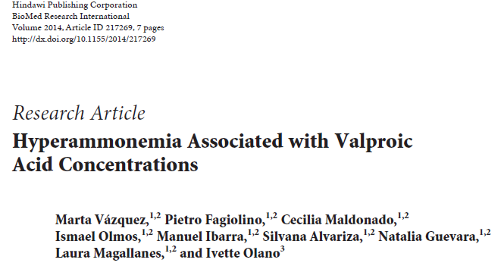
CORRELATIONS
VPA - CAR
VPA - ACETYLCAR
VPA – NH₄⁺
Notes:
The previous finding was corroborated by a positive correlation between VPA concentration and ammonia level (𝑝< 0.025), whereas VPA correlated negatively with CAR (𝑝< 0.0001)and there was a trend towards lower ALCAR levels,as showni

Slide 12
MEAN COMPARISONS BETWEEN GROUPS
Notes:
As shown in Table1, mean ammonia concentration (SD) in Group A was 61.7 (27.3)𝜇g/dL falling within the reference
ammonia levels of our laboratory (25–94𝜇g/dL). CAR, ALCARconcentrations,andACYLCAR/CARratiowere37.8 (8.6)𝜇mol/L, 11.5 (3.0)𝜇mol/L, and 0.35 (0.15), respectively. These values do not differ from the reference values of our laboratory or the reported ones in the literature [2, 18, 22]. None of the patients in this group presented hyperammonemia.
In Group B, 8 patients presented hyperammonemia, representing 28.6% of the subjects treated with VPA. All the patients with hyperammonemia remained asymptomatic.
Patients with hyperammonemia in Group B presented an ACYLCAR/CAR ratio of 0.44 (0.13) significantly different (𝑝 < 0.001) from Group A, 0.35 (0.15), showing that ALCAR and/or CAR deficiency may be present in patients with hyperammonemia treated with VPA.These results are in accordance with other studies that propose CAR depletion in patients with long term VPA treatment.
There was a significant difference (𝑝 < 0.05) in VPA plasma concentrations in Group B between patients with hyperammonemia and patients with normalammonia levels, 44.
In this group, ammonia level (105.2 ± 57.2 𝜇g/dL) was significantly higher (𝑝 < 0.005) than in Group A. CAR and ALCAR levels did not show any differences between the two groups; nonetheless,when patients were divided according to their ammonia level and compared within GroupB, patients with hyperammonemia presented CAR(34.9 ± 11.4 𝜇mol/L) and ALCAR (9.9 ± 3.0 𝜇mol/L) concentrations significantly lower (𝑝 < 0.05 and 𝑝 < 0.002, resp.) than patients with normal levels of ammonia. Patients with hyperammonemia presented ALCAR levels significantly lower than patients of Group A andtherewasatrendtowardslowerCARlevelsalso
Surprisingly, when comparing CAR and ALCAR levels in patients of Group B without hyperammonemia to Group A, significant higher concentrations were found in the former subgroup (𝑝 < 0.025 and 𝑝 < 0.001,resp.). Could the disease itself (bipolar disorder) be the cause of this difference? CAR and ALCAR especially,as it is better absorbed and more able to cross the blood brain barrier, are emerging agents with growing evidence supporting their use in several neuropsychiatric disorders mainly depression. Although ALCAR’s exact mechanism of action in treatment of depression is still not clear, animal and cellular models suggest that
its neuroplasticity effect,
membrane modulation,
serotonergic
and possibly dopaminergic activities regulation
Could play an important role as possible action mechanisms
However, its benefits must be thoroughly studied. A case was reported in which ALCAR administration precipitated psychosis in a patient with bipolar disorder. Perhaps higher levels of CAR and/or ALCAR are present in patients with bipolar disorders not stabilized with VPA yet. VPA might have as additional benefit in the treatment of bipolar disorder, the decrease of abnormal CAR and/or ALCAR levels.
No studies in the literature were carried out measuring CAR and ALCAR levels in patients with bipolar disorders. So, further studies are necessary in order to conclude if the uncontrolled pathology itself could be the cause of the higherCAR and ALCAR levels.

Slide 13
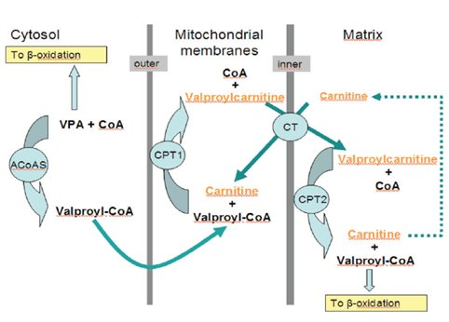
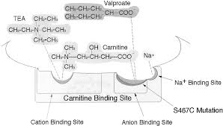
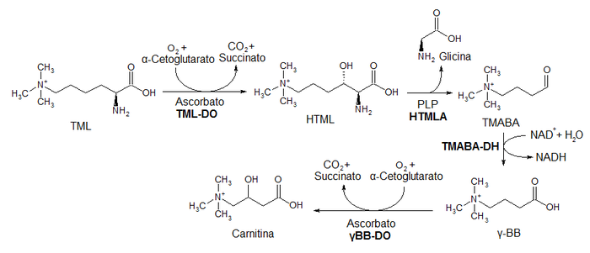
VPA INDUCED HYPERAMMONEMIA
Valproil carnitine formation
Carnitine depletion
OCTN2 inhibition
Butirobetaine hydroxylase inhibition

Slide 14
↓ Acetil-CoA
VPA ω-oxidation ↑
β-OXIDATION
UREA CYCLE
CPS-1 INHIBITION
CPS-1 ALLOSTERIC REGULATION
HYPERAMMONEMIA

Slide 15
RESULTS
CARNITINE – AGE

Slide 16
CORRELATIONS
Age - CAR
Age - ACETYLCAR
Age – NH₄⁺
Notes:
Ammonia, CAR, and ALCAR correlations with age are shown.
As can be observed a positive correlation was found between ammonia versus age (𝑝 < 0.01) and CAR versus age (𝑝 < 0.001) whereas a negative one was found between ALCAR and age(𝑝 < 0.001).

Slide 17
MEAN COMPARISONS BETWEEN GROUPS
Notes:
CAR levels in subjects of Group C (50.1 ± 18.9 𝜇mol/L) were significantly higher(𝑝 < 0.001) than in younger adults of Group A (37.8 ± 8.6 𝜇mol/L). On the other hand, mean ALCAR concentration showed a significant difference (𝑝< 0.001),in favor of younger adults;seeTable2.Elderlypatients showed higher ammonia levels of 82.1 (35.6)𝜇g/dL than epileptic patients of GroupA, 𝑝 < 0.05.The iatrogenic cause of this ammonia increase was excluded after thorough study of their pharmacotherapy; thereby etiology should be found elsewhere. Regarding the comparison of ACYLCAR/CAR between Groups A and C, a significant difference was found showing elderly patients lower ratios(𝑝 < 0.025).

Slide 18
CAUSES OF HYPERAMMONIA IN THE ELDERLY
SIRT5
CPS-1
CARNITINE
Sexual hormones
ACETYLCARNITINE
OCTN2
Elevated ammonia
Elevated ammonia
Notes:
Aging is associated with higher oxidative stress and ALCAR lower levels have been pointed out as one of the causes.
ALCAR biosynthesis is dependent upon CAR entrance into the cell. OCTN2, the main transporter mediating CAR entrance into the cell is present in heart, liver, kidneys, intestine, and skeletal muscle. Elderly subjects may present decreased levels of OCTN2.This condition could influence CAR entrance to the cell and as a result its metabolism to ALCAR. Moreover, ALCAR renal reabsorption could also be impaired. This could lead to higher circulating CAR levels and lower ALCAR formation which is in agreement with the results obtained in this study.
ALCAR deficiency is placed at the spotlight, strengthened by some studies reporting hyperammonemia reversion with ALCAR administration in patients with minimal hepatic encephalopathy. ALCAR has also shown encouraging results in the treatment of degenerative brain diseases where cognitive functions are involved and in reversing the hyperammonemia in patients with Alzheimer
In spite of the usefulness of ACYLCAR/CAR ratio in other populations, in the elderly this ratio can be misleading. As serum CAR levels are augmented and ALCAR (the main component of ACYLCAR) is diminished there can be a false impression that CAR deficiency is not present, when in fact circulating CAR levels are high but tissue concentrations remain low because of impaired transport.

Slide 19
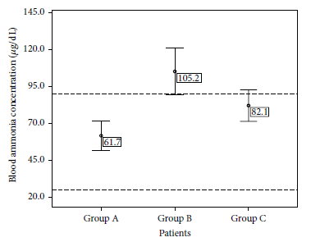
MEAN AMMONIA LEVELS IN THE THREE GROUPS
Notes:
The results obtained in Group A showed that controlled seizures, as referred to before, did not influence CAR, ALCAR, and ammonia levels or CAR availability as defined by the ACYLCAR/CAR ratio lower than0.4.

Slide 20
CONCLUSIONS
Patients with VPA
CAR deficiency
ACETYLCARdeficiency
Ammonia increase
Elderly patients
No CAR depletion
ACETILCAR deficiency
Ammonia increase
ACETYLCAR or CAR
ACETYLCAR
Notes:
In the elderly population, serum CAR could be increased due to impaired access to tissues which in turn could result in ALCAR decrease. This last fact could lead to ammonia impaired elimination. Perhaps higher ammonia levels and ALCAR deficit could be responsible for the cognitive and neurodegenerative diseases found in the elderly. ACYLCAR/CAR ratio is not a good biomarker for all populations.
Although ALCAR arises as a promising agent to control ammonia levels, it should be used with caution in patients with bipolar disorders, the use of CAR being preferable

Slide 21
NOW WHAT????

Slide 22
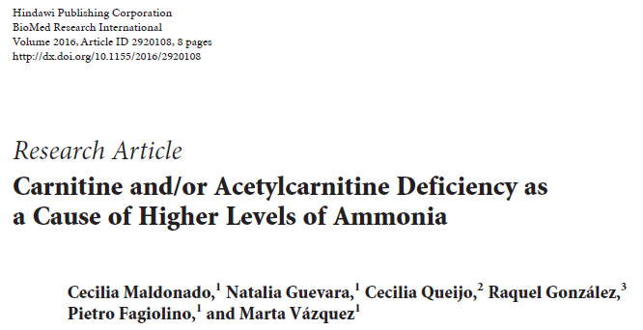
THANKS!
Any questions?
You can find me at
cmaldonado@fq.edu.uy

Slide 23





Slide 24
Let us meet again..
We welcome you to our future conferences of Conference Series LLC
through
9th International Conference and Exhibition on Pharmacovigilance
July 17-19, 2017 Munich, Germany
http://pharmacovigilance.pharmaceuticalconferences.com/

