Slide 1
Novel Carbohydrate-based Ligands with Immunostimulatory Properties
Cecilia H Marzabadi, Vikram Basava and Constantine Bitsaktsis
Seton Hall University
South Orange, NJ USA

Slide 2
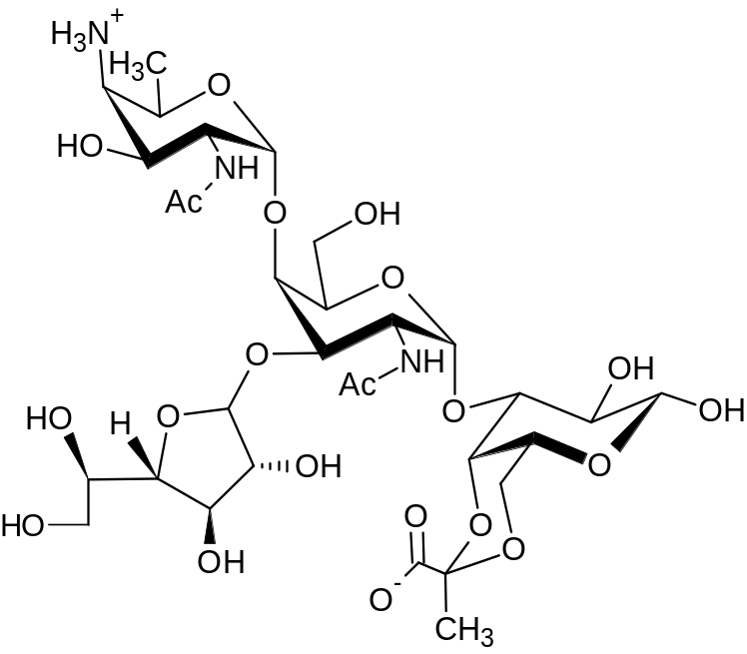
Introduction
The zwitterionic polysaccharide, PSA1, isolated from the capsule of Bacteroides fragilis, has been shown to stimulate both innate and adaptive immune responses in mammals and is believed to be important in establishing a balanced immune system which is mediated by T-lymphocytes.
1

Slide 3
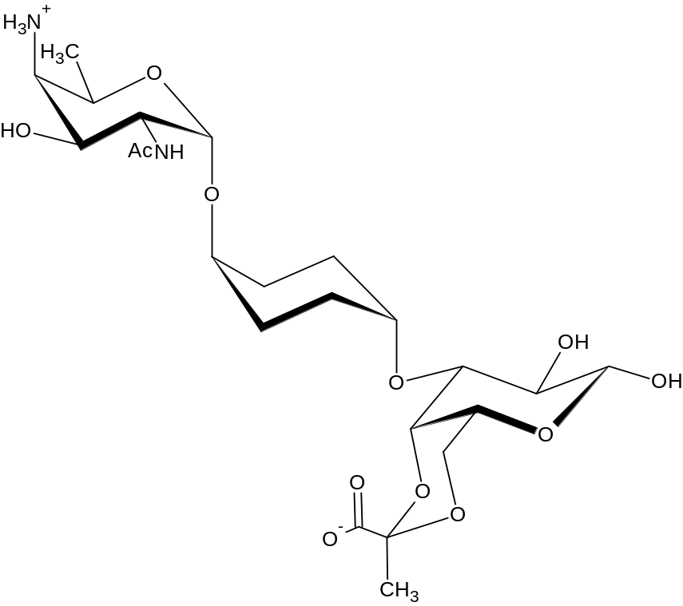
INtroduction
Work in our laboratory involves the synthesis of simpler zwitterionic saccharide analogues for evaluation as potential stimulants of innate and/or adaptive immunity.
Recently, One such analog, 2, has been synthesized and has been shown to possess immunostimulatory properties.
2

Slide 4
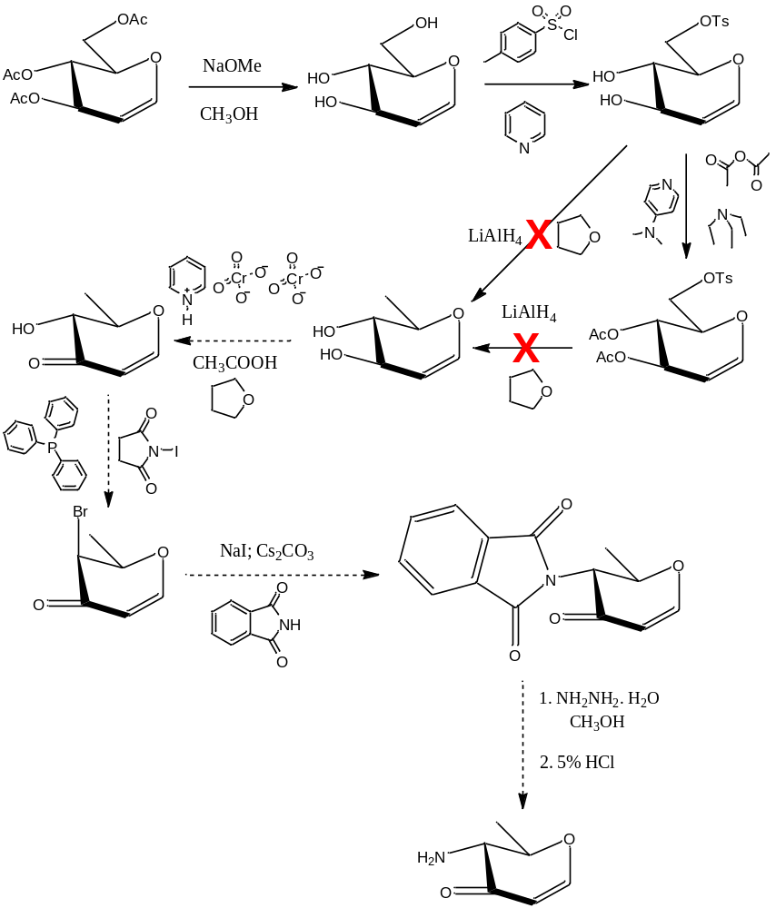
Synthetic STUdies
Synthesis of Subunit A:
(Proposed Scheme)

Slide 5
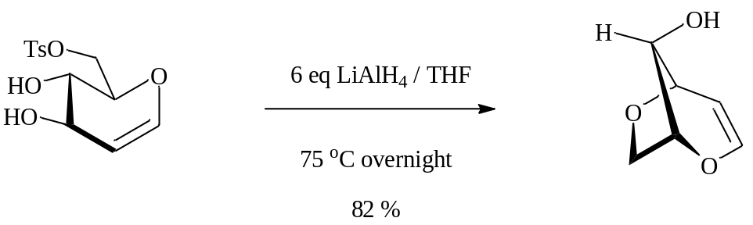
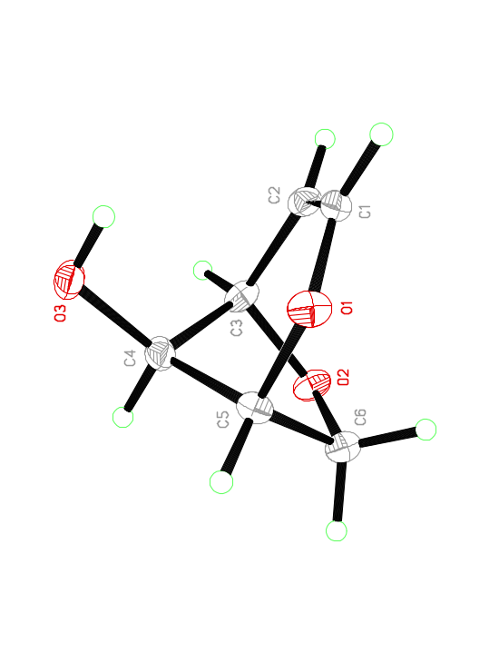
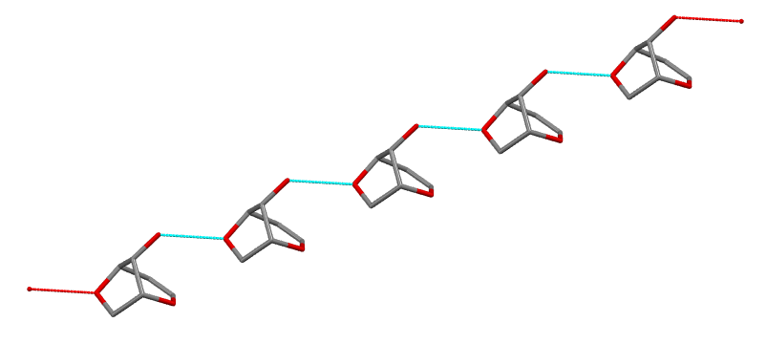
Synthetic STUdies
ORTEP representation
of the anhydride
3,6-Anhydride molecules showing intermolecular H-bonding

Slide 6
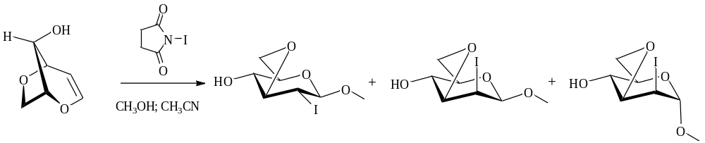
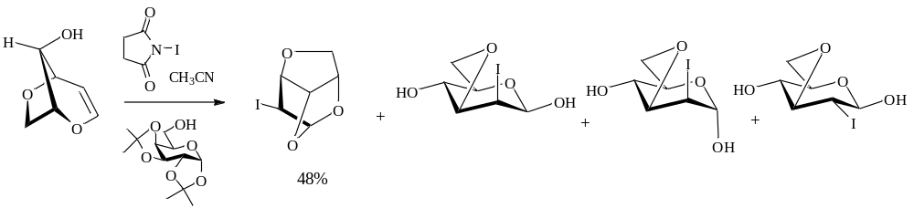
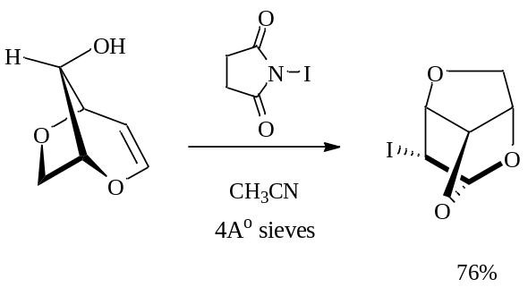
Synthetic STUdies
Reactivity of 3,6-Anhydro-D-glucal:

Slide 7
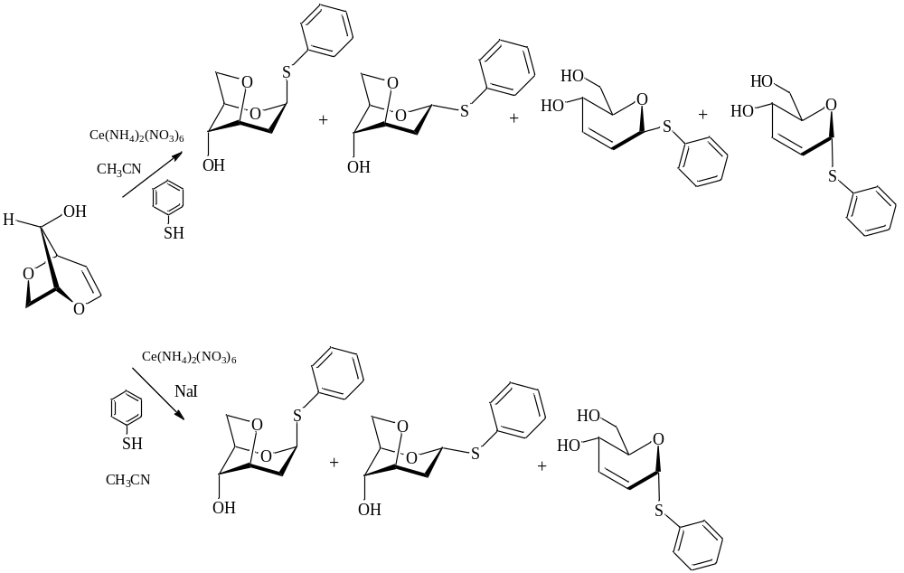
Synthetic STUdies
Reactivity of 3,6-Anhydro-D-glucal:

Slide 8
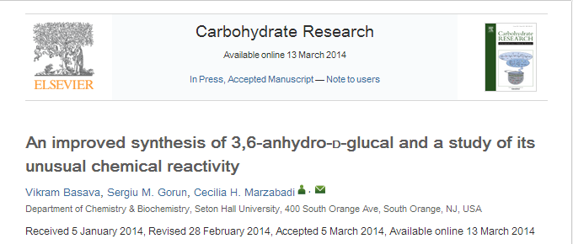

Slide 9
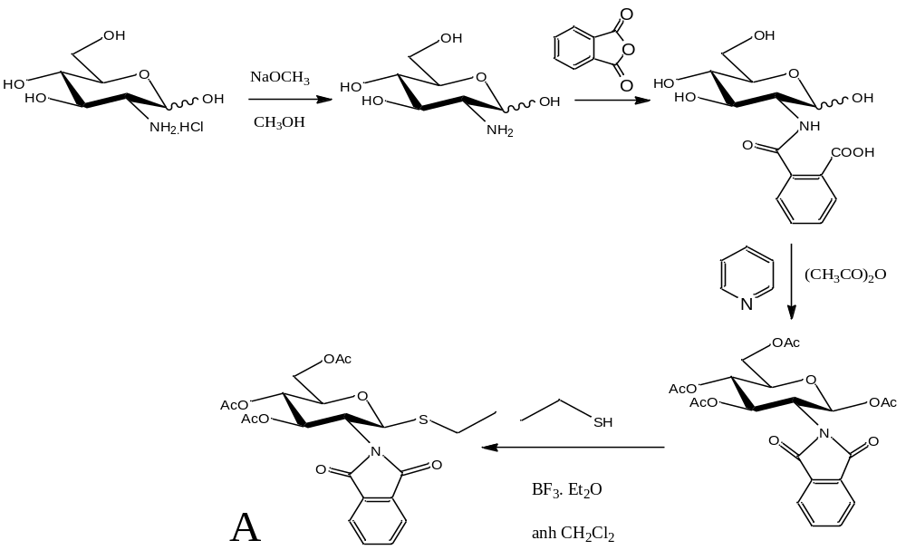
Synthetic STUdies
Synthesis of Subunit A:

Slide 10
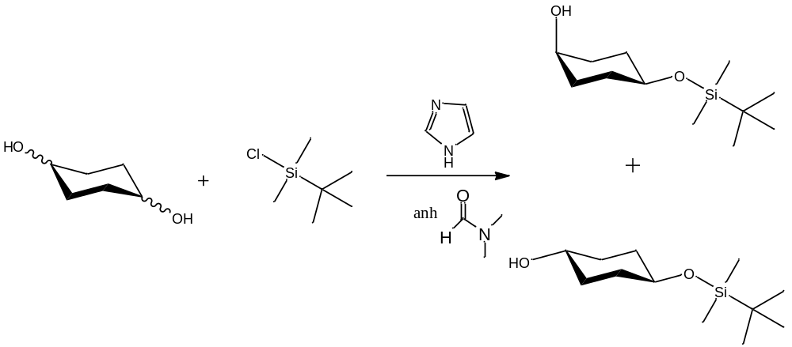
Synthetic studies
Synthesis of Subunit B:
B

Slide 11
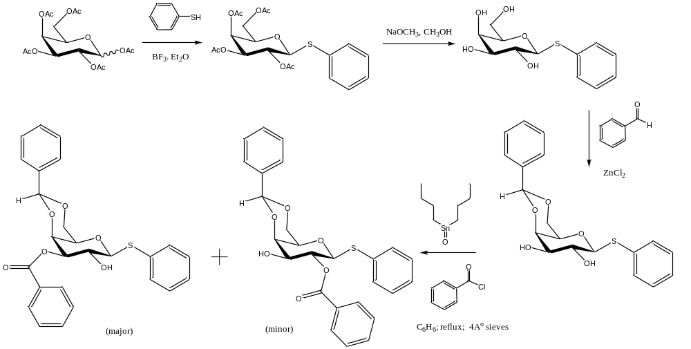
Synthetic studies
Synthesis of Subunit C:

Slide 12
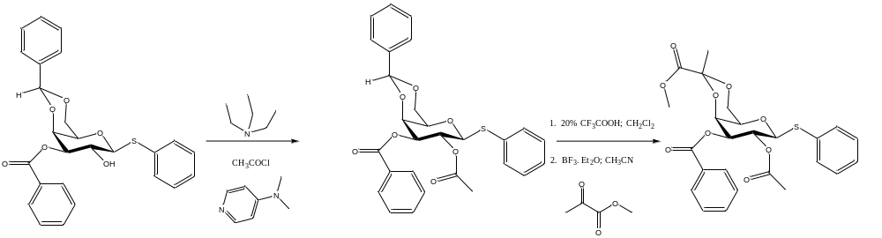
Synthetic studies
Synthesis of Subunit C (cont):
C

Slide 13
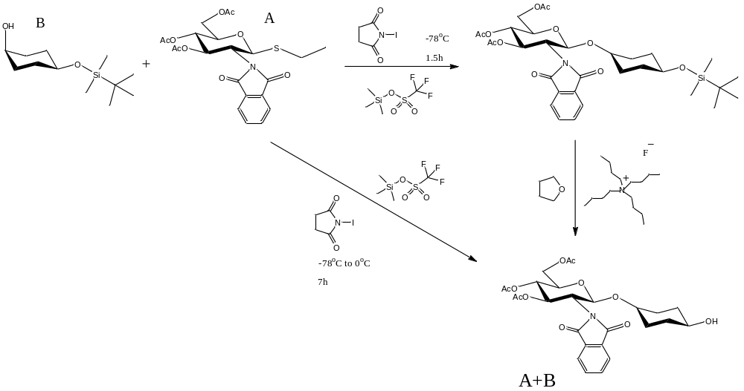
Synthetic studies
Coupling of Subunits A and B:

Slide 14
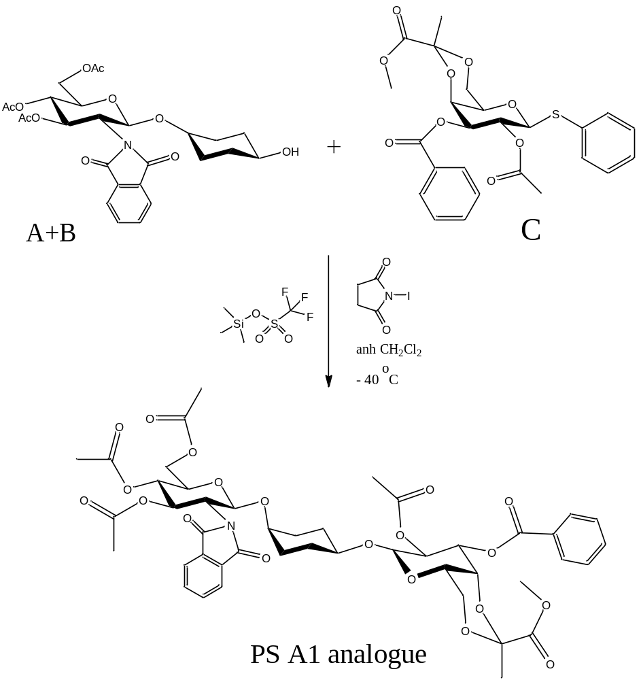
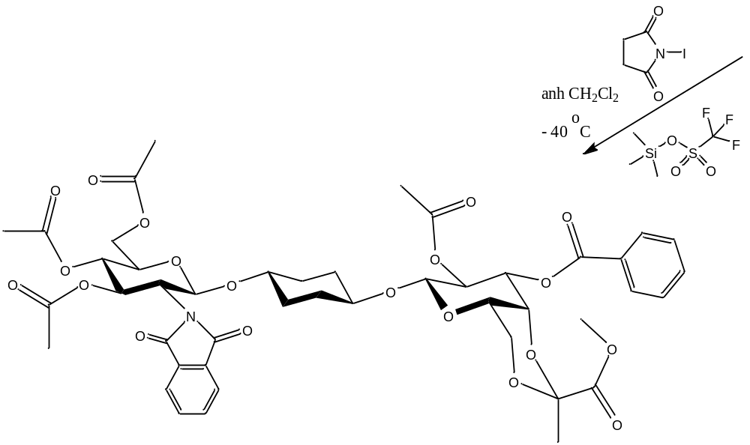
Synthetic studies
Coupling of Subunit A+B with C:

Slide 15
BIOLogical Evaluation
Innate Immunity:
Protected analog 2 was evaluated in ELISA assays for the production of the proinflammatory cytokines TNF-α and IL-6 using Raw 264.7 and mouse peritoneal macrophages (C57 BL/6, Jackson)

Slide 16
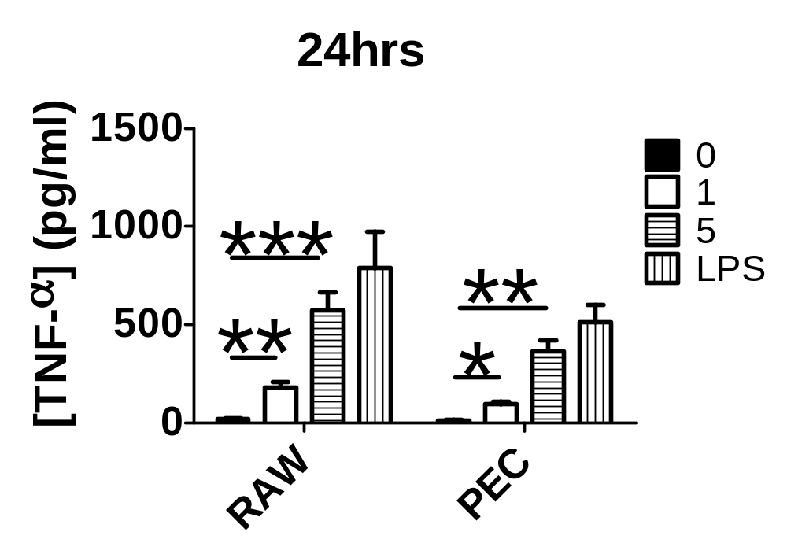
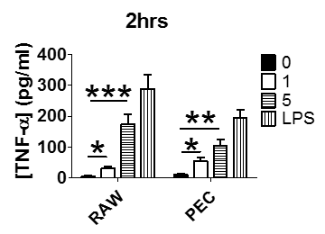
BIOLogical Evaluation
Innate Immunity:
Tnf-α

Slide 17
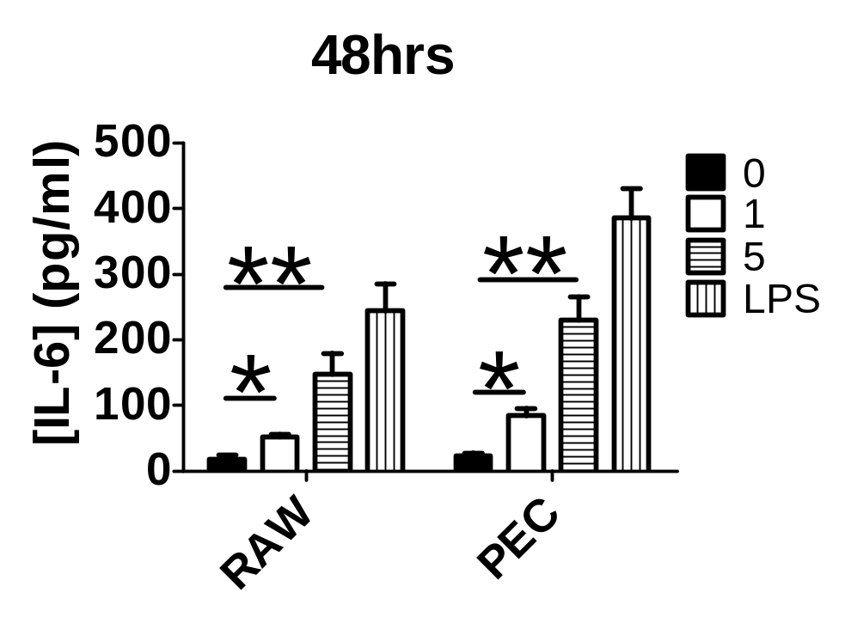
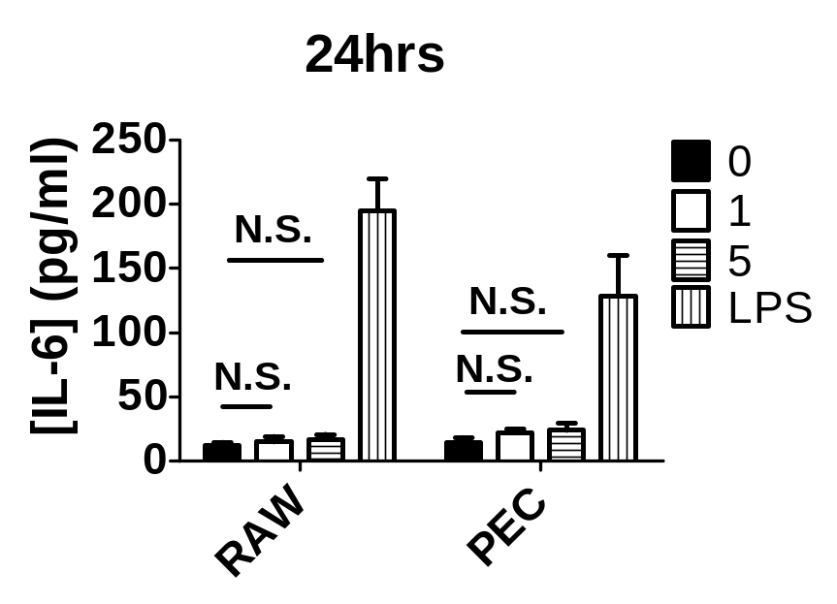
BIOLogical Evaluation
Innate Immunity:
IL-6

Slide 18
BIOLOGICAL EVALUATION
Adaptive Immunity:
The molecule synthesized was also tested in spleen cells from the same mice looking for T and B cell proliferation, levels of IFN-g in the supernatants (indicative of a T cell response), and polyclonal IgM and IgG levels in the supernatants l (indicative of a B cell response) were Measured.
No T Cell or B Cell responses were observed.

Slide 19
BIOLOGICAL EVALUATION
Innate Immunity: TLR2 vs TLR4 Ligand
To elucidate the bacterial Toll Like Receptor responsible for cytokine production, the peritoneal macrophages from TLR2 and TLR4 knockout mice (female, 4-6 week old C57BL6) were dosed with compound 2 and, tnf-a and IL6 levels were measured overtime in the supernatents.

Slide 20
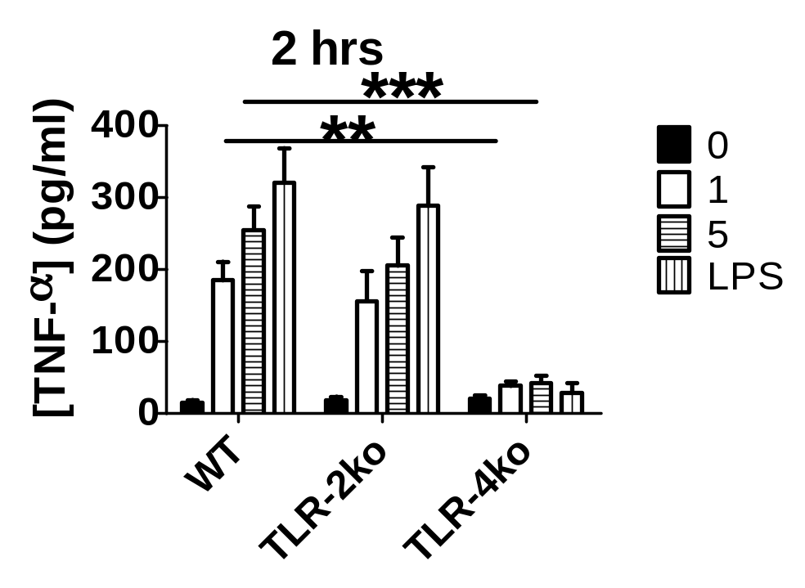
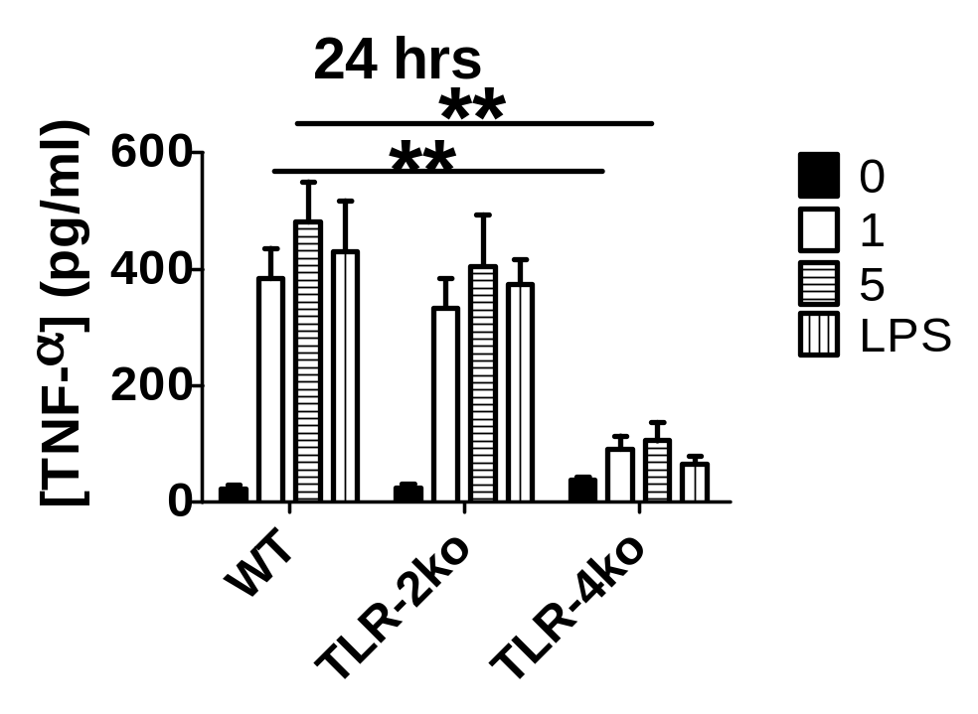
BIOLOGICAL EVALUATION
TLR KO MICE: TNF-α Production

Slide 21
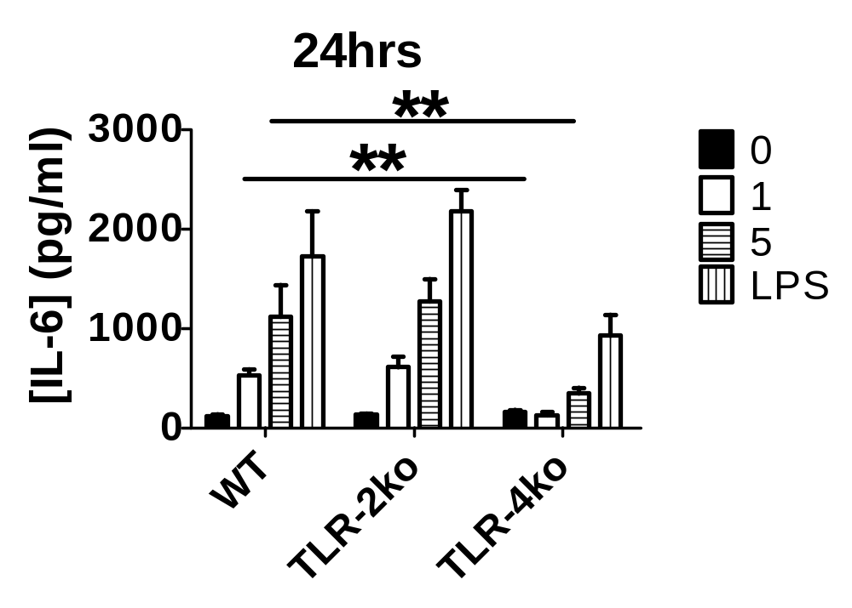
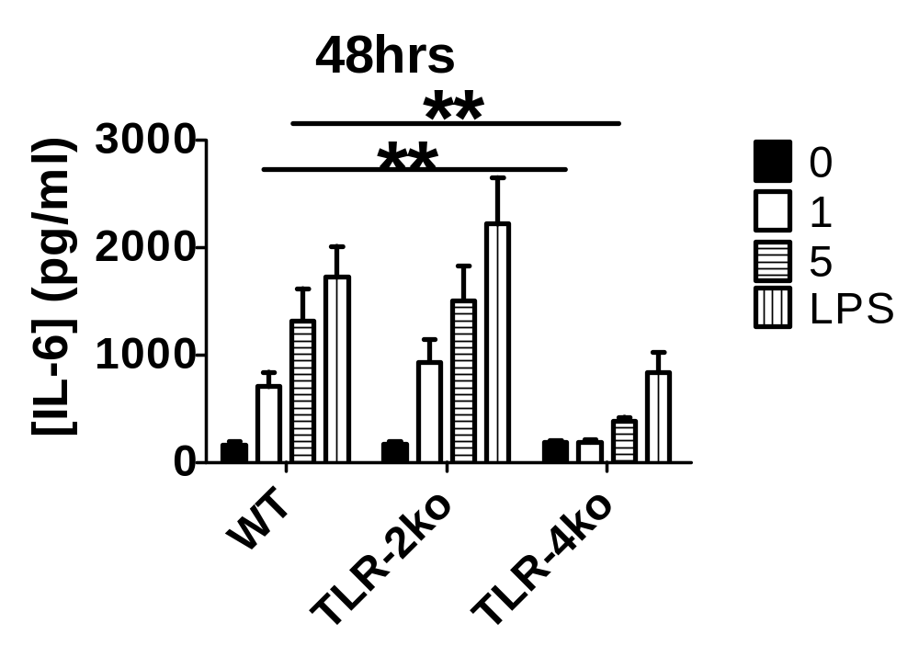
BIOLOGICAL EVALUATION
TLR KO MICE: IL-6 Production

Slide 22
BIOLOGICAL EVALUATION
TLR-4 EXPRESSION: Flow Cytometry
the extent of binding of analogue 2 to the TLR-4 receptors was illustrated by treating the peritoneal exudate cells (pec) with different concentrations of the compound. The cells were pre-incubated with the compound, after which were washed. To the washed cells was added the antibody followed by the phytoerythrin dye and, the number of the coloured cells was observed by flow cytometry.

Slide 23
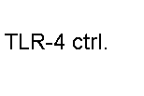
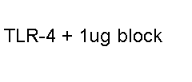

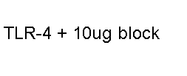
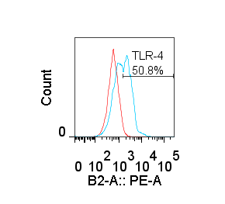
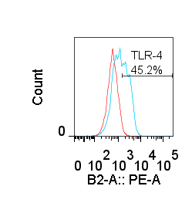
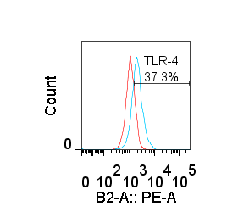
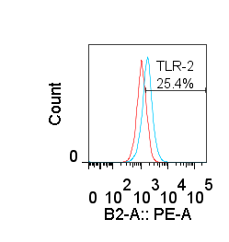
BIOLOGICAL EVALUATION
TLR-4 EXPRESSION: Flow Cytometry
TLR-4

Slide 24
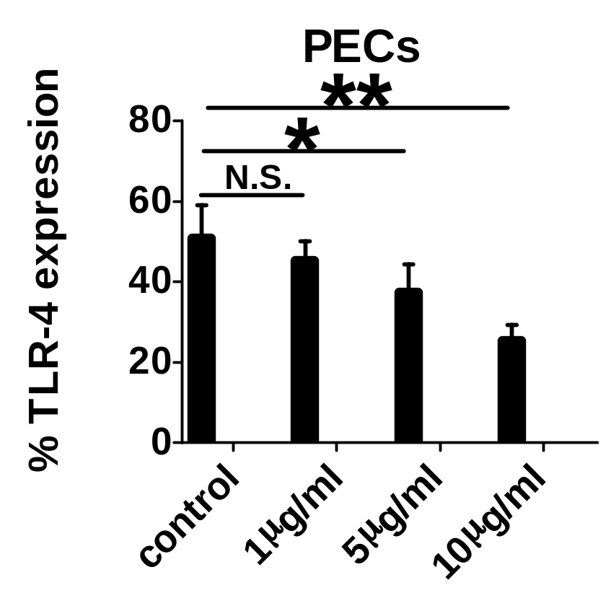
BIOLOGICAL EVALUATION
TLR-4 EXPRESSION: Flow Cytometry

Slide 25
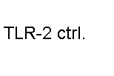
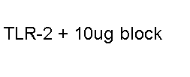
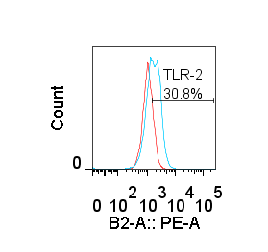
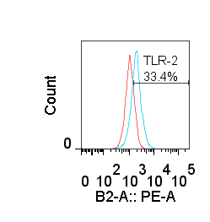
BIOLOGICAL EVALUATION
TLR-2 EXPRESSION: Flow Cytometry

Slide 26
BIOLOGICAL EVALUATION
SUMMARY: TLR KO MICE
A reduction in the production of both TNF-a and IL-6 was observed in only the TLR4 knockout mice suggesting that signaling of 2 occurs through TLR4. Furthermore, the magnitude of TLR4 signaling with 2 was greater than the known TLR4 AGONist, e. coli LPS (LIPOPOLYsaccharide)

Slide 27
Conclusions
The desired zwitterionic polysaccharide, an analogue of psa1, was successfully synthesized with both amino and carboxylate moieties
The biological evaluation clearly denotes that the analogue 2 shows immunostimulatory properties
Analogue 2 was found to stimulate the innate immune system, and not the adaptive immune system
an unexpected and an efficient synthesis of 3, 6-anhydro-d-glucal paves a route to the synthesis of interesting new carbohydrate moieties

