Slide 1

MFI Zeolite Membranes for Water Desalination
Catia Algieri¹, Angelo Garofalo¹, Laura Donato¹, Enrico Drioli¹, Alessandra Criscuoli¹, Maria Concetta Carnevale¹, Omar Alharbi², Saad Aljlil²
¹National Research Council ‑ Institute for Membrane Technology (ITM–CNR) c/o The University of Calabria, cubo 17C, Via Pietro BUCCI, 87036 Rende (CS), Italy
²King Abdulaziz City for Science and Technology (KACST) (Saudi Arabia)

Slide 2
IN THIS WORK
MFI Zeolite
Silicalite | Hydrophobic (aluminum free)
ZSM5 | Hydrophilic
Tubular MFI (Silicalite) zeolite membranes were prepared by secondary growth method coupled with the cross-flow seeding procedure
Seeding parameters studied:
Support pore size (70 and 200 nm)
Zeolite slurry concentrations (0.032; 0.07 and 0.1 wt.%)
The prepared membranes were characterized by means of:
Single gas permeation tests
Vacuum membrane distillation

Slide 3
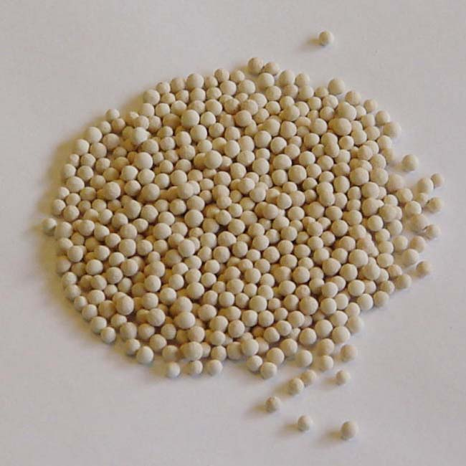
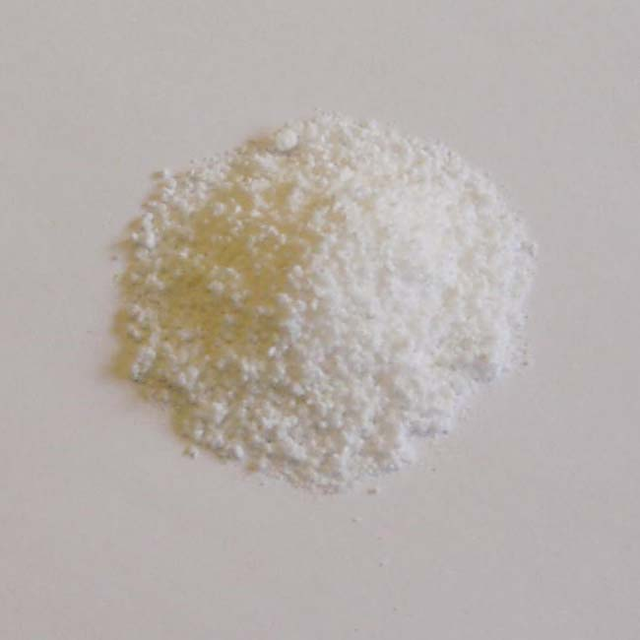
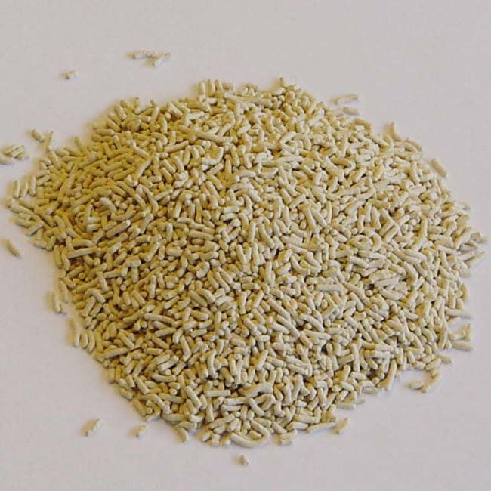
Major current applications for zeolites in the form of powders or pellets
Zeolite is………….
Aluminosilicate mineral
Stable at high temperatures (several hundred °C)
Well defined pore size (0.3-1.3 nm)
Over 176 different zeolites are known
Occur in nature as minerals and can also be prepared synthetically
Good adsorbents, ion-exchangers and catalysts
Adsorbent
Detergent powder
Catalyst
Zeolite A crystals act as
softeners (by ion-
exchange) in detergent
Zeolites can be used for catalytic cracking
Zeolite beads (d= 4mm)
for drying of gas and
liquids

Slide 4



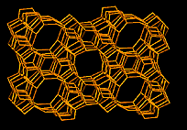

Zeolite Membranes
Zeolites
Supported zeolite membranes
Applications
LTA, d_{pore}= 4.0 Å
Separation membranes
Catalytic membranes
MFI, d_{pore}=5.4× 5.6 Å
Chemical sensor
High selectivitiy
High thermal and chemical
stability
Thermoelectric devices
FAU, dpore= 7.4 Å

Slide 5
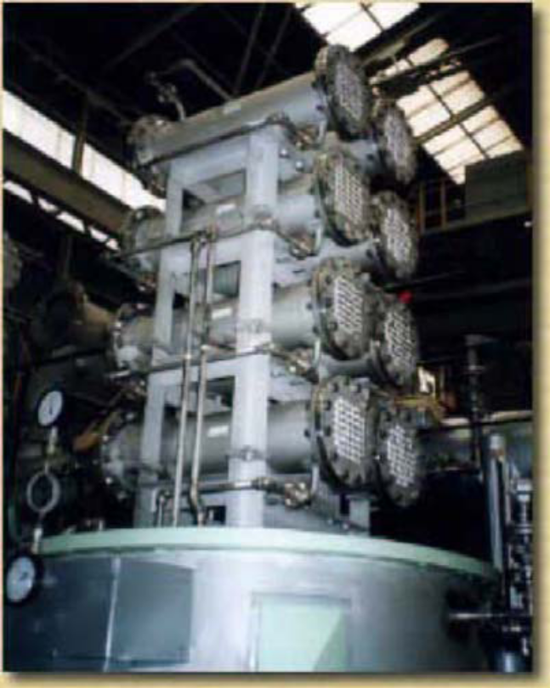
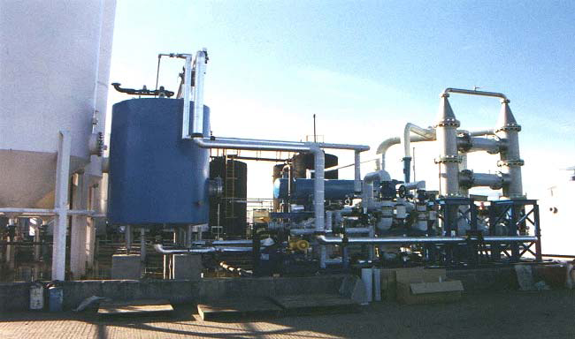
Zeolite Membranes-Hurdles of a Commercialization
Reproducibility problems of the membrane synthesis
Inter-crystaline defects
Membrane cost (US $ 3000 per m² installed membrane area !!!!!!!)
First large scale pervaporation unit designed by Mitsui Engineering and Shipbuilding (MES) in 2001
Bio ethanol de-hydration plant in UK

Slide 6
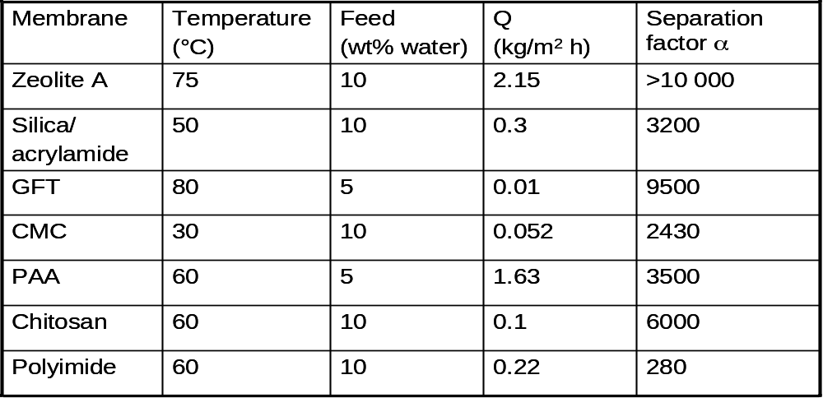
Industrial NaA-membranes
Separation of water/ethanol by pervaporation
Knudsen behavior for H₂/CO₂
Commercial Membrane | α_{H2O/EtOH} | α_{H2/CO2}
NaA Mitsui * | 10.000 | 6.0
NaA Inocermic** | 10.000 | 5.6
Industrial produced membranes containing larger inter crystalline pores**
These pores are non selective in gas separation
In presence of water all pores - zeolite and inter crystalline- of hydrophilic NaA are filled with liquid water
* Kita et al., 6th ICIM Montpellier 2000
** Noack et al., Chemie Ingenieur Technik (73), 2001, 958-967

Slide 7
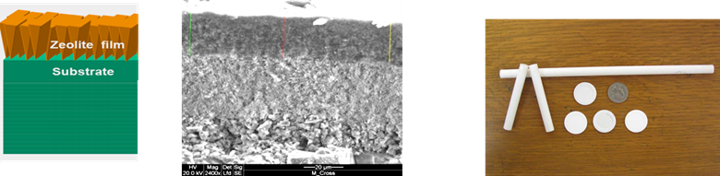

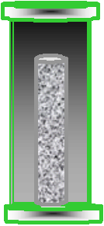
Two Main Routes for the Preparation of Zeolite Membranes
One step method
Secondary growth method
Secondary growth
Seeding
Support
+
Zeolite crystals
Seeded Support
suspension
Growth
+
Tetrapropylammonium
Tetraethoxysilane
+
hydroxide
+
Sodium
+
Deionized
hydroxide
water
Synthesis solution
Growth
Optimization of nucleation and crystal growth
More reproducible than the in situ method
Washing and
drying
Zeolite membrane
M . C. Lovallo and M. Tsapatsis AICHE J. 42 (1996) 3020.

Slide 8
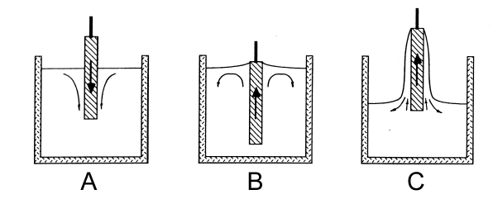
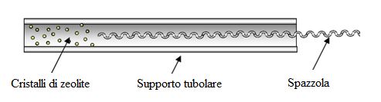
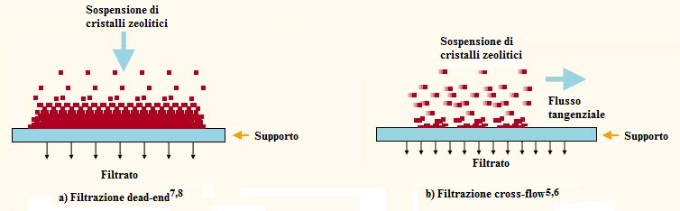
Secondary Growth
Critical Step: SEEDING
Rubbing ¹⁻²
Dip Coating ³⁻⁵
More controllable seeding procedures described in literature involve the filtration of a zeolite water suspension through a porous support
[1] K. Kusakabe, S. Morooka, Y. Kubo, JP10036114; [2] K. Kusakabe, T. Kuroda, S. Mooroka, J. Membr. Sci. 148 (1998) 13; [3] M.C. Lovallo, M. Tsapatsis, AICHE J. 42 (1996) 3020; [4] M.P. Bernal, G. Xomeritakis, M. Tsapatsis, Catal. Today 67 (1–3) (2001) 101; [5] S. Mintova, T. Bein, Adv. Mater. 13 (24) (2001) 1880; [5] M. Pera-Titus, J. Llorens, F. Cunill, R. Mallada, J. Santamarıa, Catal. Today 104 (2005) 281. [6] S. Nakao, I. Kumakiri, T. Yamaguchi, T. Ando, JP2001097715. [7] A. Huang, Y.S. Lin, W. Yang, J. Membr. Sci. 245 (2004) 41. [8] Y. Takata, T. Tsuru, T. Yoshioka, M. Asaeda, Micropor. Mesopor. Mater. 54 (2002) 257.

Slide 9
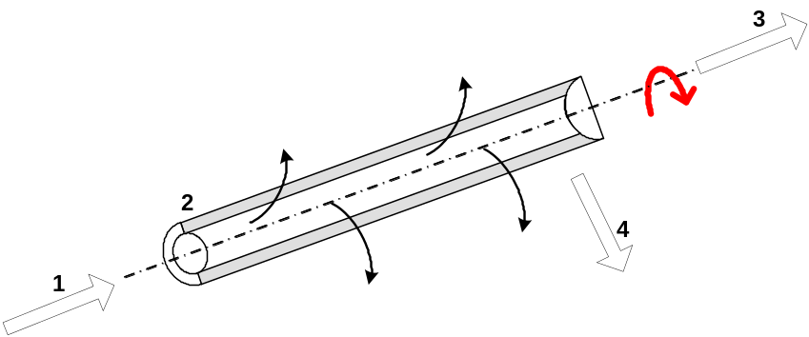
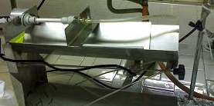
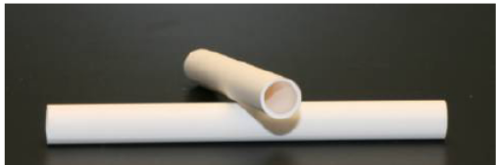
Novel Seeding Procedure for Preparing Tubular MFI Membranes
α-Al₂O₃ tubular supports (IKTS, Germany)
d_{pore} [nm] | I.D. [mm] | O.D. [mm] | L_{eff}[cm]
70 200 | 7 | 10 | 10
Cross-flow filtration of a water suspension of zeolite seeds through a porous support
Support rotation along its longitudinal axis
Support tilting with respect to the horizontal plane
Patent: C. Algieri, P. Bernardo, G. Barbieri, E. Drioli, “Procedimento per la produzione di membrane zeolitiche su supporti porosi tubolari”, RM 0001388750, 2011.
C. Algieri, P. Bernardo, G. Barbieri, E. Drioli, , Micropor. Mesopor. Mater. 119 (2009) 129.

Slide 10
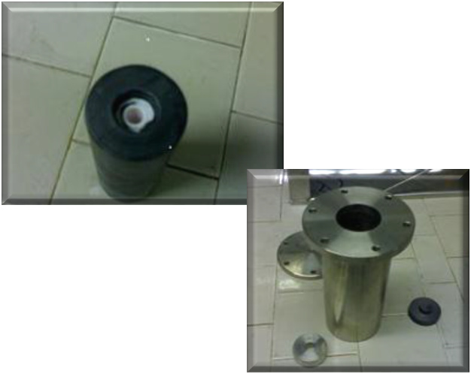
Operating Conditions Used During the
Membrane Synthesis
Seeding procedure
Seeds | Synthesized Silicalite crystals (~ 500 nm)
Zeolite concentration | 0.032 wt. %; 0.07wt. % and 0.1 wt.%
pH suspension | 7.0
Tilting | 2°
Rotation | 0.05 rpm
Feed flow rate | 8 ml min⁻¹
Temperature | 23 °C
Time | 36 minutes
Pore size (α-Al₂O₃ support) | 70 and 200 nm
Hydrothermal treatment [1]
Molar ratio | 4 SiO₂: 0.9 NaOH : 0.9 TPAOH : 1000 H₂O
Solution aging | 12 hours
Temperature | 175 °C
Time | 70 hours
[1] G. Xomeritakis, A. Gouzinis, S. Nair, T. Okubo, M. He, R. N. Overney, M. Tsapatsis, Chem. Eng. Sci. 54 (1999) 3521.

Slide 11
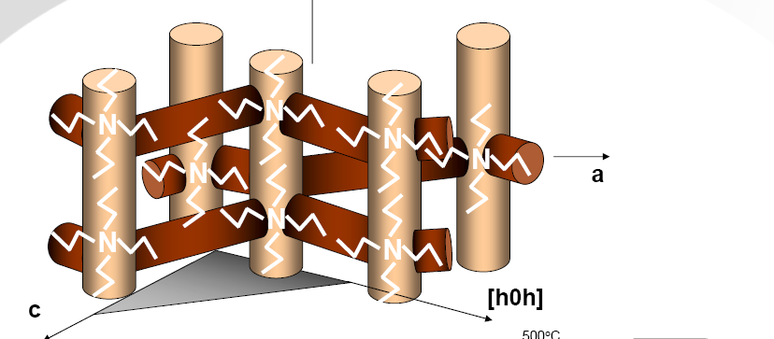
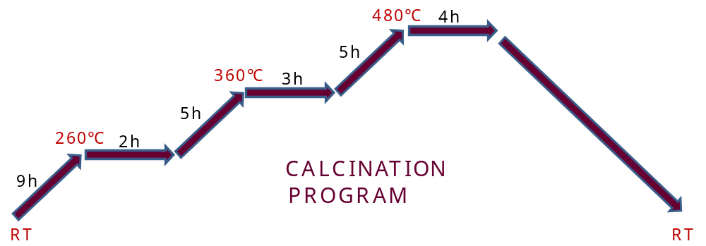
MFI Membrane Preparation: Calcination Step
MFI Topology
Membranes synthesis was carried out in presence of the organic template, therefore calcination of the membranes was required for removing the TPAOH [1].
The calcination heating profiles in static air was performed at very low heating rates to minimize the defects formation.
During calcination defects are created into the zeolite layer considering the different thermal expansion coefficients of alumina and zeolite
[1] E. R. Geus and H. van Bekkum, Zeolites 15 (1995) 333.

Slide 12
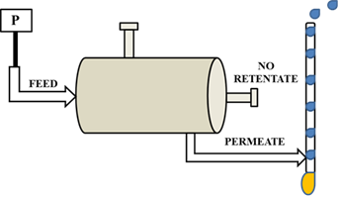
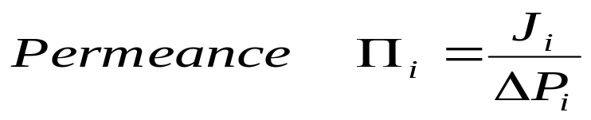
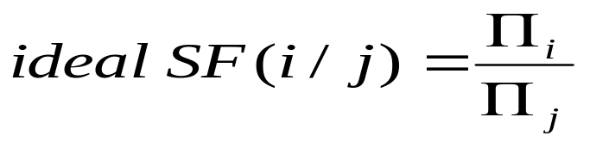
Single Gas Permeation Tests
The prepared MFI membranes were characterized before and after calcination by single gas (N₂ and CO₂) permeation tests at room temperature, according to the pressure drop method [1] and by setting a trans-membrane pressure difference without a sweep gas.
ΔP = 0.4 – 2.8 bar
[1] T. Matsufuji, N. Nishiyama, K. Ueyama, M. Matsukata, Catal. Today 56 (2000) 199.

Slide 13
Gas Tests Before Calcination
Sample | Crystals size (nm) | Support pore size (nm) | Zeolite slurry concentration (wt.%) | ∏_{N2} (µmol m⁻² sec⁻¹ Pa⁻¹)
ZM1 | 500 | 70 | 0.032 | Gas-Tight
ZM2
ZM3
ZM4
ZM5 |  |  | 0.07 | 1.9×10⁻³
ZM6 |  |  | 0.1 | 7.5×10⁻³
ZM7 |  | 200 | 0.032 | 3.2×10⁻²
ZM8 |  |  | 0.07 | 8.3×10⁻²
ZM9 |  |  | 0.1 | 5.4×10⁻¹
Secondary growth method coupled with the cross-flow seeding procedure, using support of 70 nm and zeolite slurry concentration of 0.032 wt.% is a potential route to synthetize MFI zeolite membranes almost defects free
MFI membranes synthesized using larger support pore size (200 nm) were permeable indicating presence of defects

Slide 14
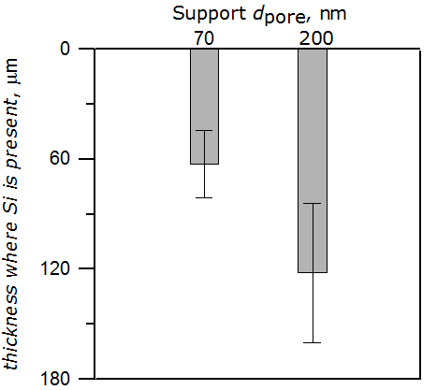

EDX analyses showed the presence of siliceous species in the support pores
due to the synthesis solution infiltration during the hydrothermal treatment
The solution infiltration is less pronounced for 70 nm supports [1]
More homogeneous
zeolite layer
Better permeation
properties
Low concentration of zeolite water slurry permits to obtain sufficient uniform layer avoiding the formation of crystal clusters on the support surface [2]
[1] J.D.F. Ramsay et al., FOAA6, 24-28 May 1998, Elsevier.
[2] A. Huang, Y. S. Lin, W. Yang, Synthesis and properties of A-type zeolite membranes by secondary growth method with vacuum seeding, J. Membr. Sci. 245 (2004) 41-51.

Slide 15


Gas Tests After Calcination
Sample | Crystals size (nm) | Calcination program (°C) | ∏_{N2} (µmol m⁻² sec⁻¹ Pa⁻¹) | ∏_{CO2} (µmol m⁻² sec⁻¹ Pa⁻¹) | iSF CO₂/N₂
ZM1 | 500 | 480 | 1.7 | 3.8 | 2.2
ZM2 |  |  | 1.7 | 3.9 | 2.3
ZM3 |  |  | 1.2 | 3.1 | 2.6
ZM4 |  |  | 1.3 | 3.2 | 2.5
THESE MEMBRANES
Gas Separations
Desalination process

Slide 16
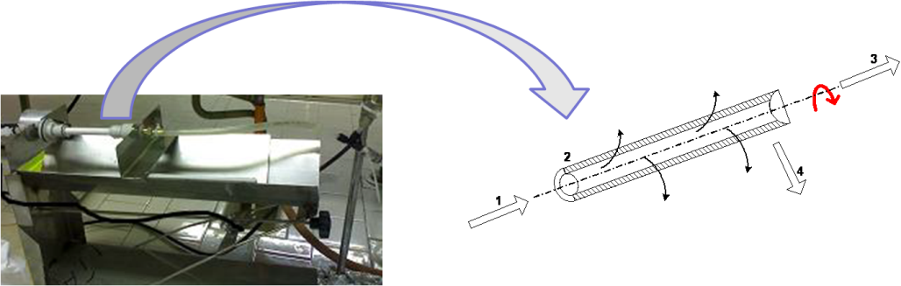
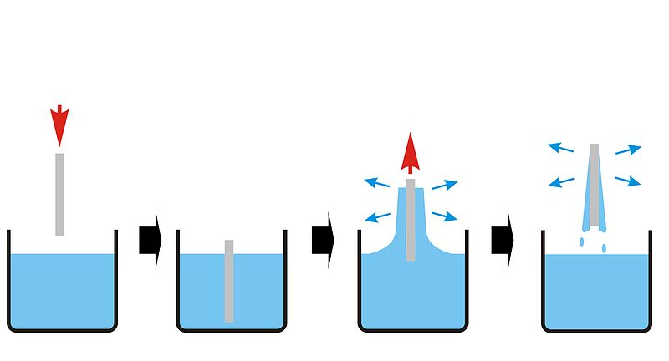
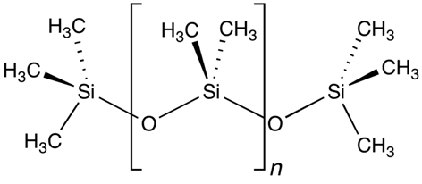
Membrane Post-Treatments
New cross-flow filtration
Seeds | Synthesized silicalite crystals (500 and 200 nm)
Zeolite concentration | 0.032 wt. %
pH suspension | 7.0
Tilting | 0°
Rotation | 0.05 rpm
Temperature | 23 °C
Time | 5 hours
A new cross-flow filtration through the calcined membranes of a zeolite suspension was carried out using crystals with two different size (500 nm and 200 nm)
Dip-coating with polydimethylsiloxane (PDMS, Dow Corning) [1]
polydimethylsiloxane
[1] J. M. S. Henis and M. K. Tripodi, U. S. Patent 4,230,463 (1980).

Slide 17
Gas Tests After Post-Treatments
Sample | Post treatment | ∏_{N2} (µmol m⁻² sec⁻¹ Pa⁻¹) | ∏_{CO2} (µmol m⁻² sec⁻¹ Pa⁻¹) | iSF_{CO2/N2}
ZM1 | Cross flow * | 1.1 | 3.4 | 3.1
ZM2 | Cross flow ** | 3.2x10⁻¹ | 1.1 | 3.4
ZM3 | Dip coating *** | 2.6x10⁻⁵ | 1.7x10⁻⁴ | 6.5
ZM4 | Dip coating **** | 1.4x10⁻⁴ | 5.3x10⁻⁴ | 3.9
* cross flow with crystals of ~ 500 nm
** cross flow with crystals of ~ 200 nm
*** dip coating repeated 4 times
**** dip coating repeated twice
MFI membranes cured with the cross-flow using crystals of about 500 nm exhibited a little improvement of the permeation properties
The cross-flow with smaller crystals (~200 nm) produced a significant decrease of the N₂ and CO₂ permeances with a little enhancement of the ideal separation factor. These results evidenced that not all defects were sealed
MFI membranes “coated” four times with the PDMS exhibited an improvement of the membrane quality (higher ideal separation factor and low permeances)
Two coating with the PDMS determined an increase of the gas permeances with a decrease of the ideal separation factor

Slide 18
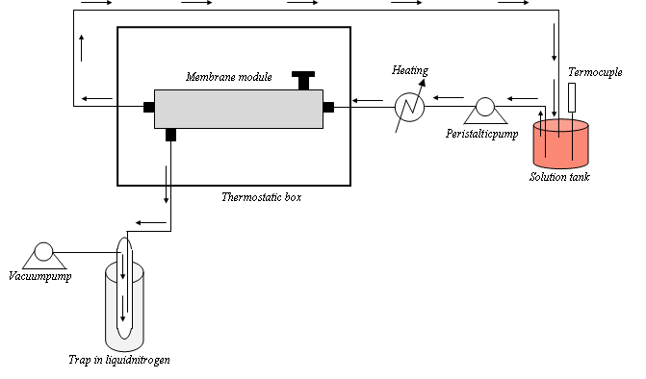
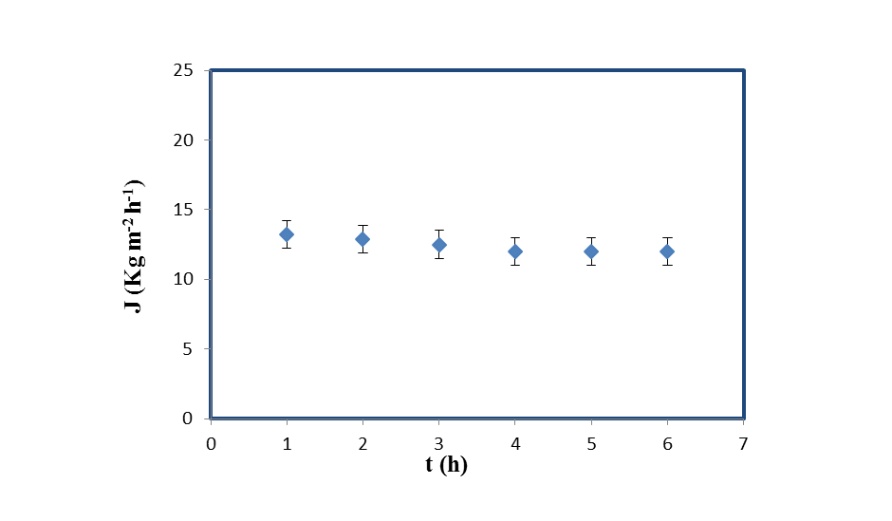
Vacuum Membrane Distillation (VMD)
The possibility to reject monovalent ions with MFI membranes (pore size about 5.5 Å) was investigated in Membrane Distillation Process
Ion | Hydrated Diameter Å
H₂O | 5.6
Li⁺ | 7.6
Na⁺ | 7.2
K⁺ | 6.6
Mg²⁺ | 8.6
Ca²⁺ | 8.2
OH⁻ | 6.0
Cl⁻ | 6.6
NO₃⁻ | 6.8
Feed side (heated water) in direct contact with the inner membrane surface
Permeate was vapor under reduced pressure condensed in a separate external device
Scheme of the VMD set-up
Operating conditions
Feed | Feed flow rate (L h⁻¹) | P vacuum (mbar) | T feed (°C)
Distilled water | 75 | 4.5 | 60
Water flux vs. operating time (ZM2 membrane)

Slide 19
Vacuum Membrane Distillation (VMD)
Operating conditions
Feed | Feed flow rate (L h⁻¹) | P vacuum (mbar) | T feed (°C)
0.2 M NaCl solution | 75 | 4.5 | 60
0.6 M NaCl solution | 75 | 4.5 | 60
1.2 M NaCl solution | 75 | 4.5 | 60
Sample | Post treatment | Feed | Time (h) | Permeation flux (Kg m⁻² h⁻¹) | Rejection (%)
ZM2 | Cross flow | 0.2 M NaCl solution | 5 | 7.6±0.4 | 98.8±0.1
 |  | 0.6 M NaCl solution | 5 | 7.0±0.2 | 98.6±0.1
 |  | 1.2 M NaCl solution | 5 | 5.2±0.2 | 98.4±0.2
Membrane cured with PDMS were not suitable for VMD because permeate fluxes were not appreciable

Slide 20
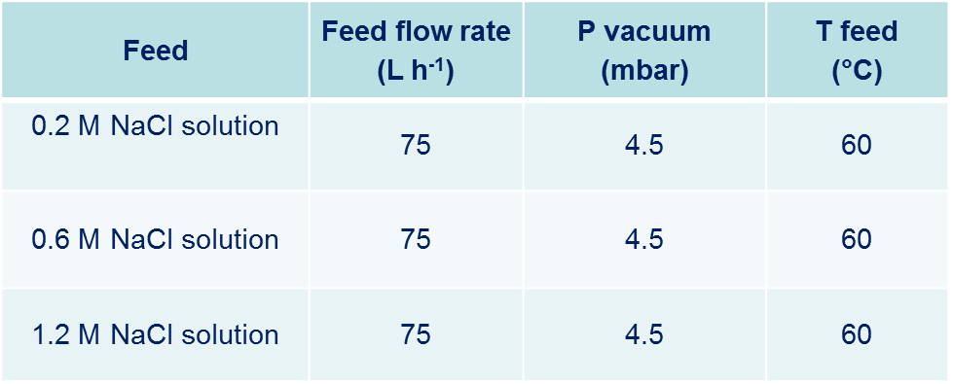
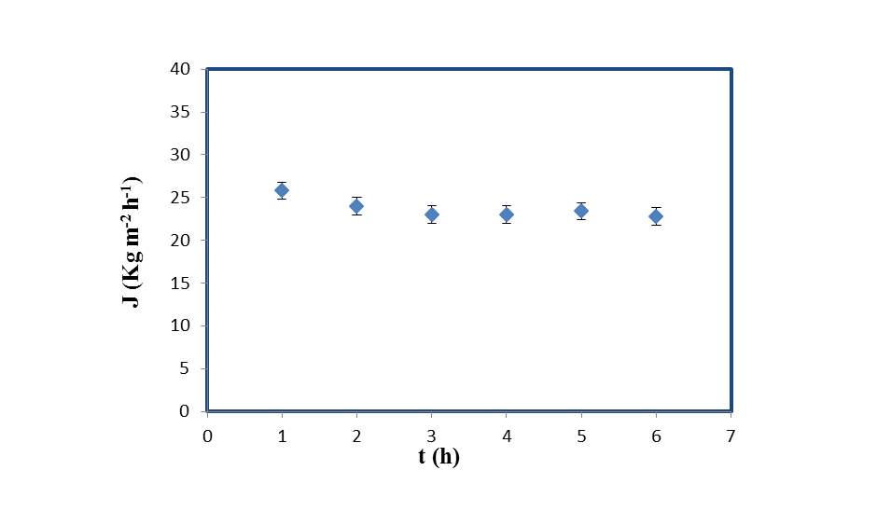
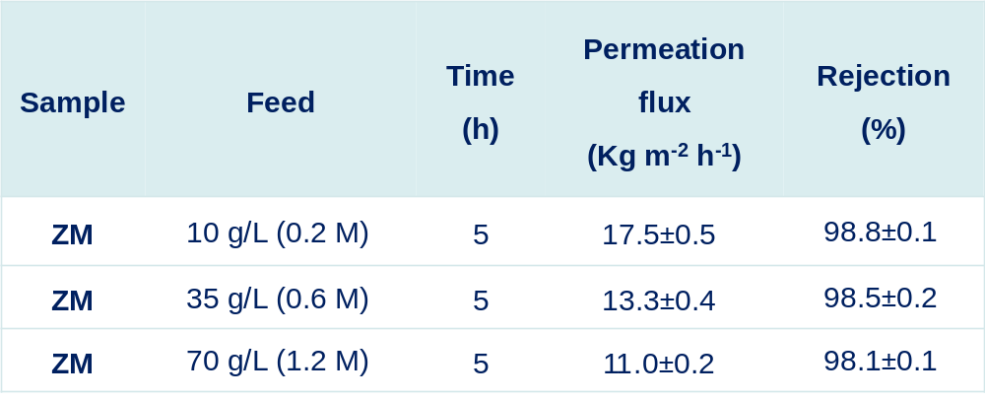
Vacuum Membrane Distillation (VMD)
Other four membranes prepared with the same characteristics of those gas-tight and without post-treatments are characterized in VMD
Operating conditions
Feed | Feed flow rate (L h⁻¹) | P vacuum (mbar) | T feed (°C)
Distilled water | 75 | 4.5 | 60
Increasing the NaCl concentration in the feed increse the driving force of NaCl across the membrane [1]
[1] A. Garofalo , L. Donato , E. Drioli , A. Criscuoli , M.C. Carnevale, O. Alharbi , S.A. Aljlil , C. Algieri, Supported MFI zeolite membranes by cross flow filtration for water treatment, Separation and Purification Technology 137 (2014) 28–35.

Slide 21
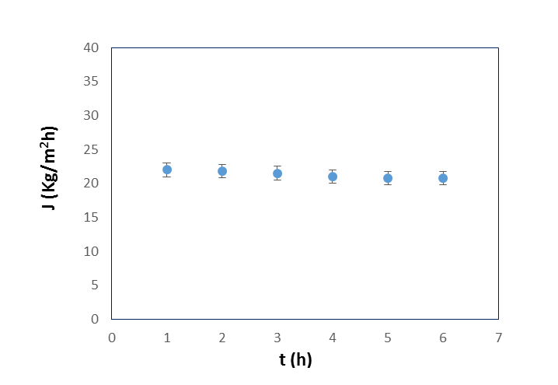
Vacuum Membrane Distillation (VMD)
Water flux after salt treatment and washing procedure

Slide 22

Comparison with Literature Data
Membrane Type | Process | Feed (NaCl solution) | Permeation flux (Kg m⁻² h⁻¹) | Rejection (%) | References
Silicalite | RO | 0.1 M | 0.16 | 22 | [1]
Silicalite | RO | 0.1 M | 0.12 | 77 | [2]
ZSM-5 | RO | 0.1 M | 1.13 | 93 | [3]
Silicalite | RO | 0.01 M | 1.2×10⁻³ | 97 | [4]
Membrane Type | Process | Feed (NaCl solution) | Permeation flux (Kg m⁻² h⁻¹) | Rejection (%) | References
Silicalite | VMD | 0.2 M | 17.5±0.5 | 98.8±0.1 | This work
Silicalite | VMD | 0.6 M | 13.3±0.4 | 98.5±0.2 | This work
Silicalite | VMD | 1.2 M | 11.0±0.2 | 98.1±0.1 | This work
ZSM-5 | PV | 0.7 M | 0.7 | 99 | [5]
Silicalite | PV | 0.6 M | 3.0 | 98 | [6]
[1] L. Li, J. Dong, T. Nenoff, R. Lee, Desalination, 170 (3) (2004) 309–316. [2] L.X. Li, J.H. Dong, T.M. Nenoff, R. Lee,, J. Membr. Sci. 243 (2004) 401-404. [3] L. Li, N. Liu, B. McPherson, R. Lee,, Ind. Eng. Chem. Res.46 (2007) 1584-1589. [4] L. Li, N. Liu, B. McPherson, R. Lee, Desalination 228 (2008) 217-225. [5] M. C. Duke, J. O’Brien-Abraham, N. Milne, B. Zhu, J.Y.S. Lin, J. C. Diniz da Costa,, Sep. Purif. Technol. 68 (2009) 343-350. [6] M. Drobek, C. Yacou, J. Motuzas, A. Julbe, L. Ding, J. Da Costa, J. Membr. Sci. 415-416 (2012) 816-823.

Slide 23
C O N C L U S I O N S
Secondary growth method coupled with the cross flow seeding procedure was used to prepare uncalcined defect free supported MFI membranes.
Curing treatments are used to seal the defects into the zeolite layer due to the calcination
Membranes treated with the PDMS could be suitable for gas separation process. A further improvement could be obtained varying both PDMS solution concentration and number of coating
It was demonstrated the possibility to use MFI zeolite membranes in vacuum membrane distillation process.
Membrane performance exhibited good results in terms of fluxes and salt rejections (~ 98.5 %).

Slide 24
Merci pour Votre Attention
شكرا لكم على اهتمامكم
당신의주의를위한 감사합니다
Gracias por su Atención
感謝您的關注
Thanks for Your Attention
Kiitos Huomiota
Grazie per l’Attenzione
आपका ध्यान के लिए धन्यवाद
The authors gratefully acknowledge the support of the King Abdulaziz City for Science and Technology (KACST) for funding the research Project 895/33 entitled “Preparation and Characterization of Zeolite Membranes for Water Treatment”.

