Slide 1
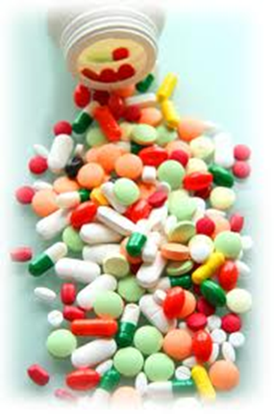
Pharmacogenomics at Boston Children’s Hospital
Catherine Brownstein, MPH, PhD
Boston Children’s Hospital

Slide 2

Statistics
395 bed (soon to be 430+ beds) quaternary care, Magnet hospital
All transplants – first pediatric hand transplant center. Only thing we don’t do is burns (and we try to stay away from pesky adults!)
>65,000 ED visits, >25,000 admissions and >550,000 clinic visits per year
Awarded most NIH pediatric research dollars in the US
Cerner CPOE since 2005
First pediatric institution to receive HIMSS7 designation

Slide 3
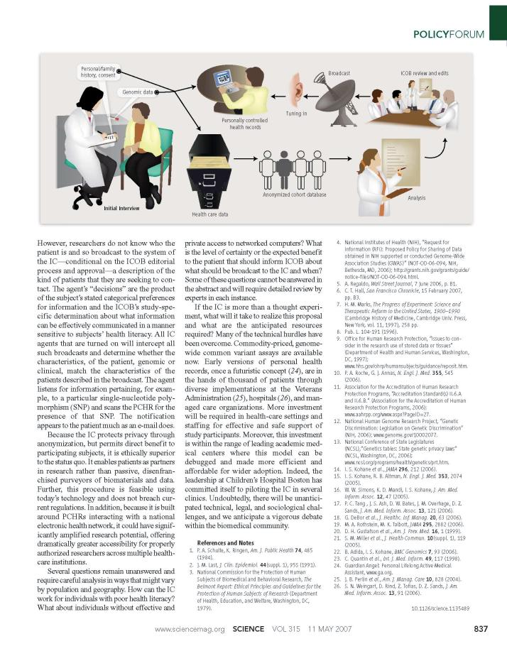
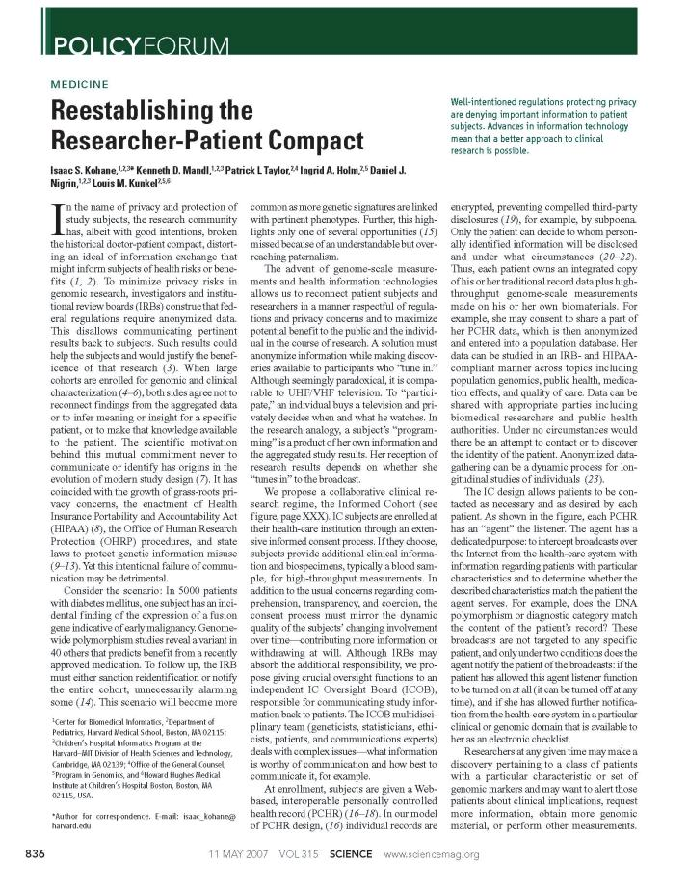
Gene Partnership Vision
Institutional genetic research repository
Link to EMR
Longitudinal participant engagement
Facilitate large-scale research and discovery (multi-institution?)
Investment into cutting edge research

Slide 4






A Significant Opportunity Exists for BCH
Current Status
Proposed Future
Care
Care &
Discovery
Discovery
More explicitly integrate research and clinical care into the patient experience and in the eyes of the public

Slide 5
Re-envisioning GP: rebranded as Research Connection
Pilot Projects
Pharmacogenomics
  Clinical Pharmacogenomics Service
  High throughput drug screening research
BCH Sequencing
Cancer Genomics
Neurodegeneration and Developmental disease

Slide 6
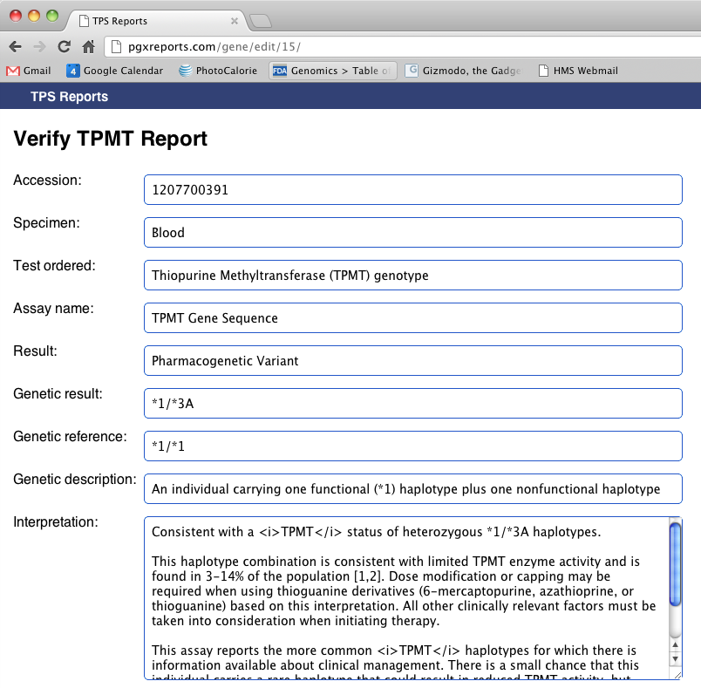
Pharmacogenomics at BCH
April 1, 2012
  Clinical Pharmacogenomic Oversight committee established, meeting monthly
August 1, 2012
  PGx result return (TPMT) to the EMR
    PGx Specialty View
    High-risk genotypes manually added into Problem and Diagnosis List
  Interpretation report engine
  Decision support PGx rules for prescribers and pharmacists
  Formal consult process for the CPS in the EMR
  Presented initial PGx training to the pharmacy staff, prescribers

Slide 7
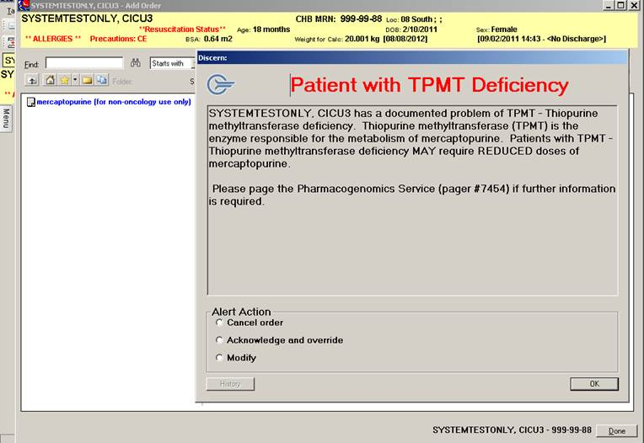
Pharmacogenomics at BCH
Oct 31, 2013:
  246 TPMT samples run in house (GI, Oncology, and Transplant)
  All results returned to the EMR
  89.7% wild type homozygous (consistent with literature)
  33% reduction in TPMT for non-wild type (on average, different for indication, genotype)
Clinical Decision Support Alerts
  54.1% physician, remainder evenly split between NPs and pharmacists
  2.6 alerts per practitioner
  3.8 alerts per patient
  ONLY patients with a variant status fire an alert
Sept. 2013
  Research into the clinical use and utility of PGx data

Slide 8
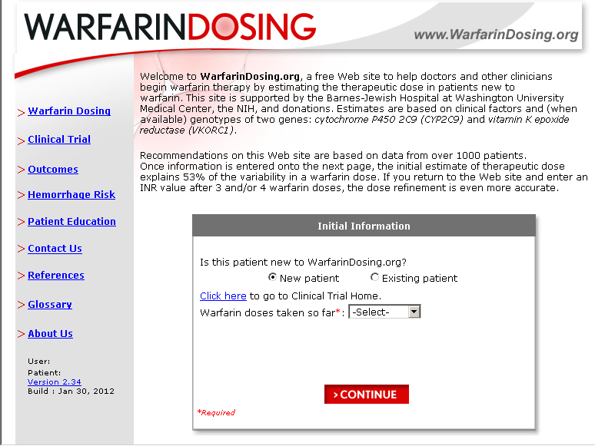
Clinically Actionable PGx tests (example)
Warfarin
  CYP 2C9
  VKORC1
  CYP 4F2
There are multiple clinical variables, including age, race, body weight, sex, smoking status, liver disease and other concomitant medications.
VKORC1 is responsible for approximately 25% of the warfarin dosing variation, so it is the most heavily weighted. This is followed by the clinical variables ~20% and by CYP2C9 at ~10%.
www.warfarindosing.org

Slide 9
Warfarin testing at BCH
Sending to ARUP (first pediatric institution)
Basic genotyping with no dosing (not appropriate for under 18)
Work together with anti-coagulation clinic for best use of information
Validating most recent PD guidelines
Retrospective data
Submitting an IRB proposal to provide data as part of eMERGE consortium

Slide 10

When are PGx tests worth it?
What is the number needed to treat?
What is the ethnic variation?
How much does the test cost to run? To interpret?
Will it be reimbursed?
What are the cost savings gained by implementing pre-emptive testing?

Slide 11
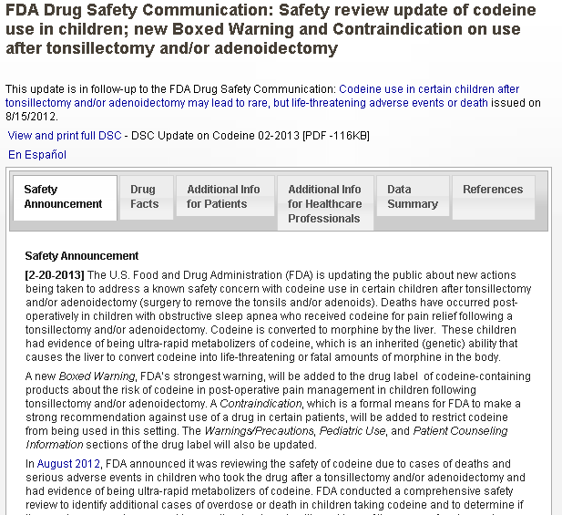
Clinically Actionable PGx tests (example)
Codeine
  CYP 2D6
Pseudogenes, indels and copy number variation (CNV)
Assay is proving extremely difficult to design
Most PGx researchers agree that CYP2D6 is NOT ready for mainstream use

Slide 12
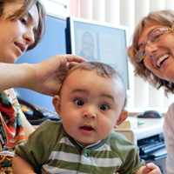
Clinical Pharmacogenomics Consultation Service
Official and “curb-side” consults by CPS pharmacists
Inpatient and outpatient, hospital wide
Referrals via genetics clinic, will send pre-screening questionnaire (it is short!)
Reimbursement
  currently in process of finding out!
  For the consult and clinic visits – utilizing CDTM (collaborative therapy drug management) law, currently in credentialing hell

Slide 13

“Don’t want to be normal”
Complex patients
Multiple adverse reactions
Adult referrals seen in clinic (no other CPS around, so referred to BCH)

Slide 14
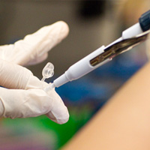
“I know I have CYP2D6 sensitivity”
(DTC results in the clinic)
One of first cases
Family insists child has a 2D6 variant, 2 non functioning alleles. No documentation anywhere but says *4/*5. Avoided every drug known to man. Very determined to avoid, living in fear.
Testing done 17 years ago
Part of identity.
Retesting done
“Can s/he get this drug?”

Slide 15
DTC problems
Image from: Recent Advances in Pharmacogenomic Technology for Personalized Medicine. Toshihisa Ishikawa and Yoshihide Hayashizaki
DOI: 10.5772/29316

Slide 16
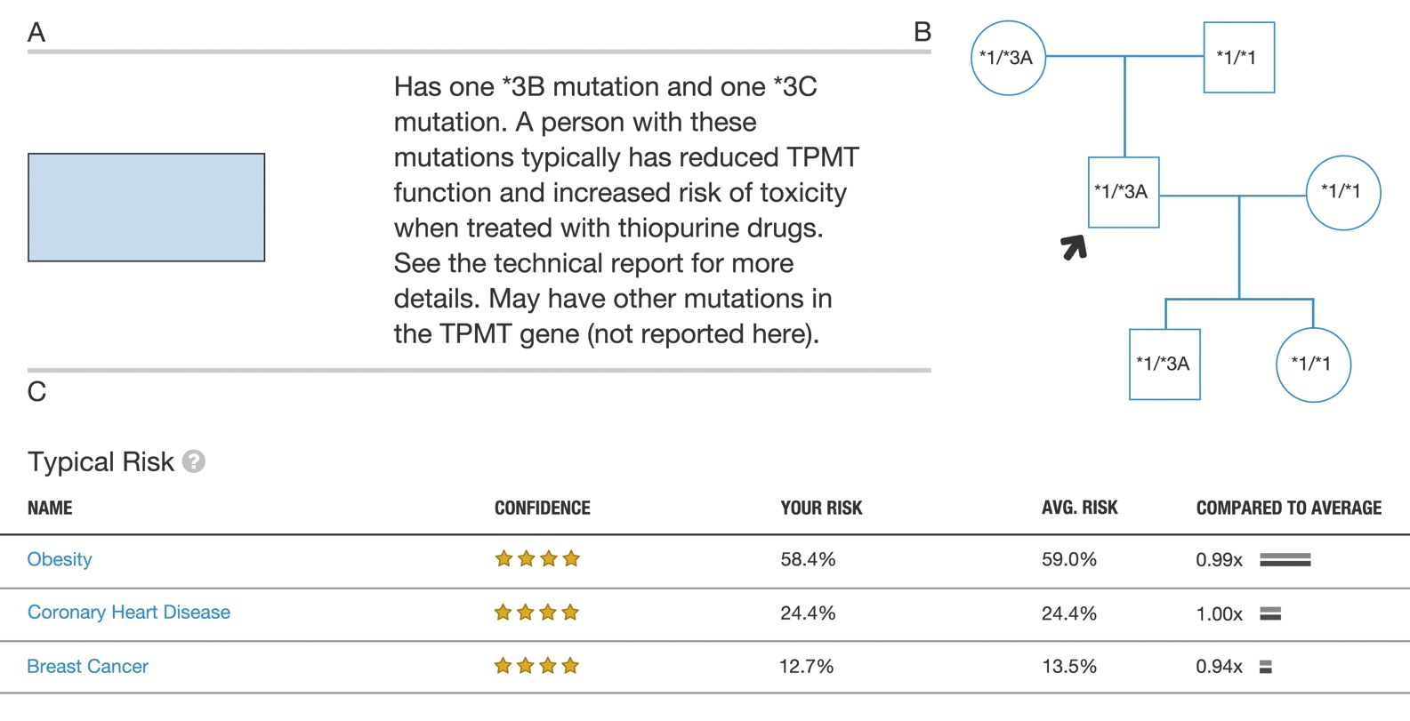
DTC problems

Slide 17
The Trouble with CYP2D6 genotyping
Copy Number Variation (CNV)
  2 to 18 copies reported in humans
  All copies contribute, must ensure adequate capture
  Final genotype scoring (Gaedick)
Pseudogene
  CYP2D7
Sequencing coverage
Use caution, understand the assay before accepting the genotype

Slide 18
Show me the money (esoteric)
Resource Utilization
Personnel: One pharmacist dedicated at 80 percent effort, with dedicated bioinformatics (15 percent), and intermittent ISD support.
IT and other infrastructure: Up front build upon existing EMR infrastructure. Estimated at a combined 40 hours from various ISD personnel.
Supply Expense: None
Return on Investment: By March 2013, we had run 84 TPMT samples pre-emptively at a cost of $55,200 (we saved $19,000 by bringing the assay in house). Nine samples (10.7 percent) have returned with a variant requiring dosage adjustment. Without dose adjustment, the patients could have experienced severe myelosuppression requiring hospitalization. The average length of stay for an ADR requiring hospitalization (no ICU) is four days, or about $14,000. Thus, the total cost from the ADRs could have been as high as $126,000. The net savings of avoiding the ADRs is estimated at $70,800 from this single drug/gene pair.
******AVERAGE ADR modeling. No way to know for sure. All in theory.
Notes:
were

Slide 19

Show me something other than the money
Recognized Intangible Benefits
Our staff have a greater appreciation of the role that a person’s genetics can play in medication tolerance. We have identified an area of unlimited possibility for ISD, prescriber, nursing, laboratory and pharmacist involvement as we move into the future of personalized medicine, particularly as it relates to pediatrics.

Slide 20
The Future
Platform migration to whole exome/whole genome sequencing
  Data handling, storage in current EMR system is unlikely to be possible
  Cross-reference genes that have both a pharmacogenetic implication and a disease modifying implication
    Example: SCN5A – gated sodium channel, long QT, lidocaine (anti-arrhymythic).
  Secondary (incidental) findings
  Consent policies and online capture
  Data sharing (genotype/phenotype/outcome data)
  Revisible reporting
  Patient portal
    Return of result- telehealth- policies need to be put in place
    Reimbursement, State lines
    Comprehension- Hear what they want to hear?

Slide 21
The Ultimate Goal
Complete “safe med” system
  Incorporates all known med safety data related to the patient, including but not limited to:
    PGx, biomarkers, drug-drug interactions, drug-food interactions with intelligent design (cannot be 20 different alerts).
Life long data must be always available when relevant and NOT encounter based
  Can’t see results across the continuum. Right now, the NICU genetic test can’t be seen in Pain Clinic
  Was designed that way, couldn’t handle data before, didn’t want to propagate errors.
Each site should not need to develop and institute their own rules
  A core set of rules based on consensus guidelines (i.e. CPIC) that may be further customized by the sites
  Ability to update in (relatively) real time

Slide 22
PGx Research at BCH

Slide 23

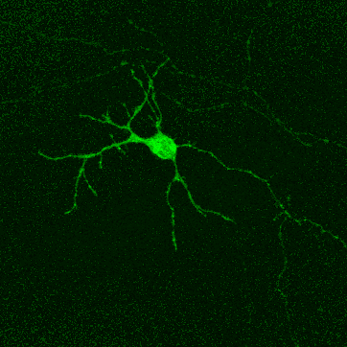
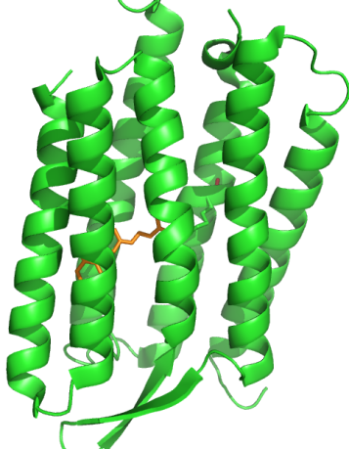
Adam E. Cohen
Chemistry and Chemical Biology
and Physics
Harvard University
Fluorescence
+
Voltage
Notes:
Voltage reporter and a calcium reporter. Burst of calcium once membrane is deporalized. 2 linked
Some drugs act by blocking channel agent. Lower calcium flux would be. Cause heart to beat faster. Measure heart rate contractility intensity and calcium flux optically. Correlate with known effects of those drugs in vivo.
Real EKG would model the same way
Membrane stability or calcium release could be modeled ex vivo.

Slide 24
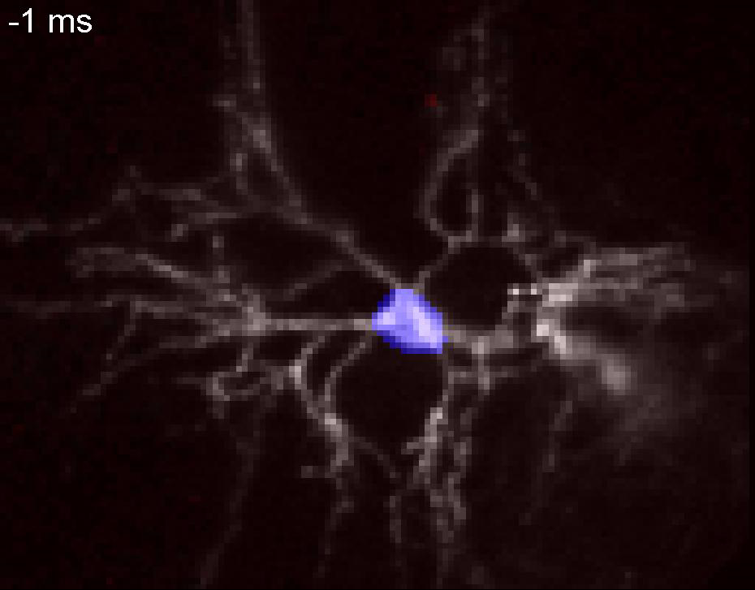
All-optical electrophysiology
3 key technologies:
Optogenetic tools for simultaneous stimulation and imaging
Advanced microscopy
Sophisticated software
Click here →
Mouse neuron expressing the “Optopatch” genetic construct. Optical stimulation at the cell body (blue) excites Channelrhodopsin. This causes the neuron to fire. An Archaerhodopsin-based voltage indicator converts this activity into fluorescence. Using custom microscopes and software, we follow the electrical propagation at 100,000 frames/s. Precision of about 1 mV in a 1 kHz bandwidth.

Slide 25
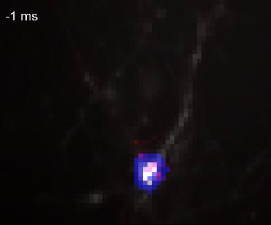
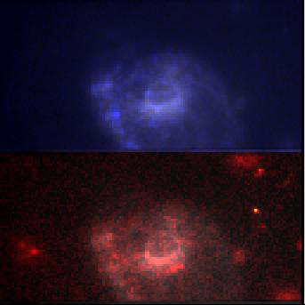
Imaging voltage in human cells
Optopatch in a hiPSC-derived neuron
CaViar: A Ca²⁺ and Voltage Indicator
Video at 20,000 frames/s showing electrical propagation in a human neuron. A flash of blue light to the cell body caused the neuron to fire, which manifested as a wave of red fluorescence.
Simultaneous monitoring of Ca²⁺ and voltage in a single hiPSC-derived cardiomyocyte. “Calcium sparks” appear as flashes in the Ca²⁺ channel.
Human induced pluripotent stem cell (hiPSC)-derived neurons and cardiomyocytes are emerging as a promising model for studying disease. These cells can be derived from individuals with mutations associated with many diseases, or engineered to express disease-associated genes. A key bottleneck in adoption of this technology has been the difficulty in electrophysiological characterization. New HMS created technology provides electrophysiology data with ~100x speedup and vastly more information compared to patch clamp recordings.
Ca²⁺
Click here
← →
Voltage

Slide 26
Example application:
Cardiac safety testing
In the following slides we show examples of 2 drugs (+ DMSO vehicle control) and their effect on electrical (red) and calcium (blue) dynamics in single human iPS-derived cardiomyocytes. Each drug was tested at 5 – 7 concentrations, in 30 – 40 cells at each concentration. This screen took ~4 hours to run. With manual patch-clamp this would have taken several months.

Slide 27
DMSO (Vehicle control)
Voltage Calcium
0.6
0
0.003%
0.01%
0.03%
0.1%
0.3%
0.4
0.2
0
Ouabain
1
0 nM
3 nM
10 nM
30 nM
100 nM
300 nM
0.5
0
Nifedipine
0.5
0.4
0 nM
10 nM
30 nM
100 nM
300 nM
1000 nM
0.3
0.2
0.1
0

Slide 28
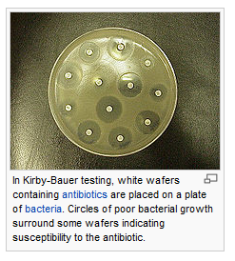
Ex vivo Modeling -- v 2.0
V 1.0 PLUS:
Demonstrate optogenetic ‘phenotype’ of derived neuronal networks
Demonstrate that optogenetic patterns are also
  Reproducibly differentiating between nls and unique mutations
  Affected by drugs
  Useful to diagnose and select therapies for individual patients
Notes:
V 2.0
Simultatious transcriptome and response to drugs.
This is the future.

Slide 29
Conclusions
BCH has retooled its infrastructure to incorporate pharmacogenomics data at the beside
This approach has yielded successes in less than 18 months
BCH is actively pursuing Ex Vivo modeling with the goal of high throughput screening

Slide 30
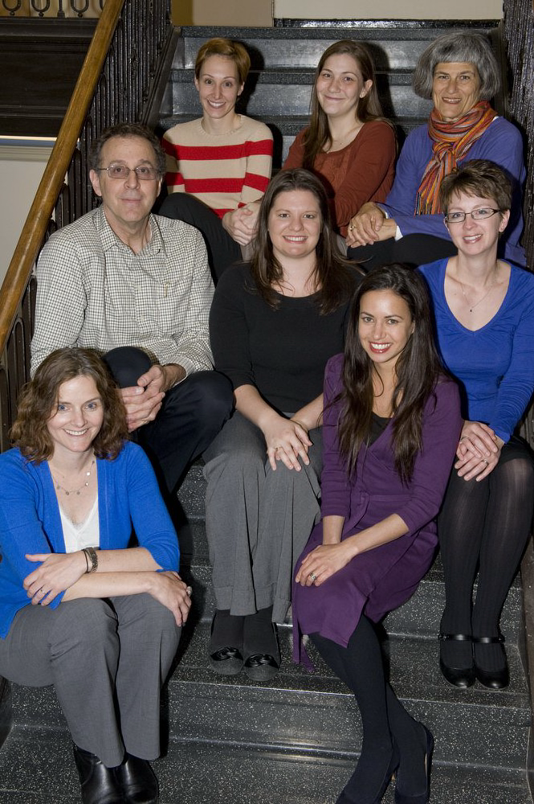
The CPS Team
Shannon Manzi, PharmD
Jared Hawkins, PhD
Catherine Clinton, MSGC
David Margulies, MD
Wendy Wolf, PhD
Catherine Brownstein, PhD

Slide 31

Thank you
St. Jude’s Hospital
Medical College of Wisconsin
ARUP
Manton Center for Orphan Disease Research
Shannon Manzi, PharmD
Cohen Lab
Eggan Lab
Research Connection team
Harvard Center for Biomedical Informatics (CBMI)

