Slide 1
Introduction to GPC with triple detection and capabilities
Carrie Schindler, PhD
Technical Specialist—GPC/SEC & Light Scattering
Carrie.schindler@malvern.com
Phone: 360-888-4024

Slide 2
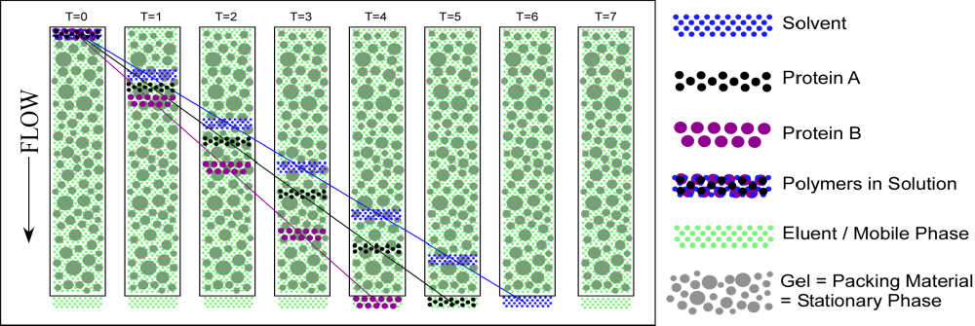
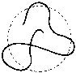
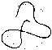
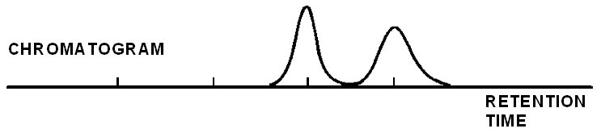
Size Exclusion Chromatography
Size Exclusion Chromatography (SEC) or Gel Permeation Chromatography (GPC) or Gel Filtration Chromatography (GFC) is the most widely used technique to determine the molecular weight distribution of synthetic and natural polymers and proteins.
Dissolution Solvent
Component A
Component B
Sample Solution
Eluent / Mobile Phase
Gel = Stationary Phase
(Packing Material)
Separation is based on hydrodynamic size, NOT molecular weight!

Slide 3
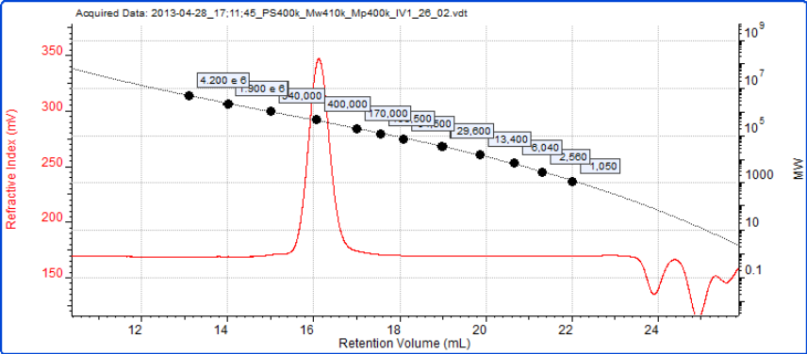
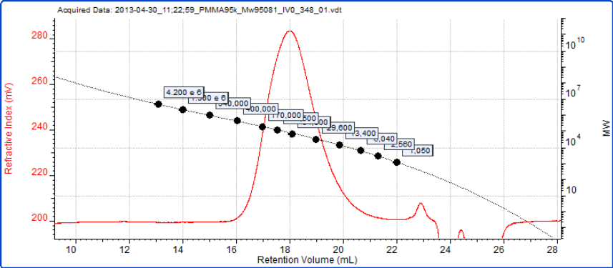
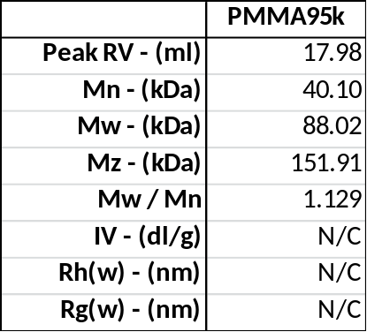
Convention calibration
Conventional calibration takes some standards of known molecular weight to create a calibration curve
The unknown sample is then measured and its elution volume compared with the standards
This has many limitations including, most-notably, that if the standard and sample polymers are different, the molecular weight will be only a relative estimate
Polystyrene 400k as part of calibration curve
PMMA is measured against this curve
Notes:
Let’s look at another polymer, poly methyl methacrylate (PMMA). Here, the molecular weight of a PMMA sample is being measured with conventional calibration. A series of polystyrene samples has been used to create the conventional calibration curve in the left hand chromatogram.
This has then been used as a referecnce for the PMMA sample in the main chromatogram on the right. The results are displayed in the box.
The Mw has been measured to be 88 kDa which is significantly lower than the specified 95kDa. The reason for this is that the structure of PMMA is different to that of polystyrene and so molecules of the same molecular weight will elute at different retention volumes given the wrong answer.
Additionally, this setup cannot measure Rg, IV, or Rh.

Slide 4
Overlay of Conventional Calibration Curves
6.5
6.0
PS
PAMS
PMMA
5.5
PIP
PBD
5.0
PPG
Log (Molecular Weight)
4.5
4.0
Each Polymer has its own size to Molecular weight relationship:
V_{h} ≈ [η]xM
3.5
3.0
2.5
18
20
22
24
26
28
30
Retention Volume (ml)
Notes:
Since only a concentration detector is used, the standard curves that are generated give just relative molecular weight information. As you can see from this slide, we have 6 different types of materials used to generate the calibration curve. As expected, since size is not considered, you get six different curves which in turn would give six different sets of molecular weight for the same type of sample. This is one of the biggest drawbacks to using just relative calibration as an analytical technique.

Slide 5
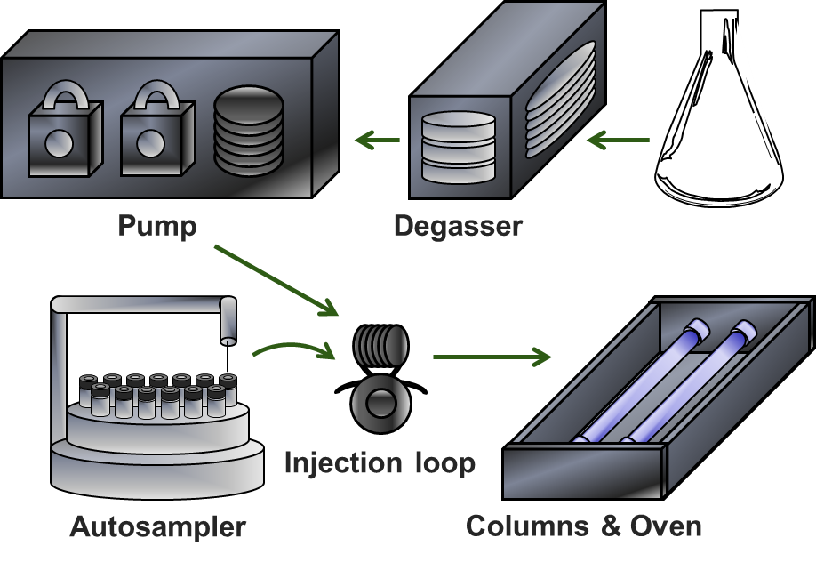
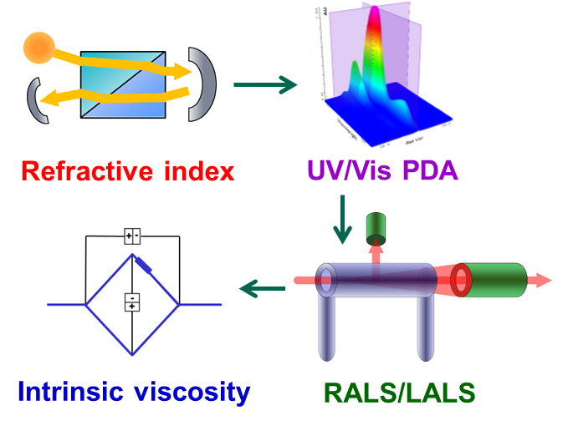
Typical Triple/Tetra Detection GPC/SEC Schematic
Separation by Size
Detection by ____

Slide 6
Why use multiple detectors with GPC/SEC?
RI Output (mV) = K_{RI} • dn/dc • Concentration • Inj. Vol.
UV Output (mV) = K_{UV} • dA/dc • Concentration • Inj. Vol.
Visc. Output (mV) = K_{Visc} • IV • Concentration • Inj. Vol.
LS Output (mV) = K_{LS} • Mw • (dn/dc)² • Concentration • Inj. Vol.

Slide 7
What information do I get from advanced GPC/SEC?
Molecular weight moments
  Number average molecular weight (Mn)
  Weight average molecular weight (Mw)
  Z-average molecular weight (Mz)
Polydispersity—Mw/Mn (PDI)
Hydrodynamic Radius (viscometer or DLS)
Intrinsic Viscosity (viscometer)
Mark Houwink parameters (viscometer)
Composition information (RI and UV)
Radius of Gyration (multiangle light scattering)

Slide 8
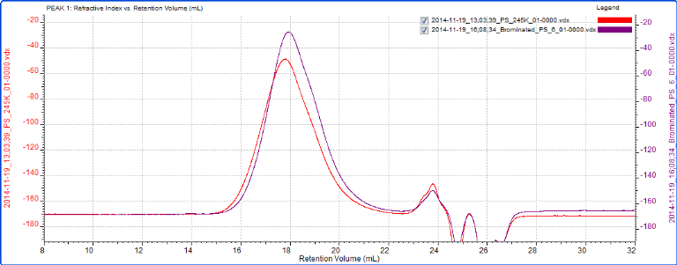
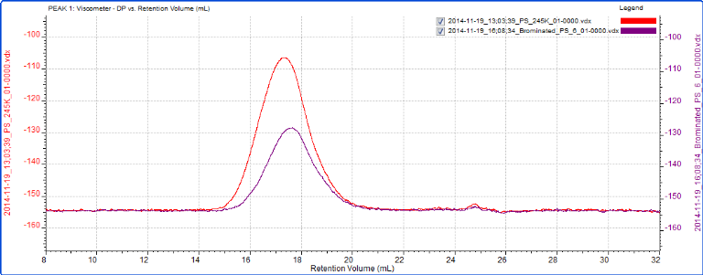
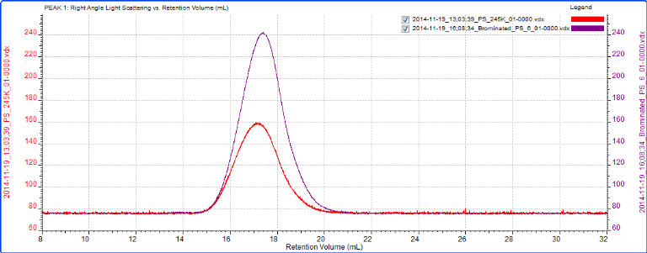
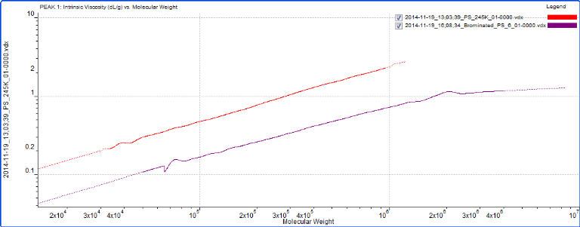
Detectors Respond Differently: PS & Brominated PS
RI signals show similar retention volume = same molecular size
VISC shows PS-Br has weaker signal = PS-Br is more dense (i.e. has a lower viscosity)
LS shows PS-Br has stronger signal = PS-Br has higher MW
Retention Time Constant
(Same Size)
RI
Viscosity Falls
(More Dense)
PS PS-Br
Mw 246 kDa 429 kDa
IV 0.835 dL/g 0.389 dL/g
Rh 13.95 nm 13.01 nm
VISC
Light Scattering Rises
(Higher MW)
PS-Br is more dense than PS
LS

Slide 9

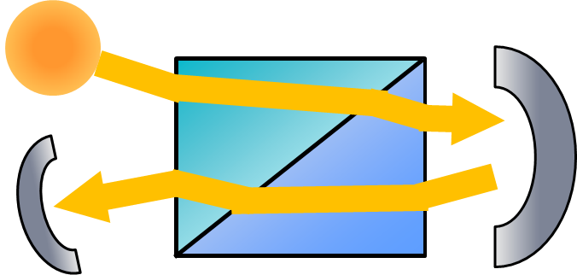
Refractive index
Different materials refract (bend) light different amounts
Dissolving a solute in a solvent changes the magnitude of light refraction by the solution
The RI detector measures concentration by measuring the magnitude of the refraction at a known dn/dc or a known total injection mass
Notes:
Let’s consider the different detectors and start with the refractive index detector.
Different materials refract (bend) light different amounts
Dissolving a solute in a solvent changes the magnitude of light refraction by the solution
The RI detector measures concentration by measuring the magnitude of the refraction at a known dn/dc or a known total injection mass

Slide 10
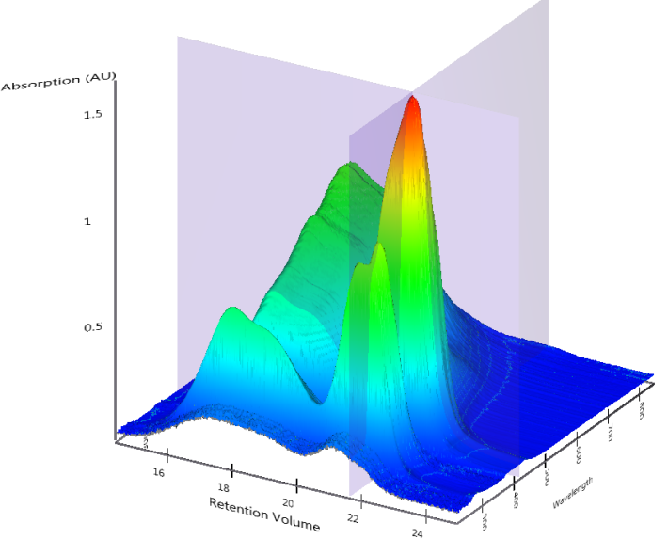
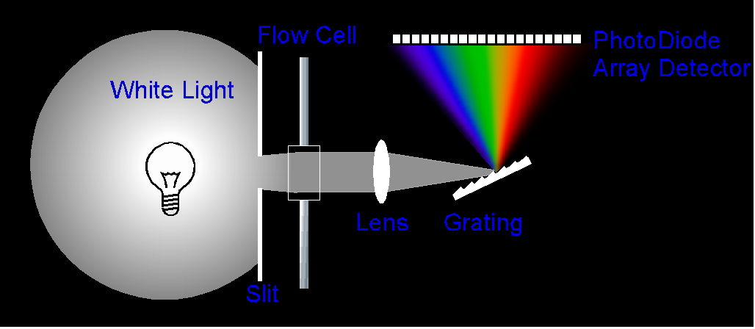
UV/Vis Photodiode array
UV/Vis PDA covers 1024 wavelengths from 190 to 900 nm at 5Hz
Measure concentration of samples with chromophores
  Polythiophenes
  Copolymers
  Blends
Measure dA/dc
Assess changes in absorbance spectra
Notes:
The UV/Vis PDA is new and includes both the ultraviolet and visible wavelengths. It therefore covers from 190 to 900nm.
This allows you to measure samples with chromophores such as proteins or polythiophenes; you can also measure dA/dc.
You can look at changes in absorbance spectra.
Improvements over the PDA in the TDA mean that data collection has been increased from 1 Hz to 5 Hz so that it now matches the other detectors

Slide 11
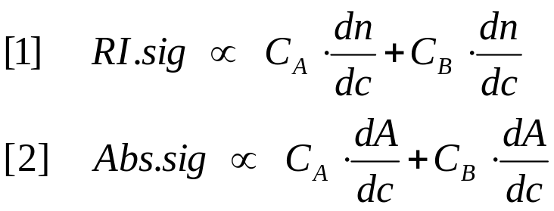
Copolymer Analysis
Requires RI and UV-Vis detectors
Two equations, two unknowns
  Must know the dn/dc of both components and at least one component must have a chromophore:
Can determine concentration and wt. fraction of each component

Slide 12
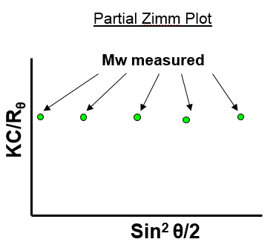
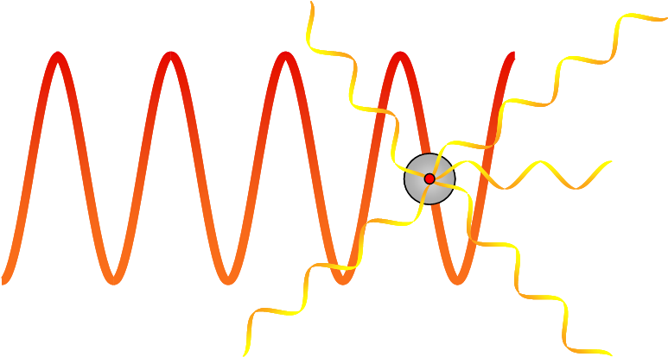
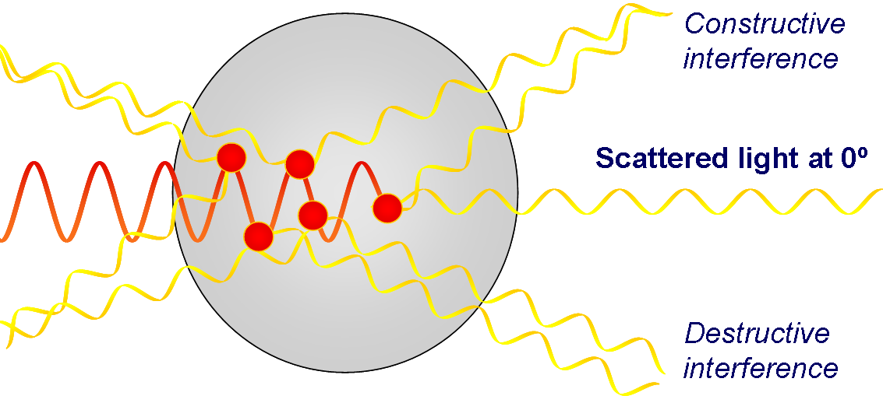
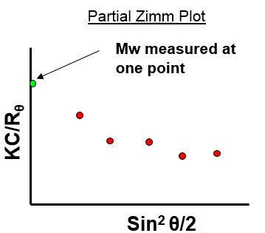
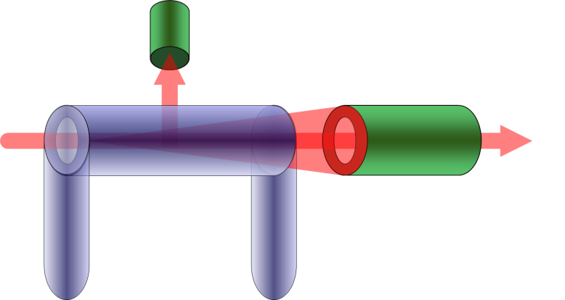
Light scattering
Light scattering is used to measure absolute molecular weight of samples independent of column retention volume
Consider a RALS/LALS detector for absolute molecular weight.
Rg < 15nm
Rg > 15nm
Notes:
The light scattering detector is used to measure the molecular weight of samples independently of their retention volumes. This is why we call the call the molecular weight measurement absolute
The light scatterinf detector in OMNISE CREVEAL is a RALS/LALS detector. The light is now fibre delivered from a 50 mW laser. Higher laser power and the larger scattering volume from the improve sensitivity. The improved temperature control and electronics mean reduced baseline noise. In combinations these improvements make for approximately a 5 times increase in detector signal-to-noise

Slide 13
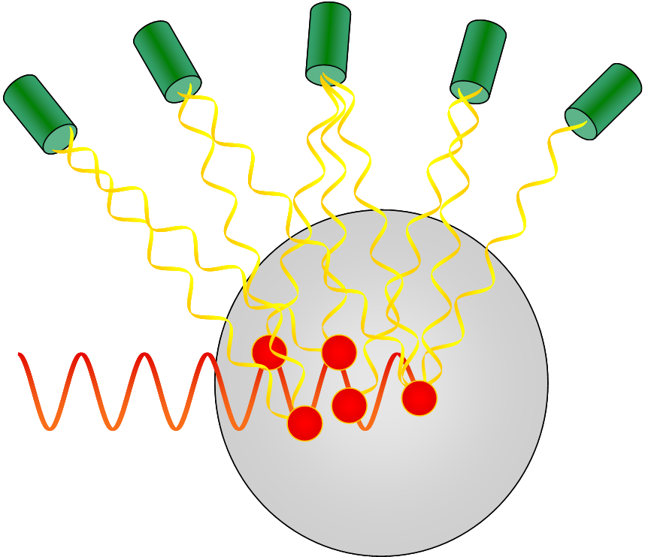
MALS for molecular weight and Rg –Large Sizes
The intensity of scattered light is measured at multiple angles. The results are extrapolated back to 0º
The relationship between angle and intensity is size and shape dependent, usually non-linear, difficult to model and can lead to errors in calculated molecular weight.
Mw at intercept of extrapolated line
KC/R_{θ}
Sin² θ/2

Slide 14
Viscometer
When something dissolves in a solvent it changes the viscosity of the solution
The more extended/open/rigid a molecule, the more it will affect the viscosity
Intrinsic viscosity is the magnitude to which a single molecule, on its own (i.e. not interacting with any other, that’s rheology) affects the solution viscosity
Notes:
To briefly describe the principle of intrinsic viscosity, when something dissolves in a solvent it changes the viscosity of the solution
The more extended/open/rigid a molecule, the more it will affect the viscosity.
Intrinsic viscosity is the magnitude to which a single molecule, on its own (i.e. not interacting with any other, that’s rheology) affects the solution viscosity

Slide 15
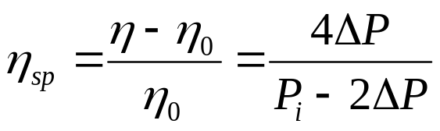
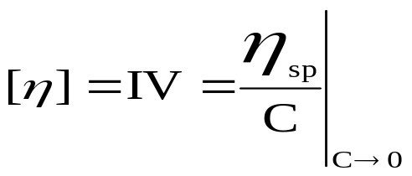
Viscometer
A 4-capillary Wheatstone-bridge viscometer measures the changing solution viscosity as the sample elutes
+
-
IP
DP signal
Solvent
-
DP
+
SEC IN
OUT
Sample
Notes:
A wheatstone bridge viscometer measures the changing viscosity of the solution as the flow from the HPLC system passes through it. It begins with the capillary setup as shown in the diagram.
[CLICK] As the mobile phase passes through the detector it is split across the two sides of the bridge before being recombined at the end. [CLICK] As the sample elutes, it is also split. When the sample comes through, it is held up on one side by a delay volume and elutes on the other side. This imbalance causes a peak in the chromatogram. [CLICK] Once the sample has eluted, the peak is finished. [CLICK] A little while later, the sample in the delay volume elutes and we see a negative peak in the chromatogram.

Slide 16
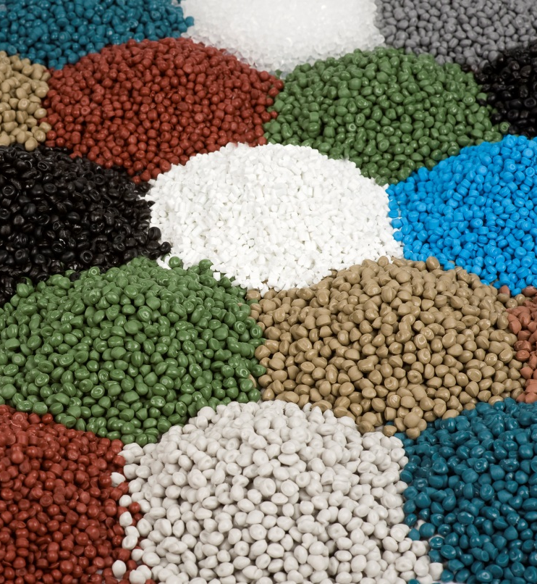
Viscometer benefits
With a Viscometer you can:
  Measure:
    Intrinsic viscosity
    Hydrodynamic radius
    Branching (future software release)
  Relate structural properties to bulk sample behaviour
    Polymer processability
    Observe broad conformational changes in proteins
Notes:
Having a viscometer in a system allows you to measure the parameter of intrinsic viscosity, which is a measure of molecular structure. Beyond that, you can calculate a molecules’ hydrodynamic radius and branching.
The benefits of these measurements is that polymer behaviour is related to these parameters. For instance, a branched polymer will have a lower viscosity and be easier to process but have the same strength that comes from a high molecular weight.
In the protein field these measurements can be used to look at large conformational changes.

Slide 17
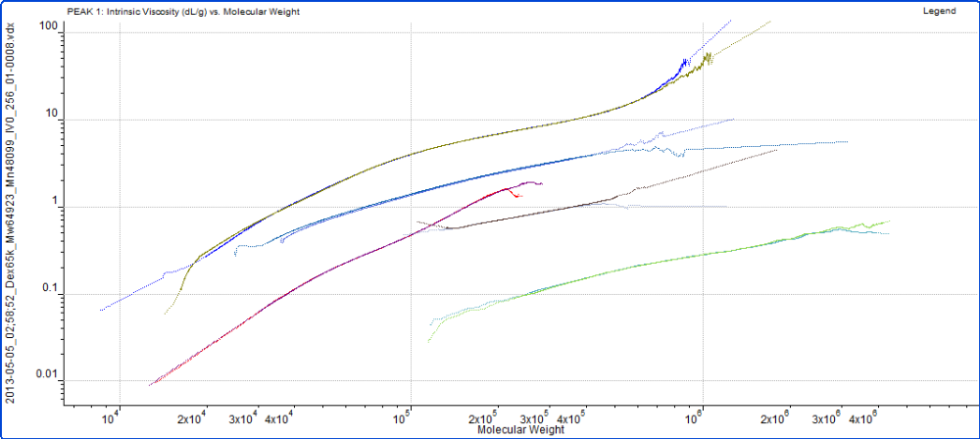
Mark-Houwink plots
The Mark-Houwink plot is used to compare the different structures of polymers
It is often used to study branching
Notes:
Here we have a Mark-Houwink plot of different polysaccharides. The Mark-Houwink plot shows IV as a function of molecular weight. As molecules become more dense, depending on the structure and folding, they move down on the Mark-Houwink plot. Structural changes such as branching can then be visualized and quantified.

Slide 18
What does advanced SEC offer
Light scattering overcomes the basic flaw in conventional calibration (it is a relative technique) and measures absolute molecular weight
The addition of intrinsic viscosity adds extra information about the sample structure and size
An advanced system can measure
  Concentration
  Molecular weight (distribution)
  Structure (IV), Mark Houwink parameters & size (Rh & Rg)
  Copolymer composition (RI/UV)
An integrated advanced system has:
  Temperature control across columns, detectors and inter-detector tubing to improve separation and result accuracy
  Reduced band-broadening (dispersion) between detectors for improved accuracy
In short, advanced SEC means more and better information about a sample

Slide 19
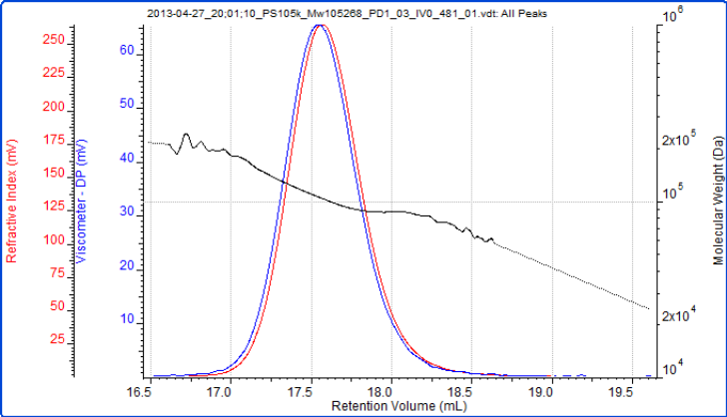
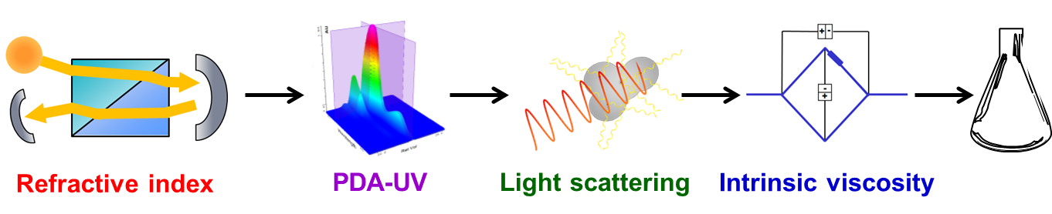
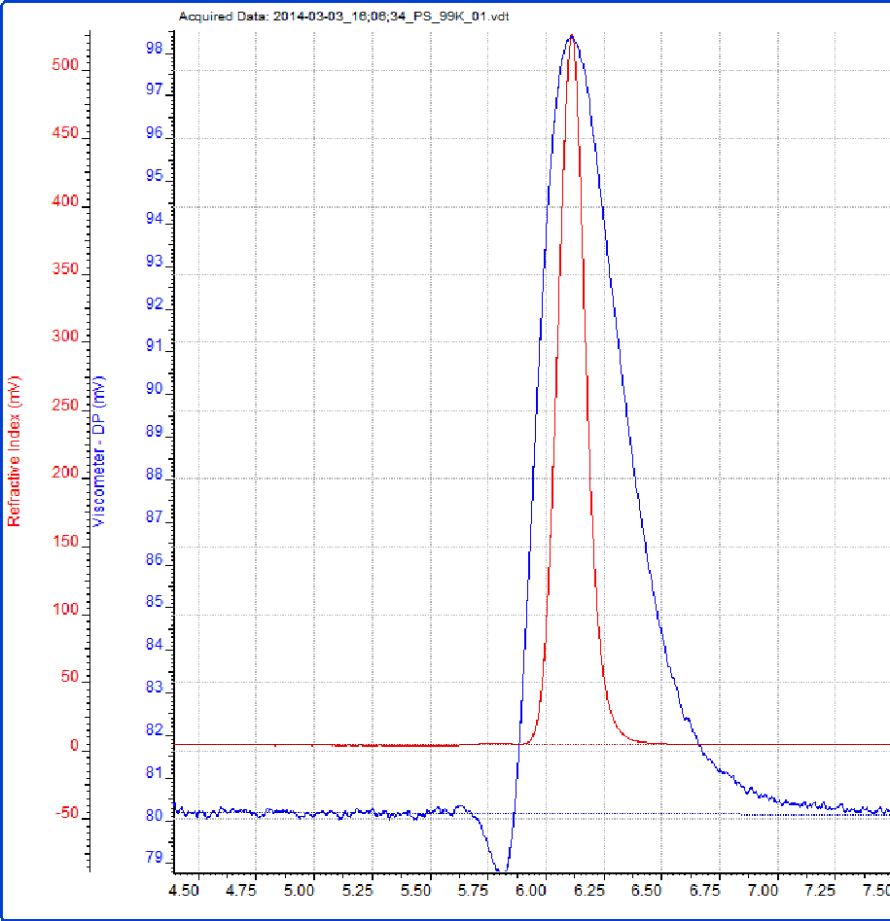
What does a good multi-detector GPC look like?
Integrated systems with all detectors as close together as possible are preferred.
Why?
Better temperature control, reduced band broadening, and highest sensitivity of detection.
Concentration
2

Slide 20
What detectors do I need?
Branching
Indirectly calculate:
Hydrodynamic radius (Rh)
Mark-Houwink parameters
Molecular weight (SLS)
Intrinsic viscosity
Directly calculate:
Radius of gyration (Rg)
Concentration
Composition
Directly measure:
Light scattering intensity
δ Refractive Index
UV
absorbance
δ viscosity
Notes:
This diagram shows how light scattering and the other detectors all fit together in a multi-detector system. In this way we can see that as well as molecular weight, the detectors combine to give even more information. At the bottom, we have what the detectors are actually measuring – light scattering intensity, a change in refractive index, UV absorbance, or a change in solution viscosity. [CLICK] These measurements allow us to calculate concentration, molecular weight and intrinsic viscosity (molecular density). [CLICK] When these measurements are combined we can also get more information such as hydrodynamic radius and structural parameters called Mark-Houwink parameters (although these are not so important for proteins). From the structural data we can then calculate Branching.

Slide 21
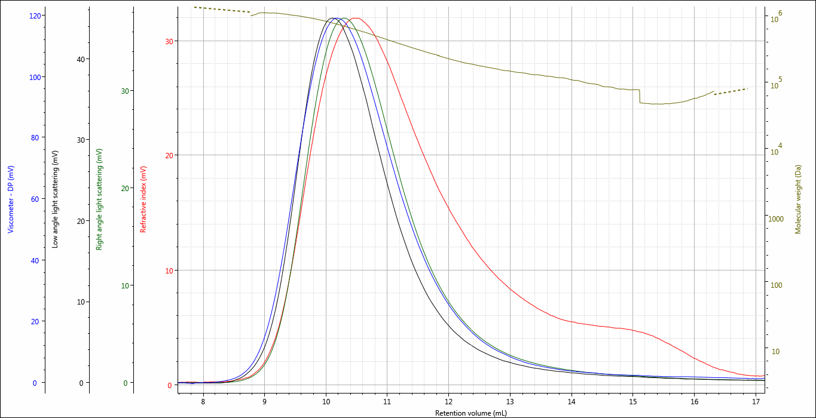
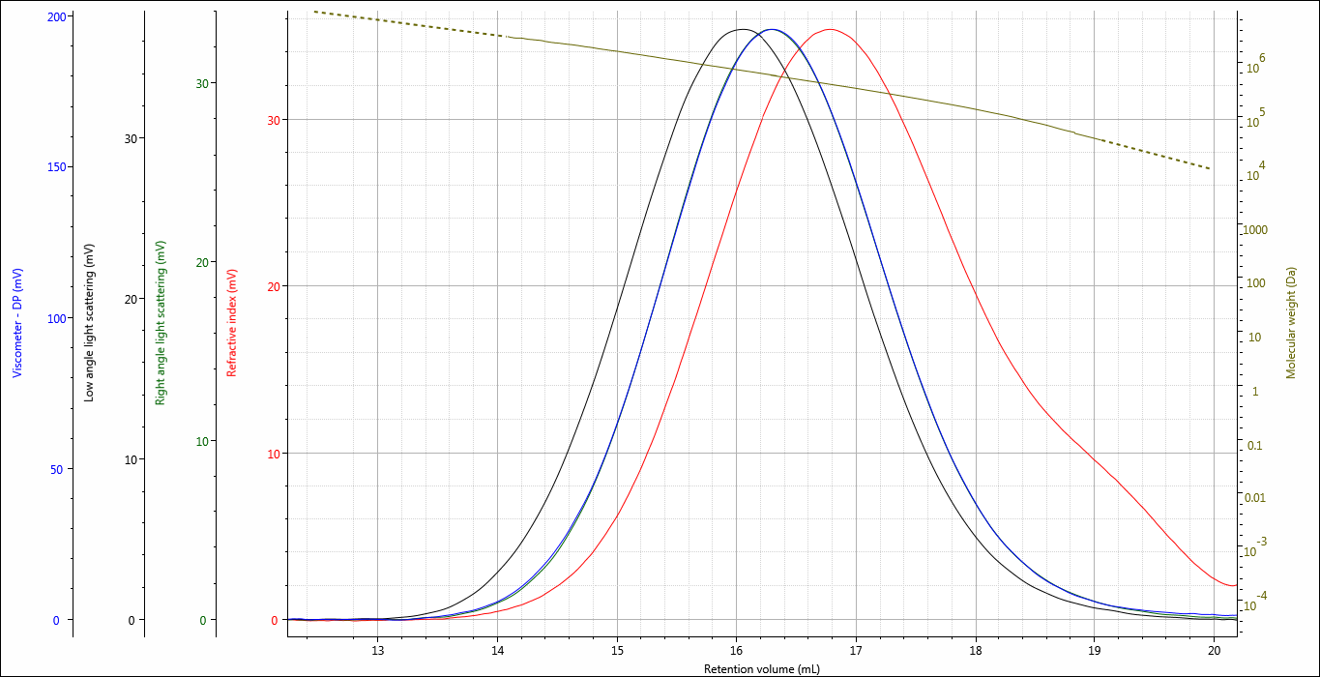
What else should I consider?
Columns for separation
Same sample
Same concentration
Same conditions
Different Columns
exclusion

Slide 22
Looking for more information?
Application Notes, Webinars, Technical Notes www.Malvern.com
Materials talks blog www.materials-talks.com
Carrie.schindler@malvern.com
Phone: 360-888-4024

