Slide 1
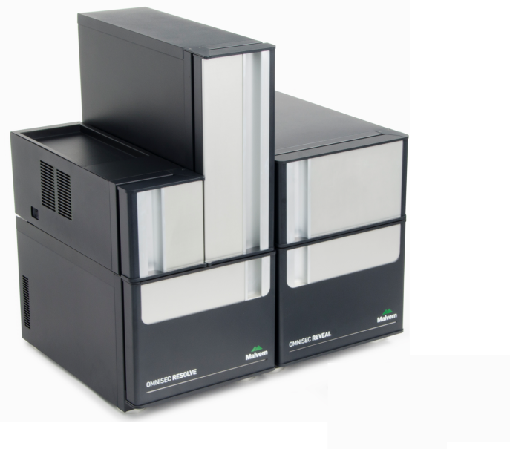
Latest developments in hardware and applications for advanced, multi-detector GPC/SEC
Carrie Schindler, PhD
Technical Specialist—GPC/SEC & Light Scattering
Carrie.schindler@malvern.com
Phone: 360-888-4024

Slide 2
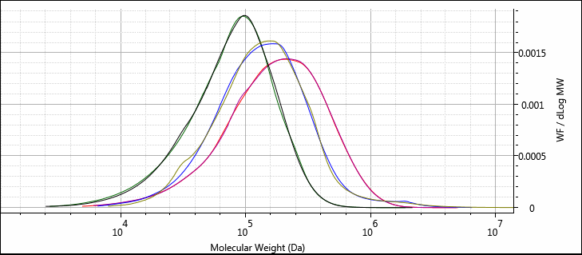
Molecular weight
The most fundamental molecular property that controls a polymer’s behaviour is its molecular weight
A polymer sample normally contains a range (distribution) chains of varying molecular weight
PVC
PMMA
PS

Slide 3
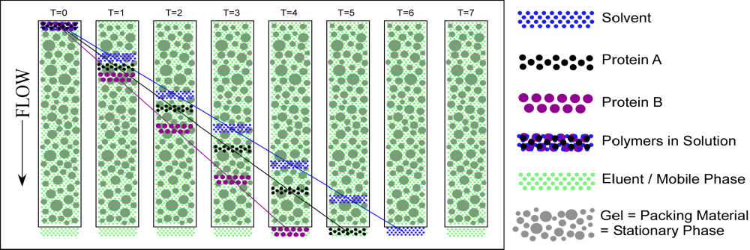
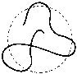
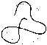
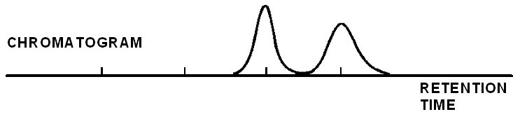
Size Exclusion Chromatography
Size Exclusion Chromatography (SEC) or Gel Permeation Chromatography (GPC) or Gel Filtration Chromatography (GFC) is the most widely used technique to determine the molecular weight distribution of synthetic and natural polymers and proteins.
Dissolution Solvent
Component A
Component B
Sample Solution
Eluent / Mobile Phase
Gel = Stationary Phase
(Packing Material)
Separation is based on hydrodynamic size, NOT molecular weight!

Slide 4
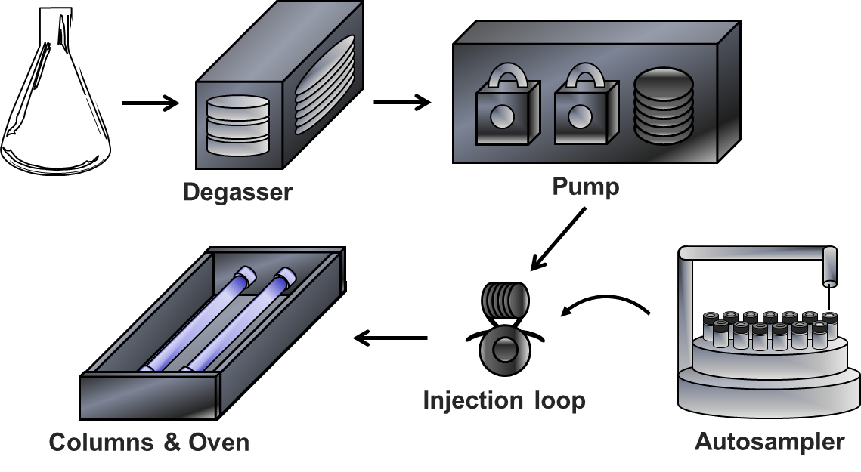
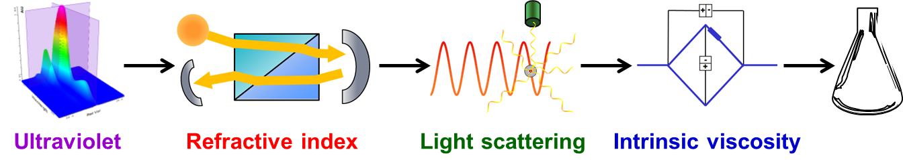
Multi-detector GPC
GPC with static light scattering and intrinsic viscosity can quantify the absolute molecular weight distribution, distinguish differences in conformation or structural changes, and identify composition differences.

Slide 5
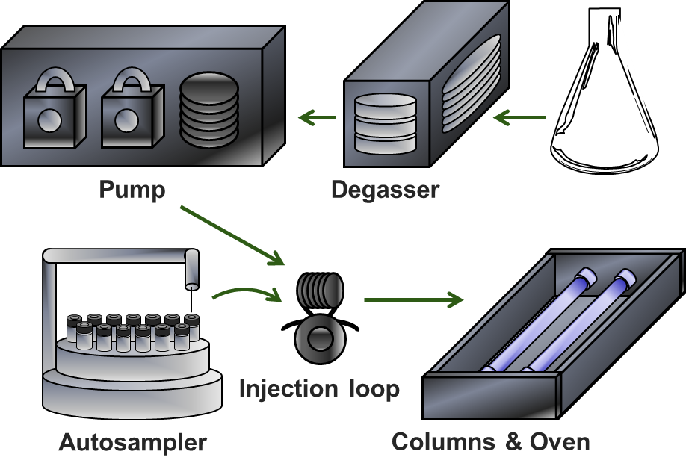
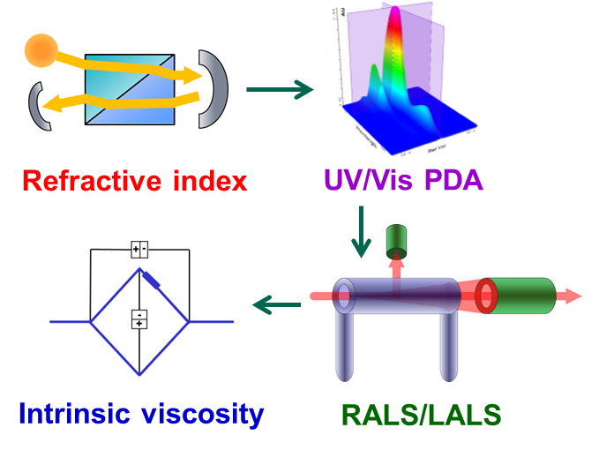
OMNISEC
Separations module
OMNISEC RESOLVE
Sample characterization
OMNISEC REVEAL
Notes:
The two parts of the system are the separations module, which is called OMNISEC RESOLVE and the detector or sample characterisation module, OMNISEC REVEAL.

Slide 6
The multi-detection pyramid
Branching
Indirectly calculate:
Hydrodynamic radius (Rh)
Mark-Houwink parameters
Molecular weight (SLS)
Intrinsic viscosity
Directly calculate:
Radius of gyration (Rg)
Concentration
Composition
Directly measure:
Light scattering intensity
δ Refractive Index
UV
absorbance
δ viscosity
Notes:
This diagram shows how light scattering and the other detectors all fit together in a multi-detector system. In this way we can see that as well as molecular weight, the detectors combine to give even more information. At the bottom, we have what the detectors are actually measuring – light scattering intensity, a change in refractive index, UV absorbance, or a change in solution viscosity. [CLICK] These measurements allow us to calculate concentration, molecular weight and intrinsic viscosity (molecular density). [CLICK] When these measurements are combined we can also get more information such as hydrodynamic radius and structural parameters called Mark-Houwink parameters (although these are not so important for proteins). From the structural data we can then calculate Branching.

Slide 7
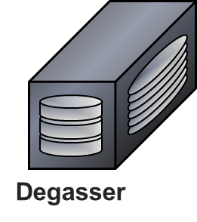
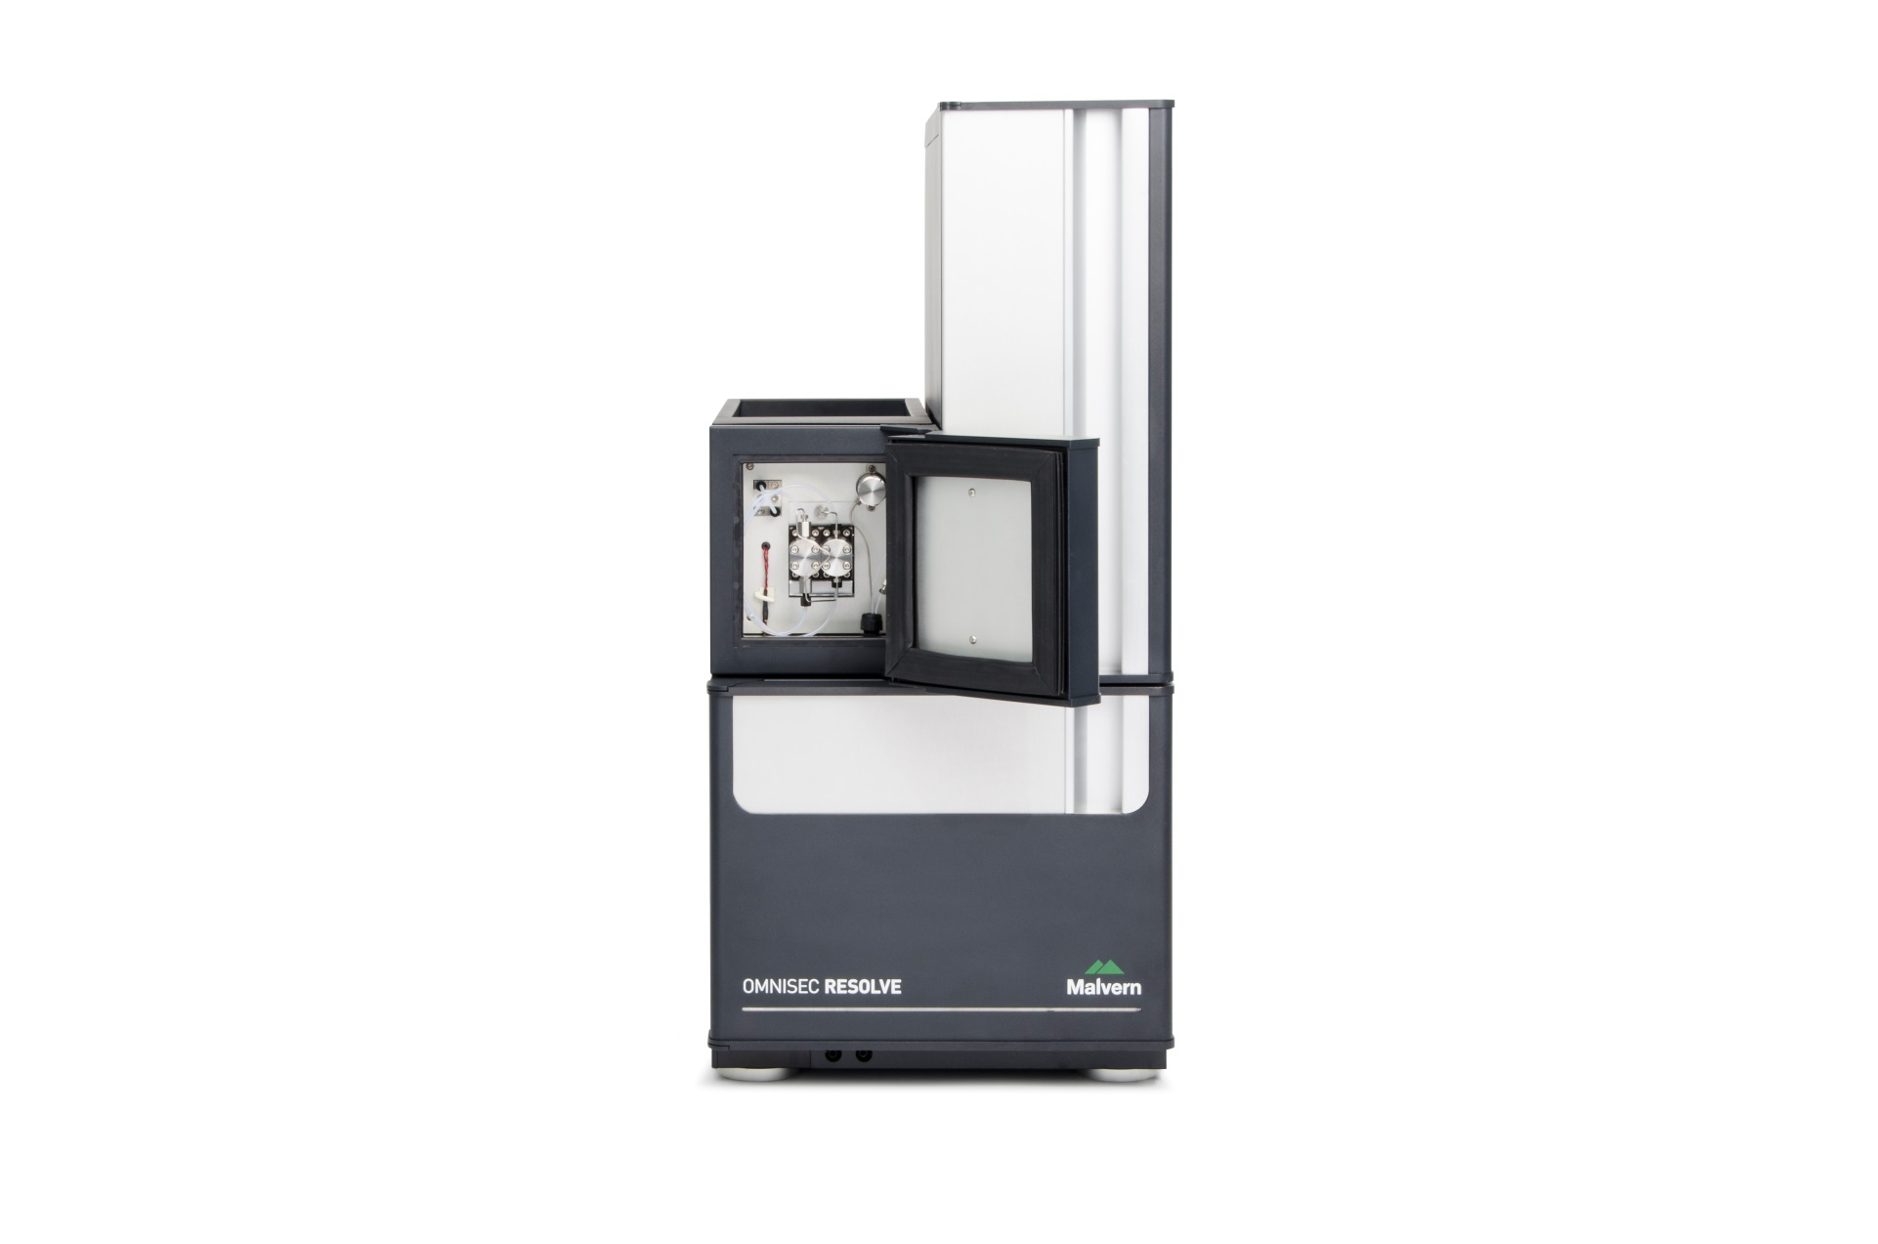
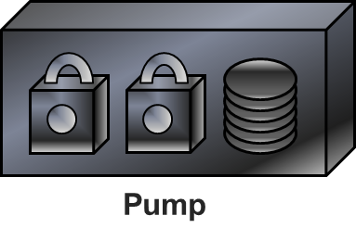
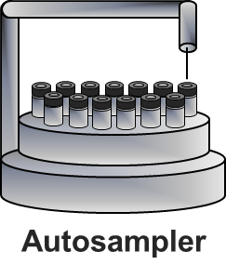
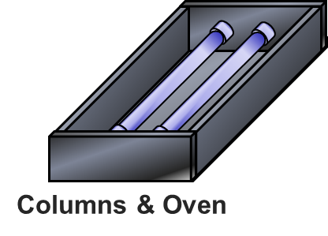
Degasser
Degassing removes dissolved gases for better baseline stability and pump performance
Low-volume (2 x 2 mL channels), high efficiency degasser
Faster solvent exchange and quicker equilibration
Better baseline stability and reduced instrument down-time during solvent exchange
Notes:
The degasser removes dissolved gases for better baseline stability and pump performance. It has a low volume of just 4 ml. This means solvent exchange is quick and easy and reequilibration after solvent exchange is significantly reduced compared to the GPCmax.

Slide 8
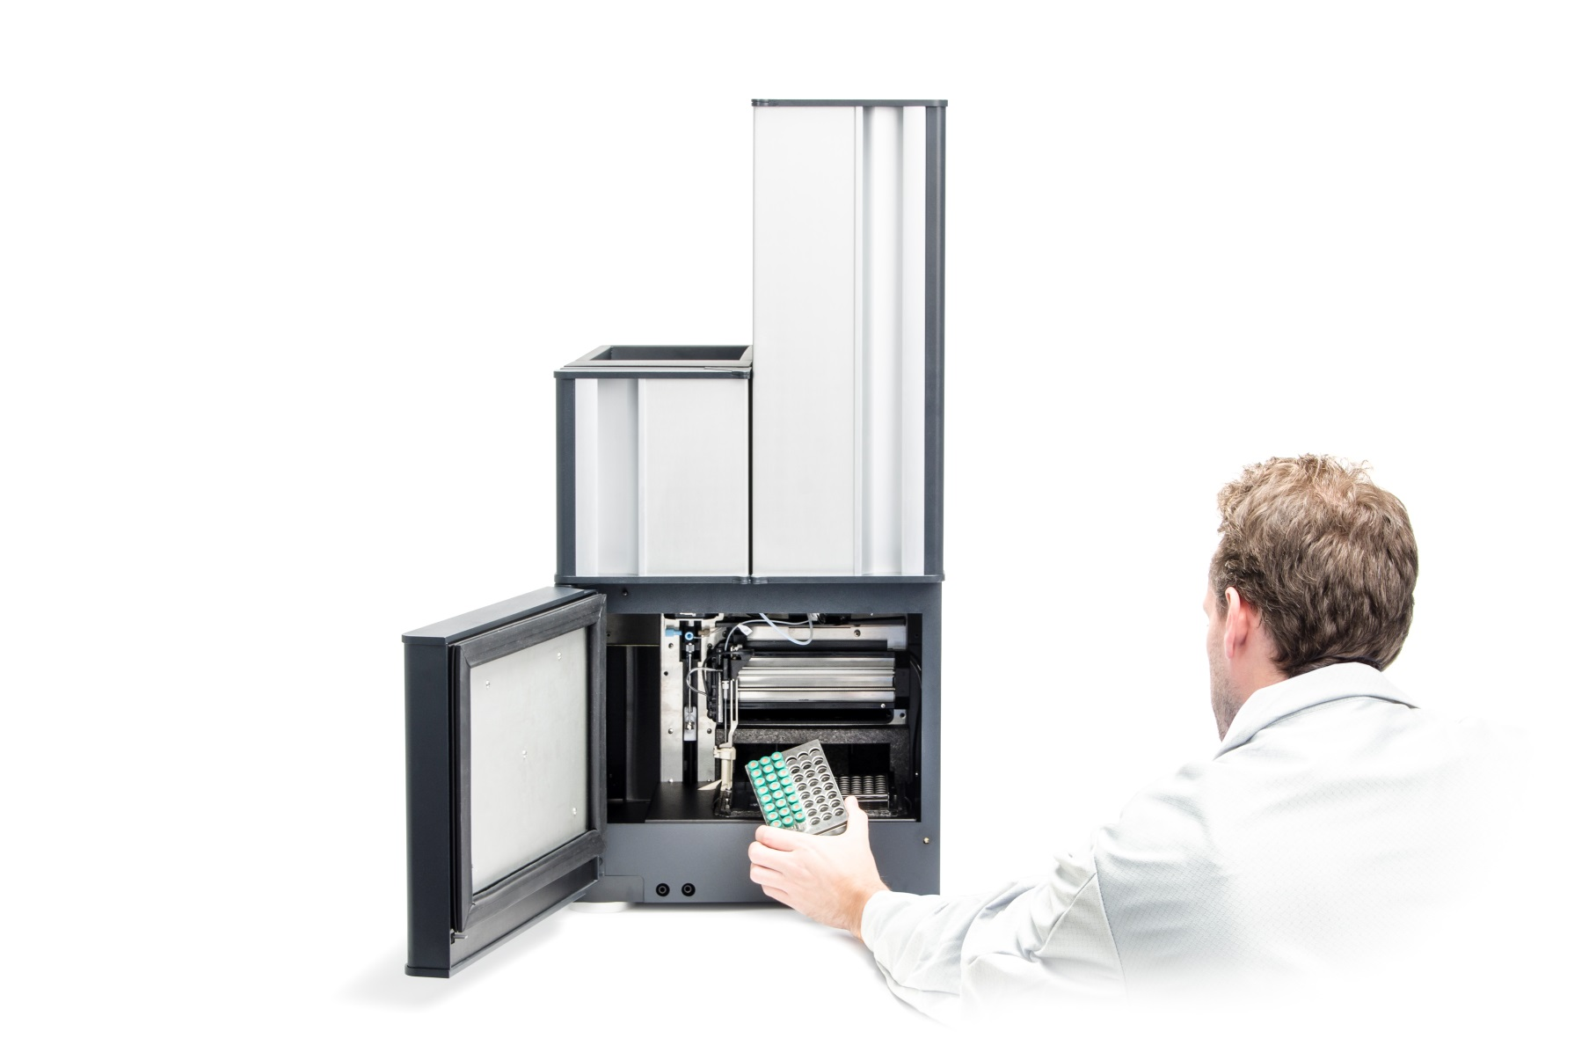
Autosampler
Injections from vials or 96-well microtiter plates
Temperature controlled (4-65°C) plate holder
  Preserve protein samples from aggregation
  Maintain polymer dissolution
  Improve injection of high viscosity samples (e.g. in DMSO)
µl pickup mode
  Zero injection overhead
  No sample waste during injections
Partial loop mode
  45 µl sample overhead
  Improved injection accuracy and precision
Post injection washing means undetectable carry-over
Notes:
The autosampler is far more advanced than the autosampler in the GPCmax and is now a very high-end example.
It is capable of making injections from vials or 96-well plates.
It can control the sample temperature from 4-65 degrees C. This allows the user to keep thermolabile samples such as proteins stable. On the other hand, the wamr temperatures can help with sample dissolution for applications such as xylene solubles or reduce the viscosity of some solvents, such as DMSO, for more accurate injections.
Finally, the autosampler can make injections in two different modes. Partial loop mode, is the most accurate and repeatable but includes a sample overhead of about 45 ul. Microliter pick up mode is capabale of making injections up to 100 ul without any sample waste or overhead at all.
Finally, automated washing after the injection means there is no detectable sample carryover

Slide 9
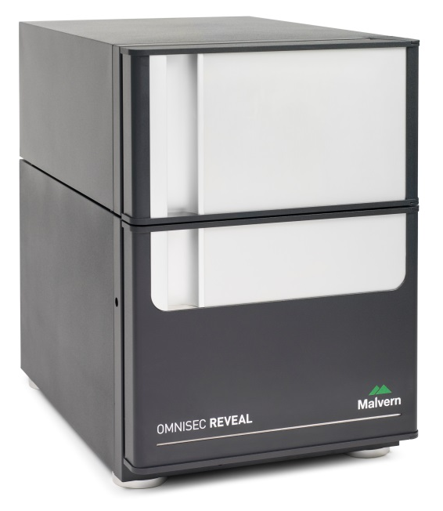
Detector module – OMNISEC REVEAL
Redesigned RALS/LALS with significant sensitivity improvements
New viscometer design (self-balancing bridge with user-exchangeable capillaries)
Improved RI, including change of position in detector module, and excellent sensitivity
Completely new UV-diode array (full UV/Vis range)
Temperature control of all detectors and inter-detector tubing (20 to 65°C)
Optional Detectors:
MALS 20
Notes:
In summary, the detector module, OMNISEC REVEAL contains a redesigned RALS/LALS detector with significant sensitivity improvements; a new viscometer with an autobalancing mechanism and a user-exchangeable bridge; an improved RI detector enabling it to be the first detector in sequence and with some signal to noise improvements; a new UV/Vis absorbance detector with a wider wavelength range; and improved temperature control of the detectors from 20 to 65 degrees C. This includes the detectors themselves but also the inter-detector tubing.

Slide 10
Advanced GPC/SEC Applications

Slide 11
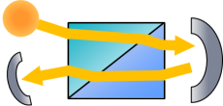
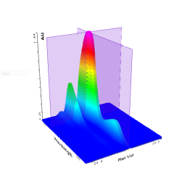
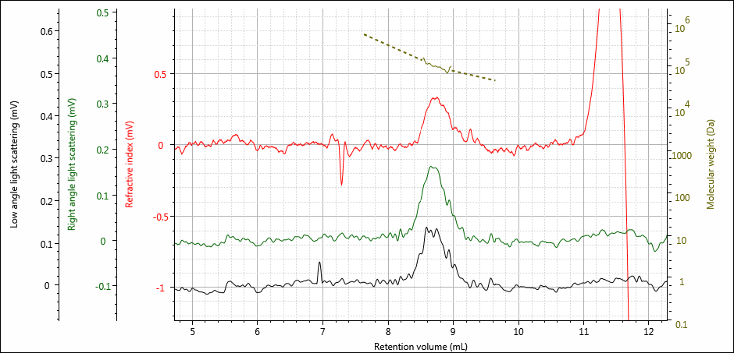
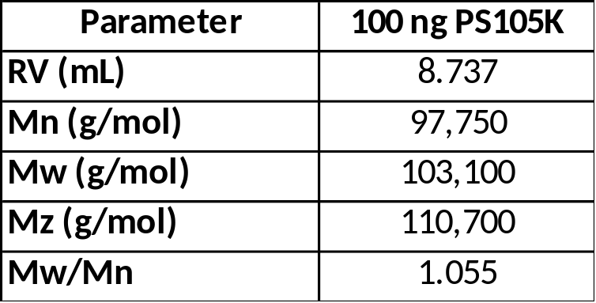
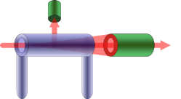
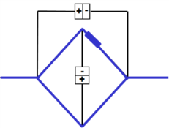
Light Scattering
Refractive index
Molecular weight quantification at 100 ng!
Polystyrene 105 KDa in THF, 0.01 mg/mL, 10 µL injection
UV/Vis PDA
RALS/LALS
Intrinsic viscosity
Notes:
The improvement in signal-to-noise means that the limit of detection has also been significantly improved.
It is now possible to measure accurately as little as 100ng of PS 105k.
Of course, the RI sensitivity improvements also contribute to this ability to measure at such low sample loadings

Slide 12
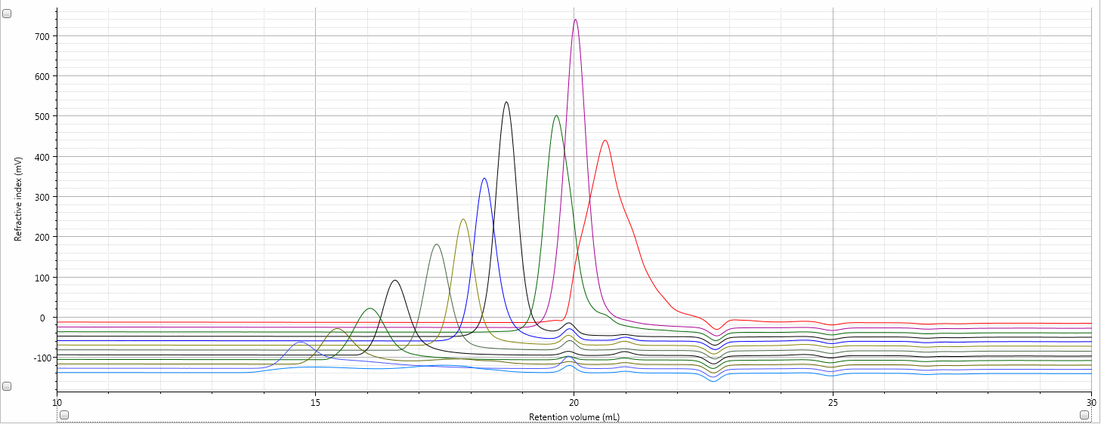
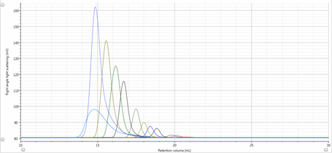
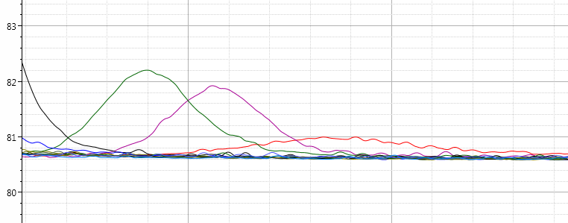
PEO standards - RI and RALS 196 to 992,000 Da
992,000 Da
196 Da
RI
RALS
Notes:
Light scattering is fighting for signal on low molecular weight and low dn/dc, RI is fighting for signal with low dn/dc and low concentration

Slide 13
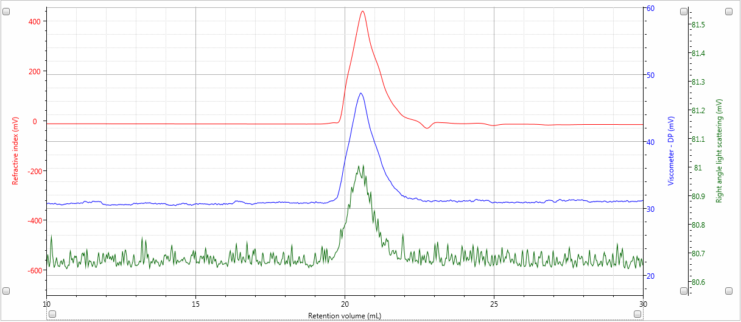
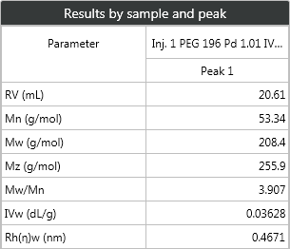
PEO 196 Da by Triple Detection !
PEO 196 Da
3.9 mg/ml, 100 µl injection
Notes:
Here is that 196 Da PEO in more detail. The RALS peak is small but clear.

Slide 14
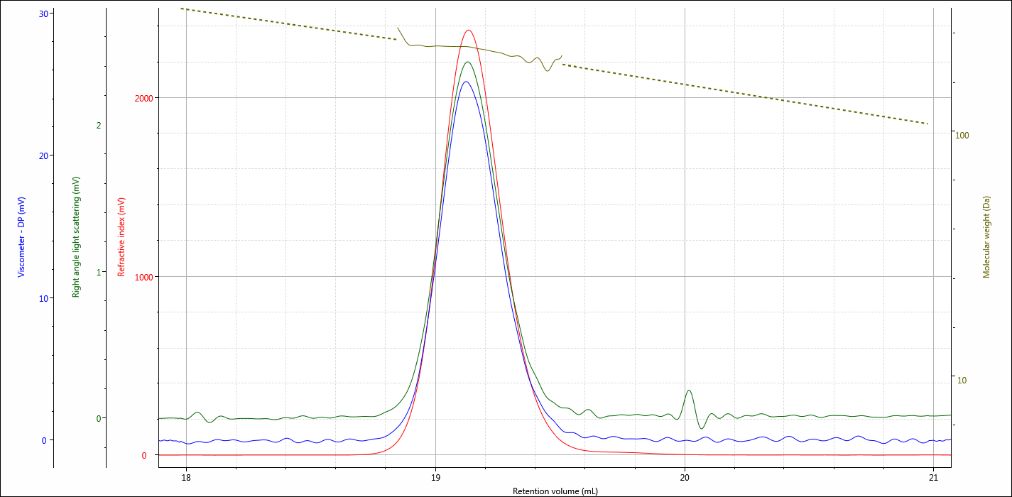
Triple Chromatogram of Bisphenol A (MW = 228)
-Monomer for epoxy resins and various specialty plastics
Mobile Phase: THF Columns: 2 X T2500 Flow Rate: 1 mL/min
Temperature: 30C Injections: 100 µL of 3 mg/mL dn/dc: 0.195
Notes:
Monomer for epoxy resins and PC, used in synthesis of PVC…epoxy resins used as coatings on food and beverages containers unless it’s BPA free then it’s mostly PET

Slide 15
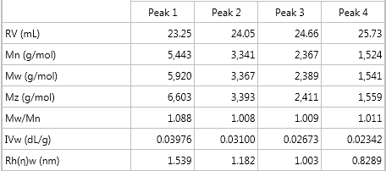
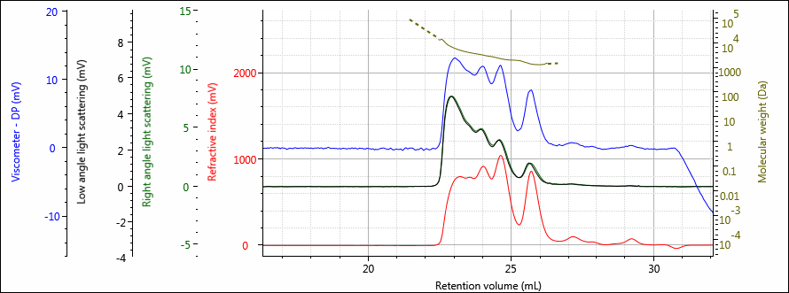
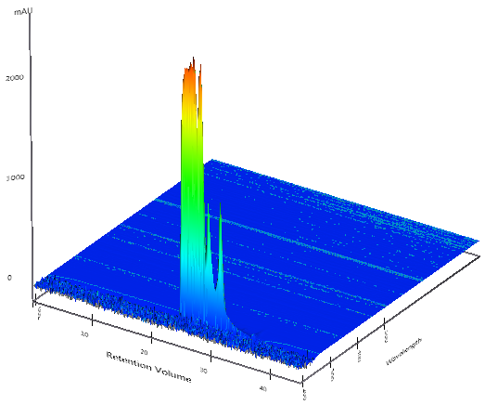
UV absorbing additive
Oligomer resolution and MW measurement over the different populations
THF, SVB columns, 35°C
Notes:
Here we’ve got a UV absorbing additive that goes into polymers to protect them from sunlight degradation. They are so low molecular weight you can see the different oligomers and we can measure all their molecular weights which go down to just 1500 Da!

Slide 16
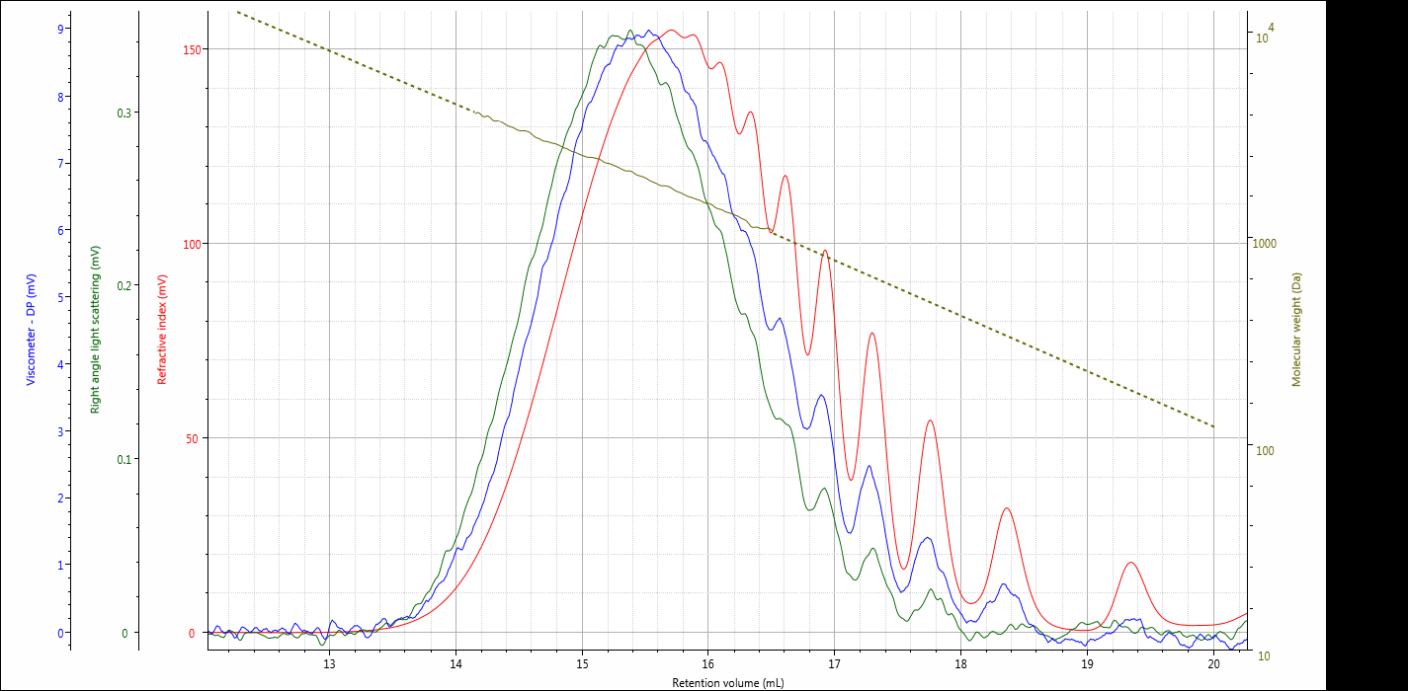
Triple Chromatogram of Polycaprolactone (Mw = 1,600)
Mobile Phase: THF Columns: 2 X T2500 Flow Rate: 1 mL/min
Temperature: 30C Injections: 100 µL of 5 mg/mL dn/dc: 0.06

Slide 17
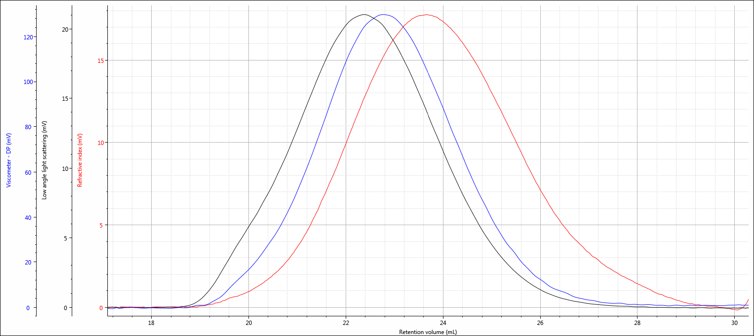
Triple Chromatogram of Carrageenan-2 (Mw = 572,000, IV = 7.0)
-Thickening, gelling, and stabilizing agents
-Mixtures of water-soluble, linear, sulfated galactan
Mobile Phase: 0.05M Na₂SO₄ Columns: 1XA7000 + 2XA6000M Flow Rate: 1 mL/min
Temperature: 50C Injections: 100 µL of 1.0 mg/mL dn/dc: 0.115

Slide 18
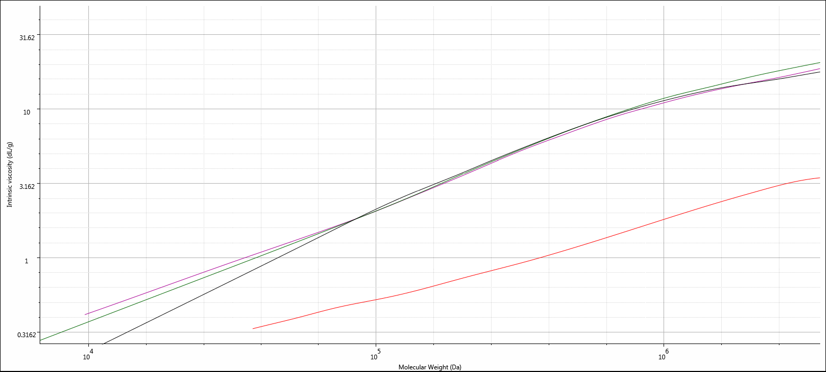
M-H Overlay Plots of Pullulan vs Carrageenan Samples
Red Line = Pullulan 525K
Purple Line = CARR-1
Green Line = CARR-2
Black Line = CARR-3
Notes:
Even the overlay of the molecular weight distribution and Mark-Houwink plot is excellent.

Slide 19
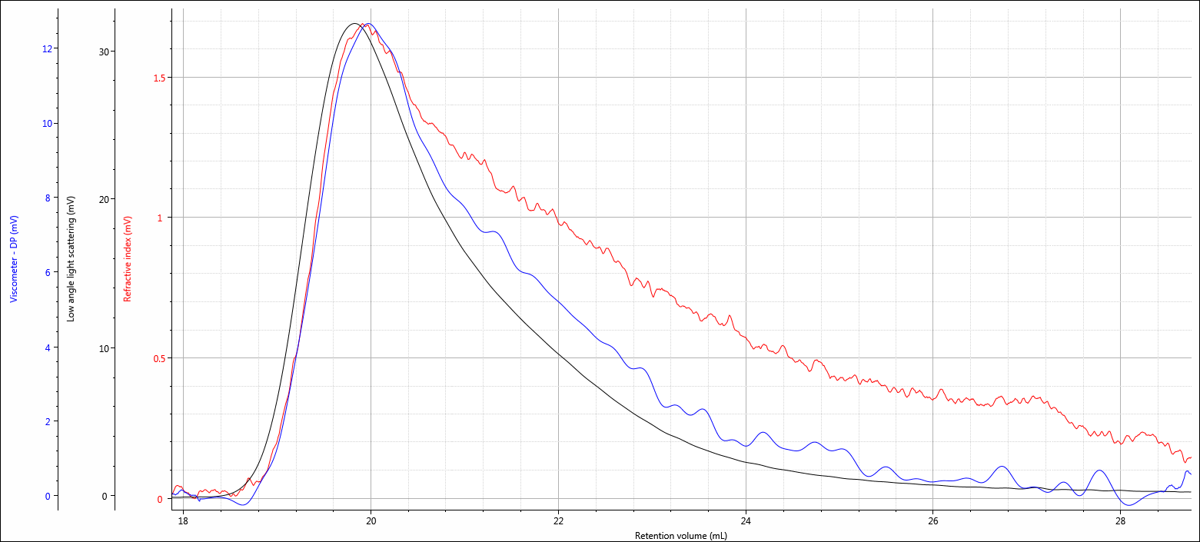
Triple Chromatogram of Polyacrylamide (Mw = 4,300,000, IV = 8.4)
-Enhanced Oil Recovery
-Cationic polymer used as a flocculation agent
Mobile Phase: 0.05M Na₂SO₄ Columns: 1XA7000 + 2XA6000M Flow Rate: 1 mL/min
Temperature: 50C Injections: 100 µL of 0.052 mg/mL dn/dc: 0.115

Slide 20
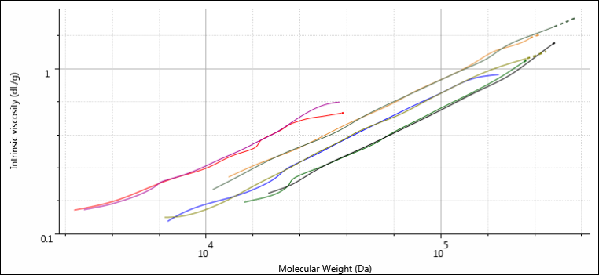
PLA/PLGA
Different copolymer compositions can be distinguished using the Mark-Houwink plot
The greater the proportion of PG, the more dense/compact the molecule
Increasing PG content
PLA:PG 100:0
PLA:PG 75:25
PLA:PG 65:35
PLA:PG 50:50
Notes:
Combining the molecular weight and IV data we can build a Mark-Houwink plot for the different samples. Since the MH plot can distinguish the different structures of different molecules, it has the capacity to distinguish between the different PLA and PLGA samples. We can clearly see the trend in structures/conformations between the samples. The PLA has the most open structure at the ‘top’ of the MH plot. As we add increasing amounts of the poly-glycolide, the molecular density becomes greater.
We can use these known samples to get information on unknown samples.

Slide 21
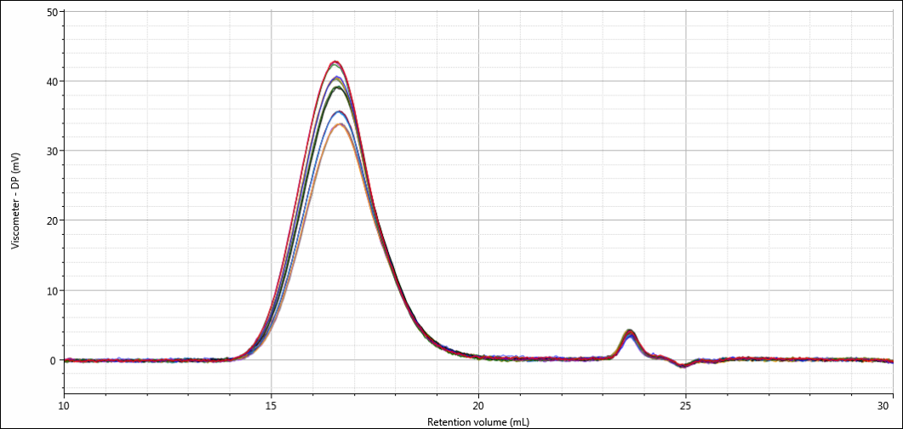
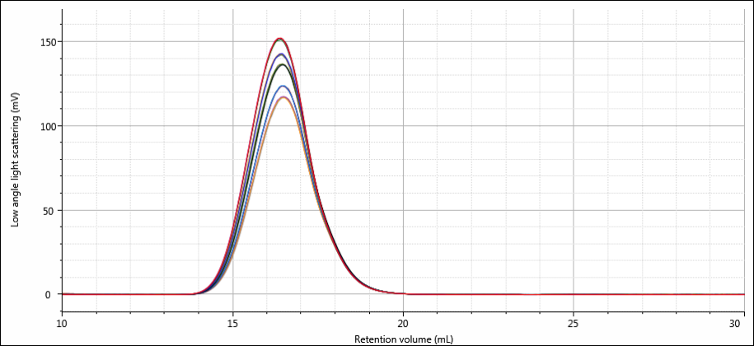
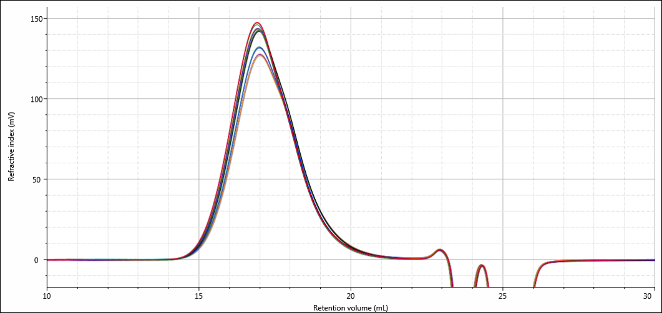
Polystyrene degradation
Sample of polystyrene run through 5 capillary rheology measurements simulating cycles of moulding and re-moulding
  (each line is overlay of 4 injections showing 20 in total!)
IV
RI
LALS
Cycle 1 - 5
Notes:
In this example, a sample of polystyrene was run through a capillary rheometer 5 times to simulate cycles of moulding and re-moulding.
The chromatograms show the changing sample with each detector showing slightly different differences.
Each line here is 4 repeat injections overlaid so each charts shows 20 injections! This demonstrates the incredible repeatability of OMNISEC

Slide 22
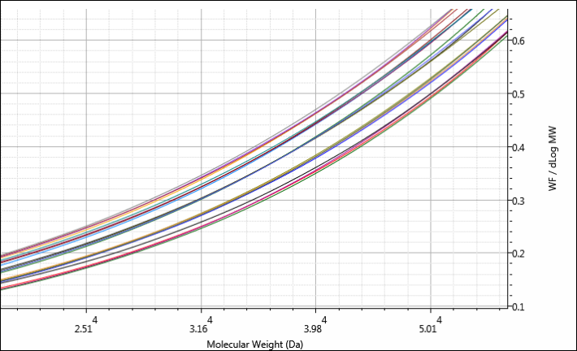
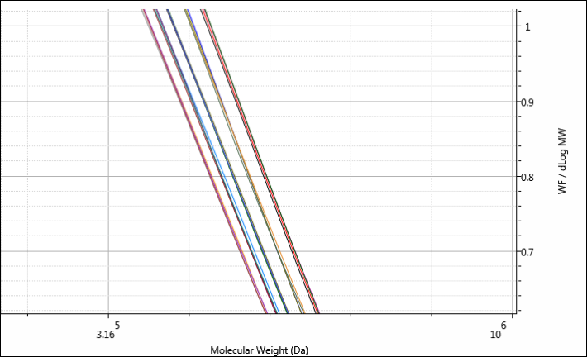
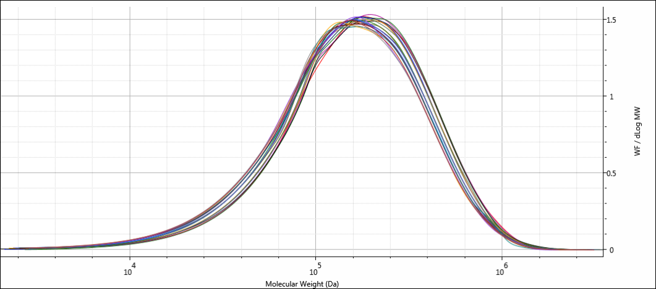
Polystyrene degradation
Molecular weight decreases with each cycle
  (each line is overlay of 4 injections!)
Cycle 1 - 5
Cycle 1 - 5
Notes:
The differences after processing show up in the molecular weight distributions which shift to the left (lower molecular weight) with each processing.
The differences are small but the exceptional measurement repeatability shows the precision of the measurement.
Again the plot shows all 20 molecular weight distributions.
Zooming in on the edges of the peak clearly shows the step change in molecular weight with each processing cycle.
It is clear from this that each processing cycle will change the properties of the plastic, in this case, likely weakening it until it becomes unusable.

Slide 23
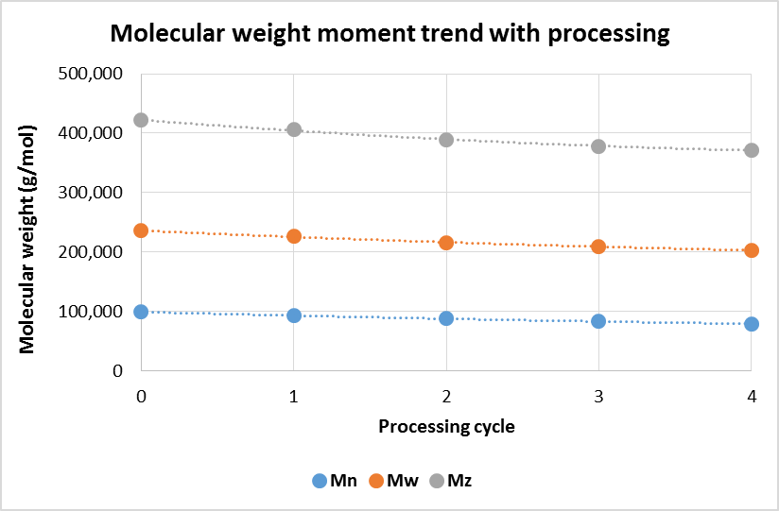
Polystyrene molecular weight
Molecular weight reduced by approximately 5% with each processing cycle
Reduced Mw means weaker material…
…means more failures…
…means more quality issues…
…means lower profitability
Notes:
Plotting the molecular weight moments together, again, the trend in decreasing molecular weight across the distribution is clear.
Each processing cycle reduces the molecular weight of the entire sample by approximately 5%
This has significant implications for polymer manufacturing.

Slide 24
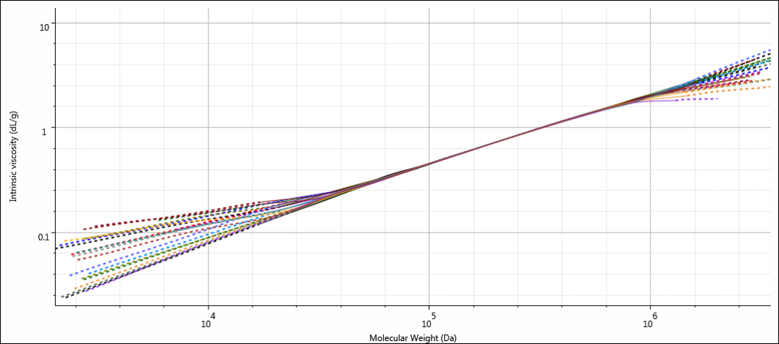
Polystyrene degradation
Mark-Houwink Plots all overlay
Structure remained unaffected by the processing
Notes:
The Mark-Houwink plots, which represent the structure of the sample are unchanged showing that the structure of the polystyrene has not changed during the processing.

Slide 25
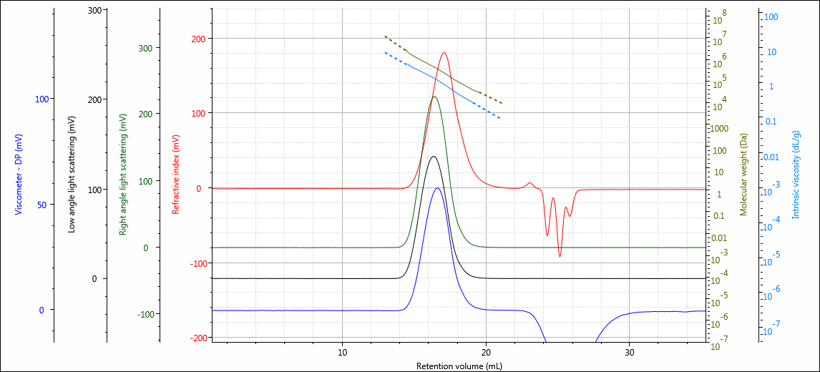
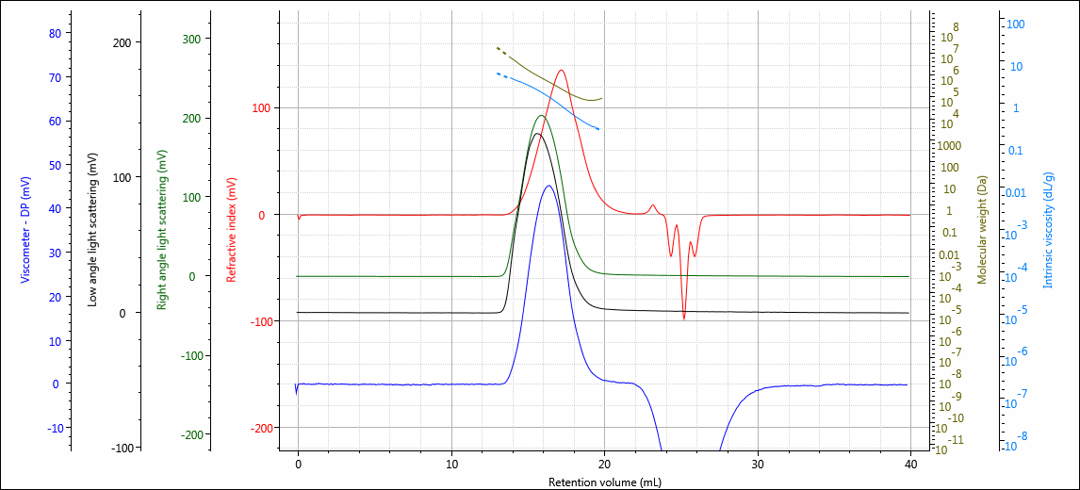
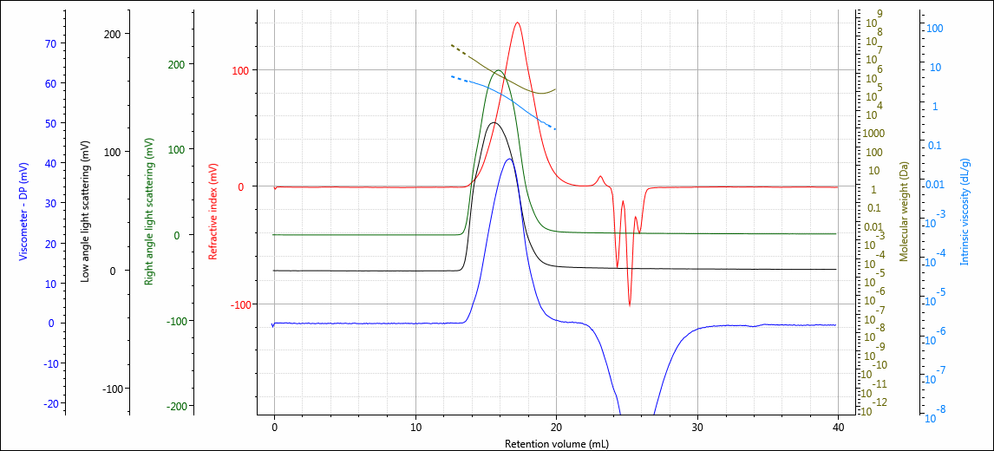
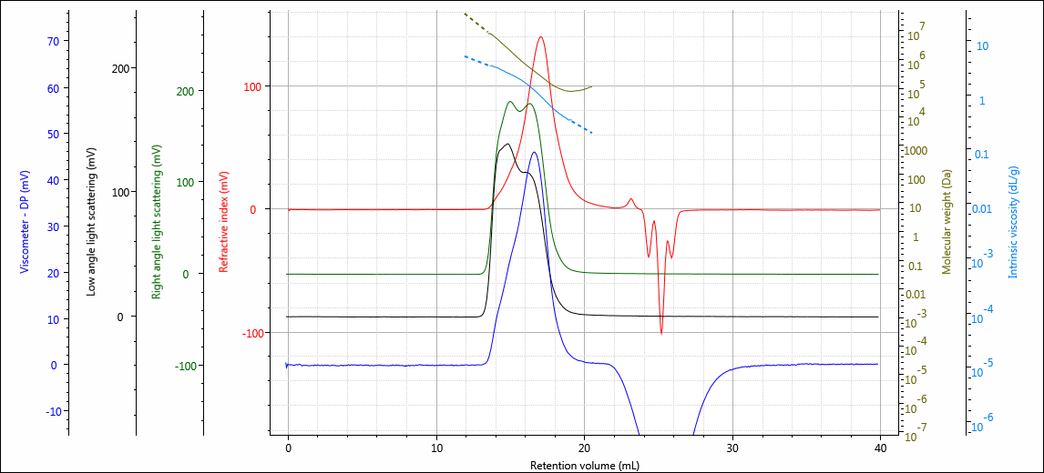
Branched series of polystyrenes
1
2
3
4
Notes:
Here is a series of branched polystyrenes, 1 through 4. Sample 1 is linear but in the other 3, you can see the growing peak in the ascending edge of the peak. This appears to indicate an increased level of branching in the samples.

Slide 26
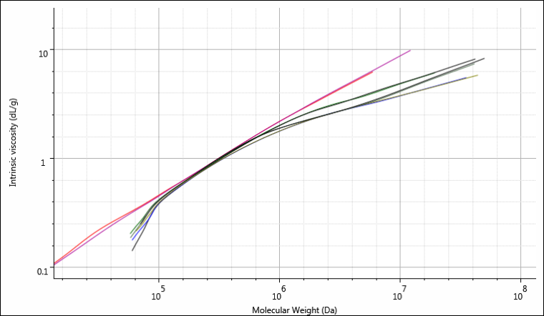

Mark-Houwink Comparison of branched polystyrenes
Increasing branching
Notes:
Here is the Mark-Houwink plot overlays. The clear difference between the more linear and branched samples can be seen
At lower molecular weights, the samples are the same i.e. both linear. However as MW increases, the branched samples show distinct curvature as the higher molecular weight material is branched.

Slide 27
Find out what you’ve been missing in your GPC/SEC analysis…send us samples!
Application Notes, Webinars, Technical Notes www.Malvern.com
Materials talks blog www.materials-talks.com
Carrie.schindler@malvern.com
Phone: 360-888-4024

