Slide 1

Alzheimer’s What They Forget to Tell You
Caron Leid

Slide 2






Notes:
This is exactly what happened to me 15 years ago.

Slide 3

Notes:
Everyone wants to know, How do you live with the disease
You don’t, The disease lives with you..
You move it in,
You take care of it
You entertain it,
And at the end of the day,,, That’s it.

Slide 4




.
Notes:
How can I talk about the last 15 years of dealing with Alzheimer’s disease in a 30 minute segment?
I had to think what my audience will want to hear, what they will want to know, how can I leave an impact on you in 30 minutes.
Then when looking to develop my presentation there it was, this “ask and you shall receive” thing really works. 2 slides that demonstrate exactly what my book cover tried to.
I am not sure if you picked it up, but we will go back to that slide in a moment.
I want you to really look at the this slide and the next.

Slide 5

Notes:
Did you pick up on it?
That’s what I am sure Alzheimer’s feels like..
You started as a whole person,,,, with all your memories intact and then slowly layers are peeled and you don’t remember anything.
And there is nothing you can do about it.
Another memory gone

Slide 6

Notes:
…global causes.

Slide 7
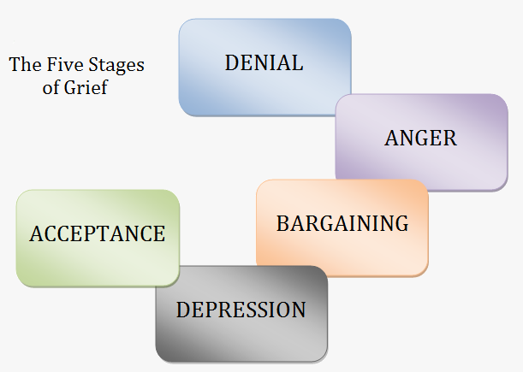
Notes:
Caregiving should be called – Care- taking,,,, because it is a thankless job. And it takes and takes and takes and takes…..

Slide 8
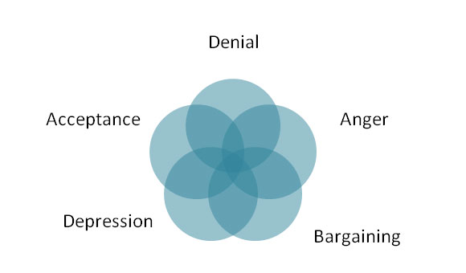

Slide 9

Notes:
https://vimeo.com/album/3542326

Slide 10
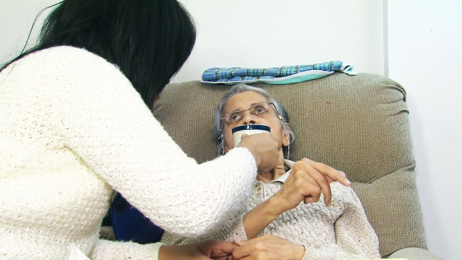
Notes:
http://www.ctvnews.ca/health/women-make-up-72-per-cent-of-alzheimer-s-patients-in-canada-1.2175208

Slide 11
