Slide 1
Adsorption of simple molecules on metal oxides by ab initio calculations
Application to the detection of gases
Caroline LAMBERT – MAURIAT
Vincent OISON, Laurent RAYMOND, Khalifa AGUIR, Roland HAYN
Thesis: Lama SAADI and Hela OUALI
6th International Conference and Exhibition on Materials Science and Engineering, September 12-14, 2016 Atlanta, USA

Slide 2
Plan
Principle of gas sensor devices
Calculations method
Results
  WO₃ surface: O₃, NO₂ and CO adsorption
  CuO and Cu₂O surfaces: O₃ adsorption
Conclusion & perspectives

Slide 3
Principle of gas sensor devices
Electrical resistivity variation as principle of sensor device
I (R) measurement
Sensitive layer (MOx)
Gas
Pt-electrodes
50 nm
SiO₂
0.2 µm
SiO₂ + Si₃N₄
1.7 µm
Si
Si
ab initio calculations to understand microscopic mechanisms for gas detection

Slide 4
Plan
Sensor devices: principle
Calculations method
Results
  WO₃ surface: O₃, NO₂ and CO adsorption
  CuO and Cu₂O surfaces: O₃ adsorption
Conclusion & perspectives

Slide 5
Principle
Bulk study by geometry optimization
  Cell parameters, bulk modulus,…
  Electronical properties: DOS (density of states)
              Surface building
                Choice of the orientation
                In the case of non-trivial orientation: new unit cell
                Creation of the supercell = cell calculation
              Adsorption study
                Molecule on surface into specific site
Vacuum
Surface
Slab
Surface

Slide 6
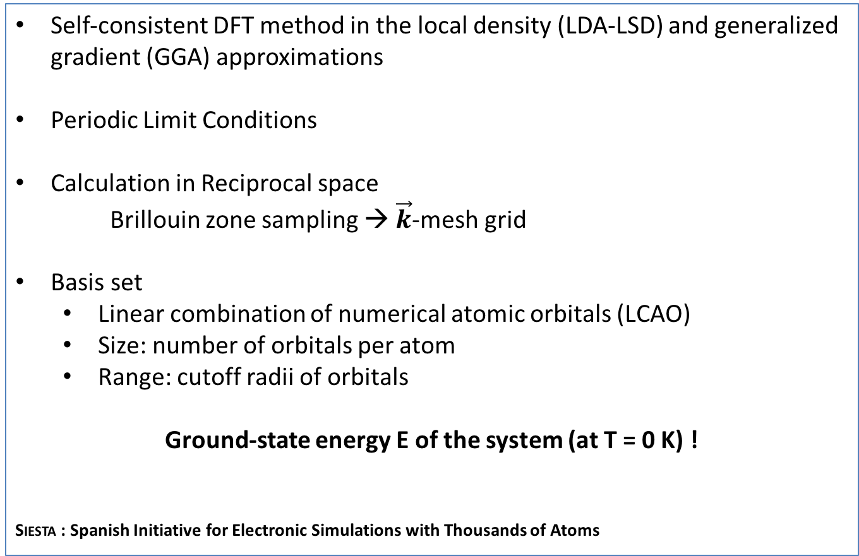
siesta code
Self-consistent DFT method in the local density (LDA-LSD) and generalized gradient (GGA) approximations
Periodic Limit Conditions
Calculation in Reciprocal space
Brillouin zone sampling → $\vec{k}$-mesh grid
  Basis set
    Linear combination of numerical atomic orbitals (LCAO)
    Size: number of orbitals per atom
    Range: cutoff radii of orbitals
Ground-state energy E of the system (at T = 0 K) !
Siesta : Spanish Initiative for Electronic Simulations with Thousands of Atoms
c
b
a

Slide 7
Plan
Sensor devices: principle
Calculations method
Results
  WO₃ surface: O₃, NO₂ and CO adsorption
  CuO and Cu₂O surfaces: O₃ adsorption
Conclusion & perspectives

Slide 8
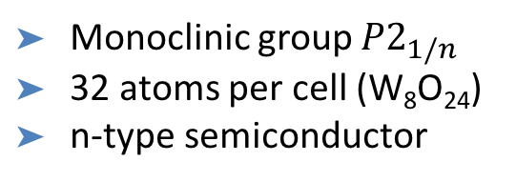
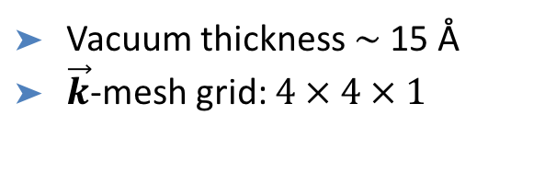
Bulk WO₃ (L. Saadi thesis)
Bulk primitive cell
Supercells: W_{n}O_{3n} (n = 64)
Cell parameters
 | a* = 2a (Å) | b* = 2b (Å) | c* = 4c (Å) | β (deg.)
LDA | 14.48 | 14.90 | 30.44 | 90.5
GGA | 14.96 | 15.32 | 31.40 | 90.4
c = 7.61 Å
b = 7.45 Å
a = 7.14 Å
Monoclinic group $P2_{1/n}$
32 atoms per cell (W₈O₂₄)
n-type semiconductor
Vacuum thickness $\sim$ 15 Å
$\vec{k}$-mesh grid: $4 × 4 × 1$
Atomic electronic structure
W: [Xe]4f¹⁴ 6s²5d⁴ O: 1s² 2s²2p⁴
Core electrons
norm-conserving pseudopotentials
Valence electrons
Wave functions localized on atomic nucleus

Slide 9
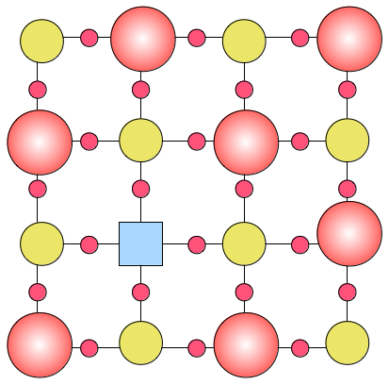
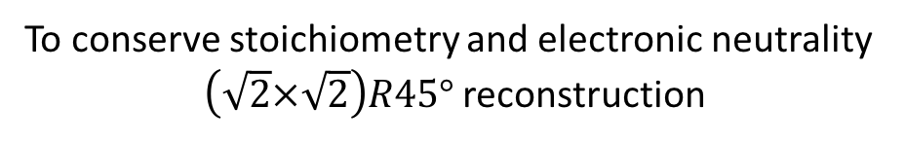
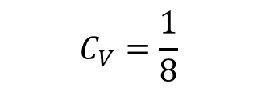
Surface (001) of WO₃
To conserve stoichiometry and electronic neutrality
$\left(\sqrt{2}×\sqrt{2}\right)R45°$ reconstruction
$$C_{V}=\frac{1}{8}$$
Oxygen
Tungsten
Vacancy
Formation energy of surface (meV/Å²)
Formation enthalpy (eV)
 | O₂-poor | O₂-rich
LDA | -1.65 | +1.45
GGA | -1.36 | +1.28
LDA | 41.3
GGA | 21.0
I.N. Yakovkin and al. Surface Science 610 (2007):
22 meV/Å² by VASP (GGA) calculations on WO₃ cubic phase

Slide 10
Surface (001) of WO₃
Total electronic Density Of States (DOS)
Filling the bottom of conduction band n-doping

Slide 11
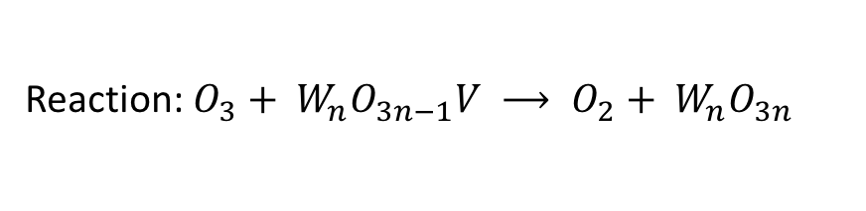
O₃ dissociation on WO₃
∆H
Reaction: $O_{3}+ W_{n}O_{3n−1}V ⟶ O_{2}+ W_{n}O_{3n}$
$$ΔH≈E\left(W_{n}O_{3n}\right)+E\left(O_{2}\right)−E(W_{n}O_{3n−1}V)−E\left(O_{3}\right)$$
Exothermic
LDA/GGA agreement
Cancellation of oxygen vacancy
 | LDA | GGA
∆H (eV) | - 2.54 | - 2.86
Increasing partial pressure of O₃ decreases the number of oxygen vacancies
The conductance of WO3 sensitive layer is decreased

Slide 12
Response to ozone
M. Bendahan et al. / Sensors and Actuators B 100 (2004) 320–324
T_{work} = 523 K
Conductance (Ω⁻¹)
Time (min)

Slide 13
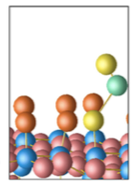
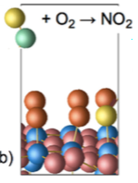
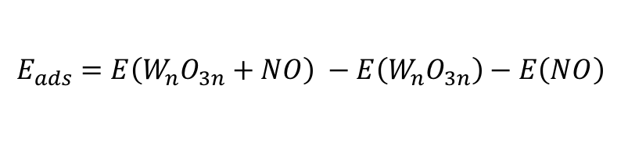
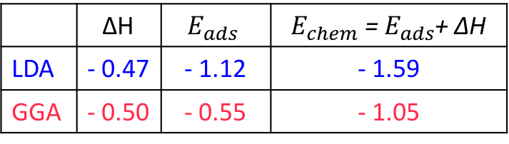
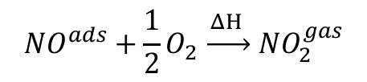
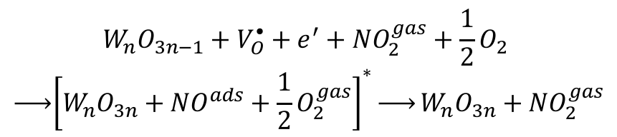
NO₂ dissociation
NO₂ dissociation + NO adsorption
$$W_{n}O_{3n−1}+V_{O}^{•}+e^{′}+{NO}_{2}^{gas} \underset{→}{ ΔH } W_{n}O_{3n}+{NO}^{gas}$$
$$E_{ads}=E\left(W_{n}O_{3n}+NO\right) −E\left(W_{n}O_{3n}\right)−E\left(NO\right)$$
 | ∆H | $$E_{ads}$$ | $E_{chem}$ = $E_{ads}$+ ∆H
LDA | - 0.47 | - 1.12 | - 1.59
GGA | - 0.50 | - 0.55 | - 1.05
Wv
2) NO re-oxidation
$$W_{n}O_{3n−1}+V_{O}^{•}+e^{′}+{NO}_{2}^{gas}+\frac{1}{2}O_{2}$$
$$\underset{→}{ }{\left[W_{n}O_{3n}+{NO}^{ads}+\frac{1}{2}O_{2}^{gas}\right]}^{∗}\underset{→}{\begin{aligned} \\ \\ \end{aligned}}W_{n}O_{3n}+{NO}_{2}^{gas}$$
$$NO^{ads}+\frac{1}{2}O_{2} \underset{→}{ ΔH } NO_{2}^{gas}$$
Transition state
Cancelling oxygen vacancy conductance decreasing

Slide 14
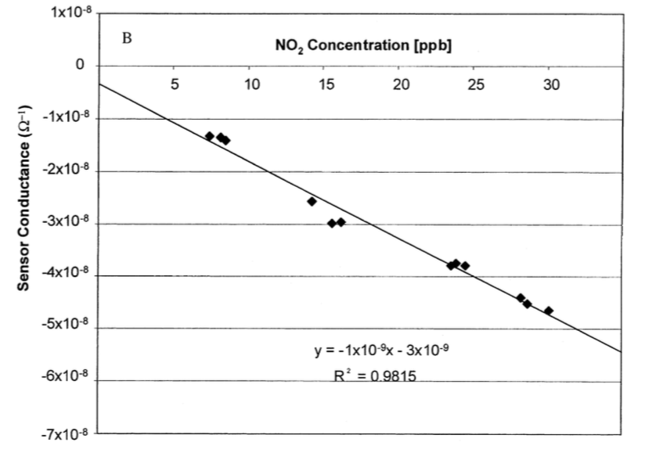
Response to NO₂
B. Fruhberger et al. / Sensors and Actuators B 76 (2001) 226-234

Slide 15
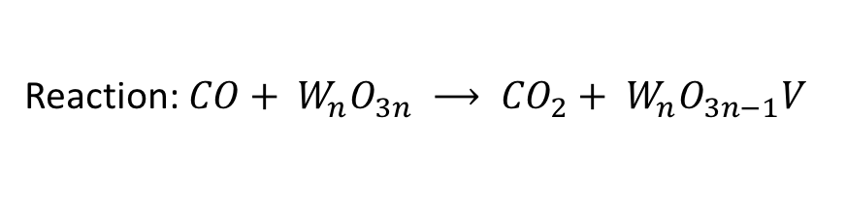

CO oxidation
CO approaching
CO₂ weakly interacting
∆H
Reaction: $CO+ W_{n}O_{3n} ⟶ {CO}_{2}+ W_{n}O_{3n−1}V$
$$ΔH≈E\left(W_{n}O_{3n−1}V\right)+E\left({CO}_{2}\right)−E(W_{n}O_{3n})−E\left({CO}_{ }\right)$$
 | LDA | GGA
∆H (eV) | - 1.73 | - 1.52
Exothermic
LDA/GGA agreement
Generation of oxygen vacancy
CO oxidation on stoichiometric surface leads to oxygen vacancy formation
The conductance of WO3 sensitive layer is increased

Slide 16
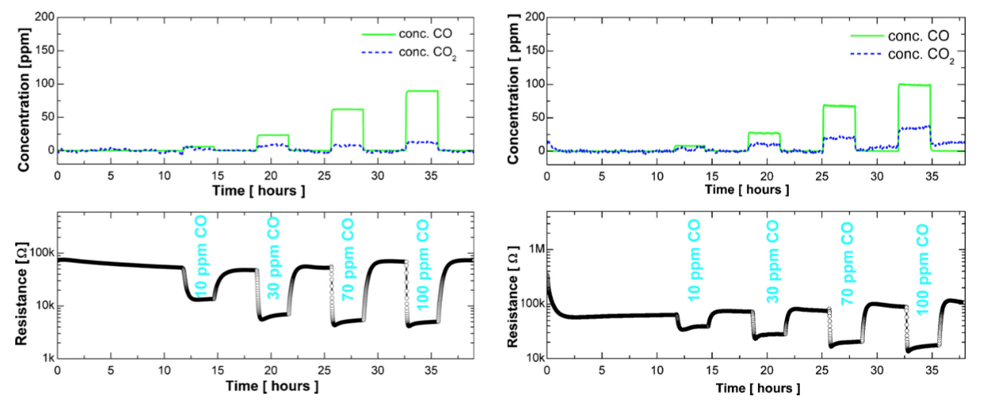
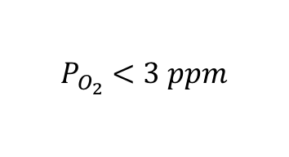
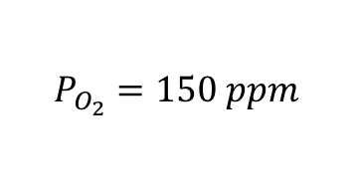
Response to CO
M. Hübner et al. / Sensors and Actuators B 151 (2010) 103–106
$$P_{O_{2}}<3 ppm$$
$$P_{O_{2}}=150 ppm$$
As CO increasing, the resistance decreasing ( = conductance increasing)

Slide 17
Plan
Sensor devices: principle
Calculations method
Results
  WO₃ surface: O₃, CO and NO₂ adsorption
  CuO and Cu₂O surfaces: O₃ adsorption
Conclusion & perspectives

Slide 18
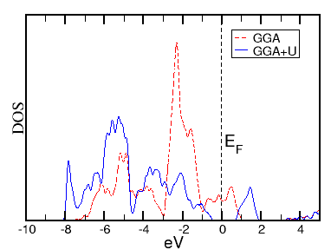
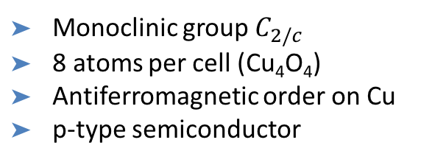
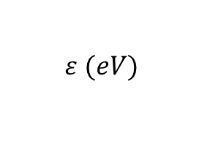

Bulk CuO (H. Ouali thesis)
Bulk primitive cell
$$g\left(ε\right)a.u.$$
Monoclinic group $C_{2/c}$
8 atoms per cell (Cu₄O₄)
Antiferromagnetic order on Cu
p-type semiconductor
$$ε (eV)$$
 | a (Å) | b (Å) | c (Å) | E_{g} (eV) | µ (µ_{B}/Cu)
LDA+U | 3.403 | 4.660 | 5.098 | 1.37 | ± 0.62
GGA+U | 3.498 | 4.787 | 5.242 | 1.48 | ± 0.63
Exp. | 3.423 | 4.684 | 5.129 | 1.2 – 1.9 | ± 0.68
β = 80.46°

Slide 19
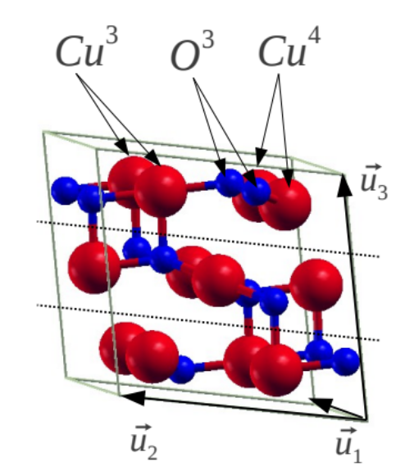
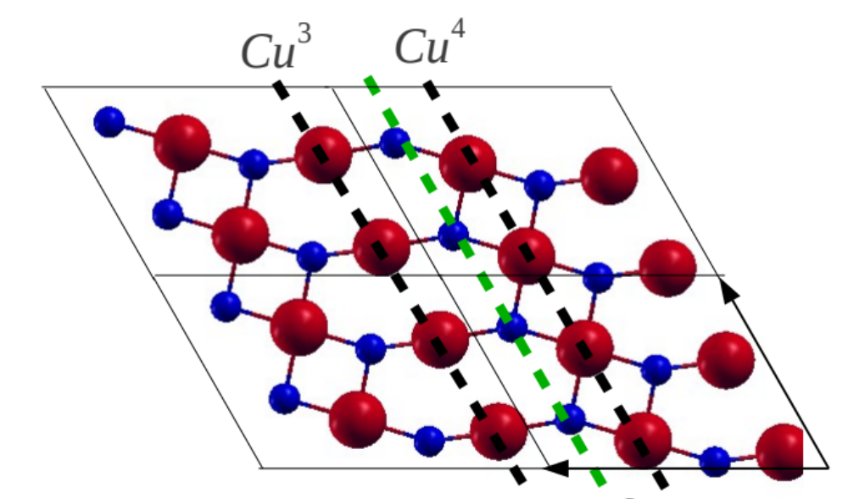
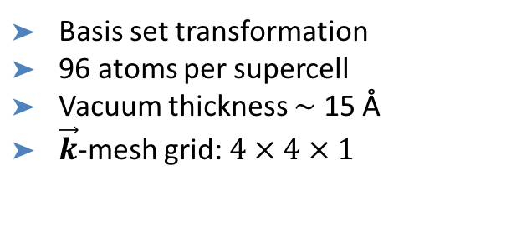
Surface (111) of CuO
Primitive cell
Top view
Basis set transformation
96 atoms per supercell
Vacuum thickness $\sim$ 15 Å
$\vec{k}$-mesh grid: $4 × 4 × 1$
Cu³ (3-coordinated Cu) named Cu1
Cu⁴ (4-coordinated Cu) named Cu2

Slide 20





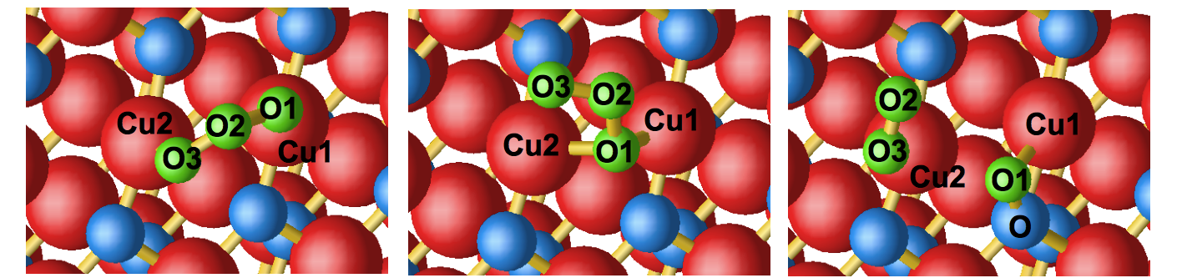
O₃ dissociation on CuO
GGA + U calculations
0 eV
-0,81 eV
– 1,03 eV
-1,15 eV
-1,27 eV
Reaction steps

Slide 21
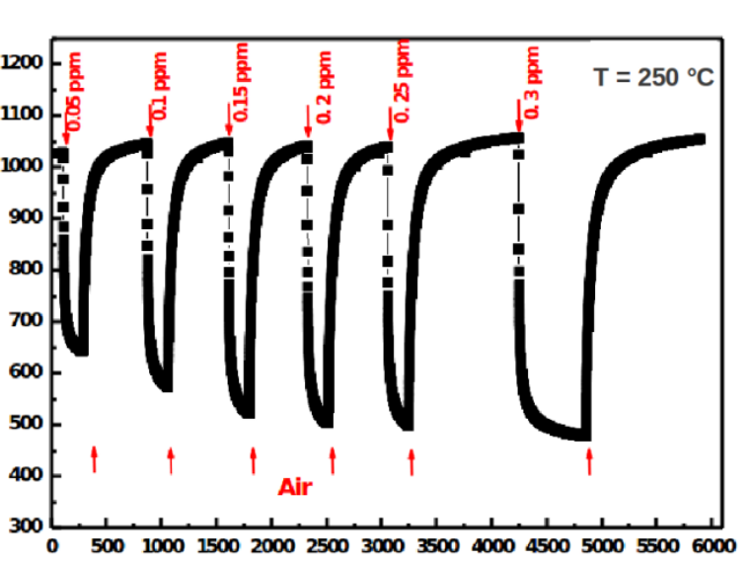
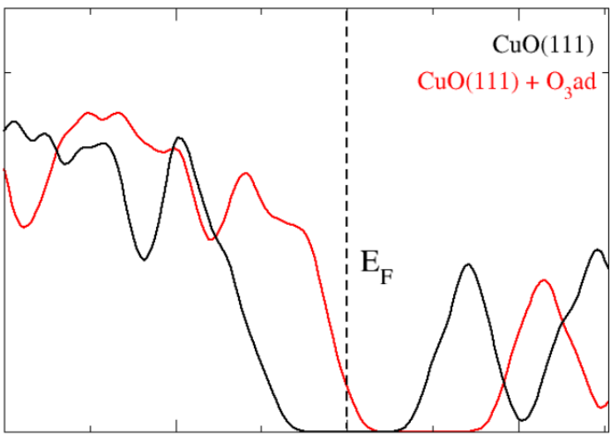
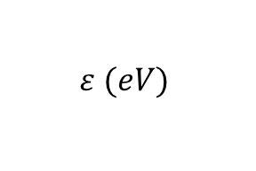

Response to O₃ / DOS
A. Bejaoui et al. / Sensors and Actuators B 190 (2014) 8—15
1,200
1,100
1,000
900
800
700
600
500
400
300
T_{work} = 523 K
Resistance (Ω)
$$g\left(ε\right)a.u.$$
0 1,000 2,000 3,000 4,000 5,000 6,000
Time (s)
-2 -1 0 1
Diminution of the resistance
$$ε (eV)$$
E_{F} in the valence band
p-doping increases

Slide 22
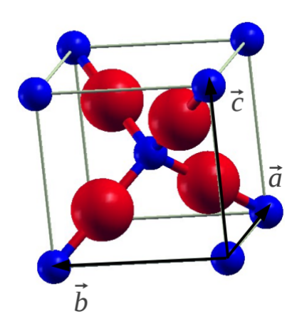
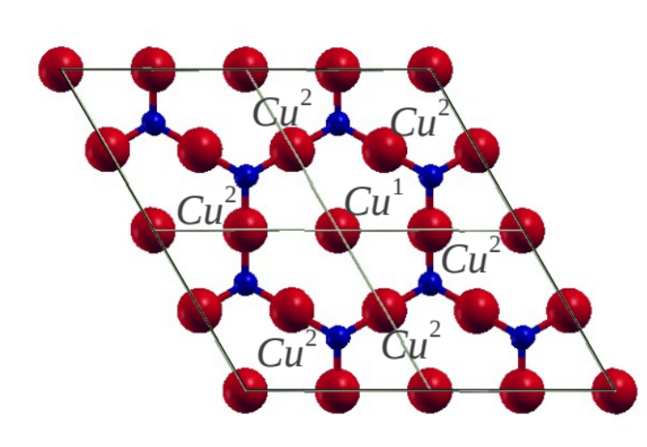
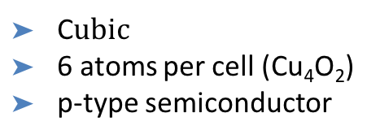
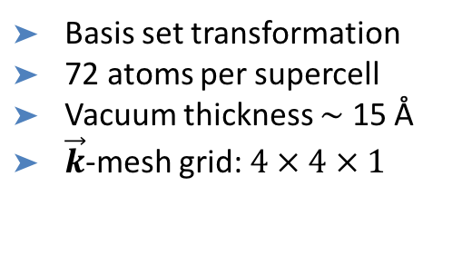
Cu₂O: Bulk and (111) surface (H. Ouali thesis)
Bulk primitive cell
(111) Surface -Top view
C$ubic$
6 atoms per cell (Cu₄O₂)
p-type semiconductor
Basis set transformation
72 atoms per supercell
Vacuum thickness $\sim$ 15 Å
$\vec{k}$-mesh grid: $4 × 4 × 1$
 | a (Å) | E_{g} (eV)
LDA | 4.223 | 0.52
GGA | 4.353 | 0.27
Exp. | 4.270 | 2.0 – 2.7

Slide 23
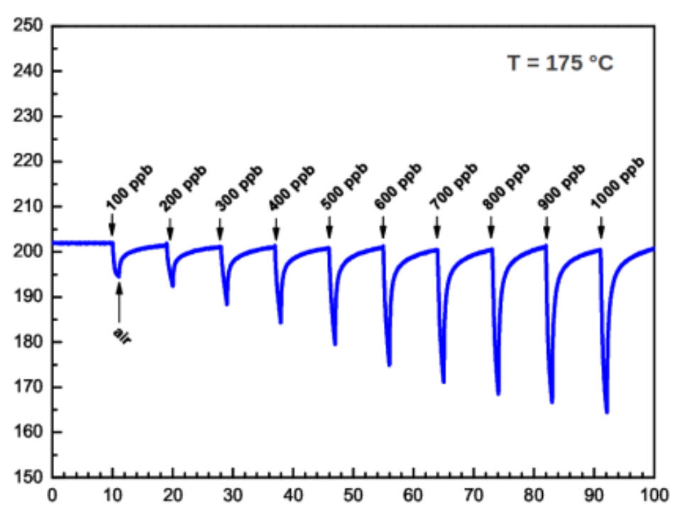
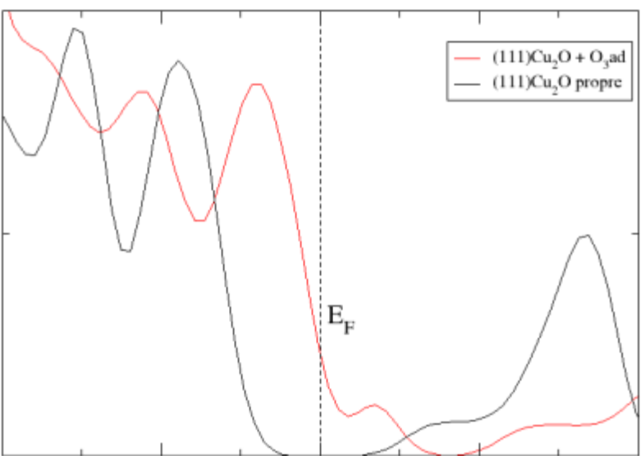
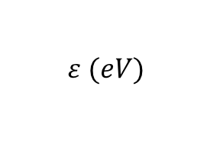
Response to O₃ /DOS
T_{work} = 448 K
Density of electronic states
Resistance (Ω)
Time (min)
Diminution of the resistance
-2 -1 0 1 2
$$ε (eV)$$
E_{F} in the valence band
p-doping increases

Slide 24
Plan
Sensor devices: principle
Calculations method
Results
  WO₃ surface: O₃, NO₂ and CO adsorption
  CuO and Cu₂O surfaces: O₃ adsorption
Conclusion & perspectives

Slide 25
Conclusion & perspectives
Adsorption on (001) surface of WO₃
  O₃ & NO₂
    molecule dissociation leads to vacancy cancelling
    conductivity decreases (by n-doping weakening)
  CO
    oxidation to CO₂ leads to vacancy formation
    Conductivity increases (by n-doping enhancement)
O₃ adsorption on (111) surface of CuO & Cu₂O
    Non dissociative adsorption leads to p-doping enhancement
      Conductivity increases
    Desorption of O₂ leaves adsorbed O and decreases p-doping
      Conductivity decreases when O₃ flux is stopped
Ab initio calculations allow to specify the mechanisms involved in the gas detection
Perspectives
Expand this approach to others oxides (ZnO) and others molecules
Use adsorption energies as input for molecular dynamic simulation

