Slide 1
Cell Division Labeling by Chromosome Changes for Monozygotic Twinning and Its Implications to Cancerogenesis
Carol M. Jim
The George Washington University
Department of Computer Science

Slide 2
Outline
Introduction and background
Problem description
Related work
Considered cell labeling models
Cell labeling combinations
Results and discussion on its implications
Conclusion

Slide 3
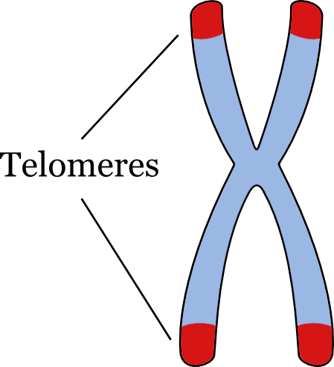
Introduction and Background
Cell development of evolving organism can be viewed in terms of developmental trees
Leonard Hayflick¹
  Hayflick limit: normal human fetal cells will divide about 40 to 60 times
  Promoted idea of internal cellular clock
Alexey Olovnikov²
  Telomeres slightly shorten with each cell
  division until a critical length is reached
¹ Leonard Hayflick. “The limited in vitro lifetime of human diploid cell strains.” Experimental Cell Research, Vol. 37, No. 3, March 1965, pp. 614-636.
² A. M. Olovnikov. “Telomeres, telomerase, and aging: origin of the theory.” Exp. Gerontol., Vol. 31, No. 4, Jul.-Aug. 1996, pp. 443-448.

Slide 4
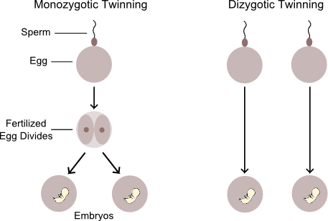
Introduction and Background/2
Monozygotic (MZ) twins derive from single zygote that divides into two separate cell masses
  Occurs at frequency of about 1 in 250 to 300 births³
Dizygotic (DZ) twins derive from two zygotes that develop at the same time into two individuals
³ Jeroen Smits and Christiaan Monden. “Twinning Across the Developing World.” PLoS ONE, Vol. 6, No. 9, 2011.

Slide 5
Problem Description
It is unclear why some zygotes split whereas others do not
Little is known about the origins of pairs of MZ twins and higher order multiples
Insight into mechanism is key to future developments in developmental biology, the human aging process, and cancerogenesis

Slide 6
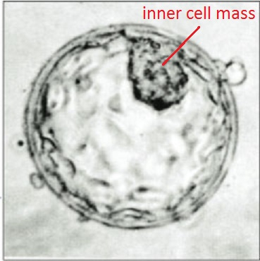
Related Work
Mechanisms and etiology of MZ twinning
  Many theories exist including:
    Every embryo develops along an axis giving it a bilateral symmetry⁴
    Cells within blastocyst exhibit genetic
    differences and separate into two
    different cell masses⁵
  Difficult to determine because of randomness and rarity of MZ twinning events
⁴ V. J. Baldwin. Pathology of Multiple Pregnancy. Springer-Verlag: New York, 1994, pp. 29-62.
⁵ Judith G. Hall. "Twinning: mechanisms and genetic implications." Curr. Opin. Genet. Dev., Vol. 6, No. 3, June 1996, pp. 343-347.

Slide 7
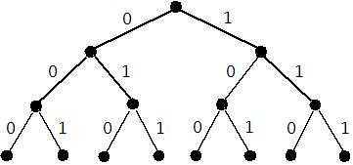
Binary Cell Labeling Scheme
Binary sequence describes history of cell’s origin and makes distinction between cells
Illustrates process of cell differentiation

Slide 8
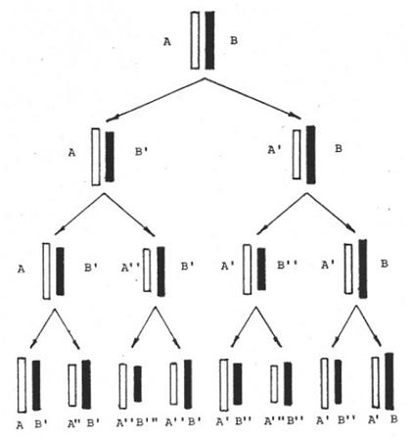
Chromosomes Labeling Scheme⁶
Takes into account DNA changes during semiconservative replication
If a single strand accumulates i changes, its complement can only have (i – 1) or (i + 1) changes
⁶ Simon Y. Berkovich. “A Cybernetical Model of the Internal Cellular Clock.” Medical Hypotheses, 1981, pp. 1347-1357.

Slide 9
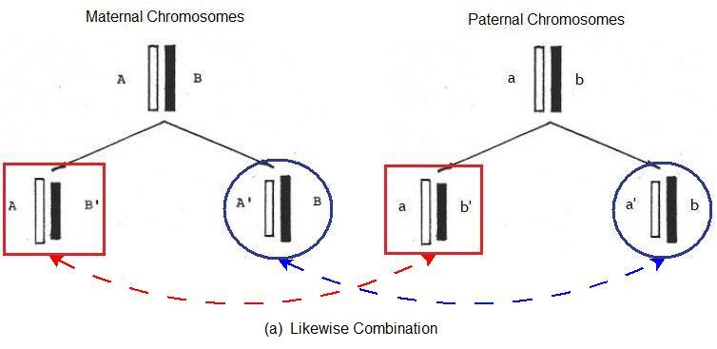
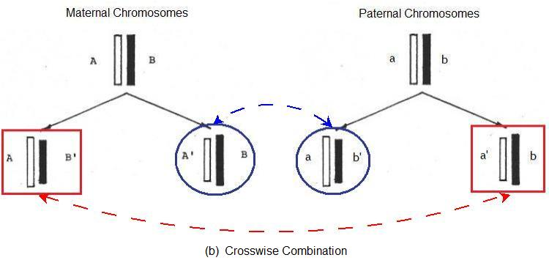
Cell Labeling Combinations
Can be deduced from chromosomes labeling scheme
Two possible types of combinations
  Likewise
  Crosswise

Slide 10
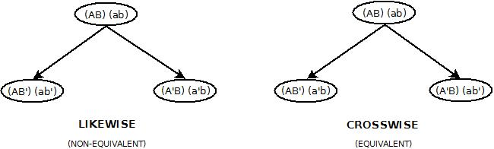
Cell Labeling Combinations/2
Components of the homologous chromosomes are equivalent where A ≡ a and B ≡ b
Assume K pairs of homologous chromosomes control the internal cellular clock
  Possibility of 2^{K} ways of organism beginning its development
  P(MZT) = (1/2)^{K}
K = 8 for humans

Slide 11
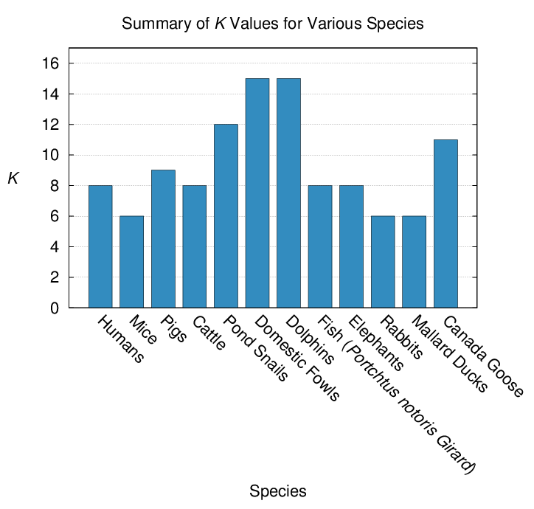
MZ Twinning Frequency
  P(MZT) = (1/2)^{K}, where K = number of pairs of homologous chromosomes
  Much data on MZ twinning frequency in various species support hypothesis

Slide 12
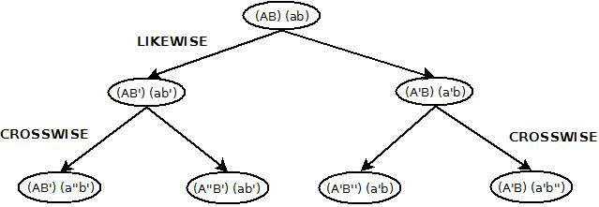
Results
Proposed theory: MZ quadruplets are two pairs of MZ twins, i.e. “quadruplet twins”
  Cells in each pair have identical states of the cellular clock whereas the two pairs slightly differ in their genetic labeling
DNA analysis of quadruplets to test this theory

Slide 13
Results/2
Probability of MZ quadruplets (or triplets)
  P(MZQ) = (1/8)^{K}
Assuming K = 8, frequency of human quadruplets (or triplets) is about 1 in 16 million
  Close to odds observed in several articles⁷
Nine-banded armadillo also exhibits phenomenon of MZ quadruplet births
  May be the case that quadruplets in the armadillo are quadruplet twins
  Genetic variability in armadillos from Brazil
⁷ Articles from UPI, NBC Washington, Los Angeles Times, and “About Four of a Kind” TV show

Slide 14

Implications on Cancerogenesis
Mechanism of MZ twinning at beginning of cell development and apoptosis at the end provides insight into process of cancerogenesis
Emergence of cancerogenesis is a result of a breakdown of protection by apoptosis
Probability of failure of cell death, Z_{T}, between cell divisions⁸:
  M: Hayflick limit
  K: number of pairs of homologous chromosomes
  α: standard deviation coefficient about 1
⁸ Simon Y. Berkovich. “A Cybernetical Model of the Internal Cellular Clock.” Medical Hypotheses, 1981, pp. 1347-1357.

Slide 15
Implications on Cancerogenesis/2
K value of certain laboratory animals, like mice (K = 6), can be used to study the considered threshold effect for cancerization
Results can be quantitatively transferred and compared with the observations on humans

Slide 16
Conclusion
Gained insight into the origins of pairs of MZ twins and higher order multiples
MZ quadruplets may be two pairs of MZ twins
  DNA analysis of quadruplets to test theory
Parameter K reveals structure of internal cellular clock and determines threshold effect in cancerization
  Test theory on laboratory animals such as mice

Slide 17
Thank you!
Questions?

