Slide 1



Separation of cerium from other rare Earth elements by solvente extraction
NUCLEAR TECHNOLOGY DEVELOPMENT CENTER
NATIONAL COMMISSION FOR NUCLEAR ENERGY
Belo Horizonte, Brazil
2nd International Conference and Expo on Separation Techniques
Carlos Antônio de Morais
Thiago Silveira Formiga
Valencia, Spain
September 26-28, 2016

Slide 2
THE PAPER
This work presents an investigation of solvent extraction parameters in order to obtain high purity cerium from a liquor containing a mixture of rare earths elements, as an alternative to cerium oxidation and selective RE dissolution. The sample used was a sulfuric liquor obtained from the leaching of monazite, rich in light rare earth elements (La, Ce, Pr, Nd). The experiments were carried out in hydrochloric, nitric and sulphuric media.

Slide 3

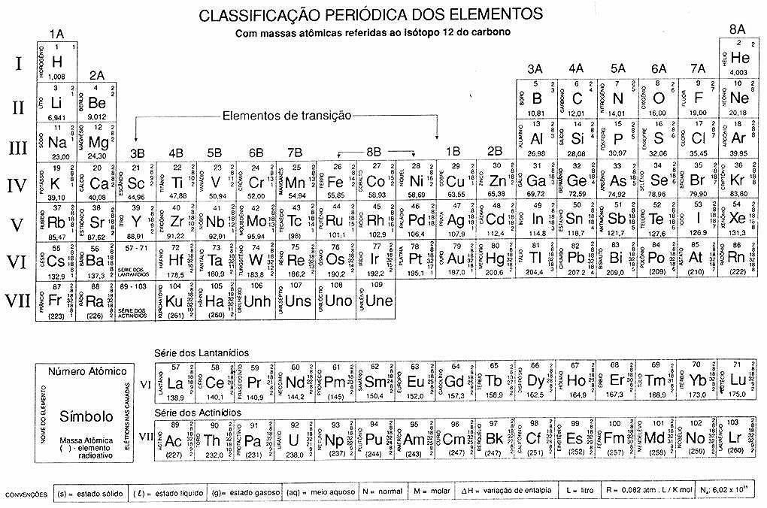
Introduction
The RE are a group of 17 elements composed of the lanthanides, scandium and yttrium

Slide 4
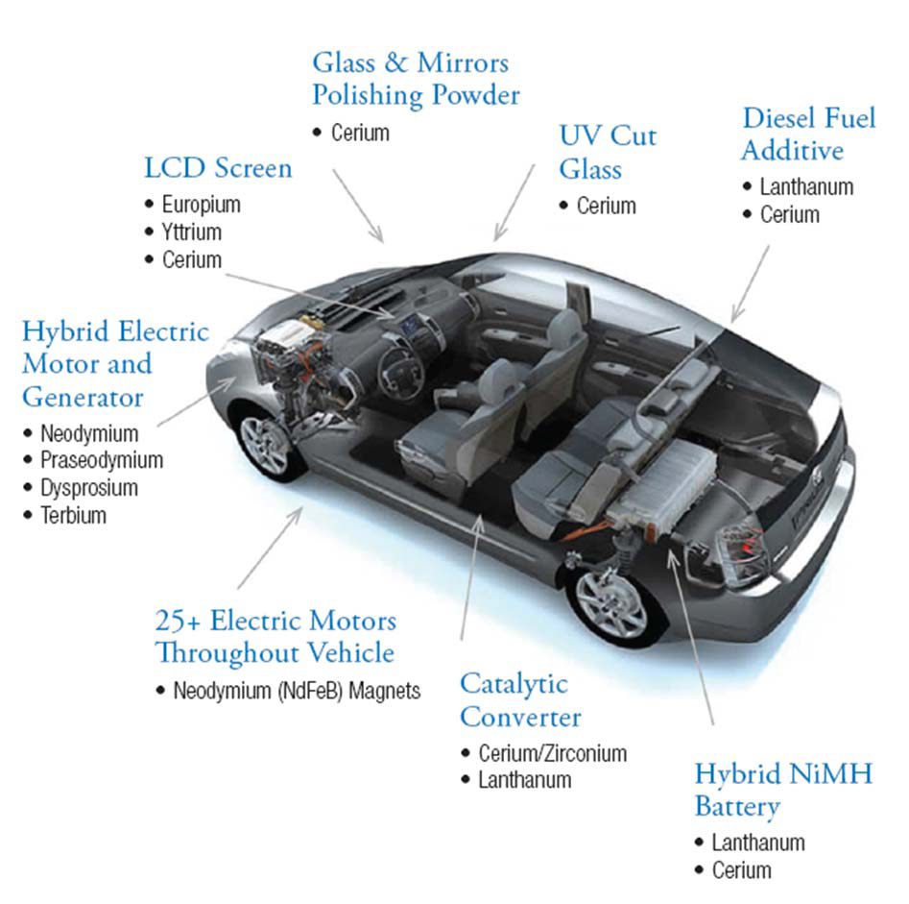
Introduction
The rare earth elements have extreme importance to advanced technology industry (electronic components, permanent magnets, nuclear medicine, automobile industry, wind turbines, among others).

Slide 5
Introduction
The rare earth elements have very similar physical and chemical properties and therefore occur together in different proportions in their mineral sources. Obtaining the individual rare earth elements in industrial scale is very complex and only dominated by a few countries.
This behavior is responsible for the high prices of these elements (difficulties in detection, analysis and commercial extraction).

Slide 6
Introduction
Schematic diagram of the continuous SX circuit – mixer-settlers counter current system
Feed solution
SOLVENT
Regeneration
Extraction
Scrubbing
Stripping
Raffinate
Scrubbing solution
Stripped solution
Stripping solution

Slide 7
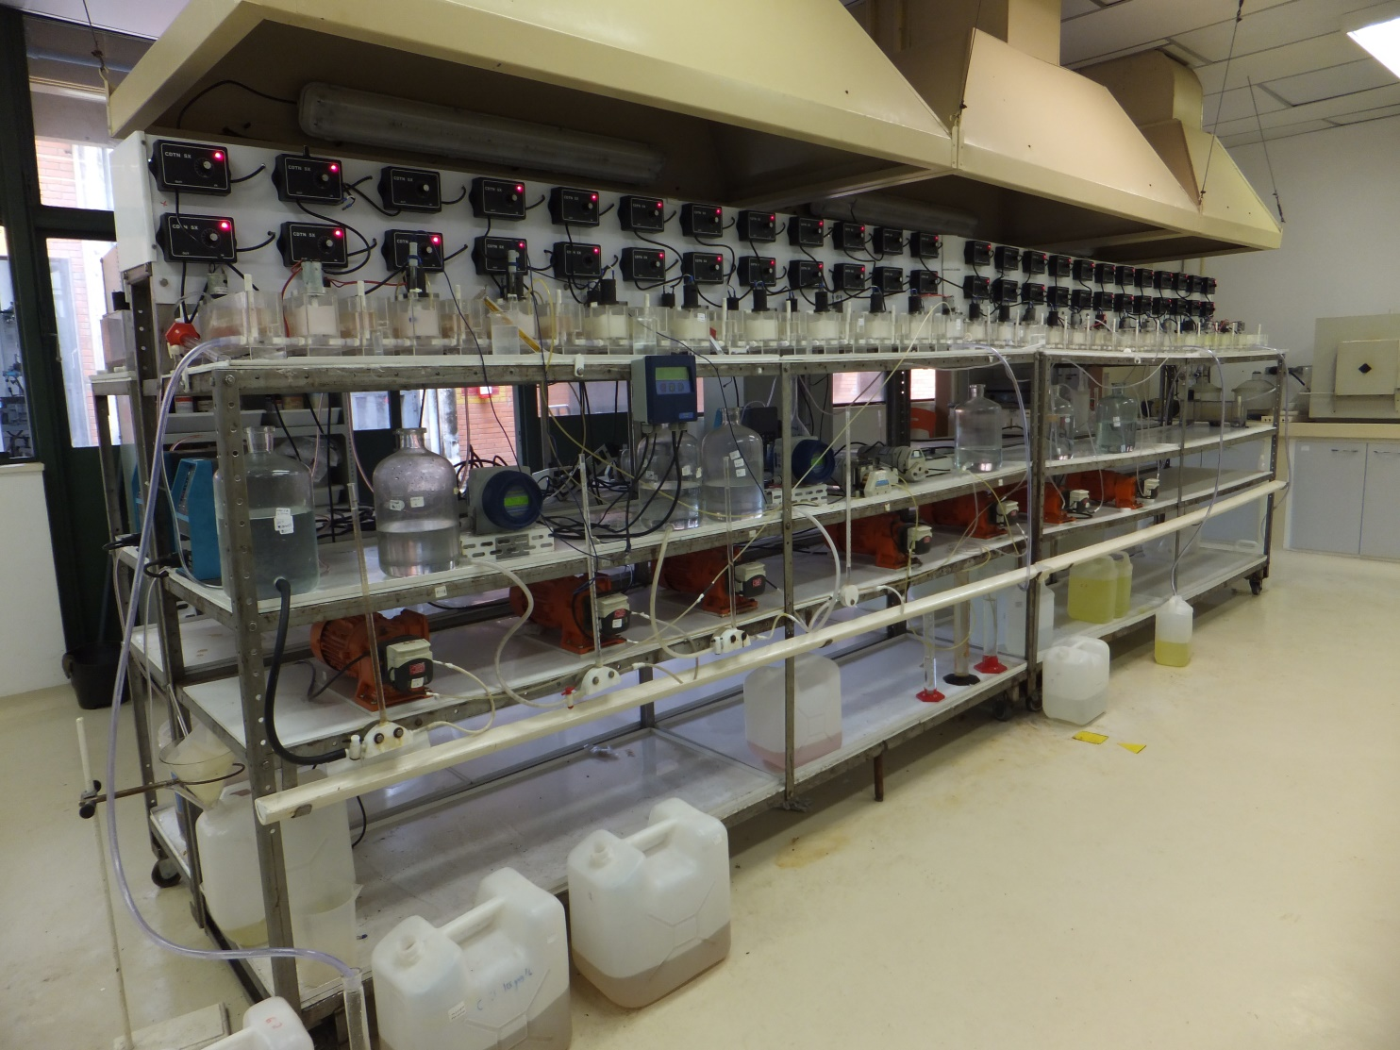
Introduction
Solvent extraction Laboratory – CDTN, Brazil

Slide 8
Introduction - Cerium
Generally the separation of cerium is accomplished by the oxidation of Ce (III) to Ce (IV) following by the selective dissolution of the trivalent REEs. By this technique, the other REEs are usually contaminated with cerium or cerium is contaminated with other rare earth elements, justifying the study of its separation by the solvent extraction technique.

Slide 9
Methodology
The Sulphuric liquor was provided by the Nuclear Industries of Brazil S.A. - INB.
Nitric and hydrochloric media were also investigated.
The nitric and hydrochloric solutions were prepared from the sulphuric liquor by precipitation of the rare earths as oxalate, calcination and dissolution of the rare earth elements in nitric or hydrochloric acid.

Slide 10
Methodology
PARAMETERS INVESTIGATED
  Extractants:
    Solvation extractants (TBP, Cyanex®923);
    Cationic extractants (D2EHPA, P507);
    Anionic extractants (Primene®J-MT, Alamine®336 and Aliquat®336);
  Aqueous phase:
    The medium (hydrochloric, nitric and sulphuric);
    Acidity;
  Aqueous/organic volumetric ratio;
  Presence and absence of oxidizing agent.
Notes:
Solvatação: Substitui água de hidratação
Ácidos ou catiônicos: Liberam H⁺ e se ligam ao cátion do metal
Básicos ou aniônicos: Possuem região positiva e se ligam em complexos aniônicos dos metais

Slide 11
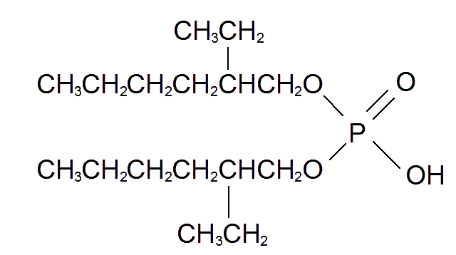
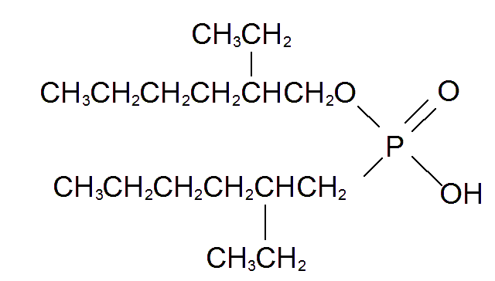
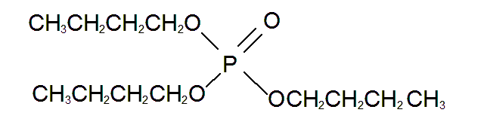

Methodology
TBP - tri-n-butyl-phosphate
D2EHPA - di-2-ethylhexyl phosphoric acid -
P507 - 2-ethylhexyl mono (2-ethylhexyl) ester phosphonic acid
Alamine®336 -trioctyl/decyl amine
Primene®JMT
T-Alkyl(C16-C22) primary amine
Cyanex®923 - trialkylphosphine oxide
Aliquat®336
trialkyl-methyl-ammonium-chloride
Notes:
Solvatação: Substitui água de hidratação
Ácidos ou catiônicos: Liberam H⁺ e se ligam ao cátion do metal
Básicos ou aniônicos: Possuem região positiva e se ligam em complexos aniônicos dos metais

Slide 12
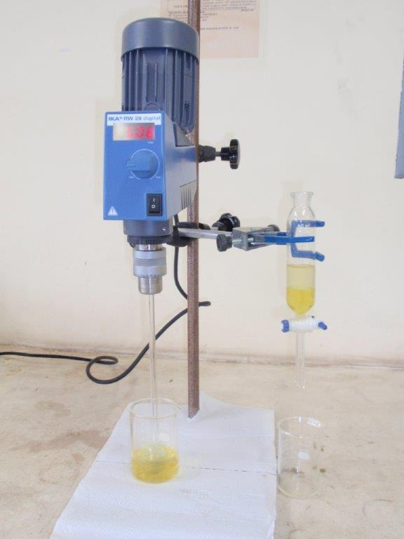
Methodology
Bench extraction experiments
Organic phase
Extractant
Aqueous phase
RE liquor
Agitation
(5 min)

Slide 13
Samples
  Chemical composition of the liquors
Sample | Content (g/L)
 | La | Ce | Nd | Pr | Sm | Gd | Dy | Y
Sulphuric liquor | 6.7 | 14.8 | 5.6 | 1.5 | 0.69 | 0.56 | 0.16 | 0.49
Hydrochloric liquor | 6.5 | 14.6 | 5.6 | 1.6 | 0.70 | 0.56 | 0.16 | 0.47
Nitric liquor | 6.5 | 14.5 | 5.7 | 1.5 | 0.71 | 0.56 | 0.16 | 0.50

Slide 14
Results - Sulphuric liquor
REE extraction – without oxidant addition
  It was observed no extraction of REE.
  High acidity of the liquor – about 1 mol/L H⁺.
  The pH adjustment was unfeasible due to formation a precipitate of double sulfate of rare earth and sodium or ammonium, depending on the basic reagents used (NaOH, NH₄OH or Na₂CO₃).

Slide 15
Results - Hydrochloric liquor
REE extraction – without oxidant addition
Extractant | pH | Extraction (%) |  |  |  | Separation factor
 |  | La | Ce | Pr | Nd | Ce/La | Pr/Ce | Nd/Pr
P507 | 0.5 | 0.7 | 1.8 | 6 | 7 | 3.5 | 3.2 | 1.2
P507 | 1.0 | 5.0 | 16 | 37 | 40 | 3.9 | 3.2 | 1.2
P507 | 2.0 | 13 | 37 | 66 | 70 | 4.1 | 3.2 | 1.2
D2EHPA | 0.5 | 17 | 38 | 61 | 64 | 3.1 | 2.7 | 1.1
D2EHPA | 1.0 | 36 | 64 | 80 | 82 | 3.2 | 2.3 | 1.1
D2EHPA | 1.5 | 65 | 86 | 93 | 94 | 3.3 | 2.2 | 1.1

Slide 16
Results - Hydrochloric liquor – pH 0
REE extraction – with oxidant addition
Extractant | Oxidant | Extraction (%) |  |  |  | Separation factor
 |  | La | Ce | Pr | Nd | Ce/La | Pr/Ce | Nd/Pr
P507 | Na₂S₂O8 | 6 | 12 | 15 | 17 | 2.1 | 1.3 | 1.2
P507 | K₂S₂O₈ | 7 | 13 | 16 | 18 | 2.0 | 1.3 | 1.2
D2EHPA | Na₂S₂O8 | 16 | 28 | 37 | 42 | 2.1 | 1.5 | 1.1
D2EHPA | K₂S₂O₈ | 16 | 27 | 38 | 39 | 2.0 | 1.5 | 1.1
Potential: Initial: 550 mv
After oxidant addition: 980 mv
After extraction : 580 (mV)
Notes:
Extratantes que demonstraram maior potencial na primeira etapa deste estudo

Slide 17
Results - Nitric liquor
REE extraction – without oxidant addition – pH 1.0
Extractant | Extraction (%) |  |  |  | Separation factor
 | La | Ce | Pr | Nd | Ce/La | Ce/Pr | Nd/Pr
Cyanex® 923 | 98 | 100 | 99 | 99 | - | - | -
P507 | 7 | 76 | 34 | 36 | 44 | 6.2 | 1.1
D2EHPA | 54 | 95 | 91 | 89 | 17 | 2.6 | 1.1
Notes:
TBP e básicos não apresentaram extração (<5%)
Extração seletiva de Ce, meio nítrico é mais oxidante, manteve o Ce que oxida na calcinação na forma +4
D2EHPA extrai mais, P507 mais seletivo

Slide 18
Results - Nitric liquor
REE extraction – without oxidant addition at different pH without oxidant addition
Extractant | pH | Extraction (%) |  |  |  | Separation factor
 |  | La | Ce | Pr | Nd | Ce/La | Ce/Pr | Nd/Pr
P507 | 1,0 | 7 | 76 | 35 | 36 | 44 | 5.8 | 1.0
P507 | 2,0 | 26 | 89 | 80 | 80 | 24 | 2.2 | 1.0
D2EHPA | 0,5 | 25 | 88 | 69 | 69 | 22 | 3.4 | 1.0
D2EHPA | 1,0 | 54 | 93 | 88 | 89 | 16 | 2.6 | 1.0
D2EHPA | 1,5 | 86 | 99 | 98 | 98 | 20 | 2.2 | 1.0
Initial potential: 1460 mv
Notes:
P507 – pH 1,0 melhor separação

Slide 19
Results - Nitric liquor
REE extraction – with oxidant addition - high acidity liquor
Oxidant | Contact | Extraction (%)
 |  | La | Ce | Pr | Nd
None | 1st | <1 | 45 | <1 | <1
 | 2nd | <1 | 15 | <1 | <1
K₂S₂O₈ | 1st | <1 | 45 | <1 | <1
 | 2nd | <1 | 16 | <1 | <1
AgNO₃ | 1st | <1 | 44 | <1 | <1
 | 2nd | <1 | 19 | <1 | <1
K₂S₂O₈ + AgNO₃ | 1st | <1 | 95 | <1 | <1
 | 2nd | <1 | 5 | <1 | <1
Potential
Initial: 1460 mv
K₂S₂O₈ + AgNO₃ :1620 mv
Final: 1410 mV

Slide 20
Conclusions
The experiments without the oxidation of cerium (III) to cerium (IV) indicated the difficulty in its separation from the other trivalent REE.
In nitric medium, cerium was preferentially extracted from the other rare earth elements. Using a mixture of potassium persulfate and silver nitrate as oxidizing and P507 as extractant, 99.9% recovery with 99.9% purity was achieved in two stages.

Slide 21
Thank you for the attention

