Slide 1


Carbon stocks and fluxes in the Andean treeline of Polylepis reticulata in Ecuador:
present balance and projected values for the XXI century.
Carlos Gracia & Aldemar Carabajo
Department of Ecology, University of Barcelona (Spain) and
Department of Hydric Resources, University of Cuenca (Azuay, Ecuador)
World Conference on Climate Change, October 24-26, 2016 Valencia

Slide 2
Background:
Frequent oppinions about afforestation to reduce atmospheric CO₂, often without good empiric data on the table...
but.....
What is the role of forests in this context?
What about side effects i.e. shortage of water in arid and semi-arid areas in the world?

Slide 3
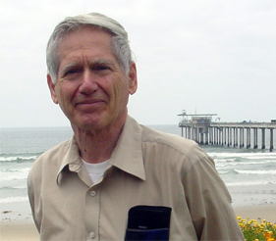
CO₂ concentration at Mauna Loa
͠ 8 ppmv/year
Charles David Keeling
Updated April 2016

Slide 4
Background
  Polylepis species are among the trees living at higher altitude in the world.
  The genus is endemic from the Andean Cordillera. These are forests at the limit.
  P. reticulata is one of these species living between 3800 and more than 4500 m a.s.l. in the Ecuadorian Andes.
  The open question is: How Polylepis will cope with the increasing temperature and increasingly dry periods?.

Slide 5
Two main objectives:
To understand the basic ecophysiology of Polylepis reticulata by analyzing the carbon stocks and fluxes.
To explore the possible responses of P. reticulata to Climate Change in the coming decades.

Slide 6
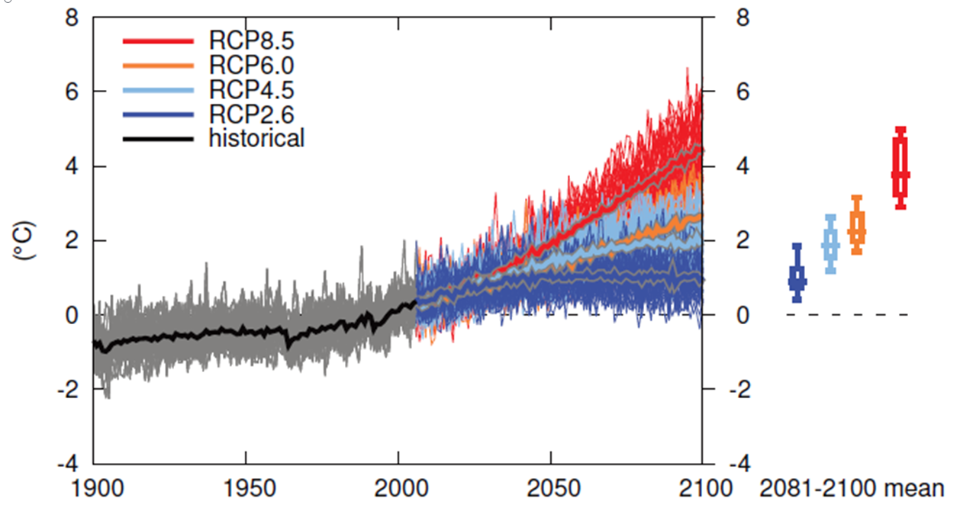
Temperature change
West Coast South America…
Source: IPCC, 5th AR, 2013
Notes:
Just some basic info needed to open some closed eyes.

Slide 7
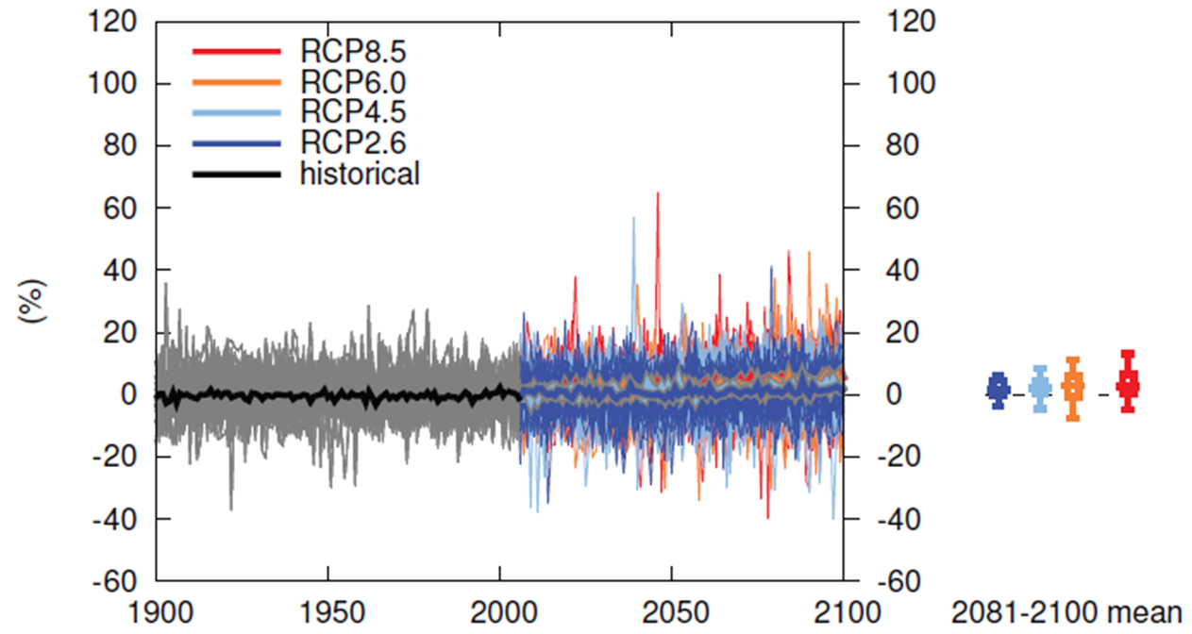
Precipitation change
West Coast South America…
Source: IPCC, 5th AR, 2013
Notes:
Just some basic info needed to open some closed eyes.

Slide 8
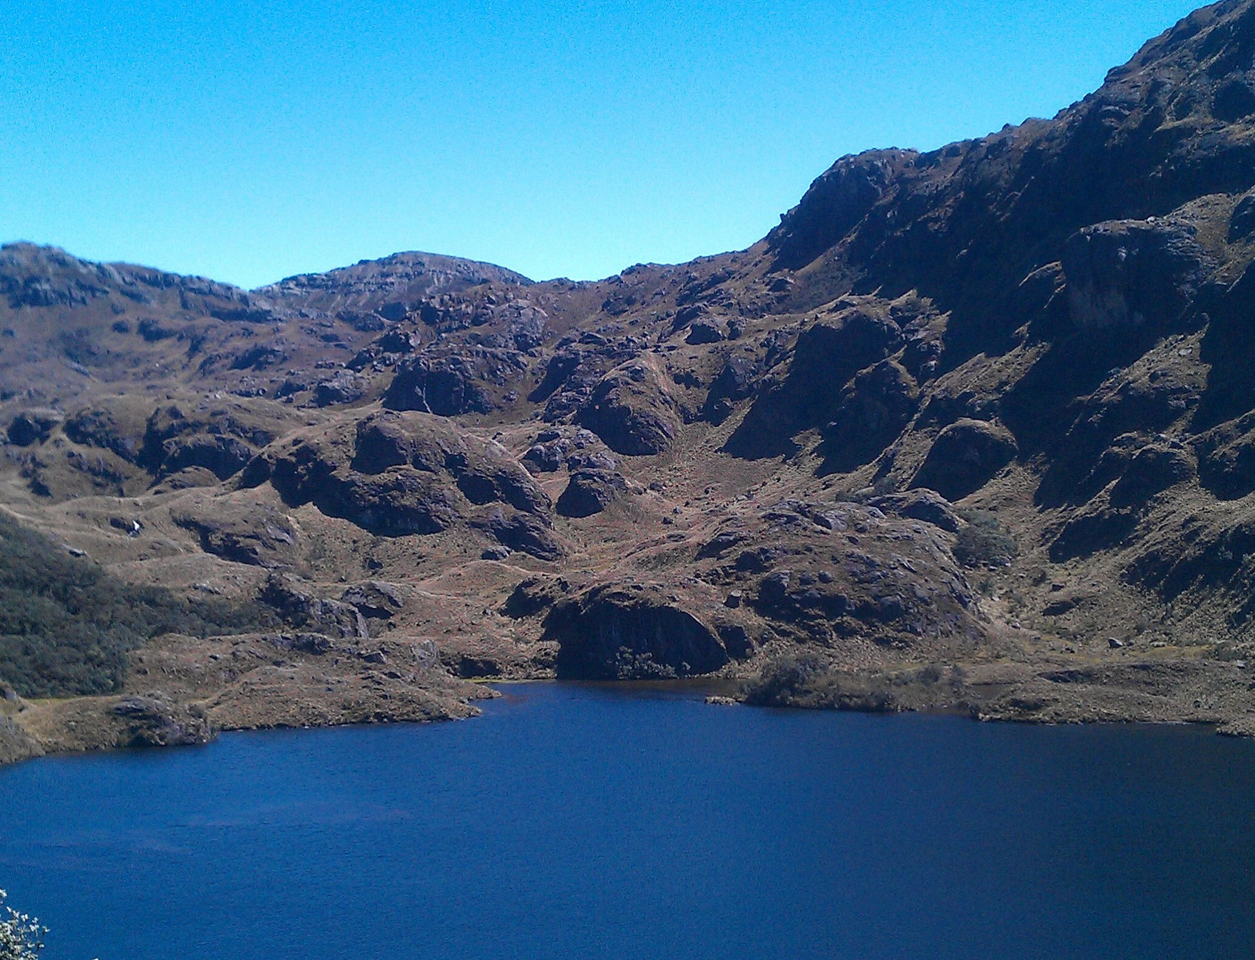
Environmental conditions…

Slide 9
Temperature and thermal amplitude...
P.N. El Cajas: Minimum and maximum daily temperatures
Summer every day and winter every night (Lüttge 2008).
P.N. El Cajas: daily thermal amplitude

Slide 10
Annual Solar Radiation…
Annual Solar Radiation:
Cajas N. P. : 4249 MJ·m⁻²
Prades Spain: 6280 MJ·m⁻²

Slide 11
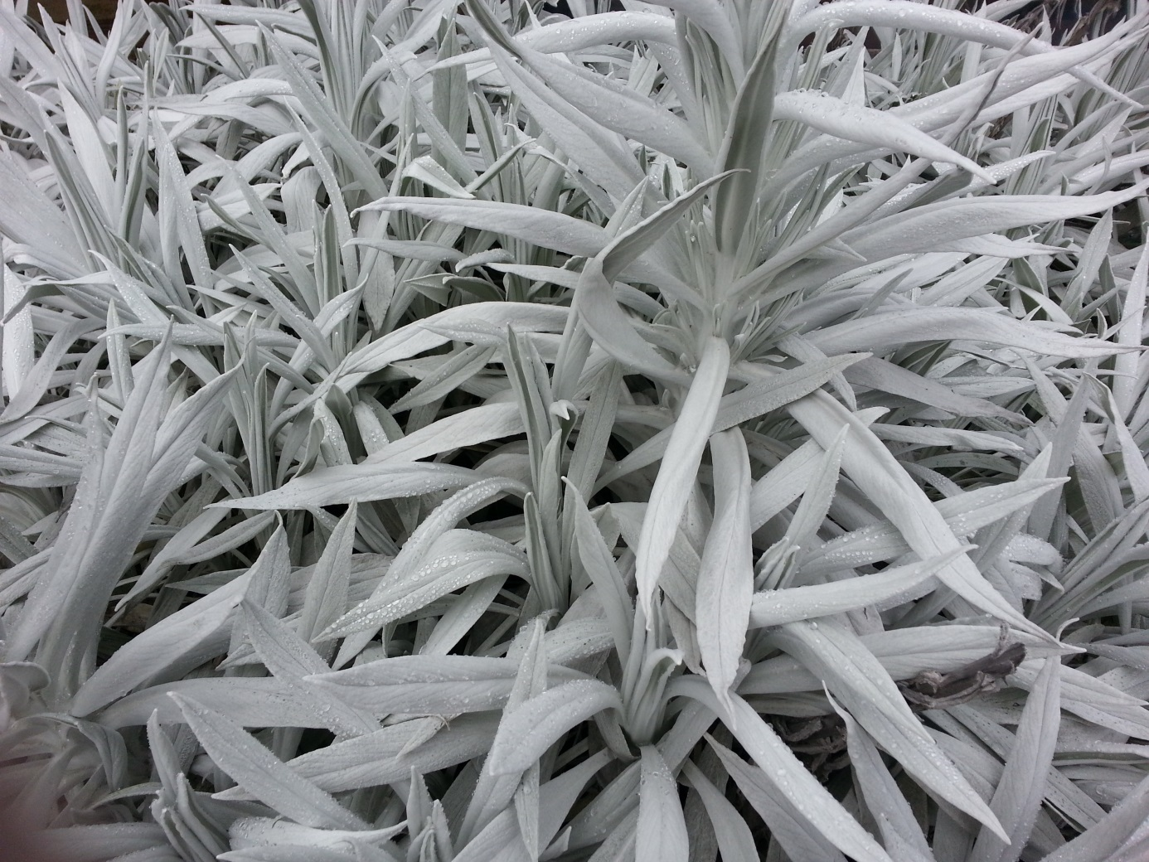
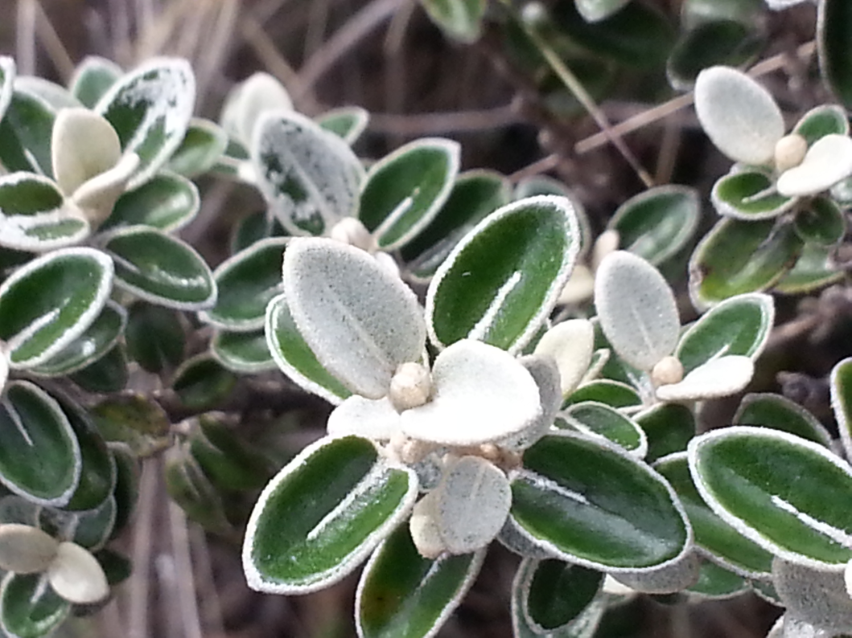
The high UV component of solar radiation induces particular responses of vegetation such as...
...the common white hairy leaves very efficient to reflect incident radiation.

Slide 12
Precipitation vs. ET₀...
precipitation potential evapotranspiration
Annual precipitation: 957 mm
Annual ETo: 740 mm

Slide 13
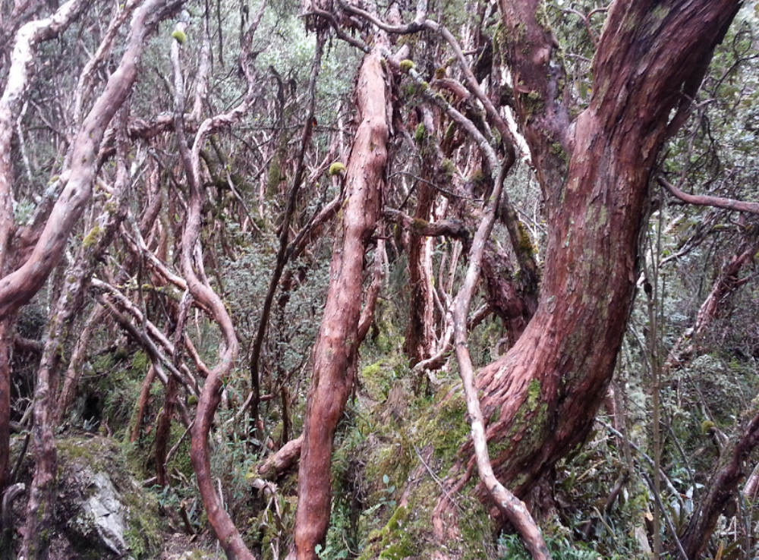
Polylepis reticulata

Slide 14
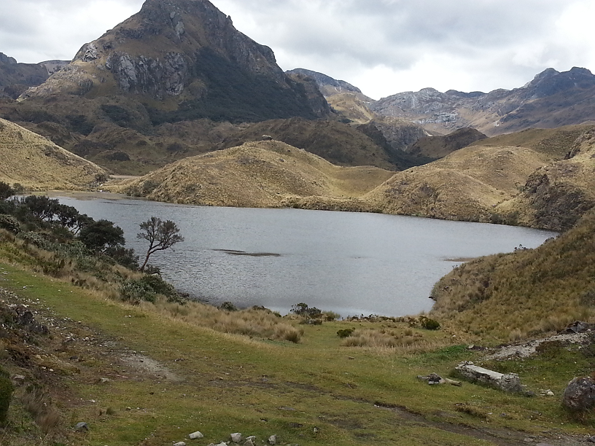

Slide 15
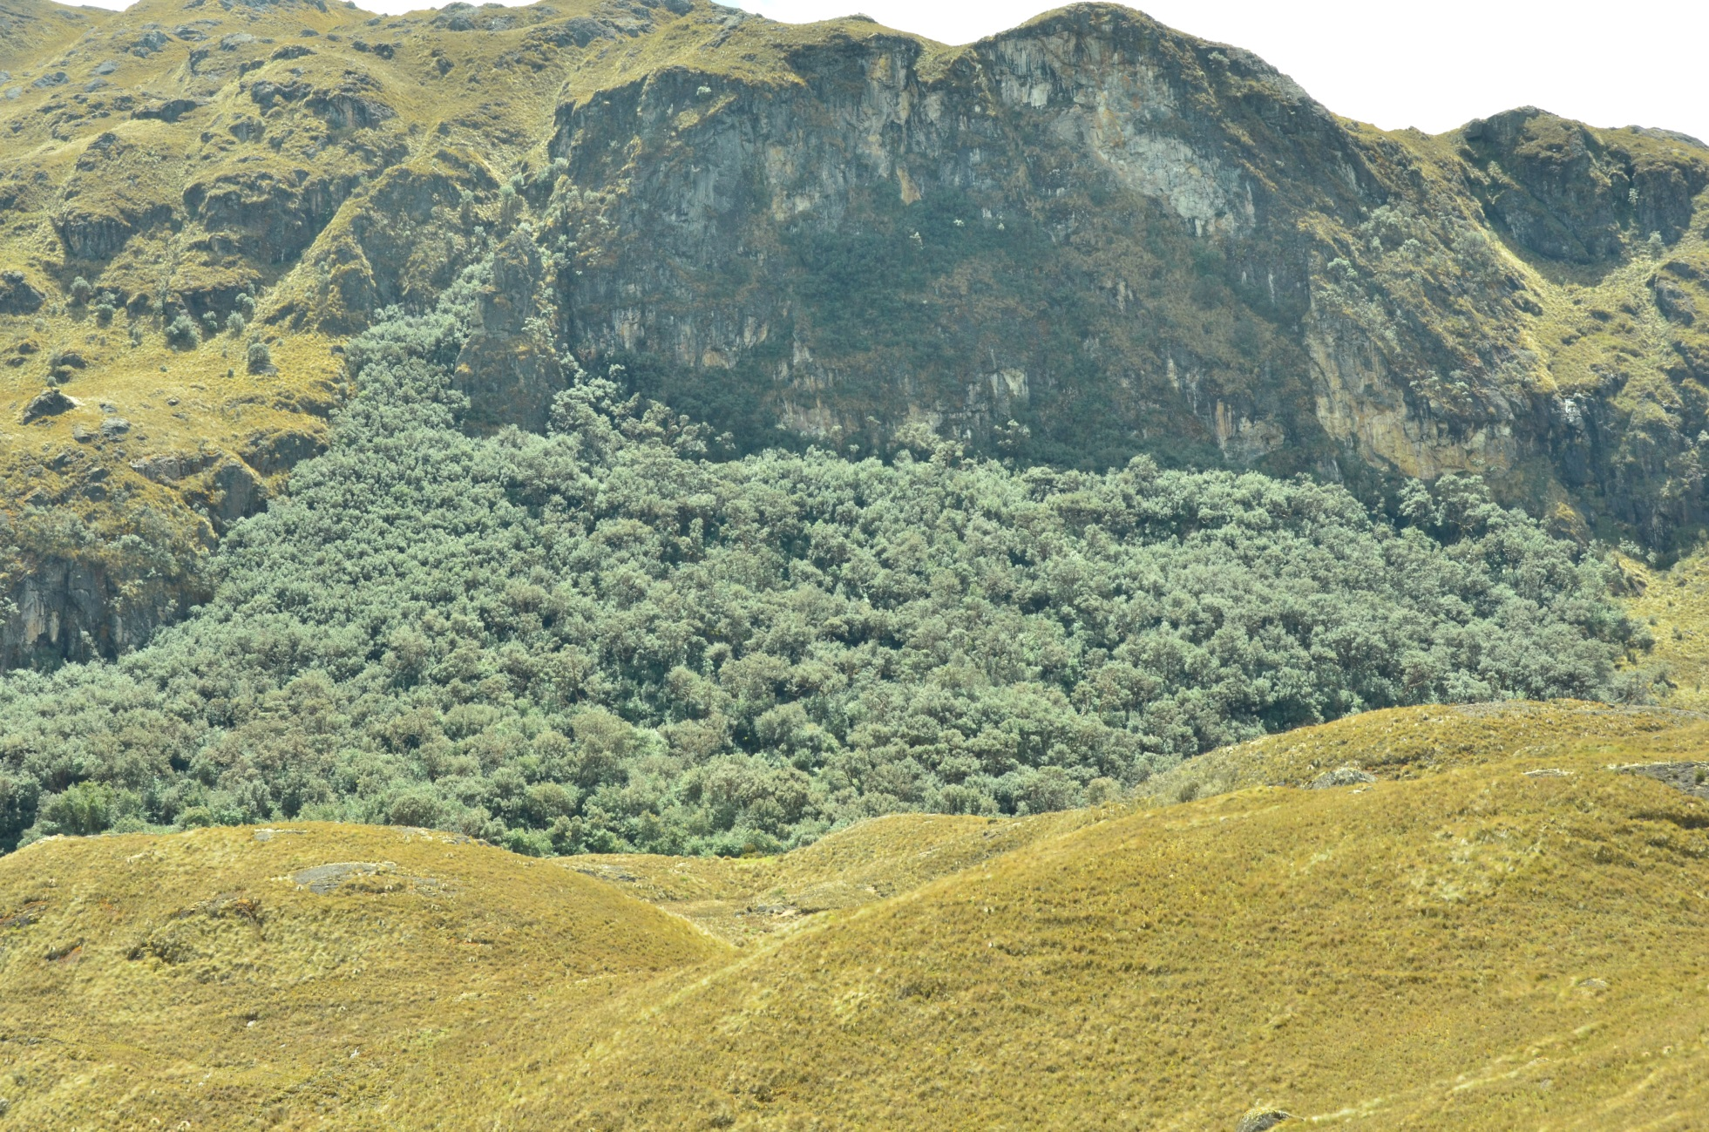
Polylepis reticulata Cajas N.P.

Slide 16
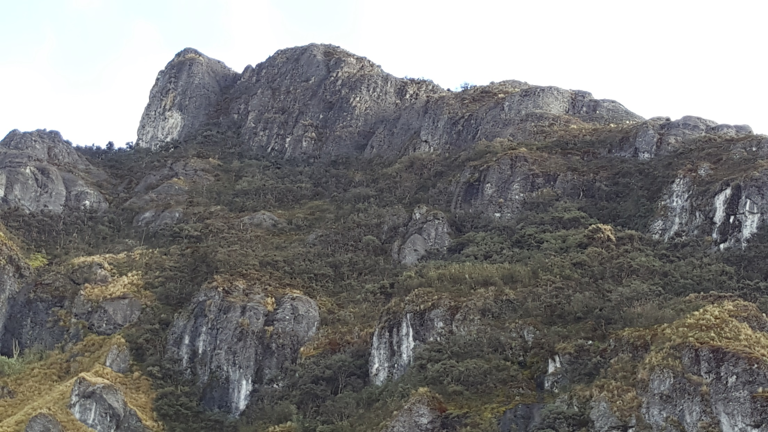
Polylepis reticulata Burines valley

Slide 17
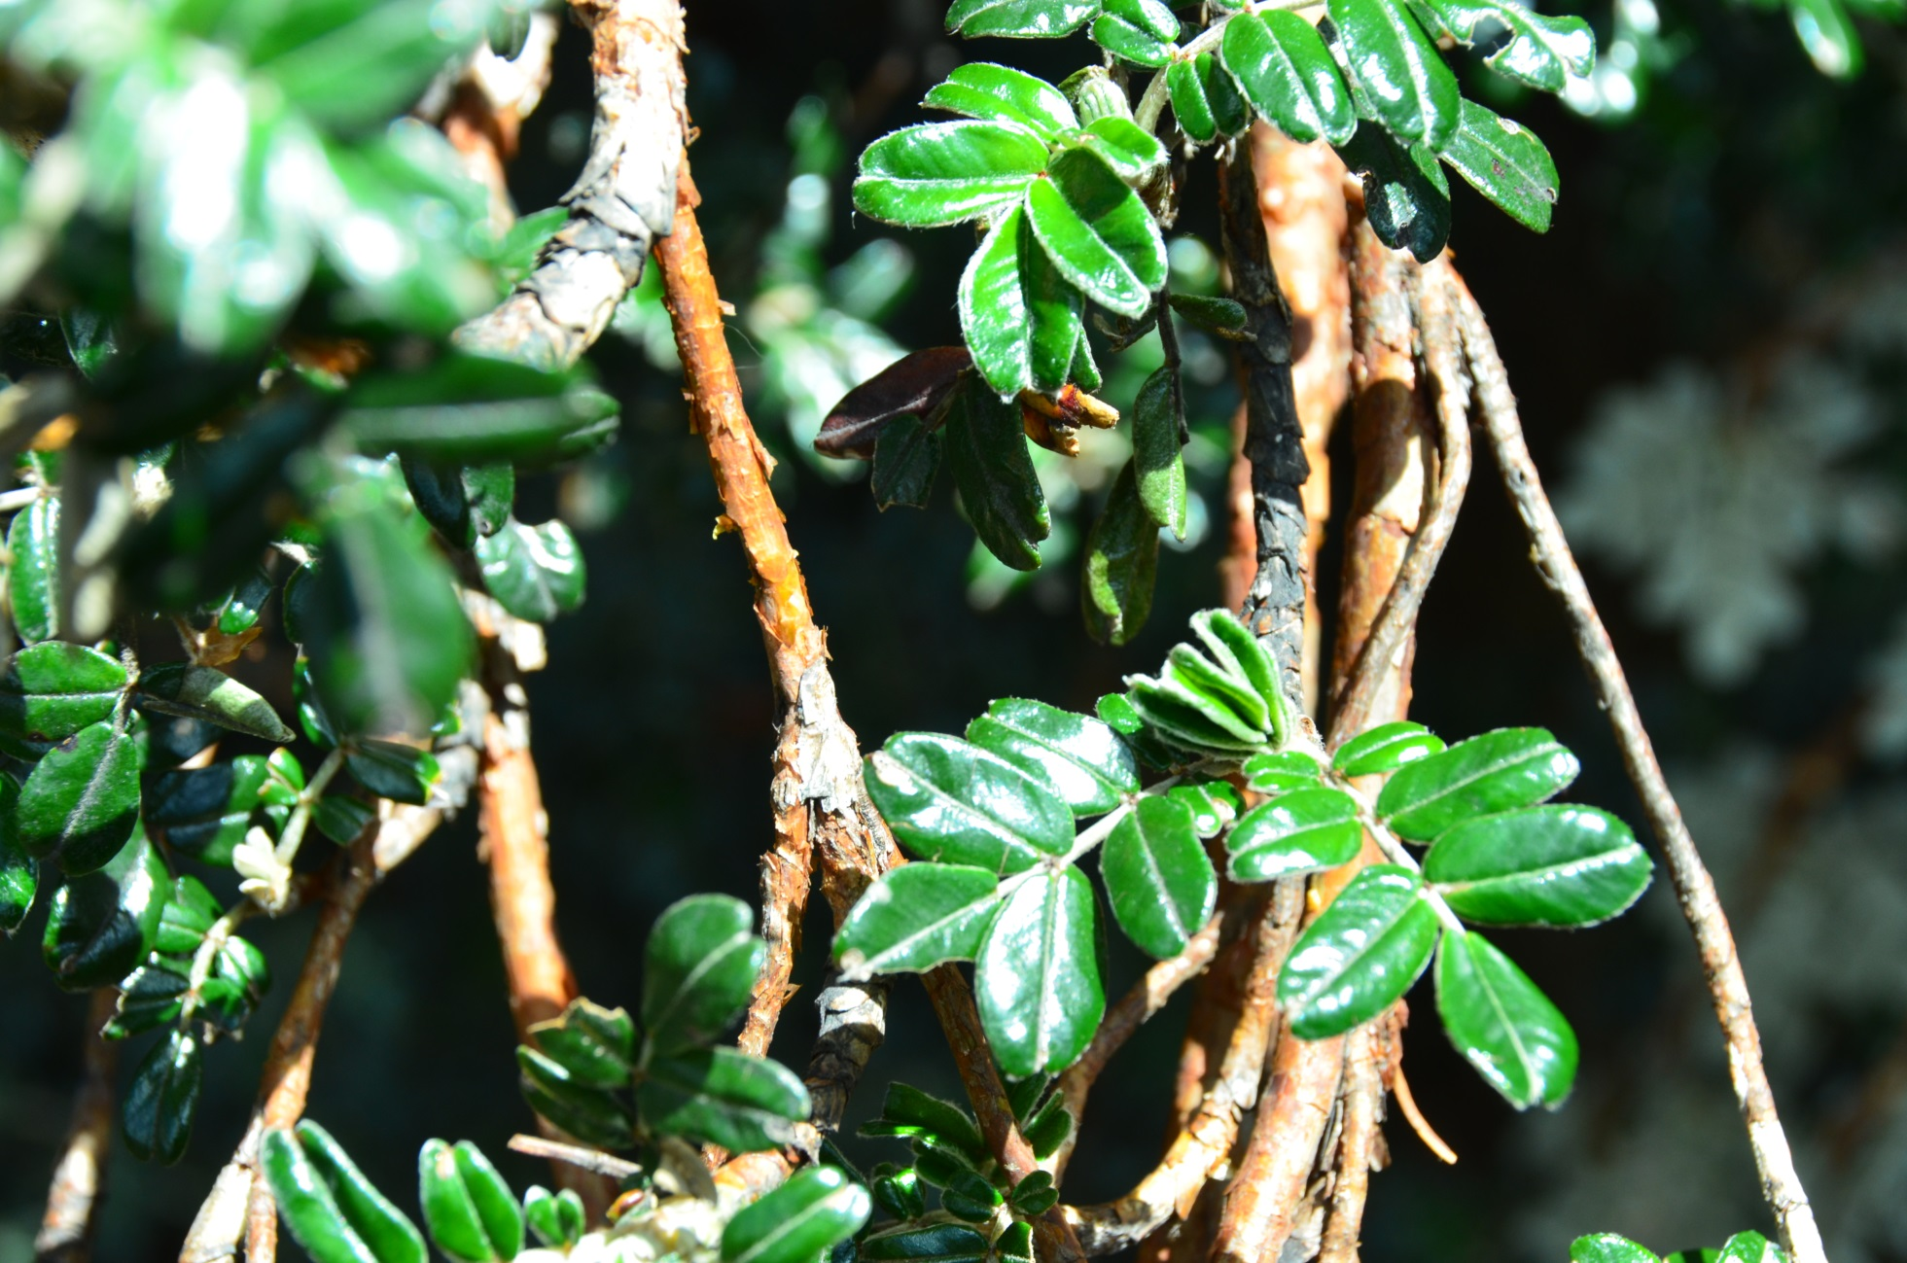
Polylepis reticulata

Slide 18
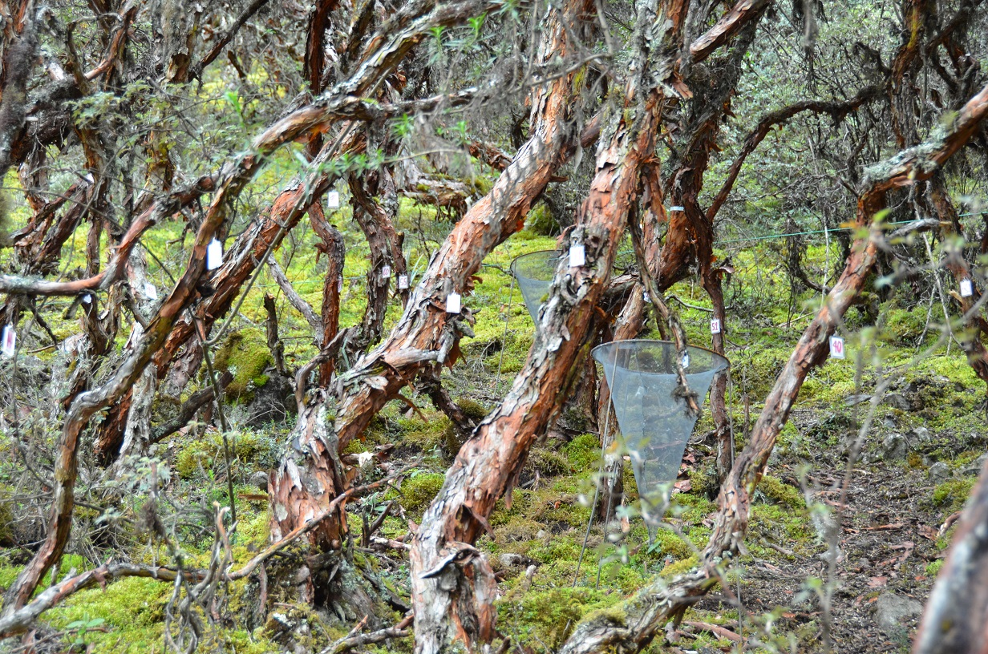
Polylepis reticulata Quinoas plot

Slide 19
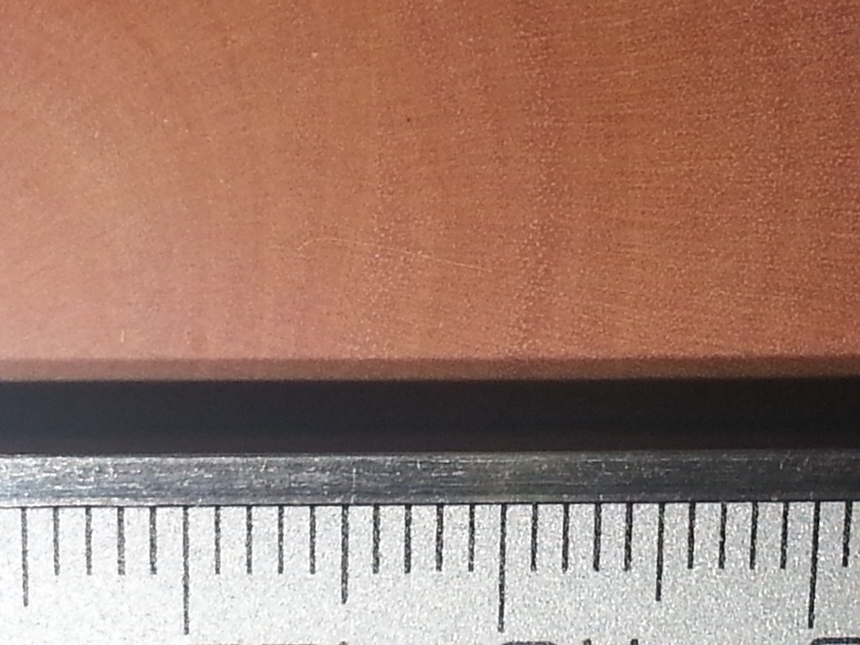
Growth pattern... no annual tree rings
To estimate the annual growth rate, tree ring analysis is required.
  Tree rings not easy to identify and most of the visible rings are not annuals.

Slide 20
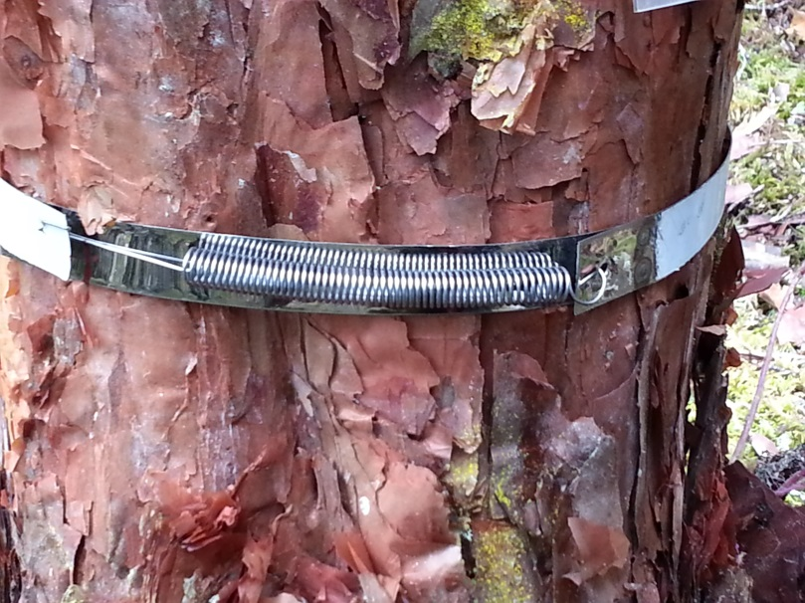
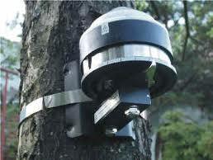
Polylepis growth rates…..
The growth rate has been estimated using continuous recording with dendrometers

Slide 21
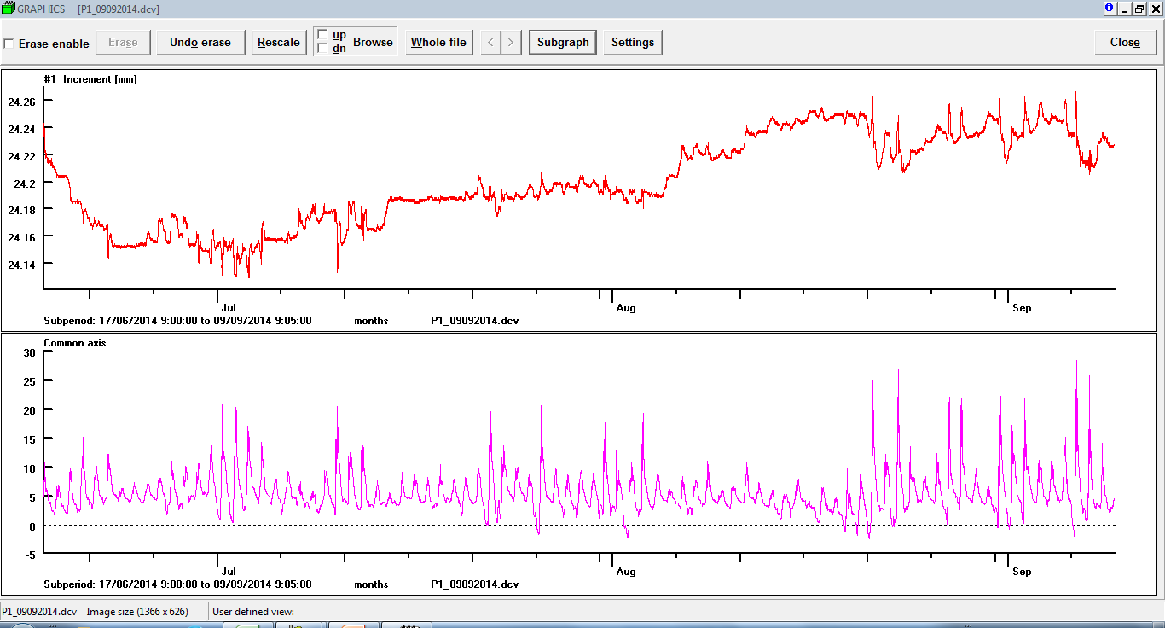
Dendrometric continuous recording
Increment (mm)
Temperature ºC

Slide 22
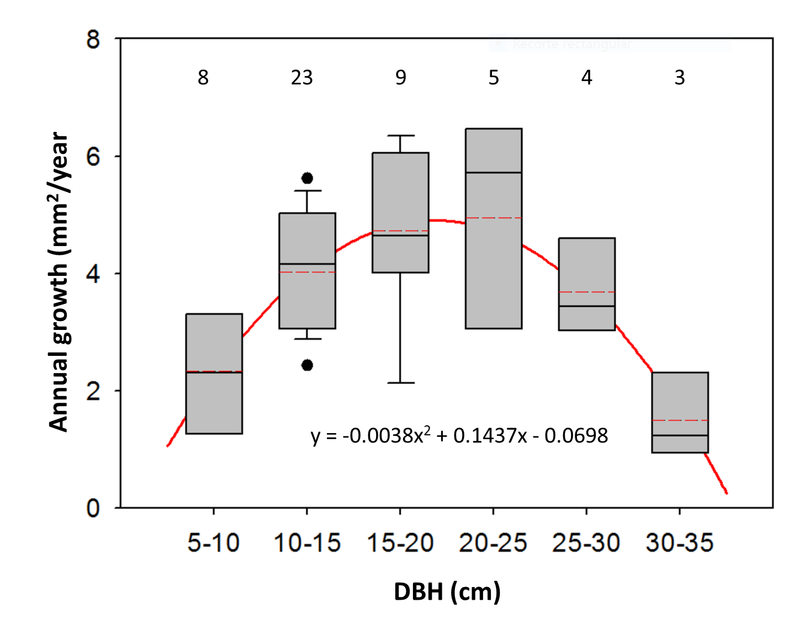
Annual growth as a function of tree size
Trees of 30-35 cm DBH are around 400 years old.

Slide 23
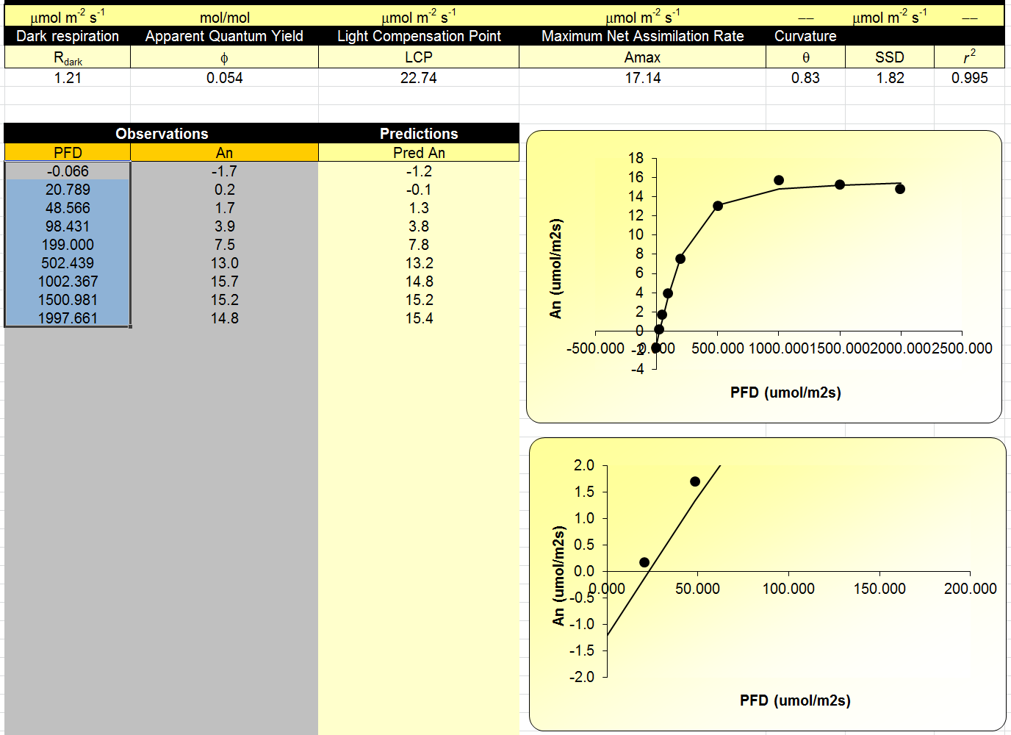
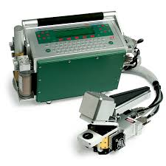
PR_JG_P2_LUZ(400CO2)_02062016
Light response of photosynthesis

Slide 24
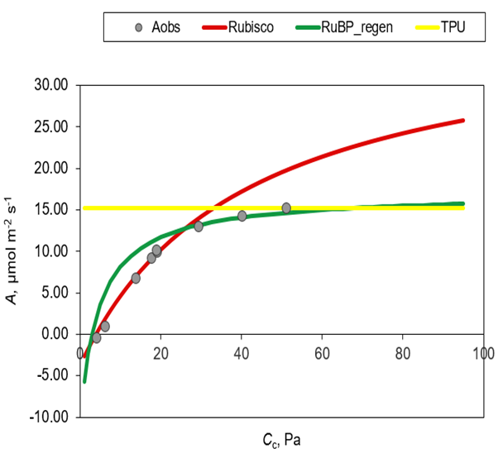
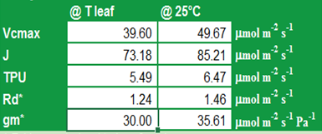
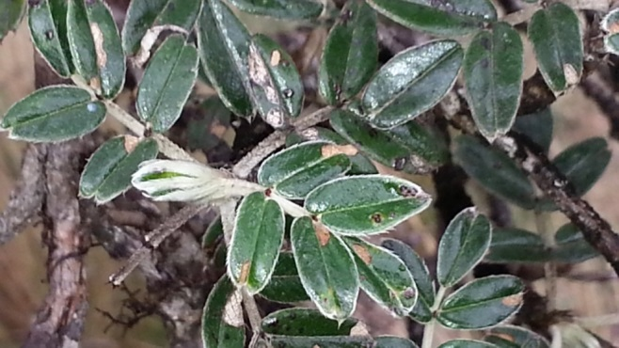
PR_EC_P2_CO2(1000PAR)_01042016
response of photosynthesis to CO₂
PR_JG_P2_LUZ(400CO2)_02062016

Slide 25
response of photosynthesis to light and CO₂
CO₂ (ppmv)

Slide 26
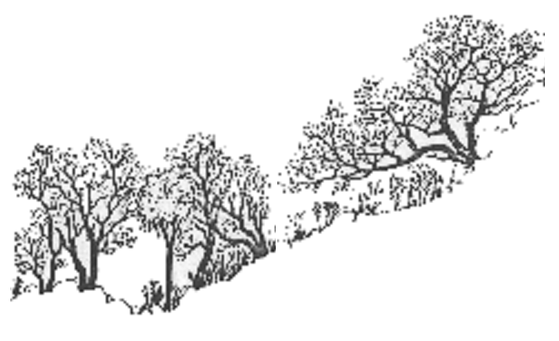
WUE: 7.72 mmols C·mol⁻¹ H₂O
Transpiration
Atmospheric CO₂
  A synthetic view of Carbon stocks and fluxes in P. reticulata.
GPP: 1151 gC·m⁻²·y⁻¹
224 kg·m⁻²·y⁻¹
R: 888 gC·m⁻²·y⁻¹
SLM= 189 g·m⁻²
LAI = 3.96
Turnover rate = 1.75 y
NPP: 263 gC·m⁻²·y⁻¹
192 g·m⁻²·y⁻¹
(only in litter)
To stems and branches
To leaves
46 g·m⁻²·y⁻¹
To the roots
194 g·m⁻²·y⁻¹
C in leaves 326 g·m⁻²
24 g·m⁻²·y⁻¹
Litterfall
193 g·m⁻²·a⁻¹
C in stems and branches
4753 g·m⁻²
Litter on the floor
288 g·m⁻²
k =0.40 a⁻¹
C in the roots
≈ 1757 g·m⁻²
C stored in soil
?? g·m⁻²
Density: 4025 trees·ha⁻¹

Slide 27
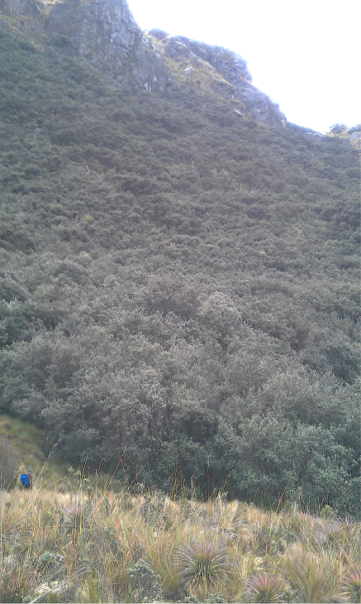
Polylepis at present
WUE: 7.72 mmols C·mol⁻¹ H₂O
transpiration
atmospheric CO₂
GPP: 1151 gC·m⁻²·y⁻¹
224 kg·m⁻²·y⁻¹
R: 888 gC·m⁻²·y⁻¹
NPP: 263 gC·m⁻²·y⁻¹
to stems and branches
to leaves
46 g·m⁻²·a⁻¹
194 g·m⁻²·a⁻¹
to the roots
  1 kg of wood = 5 m³ of water
24 g·m⁻²·a⁻¹

Slide 28
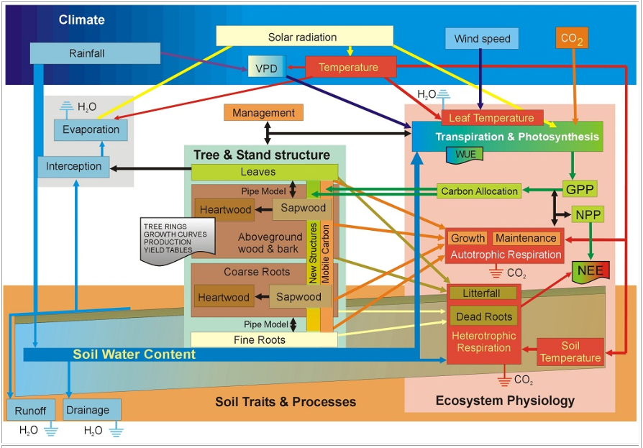
GOTILWA+ model
Gracia et al. 1998-2016
http://www.creaf.uab.es/gotilwa/

Slide 29
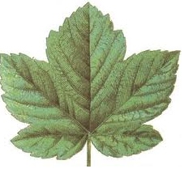
Day=1
Net Primary Production
Initial forest structure
Carbon Allocation
Day=
Day +1
Incoming Solar Radiation
Leaf dropping
Climate data for the day
Soil Organic Matter
Climate change
(if applicable)
Soil temperature
Leaf temperature
(Leaf Energy Balance)
Sun and Shade
leaves
Fine roots mortality
X 24
Stomatal Conductance
Sapwood to Heartwood
X 2
Transpiration
Tree mortality
Hourly calculation and daily integration
Gas exchange
(sun and shade leaves)
Understorey
Logging (if applicable)
VOC emissions
Fire Risk Estimation
Drainage and Runoff
Nutrient balance
Regeneration
Gross Primary Production
Soil respiration
Leaf Respiration
Fine roots mortality
Sapwood Respiration
OUTPUT
(Results integration)
Fine Roots Respiration

Slide 30
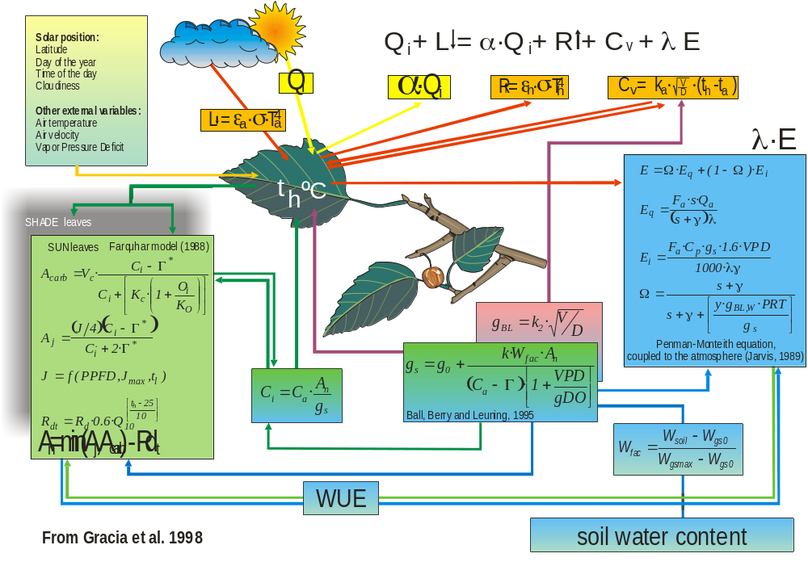
Leaf Energy Balance vs. Gas Exchange

Slide 31
Polylepis 2095-2100
Scenario IPCC RCP 2.6
WUE: 8.64 mmols C·mol⁻¹ H₂O
transpiration
atmospheric CO₂
GPP:1831 gC·m⁻²·y⁻¹
318 kg·m⁻²·y⁻¹
R:1469 gC·m⁻²·y⁻¹
NPP: 362 gC·m⁻²·y⁻¹
to stems and branches
to leaves
23 g·m⁻²·y⁻¹
325 g·m⁻²·y⁻¹
to the roots
  1 kg of wood = 14 m³ of water
15 g·m⁻²·y⁻¹

Slide 32
?
Polylepis 2095-2100
Scenario IPCC RCP 8.5
WUE: 13.4 mmols C·mol⁻¹ H₂O
transpiration
atmospheric CO₂
GPP:2971 gC·m⁻²·y⁻¹
332 kg·m⁻²·y⁻¹
R: 2388 gC·m⁻²·y⁻¹
NPP: 584 gC·m⁻²·y⁻¹
to stems and branches
to leaves
Acclimation ?
Down regulation of
photosynthesis?
28 g·m⁻²·y⁻¹
527 g·m⁻²·y⁻¹
to the roots
  1 kg of wood = 12 m³ of water
29 g·m⁻²·y⁻¹

Slide 33
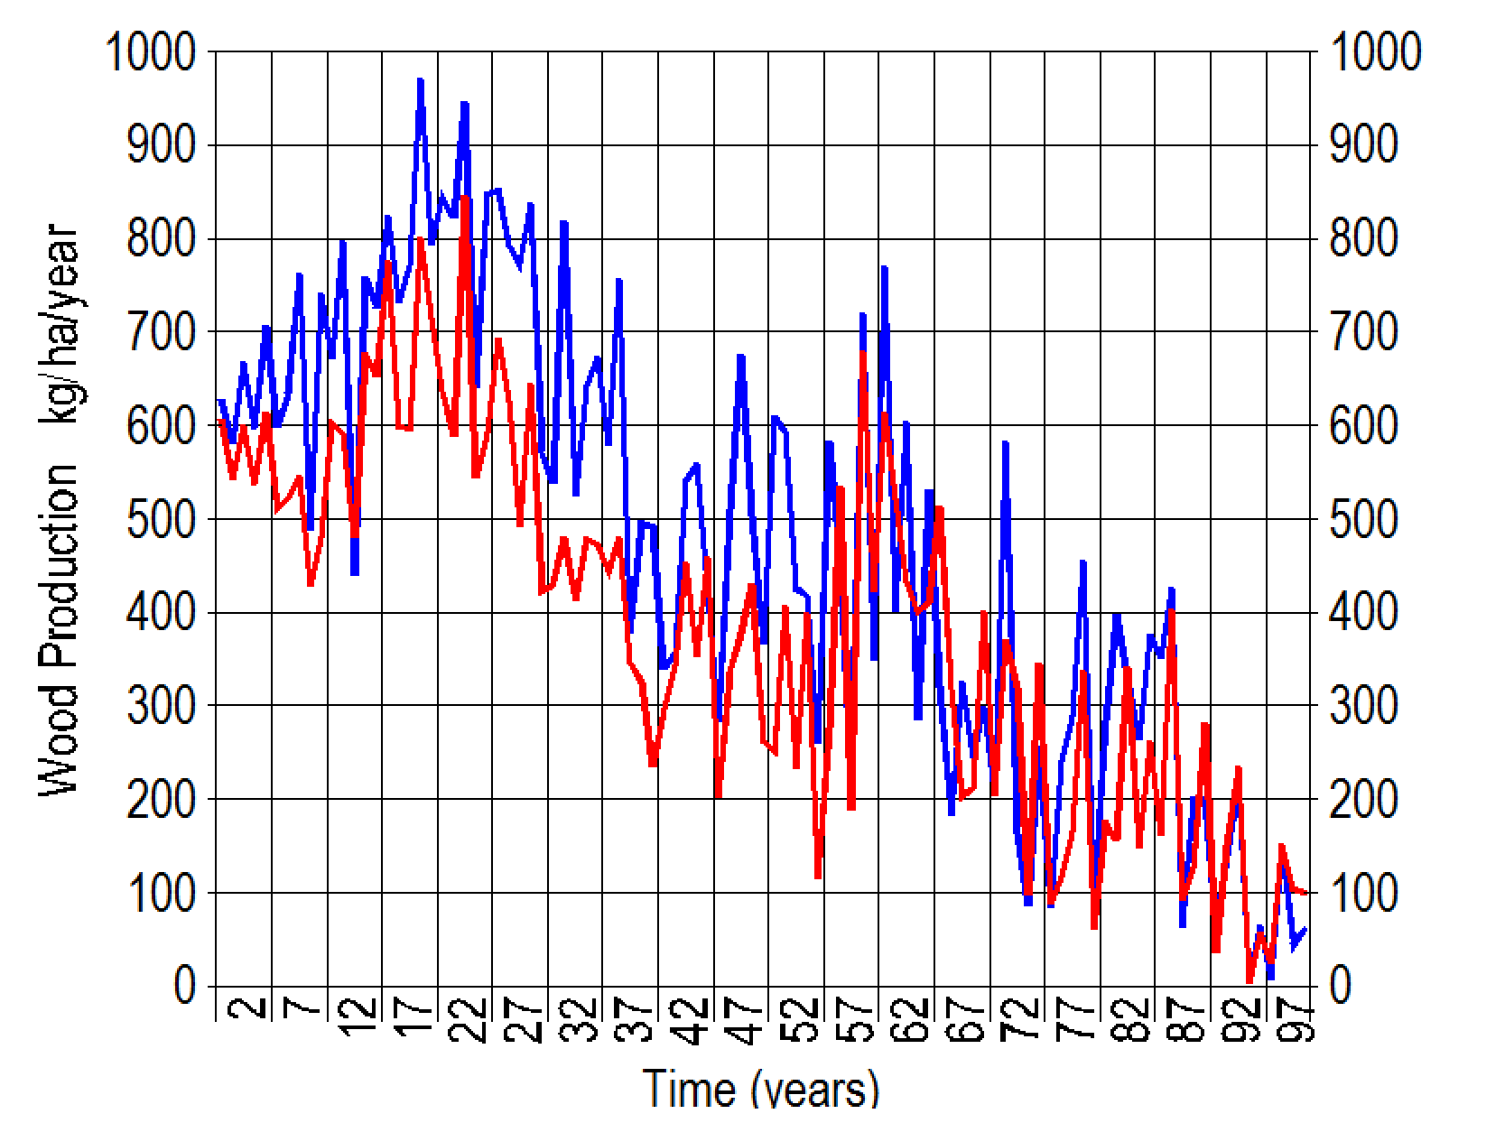
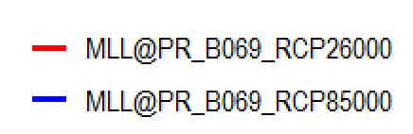
WOOD production
La producción de tejidos leñosos experimenta un moderado incremento durante los próximos 20 a 40 años debido a que el aumento de la temperatura se traduce en efectos positivos sobre la fotosíntesis, pero pasado este periodo, las diferencias se van reduciendo drásticamente. A finales de siglo la producción, que hoy es de 500 kg/ha/año, se reduce hasta 60 kg/ha/año

Slide 34
Conclusions...
77 per cent of Carbon uptake (1151 gC·m⁻²·y⁻¹) is returned to the atmosphere by respiration (888 gC·m⁻²·y⁻¹).
74 per cent of NPP is allocated to leaves.
In the coming decades increasing temperature and dry periods will increase the respiration rate.
At present 5 m³ of water are invested to produce 1 kg of woody tissues
The amount of water is projected to increase up to 14 m³ by the end of the century (scenario RCP2.6)

Slide 35
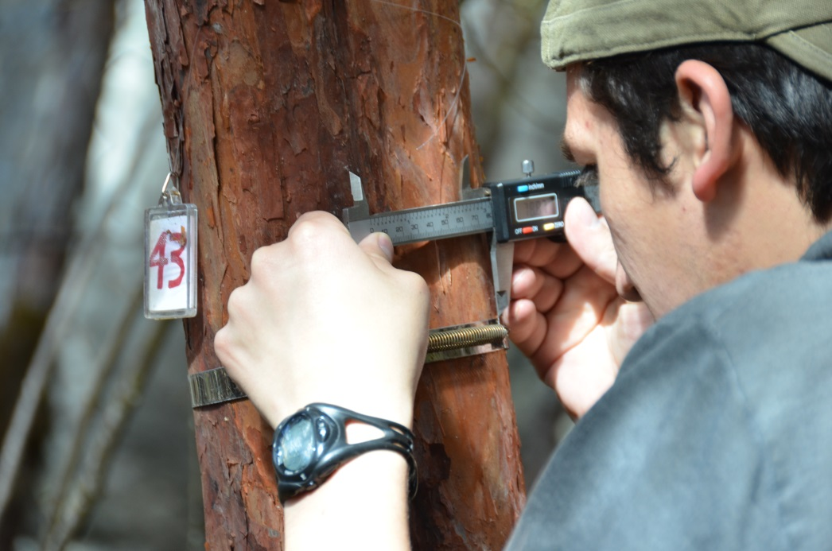
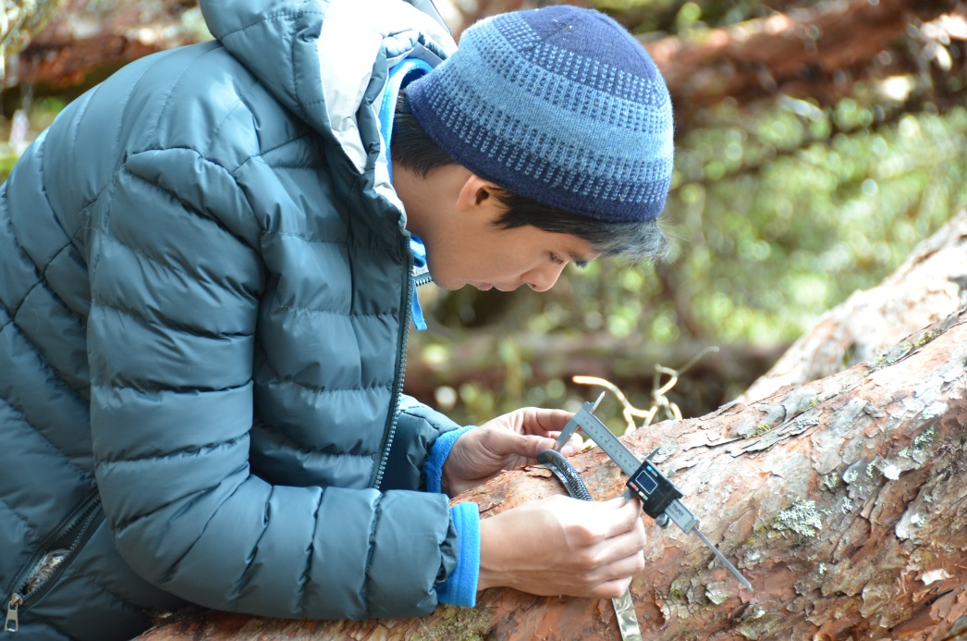


This research project has been funded by
DIUC and SENESCYT

Slide 36
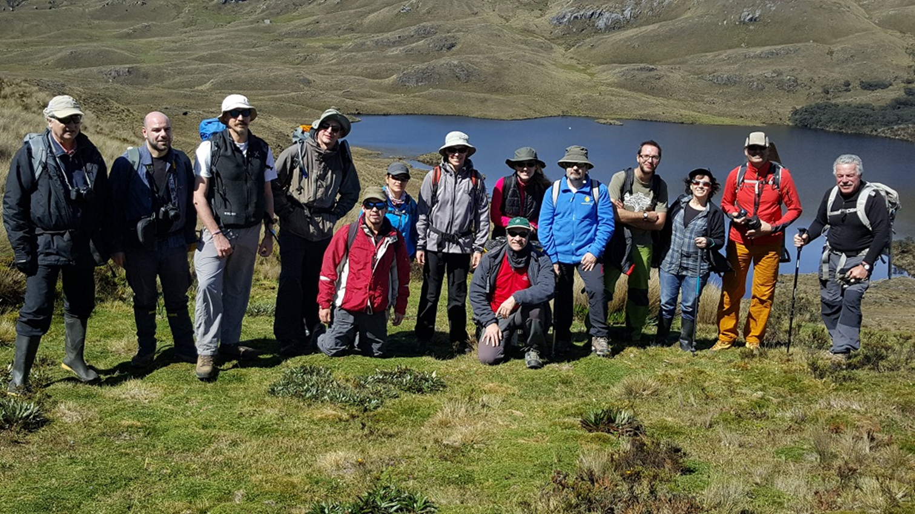
The ECUAFLUX team
Dr Ramon Vallejo
Dr Marco Lauteri
Dr Giovanni Santopuoli
Gonzalo Sotomayor
Dr Pere Rovira
Dr Luis Camarero
Paula Cordero
Javier Reina
Estefanía Crespo
Naarah Martínez
Dr Miguel Alonso
Aldemar Carabajo
Dr Santi Sabaté
Dra Teresa Sauras

Slide 37
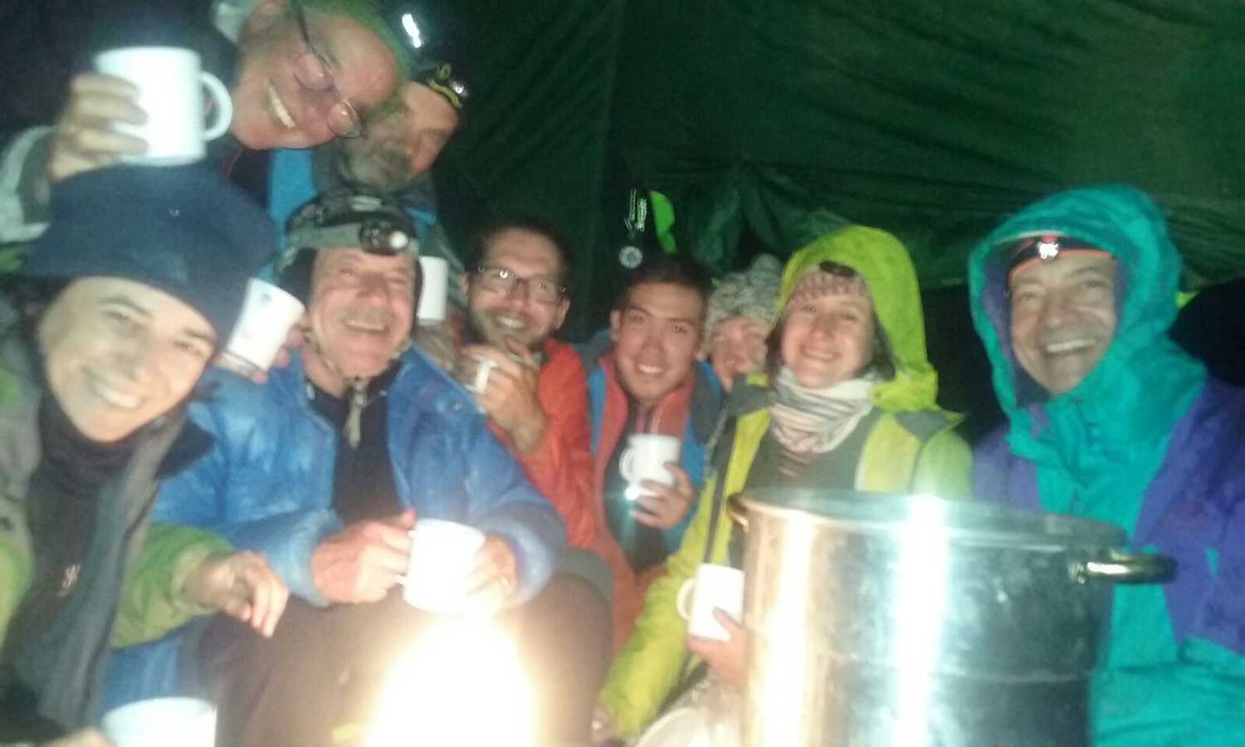
Thank you very much!

Slide 38
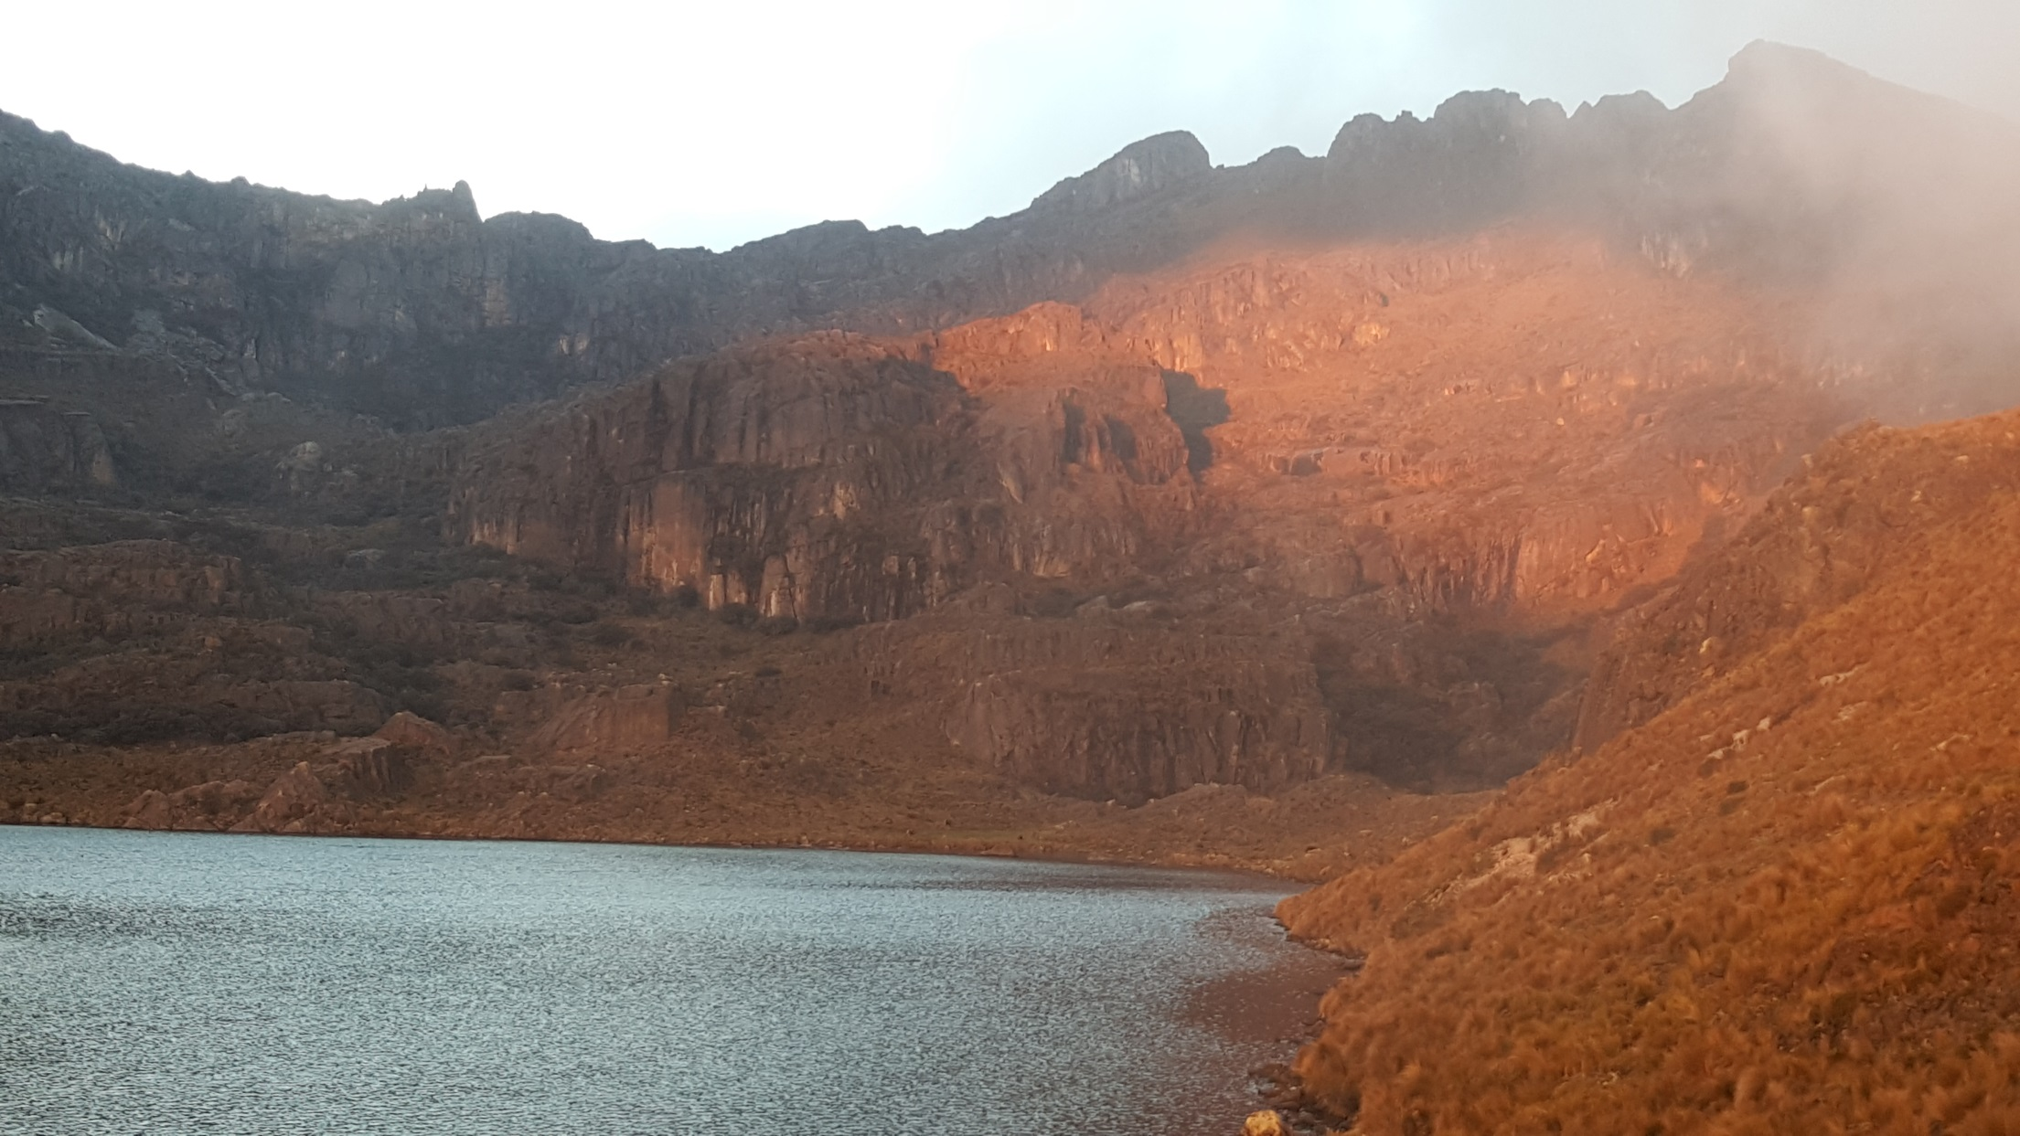
Polylepis reticulata Estrellascocha

Slide 39
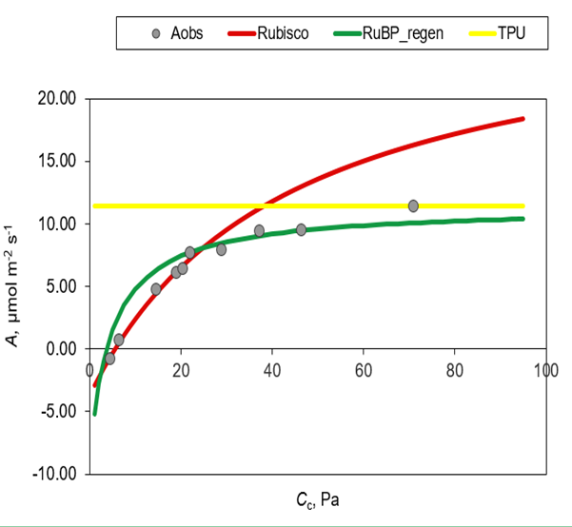
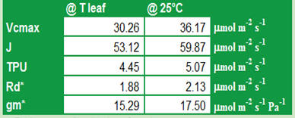
PR_EC_P2_CO2(200PAR)_21042016
CO₂ response of photosynthesis

Slide 40
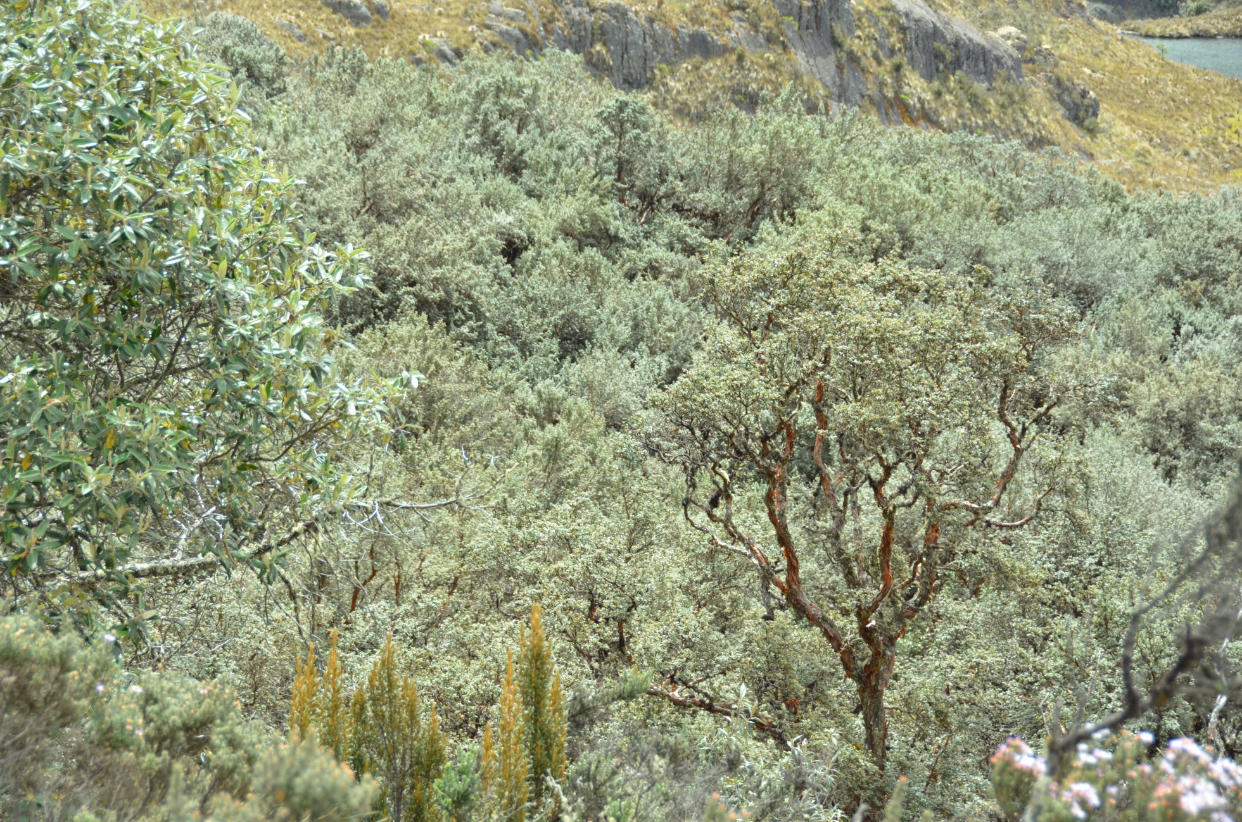
Polylepis reticulata Cajas N.P.

