Slide 1
Scientific Discovery by Machine Intelligence:
A New Avenue for Drug Research?
Big Data Analysis and Data Mining, London 2016
Dr. Carlo A. Trugenberger
Co-Founder and Chief Scientific Officer
InfoCodex Semantic Technologies AG, CH-9470 Buchs

Slide 2
Big changes in pharmaceutical research
The end of the blockbuster era?
Challenges Opportunities
Costs are exploding
Regulatory pressure
Personalized medicine
Outsourcing of critical
processes
Genomics / Proteomics
Big data / data mining
➪ structure-based design
Drugs are “computed”
rather than discovered
Critical for survival:
Shorten time-to market
Early recognition of dead ends
Critical to beat competition:
Data + data analysis power
Machine intelligence

Slide 3
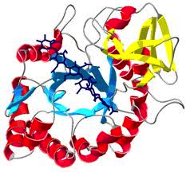

The data deluge as an opportunity for eDiscovery
Traditional bioinformatics: structured data
New Idea: exploit unstructured data
sequence alignment, gene finding, genome assembly, protein structure prediction, gene expression…
PubMed: 22 million citations, growing at the rate of I.7 paper/minute
Experiment: Merck + Thomson Reuters + InfoCodex
Is it possible to drive drug research by text mining
large pools of biomedical documents?

Slide 4
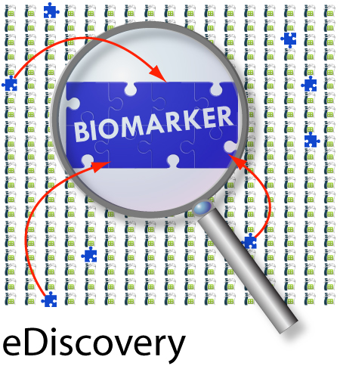
The Experiment of Merck & Co with InfoCodex
Biomarker: $13.6 billion market in 2011, growing to $25 billion by 2016.
The tasks:
Discover novel biomarkers for diabetes and obesity (D&O) by analyzing 120’000 medical publications (PubMed +ClinicalTrials.org + internal)
Blind experiment, no human feedback
The aim:
Test pure machine intelligence for “semantic drug research”

Slide 5

Semantic technologies in the pharma industry
Most existing projects use NLP to extract triples “entity 1-relation-entity 2” sentence by sentence ➪ help to curate ontologies / libraries
However: this is not a discovery approach
Relations found this way have been explicitly written by human authors and are thus known in one way or another
Going beyond triples: analyze text collections globally to identify small, seemingly unrelated and unnoticed facts dispersed over isolated texts
assembling the scattered pieces of a puzzle
Critical: machine intelligence

Slide 6
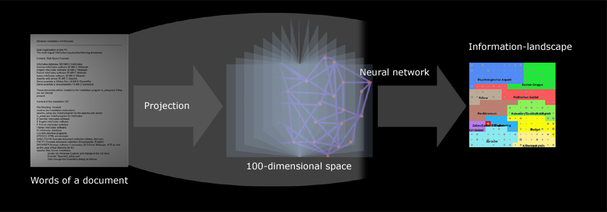
The Technology: eDiscovery by InfoCodex
Linguistics + Information Theory + Self-Organization
Completely automatic semantic analysis of content.
Designed for uncovering unnoticed correlations amongst information
distributed over document groups and collections (contrary to NLP)
“Assemble the pieces of a puzzle”
Knowledge discovery as opposed to information extraction

Slide 7
The InfoCodex technology (2 international patents)
Semantics:
Very large, multi-language, universal thesaurus
Words and phrases
up to 5 components
“President of the
United States”
Semantic concepts
declensions (number,
gender, cases)
forms of a verb (more
than 20 in Italian e.g.)
synonyms
Seven-level taxonomy
Ever more generic
hypernyms

Slide 8
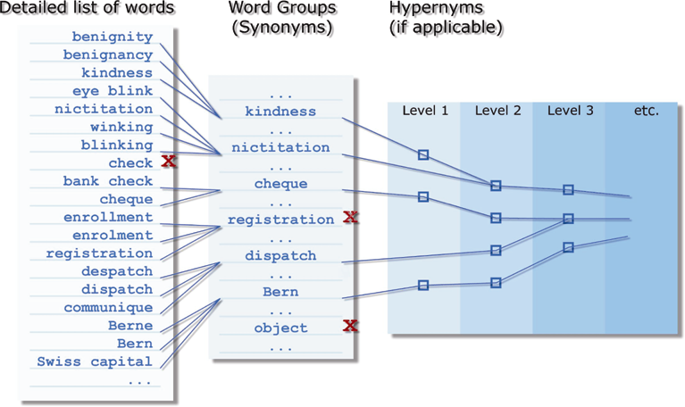
Languages:
Linguistic structure is formulated
in an abstract meta-language
Languages are instances:
Full: English, German, French
Italian, Spanish
Preliminary: Arabic, Russian
Chinese, Japanese
Polysemy:
Polysemic words are flagged
Inter-language: “gift”
X by language determination
Intra-language: “windows”
X by entropy calculations
Relevance factors:
0: stopwords → fully neglected
1: pronouns, adjectives → search only
2,3: adjectives, verbs → search + classification
2,3,4 : nouns → search + classification

Slide 9
Scope of the universal thesaurus
Content gathered from more than 100 sources and harmonized into a consistent multilingual stucture.
“Largest thesaurus in the world”: Hist. Thes. of the Oxford English Dictionary (Wikipedia): ) with 920’000 words, the InfoCodex universal thesaurus contains more than 4 million words assigned to more than 7000 taxonomy hypernyms.
Sources for proteins/genes important for present project
WordNet, UMLS database, PDB, UniProt, www.medterms.com,
Roche Lexicon, Various open biological and biomedical ontologies,
BiotechGate and EDB Group.
Proteins: 37 nodes in the taxonomy tree with 74’388 synonym groups/synonyms
Genes: 8 nodes in the taxonomy tree with 26’699 synonym groups/synonyms.

Slide 10
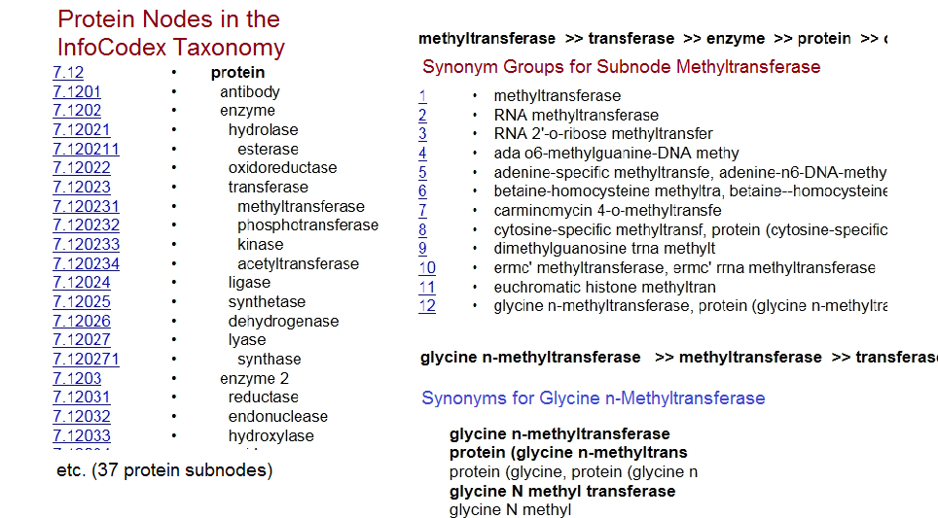
Examples of proteins in the database

Slide 11
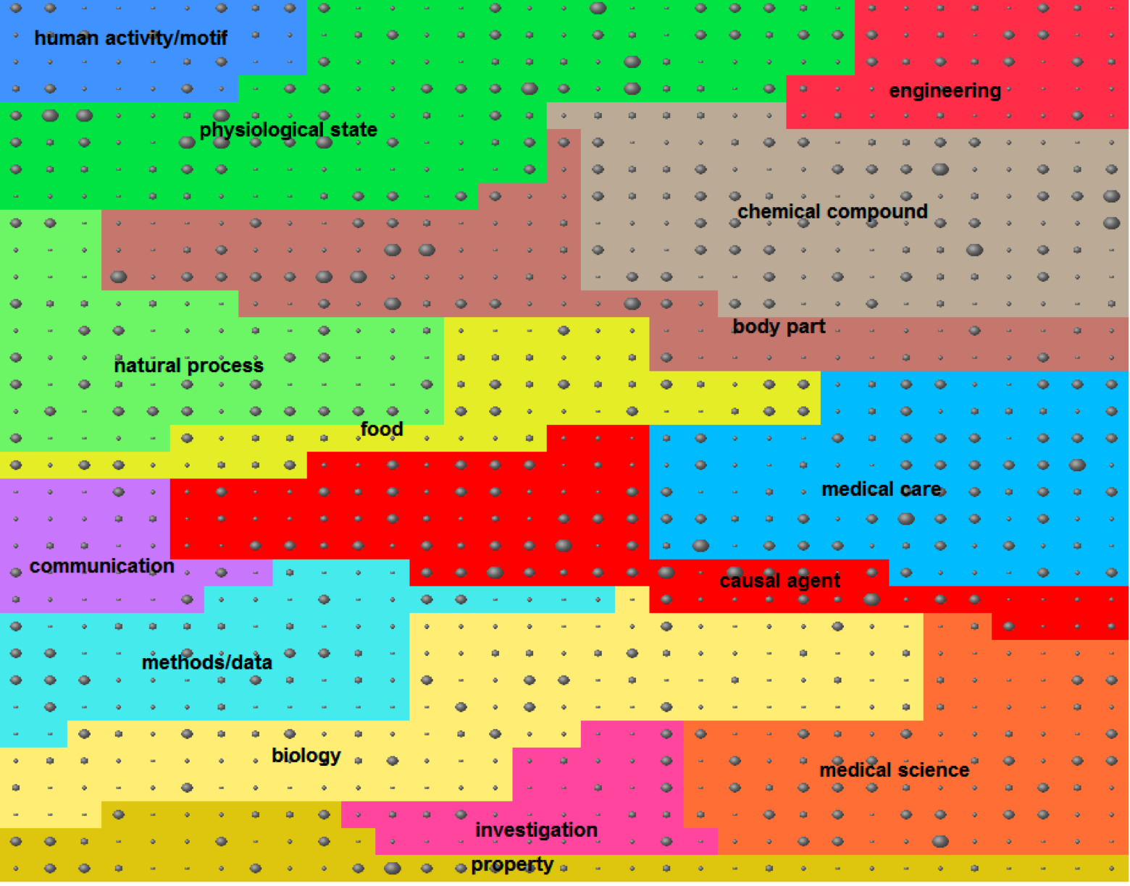

Slide 12
Classification benchmark
The task
Automatic classification of some 3000 multi-language, commercial Web pages onto an English taxonomic scheme with 753 classes distributed on 4 hierarchical levels.
No training documents provided
Languages: English, German, French, Italian, Spanish
Participants
14 international vendors (the “usual suspects”)
InfoCodex won the benchmark with
precision = tp/(tp+fp) = 85% recall = tp/(tp+fn) = 91% F1= 88%

Slide 13
Step 1 : establish reference models for biomarkers / phenotypes
Cluster documents describing known biomarkers (224 references found)
Reference model for each cluster → meanings for “biomarkers diabetes” …
Step 2: determine the meaning of unknown words by machine
inference.
Step 3: analyze documents and generate a list of potential D&O
biomarkers/phenotypes by comparison with the reference models.
Step4: establish confidence levels
Encoded
meanings

Slide 14
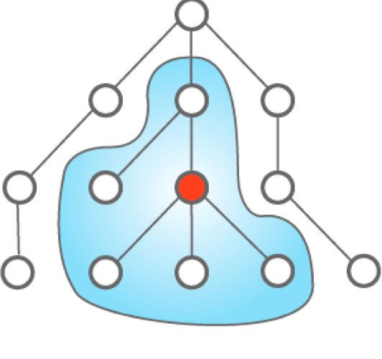
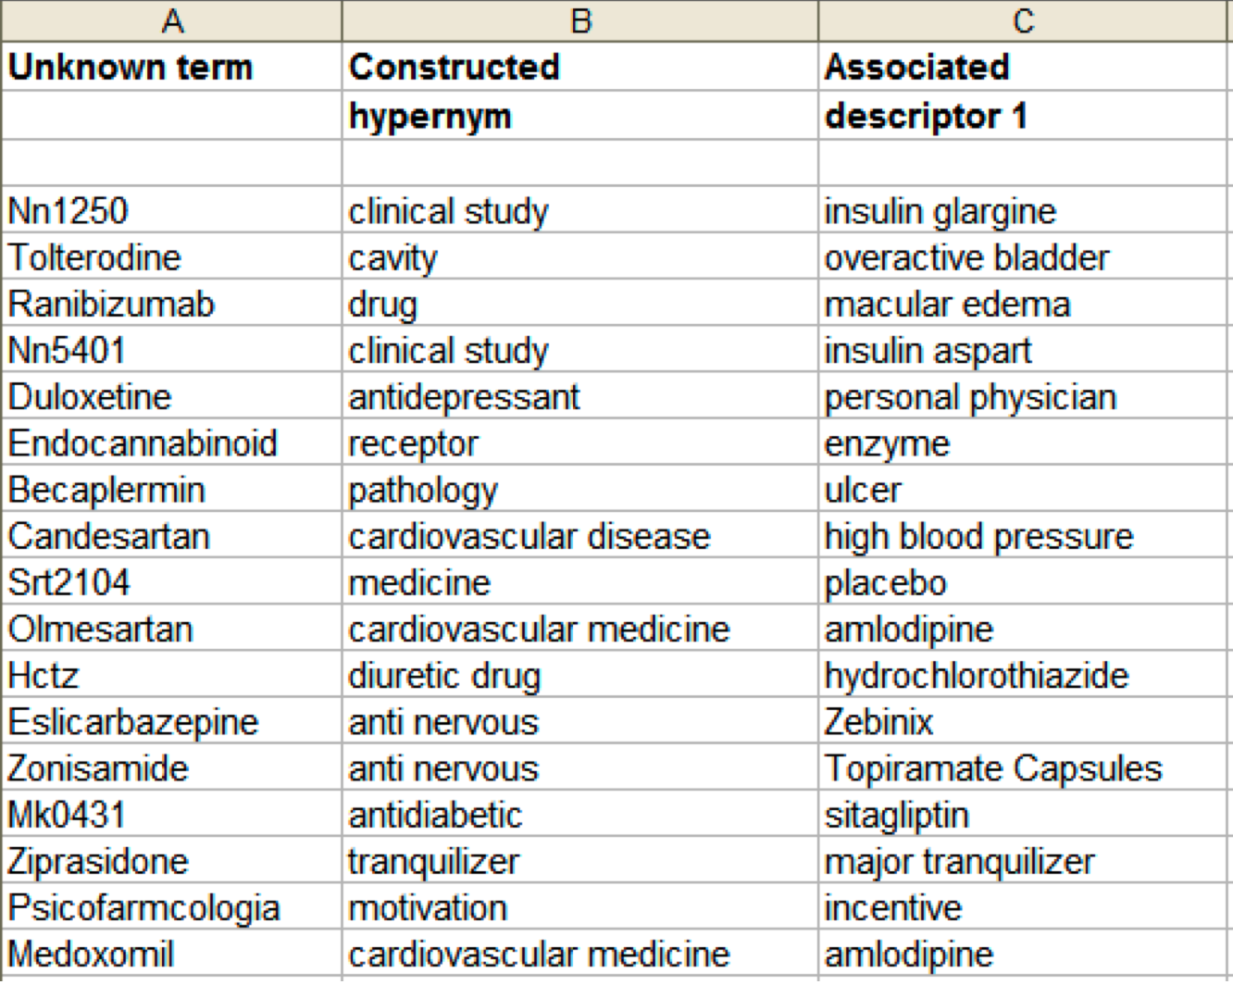
Determination of the meaning of unknown words: machine inference
Example:
“Hctz” is a “diuretic drug” and is a
synonym of “hydrochlorothiazide”
Such relations established only on the
basis of machine intelligence combined
with internal knowledge base
Co-occurrences with words in internal knowledge base
→ most probable hypernym → “is a” , “has to do”

Slide 15
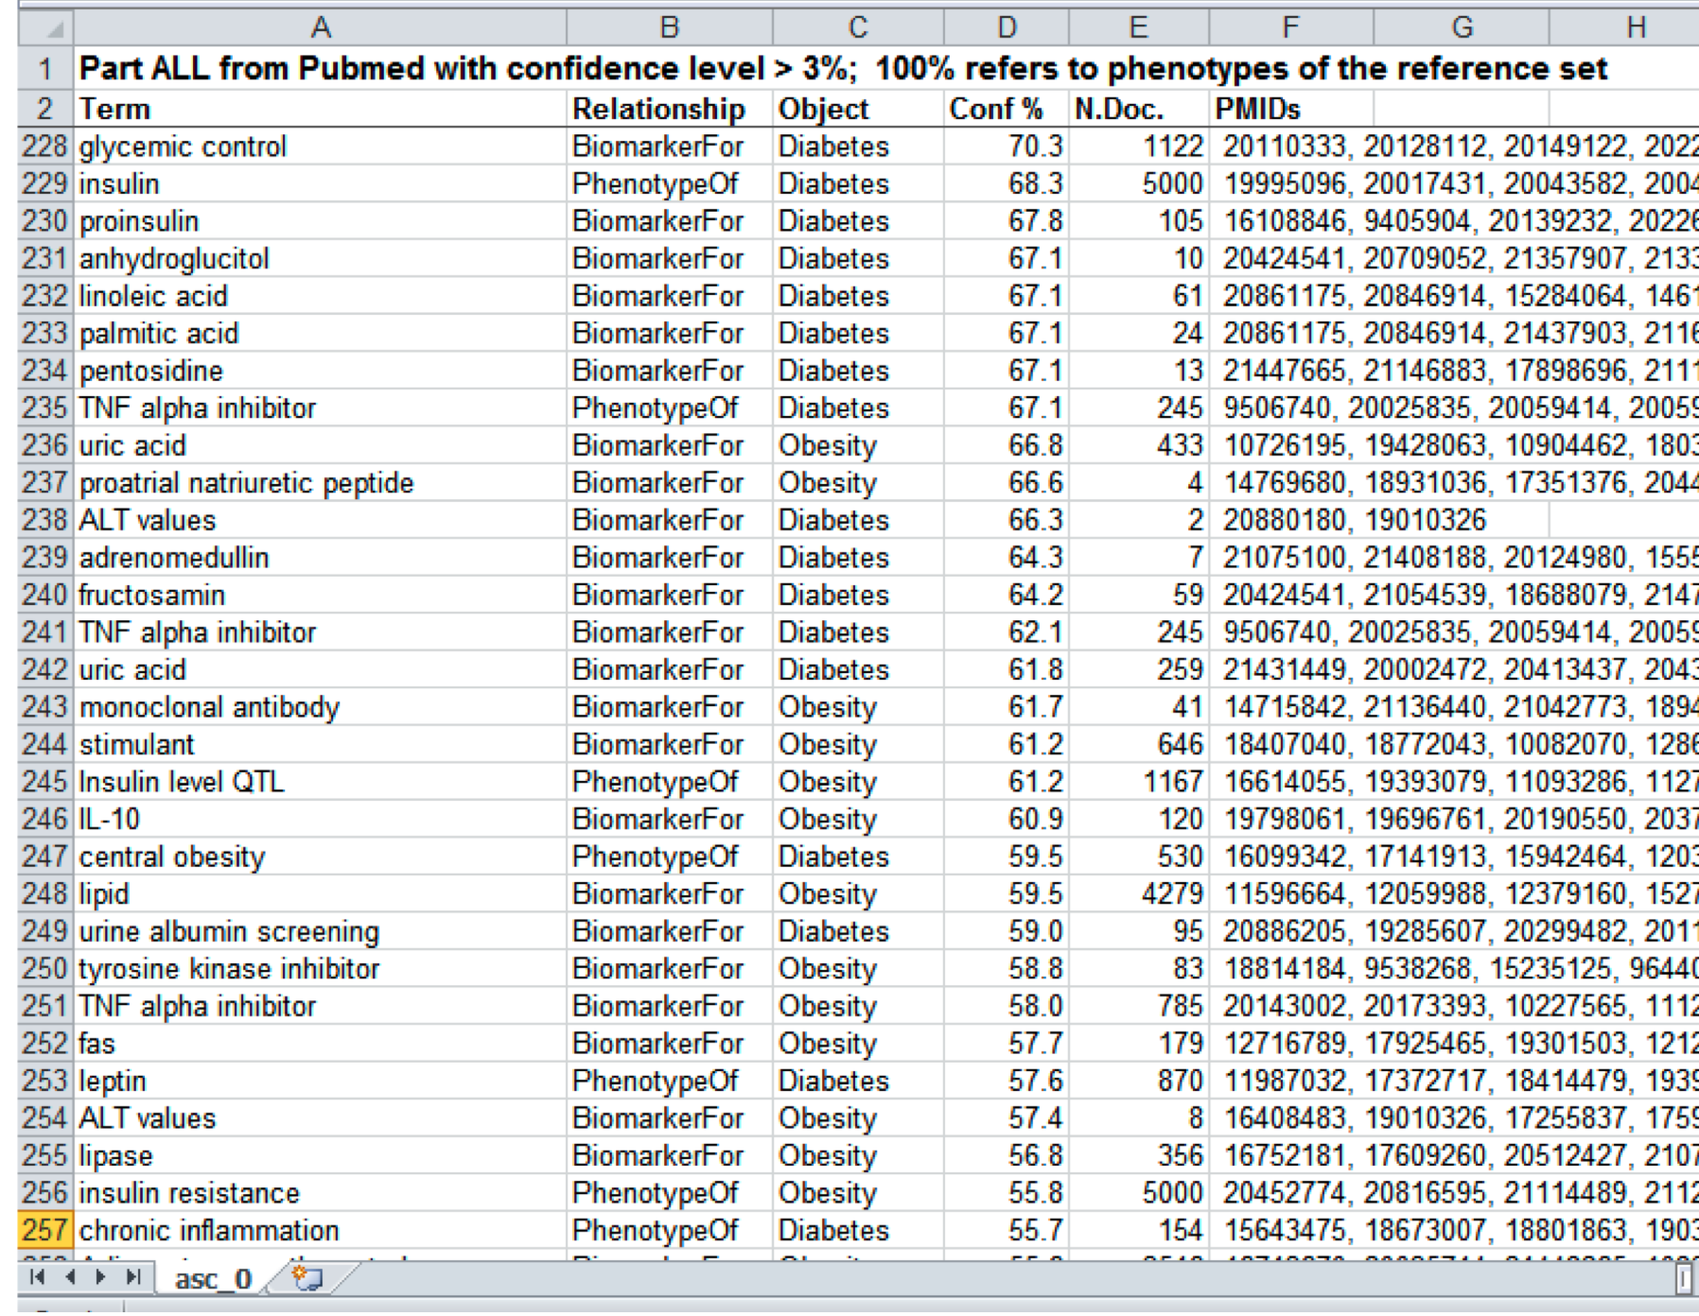
The output

Slide 16
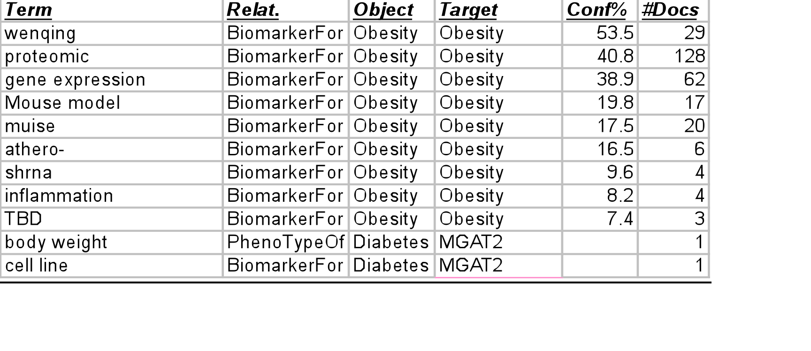
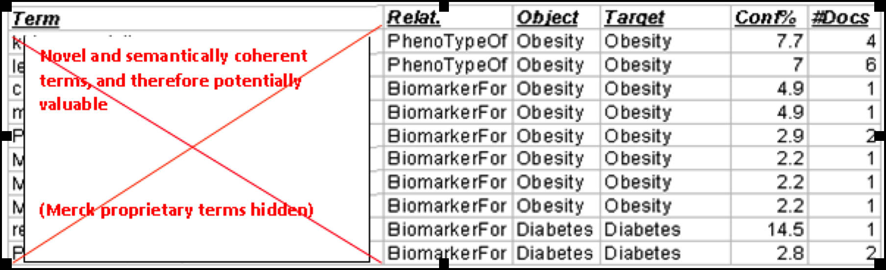
The Results
Many uninteresting candidates
Too much noise
(the problem has been identified
and corrected)
Lots of “needles in the haystack”
Tens of extremely interesting and
valuable candidates with very
high potential

Slide 17
Conclusion
Approach has high potential for discovery
Approach has potential to impact pharma research
  Speed up time-to-market
  Early recognition of dead ends
Improvements in the process are needed: problems have been identified and corrected.
Most promising is a hybrid approach
  Human expertise in formulation of reference models
  Human curation of candidates prior to passing to the laboratory
Possibly inevitable development
Trugenberger et al. BMC Bioinformatics 2013, 14:51

