Slide 1
Conference Series LLC Conferences
Conference Series LLC is a pioneer and leading science event organizer, which publishes around 500 open access journals and conducts over 500 Medical, Clinical, Engineering, Life Sciences, Pharma scientific conferences all over the globe annually with the support of more than 1000 scientific associations and 30,000 editorial board members and 3.5 million followers to its credit.
Conference Series LLC has organized 500 conferences, workshops and national symposiums across the major cities including San Francisco, Las Vegas, San Antonio, Omaha, Orlando, Raleigh, Santa Clara, Chicago, Philadelphia, Baltimore, United Kingdom, Valencia, Dubai, Beijing, Hyderabad, Bengaluru and Mumbai.

Slide 2

Evaluating Immunogenicity In Biosimilars
5th European Biosimilars Congress
Candida Fratazzi MD
President
BBCR Consulting
Cambridge, MA-USA
June 27, 2016
Valencia, Spain

Slide 3
Biologics Patent Expiry
“patent cliff”
Humira
(adalimumab)
US
EU
Rituxan
(rituximab)
Remicade
(infliximab)
Avastin
(bevacizumab)
Herceptin
(trastuzumab)
Enbrel
(etanercept)
2000
2010
2020
2030
Year
GaBI Online – US$67 billion worth of biosimilar patent expiring before 2020.
Ventola CL.. P & T. 2013;38(5):270-276.
Notes:
Slide 21
Within the next 5 years, patents for many blockbuster biologics, such as Rituxan, Remicade, and Humira, will have expired in both Europe and the US.¹ [GaBI 2014, p1, para 1/2; Figure 1 “Expiry dates for major patents on best-selling biologicals”]
This “patent cliff” is expected to drive the development and market of similar biological medicinal products, or biosimilars.^{1,2} [GaBI 2014, p1, para 4; Ventola 2013; p271, col 1, para 2]
References
GaBI Online – US$67 billion worth of biosimilar patent expiring before 2020. Posted 20/01/2014. http://www.gabionline.net/Biosimilars/General/US-67-billion-worth-of-biosimilar-patents-expiring-before-2020. Accessed April 20, 2015.
Ventola CL. Biosimilars. Part 1: Proposed regulatory criteria for FDA approval. P & T. 2013;38(5):270-276.

Slide 4

What’s the role of the Immune System
An organization of cells and molecules to recognize and eradicate a foreign substance inside the body

Slide 5
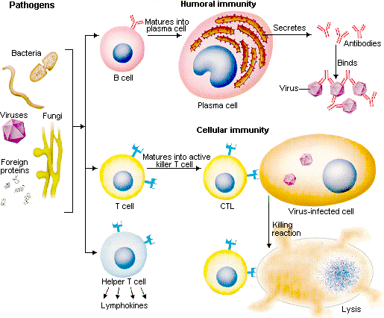
How does the immune system work?

Slide 6
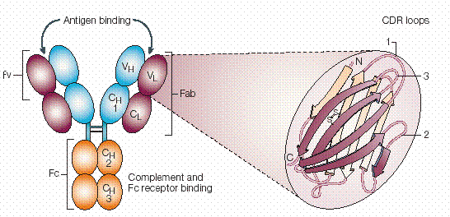
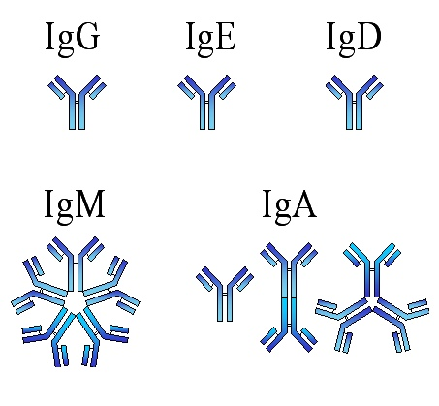
Classes of Igs and Molecular Structure

Slide 7
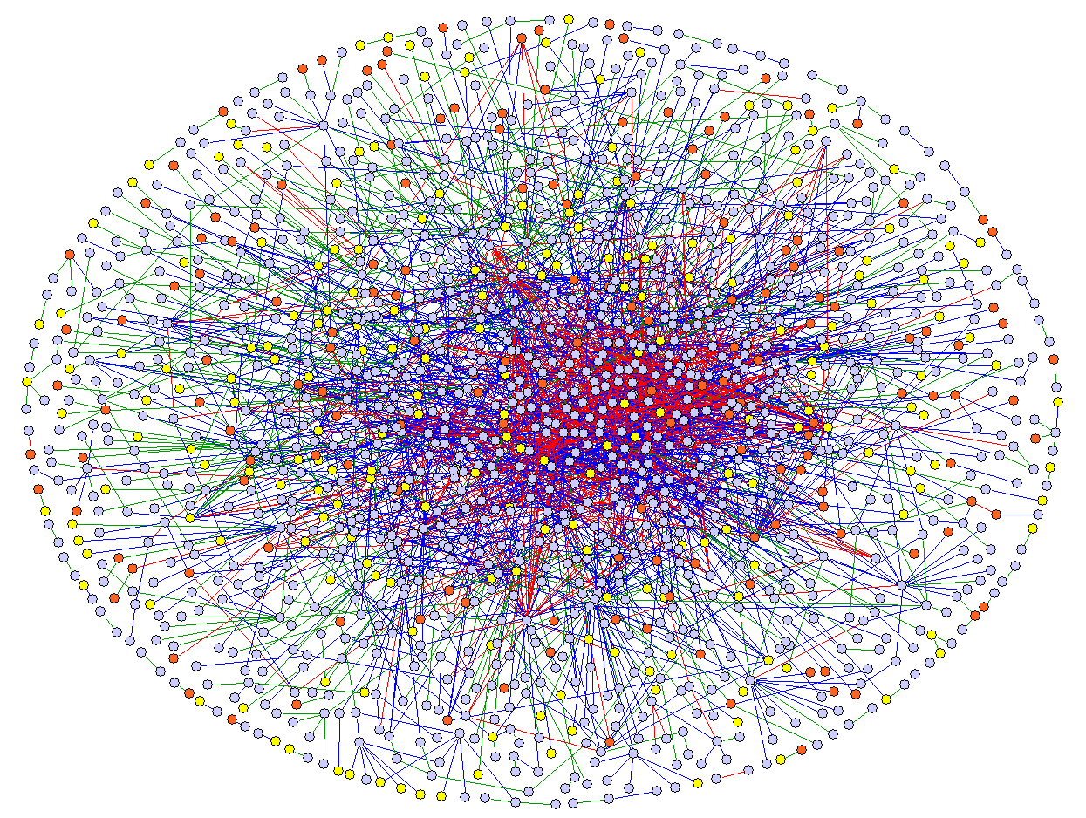
The immune system network

Slide 8
Presentation Outline
What is Immunogenicity
Consequences of Immunogenicity
Assessment of immunogenicity
Risk of Immunogenicity
Post marketing

Slide 9
What is Immunogenicity?
Definition
Immunogenicity:
Potential for a protein to elicit an immune response
The consequence of that response

Slide 10
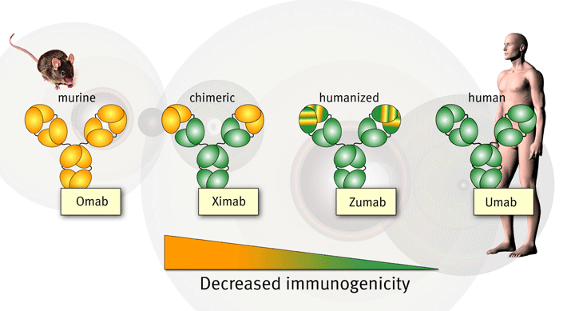
Antibody Response
Antibody response

Slide 11


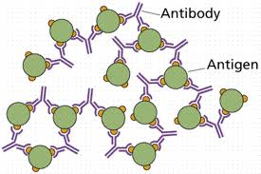
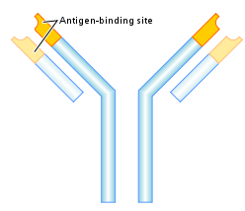
Product-Immunogenicity
Protein biologics induce anti-drug antibodies (ADAs), regardless of whether they are non-human or completely human in origin¹
1
3
ligand-binding site
Neutralizing antibodies bind to the ligand-binding site
May also:
Change bioavailability
Alter drug clearance
Alter biodistribution
Fab’
Immune-complex formation:
Non-acute reactions
Change in bioavailability
Fc
2
Non-neutralizing antibodies bind outside of the ligand binding site:
Change in bioavailability
Alter drug clearance
Alter biodistribution
Have no effect
4
Consequences for patient safety:
Hypersensitivity reactions
Cross-reactive neutralization of an endogenous protein
11
1. Sekhon BS, Saluja V. Biosimilars: an overview. Dovepress J. 2011;1(1):1-11. 2. Bendtzen KII. Front Immunol. 2015;6(109):1-5. 3. FDA: Guidelines for industry. Immunogenicity assessment for therapeutic protein products. August 2014.
Notes:
Slide 13
Biologics have a significantly higher potential for immunogenicity than small-molecule drugs.¹ [Sekhorn 2011, p3, col 1, para 1]
This is because protein biologics induce anti-drug antibodies or ADAs, regardless of whether they are non-human or completely human in origin.¹ [Sekhorn 2011, p3, col 1, para 1]
ADAs are classified based on whether they are neutralizing or non-neutralizing:^{2,3} [Bendtzen 2015, p1, col 1, para 4; p1, col 2, para 1; FDA 2014, p3, para 2]
Neutralizing ADAs bind to the ligand-binding site of the protein biologic and, as a result, “neutralize” its ability to bind its ligand.
Neutralizing ADAs may also:
- change the bioavailability of the protein biologic;
- alter its clearance and/or
- alter its biodistribution
Non-neutralizing ADAs bind outside of the ligand-binding site.
Non-neutralizing ADAs may:
- change the bioavailability of the protein biologic;
- alter its clearance and/or
- alter its biodistribution
- have no effect on function
The production of ADAs also results in immune-complex formation, which may also affect the bioavailability of the protein biologic.² [Bendtzen 2015, p1, col 2, para 1]
Unwanted immune responses to protein biologics may also affect the safety of the patient in addition to the efficacy of the product.³ [FDA 2014, p2, para 2]
Consequences for safety:³ [FDA 2014, p4, para 1-4; p5, para 2]
- Hypersensitivity reactions such as anaphylaxis, cytokine release syndrome, and infusion reactions
- Cross-reactive neutralization of an endogenous protein
References:
1, Sekhon BS, Saluja V. Biosimilars: an overview. Dovepress J. 2011;1(1):1-11.
2. Bendtzen K. Immunogenicity of anti-TNF-α biotherapies: II. Clinical relevance of methods used for anti-drug antibody detection. Front Immunol. 2015;6(109):1-5.
3. FDA: Guidelines for industry. Immunogenicity assessment for therapeutic protein products. August 2014.

Slide 12
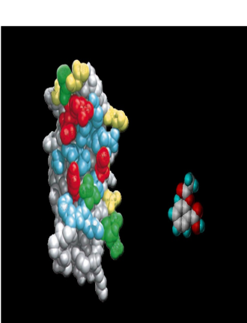
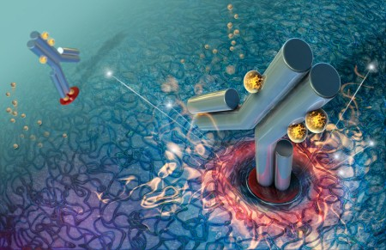
How biological products differ from small molecules?
Biological products go through a series of steps during the production that can result in denaturation and renaturation with change in the tertiary structure and formation of aggregates
Facts:
Most biologics have some degree of immunogenicity
All antibodies are unique and potentially immunogenic (idiotypic determinant)
Biologics are degraded versus synthetic products that are metabolized
Batch to batch variations are common due to the complicated steps of production
Biologics have a long half life with longevity of action (weeks)
Biologics can be administered with longer intervals rather than daily dose

Slide 13
Consequences of Immunogenicity
What are the consequences of immunogenicity?
Transient appearance of antibodies without any clinical significance
Loss of efficacy with an impact on the drug clearance
Cross reactivity with endogenous protein
Severe life threatening conditions like Anaphylaxis

Slide 14
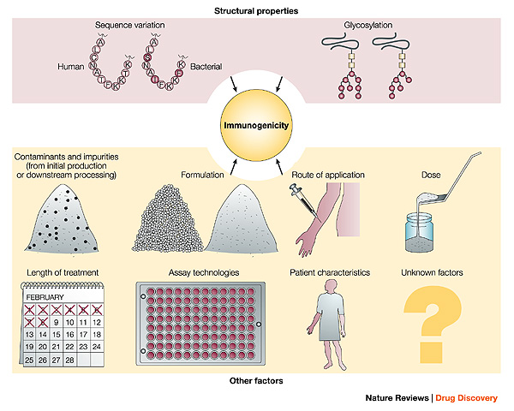
Factors Affecting Immunogenicity

Slide 15
Factors Affecting Immunogenicity
Patients population Genetic, Kidney and Liver Diseases, Pre-existing Abs
Concomitant Med Chemo, Immunosuppressive Drugs
Dose and length of treatment Exception may be high dose tolerance
Route of administration SC, IV, IM
Modified protein New Antigenic Determinants
Formulation and storage New Antigenic Determinants
Sequence variation New antigenic determinants conjugation/fusion site
Contaminants and impurities Aggregates, Fragments, Chemical Modifications

Slide 16
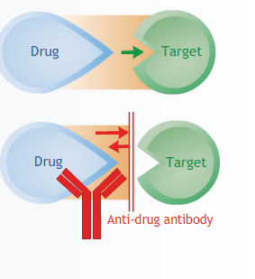
Effects of ADA
ADA can affect PK,PD, efficacy/safety causing change in drug clearance
ADA cause a decrease of clearance for drug with short half life
In case of replacement therapy, development of ADA that cross-react to this endogenous protein is one of the greatest concern
Formation of ADA in this setting may neutralize the endogenous protein, resulting in catastrophic consequences

Slide 17

Impact of Immunogenicity
Effects on bio-availability
Effect on Safety and Efficacy
Effect on PK including potential cross reactivity to endogenous proteins
Inhibition of the function of endogenous protein
Immunogenicity
Injection site reactions
Systemic reactions mild or life threatening
Formation of ADA (HAMA,HACA,HAHA)
Formation of neutralizing antibodies
Formation of immune complexes
Formation of anti-idiotypic antibodies

Slide 18

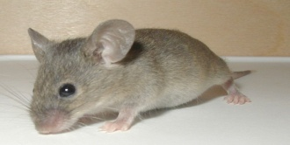
Non Clinical Immunogenicity
Effects of ADA on PK and PD:
Alteration of clearance
Neutralization of the therapeutic bioactivity
Antibody characterization and data interpretation:
Number of responding animals
Titer
Neutralizing or non neutralizing Abs
Correlation with PK, PD & toxicological changes:
  Hypersensitivity
  Incidence and Severity of AE
ADA Assay:
The assay should:
Run in parallel with PK studies
To have sufficient sensitivity and specificity for non GLP
Be validated for GLP studies
Neutralizing Abs are typically not done in non-human primates but is considered in a case by case basis and depends upon a variety of factors that include:
Type of drug and MOA
ADA incidence
Toxicity
PK data

Slide 19

Clinical Immunogenicity
Immunogenicity should be considered as part of clinical studies:
Adequate characterization of immunogenicity profile
Meeting regulatory expectations
Be cost effective
ADA Testing:
Regulatory recommend real time immunogenicity testing for drugs that are considered at high risk
Timely immunogenicity data may prove useful in determining whether to carry on therapy and impact of ADA on efficacy and safety
Biologics that are generally considered of low-medium risk for immunogenicity, real time immunogenicity is generally not employed

Slide 20
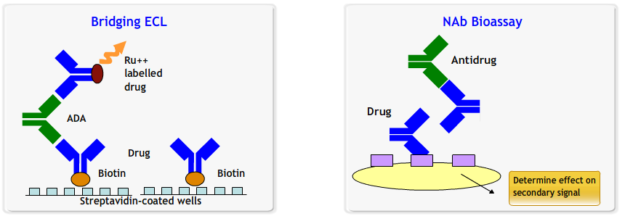
How can we detect Immunogenicity?
ADA Assay
Neutralizing Antibodies Bio-Assay
  Usually IgG
  Directed against biologically active sites
  interferon (IFN)
  anti-viral
  idiotype
  IgM and IgG

Slide 21
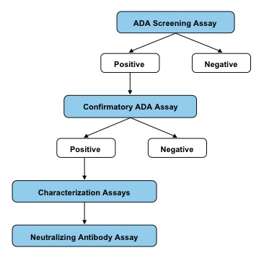

Slide 22
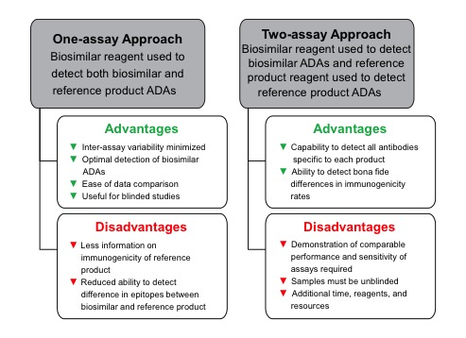

Slide 23
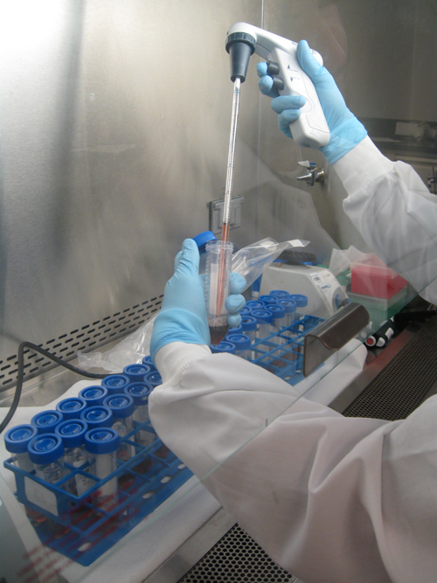
What does affect the detection of Immunogenicity?
Influenced by the detection assay
  Sensitivity
  Specificity
Product specific
  idiotypes on mAb
  other unique determinants
Influenced by the timing of sample collection
Influenced by the presence of circulating drug
Caveat!!
  Immunogenicity must be evaluated for each product
  Comparison of immunogenicity across products is not appropriate

Slide 24
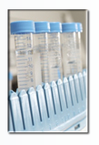
Samples Collection
Samples should be collected from a sufficient number of subjects to characterize the variability of the antibody response
Collection time points should be carefully assessed based on the half life of the drug and patients population
Caveat!!!
Immunogenicity data from healthy volunteers cannot substitute for generation of data from patient population due to expected different susceptibility

Slide 25
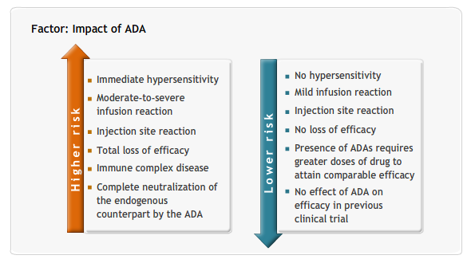
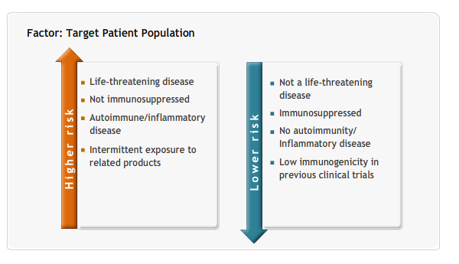
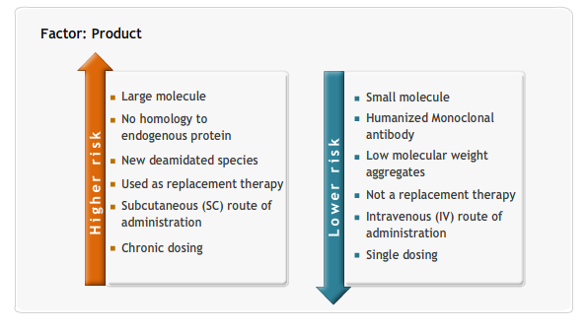
Assessing the Risk of Immunogenicity
A number of factors can be used to estimate the risk of potential immunogenicity.
By separating those factors that can affect the likelihood of ADA.
Proteins can be separated into immunogenicity risk classes by:

Slide 26
Expectations for therapeutic mAbs
Set proper expectations:
  Fully-human antibody doesn’t eliminate immunogenicity
  Anti-Idiotypic response to be expected
  An issue for chronic treatments
Assays are important:
  FDA requested that we develop improved assay
  Need careful thought about Phase 1 design

Slide 27
Factors influencing Post-Marketing
Immunogenicity data collected in the post marketing depends on:
Preauthorization immunogenicity findings
  Effects on efficacy and safety
Serious immune reactions
Immunogenicity experience with similar proteins,
  Products manufacturing with similar production process
Diseases related factors,
  Vulnerability of the patient population
  Duration of the treatment

Slide 28
Conclusions
There are not absolutely predictors of immunogenicity other than clinical studies
These are the most important studies to address the potential of immunogenicity

Slide 29
Thank you for your attention
?
Questions
???
? ? ? ?

Slide 30
Let us meet again..
We welcome you to our future conferences of Conference Series LLC
through
6th International Conference and Exhibition on Biologics and Biosimilars
October 19-21, 2016 Houston, TX, USA
http://biosimilars-biologics.pharmaceuticalconferences.com/europe

