Slide 1
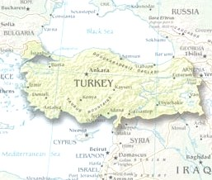

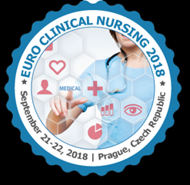
Turkey's Nursing Education System and Clinical Nursing
Dr. Canan BİRİMOGLU OKUYAN

Slide 2

The Best Official Türkiye - Türkei - Turkey - 터키 Promotional Video.mp4

Slide 3
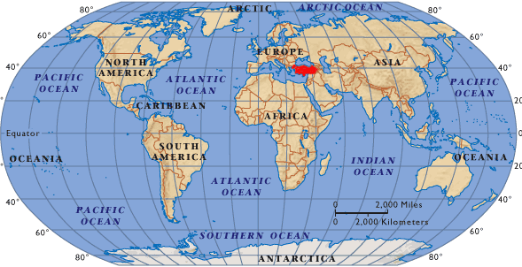
WHERE IS TURKEY?
Turkey is located on a peninsula Asia and Europa, and has a population of about 77 million

Slide 4
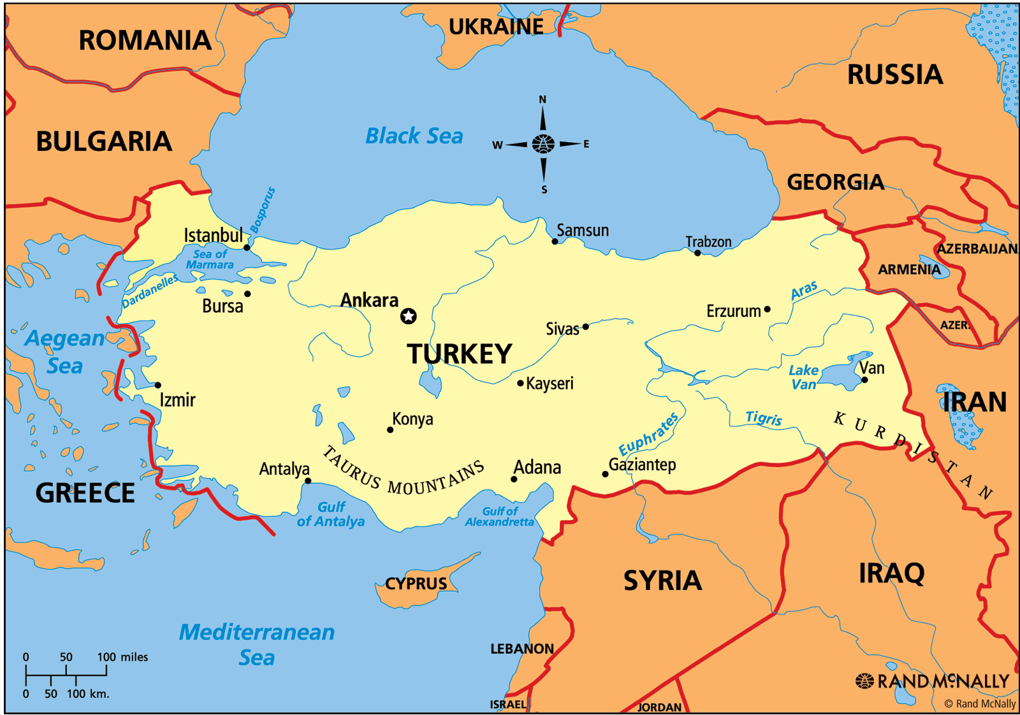

Slide 5

NURSING EDUCATION IN TURKEY

Slide 6
DOCTORATE (4 YEARS)
MASTER (2 YEARS)
BACHLEORS
(4-6 YEARS)
PRE-BACHLEORS SCHOOLS
(2 YEARS)
HIGH SCHOOLS (4 years)
VOCATIONAL HIGH SCHOOLS (2 -4 years)
PRIMARY EDUCATION (8 years)
PRESCHOOL (1-2 years)

Slide 7

Bachelor Nursing
Higher education of Nursing in our country, is given for 4 years after a total 12 years of primary, secondary and high school education.
Nursing programmes include 4600 hours of theoretical and practical education. (2300 theory and 2300 practical training)

Slide 8
Bachelor Nursing - Academic calender
The academic year consists of two semesters:
The first semester runs from the second half of September to the end of January
The second semester runs from the beginning of February to the end of June
Each semester: 13 weeks of courses, followed by final exams

Slide 9

Departments in nursing faculty
Fundamentals of nursing
Medical nursing
Surgical nursing
Obstetric gynecology nursing
Pediatric nursing
Mental health nursing
Community health nursing
Nursing management

Slide 10
Curriculum of Bachelor Nursing (1st year)
Fundamentals of Nursing (5ECTS)
Fundamentals to Nursing (14ECTS)
Communication in Nursing (5ECTS)
Medical sciences (Anatomy, Microbiology and Parasitology, Physiology, Histology, Pathology)
Social sciences (Foreign Language, Turkish Language, Ataturk’s Principles and History of Turkish Revolution)
Basic Computer Science
Sports or Arts
Notes:
undergraduate

Slide 11
Curriculum of Bachelor Nursing (1st year)
1st year teorical + laboratory practice (practical training on the models) + Medical simulation center (if it possible).
In general, after teorical lesson and demonstration, approximately 10-15 students study this practice with a teacher in the laboratory.

Slide 12
Curriculum of Bachelor Nursing (2nd year)
Medical Nursing (16 ECTS)
Surgical Nursing (16 ECTS)
Histology of Nursing
Deontology
Health Care Ethics
Communication in Nursing Practice
Care to Infection Diseases or Epidemic Diseases
BioMedical sciences (Pharmacology, Health Sociology, Nutrition,
Psychology, Biochemistry)
Social sciences (Vocational Foreign Language)
Basic Computer Science
Sports or Arts

Slide 13
Curriculum of Bachelor Nursing (2nd year)
Second year students study respectively to medical nursing and surgical nursing courses
  Second year students usually practice in the orthopedics and traumatology, chest diseases clinics, neurology, cardiovascular and neurosurgery clinics area.
  They can be observer in the a lot of polyclinics, operating room, feeding units, endoscopy unit etc.

Slide 14
Curriculum of Bachelor Nursing (3rd year)
Obstetric & Gynecological Nursing (16 ECTS)
Pediatric Nursing (16 ECTS)
Teaching in Nursing
Emergency Care in Nursing
Trauma Nursing
Medical sciences
(Biostatistics, Disaster Care and First Aid Epidemiology
Social sciences
(Vocational Foreign Language )
Basic Computer Science
Sports or Arts

Slide 15
Curriculum of Bachelor Nursing (4th year)
Psychiatric-Mental Health Nursing (16 ECTS)
Public Health Nursing
(16 ECTS)
Management in Nursing
Nursing Informatics or Quality Management
Medical sciences
Social sciences
(Vocational Foreign Language)
Basic Computer Science
Sports or Arts

Slide 16
Bachelor Nursing - Practical training
  Courses lecturers manage both theoretical and clinical practice
  In general, 10-15 nursing students study in the clinic area with 1 teacher
  Students can study with experienced nurses working in the clinics. They are clinics nurses
  Clinical practice can be done university hospitals, state hospitals or family medicines.

Slide 17
Bachelor Nursing
We do not have a nursing licensure exam in Turkey. Any nursing school graduate becomes registered by the ministry of health.
Graduates of nursing schools have to pass the Exam for Public Personnel Selection (KPSS), which is specific to Turkey, in order to serve in public services.

Slide 18
Exam for Public Personnel Selection (KPSS)
Candidates who pass this examination are eligible to start working in public institutions and they can choose a lot of hospital if they are successful
Graduate nurses who take a low point, they probably study small cities, villages, etc. If they want, they can wait the next exam term.

Slide 19
Master of Science degree programs
After 4 years in nursing, graduates can continue with postgraduate education.
If graduates want, they can both continue master or doctoral degree and with clinic nursing
Bachelor’s degree or master’s program graduates are preferred for administrator-nurse positions in the institutions.

Slide 20

Master of Science degree programs
After 4 years Bachelor Science Nursing degree
For application to Master of Science degree programs;
  Postgraduate education exam (ALES –like GRE) (>50)
  Foreign language exam (YDS, YOKDIL –like IELTS) (>55)
  Master Exam (by Faculty members)
Notes:
After 4 years Bachelor Science Nursing degree, graduates must have three exam. They are Postgraduate education exam , Foreign language exam, Master Exam

Slide 21
Departments; Master of Science for nurses
For master of science, graduates choose one department for specialization of nursing. Nursing degrees can be followed up with specialization opportunities in several branches such as:
Fundamentals of nursing
Medical nursing
Surgical nursing
Women’s health and obstetrics nursing
Children’s health and diseases nursing
Mental health and psychiatry nursing
Public health nursing
Nursing management
Nursing education
Neonatal nursing
Cancer nursing
Emergency nursing
Critical care nursing
Workplace and worker health nursing etc..
Notes:
We have a lot of specialization department for master nursing
For example I interested in publıc health nursing. Evrim interesting in fundamentals of nursing

Slide 22
Master of Science degree programs
Master programme consists of two stages:
Completing a number of courses
And research thesis.

Slide 23
Master of Science degree programs
Students attend courses in the first year (in two terms, each for approximately four-months) and are required to take at least 7 different courses and gain 21- credits;
If they can successfully complete the courses, they make their research in the area chosen by the help of their supervisor and write their thesis in the second year of the program.

Slide 24
Master of Science degree programs- Thesis
Afterwards, they present their thesis against the jury, composed of either from three or five dons, chosen from the related disciplines, one of them being the supervisor of the student.

Slide 25
Master of Science degree programs- Thesis
If successful, they are granted the title of M.S.
Otherwise; they are given a make-up time of three months by the jury and are re-evaluated by the same jury at the end of this period.

Slide 26

Doctorate education (Ph.D.)
Doctorate education program also consists of two stages:
Two years for the teorical courses and two years for the theses preparation.
Especially doctorate program graduates prefer working mostly in the academic area.

Slide 27
Doctorate education (Ph.D.)
Currently, there is only ‘’Discipline of Nursing Doctorate Program’’ in some universities, while there are;
Fundamentals of Nursing,
Medical Nursing,
Surgical Nursing,
Gynecology and Obstetric Nursing,
Pediatric Nursing,
Psychiatry Nursing,
Public Health Nursing,
Management at Nursing doctorate programs in some other universities.

Slide 28
Doctorate education (Ph.D.)
After successfully completing their courses, they enter to a written and subsequently to an oral science exam (proficiency exam) against a jury consisting of 5 dons.
If successful, they choose an original thesis subject within three months, in accordance with the proposal of their supervisor.

Slide 29
Doctorate education (Ph.D.)
Afterwards, they can start working on their thesis subsequently after the necessary changes are made.
Twice a year, once between January and June and once between July and December, the Dissertation Evaluation Committee meets and follows up on the progress of the student’s work.

Slide 30


Turkey socialized its healthcare system to focus on preventing disease, promoting health, and providing treatment and rehabilitation.
The Ministry of Health is the main actor and provides primary, secondary and tertiary care through its facilities across the country.

Slide 31
Turkey provides,
Primary healthcare
Secondary healthcare
Tertiary healthcare.

Slide 32
Primary healthcare system focuses on preventing disease and provides preventive and curative basic medical services to the population.

Slide 33
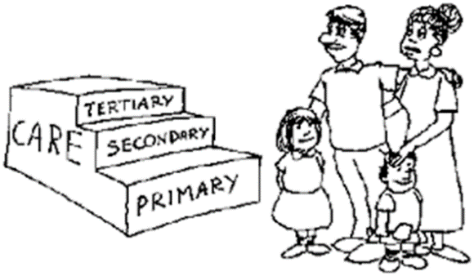
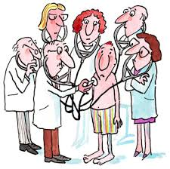
SECONDARY CARE
Public healthcare service providers constitute the majority in terms of secondary and tertiary healthcare
Secondary healthcare is structured around state hospitals, with a national insurance system for workers.

Slide 34
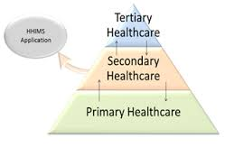
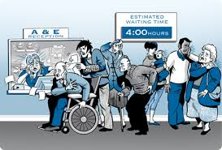
Secondary care includes specialist consultation, local surgeries, emergency care, laboratory services and diagnostics and acute treatment at our leading hospitals and laboratories across our markets.

Slide 35

Tertiary Care
Tertiary care includes specialist consultative care, advanced treatment or complex surgery and inpatient care. Delivered via our hospitals and medical centres which have specialised equipment and facilities.
Secondary and tertiary healthcare depends on the choice of consumers; can be public or private.

Slide 36

Universities are also major providers of tertiary care in the system.
The private sector has gained power over recent years, particularly after arrangements paved the way for private provision of services to the SSI (Social Security Institution ).
Notes:
Social Security Institution (SSI)

Slide 37

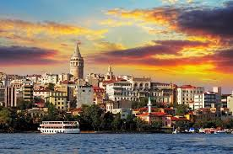

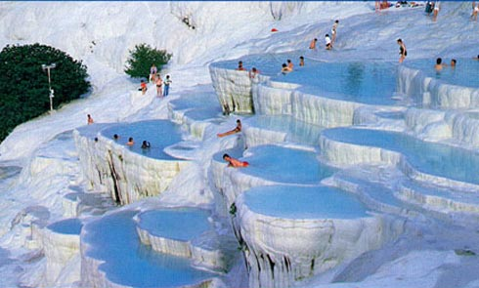

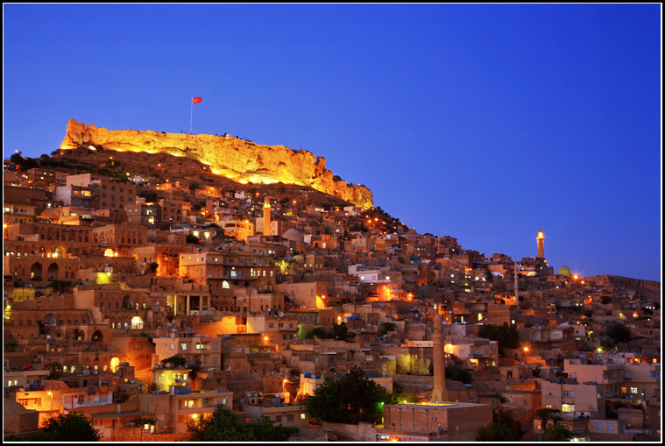

FOR A BETTER TOMORROW…
THANK YOU….

