Slide 1
Therapist Driven Protocols Revisited
Camille Lowman, BSBA, RRT
Director of clinical Education
Respiratory Care Program
Tacoma Community college, Tacoma Washington, USA

Slide 2
Objectives
To familiarize physicians, managers and health care staff with therapist driven protocols
  What they are, and what they are not
Clarify how TDPs fit into the changing health care system in the United States
Provide a plan to address high readmission rates for COPD patients in the United States

Slide 3

Reimbursement prior to 2010
Insurance/Reimbursement for medical care
Insurance mainly provided through work
  Employee, spouse & dependents covered
  Employer paying majority, employee paying portion
Small businesses: no coverage
  Private insurance: very expensive
Medicare: disabled and elderly
Medicaid: low income who qualify
Rules for reimbursement:
Medicare:
  Diagnosis Related Groups (DRGs)
  Bundling services

Slide 4

Historical overview of medical care in the United States prior to 2010
Hospital focus
  Reimbursement related to DRG
  Concentration on acute illness without much emphasis on wellness beyond the acute event
  High cost of medical care
  High readmission rates for specific diagnosis groups
Respiratory Care Departments
  “Do more with less staff”
    Aerosol therapy to nursing in many hospitals
    Patients no longer assessed by therapist unless having difficulty
  Respiratory Therapists in ICU, ER, seeing only the sickest patients

Slide 5

Paradigm Shift with Affordable Care Act
Affordable Care Act introduced in 2010
  Goal for all US citizens to have health insurance
  Hospital focus on wellness and prevention as well as acute illness
Medicare/Medicaid fines for readmissions FY 2012
  “bounce-back admissions” within 30 days of discharge
    Pneumonia
    Acute MI
    Heart failure
FY 2015
  COPD exacerbation, Total Hip arthroplasty and Total knee arthroplasty

Slide 6
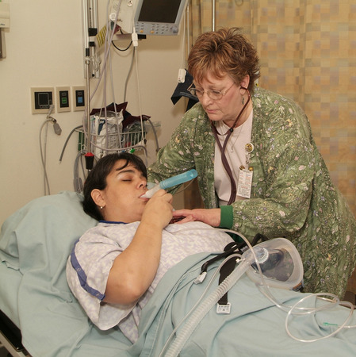
How do we fix what’s broken?
Respiratory Management
  “taking back” floor therapy
    May mean staff adjustments
  Preparation for therapist driven protocols
    TDP development in partnership & with approval of department medical director
    Staff training and competency assurance
  Institute therapist driven protocols
    Assessing indications & appropriateness of therapy
    Assuring optimum therapy for greater outcomes
    Assuring cost efficient therapy
      Contacting physicians when therapy is not indicated or change in therapy is indicated
  Respiratory Therapists as COPD Case Managers

Slide 7
Flow of Care with & Without TDP
TDP Trained Staff
Non-TDP Trained Staff
Respiratory Therapist called to bedside when patient having difficulty breathing
Systematic Collection of Clinical Data
Days
Evenings
Nights
Ongoing consistent and precise assessment keeping physician in loop
Days
Evenings
Nights
Consistent and optimal treatment selections
ongoing adjustments as indicated based on assessment
Upregulation
Downregulation
Good response to therapy, and compliance
Therapist involvement in pt. education
Incomplete or no clinical data collected
Assessments variable and inaccurate
Physician sees patient once daily on rounds
No input asked or given on therapy resulting in poor results
Poor response to therapy, refusal of treatments, high readmission rates
Treatments delivered by variable staff
Respiratory Therapist sees patient with every treatment
Physician initiates TDP & sees patient once daily
Per currently available studies

Slide 8

How decisions are made in TDP
Therapist receives the order for TDP
Clinical data is gathered and analyzed
Patient assessed based upon clinical data
Therapy chosen based upon clinical manifestations of the disease process
Therapy is adjusted (start, stop, upregulate, downregulate based upon patient need and measureable clinical indicators) based on clinical practice guidelines set forth by the American Association of Respiratory Care

Slide 9
What are the protocols?
Based on treatment of clinical manifestations rather than the disease process.
Oxygen Therapy
Bronchial Hygiene Therapy
Lung Expansion Therapy
Aerosolized Medication Protocol
Mechanical Ventilation Protocol

Slide 10
Aerosolized medication protocol for bronchospasm
Therapy not indicated. Other therapy indicated. Notify ordering physician
Continue therapy, upregulate prn, adjust to meet patient needs, consider other protocols as needed
Initiate protocol with Small Volume Nebulizer
no
no
Review indications; select appropriate medication
Able to deep breathe with 3 second breath hold? Follows commands?
Med available in MDI or DPI?
Initiate med protocol with
MDI or DPI
Reevaluate daily or more often prn; bedside education prn
Respiratory Care order received
Patient alert & oriented?
yes
yes
Breath sounds equal? Good air movement?
yes
yes
yes
no
Muscle weakness? Fatigue? Kyphosis?
yes
Initiate therapy with IPPB or MetaNeb as indicated
no
Downregulate therapy to meet pt needs; D/C when no longer indicated
no
Improvement observed/sustained over 24 hours?
Does patient use medications at home?
yes
Discharge education re: medication and delivery devices
yes
Maintain at no less than home frequency; review for maintenance meds

Slide 11
Aerosolized Medication Protocol
Indications for Therapy
Desired outcomes/Goals of Therapy
Primary indication for bronchodilators: Reversible airway constriction
  Reduction in airflow
    ↓ Peak expiratory flow rate, ↓ FVC, ↓ FEV₁
    C/O dyspnea
    Wheezing/decreased air entry
    Prolonged expiration
Increased aeration
  Decreased wheezing
  Improved airflow
    ↑ Peak expiratory flow rate
  Improved vital signs
  Improved patient appearance and use of accessory muscles
  Pt subjectively feels less dyspneic

Slide 12
Medications
Rescue
Maintenance
Short acting beta₂ agonists
  Albuterol
  Levalbuterol
Short acting Anticholinergics
  Ipratropium bromide
Combined beta₂ agonists & anticholinergics
  Albuterol/Ipratropium bromide
Long acting beta₂ agonists
Long acting anticholinergics
Inhaled corticosteroids
Combined long acting beta₂ agents with inhaled corticosteroids
Mucolytics

Slide 13
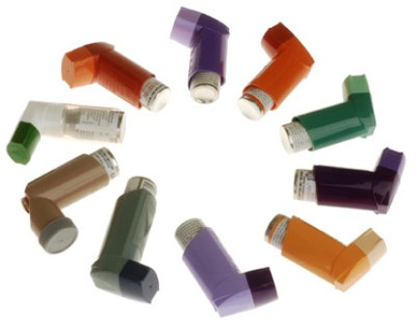
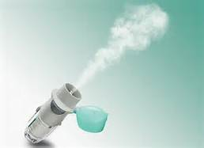
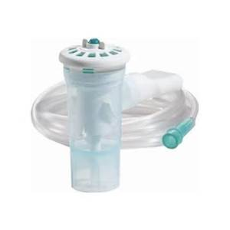
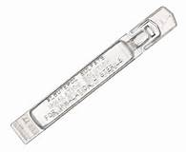
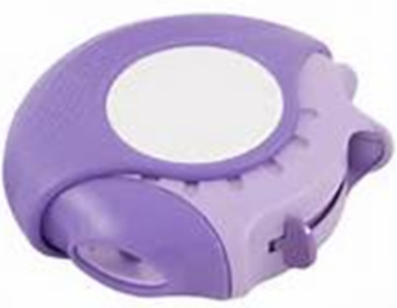
Considerations when choosing delivery method
Availability of drug via chosen device
Clinical setting
Age of patient
Ability of patient to use device correctly
Use with multiple meds
Cost/reimbursement
Treatment administration time
Convenience both inpatient & outpatient
Physician & patient preference
(Dolovich, et al, 2005)

Slide 14
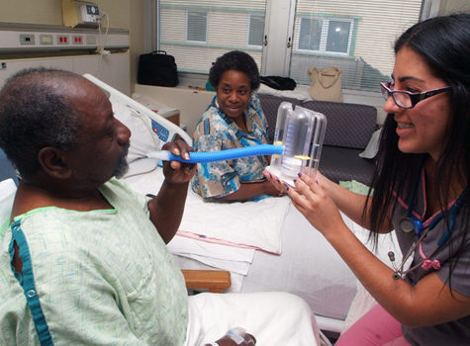
Patient Education
Multiple Therapist/Patient interactions allow for many teachable moments regarding disease self-management
Home medications and delivery devices
  Rescue meds v maintenance
Oxygen equipment
Recognizing early onset of exacerbation symptoms
  When to see family physician
  Change in sputum color and quantity

Slide 15
Conclusion
Therapist driven protocols
Match proper therapy with changes in frequency as needed based on patient improvement or digression
  Decrease both over and under ordering of therapy
  Decrease cost of care
  Decrease missed therapy
  Increase patient compliance with therapy
Helps ensure patient education on discharge re self care; ↓ readmissions
  Recognizing signs/sx of exacerbation early
  Proper use of home medications/therapy
Ongoing data collection
  Many respiratory departments are currently in transition
  Further studies are needed
    Impact on readmission rate, cost, and appropriateness of care

Slide 16
References
AARC.org (2016) Respiratory Care Clinical Practice Guidelines retrieved from http://www.rcjournal.com/cpgs/
CMS.gov (2016) Readmission Reduction Program (HRRP), retrieved from https://www.cms.gov/Medicare/Medicare-Fee-for-Service-Payment/AcuteInpatientPPS/Readmissions-Reduction-Program.html
Dolovich, MB, Ahrens, RC, Hess, DR, Anderson, P, Dhande R, Rau, JL, …Guyatt, G. (2005) Device Selection and Outcomes of Aerosol Therapy: Evidence-Based Guidelines. Clinical Practice Guidelines, Guidelines from Other Organizations, ACCP. Retrieved from: http://www.rcjournal.com/cpgs/#evidence PDF: http://journal.publications.chestnet.org/data/Journals/CHEST/22020/335.pdf
Gardenhire, D.S., Ari, A., Hess, D., Meyers, T.R. (2013) A Guide to Aerosol Delivery Devices for Respiratory Therapists. Retrieved from http://www.aarc.org/resources/clinical-resources/aerosol-resources/
Harbrecht, BG, Delgado, E., Tuttle RP, Cohen-Melamed, MH, Saul, MI, Velenta, CA. (2009) Improved outcomes with Routine Respiratory Therapist Evaluation of Non-Intensive-Care-Unit Surgery Patients. RC Journal, Volume 54 No. 7, 861-867. Retrieved from http://rc.rcjournal.com/content/54/7/861.short
Des Jardins, T, Burton, GG, Clinical Manifestations and Assessment of Respiratory Disease. Therapist Driven Protocols.115-137.
Kollef, MH, Shapiro, SD, Clinkscale, D. , Crecahiolo, L., Clayton, D., Wilner, R. Hossin, L. (2009)The Effect of Therapist-Initiated Protocols on Patient Outcomes and Resource Utilization. Chest, 2000, 117(2), 467-475. Retrieved from http://journal.publications.chestnet.org/article.aspx?articleid=1078573
Modrykamien, AM, Stoller JK. Scientific basis for protocol directed Respiratory Care. (2013) RC Journal , Volume 58 No. 10. Retrieved from http://rc.rcjournal.com/content/58/10/1662.full
Volsko, T. A. (2013) Airway Clearance Therapy: Finding the Evidence. RC Journal, Volume 58, No. 10. 1669-1678. Retrieved from http://rc.rcjournal.com/content/58/10/1669.full

