Slide 1
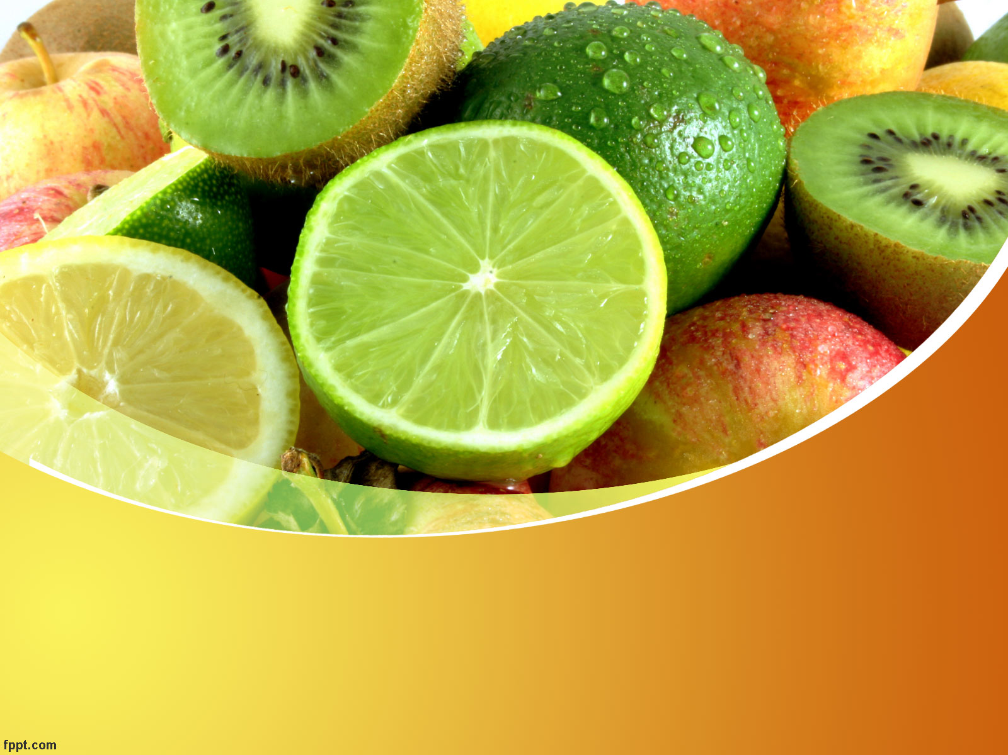

Prof. Dr.Camilia George Michel
Pharmacognosy Department, Faculty of Pharmacy
Cairo University

Slide 2
Chemical Composition, Antioxidant,
Anti-inflammatory and Antimicrobial
Activities of Essential Oil from Citrus maxima (burm.) Merrill.

Slide 3
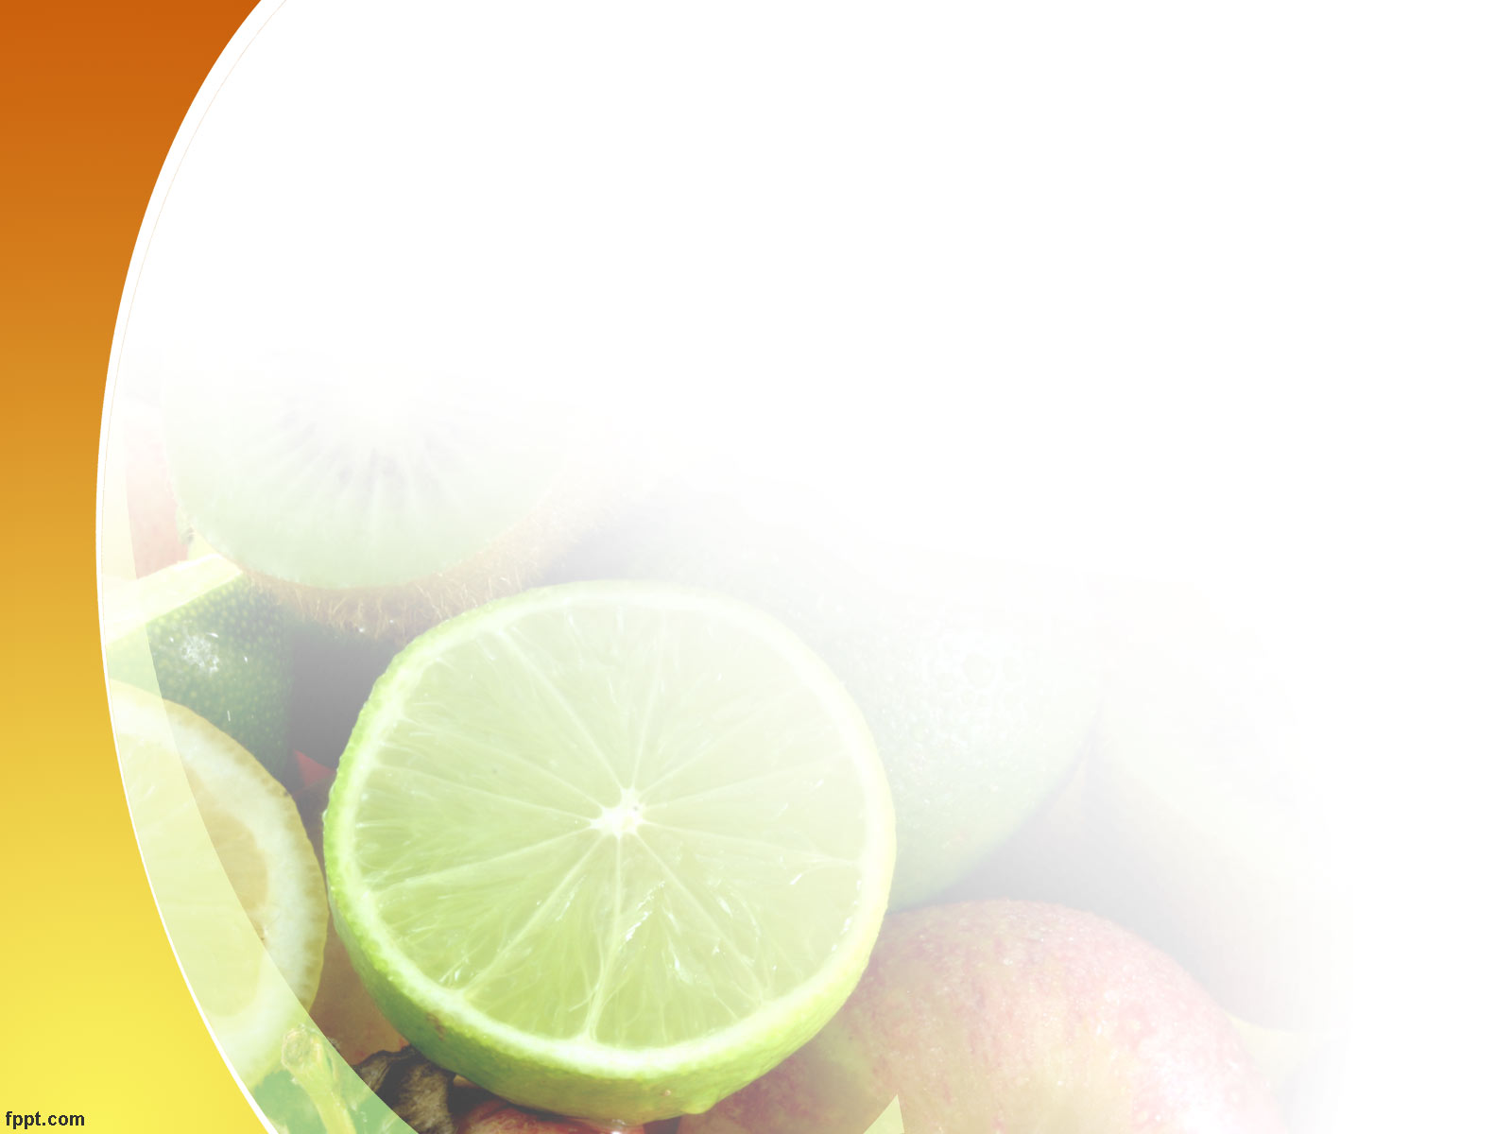
This work is a Master Thesis
Mohamed Shahat Sedeek
Prof. Dr. Mostafa Aly Abd El Kawy
Prof. Dr. Camilia George Michel
Dr. Farid Noshy Kirollos
Faculty of Pharmacy - Cairo University

Slide 4
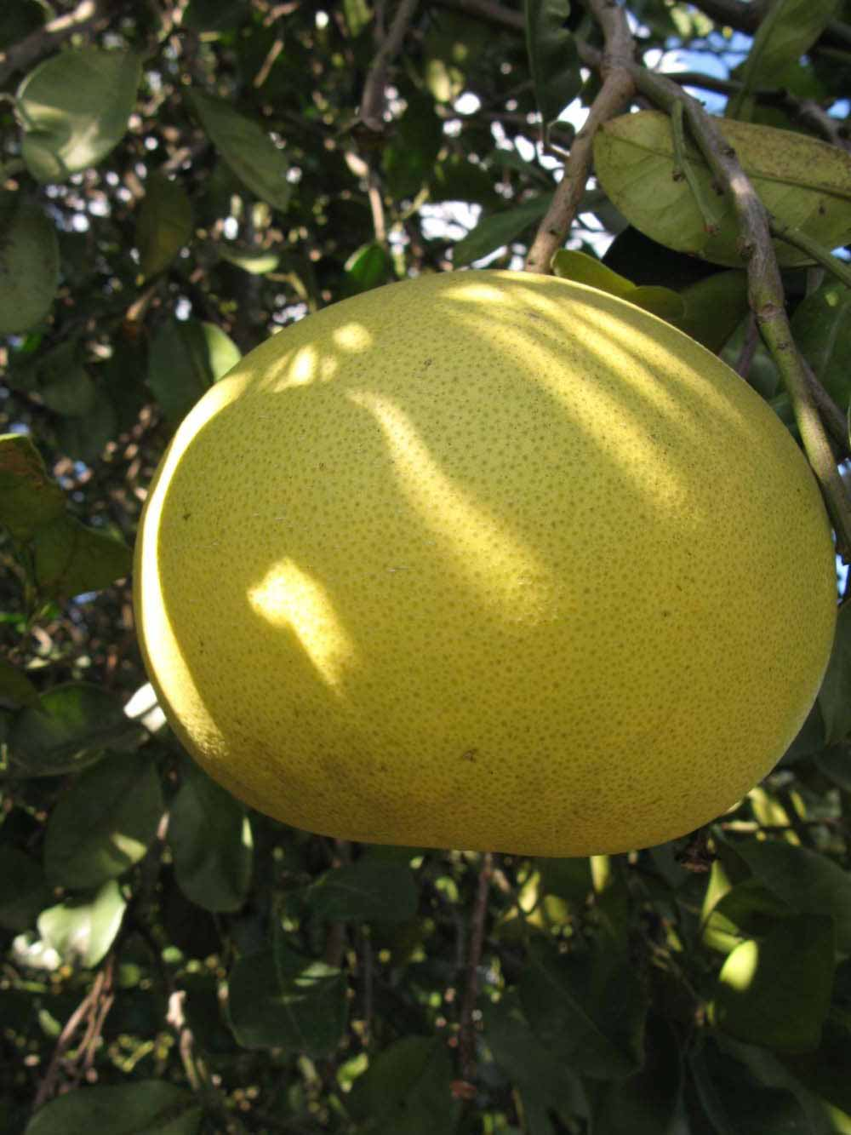
Citrus maxima (Burm.) Merrill.
Synonyms:
Citrus grandis
Citrus decumana
Common Names:
Pomelo, Pummelo
Pompelmous
Shaddock
Geographical source:
The species is native to southern China
and Malaysia and is now cultivated
in many tropical and semi-tropical countries for its large fruits
30 cm

Slide 5
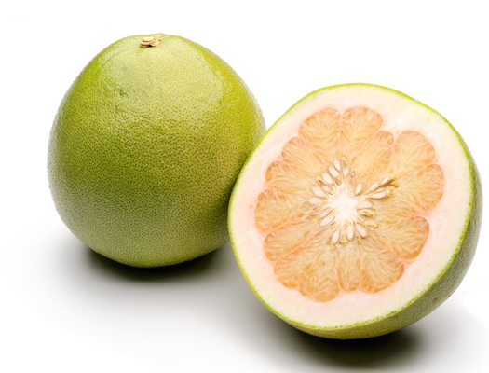
Family Rutaceae
Commonly known as the Rue or Citrus family.
Includes about 160 genera, totaling over 1600 species.
The most economically important genus in the family is Citrus , which includes the orange (C. sinensis), lemon (C. limonum), grapefruit (C. paradisi) and lime (C. aurantifolia).

Slide 6
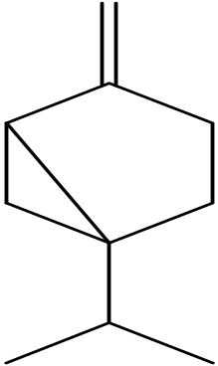
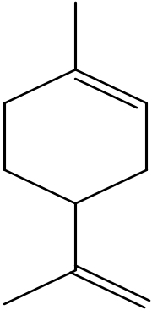
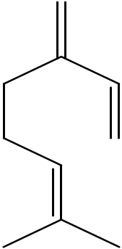
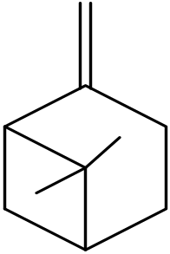
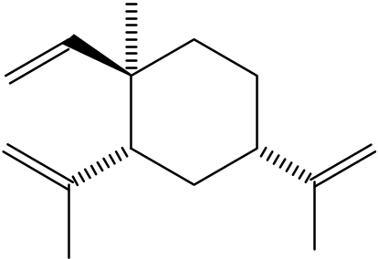
Review Of Literature
Aroma Active Constituents:
Sabinene
Limonene
Myrcene
β-elemene
β-pinene

Slide 7
Traditional Medicinal Uses:
Fruits are used as a mood elevator.
Vitamin C-rich fruit may help reduce cold symptoms.
Reduce blood levels of cholesterol and triglycerides.
An essence prepared from the flowers is taken to overcome insomnia and in aromatherapy.
Antidotes against certain venoms.

Slide 8
Reported Pharmacological Activities
Endocrine System :
C. maxima has a potential anti-hyperglycemic effect.
Cardiovascular System :
C. maxima is useful for treating circulatory problems such as thrombosis.
Gastrointestinal System:
- Antiemetic.
- Stomachic .

Slide 9
Renal System:
Juice significantly reduce the risk of forming calcium oxalate kidney stones.
Other Biological Activities:
Cytotoxic Activity:
Limonoids have been shown to help fight mouth, skin, lung, breast, stomach and colon cancers.

Slide 10
Antimicrobial Activity:
Seed extract has powerful antibacterial and antifungal activities.
Antidepressant Activity:
Antidepressant like effect of C. maxima seems to be mediated by an increase in nor epinephrine and serotonin level in synapses.

Slide 11
Nutritional Value Per 100 Grams Of Raw Edible Parts Of The Fruit Of Citrus maxima (Burm.) Merrill.
Item | % calculated
Moisture | 87.26
Ash | 0.43
Total lipid | 0.1
Total carbohydrate | 11.95
Total protein | 0.26
Vitamin C | 55
Fe | 0.17
Ca | 42
Total carbohydrate of peel | 73.24

Slide 12
This study includes
Investigation of essential oils of peels from four different cultivars:
Egypt (Giza, Alexandria), Jordan and Syria extracted by Hydrodistillation
(according to E.P. 2005)

Slide 13
Citrus maxima (Burm.) Merrill
(Giza cultivar)
GC–MS Solid Phase Micro-extraction (SPME) profiling of essential oil obtained from the fresh peels of Citrus maxima (Burm.) Merrill (Giza cultivar).

Slide 14
Effect of seasonal variation on yield and composition of essential oils of fresh leaves of the Giza cultivar of Citrus maxima.

Slide 15
Isolation and identification of major constituent (limonene) from the Giza cultivar.

Slide 16
The essential oil of peels of the
Giza cultivar of Citrus maxima obtained by hydrodistillation was subjected to:
Antimicrobial study
Antioxidant study
Anti-inflammatory study

Slide 17
Yield and Physical Characters Of The Essential Oils Of The Four C. maxima Cultivars:
Citrus Cultivars | Physical Characters
 | Percentage yield (w/v%) | Colour | Odour | Sp. gr.
Alexandrian | 2.091% | Pale yellow to colorless | Mandarin like odor | 0.83
Giza | 1.210% |  |  | 0.82
Jordan | 1.543% |  |  | 0.70
Syrian | 3.575% |  |  | 0.76

Slide 18
GC/MS Analysis Of The Essential Oils Of Peels Of The Four C. maxima Cultivars prepared by hydrodistillation
Peak No. | KI | Compound | Area %
 |  |  | Alex | Giza | Syria | Jordan
1 | 939 | α-pinene | 0.56 | 0.49 | 0.51 | 0.77
2 | 975 | Sabinen | 0.75 | - | 0.31 | 0.64
3 | 991 | Myrcene | 2.19 | 1.67 | 1.81 | 2.17
4 | 1005 | Octanal | 2.9 | - | 0.75 | 0.93
5 | 1034 | Limonene | 87.22 | 97.74 | 93.26 | 90.83
6 | 1038 | Cis β-Ocimene | - | 0.094 | - | -
7 | 1050 | trans β-Ocimene | 0.38 | - | 0.12 | 0.37
8 | 1063 | γ-Terpinene | 0.47 | - | - | 0.23
9 | 1074 | Octanol | - | - | 0.41 | 0.69

Slide 19
Peak No. | KI | Compound | Area %
 |  |  | Alex | Giza | Syria | Jordan
10 | 1078 | linalool oxide | 0.4 | - | 0.7 | 0.4
11 | 1090 | α –Terpinolene | - | - | - | 0.28
12 | 1093 | Unidentified | - | - | 0.33 | -
13 | 1101 | Linalool | 0.53 | - | 0.54 | 0.58
14 | 1153 | Citronellal | 0.47 | - | - | -
15 | 1189 | α-Terpineol | 0.86 | - | - | 1.11
16 | 1204 | Decanal | 2.74 | - | 0.96 | 0.99
17 | 1274 | Geranial | 0.5 | - | - | -
18 | 1439 | β -copaene | - | - | 0.3 | -

Slide 20
Histogram representing the relative percentages of the major constituent limonene of the four C. maxima cultivars.

Slide 21
Comparative study Of Essential Oil Components Of The Four Cultivars:
Oil constituents | Cultivars (%)
 | Alexandria | Giza | Jordan | Syria
Identified components | 99.97 | 99.99 | 99.67 | 99.99
Unidentified components | 0.03 | 0.01 | 0.33 | 0.01
Monoterpene hydrocarbons | 91.57 | 99.99 | 96.01 | 95.29
Sesquiterpene hydrocarbons | - | - | 0.3 | -
Other hydrocarbons | - | - | - | -
Total hydrocarbons | 91.57 | 99.99 | 96.31 | 95.29
Oxygenated monoterpenes | 2.76 | - | 1.24 | 2.09
Oxygenated sesquiterpenes | - | - | - | -
Other oxygenated constituents | 5.64 | - | 2.12 | 2.61
Total oxygenated compounds | 8.4 | - | 3.36 | 4.7
Total monoterpenes | 93.83 | 99.99 | 97.25 | 97.38
Total sesquiterpenes | - | - | 0.3 | -

Slide 22
Histogram representing collective percentage of the identified constituents of the four C. maxima cultivars.

Slide 23
Comparative study Of Oxygenated Compounds Of Essential Oil Components Of The Four Cultivars:
Oil constituents | Cultivars (%)
 | Alexandria | Giza | Jordan | Syria
Ketones | - | - | - | -
Alcohols | 1.39 | - | 0.95 | 2.38
Aldehydes | 6.61 | - | 1.71 | 1.92
Esters | - | - | - | -
Oxides | 0.4 | - | 0.7 | 0.4
Total oxygenated compounds | 8.4 | - | 3.36 | 4.7

Slide 24
Histogram representing collective percentage of the identified oxygenated constituents of the four C. maxima cultivars

Slide 25
GC/MS Analysis Of The SPME Profiling Of Essential Oil Obtained From The Fresh Peels Of C. maxima Giza cultivar (Vas and V’ekey, 2004)
Peak | RT | KI | Compound | Area (%)
1 | 2.082 | 645 | Unidentified | 0.023
2 | 7.754 | 932 | α-thujene | 0.176
3 | 7.796 | 934 | α-pinene | 1.312
4 | 8.543 | 976 | Sabinene | 0.466
5 | 8.648 | 982 | β-Pinene | 0.583
6 | 8.805 | 990 | Myrcene | 4.400
7 | 9.130 | 1010 | α-Phellandrene | 1.665
8 | 9.503 | 1034 | Limonene | 84.421
9 | 9.756 | 1050 | Trans β-ocimene | 0.639
10 | 10.594 | 1104 | Linalool | 0.518
(97.74%)

Slide 26
Peak | RT | KI | Compound | (%)
11 | 12.060 | 1206 | Decanal | 0.218
12 | 12.406 | 1232 | Mentha-1(7),8-dien-2-ol | 0.857
13 | 12.723 | 1256 | Geraniol | 0.733
14 | 12.973 | 1275 | Geranial | 0.188
15 | 13.688 | 1331 | Unidentified | 0.429
16 | 13.925 | 1351 | silphinene | 0.322
17 | 14.041 | 1360 | Silphiperfol-5,7(14)-diene | 0.414
18 | 14.275 | 1379 | α- copaene | 0.598
19 | 14.440 | 1393 | β- cubebene | 0.513
20 | 15.024 | 1440 | β- copaene | 0.913
21 | 15.797 | 1502 | Bicyclogermacrene | 0.609

Slide 27
Collective Percentage Of The Fresh Peels Essential Oil Obtained by SPME:
Oil constituents | Percentage (%)
Identified components | 99.545
Unidentified components | 0.455
Monoterpene hydrocarbons | 93.662
Sesquiterpene hydrocarbons | 3.369
Other hydrocarbons | -
Total hydrocarbons | 97.031
Oxygenated monoterpenes | 2.296
Oxygenated sesquiterpenes | -
Other oxygenated constituents | 0.218
Total oxygenated compounds | 2.514
Total monoterpenes | 95.958
Total sesquiterpenes | 3.369

Slide 28
Histogram representing collective percentage of the identified constituents of the fresh peels essential oil obtained by SPME

Slide 29
Collective percentage of oxygenated constituents of the fresh peels essential oil obtained by SPME:
Oil constituents | Percentage (%)
Alcohols | 2.108
Aldehydes | 0.406
Total oxygenated compounds | 2.514

Slide 30
Histogram representing collective percentage of the identified oxygenated constituents the fresh peels essential oil obtained by SPME

Slide 31
Oil constituents | Giza Cultivars (%)
 | Hydro distillation | Solid Phase Micro Extraction
Identified components | 99.99 | 99.54
Unidentified components | 0.01 | 0.45
Monoterpene hydrocarbons | 99.99 | 93.66
Sesquiterpene hydrocarbons | - | 3.36
Total hydrocarbons | 99.99 | 97.03
Oxygenated monoterpenes | - | 2.29
Oxygenated sesquiterpenes | - | -
Other oxygenated constituents | - | 0.21
Total oxygenated compounds | - | 2.51
Total monoterpenes | 99.99 | 95.95
Total sesquiterpenes | - | 3.36

Slide 32
Yield And Physical Characters Of The Essential Oil Of C.maxima Leaves At Different Seasons:
Season | Physical characters
 | Percentage Yield (%w/v) | Colour | Odour | Sp. gr.
Winter | 0.09 | Yellow | Characteristic, strongly aromatic | 0.86
Spring | 0.05 |  |  | 0.84
Summer | 0.03 |  |  | 0.81
Autumn | 0.08 |  |  | 0.83

Slide 33
GC/MS Analysis Of The Essential Oils Of Leaves Of C. maxima At The Four Seasons:
Peak | KI | Compound | Winter (%) | Spring (%) | Summer (%) | Autumn (%)
1 | 650 | Unidentified | 0.020 | - | - | -
2 | 728 | Unidentified | - | - | 0.059 | -
3 | 767 | Toluene | - | - | 0.069 | -
4 | 804 | Unidentified | - | 0.042 | - | -
5 | 860 | Unidentified | - | 0.079 | 0.110 | 0.089
6 | 874 | Unidentified | - | 0.039 | 0.066 | 0.090
7 | 877 | Hexenol | - | 0.100 | 0.160 | 0.157
8 | 899 | Nonane | - | - | 0.059 | -
9 | 901 | Santolina triene | 1.200 | -- | - | -
0 | 926 | Tricyclene | 4.400 | 0.072 | - | -
11 | 930 | α-thujene | - | 0.680 | 1.250 | 1.398
12 | 939 | α-pinene | 0.168 | 4.171 | 3.000 | 3.273
13 | 947 | Unidentified | - | 0.031 | - | -
14 | 955 | Camphene | - | 0.255 | 0.102 | 0.128

Slide 34
Peak | KI | Compound | Winter (%) | Spring (%) | Summer (%) | Autumn (%)
15 | 975 | Sabinene | 16.655 | 5.260 | 45.746 | 46.220
16 | 979 | β-Pinene | 18.843 | 51.080 | 4.840 | 4.740
17 | 987 | Mentha-2,8-diene | - | 0.329 | - | -
18 | 991 | Myrcene | 3.390 | 0.890 | 4.450 | 4.738
19 | 999 | Octanal | -- | - | 0.169 | 0.055
20 | 1007 | dehydroxy cis-Linalool oxide | 0.079 | 0.174 | - | 0.258
21 | 1009 | α-Phellandrene | 0.138 | 0.035 | 0.300 | -
22 | 1013 | δ-3-Carene | 0.162 | 0.047 | 0.208 | 0.196
23 | 1020 | α-Terpinene | 3.000 | 0.290 | 3.707 | 3.921
24 | 1028 | ο-Cymene | 0.138 | 0.145 | 0.458 | 0.339
25 | 1034 | Limonene | 2.370 | 3.517 | 2.844 | 2.769
26 | 1036 | Cis β-ocimene | 1.670 | 2.460 | 1.515 | 1.385
27 | 1048 | Trans β-ocimene | 9.910 | 16.220 | 5.568 | 5.504
28 | 1063 | δ-Terpinene | 4.730 | 0.503 | 6.199 | 6.266

Slide 35
Peak | KI | Compound | Winter (%) | Spring (%) | Summer (%) | Autumn (%)
29 | 1077 | Cis-Linalool oxide | 0.213 | 0.069 | .622 | 0.527
30 | 1090 | α-Terpinolene | 1.370 | 0.208 | 1.407 | 1.374
31 | 1096 | Fenchone | - | 0.614 | - | -
32 | 1101 | Linalool | 0.060 | 0.858 | 0.162 | 0.121
33 | 1110 | 1,3,8-p-menthatriene | 0.076 | - | 0.207 | 0.228
34 | 1114 | trans-Thujone | 0.077 | - | - | 0.051
35 | 1128 | Unidentified | - | 0.076 | - | -
36 | 1133 | Unidentified | 0.277 | 0.036 | 0.655 | 0.608
37 | 1152 | Menthone | 0.170 | - | 0.349 | 0.328
38 | 1155 | Citronellal | - | 0.290 | 0.132 | 0.076
39 | 1175 | Terpinen-4-ol | - | 0.065 | - | -
40 | 1182 | Unidentified | - | .072 | - | -
41 | 1184 | Unidentified | - | 0.035 | - | -
42 | 1190 | α-Terpineol | 5.580 | 0.959 | 13.06 | 12.410

Slide 36
Peak | KI | Compound | Winter (%) | Spring (%) | Summer (%) | Autumn (%)
43 | 1203 | Unidentified | - | 0.376 | 0.305 | 0.417
44 | 1206 | Decanal | 0.475 | - | 0.122 | -
45 | 1218 | cis-Sabinene hydrate acetate | 0.093 | - | 0.138 | 0.149
46 | 1231 | Mentha-1(7),8-dien-2-ol | 0.077 | 0.190 | - | 0.105
47 | 1245 | Neral | - | 1.190 | - | -
48 | 1254 | Geraniol | - | 0.205 | - | -
49 | 1273 | Geranial | - | 1.618 | - | -
50 | 1346 | δ- elemene | 0.097 | 0.125 | - | -
51 | 1349 | silphinene | 0.084 | - | - | -
52 | 1359 | Silphiperfol-5,7(14)-diene | - | 0.244 | - | -
53 | 1378 | α –copaene | 0.144 | 0.650 | - | -
54 | 1392 | β –cubebene | 0.045 | 0.022 | - | -
55 | 1395 | Sesqthujene | 0.037 | - | - | -
56 | 1402 | β- Longipinene | 1.280 | 1.589 | 0.470 | 0.539

Slide 37
Peak | KI | Compound | Winter (%) | Spring (%) | Summer (%) | Autumn (%)
57 | 1419 | Unidentified | 0.048 | - | - | -
58 | 1431 | α-Santalene | 4.680 | - | - | -
59 | 1439 | β -copaene | 4.600 | 1.858 | 0.570 | 0.514
60 | 1447 | Epi-β-Santalene | 0.038 | - | - | -
61 | 1454 | α-Humulene | 0.242 | - | 0.098 | 0.182
62 | 1459 | Trans-β-farnesene | 0.560 | - | - | -
63 | 1472 | Cumacrene | 0.686 | - | - | -
64 | 1476 | Germacrene D | 0.800 | 0.210 | 0.199 | 0.238
65 | 1492 | Cis- β-Guaiene | 0.295 | .0440 | - | -
66 | 1501 | Bicyclogermacrene | - | 0.100 | - | -
67 | 1507 | E,E- α- Farnesene | 0.908 | 0.347 | - | -
68 | 1511 | γ-Cadinene | 0.260 | - | - | -
69 | 1516 | Germacrene A | 2.906 | 0.777 | 0.168 | 0.182
70 | 1531 | α-Cadinene | 0.398 | 0.230 | - | -

Slide 38
Peak | KI | Compound | Winter (%) | Spring (%) | Summer (%) | Autumn (%)
71 | 1557 | Unidentified | - | 0.018 | - | -
72 | 1563 | (E)-Nerolidol | 0.206 | - | - | -
73 | 1575 | Spathulenol | 0.280 | - | - | -
74 | 1581 | Caryophyllene oxide | - | 0.074 | - | -
75 | 1600 | Fokienol | 0.290 | 0.193 | - | -
76 | 1607 | Unidentified | - | 0.110 | - | -
77 | 1616 | Unidentified | 0.167 | - | - | -
78 | 1668 | E-Bisabol-11-ol | 3.990 | - | - | -
79 | 1671 | Unidentified | - | 0.084 | - | -
80 | 1675 | Santalol a | - | - | 0.269 | 0.294
81 | 1679 | Farnesal | 0.283 | - | - | -
82 | 1701 | β-Sinensal | - | - | 0.167 | 0.268

Slide 39
Histogram representing the major identified constituents of C. maxima leaves at the four seasons.

Slide 40
Collective percentage of essential oil components of of leaves at the four seasons:
Oil constituents | Cultivars (%)
 | Winter (%) | Spring (%) | Summer (%) | Autumn (%)
Identified components | 98.153 | 98.957 | 98.784 | 98.933
Unidentified components | 1.847 | 1.043 | 1.216 | 1.067
Monoterpene hydrocarbons | 68.220 | 86.162 | 81.801 | 82.479
Sesquiterpene hydrocarbons | 18.060 | 6.196 | 1.505 | 1.655
Other hydrocarbons | - | - | 0.128 | -
Total hydrocarbons | 86.200 | 92.358 | 83.434 | 84.134
Oxygenated monoterpenes | 6.349 | 6.232 | 14.463 | 14.025
Oxygenated sesquiterpenes | 5.049 | 0.267 | 0.436 | 0.562
Other oxygenated constituents | 0.475 | 0.100 | 0.451 | 0.212
Total oxygenated compounds | 11.873 | 6.599 | 15.350 | 14.799
Total monoterpenes | 74.569 | 92.394 | 96.264 | 96.504
Total sesquiterpenes | 23.109 | 6.463 | 1.941 | 2.217

Slide 41
Histogram representing collective percentage of the identified constituents of C. maxima leaves at the four seasons.

Slide 42
Collective Percentage Of Oxygenated Compounds Of Essential Oil Components Of leaves at the Four seasons:
Oil constituents | Season
 | Winter (%) | Spring (%) | Summer (%) | Autumn (%)
Ketones | 0.247 | 0.614 | 0.349 | 0.379
Alcohols | 10.406 | 2.380 | 13.651 | 12.982
Aldehydes | 0.835 | 3.288 | 0.590 | 0.504
Esters | 0.093 | - | 0.138 | 0.149
Oxides | 0.292 | 0.317 | 0.622 | 0.785
Total oxygenated compounds | 11.873 | 6.599 | 15.350 | 14.799

Slide 43
Histogram representing collective percentage of the identified oxygenated constituents of C. maxima leaves at the four seasons

Slide 44
Conclusion
Hydrodistillation can be used as the method of choice for isolation of Limonene with high purity and yield (98%)

Slide 45
Isolated Limonene was identified by:
Physical characters | Colourless oily liquid
Molecular formula | C₁₀H₁₆
Colour of spot with vanillin sulfuric acid | Reddish violet
EI/MS m/z (70ev,rel.int) | 136[M]⁺,121,107,93,79,68(100%) and 53
¹HNMR: δ(400MHz) | 1,5 (2H, m, H-5), 1,65 (3H, s, H-7), 1,75 (3H, s, H-10), 1,9 (2H, m, H-3), 1,9 (2H, m, H-6), 2,1 (H, m, H-4), 4,7 (2H, s, H-9), 5,4 (H, s, H-2)

Slide 46
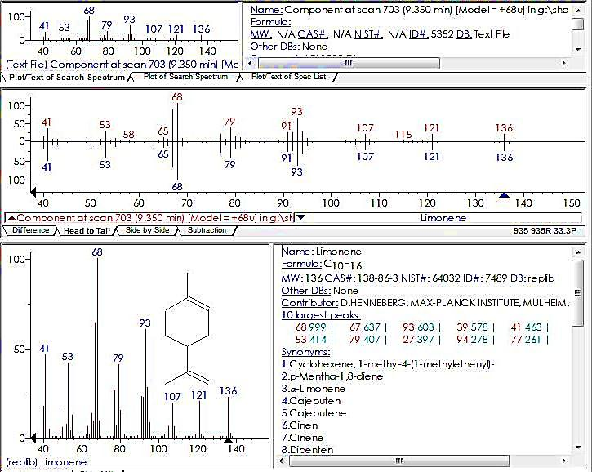
EI-MS spectrum of compound C₁ from NIST Library

Slide 47
¹H-NMR spectrum of compound C₁

Slide 48
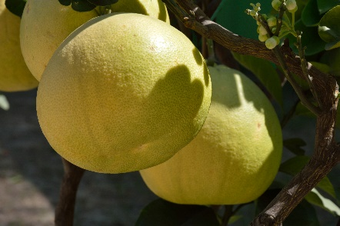
Obtained by hydrodistillation from fresh peels of
Citrus maxima
(Giza cultivar)
Biological studies of Essential oil from C. maxima

Slide 49
Antimicrobial Activity

Slide 50
Antimicrobial Activity of Essential Oil Isolated From C. maxima Peels
Sample | Essential oil Mean zone of inhibition(mm) ± SD | Percentage from standard | Standard
Tested Microorganisms
Gram Positive Bacteria |  |  | Ampicillin
Staphylococcus aureus | 20.6 ± 0.58 | 71.28 | 28.9 ± 0.14
Streptococcus pyogenes | 22.4 ± 0.63 | 84.85 | 26.4 ± 0.34
Gram Negative Bacteria |  |  | Gentamycin
Salmonella typhi | 16.7 ± 0.63 | 67.34 | 24.8 ± 0.24
Pseudomonas aeruginosa | NA |  | 17.3 ± 0.12
Escherichia coli | 22.4 ± 1.2 | 88.54 | 25.3 ± 0.18

Slide 51
Antimicrobial Activity of Essential Oil Isolated From C. maxima Peels

Slide 52
Antimicrobial Activity Of Essential Oil Isolated From C.maxima Peels
(Agar well diffusion method, Samnia et al 1999)
Sample | Essential oil | Percentage from standard | Standard
Tested Microorganisms | Mean zone of inhibition(mm) ± SD
Fungi |  |  | Amphotericin B
Aspergillus flavus | 20.6 ± 0.63 | 75.46 | 27.3 ± 0.10
Candida albicans | 18.4 ± 0.58 | 84.02 | 21.9 ± 0.12

Slide 53
Antimicrobial Activity Of Essential Oil Isolated From C. maxima Peels

Slide 54
Minimum Inhibitory Concentration of essential oil of Citrus maxima (Burm.) Merrill (Giza cultivar)
Sample | Essential oil MIC (µg/ml) | Standard
Tested Microorganisms
Gram Positive Bacteria |  | Ampicillin
Staphylococcus aureus | 1.95 | 0.49
Streptococcus pyogenes | 0.98 | 0.49
Gram Negative Bacteria |  | Gentamycin
Salmonella typhi | 15.63 | 0.98
Escherichia coli | 0.98 | 0.98

Slide 55
Minimum Inhibitory Concentration of essential oil of Citrus maxima (Burm.) Merrill (Giza cultivar)

Slide 56
MIC of essential oil of Citrus maxima (Burm.) Merrill (Giza cultivar) on fungi:
Sample | Essential oil MIC (µg/ml) | Standard
Tested Microorganisms
Fungi |  | Amphotericin B
Aspergillus flavus | 3.9 | 0.98
Candida albicans | 7.81 | 1.95

Slide 57
MIC of essential oil of Citrus maxima (Burm.) Merrill (Giza cultivar) on fungi:

Slide 58
Antioxidant Activity

Slide 59
Item | IC₅₀
Ascorbic acid | 11.2 µg/ml
Essential Oil | 2.98 µg/ml
DPPH following method of Alothman et al (2009)

Slide 60
In-vitro Antioxidant Activity Of Essential Oil From C.maxima Peels

Slide 61
Anti-inflammatory

Slide 62
Carrageenan-induced hind paw edema
Dharmiasiri et al (2003)
Carrageenan-induced edema is a biphasic response:
The first phase is mediated through the release of histamine, serotonin and kinins.
The second phase is related to the release of prostaglandin and slow reacting substances which peak at 3 h.

Slide 63
Anti-inflammatory Activity Of E.O. Against Formalin-Induced Paw Edema In Rats.
Group | Dose /Kg | Edema inhibition %
 |  | 30 min | 1 hour | 2 hours | 3 hours
Control (Tween 80) | 5 ml | 0 | 0 | 0 | 0
Ibuprofen | 25 mg | 92.73 | 100 | 100 | 100
Essential Oil | 5 ml | 29.09 | 35.08 | 38.14 | 40.32

Slide 64
Essential Oil produced a time-dependent and significant inhibition of carrageenan-induced paw edema when compared to Ibuprofen.
The inhibition was significant at the dose of 5 ml/kg (40.32%) to that of the standard drug, ibuprofen (100%).

Slide 65
Anti-inflammatory Activity Of Limonene Isolated From C.maxima Peels

Slide 66
All previous results
Were in agreement with published data:
Antimicrobial activity
Espina et al (2010), Caccion et al (1998).
Anti-inflammatory activity
Hirota et al (2010), Yoon et al (2010).
Antioxidant activity
Malhotra et al (2009).

Slide 67
The volatile constituents of the peel and leaves of Citrus maxima could be:
incorporated in antioxidant, anti-inflammatory and antimicrobial preparations or food supplement.
Can be used as a step towards reusing and recycling of these by-products obtained from Citrus species.
used as a main source of limonene

Slide 68
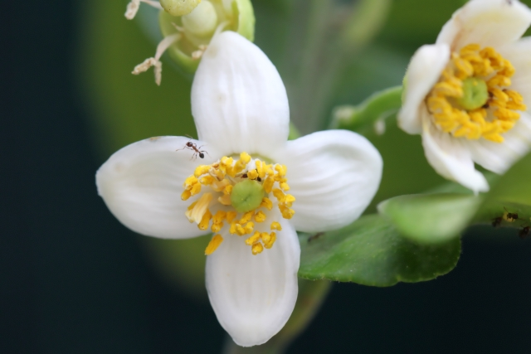
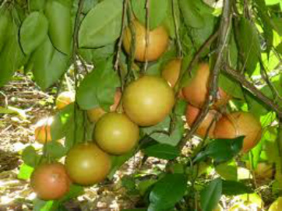
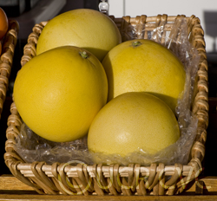
Thank you

