Slide 1

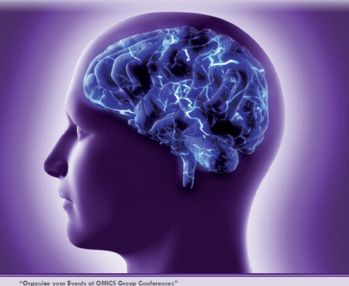

METABOLIC SYNDROME, NEUROINFLAMMATION AND COGNITIVE IMPAIRMENT: STATE OF THE ART AND DATA FROM A SECOND LEVEL OUTPATIENT CLINIC IN ITALY
Valeria Calsolaro
Post graduating school on Geriatric medicine
University of Pisa
Italy

Slide 2
ALZHEIMER’S DISEASE
35.6 million people worldwide living with dementia in 2010, expected to become 65.7 million in 2030 and 115.4 million in 2050
Alzheimer’s disease (AD) is the most prevalent type of dementia, comprising about 60%–70% of all dementia cases

Slide 3
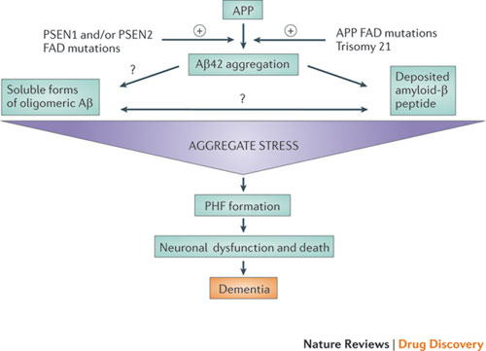
AMYLOID CASCADE HYPOTHESIS…
…NOT ENOUGH…

Slide 4
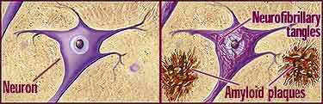
authoptic and imaging studies showed that amyloid deposition, such as neurofibrillary tangles, can be found in cognitively and well-educated normal old subjects
therapeutics attempt to clear Aβ, although efficient in reducing Aβ load both in animal and human models, didn’t stop or reduce the progression of AD

Slide 5
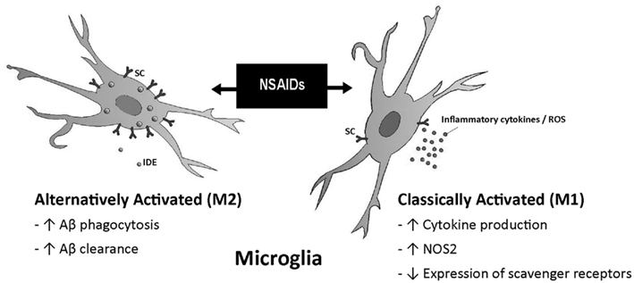
…NEUROINFLAMMATION…
INFLAMMATORY RESPONSE IN THE CENTRAL NERVOUS SYSTEM, DUE TO INJURY; ASTROCITES AND MICROGLIAL CELLS ARE THE MAIN ACTORS IN THE INFLAMMATORY RESPONSE IN THE CNS
Modiefied from Microglia function in Alzheimer’s disease Egle Solito1 and Magdalena Sastre

Slide 6
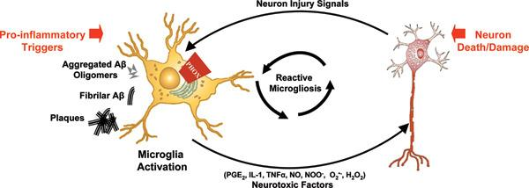
…SELF-PERPETUATING CYCLE OF NEURONAL DAMAGE/DEATH FOLLOWED BY MICROGLIAL ACTIVATION IS COMMONLY REFERRED TO AS REACTIVE MICROGLIOSIS AND MAY BE AN UNDERLYING MECHANISM OF THE PROGRESSIVE NATURE OF DIVERSE NEURODEGENERATIVE DISEASES, INCLUDING ALZHEIMER'S DISEASE...
NADPH oxidase as a therapeutic target in Alzheimer's disease. Michelle L Block

Slide 7
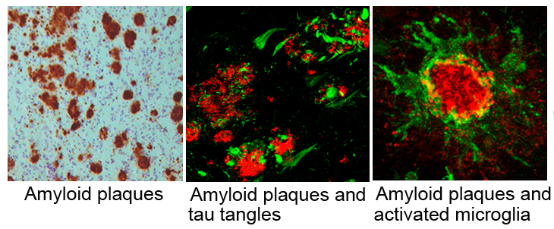
NEUROINFLAMMATION AND NEURODEGENERATION: SUPPORTING EVIDENCE
up-regulated inflammatory mechanisms co-localize in the same region with high level of AD pathology, absent in the region with low AD susceptibility (eg cerebellum)
microscopical examinations showed that inflammatory mediators are expressed overall closest to the Aβ deposits and neurofibrillary tangles
http://ucmkitazawa.web.fc2.com/mind_project.html

Slide 8
NEUROINFLAMMATION AND NEURODEGENERATION: SUPPORTING EVIDENCE
subjects withouth dementia but authoptic funding of limbic Aβ and neurofibrillary tangles sufficient to pone diagnosis of AD show a modest elevation of inflammatory markers, greater than non dement subjects but less than AD subjects
ultrastructural evidence of inflammatory toxicity in AD brain
potential protective effect of the chronic use of Non-Steroidal Anti-Inflammatories

Slide 9
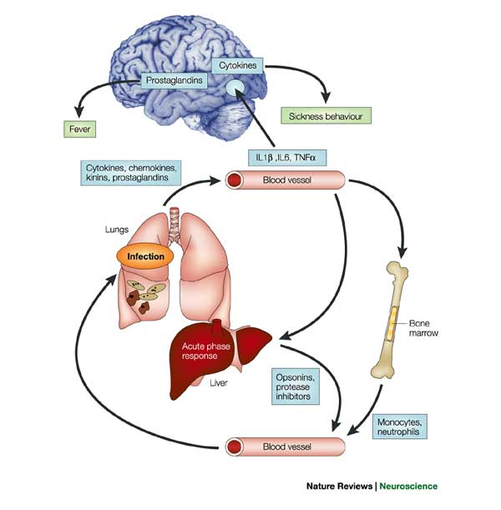
PERIPHERIC INFLAMMATION AND NEUROINFLAMMATION
inflammatory mediators by cells local to the insult
liver acute phase response and immune cell recruitment from the bone marrow.
The circulating cytokines also communicate with brain centres through the cerebral endothelium, the vagal nerve and the circumventricular organs to effect local cytokine and prostaglandin synthesis and produce sickness behaviours such as fever and reduced locomotor activity. IL and TNFalpha

Slide 10
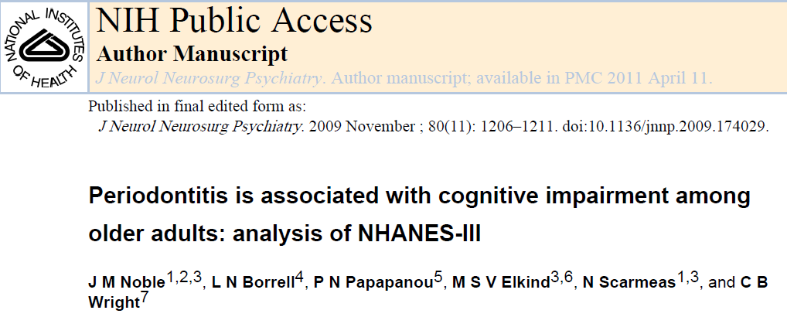
PERIPHERIC INFLAMMATION AND NEUROINFLAMMATION
periodontitis, a clinical condition characterized by chronic periodontal inflammation and systemic release of inflammatory cytokines (Il-1, Il6, TNF)

Slide 11
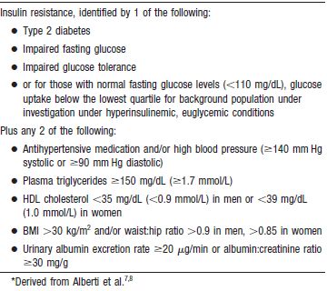
PERIPHERIC INFLAMMATION AND NEUROINFLAMMATION
METABOLIC SYNDROME:

Slide 12
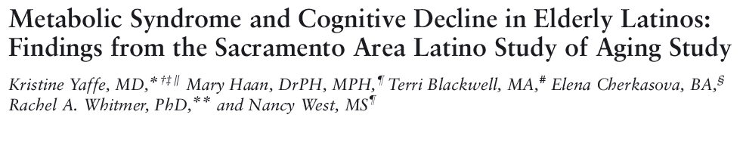

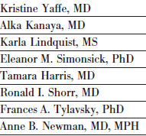
Longitudinal cohort study, counting 1624 Latinos aged 60 and older who participated.
Conclusions: Metabolic syndrome and inflammation may both contribute to cognitive decline in older people of diverse backgrounds…the composite measure of metabolic syndrome is a greater risk for cognitive decline than its individual components.
A 5-year prospective observational study conducted from 1997
to 2002 at community clinics at 2 sites, for a total of 2632 black and white elders (mean age, 74 years).
Conclusions: metabolic syndrome contributes
to cognitive impairment in elders, but primarily in those with high level of inflammation

Slide 13
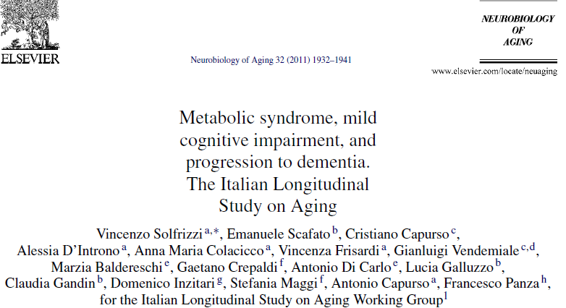
A total of 2097 participants from a sample of 5632 65–84-year-old subjects from the Italian Longitudinal Study on Aging
Among MCI patients the presence of MetS independently predicted an increased risk of progression to dementia over 3.5 years of follow-up.

Slide 14
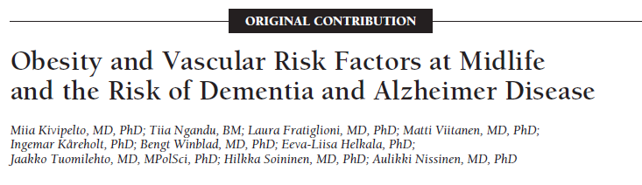
High cholesterol and systolic blood pressure were significant predictors of dementia and their risk was additive to that of obesity in this population.
Midlife obesity, high SBP, and high total cholesterol level were all significant risk factors for dementia, each of them increasing the risk around 2 times. Clustering of these vascular risk factors increased the risk of dementia and AD in an additive manner so that persons with all 3 risk factors had around a 6 times higher risk for dementia than persons having no risk factors.

Slide 15
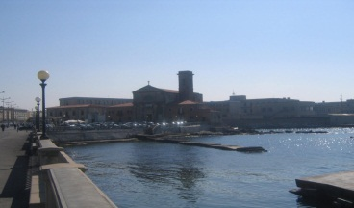

ALZHEIMER’S OUTPATIENT CLINIC
LIVORNO HOSPITAL (TUSCANY)
 | subjects (n=127) | female (n=76) | male (n=51) | p (F vs M)
Age | 78,2±7,1 | 78,5±7,1 | 77,6±7,2 | 0,5
MMSE | 20,6±5,1 | 20,2±4,9 | 21,0±5,4 | 0,4
HBP | 53,1% | 54,2% | 51,4% | 0,8
DM | 34,7% | 35,6% | 33,3% | 0,6
IFG | 7,9% | 10,2% | 4,8% | 0,6
Dyslipidemia | 79,1% | 88,5% | 64,7% | 0,08
CVI | 53,1% | 48,8% | 57,9% | 0,4
CRI | 24,0% | 48,6% | 30,9% | 0,4
↑ Inflammation indexes | 41,7% | 48,6% | 30,4% | 0,2
With contribution of Cassa di Risparmio di Livorno

Slide 16
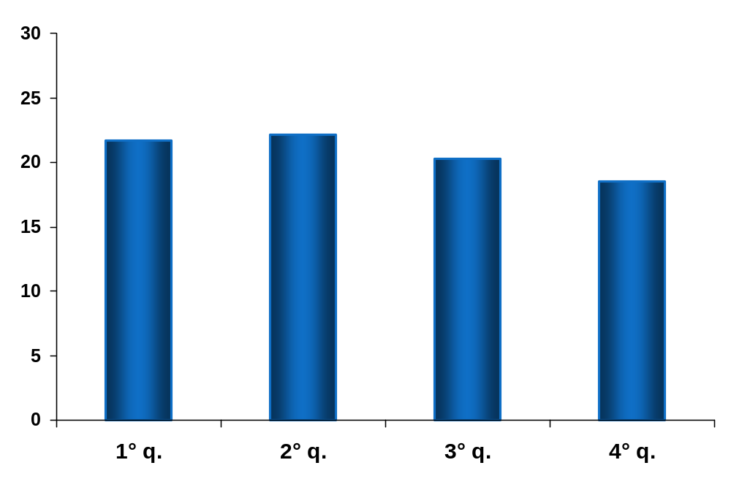
ALZHEIMER’S OUTPATIENT CLINIC
LIVORNO HOSPITAL (TUSCANY)
p=0.02
p=0.05
1° <65 n=7
2° 65-75 n=28
3° 75-85 n=66
4° >85 n=26
Mean MMSE score
Quartiles of age
With contribution of Cassa di Risparmio di Livorno

Slide 17
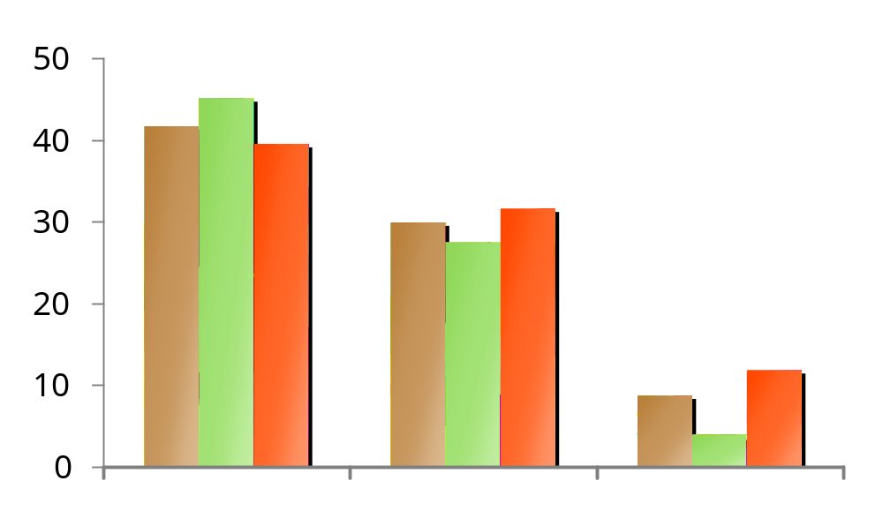
ALZHEIMER’S OUTPATIENT CLINIC
LIVORNO HOSPITAL (TUSCANY)
PREVALENCE OF CARDIOVASCULAR RISK FACTORS
Patients %
All M F
All M F
All M F
1 risk factor
2 risk factors
3 risk factors
With contribution of Cassa di Risparmio di Livorno

Slide 18
INTERESTINGLY, ALTHOUGH THE ASSOCIATION BETWEEN PERIPHERAL INFLAMMATION AND COGNITIVE IMPAIRMENT IS GENERALLY RECOGNIZED, RHEUMATOID ARTHRITIS, A TYPICAL SYSTEMIC AUTOIMMUNE DISORDER, SEEMS NEGATIVELY ASSOCIATED TO ALZHEIMER’S DISEASE DEVELOPMENT

Slide 19

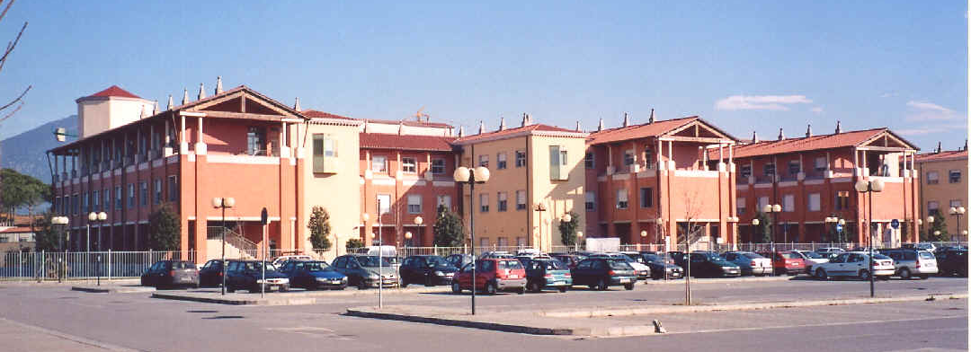

On this basis, we propose a translational research project
Relationship between cognitive function and inflammation in animal models and in patients with morbid obesity, rheumatoid arthritis, osteoarthritis and periodontitis
to evaluate the effect of peripheral chronic inflammation on neuro-inflammation and cognitive function as well as AD pathophysiology,

Slide 20
GOALS:
Demonstrate that peripheral chronic inflammation, depending on the cytokine pattern, specific for MORBID OBESE, REUMATHOID ARTHRITIS AND PERIODONTITIS PATIENTS, could act at CNS level and favor or prevent negative inflammation and consequent oxidative stress on the ad developing process.
Pisa University Hospital:
Geriatrics Unit (PI)
Rheumathology Unit
Odontostomatholgy Unit
Neurology Unit
Endocrinology Unit
Imperial College, London:
Neuro-Imaging Unit, Hammersmith Hospital

Slide 21

THANK YOU

