Slide 1
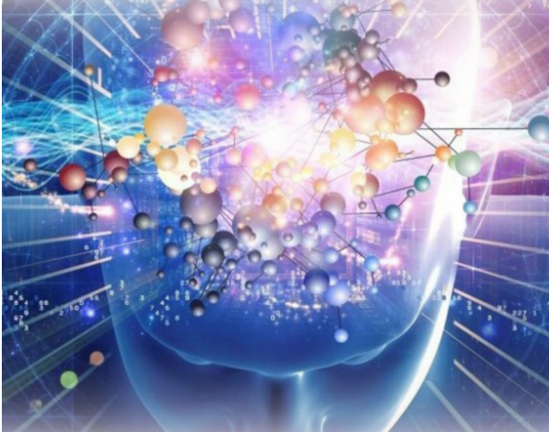
Unified Field Theory for All Physics and Beyond
International Conference on Quantum Physics and Nuclear Engineering,
March 14-16, 2016 London, UK
C. Wei Xu,
Virtumanity, USA
The author grants this presentation redistributable as a whole freely for non-commercial use only.

Slide 2
AGENDA I
  YinYang Motion Equations
  Horizon of Quantum Fields
  Horizon of Macroscopic Densities
  Horizon of Thermodynamics
  Horizon of Electromagnetic Fields
  Horizon of Gravitational Fields
  General Gravitational Fields
  Questions and Discussion
All rights reserved Copyright@ 2016

Slide 3
Terminology (I)
Virtual and Physical Worlds
A world is an environment composed of events or constituted by hierarchical structures of massless objects, massive matters, or both.
These hierarchical structures are respectively defined as virtual world, physical world, and universe.
Traditionally, for example, the virtual world is referred to as the inner world, the physical world as the outer world, and together they form holistic lives in universe.

Slide 4
Terminology (II)
Yinyang Duality
Defines the complementary opponents of inseparable, reciprocal pairs of all natural states and events. Among them, the most fundamental duality is known as yin “-” (阴 in Chinese) and yang “+” (阳 in Chinese), with neutral balance “o” that appears as if there were nothing.
Presents the two-sidedness of any event or world, each dissolving into the other in an alternating stream that generates the life of situations, movements, or actions through continuous helix-circulations in a universe manifold.
Because of this yinyang nature, a universe manifold always has a mirrored pair in the imaginary part, a conjugate pair of a complex manifold, defined as Yinyang Manifold.

Slide 5
Terminology (III)
Horizon Manifold
In the physical domain, called spacetime, virtual events continuously and progressively rise through various stages of physical formations.
Together, each advances from the others under a topological hierarchy of the universe to develop a consistent system of stages.
The domain of this consistent system of stages is divided into various scopes, called horizon.
A horizon is the apparent boundary of a realm of perception or the like, where unique structures are evolved, topological functions are performed, various neighborhoods form interactions, and worlds are composed through transformations.
Each horizon rises and contains specific fields as a construction of the dynamics within or beyond its own range. In other words, fields vary from one horizon to the others, each of which is part of and aligned with the horizon topology of the world.

Slide 6
AGENDA II
  YinYang Motion Equations
  Horizon of Quantum Fields
  Horizon of Macroscopic Densities
  Horizon of Thermodynamics
  Horizon of Electromagnetic Fields
  Horizon of Gravitational Fields
  General Gravitational Fields
  Questions and Discussion
All rights reserved Copyright@ 2016

Slide 7
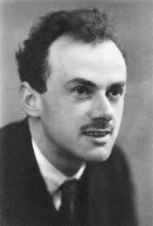
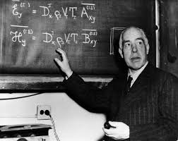
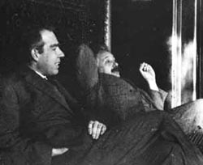
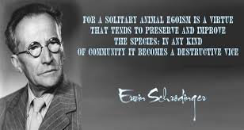
What is Quantum Fields ???
Niels Bohr (1885–1962):
Everything we call real is made of things that cannot be regarded as real.
If quantum mechanics hasn't profoundly shocked you, you haven't understood it yet.
Paul Direc (1902-984):
A great deal of my work is just playing with equations and seeing what they give. .
Erwin Schrödinger
(12 August 1887 – 4 January 1961):
The mathematical framework of quantum theory has passed countless successful tests and is now universally accepted as a consistent and accurate description of all atomic phenomena.
Einstein (1879-1955):
God doesn’t throw dice
if quantum mechanics were correct then the world would be crazy.
Niels Bohr (1925):
Stop telling God what he can and can’t do.

Slide 8








Yinyang Motion equations
Spacetime coordinates:
Dynamic state fields of yin and yang :
Energy State densities in equilibrium:
U (Internal) = L(Spacetime) + T(Kinetic)
Entropy in Lagrangian (in 1788) form:
Euler-Lagrange motion equation (1755) of dynamic fields:
Yin’s derivation: and Yang’s:
An inception process can be represented as an infinite sum of terms calculated from the values of the derivatives at an initiation point (Taylor series in 1715):

Slide 9

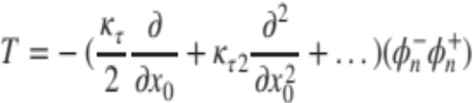









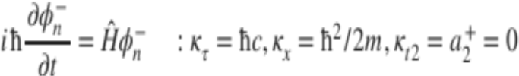





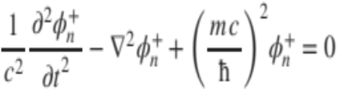
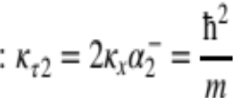

Horizon of Quantum Fields
Kinetic density with time evolution ( ):
“Local” density U_{l} emerges physical potential ( ), and U=U_{l}+U_{x} :
Yang derivations:
Give rise to Yin dynamics:
  Schrödinger equation (1925):
Yin derivations:
Give rise to Yang dynamics:
  Dirac equations (1926):

Slide 10
AGENDA III
  YinYang Motion Equations
  Horizon of Quantum Fields
  Horizon of Macroscopic Densities
  Horizon of Thermodynamics
  Horizon of Electromagnetic Fields
  Horizon of Gravitational Fields
  General Gravitational Fields
  Questions and Discussion
All rights reserved Copyright@ 2016

Slide 11
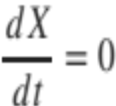
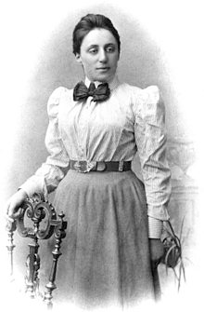
What is Conservation Law ???
A local conservation law is usually expressed mathematically as a continuity equation:
a particular measurable property of an isolated physical system does not change as the system evolves over time.
Emmy Noether (1882-1935):
“In the judgment of the most competent living mathematicians, Fraulein Noether was the most significant mathematical genius thus far produced since the higher education of women began.”
― Albert Einstein

Slide 12





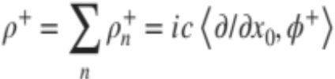



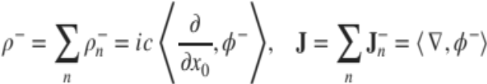

Horizon of Macroscopic Densities
Observable density of an operator :
  pair of the symmetric-antisymmetric states and at probability as horizon factor
Continuity of Yang Density:
  Define density and its current:
  Yang dynamic fields gives rise to:
Continuity of Yin Density:
  Define density and density current:
  Yin dynamic fields gives rise to:
Yin and Yang Conservations:

Slide 13
AGENDA IV
  YinYang Motion Equations
  Horizon of Quantum Fields
  Horizon of Macroscopic Densities
  Horizon of Thermodynamics
  Horizon of Electromagnetic Fields
  Horizon of Gravitational Fields
  General Gravitational Fields
  Questions and Discussion
All rights reserved Copyright@ 2016

Slide 14
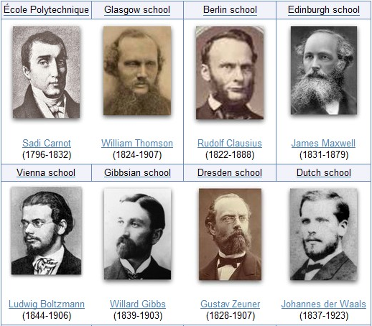
Philosophy of Thermodynamics ???
Laws:
The increase in internal energy of a closed system is equal to the difference of the heat supplied to the system and the work done by the system
Heat cannot spontaneously flow from a colder location to a hotter location
As a system approaches absolute zero the entropy of the system approaches a minimum value.

Slide 15


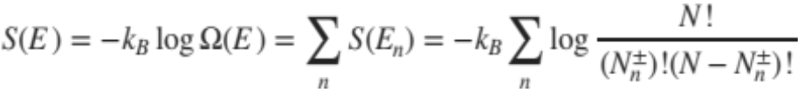

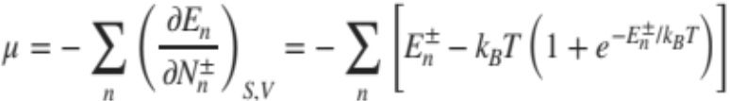
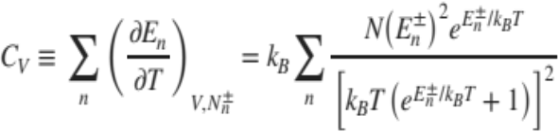
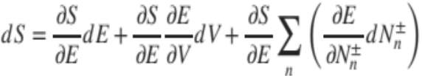
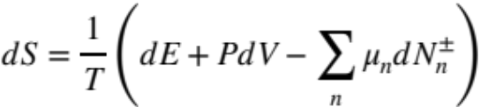
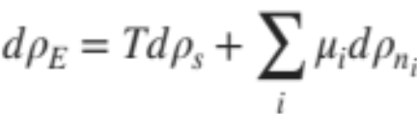
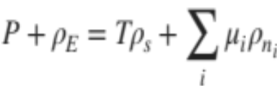
Horizon of Thermodynamics
objects at non-zero charges as the interruptible internal energy:
Entropy definition:
Rising temperature:
Therefore, it derives chemical potential and heat capacity
Entropy change:
Define each of densities:
Yin Entropy at maximum: Yang Entropy at minimum:
ρ_{E}=E/V,
ρ_{s}=S/V,
ρ_{Φ} ~1/V

Slide 16
AGENDA VGENDA V
  YinYang Motion Equations
  Horizon of Quantum Fields
  Horizon of Macroscopic Densities
  Horizon of Thermodynamics
  Horizon of Electromagnetic Fields
  Horizon of Gravitational Fields
  General Gravitational Fields
  Questions and Discussion
All rights reserved Copyright@ 2016

Slide 17
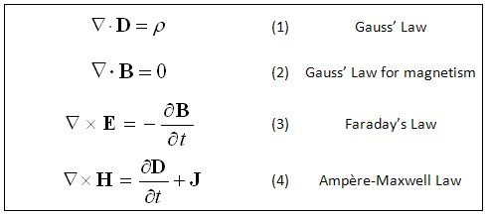
Philosophy of Electric and magnetic Fields ???
“An electromagnetic field is a physical field produced by electrically charged objects.” Isn’t it ???
Is the electric field produced by stationary charges,
the magnetic field by moving charges of currents ?

Slide 18










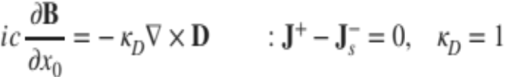
Horizon of Electric and magnetic Fields
Define, yin fields D, and yang fields B:
Virtual resources rising from constance or undetectable in physical measurements:
YinYang conserved currents gives rise to macroscopic fields of yin D and yang B:
  Known as Maxwell equations (1861):
Yin Fields
Yang Fields

Slide 19
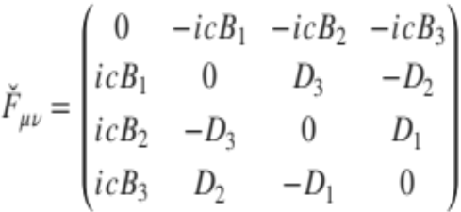



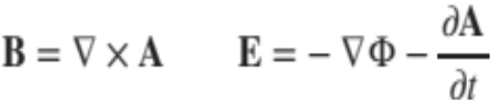
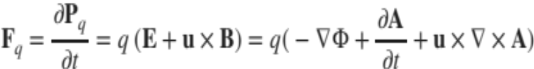
Horizon of Electromagnetic Forces
Electromagnetic fields yields the field tensor of yin primacy
Yin Potential Dynamics can be made by a 4-potential vector of ,
Both of the electric and magnetic potentials has the following relationship:
Force acting on a macro object at charge q (Lorentz force in 1889)

Slide 20
AGENDA VI
  YinYang Motion Equations
  Horizon of Quantum Fields
  Horizon of Macroscopic Densities
  Horizon of Thermodynamics
  Horizon of Electromagnetic Fields
  Horizon of Gravitational Fields
  General Gravitational Fields
  Questions and Discussion
All rights reserved Copyright@ 2016

Slide 21
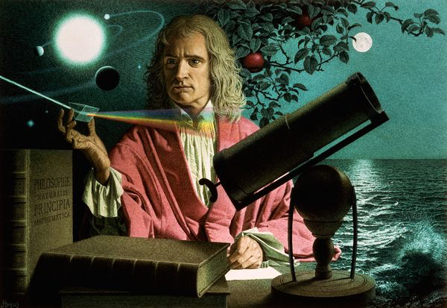
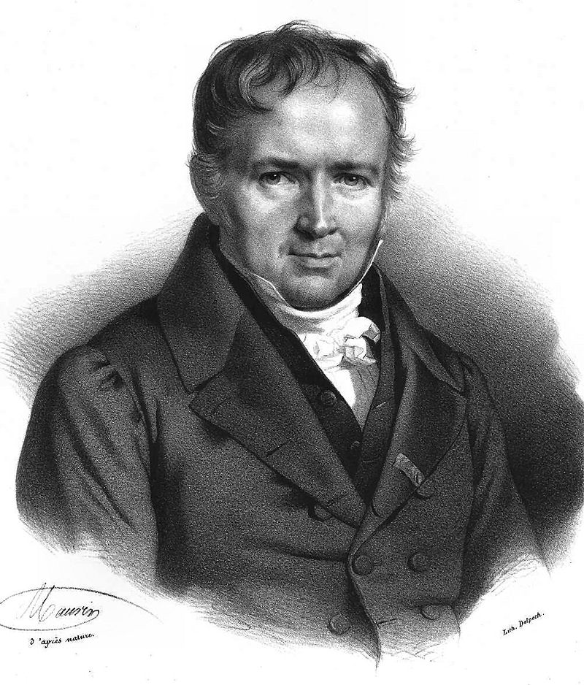
Philosophy of Gravitational Fields ???
Isaac Newton (Jan 4th 1643 – March 31st 1727)
In 1687, English mathematician Sir Isaac Newton published Principia, which hypothesizes the inverse-square law of universal gravitation.
"I deduced that the forces which keep the planets in their orbs must [be] reciprocally as the squares of their distances from the centers about which they revolve: and thereby compared the force requisite to keep the Moon in her Orb with the force of gravity at the surface of the Earth; ...” - Isaac Newton, 1666
Siméon Denis Poisson (June 21st,1781 – April 25th,1840)
“The probability of an event is the reason we have to believe that it has taken place, or that it will take place.”
“The measure of the probability of an event is the ratio of the number of cases favorable to that event, to the total number of cases favorable or contrary, and all equally possible”

Slide 22




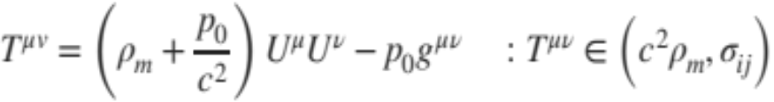

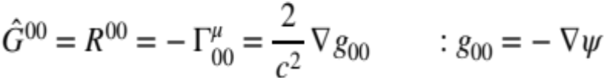
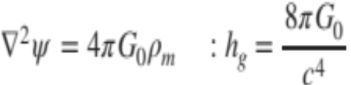
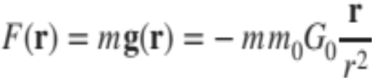

Horizon of Gravitational Fields
Electromagnetic fields yields a field tensor of yang current primacy
Yang field of Ricci tensor 1880s, and yin field of stress tensor T
Yang field equation in homogenous environment:
Derives Newtonian gravity (Poisson equation in 1813)

Slide 23
AGENDA VI
  YinYang Motion Equations
  Horizon of Quantum Fields
  Horizon of Macroscopic Densities
  Horizon of Thermodynamics
  Horizon of Electromagnetic Fields
  Horizon of Gravitational Fields
  General Gravitational Fields
  Questions and Discussion
All rights reserved Copyright@ 2016

Slide 24
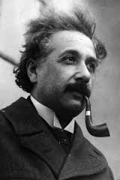
Lack of basic concepts from the beginning !!!
Albert Einstein (March 14th,1879 – April 18th,1955)
For the time being, we have to admit that we do not possess any general theoretical basis for physics, which can be regarded as its logical foundation. It is agreed on all hands that the only principle which could serve as the basis of quantum theory would be one that constituted a translation of the field theory into the scheme of quantum statistics. Whether this will actually come about in a satisfactory manner, nobody can say.
Albert Einstein, Science, 1940
(30 years after publication of General Relativity)
“The general theory of relativity is as yet incomplete … to the total field. We do not yet know with certainty, by what mathematical mechanism the total field in space is to be described and what the general invariant laws are to which this total field is subject. …”
- Albert Einstein, “The theory of relativity” 1949
(34 years later from General Relativity of 1915)
“... all attempts to obtain a deeper knowledge of the foundations of physics seem doomed to me unless the basic concepts are in accordance with general relativity from the beginning. “
- Albert Einstein, “On the generalized theory of gravitation” April 1950
(35 years late from General Relativity of 1915)

Slide 25
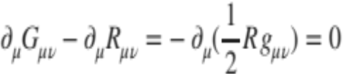
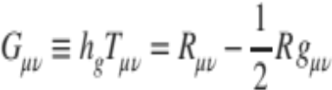
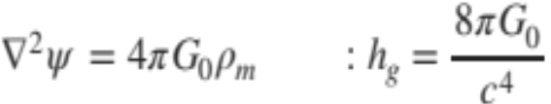

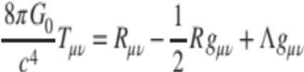
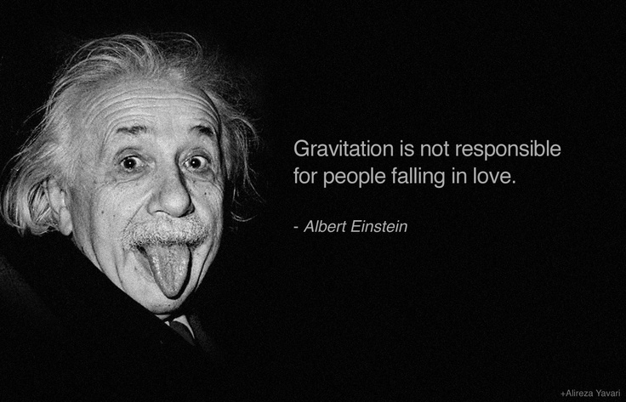
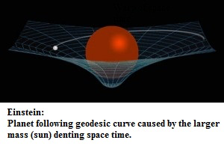
Horizon of Gravitational Fields
Yang current primacy
  Rewritten in non-zero form:
  Einstein General Relativity (in 1915)
Justification
To Gravity
Curvature
Curvature
Curvature
Gravitation is not responsible for people failing in love.
Gravity is not a force but a curvature - “the happiest thought” of my life
Albert Einstein (1919):
as far as the propositions of mathematics refer to reality, they are not certain; and as far as they are certain, they do not refer to reality. ...
- 4 years after GR of 2015
???

Slide 26
AGENDA VI
  YinYang Motion Equations
  Horizon of Quantum Fields
  Horizon of Macroscopic Densities
  Horizon of Thermodynamics
  Horizon of Electromagnetic Fields
  Horizon of Gravitational Fields
  General Gravitational Fields
  Questions and Discussion
All rights reserved Copyright@ 2016

Slide 27
Messages to Scientists of All Nations
Yinyang duality is rooted in the philosophy of seven millennia past, when our ancestors built a profound metaphysics.
History has been a long wait for the emergence of modern physics, a discipline worthy of ancient metaphysics.
Now is the time to realize the duality of metaphysics and physics, and to unite these disciplines in a greater whole.
It is time to integrate the wisdom of our ancestors with modern physics to reestablish a philosophy of science.
It is time to face the fact that never has one side of a duality existed without being destroyed or overthrown by its other half.
It is time to understand that science cannot exist without a duality of physics and metaphysics, or it shall be doomed to become a pseudoscience of materialism.
It is time to rationalize metaphysics in order to complete the framework of physics.

Slide 28

Completion of Unified Field Theory ?!
    A branch of sciences in dialectics
    of virtual and physical existences
Scientific Methodology
Philosophy ➔ Mathematics ⬅➔ Experiments

