Slide 1

mHealth enables eCare
C. Peter Waegemann
mHealth Visionary and Advocate
One of 20 outstanding people who make healthcare better (HealthLeaders Magazine)
Former chair of 12 standards organizations
“Father” of ISO TC 215
“The Ralph Nader of healthcare who tells the truth” (TEPR attendees)
Author of the book, Knowledge Capital in the Digital Society
International speaker and consultant
mHealth expert and HIT strategist
Visionary and advocate of mHealth – coined the term “mHealth”

Slide 2
What is mHealth?
Clinicians are using mDevices for
  Accessing guidelines (formularies and protocols)
  Accessing reference material
  Patient communication
  Medical networking
  Decision support functions
  Medical tools
  Communication with payers
  Patient documentation
  Care functions (e-prescribing, lab orders, online booking of hospital beds, etc.)
  + PDA functions
  + Lifestyle functions
  + News
  + eBook functions
  + And more…

Slide 3
What is mHealth?
Internet Health Resources for Patients and Consumers
Documentation Systems
Sensing, tracking, and therapeutic Tools
Internet Access for Clinicians
Research, financial and administrative solutions
New Tools for Clinicians
New Communication Patterns
and Systems

Slide 4

The Internet is empowering patients
Reliability of information
Sources
Patient communities
Breaking down language barriers

Slide 5
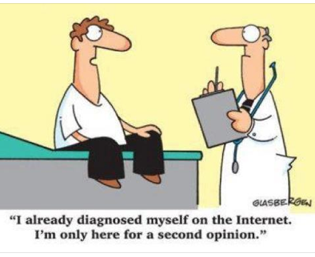
Medical Knowledge
Over 70% of patients are getting clinical advice from the Internet
But the system should tell the provider what the patient learned on the Internet and from what source
The concept of patients advising each other has been very helpful and has great promise.
Shouldn’t the patient be able to ask the doctor by email or text message? Or better: in a secure app?
© C. Peter Waegemann

Slide 6
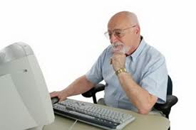
Internet access for clinicians
NIH Study in 1995 that no physician can keep up by reading and going to conferences
Trust factor
The race for Internet recognition: From Medline to Mayo
Most information in English
In some countries, patients judge their physicians…

Slide 7
Physician tools
Drug formulary apps
Reference programs
Educational apps
Medical tools
  Patient information and documenting tools
  Patient monitoring apps
  Nursing apps
  Imaging apps
  Clinical apps
Payer tools
Decision support tools
Patient support tools

Slide 8
New communication patterns
Visits at doctors’ offices are complemented by emails, text messages, and app communication
Periodic visits are replaced by communication by need
Online video visits are still a small percentage
Main problems:
Legislation and protective rules
Payment systems

Slide 9
Text messaging
Appointments
Medication reminders
General inquiries
Administrative questions
Non-healthcare related communication
Health promotion
Patient-initiated communication
  Need to reschedule appointment
  Need for prescription refill (?)
Notes:
9
9

Slide 10
How to improve internal communication among physicians, nurses, specialists, others?

Slide 11
A typical scenario
Patient is triaged in an office, in the ED, in the hospital, in an extended care facility, even in the home....
Help is needed from another doctor, specialist, medical staff member
Finding the person(s) that the doc needs help from
Determining the best way to reach them
Efficiently connecting to them
Sharing initial information with them
Meeting live and viewing/discussing the situation with them
Making decisions about the situation with them
Communicating to others (medical staff, families, etc.)
Documentation and paperwork
Post discussion actions, next steps

Slide 12
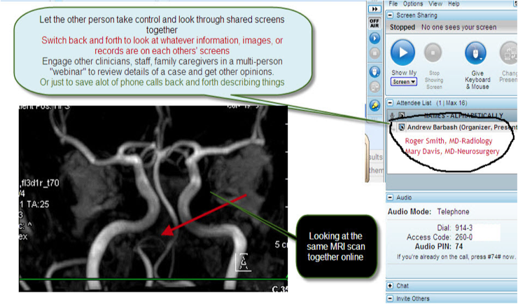
How much do clinicians in your facility use digital communication for conference calls?
Credit: Andy Barbash, MD

Slide 13
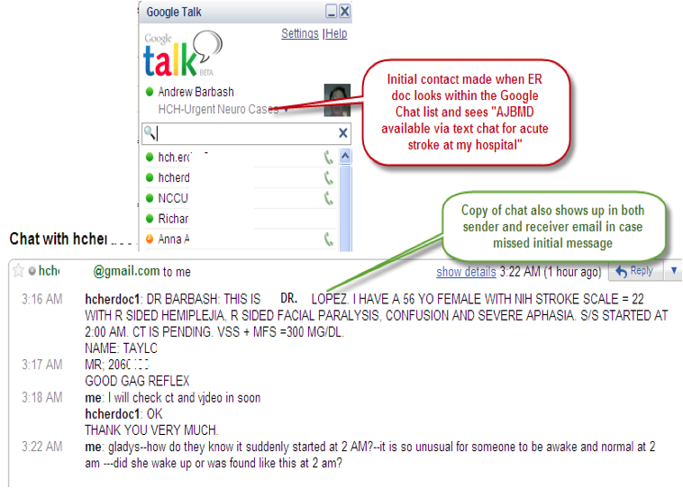
Or text to discuss a case?
Credit: Andy Barbash, MD

Slide 14
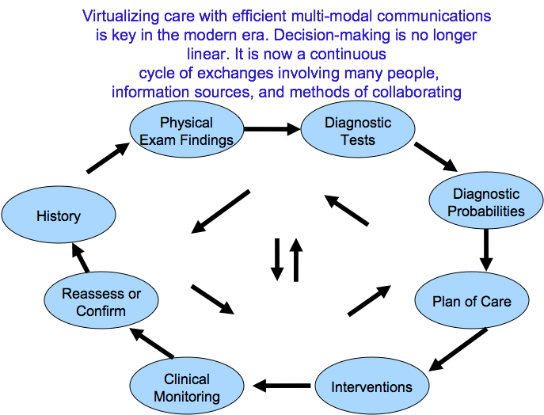
Every clinic and hospital should examine its internal communication pattern
Credit: Andy Barbash, MD

Slide 15
Research
Proving mobile devices to patients in order to collect data
Collecting data from physicians and comparing the outcome

Slide 16
Documentation
Documentation takes up a substantial part of the healthcare professional
Move toward EHRs – but got only to EMRs
Documenting at point of care is a problem
Some doctors still do some handwriting

Slide 17
INFORMATION CAPTURE
Variations
  Handwriting
  Dictation and transcription
  Speech recognition
  Direct computer input
  Point of Care
  Hybrids
Desirable characteristics
  Ease of use
  Real-time
  Point of care
  Control and access

Slide 18
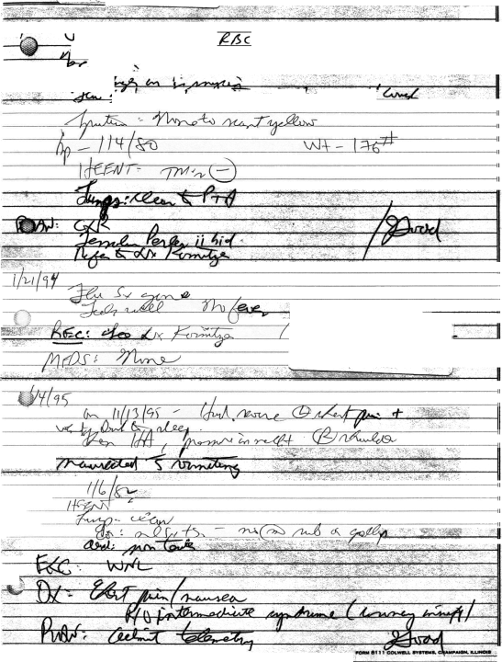
Real-time, point-of-care information capture!!!
Is such documentation acceptable anywhere else?
Legibility
Structure
Meaning
Completeness

Slide 19
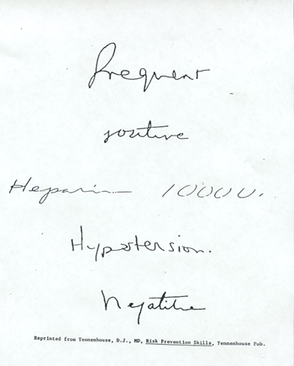
A TEST
  frequent or
  pregnant?
  routine or
  positive?
  1000u or 10000?
  hypertension or hypotension?
  negative or hepatitis?
Notes:
This is a slide that Don Berwick created. They are actual words taken from actual medical records, and it shows the problems with handwriting.
Take the audience through the slide line by line:
Let’s look at the first one. How many people think it says “frequent”? How many people think it says “pregnant”?
The next one - how many think it says “positive”? How many think it says “routine”?
Is this third one hypertension, or hypotension?
What’s this last one say? (invite people to say what they think it says) Is it “negative”, or “hepatitis”?
Now you can read this, it says “heparin”, but does it say 1,000u, or does it say 10,000?
Ask for a show of hands for the last question.
Well, about x% of you think it’s 1,000u, and y% think it is 10,000. In fact, it is 1,000u, so if you were the person filling that order, there is a x% chance you would do it wrong - not a trivial mistake.
What we see here is a system that is actually designed to faithfully produce an error rate of x%. As Don Berwick has often mentioned (next slide)...

Slide 20
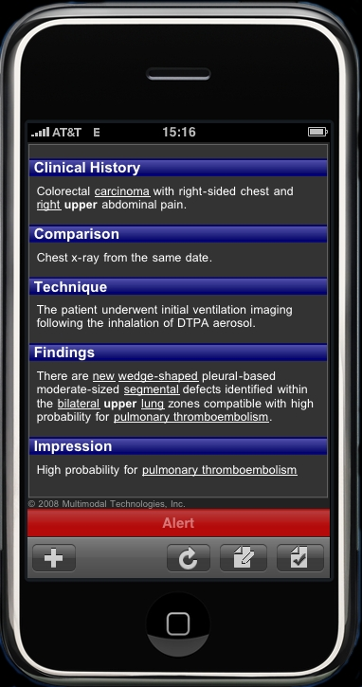
As such recordings will be integrated with online protocols (new and existing), a new process of electronically enabled care will emerge

Slide 21
Parts of a Patient’s Medical Record
May Be in Many Places
Wellness Health
Information
Prenatal Record
Family Record
Pediatric Record
Pharmacy/Medication Records
Primary Care Record
Potentially multiple providers/records
Employer/Other Health Records
Specialty Provider Record
Payer/Financial Health
History Information
Hospital Record
Emergency
Care Record
Many other Health
History Repositories
Personal Health Record
Questions:
Should there be one database?
If a network is created, which information is to be exchanged?

Slide 22
EHR Adoption – after 20 years
Major Perceived Barriers
Source: Jha, Ashish K., M.D., M.P.H. et al., “Use of Electronic Health Records in U.S. Hospitals,” The New England Journal of Medicine, 360; 16, April 16, 2009, p. 1635.

Slide 23
TRADITIONAL APPROACH
Documents to Data
Inpatient Chart
DATA
Documents
Documents
PROBLEMS
3/11/04 Myocardial Infarction
–
Anterior
Septal
9/18/92 CVA
–
Right Middle Cerebral Artery
Infarct
Clinic Chart
MEDICATIONS
Documents
Atenolol 25mg po bid (3/12/04) Last Fill
Documents
Documents
3/1/05
Coumadin 5mg qd M/W/F (3/1/05) Last Fill
3/1/05
Coumadin 7.5mg T/Th/Sat/Sun (3/1/05)
Last Fill 3/1/05
Consult Note
Documents
Documents
LABORAT
ORY
OR OTHER RESULTS
---
ENCOUNTER DOCUMENTATION
PHR/Patient
---
Documents
Documents
ETC.
---
Courtesy: Rick Peters, MD

Slide 24
NEW VISION
Data to Documents
DATA
PROBLEMS
3/11/04 Myocardial Infarction – Anterior Septal
9/18/92 CVA – Right Middle Cerebral Artery Infarct
MEDICATIONS
Atenolol 25mg po bid (3/12/04) Last Fill 3/1/05
Coumadin 5mg qd M/W/F (3/1/05) Last Fill 3/1/05
Coumadin 7.5mg T/Th/Sat/Sun (3/1/05) Last Fill 3/1/05
LABORATION RESULTS
---
HOSPITALIZATIONS
---
ETC.
---
Patient Summary
Documents
Legal Documents
Clinic Visit
Documents
CLAIM/BILL
Documents
Courtesy: Rick Peters, MD

Slide 25
Types of Communication
Patient to provider (pre-engagement)
  General inquiry
  Appointment
  Insurance coverage or cost
Provider-patient interactively
  Appointment confirmation/reminder
  Reason for visit: Agenda
  Referrals and other care management communication, e.g. ‘How r u?’
  Other
Patient education
Notes:
25

Slide 26
How to get physicians, nurses and other practitioners to document at the point of care?

Slide 27
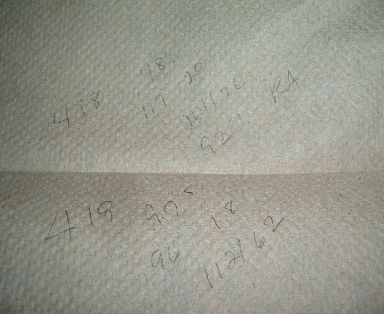

Slide 28
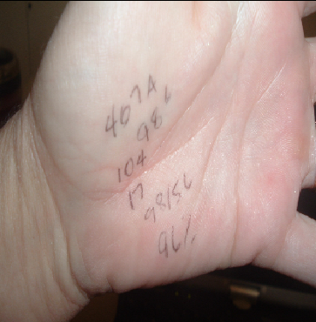

Slide 29
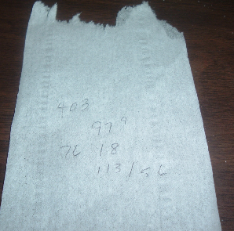

Slide 30
Is there an approach to disease management that is more effective and reduces costs?
Answer: Communication-based Disease Management

Slide 31
Saving money, providing better care through communication-enhanced disease management
Diabetes
Hypertension
Asthma
Dermatology
Smoking Recessoion
Others

Slide 32
Population
Preventive Health
Applications:
Dietary
Activity Management
Environmental Influences
Drug Management
Monitoring of Environmental Influences
Behavioral Issues
Others
Sports Medicine
Applications:
Dietary
Activities
Maximizing Energy
Symptoms
Data Collection
Diagnostic
Geriatric Care
  Telemedicine to Home
  Medication Management
  Caregiver Interaction
  Emergency Management
  Data Collection
Pre-natal
and
Pediatric Applications:
Data Collection and Transmission
Chronic Diseases
Bio-Epidemics: Unintentional and Terror
Age

Slide 33

Thank you
pwaegemann@gmail.com
www.peterwaegemann.com
Available as eBook or paperback from Amazon.com
Questions?

