Slide 1


Histone Deacetylase Inhibition Restores Expression of
Hypoxia-Inducible Protein N-myc Downstream-Regulated Gene 1
(NDRG1) in Pancreatic Cancer
Céline Tiffon, PhD
University Hospital Bern, Switzerland

Slide 2
Pancreatic ductal adenocarcinoma
(pancreatic cancer)
        ■ The most common subtype of human pancreatic cancer
        ■ One of the most lethal cancers
        ■ A major public health issue (230,000 new PC cases/year; 230,000 deaths/year)
        ■ A dismal prognosis
        (high metastatic potential; late manifestation of its symptoms; strong chemoresistance)
        ■ Death rates have increased and are predicted to continue to increase
        (2nd leading cause of cancer-related death by 2030)
        ■ Urgent need to develop new drugs and drug combinations
        ■ Identification of new biomarkers for early detection

Slide 3
Pancreatic ductal adenocarcinoma
(pancreatic cancer)
■ Characterized as an avascular, hypoxic tumor
■ Hypoxia contributes to a more malignant behavior of pancreatic cancers (VEGF, IL8)
■ High expression of HIF-1

Slide 4
Presentation highlights
Identifying N-myc Downstream-Regulated Gene 1 (NDRG1) as a candidate
biomarker of response to histone deacetylase inhibitors in pancreatic cancer

Slide 5
N-myc Downstream-Regulated Gene 1
Expression in normal tissues
Expression in tumor tissues
■ During embryogenesis, NDRG1 is upregulated
■ NDRG1 mRNA is widely expressed in many normal tissues; its protein is restricted to cells of epithelial origin
■ NDRG1 is overexpressed in many solid tumors
NDRG1: tumor marker
■ NDRG1 is down-regulated in more malignant stages of the disease
■ The presence of NDRG1 is associated with the increased survival of patients with prostate cancer or liver metastasis from colorectal cancers
NDRG1: putative tumor suppressor gene

Slide 6
N-myc Downstream-Regulated Gene 1
Basic function / cellular process
NDRG1 is involved:
in embryonic development
in cell differentiation (and cell differentiation can act as inducer of NDRG1)
in cellular stress responses including hypoxia
Other stress-inducing agents (homocysteine, tunicamycine, nickel compounds,
synthetic retinoids, and differentiation-induced agents can modulate its expression)
in carcinogenesis
in suppressing metastasis formation

Slide 7


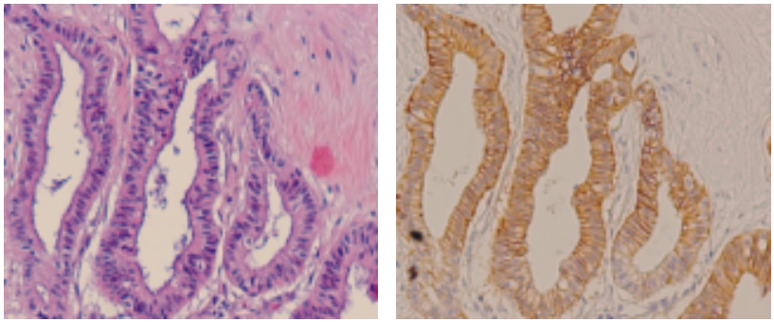
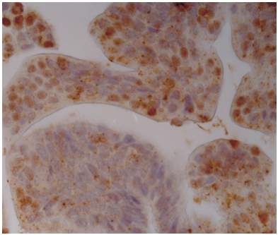
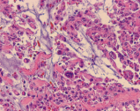
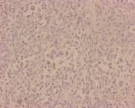
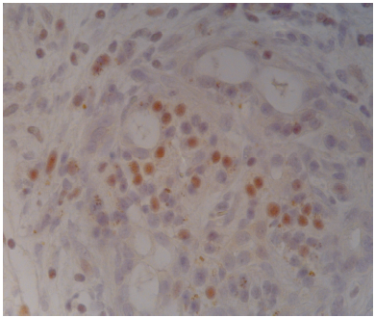
NDRG1 expression in pancreatic cancer
Pancreatic adenocarcinoma
(characterized as a highly hypoxic tumor)
H & E
NDRG1
HIF-1α
Well-differentiated
Poorly-differentiated
Angst, et.al.
Br J Cancer 2006
NDRG1 was found to be expressed in well-differentiated tumor regions while HIF-1α
protein was stabilized in both differentiated and undifferentiated pancreatic tumors

Slide 8
Objectives
To show that cellular differentiation determines the expression of NDRG1
in response to hypoxia
This hypothesis was tested using class I and class II histone deacetylase inhibition
with Trichostatin A (TSA)

Slide 9
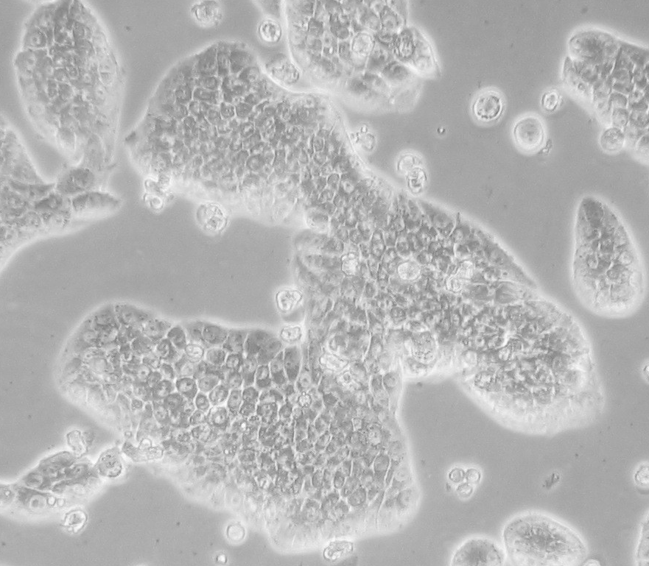
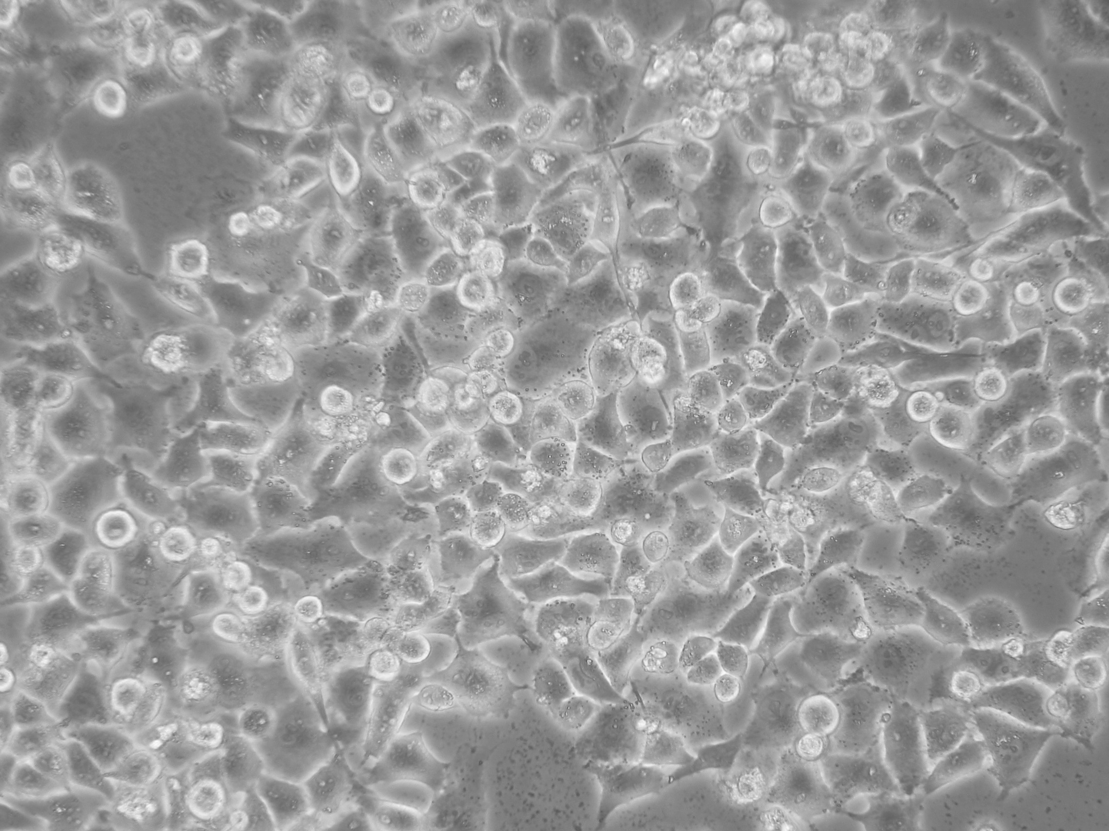
Pancreatic cancer cell lines
Capan-1
PANC-1
well-differentiated
poorly-differentiated

Slide 10
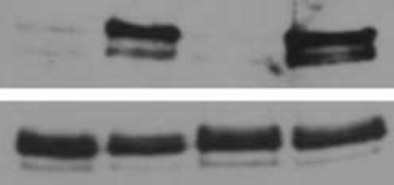






Response of Capan-1 and PANC-1 to hypoxia
HIF activation
N H N H
HIF-1
α
Sp1
Angst, et.al.
Br J Cancer 2006
PANC-1
Capan-1
B. NDRG1 expression
0 3 6 9 24 48 hrs 1.5%O₂
0 3 6 9 24 48 hrs 1.5% O₂
NDRG1
pNDRG1
β-actin
Capan-1
PANC-1
Well-differentiated cells upregulated NDRG1 under hypoxic conditions, while poorly-
differentiated cells did not despite strong detection of HIF-1α in both lines under hypoxia

Slide 11

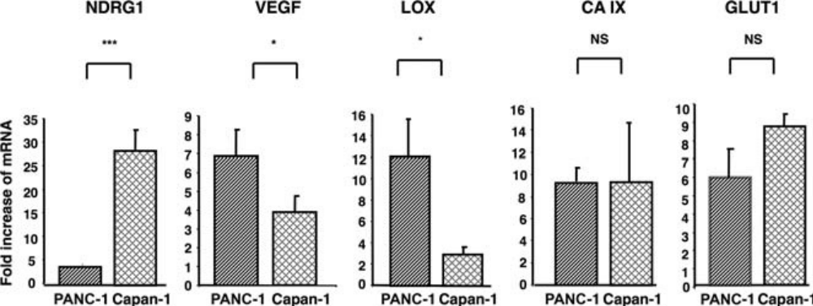
PANC-1 and Capan-1 cell lines are characterized by distinct
hypoxia-regulated gene expression patterns under hypoxia
Tiffon. Pancreas 2018
Graphs show gene transcription level as a fold change relative to untreated normoxic controls
Some hypoxia-induced genes in PANC-1 cells are functional and the lack of NDRG1
upregulation was not due to a cell line dysfunction

Slide 12
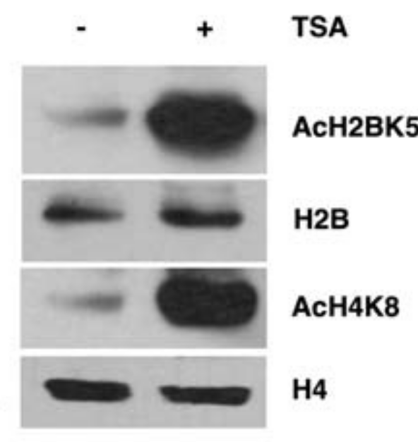
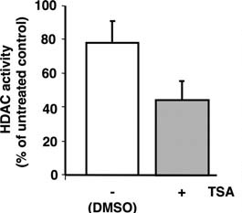
TSA inhibits HDAC enzyme activity resulting in increased
level of histone acetylation
In PANC-1 cells
Tiffon. Pancreas 2018

Slide 13
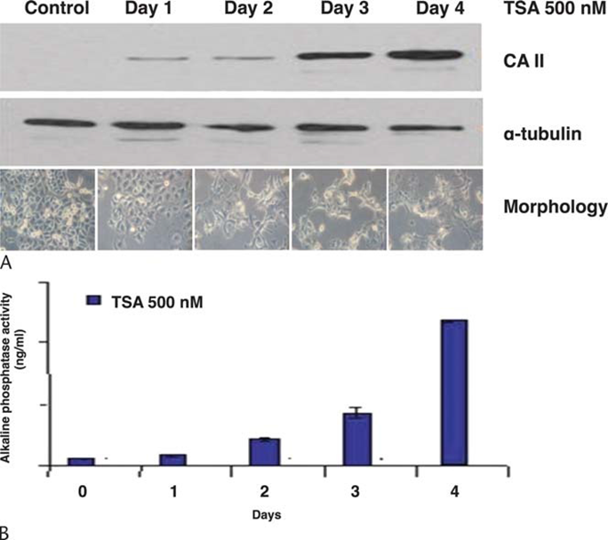
TSA induces morphological changes of PANC-1 cells
and restores differentiation markers
Tiffon. Pancreas 2018

Slide 14
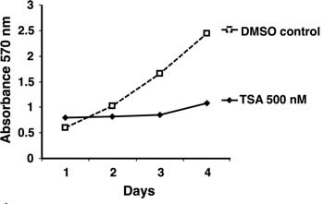
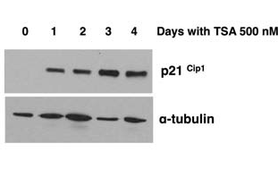
TSA inhibits the cell growth of PANC-1 cells and
induces the cell cycle inhibitor p21^{Cip1}
Tiffon. Pancreas 2018
TSA induces the differentiation of PANC-1 cells by altering the acetylation state of
histones and this phenomenon is associated with cell growth arrest

Slide 15
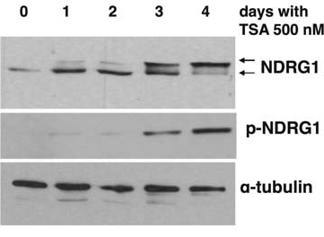
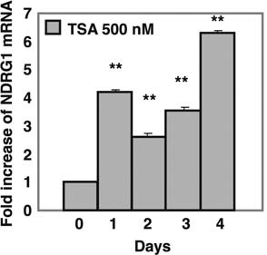
TSA-differentiated PANC-1 cells upregulate the expression of NDRG1 in normoxic conditions
Tiffon. Pancreas 2018

Slide 16
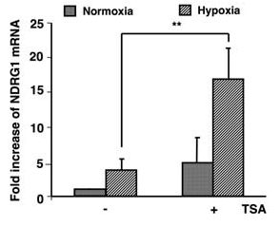
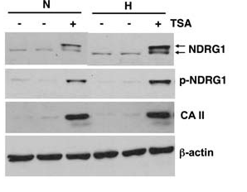
PANC-1 cells differentiated by TSA regain
responsiveness to hypoxia
Tiffon. Pancreas 2018

Slide 17
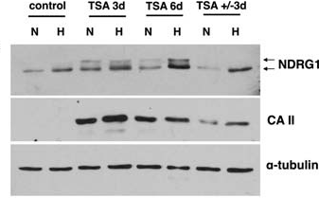
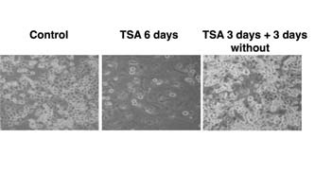
Upregulation of NDRG1 and response to hypoxia result from a differentiation state of cancer cells
In PANC-1 cells
Tiffon. Pancreas 2018
The upregulation of NDRG1 and its restored responsiveness to hypoxia appear
to be related to the cellular differentiation state, whose restoration was mediated by TSA

Slide 18
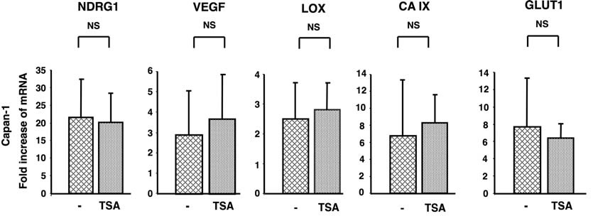
TSA has no effect on hypoxic gene expression in well-differentiated cancer cells
In Capan-1 cells
Many Capan-1 cells were noted to float in the medium,
which is an indication of cell death
Capan-1 cells treated with TSA may undergo cell death rather than differentiation in
response to TSA treatment

Slide 19
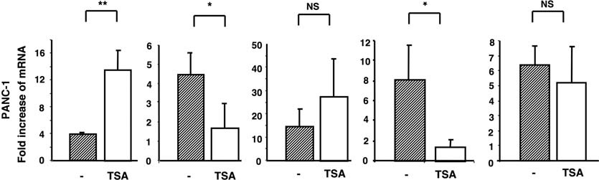
Differentiation of poorly-differentiated cancer cells modifies the expression profile of hypoxia-regulated genes in hypoxic conditions
In PANC-1 cells
NDRG1 VEGF LOX CA IX GLUT1

Slide 20
Conclusion
■ The poor differentiation of pancreatic cancer cells could be reversed using the
HDAC inhibitor TSA; this was associated with changes in hypoxia-regulated gene
expression.
■ This epi-drug strategy may allow cancer cells to overcome drug resistance and better respond to conventional cytotoxic treatments.
■ Restoration of NDRG1 expression may represent a biomarker of malignant pancreatic tumors undergoing re-differentiation and redirecting toward a lower tumor grade.

Slide 21
Perspectives (1/2)
■ The use of the human ductal PANC-1 cell line treated with TSA represents a useful tool to study cellular differentiation through epigenetic mechanisms.
■ A reduction in the overall amount of cyclin-dependent kinase (CDK) activity during G1 is associated with differentiation
■ CDK inhibitors have been shown to accumulate in many differentiated cell types in mice and can be induced by triggering differentiation and cell cycle exit
■ The CDKI p21 negatively regulates the kinases that phosphorylate the retinoblastoma protein (Rb) by binding to cyclin/CDK complexes, inhibiting CDK
activity and arresting cells in G1
■ Histone deacetylases are implicated at the interface of the cell cycle and differentiation, and exact determination of their effects, in particular on master regulators of these processes is of particular interest

Slide 22
Perspectives (2/2)
■ Further work is necessary to determine whether NDRG1 gene reactivation occurs as a consequence of a direct or indirect mechanism involving either promoter acetylation or a regulated transcription factor that influences NDRG1 expression.
■ The phosphorylated form of NDRG1 was induced from day 3. This suggests a potential relationship between cell differentiation status and NDRG1 phosphorylation.

Slide 23
Thank you

