Slide 1
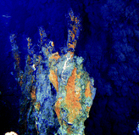
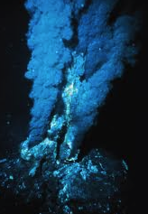

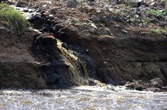
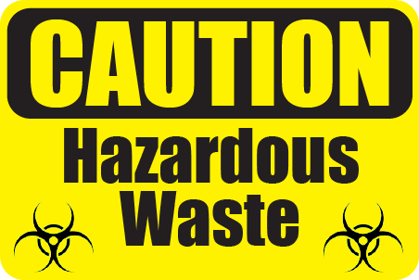
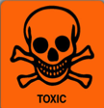

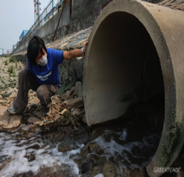


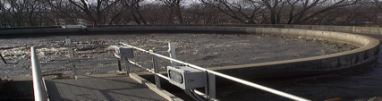
Supercritical Water Oxidation for Hazardous Waste Treatment
Bushra Al-Duri
Reader
School of Chemical Engineering, University of Birmingham

Slide 2








OUTLINE
General background.
Definition & properties of supercritical water (SCW).
Main Applications of SCW technology.
SCWO at Birmingham.
Operational challenges & aspects of SCWO.
Commercial status of SCWO.

Slide 3



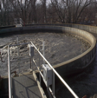
Hazardous Waste
Hazardous waste is harmful to health & well-being of humans, animals & plants; as well as the the environment including land, sea and air.
Unlike “general waste”; it is generated on the premises of modern industries (chemical, pharmaceutical, petrochemical), and healthcare sectors.
Organic wastes that cannot be reused, recycled or recovered are now subject to destruction.

Slide 4
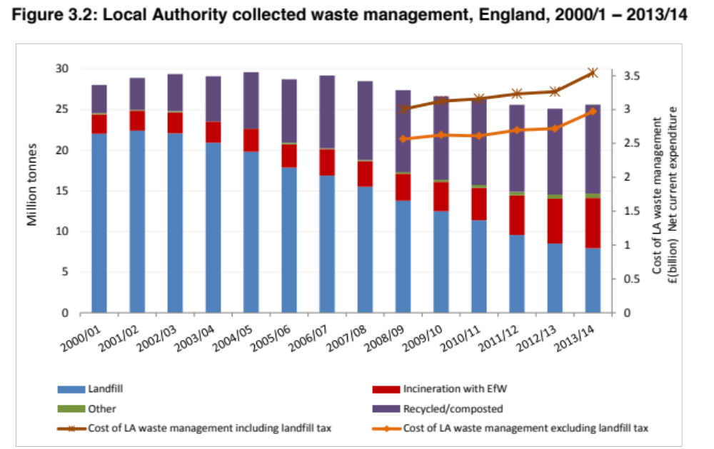
Thousand tonnes¹
 | 2010 | 2012
Household | 1,592 | 1,306
C & I | 2,899 | 3,172
Construction | 1,018 | 1,057
Others | 328 | 395
Total | 5,837 | 5,930
Nearly 7.5m tonnes of waste have been dumped as landfill in 2013/2014
Hazardous waste arising by sector in the UK
Over 8m tonnes of hazardous waste have been treated by incineration in 2013/2014
Local authority collected waste management
¹defra Digest of Waste & Resource statistics – 2015 edition

Slide 5
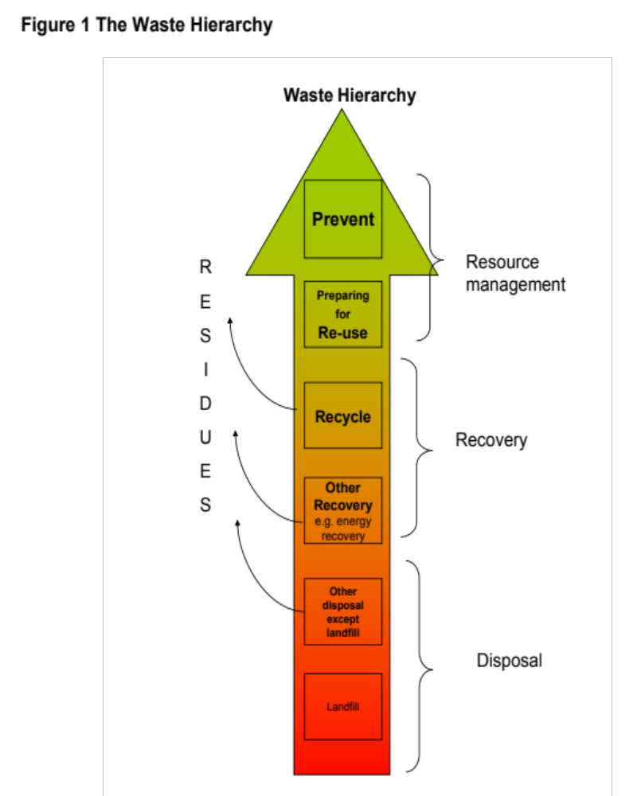
Landfill is at the bottom of the waste treatment hierarchy.
Incineration suffers toxic emissions (NO_{x}, metal vapours, fly ash), bottom ash formation (landfill), and is highly energy intensive (for < 40% waste concentration.
Directives against incineration & landfill are legislative drivers for frontier technologies to replace landfill & incineration.
SCWO has the double advantage of replacing landfill & incineration

Slide 6
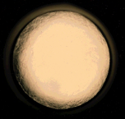
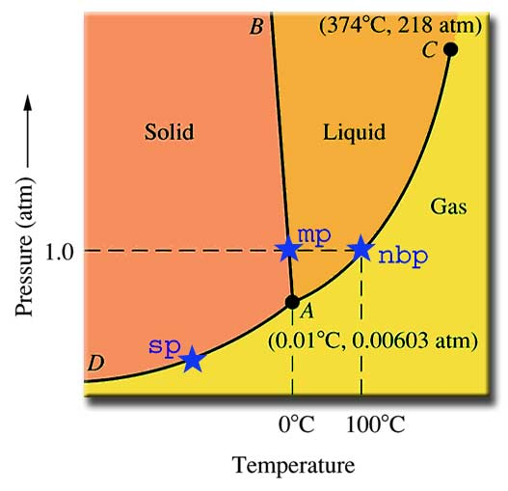


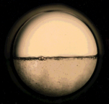
What is SCW?
Supercritical region
Critical
point
Critical
Point
T & P
increase

Slide 7
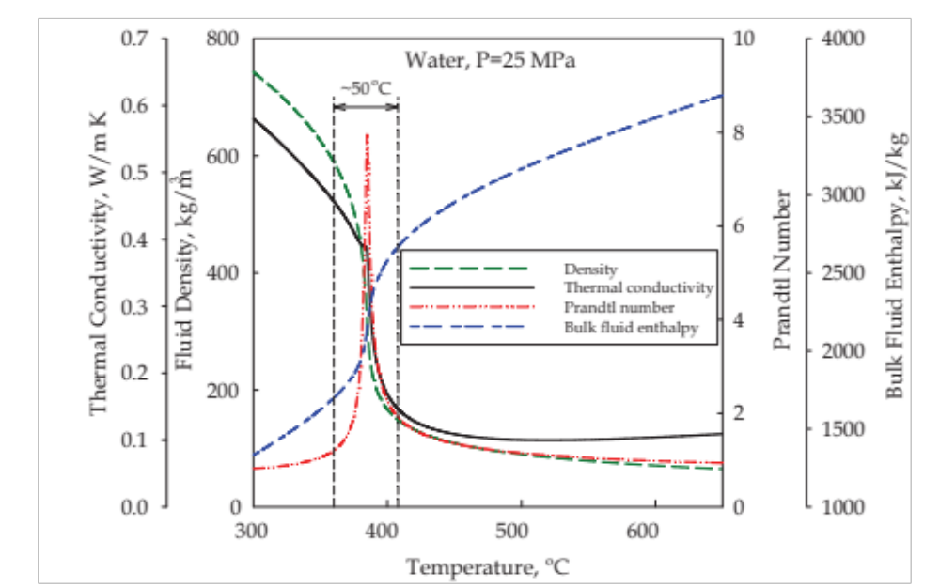
Thermo-physical Properties

Slide 8




Operational Behaviour of SCW
Superior solvent for organic-mediated reactions of polymers, hydrocarbons, biopolymers & gases.
Completely miscible (produces perfect solution) with hydrocarbons, polymers as well as gases.
Complete oxidation of organics to CO₂ without bi-products. Significant energy is released.

Slide 9
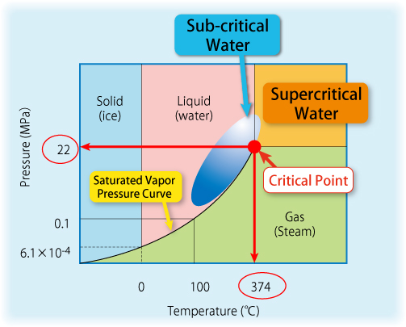
Typical Wet Air Oxidation &
Hydrothermal reaction
conditions
Typical
SCWO/SCWG
conditions
Density =
320 kg/m³
Normal Boiling Point
Liquid Density =
960 kg/m³
Triple Point
Density =
1000 kg/m³

Slide 10
Main Relevant Applications
SCW oxidation for the destruction of organic-rich wastes, with minimal solid residue and zero emissions.
SCW gasification of organics (biomass, low grade coals and petrochemical wastes) to form hydrogen – rich combustible gas.
Sub-critical degradation of biomass, bio-polymers and plastics for more useful platform chemicals.

Slide 11
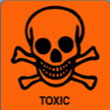

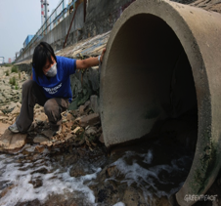



SCWO: the Laboratory Scale Work at Birmingham (UK)

Slide 12
Scope of Work
We investigate the enhancement of supercritical water oxidation (SCWO) of N-containing hazardous wastes in catalyst-free systems using simple-designed continuous reactors (plug flow).
Split – oxidant approach.
Addition of alcohol as co-fuel.
The aim is to maximise waste destruction towards benign simple products for disposal or re-use in other applications.

Slide 13

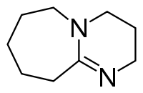
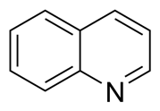
…Scope of Work
Compounds investigated so far are:
The process is continuous tubular reactor.
DMF (dimethyl
Formamide)
DBU (diazo bi-cyclo
1,4,0 un-dec-ene)
Quinoline
Cutting oil Real waste

Slide 14
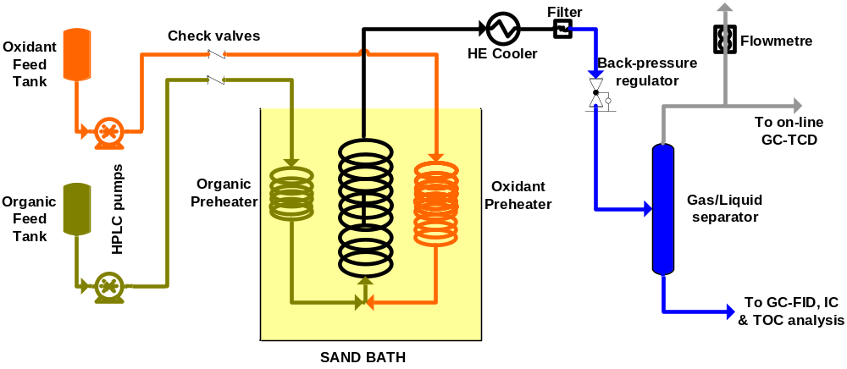
The Bench Scale Rig
Process flow diagram of continuous laboratory scale
apparatus with no heat integration

Slide 15
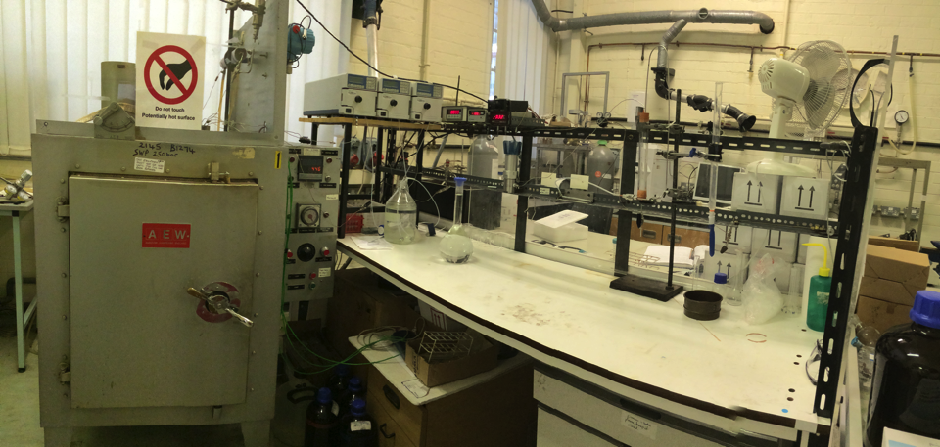
Jasco HPLC
Pumps
GO66
manual
BPR
Gas flow
rate
measurer
Heat exchange
Cooler
Gas/liquid
separator
Furnace
Heater
K-type
Controller

Slide 16
Operational Challenges & Considerations
Despite its attractive advantages, the severe operating conditions of SCWO have created challenges, which hindered exploiting SCW technology to its full potential. These are:
Corrosion
Materials of Construction in SCWO Processes

Slide 17
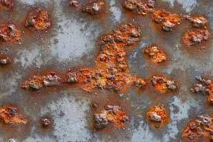
Corrosion: The reasons
The co-existence of O₂ & H₂O at high T & P.
The presence of hetero-atoms: N, Cl, Na,…
The extreme pH values.
The low solubility of salts under SC conditions.
Metals of the reactor wall form protective oxide.
If they dissolve in reactor fluids, this results in corrosion.

Slide 18
Corrosion mechanism & prevention
Balance between oxide formation & dissolutions depends on the density & dielectric constant of water; which change with temperature & pressure of water.
Corrosion extent depends on such conditions!
Thus it is essential to get the temperature balance right, to minimise corrosion.
Formation of
oxide
Reactor wall
Concentration of salts
Dissolution of
oxide
Distance from reactor wall

Slide 19
Materials of Construction
Stainless steel (AISI 316): 300 – 500 º C temperature range and pH 2 – 11.
Titanium alloys are resistant to strongly oxidising agents but their mechanical strength is relatively low at high temperatures, so they could be good coating materials.
Al- or Si-based ceramics, such as alumina, siliceous carbide or nitride are materials suitable for pH values <12. Above that they dissolve.
Ni alloys 625 and C-276: These are the most commonly used alloys with high resistance to corrosion at high temperatures.
New alloys are currently being developed but have not yet been tested in SCW.

Slide 20
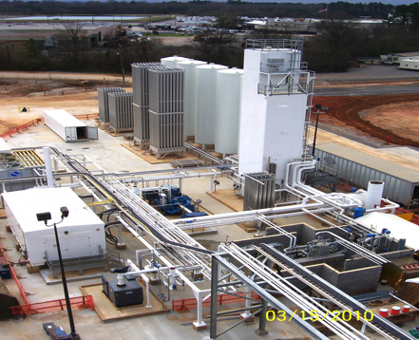
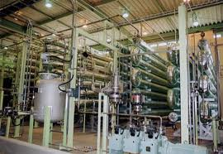
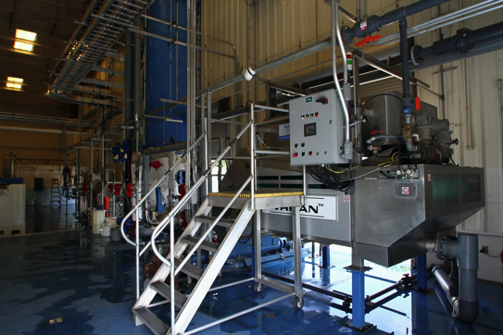
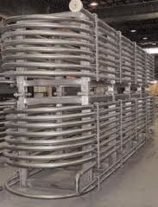
Commercial Status

Slide 21
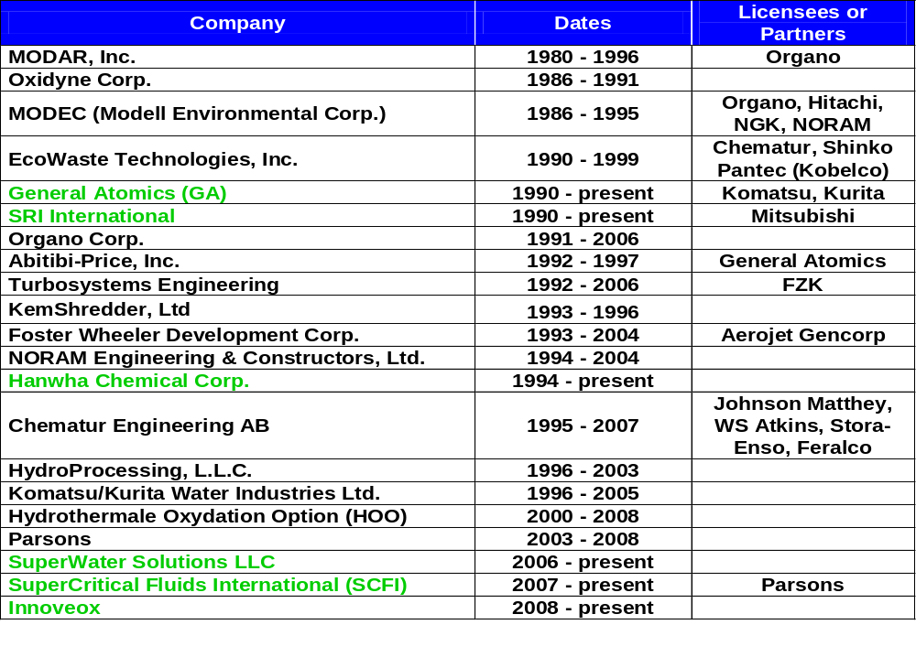
Past & Present SCWO Plants*
* Phil Marrone, ISSF2012 – San Francisco; SAIC, Newton – Boston, USA.

Slide 22
Existing & Up-coming Plants
Active Companies | Pilot-Scale | Full-Scale
 |  | Operational | Built | Planned
GA | 1 | 0 | 2 | 2
Hanwha | 1 | 1‡ | 3 | 0
Innoveox | 1 | 1 | 0 | 4
SCFI | 1 | 0 | 0 | 1
SuperWater Solutions | 1 | 0 | 0 | 1
SRI / Mitsubishi | 0 | 1 | 0 | 0
Total | 5 | 3 | 5 | 8

Slide 23
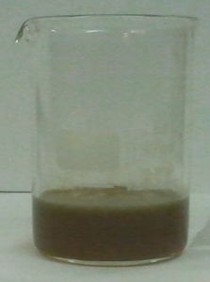
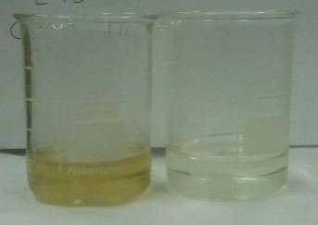
Real waste treated in bench scale unit in 17 seconds; at Duri’s Laboratory – University of Birmingham UK.

Slide 24

Thanks for your attention!

