Slide 1

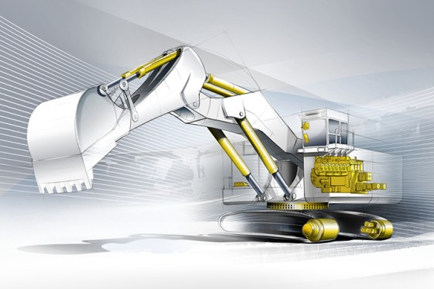
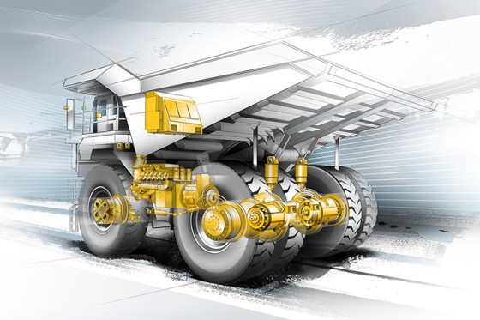
Artificial Intelligence on
Big Data for Mining Applications
Applying Data Analytics and Artificial Intelligence(AI)
Methods for Mining Efficiency
Burcin Ozturk Demirhanoz – Sept 2016

Slide 2

Biography
Burcin Ozturk Demirhanoz has been in and working professionally in mining and equipment industry more than 14 years in Europe and in Australia. She has completed her BSc, Mining Engineering (ITU, Istanbul) and MEng, Mining Engineering, Mine Management and also Business Administration (UNSW, Sydney). She is currently working as a Principal Mining Applications and Performance Engineer at WesTrac CAT and leading mining applications performance management projects at Western Australia region for some of the biggest mining companies in the world. Her research interest are mining performance analysis and modelling applying AI (Artificial Intelligence) methodologies within data analytics and machine learning.

Slide 3
Content
Introduction
Mining Applications and Technology
Prospect Objectives
The Era is on Performance Intelligence
Data analytics and AI for Mining
Conclusions

Slide 4

Introduction
In mining industry, efficient and cost effective project development is critical to be succeeded since it is long term business and also because of the global economic concerns needs new approaches more than before.

Slide 5


Introduction
One of the serious tasks faced by observing and monitoring methodologies is to ally data science into detailed engineering. This will apply scientific hypothesis-testing approach, essentially not only optimizing the algorithms but also generating new hypothesis to monitor and to improve the efficiency.

Slide 6
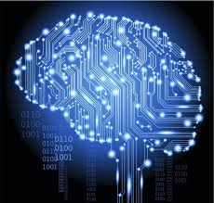
Mining Applications and Technology
Regardless of the mining booms, mining processes and systems has stayed traditional for a long time. Nowadays, Mining industry is trending for change not only to increase productivity performance, but also to monitor cost per tonne.

Slide 7
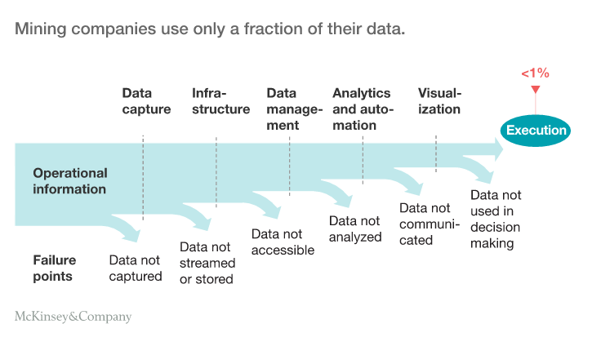
Mining Applications and Technology
Above and beyond, today’s overall mining operations productivity is approximately 28 percent less than ten years ago considering the adjustment for declining ore grades. (McKinsey, 2015)

Slide 8
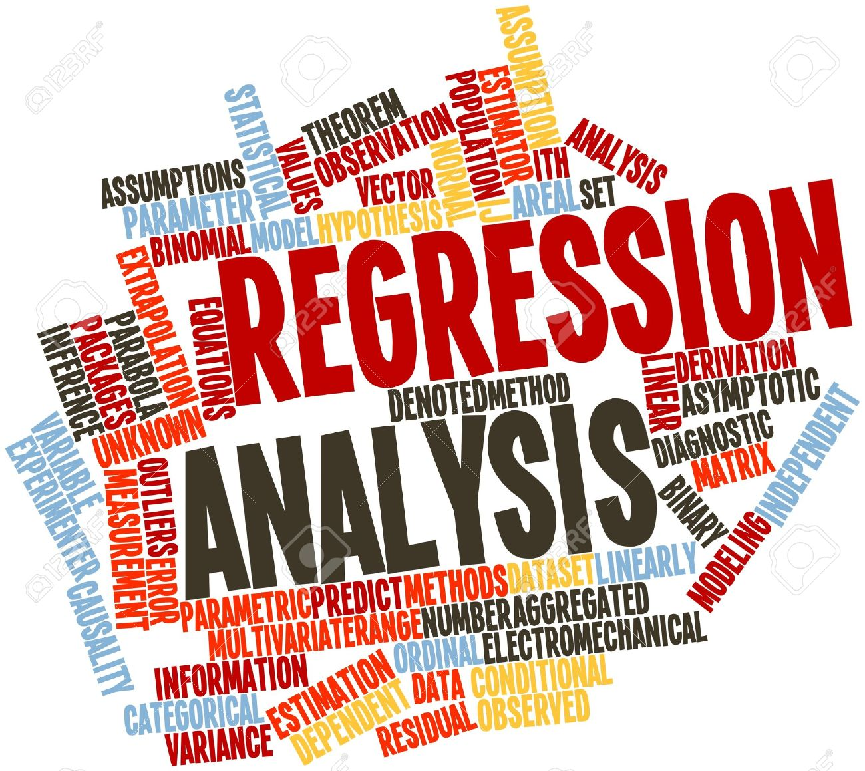
Mining Applications and Technology
The potential to achieve growth through innovation is on the way that could alter even basic characteristics of mining applications and performance to advance.
This approach will still create opportunities on big data to manage the mining applications and performance for future in an analytical manner.

Slide 9

Mining Applications and Technology
Mining Projects are contingent on new investment decisions at the moment, which are linked to emerging technologies for performance management applying new methodologies such as machine learning, big data analytics and artificial intelligence etc.

Slide 10

Mining Applications and Technology
Globally mining companies have been concentrating continuous improvements using new processes and systems such as Six Sigma Principles to eliminate the defects as much as possible for business management.
At the leading edge, big data analytics will help automate decisions for real-time business processes for instance mining trucks are applying object detections in autonomy on real time.

Slide 11

Prospect Objectives
In mining sector, especially primary organizations need to ever more emphasize continuous process improvement through –data driven decision making with predictive analytics.
Research objective will be rethinking how mine operations works in specifics and analysing the big data to have zero defect scoring for higher efficiencies in production.

Slide 12

Prospect Objectives
Innovation could be available with new mining machine learning models as soon as it has been identified, then implementing new engineering algorithms and model solutions into mine applications more intelligently.
The research focus might be to demonstrate the potential for value by undertaking a number of case studies using data collected across a number of mining operations.

Slide 13

The Era is on Performance Intelligence
Projects are depending on new investment decisions nowadays, are in terms of innovative technology for mining applications and performance supervision. Applications are to importance on learning from the previous and calculating future performance with higher confidence on continuous and statistical analysis of operating data from varied sources.

Slide 14

The Era is on Performance Intelligence
Artificial Intelligence will be one of the crucial element to compare both man fleets and autonomous fleets in mining, since it aims to achieve by foreseeing how movements will affect the model of the mine progress and production.

Slide 15
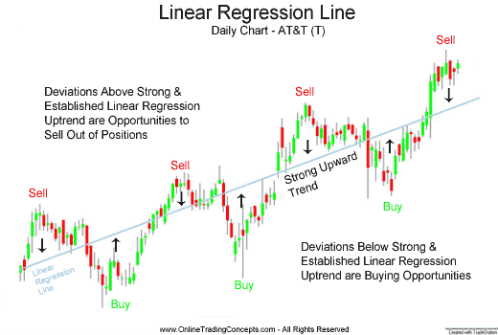
The Era is on Performance Intelligence
It takes the actions that will greatest accomplish that job on real time intelligently. Support in the exclusion of defects; observing and assessing performance enhancements are key capacities for future intelligence.

Slide 16

Data analytics and AI for Mining
Modern wireless based management systems and applications for mining equipment fleets are capable of collecting vast amounts of equipment health and mining performance data. However, when performance and machine health deviates from desired target levels, it can sometime be difficult to determine the root cause.

Slide 17

Data analytics and AI for Mining
This is because data relating to the operating environment or maintenance actions taken often reside in different data bases, applying different fields including database design, statistics, pattern recognition, machine learning, and data visualization.

Slide 18
Conclusion
The “silo” approach to data often inhibits the extent to which evidence-based root causes can be determined and generate cost modeling in advance due to actuals.
These kind of research hypotheses that there is significant value to be had by integrating data from different sources and using this to determine and manage root cause of performance and equipment health problems in advance to start with.

Slide 19
Conclusion
Big Data will be one of the main input to classify and monitor mining applications performance as well as the design of the mining production models. Specific algorithm's could be developed using Big Data to implement AI and machine learning solutions.

Slide 20

THANK YOU

