Slide 1


Development of Novel Targeted Therapies for Breast Cancer : Targeting EF2-Kinase
Bulent Ozpolat M.D., Ph.D.
Associate Professor
Department of Experimental Therapeutics
The University of Texas-Houston
MD Anderson Cancer Center

Slide 2
Outline
Currently used targeted therapies –Pros and cons!!
Identification of molecular targets
siRNA/MiR-Nanotherapy applications
    Targeting EF2-Kinase (EF2K) in preclinical models-
    Breast cancer
    Pancreatic Cancer
    Prostate cancer
    Ovarian cancer
    Lung cancer

Slide 3
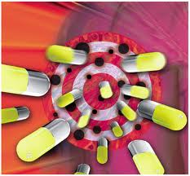
Molecularly targeted therapies

Slide 4
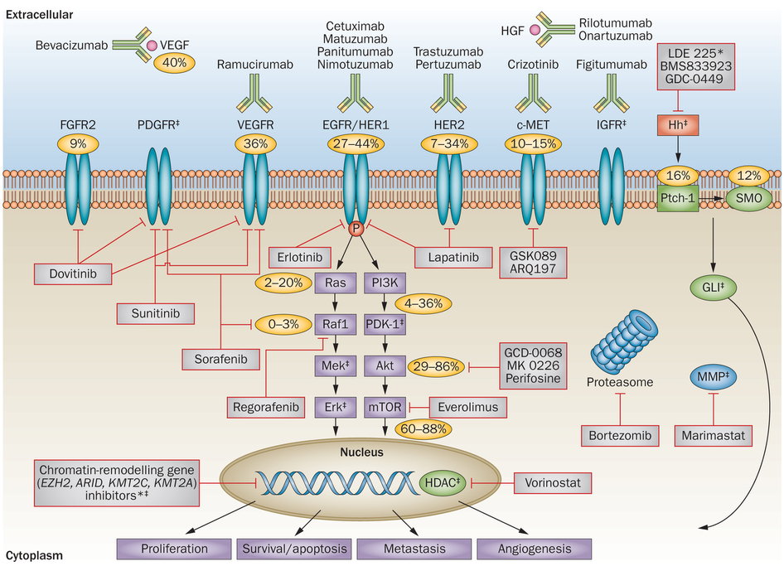
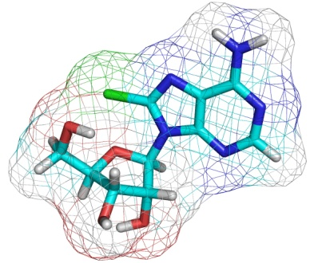
Currently used Targeted Therapeutics
Targeting Growth Factors receptors and other related pathways in cancer cells
Nature Reviews Clinical Oncology 10, 643–655 (2013)

Slide 5
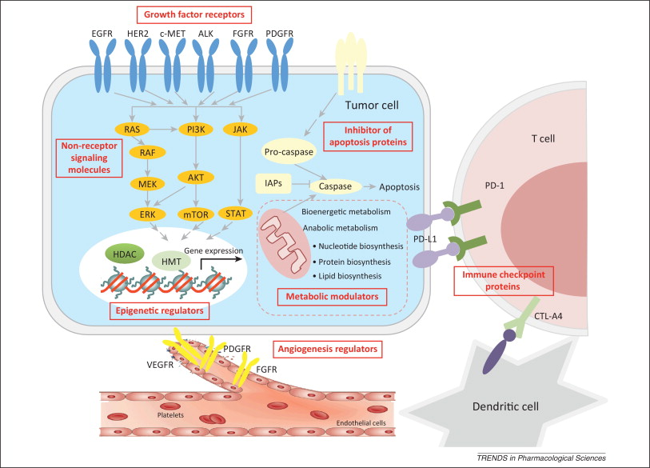

Slide 6
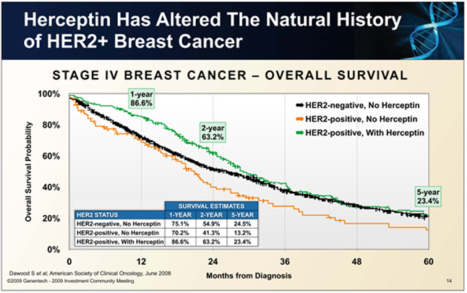
10 months

Slide 7
Problems with the Currently used targeted therapies
The response rate to targeted therapy across an unselected patient population is marginal, usually 10–20%.
In most cases, clinical responses are short-lived and are almost invariably followed by disease progression
The frequent occurrence of drug resistance to targeted therapies

Slide 8
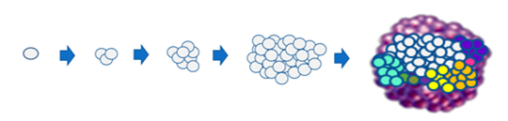
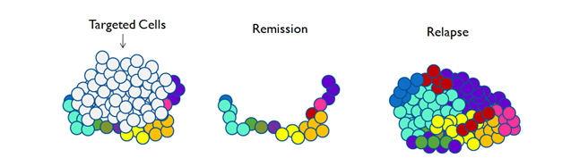
Highly targeted therapies do not inhibit all clones due to
tumor heterogeneity and eventually fails

Slide 9
Conventional therapies eliminate sensitive clones
Resistant cells survive and re-populate in advanced stage causing drug resistance disease
Rx
#2 Rx
Resistant clones
Stays & grow
Relapse & metastasis
New mutations
Drug resistant
Metastatic disease
No effective therapies
Death
Primary Cancer residual disease

Slide 10
Identification of Molecular Targets that modulate clinically
significant multiple signaling pathways can be
more effective in targeting heterogeneous tumors/clones
And successful treatment of cancer

Slide 11
Aproach
Identification of the molecular targets / Genes in breast cancer patients
Associated with significantly shorter patient survival & poor prognosis in patient databases ie TCGA (mRNA, microRNA and protein)
Investigate their role in cell survival, proliferation invasion/ metastasis, autophagy, apoptosis, drug resistance using in vitro and in vivo preclinical models various cancers.
Development of targeted nanotherapeutics
Inhibit/silence/ knock-down these target genes by siRNA/ microRNA, or Small molecule inhibitors

Slide 12
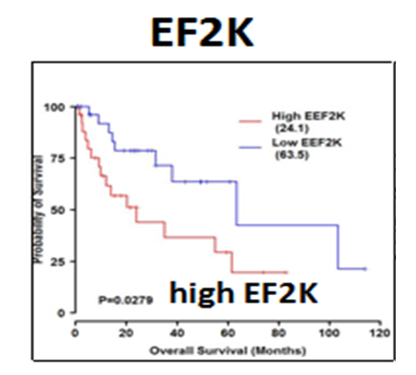
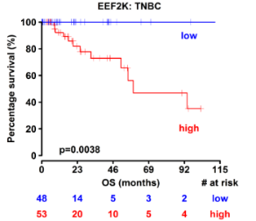
Identification of potential targets using patient gene expression and survival analysis
Expression of EF2K is associated with significantly shorter –overall patient survival NCI-TCGA (The Cancer Genome Atlas) patient data base
All Breast cancer
patients

Slide 13

Can we improve patient survival by targeting/ silence these genes in patients ?
~10 years
Gene
Silencing
Therapy

Slide 14
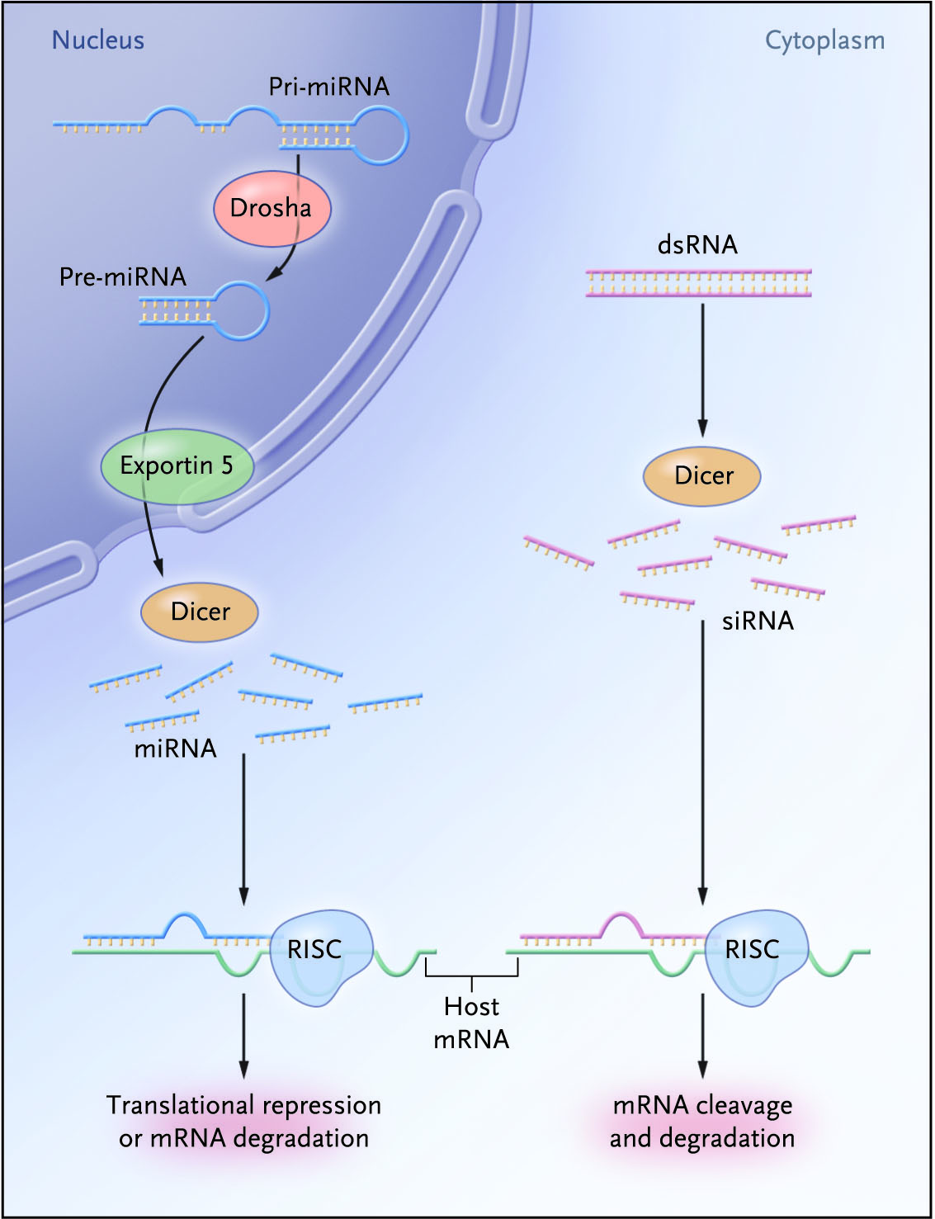
RNA interference- Based Gene Silencing
Micro RNA
pathway
siRNA
pathway
Target mRNA
Meritt NEJM 2008
Ozpolat J Internal Medicine, 2010
Notes:
RNA intererence
Sequence-specific silencing and cleavage a/degradation of their target mRNA
Natural function is protection of genemo from external genetic material transposones, viruses that produce aberrant RNA and dsRNA
In practice synthetic siRNA is given and DICER is not needed
Cleavege occuer in nucletides between 10-11
DICER= RNAaze III endonuclease complex----cleaves dsRNA into 19-23 (21-23) nucleatide long ds pieces called siRNA
RISC=RNAi-induced silencing complex
One RISC miRNA silence more than one mRNA
If full complementary ( extensive match) causes degradation
Less extensive match causes antisense effect just causes inhibiton of translation
Mechanism of RNA interference in mammalian cells. RNA interference (RNAi) pathways
are guided by small RNAs that include small interfering RNA (siRNA) and microRNAs (miRNAs). The
siRNA pathway begins with cleavage of long double-stranded RNA (dsRNA) by the Dicer enzyme
complex into siRNA. These siRNAs are incorporated into Argonaute 2 (AGO2) and the RNAi-induced
silencing complex (RISC). If the RNA duplex loaded onto RISC has perfect sequence complementarity,
AGO2 cleaves the passenger (sense) strand so that active RISC containing the guide (antisense) strand
is produced. The siRNA guide strand recognizes target sites to direct mRNA cleavage (carried out by
the catalytic domain of AGO2). RNAi therapeutics developed to harness the siRNA pathway typically
involve the delivery of synthetic siRNA into the cell cytoplasm.
The microRNA pathway begins with
endogenously encoded primary microRNA transcripts (pri-miRNAs) that are transcribed by RNA
polymerase II (Pol II) and are processed by the Drosha enzyme complex to yield precursor miRNAs
(pre-miRNAs). These precursors are then exported to the cytoplasm by exportin 5 and subsequently
bind to the Dicer enzyme complex, which processes the pre-miRNA for loading onto the AGO2–RISC
complex. When the RNA duplex loaded onto RISC has imperfect sequence complementarity, the
passenger (sense) strand is unwound leaving a mature miRNA bound to active RISC. The mature miRNA
recognizes target sites (typically in the 3′-UTR) in the mRNA, leading to direct translational inhibition.
Binding of miRNA to target mRNA may also lead to mRNA target degradation in processing (P)-bodies.
Modified with permission from Nature Rev. Genet. REF 5 © (2007) Macmillan Publishers Ltd.

Slide 15
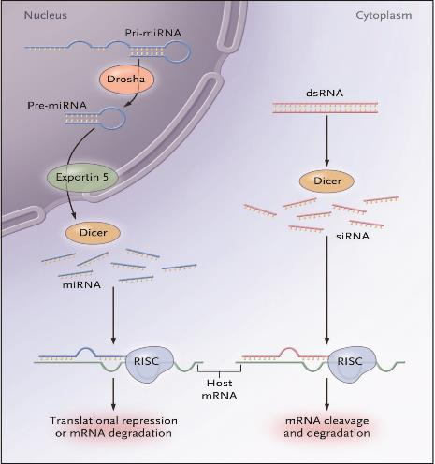
siRNA based gene knockdown / silencing
siRNA induce sequence specific gene silencing
Can be used development of “targeted therapies”for undrugable targets
Novel class of therapeutics
microRNA
pathway
siRNA
pathway
Target mRNA
Notes:
RNA intererence
Sequence-specific silencing and cleavage a/degradation of their target mRNA
Natural function is protection of genemo from external genetic material transposones, viruses that produce aberrant RNA and dsRNA
In practice synthetic siRNA is given and DICER is not needed
Cleavege occuer in nucletides between 10-11
DICER= RNAaze III endonuclease complex----cleaves dsRNA into 19-23 (21-23) nucleatide long ds pieces called siRNA
RISC=RNAi-induced silencing complex
One RISC miRNA silence more than one mRNA
If full complementary ( extensive match) causes degradation
Less extensive match causes antisense effect just causes inhibiton of translation
Mechanism of RNA interference in mammalian cells. RNA interference (RNAi) pathways
are guided by small RNAs that include small interfering RNA (siRNA) and microRNAs (miRNAs). The
siRNA pathway begins with cleavage of long double-stranded RNA (dsRNA) by the Dicer enzyme
complex into siRNA. These siRNAs are incorporated into Argonaute 2 (AGO2) and the RNAi-induced
silencing complex (RISC). If the RNA duplex loaded onto RISC has perfect sequence complementarity,
AGO2 cleaves the passenger (sense) strand so that active RISC containing the guide (antisense) strand
is produced. The siRNA guide strand recognizes target sites to direct mRNA cleavage (carried out by
the catalytic domain of AGO2). RNAi therapeutics developed to harness the siRNA pathway typically
involve the delivery of synthetic siRNA into the cell cytoplasm.
The microRNA pathway begins with
endogenously encoded primary microRNA transcripts (pri-miRNAs) that are transcribed by RNA
polymerase II (Pol II) and are processed by the Drosha enzyme complex to yield precursor miRNAs
(pre-miRNAs). These precursors are then exported to the cytoplasm by exportin 5 and subsequently
bind to the Dicer enzyme complex, which processes the pre-miRNA for loading onto the AGO2–RISC
complex. When the RNA duplex loaded onto RISC has imperfect sequence complementarity, the
passenger (sense) strand is unwound leaving a mature miRNA bound to active RISC. The mature miRNA
recognizes target sites (typically in the 3′-UTR) in the mRNA, leading to direct translational inhibition.
Binding of miRNA to target mRNA may also lead to mRNA target degradation in processing (P)-bodies.
Modified with permission from Nature Rev. Genet. REF 5 © (2007) Macmillan Publishers Ltd.

Slide 16
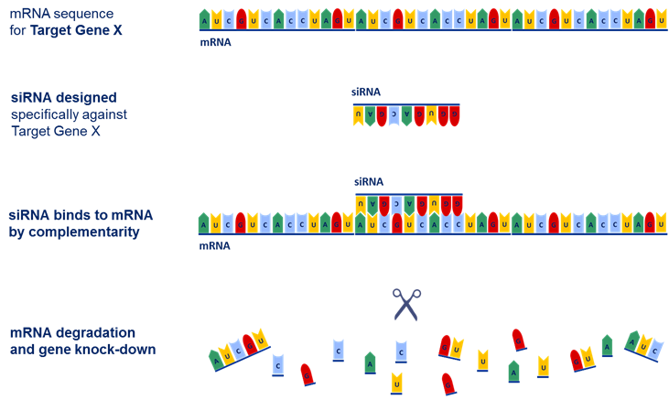
siRNA-mediated gene silencing
No po
Degradation of target mRNA
Inhibition of target protein expression

Slide 17
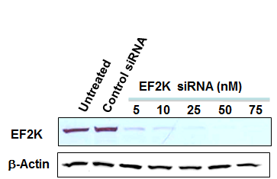
siRNA-mediated target ( EF2K) gene knockdown
Breast cancer cells
MDA-MB-231 breast cancer cells
Tekedereli PLoSONE, 2012

Slide 18
What is the Role of EF2K in breast cancer ?
Can we therapeutically target it in vivo TNBC models ?

Slide 19
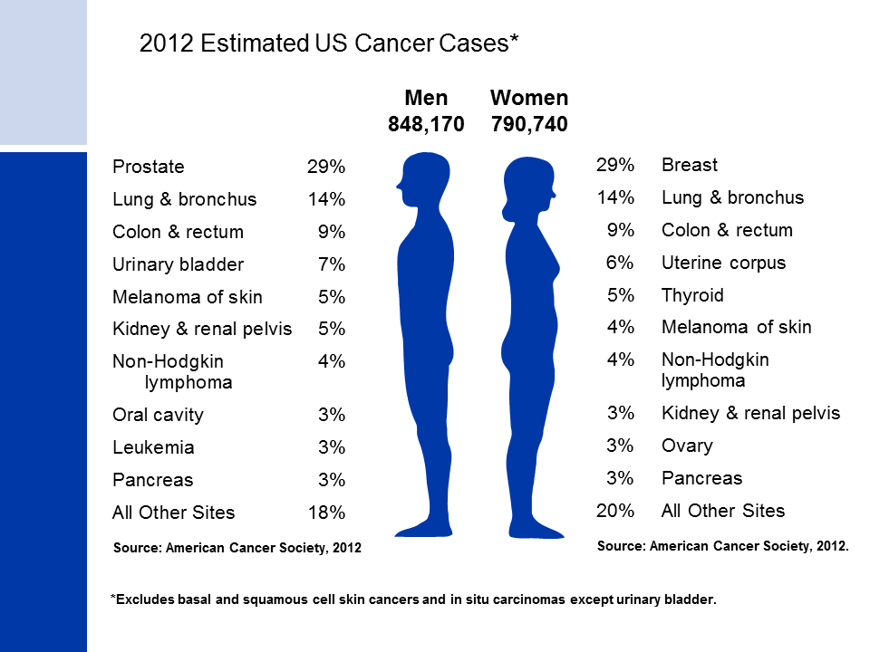

Slide 20
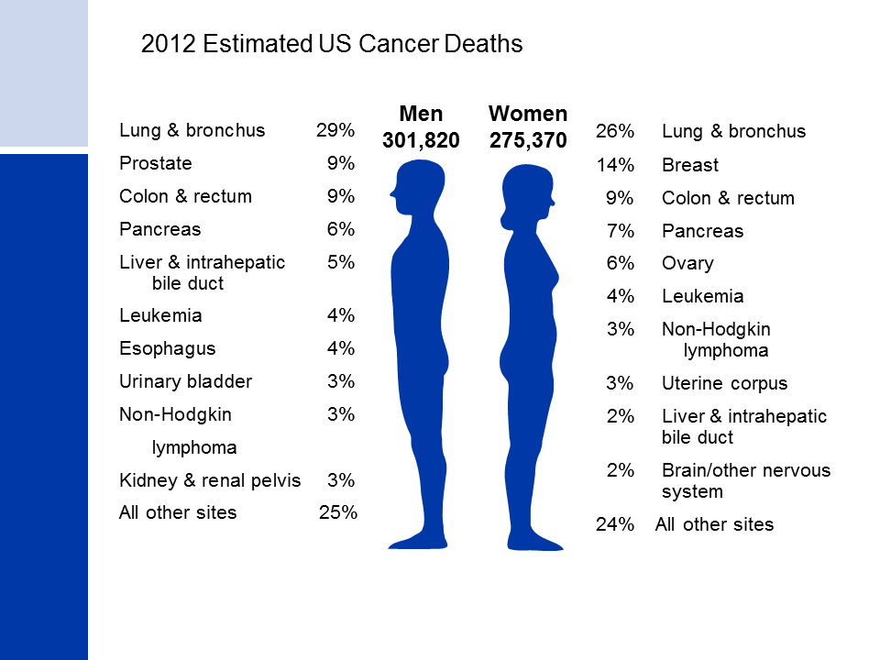

Slide 21
Breast cancer
The most common cancer in women in US
220,000 new cases/ year
41,000 deaths /year
Stage III- 30-40 % of patients survive 5 years
Stage IV- 18% survive 5 years
Triple negative breast cancer –TNBC-ER(-), PR(-) HER2 (-)
is associated with poor survival due to reduced response to
conventional therapies and lack of therapeutic targets
New molecular therapies are needed to increase patient survival

Slide 22
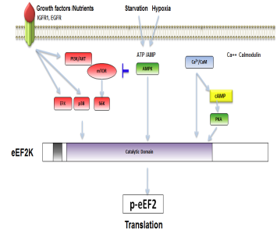
Eukaryotic Elongation Factor 2 Kinase (EF2K)
Ser/Thr protein kinase regulates rate of protein translation (by
phosphorylating EF2 (Thr56)
Induced by mitogens and growth factors, hypoxia, and metabolic stress
and mediates autophagy
Its role in breast cancer tumorigenesis
and progression is not known?
Hypothesis:
1 . EF2K acts as a survival factor and
promotes invasion, metastasis and
drug resistance in BC cells, thus has an
signifdicant impact on patient survival
2 .Targeting EF2K will block tumor growth
and enhance the efficacy of conventional
chemotherapies

Slide 23
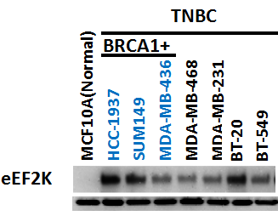
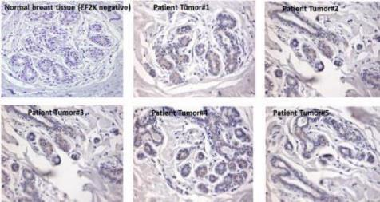
EF2K expression is associated with poor patient survival in all BC patients -especially Triple Negative Breast cancer (TNBC)
Cell lines
BC Patient tumors

Slide 24
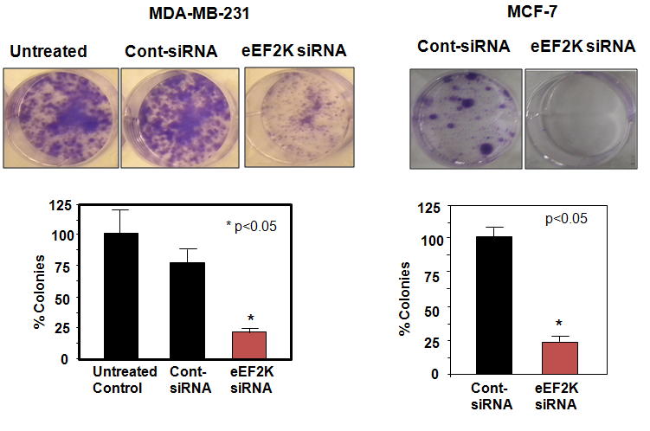
Silencing of EF2K by siRNA inhibits cell proliferation/
colony formation of TNBC and ER+ breast cancer cells

Slide 25
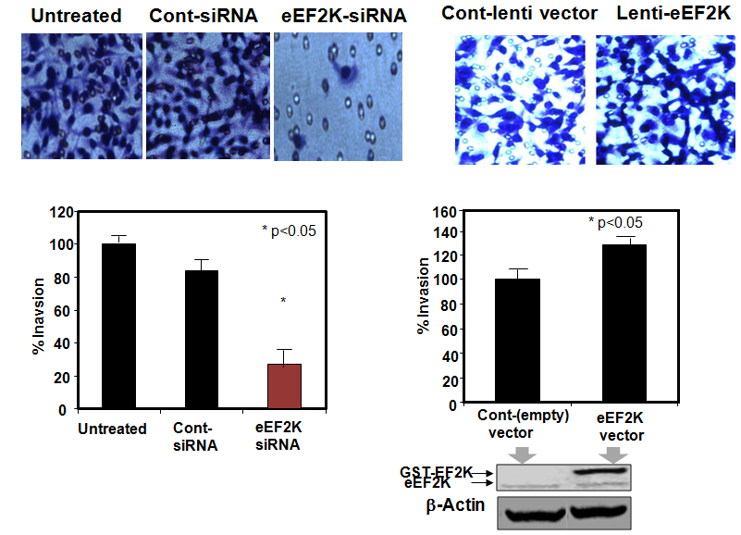
Silencing of EF2K by siRNA inhibits cell
invasion of MDA-MB-231 triple negative breast cancer cells

Slide 26
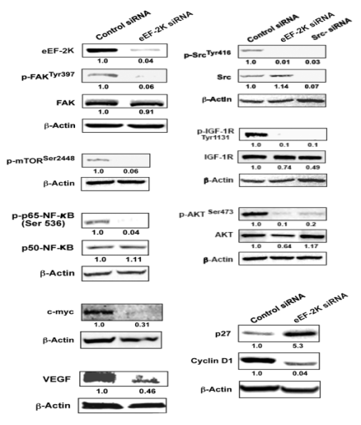
Knockdown of EF2K by siRNA inhibits multiple signaling pathways, including
Src /Fak, PI3K/Akt/ mTOR, IGFR, NF-kB, cyclin D1, c-myc and VEGF
eEF2K
Src
IGF-1R
Akt
NF-kB
mTOR

Slide 27
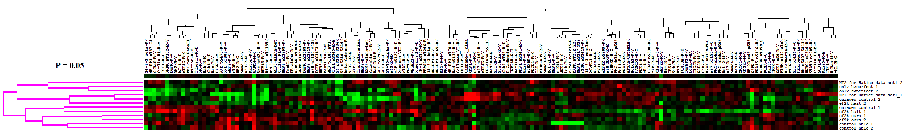
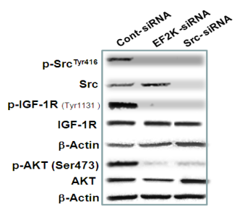
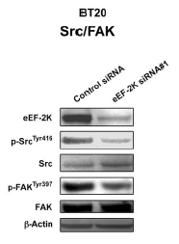
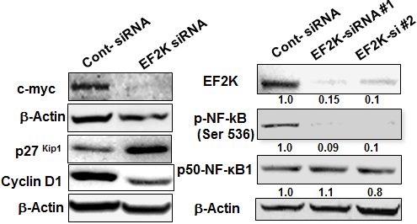
EF2 Kinase induce signaling pathways that promote cell proliferationin,
invasion/ metastasis, survival and drug resistance in breast cancer
MDA-MB-231
Tekedereli et al, Plos ONE 2012

Slide 28
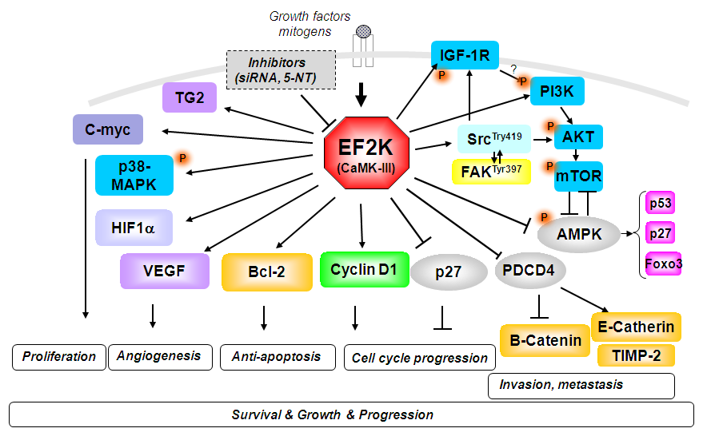
EF2K regulates signaling pathways that promote cell proliferationin,
invasion/ metastasis, survival and drug resistance in breast cancer

Slide 29
Activity of signaling pathways and expression of critical proteins is altered in Breast cancer
Increased/overexpressed / activated in breast cancer
Src (70%)
PI3K/Akt (60%)
Bcl-2 (60%)
Ras (55%) ( *5% mutation)
STAT3 (50%)
Cyclin D1 (50%)
IGF-1R (50%)
ErbB2 (Her2) (30%)
p70S6K (30%)
Translation initiation factors: eIF4E, eIF4G, p-4E-B1, ribosomal protein S6 (pS6)
Reduced/inactivated/mutated ( tumor supressors)
p53 mutation (50%)
PTEN mutation(40%)
p27 ( 50%)
PDCD4 (a translational inhibitor )- reduced expression
Notes:
c-myc [Stewart TA],
ErbB2 (Her2/neu) [ Muller WJ,]
cyclin D1, IGFr1 have been found to induce mammary tumors when overexpressed in transgenic mice.
40% invasive breast cancer have PTEN mutation
P53 overal muataion is 20%
P53 LOH56 %
Invasive (or infiltrating) ductal carcinoma accounts for 70 percent of all breast cancers

Slide 30
Development of EF2K targeted therapies
in breast cancer

Slide 31

Delivery of siRNA-based therapeutics
Liposomal siRNA
Chemically-modified siRNA
Viral vectors
*
*
siRNA
Translation
dsRNA
Dicer
RISC
miRNA
Nucleus
Translational inhibition
mRNA cleavage

Slide 32
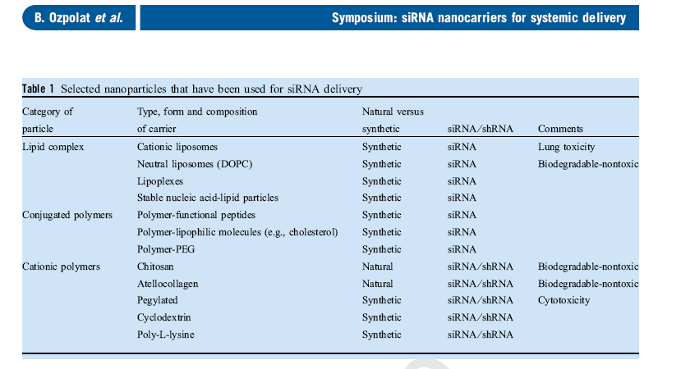
Nanoparticles used for siRNA delivery
Ozpolat J int Med 2010

Slide 33
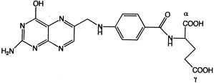
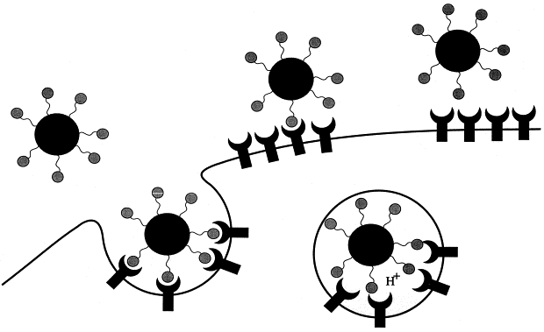

Development of Tumor-Targeting Nano-Therapeutics for in vivo Drug delivery
( siRNA, microRNA small molecule inhibitors, chemo-drugs)
Tumor receptor targeted Nanoparticles
Nanoparticle
Loaded with siRNA
or microRNA
PEG₂₀₀₀linker
Lipid
Folate
Folate
RGD peptide
Antibody coated
3
siRNA
αVβ5 integrin receptor
Folate receptor
siRNA
Ozpolat et al Advance Drug
Delivery, 2014
XYZ mRNA
Ozpolat et al
J Internal Medicine, 2010
RISC
mRNA degradation

Slide 34
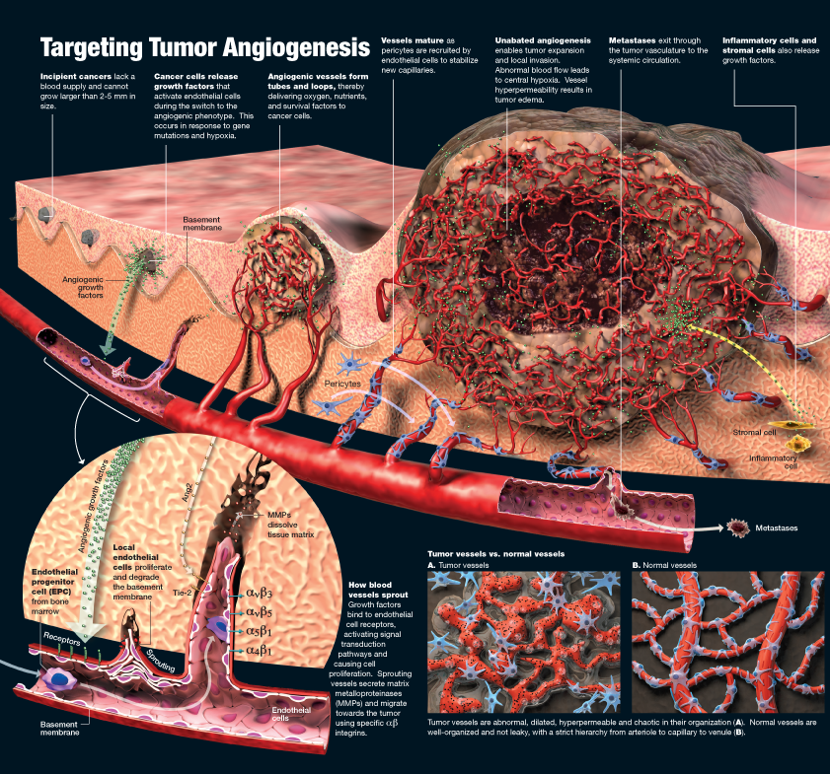





Slide 35
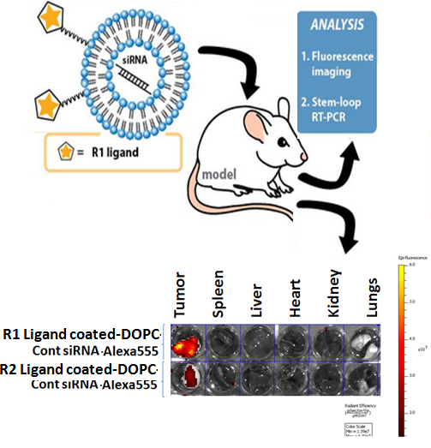
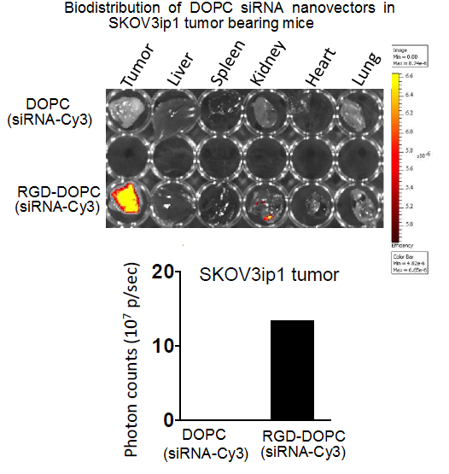
Selective cancer cell targeting strategy via specific ligands for therapeutic targeting in ovarian cancer

Slide 36
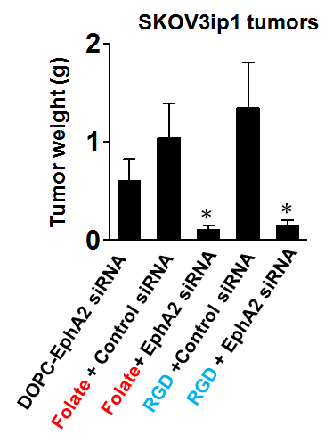
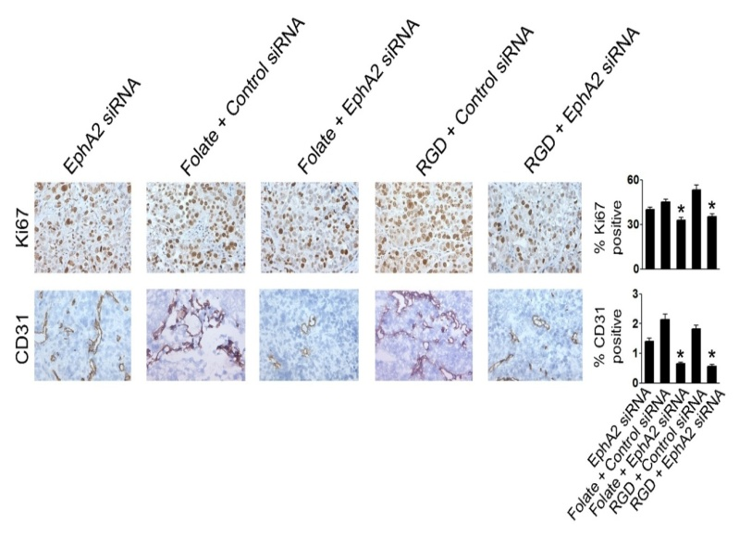
In vivo efficacy of FRα and αVβ3 integrin receptor-targeted DOPC-nanoliposomes in metastatic ovarian cancer models
In mice
Mice received liposomal EphA2 siRNA 0.15mg/kg (~4ug/mouse)
Twice/week, I.V injections from tail vein – Total of 5 weeks
n=10 mice/group
Alpay.. Ozpolat et al ( in press)

Slide 37
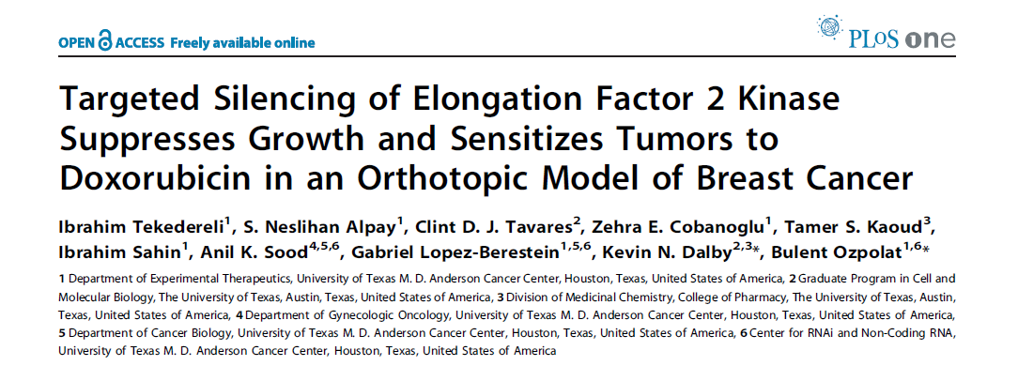

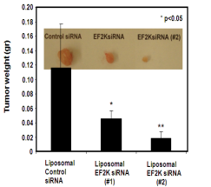
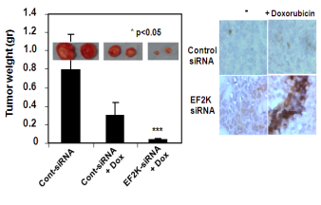
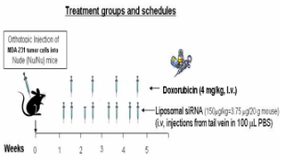
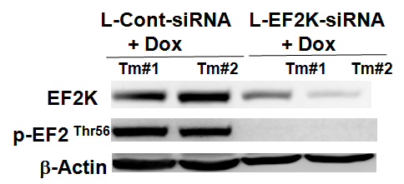
Therapeutic Silencing of EF2K by siRNA nanotherapeutics inhibits tumor growth and enhances the efficacy of chemotherapy In MDA-MB-231 TNBC model
Ibrahim Tekedereli MD

Slide 38
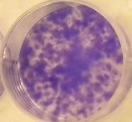
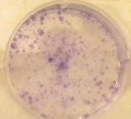
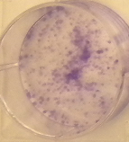
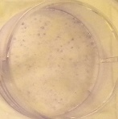
Knockdown of eEF2K enhances efficacy of paclitaxel in MDA-MB231 BC cells
- +Paclitaxel
125
100
Cont-siRNA
75
% colonies
*
50
25
*
eEF2K siRNA
0
Control
siRNA
Cont-
siRNA
+
Paclitaxel
Ef2K
siRNA
eEF2K
siRNA
+
Paclitaxel

Slide 39

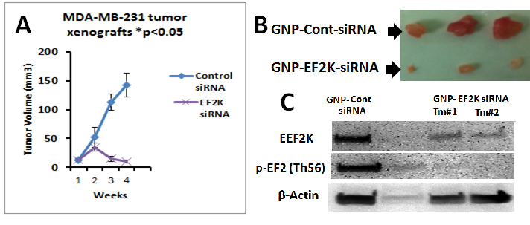
Targeting EF2K by siRNA-Nanotherapeutics TNBC tumors
Elif Asik MS
Gold NPs

Slide 40
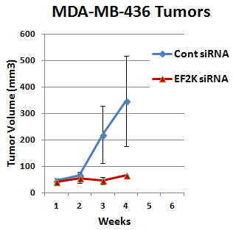
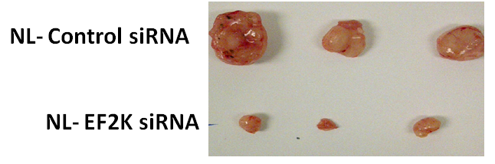
Therapeutic targeting of EF2K by MNP-siRNA
in BRCA 1 mutated tumors inhibits tumor growth in
orthotopic tumor models in mice
Elif Asik MS
BRCA1 mutated
Asik et al-submitted

Slide 41

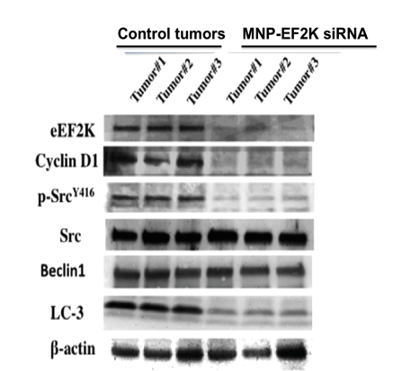
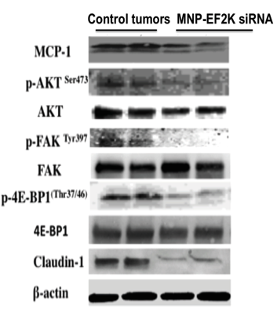
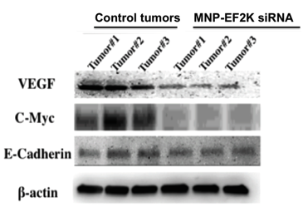
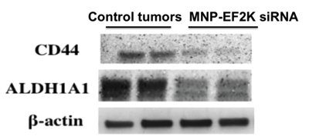
Silencing of EF2K inhibits EF2K and important signaling pathways (SRC, c-Myc, AKT) angiogenesis and stem cells in TNBC tumor models

Slide 42

Silencing of EF2K inhibit intratumoral proliferation, angiogenesis and induced apoptosis
In tumor xenografts

Slide 43


EF2K silencing therapy is safe and did not cause any toxicity in mice

Slide 44
Strategies of Targeting EF2K in human tumors
siRNA
(PLOSONE 2012)
Mol can ther 2016
Chemical compounds (synthetic, natural)
- 5NT- Synthetic EF2K inh (Patent pending)
- Rottlerin- Natural ( Ashour, 2014)
- Tymoquinone-- Natural dietary (Nashwa)
miR603
( Oncotarget 2016)
siRNA
Fox M1 transcription Factor
( Oncotarget 2016)
EF2K
Cancer cell Proliferation
Invasion /metastasis
Drug resistance
Tumor growth &Progression

Slide 45






FoxM1 transcription factor regulates EF2K gene expression and Inhibition of FoxM1 by siRNA suppresses proliferation and invasi onof TNBC
Zuhal Hamurcu PhD
Colony formation assay
MDA-MB-231 cells
EF2K protein expression
by Western blot
EF2K mRNA expression
by RT-PCR

Slide 46




Zuhal Hamurcu PhD
In vitro migration
Hamurcu et al, Oncotarget 2016

Slide 47
Potential strategies for targeting EF2K in human tumors
microRNA
miR-603
miR-22
siRNA
Chemical compounds
(Synthetic or natural)
- Rottlerin- natural
- Genistein- natural
- 5NT- Synthetic
siRNA
FOXM1
Transcription factor
EF2K
Cancer cell Proliferation
Invasion /metastasis
Drug resistance
Tumor growth &Progression

Slide 48




microRNA-603 targets EF2K in TNBC
Recep Bayraktar MS
Recep Bayraktar
TargetScan
miRDB
miR-603
microrna
Diana microT
Microrna.org
Bayraktar Oncotarget in press

Slide 49



Gene therapy with miR-603 Nanotherapeutics suppresses tumor growth TN Breast cancer

Slide 50
Summary& Conclusions:
EF2K promotes breast cancer tumorigenesis and progression by inducing
proliferation, invasion/ metastasis and drug resistance

Slide 51
Potential strategies for targeting EF2K in human tumors
siRNA
Chemical
FOXM1
miR603
EF2K
Cancer cell Proliferation
Invasion /metastasis
Drug resistance
Tumor growth &Progression

Slide 52


Summary and Conclusions
EF2-Kinase promotes cell survival, proliferation, invasion, tumor growth
and Inhibition of EF2K by different strategies inhibits TNBC
EF2K a novel potential molecular target in TNBC and BRCA1+ tumors
Indirect targeting
of EF2K
by FOXM1 or microRNA

Slide 53
Acknowledgements
MDACC- Experimental Therapeutics Univ of Texas -Austin -Pharmacy
Ibrahim Tekedereli,MD
Nesli Alpay MD, MS
Nermin Kahraman MS
Zuhal Hamurcu PhD
Ahmed Ashour MS
Recep Bayraktar MS
Elif Asik MS
Nashwa Kabil MD, MS
Alper Dogan MS
Didem Karakas MS
Gabriel Lopez-Berestein MD
Burcu Aslan MS
George Calin MD PhD
Christina Ivan, PhD
Katrien Van Roosbroeck PhD
Martin Pichler MS
MDACC-Gynecologic Oncology
Anil Sood, MD
Yunfei Wen PhD
MDACC- Bioinformatics
Keith Baggerly,Ph.D.
Kevin Dalby, Ph.D.
Tamer Kaood, Ph.D
Clint Tavares, MS
Baylor College of Medicine
Michael Ittmann, MD, PhD
James Xiao, PhD
University of Oslo-Norway
Fahri Saatcioglu PhD
Hacetepe University-Turkey
Aysegul Uner MD, PhD
Kezban Ulubayram PhD
Grant support
1. NIH-NCI R21-Breast cancer
2. DOD-Synergistic idea award
3. Texas Advance Technology-
4. Susan Komen breast cancer research award
5. CPRIT
6. CTT –Center for Targeted Therapy- MD Anderson
7. Ovarian cancer SPORE-pilot
8. NIH-NCI R21-Panc cancer

Slide 54



Slide 55




