Slide 1
About OMICS Group
OMICS Group is an amalgamation of Open Access Publications and worldwide international science conferences and events. Established in the year 2007 with the sole aim of making the information on Sciences and technology ‘Open Access’, OMICS Group publishes 500 online open access scholarly journals in all aspects of Science, Engineering, Management and Technology journals. OMICS Group has been instrumental in taking the knowledge on Science & technology to the doorsteps of ordinary men and women. Research Scholars, Students, Libraries, Educational Institutions, Research centers and the industry are main stakeholders that benefitted greatly from this knowledge dissemination. OMICS Group also organizes 500 International conferences annually across the globe, where knowledge transfer takes place through debates, round table discussions, poster presentations, workshops, symposia and exhibitions.

Slide 2
OMICS International Conferences
OMICS International is a pioneer and leading science event organizer, which publishes around 500 open access journals and conducts over 500 Medical, Clinical, Engineering, Life Sciences, Pharma scientific conferences all over the globe annually with the support of more than 1000 scientific associations and 30,000 editorial board members and 3.5 million followers to its credit.
OMICS Group has organized 500 conferences, workshops and national symposiums across the major cities including San Francisco, Las Vegas, San Antonio, Omaha, Orlando, Raleigh, Santa Clara, Chicago, Philadelphia, Baltimore, United Kingdom, Valencia, Dubai, Beijing, Hyderabad, Bengaluru and Mumbai.

Slide 3
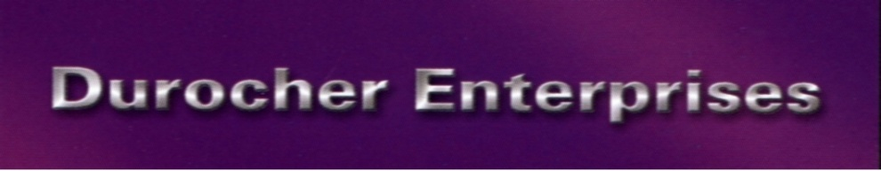
Profitable Cosmetic Practice Strategies
How to Get Clients to Make a Serious Investment in Your Services
Bryan Durocher

Slide 4
Financial Facts
The U.S. Spa industry sales increased 5.1% to 14.7 Billion dollars in 2013. Exceeding the economy’s overall growth with over 164 million visits. The spa industry is now the 5th largest leisure activity in the United States.
Medical spas make up 8.6% of the market place with 1760 true medical day spas in the U.S.
* source ISPA

Slide 5
Financial Facts
Botulinum Toxin (including Botox, Dysport and Xeomin) remained the most frequently performed noninvasive procedure with a 15.6% increase. Nonsurgical procedures increased in 2013 by 13.1% with 9.5 million procedures
In 2013, more than 2.5 billion dollars was spent on injectables alone. In addition, nearly 1.9 billion was spent on skin rejuvenation, a fast-growing sector of the aesthetic nonsurgical industry.

Slide 6
Financial Facts
The top five nonsurgical procedures were:
Botulinum Toxin (3,766,148 procedures, up 15.6%)
Hyaluronic Acid (1,872,172 procedures, up 31.5%)
Hair Removal (901,571 procedures, up 2%)
Microdermabrasion (479,865 procedures, down 3.8%)
Photo Rejuvenation (456,613 procedures, up 35.3%)

Slide 7
Financial Facts
The global anti-aging market was estimated to be worth USD 122.3 billion in 2013
Anti-Aging Market to be Worth USD 191.7 billion by 2019

Slide 8
The Web
Almost all spas (95 percent) use their own Web site to motivate consumers. Social media is a popular way to promote offerings amongst 81 percent of spas. Online reviews and directories were also popular with over 50 percent of spas utilizing them.

Slide 9
Trends
Premium Personal Care. The growing market for natural and organic personal care products joins forces with an increasing number of consumers seeking premium personal care products and benefits beyond their traditional use.

Slide 10
Luxury Mindset
Luxury is Having Enough Time to do What You Want and the Financial Means to do it
Flexibility of Time
Life Experiences
Comfort, Beauty, & Quality
“You compete with Your Client’s Lifestyle Choices.”
* Conference Board Study
Notes:
10

Slide 11

Universal Spa Brand
& Market Positions
What are your USPs?
What are your business’ features and benefits?
Who is your target market?

Slide 12
Why Clients Consider
Med Spa Services
Ageing
Self Esteem Boost
Special Occasions
Lifestyle Changes
Work Related

Slide 13
Consultation Closer
Confidentiality – HIPPA – no sign in
Tell the Client What to Expect
Ask 3 key questions
Mental needs analysis
Identify their Goals
Provide Client Examples
Quote Investment

Slide 14
Consultation Follow Up
Follow Up Letter
Time Payment Options
Schedule of Plans Up to Service Date

Slide 15
Team Mindset
Value Service Offerings
Services Enhance Client’s Lifestyles
Believe in the Quality and Experience of Service Providers

Slide 16

Med Spa Business Drivers
Retail
Referral
Pre-booking
Consultation Role-play Dialogues

Slide 17
Marketing Materials
Thank You Letters
Testimonials
Website with Before and After Photography
Meet the Doctor Evenings
E-Mail Marketing

Slide 18
Let us meet again..
We welcome you all to our future conferences of OMICS International
5th International Conference and Expo
on
Cosmetology, Trichology & Aesthetic Practices
On
April 25-27, 2016 at Dubai, UAE
http://cosmetology-trichology.conferenceseries.com/

